Slide 1

This presentation is part of the Accessibility Track, which is sponsored by

Slide 2
Reducing UDL Implementation Barriers with AI
Loyola University Chicago
Office of Online Learning

Slide 3


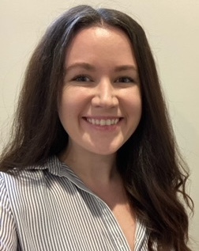



Loyola University Chicago
Office of Online Learning Team
John Gurnak
Kristlyn Thomas
Chris Dickman
Kelly Barry
Sharmeen Islam
Director
Associate Director
Senior Instructional Designer
Senior Instructional Designer
Instructional Designer
Notes:
We are recording this so you will have it later
Please begin by adding your name and department to the chat!

Slide 4
Session outcomes
01
Recognize essential components of the CAST UDL framework, its benefits, and barriers to its implementation
02
Compare the capabilities and downsides of various AI models w/r/t UDL implementation
03
Recognize effective components of general AI prompts for UDL work
04
Use a chosen AI model to assist with the design of a UDL framework component for your courses

Slide 5
UDL Benefits and Barriers

Slide 6
Review: What is UDL?
UDL is directly inspired by the Universal Design (UD) movement in architecture and industrial design.
UDL is a framework that guides the design of learning environments to remove barriers and ensure learning is accessible, inclusive, and challenging for every learner.
Ultimately, the goal of UDL is to support learner agency, the capacity for students to actively participate in making choices in service of learning goals.

Slide 7
Essential components of the
CAST UDL framework
Design multiple means of Engagement
Design multiple means of Representation
Design multiple means of Action and Expression

Slide 8
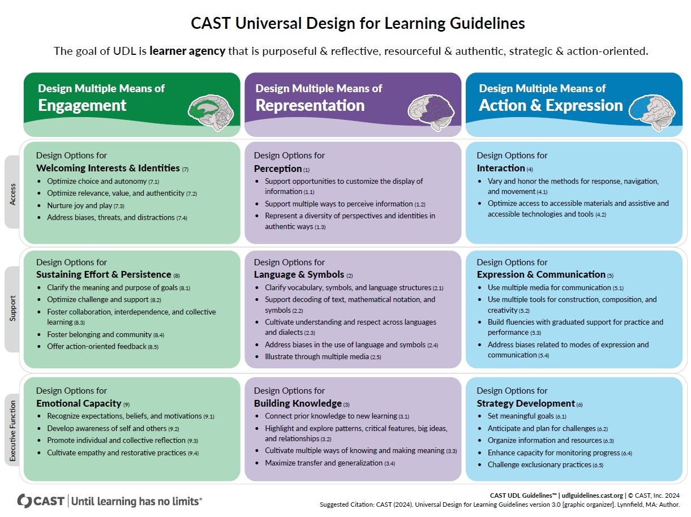
UDLGUIDELINES.
CAST.ORG

Slide 9
Top BENEFITS of CAST UDL Guidelines
Creates more equitable and accessible learning environments
Reduces – but does not eliminate – the need for
individual accommodations
Fosters student autonomy and self-determination
Increases learner engagement

Slide 10
Top BARRIERS to CAST UDL Guidelines
Lack of time for course redesign (top)
Complexity of UDL framework
Scarcity of Higer-Ed-relevant models and exemplars
Unsure where to go for support and resources

Slide 11
Choosing an AI MODEL

Slide 12
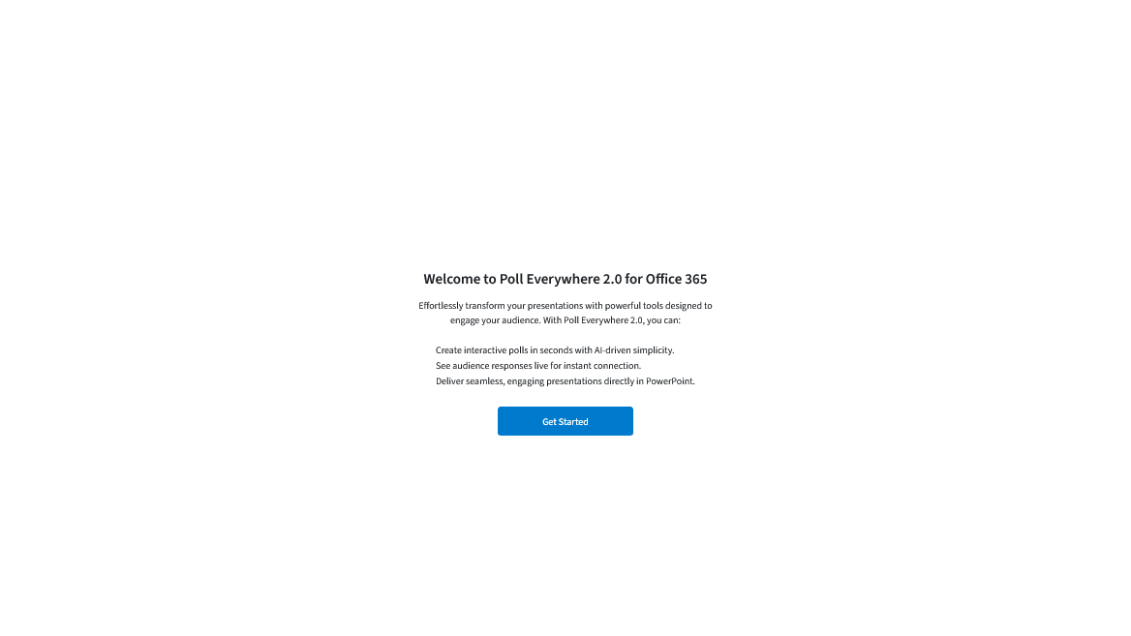
Notes:
Quick poll of our audience to get an idea about what AI Chatbots you have used or experimented with. Please scan the QR code on the slide with your phone to or navigate to “pe.app/udl” to access the poll. You may select more than one choice.

Slide 13
Chatbot | Organization | Core Strengths | UDL Support (High/Med)
ChatGPT | OpenAI | General reasoning, conversation, writing, coding, image generation, essay drafting & revision, crafting discussion prompts | Medium–High
Copilot | Microsoft | Office 365 integration, coding & data analysis, lesson planning, transforming existing materials into accessible content | High
Gemini | Google | Google integration, multimodal applications, lesson planning, differentiation, workflows | High
Claude | Anthropic | Long-form and nuanced writing, qualitative analysis, ethical reasoning, essay drafting & revision, inclusive syllabus language | Medium
Perplexity | Perplexity AI | Cited AI search, literature reviews, long-content synthesis, research literacy | Medium

Slide 14
Privacy & Data Security Concerns
Data Retention and Model Training
  AI models are often trained on user data
  Long-Term data retention
Information Security and Data Breaches
  Lack of encryption
  Data leaks
Third-Party Sharing and Data Misuse
  Ad targeting & Third-Party sharing
Mitigate these risks by using an institutional or paid version of an AI Chatbot.

Slide 15
Using AI as a
UDL Design Assistant

Slide 16
General prompt framework
01
Context: provide background, important details, roles
02
Task: define the task to be completed
03
Goal/output: define what the output should look like - examples can help
04
Constraints/ rules: set a specific tone or style, set limitations for output

Slide 17
UDL Prompt Considerations
Use “UDL” in prompts
Start with an existing course design
Solve issues first
Name focus area(s) of UDL
Specify what cannot be changed in your courses
Have AI prioritize recommendations - and tell it you’re busy!

Slide 18
UDL-specific prompt framework
01
Context:
Grade/difficulty level
Class name, description
Learning goals/outcomes
Particulars of the course (capstone, lab, experiential learning, etc.)
02
UDL Task:
Focus area for the course
UDL aspect(s) you want to use
Issues you might be encountering
03
Constraints & outputs:
Specific course needs
  Time requirements
  Desired outcomes
  Required performances
Materials needed
  Descriptions, rubrics, guides
04
Priority, time, reasoning:
Number of suggestions you want
Most impactful first
Time you can dedicate to revision or implementation
Why the suggestions work

Slide 19
Before you prompt…
Don’t feed AI your work in whole, student data, or copyrighted material*
Always review, edit, and elevate output
Don’t generate learning content from scratch
Use AI as a thinking partner and teacher

Slide 20
I teach an advanced business law class about antitrust legislation. The goals of this course are to familiarize students the specifics of antitrust law as well as develop their legal reasoning. An early assignment is a paper about an antitrust lawsuit so students can better analyze these kinds of cases. In a 5-paragraph essay, students need to overview the case, the main arguments brought by both sides, the outcome, and the student’s opinion if the judgment was correct. Enthusiasm for this assignment has waned and quality has decreased.
Context
I would like to adapt this assignment using CAST UDL framework elements 5.1 and 5.2, so that students can submit something other than an essay. Create a single assignment description that gives students at least three options for creating this assignment, one still being the essay.
UDL Task
Students still need to have covered all the topics mentioned above, have performed a thorough and accurate analysis, and have argued well for their view about the judgment. No matter what they choose to do, I would also like them to have an equal workload. In addition to the assignment description, also produce an analytic rubric that can be used to assess any piece of student work.
Constraints & Out puts
Priority, time, reasoning
Finally, after you have created these documents, tell me why they would work well – that is, why they are good pedagogy and how they will still engage students in demanding work.

Slide 21
Let’s Prompt!
Next, a QR code for a OneDrive folder
Two choices:
Word Document
Example prompts OR
Fill-in-the-blank prompts
AI model links
Pre-populated fill-in-the-blank prompt
Not secured
Use a secure model

Slide 22
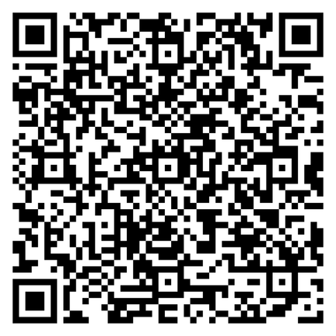
QR CODE TO ACCESS SESSION HANDOUTS

Slide 23
Reflection Questions
How were your results?
What did your AI Chatbot do well?
What did your AI Chatbot do poorly?
Does this approach feel worthwhile when applying
UDL principles to your course?

Slide 24
Iterate!
Ask for more detail Add constraints Ask for more scaffolding - or remove some Revise non-copyrighted materials into other formats | Ask for materials, outlines, etc. Results tend to vary widely Usually just a good starting point that needs revision Ask for an explanation

Slide 25
Thank you!
Contact us:
OOL@luc.edu

