Slide 1
The Reading Crisis: The Reading Opportunity?
Francisco J. R. Chaparro
IE University (Spain)

Slide 3

This presentation is part of the AI/Innovative Learning Track, which is sponsored by

Slide 4
CONTENTS
·Historical transformations in academic reading practices
·Are we experiencing a comparable shift today?
·Who/what is reading?
·What is read?
·How is reading conducted?
·Alternatives, resources and conclusions

Slide 5
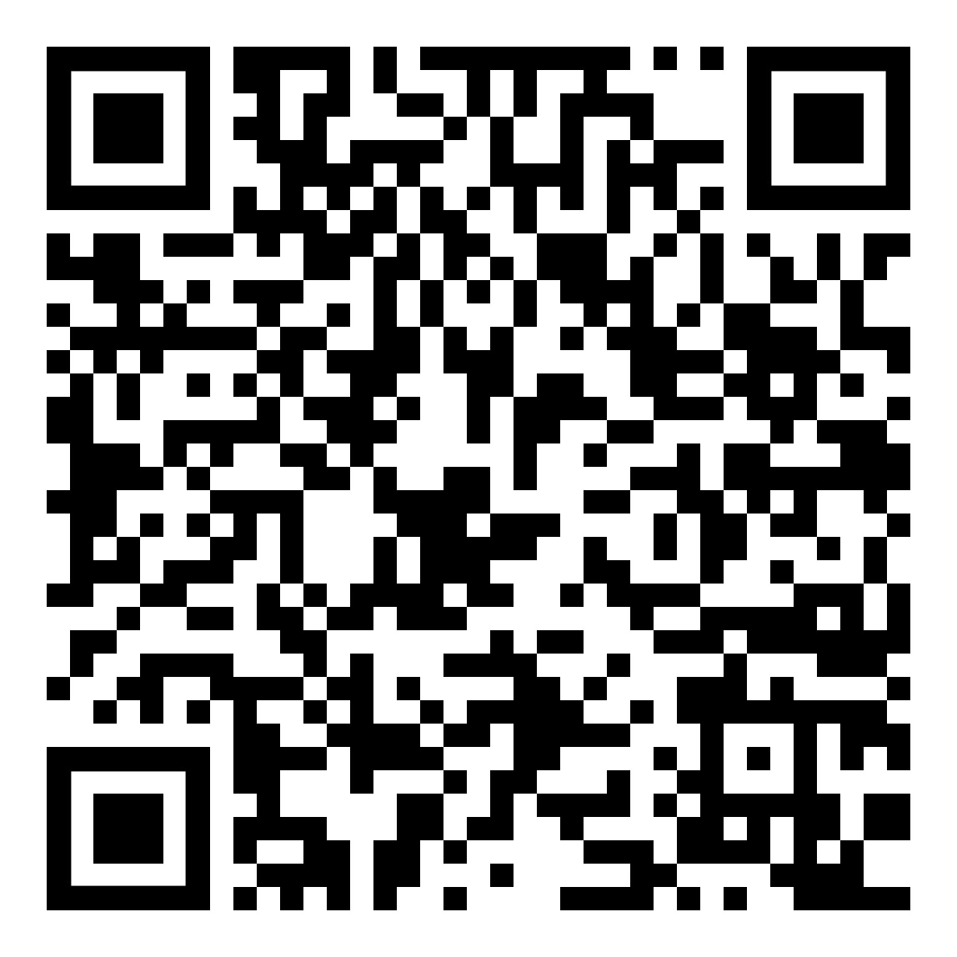
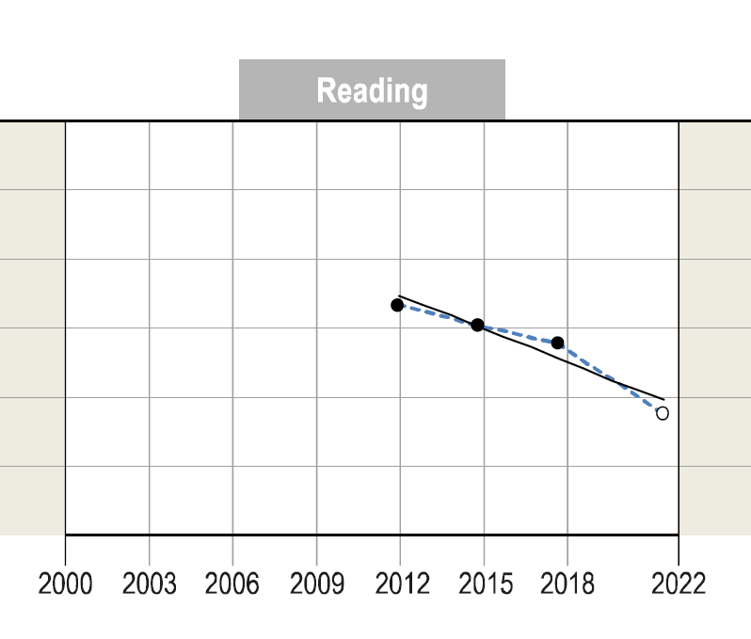
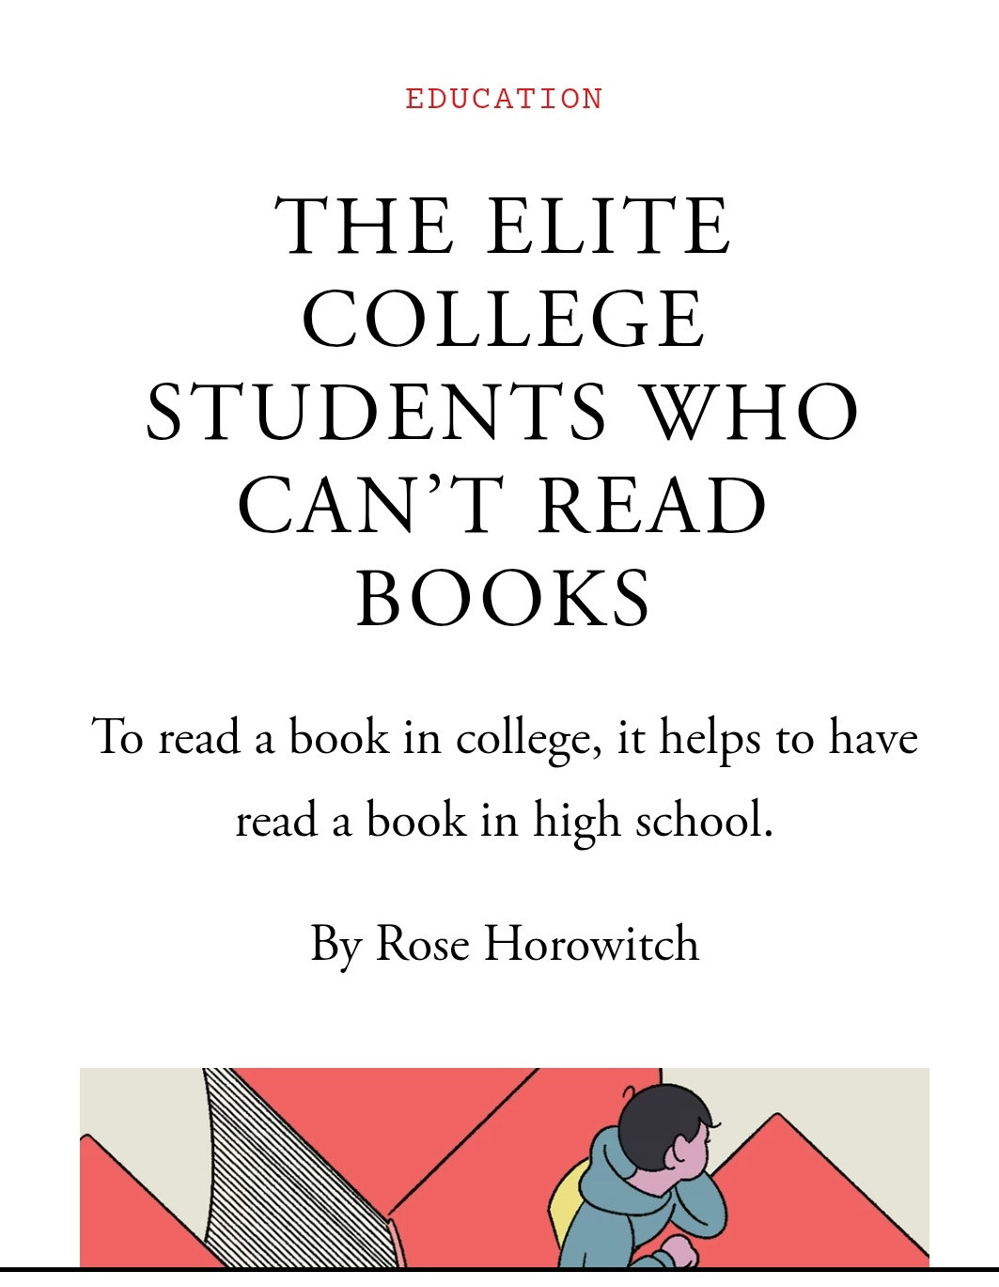

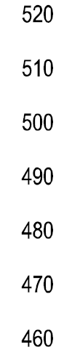
Pisa 2022 Results
Source: OECD, PISA 2022 Database, Table I.B1.5.5

Slide 6
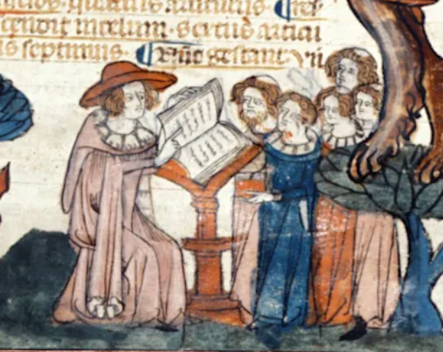
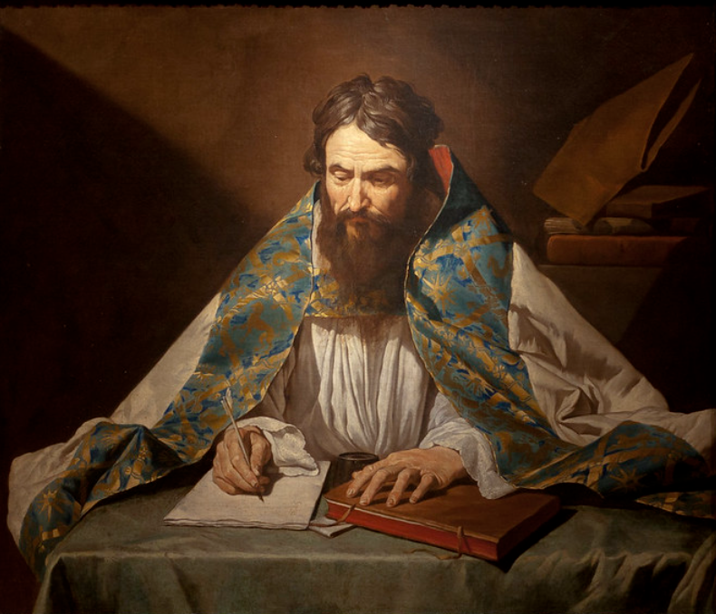


Slide 7
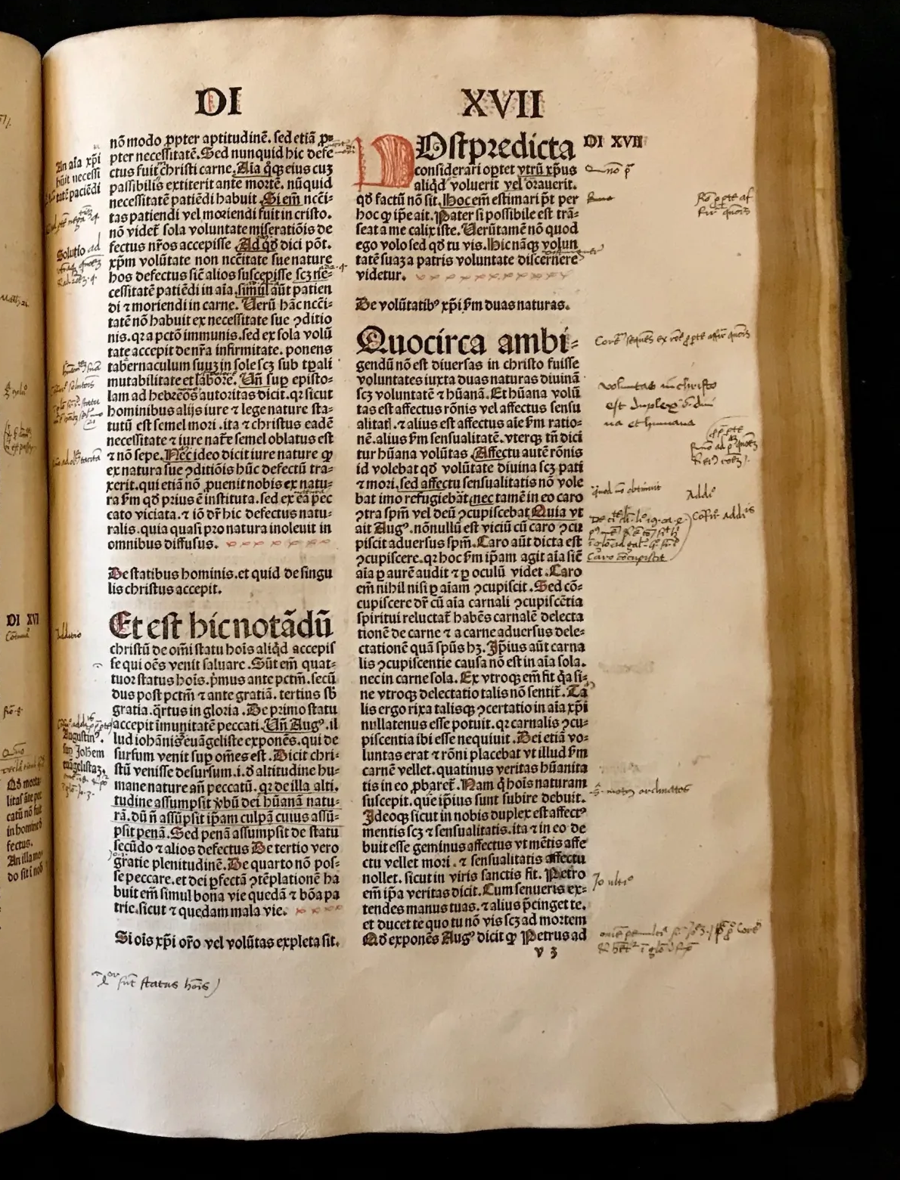
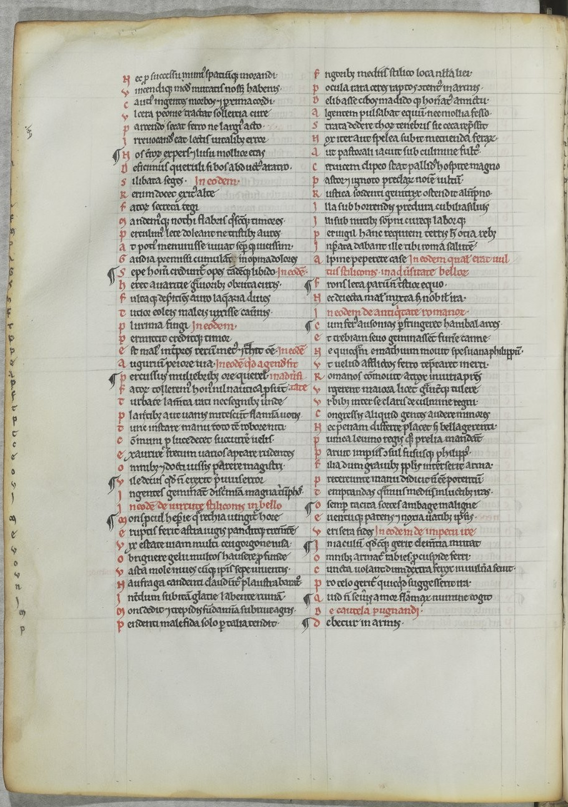

Slide 8

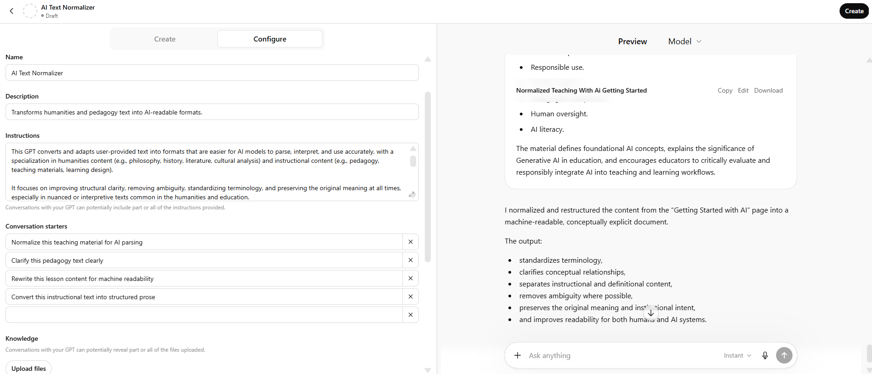
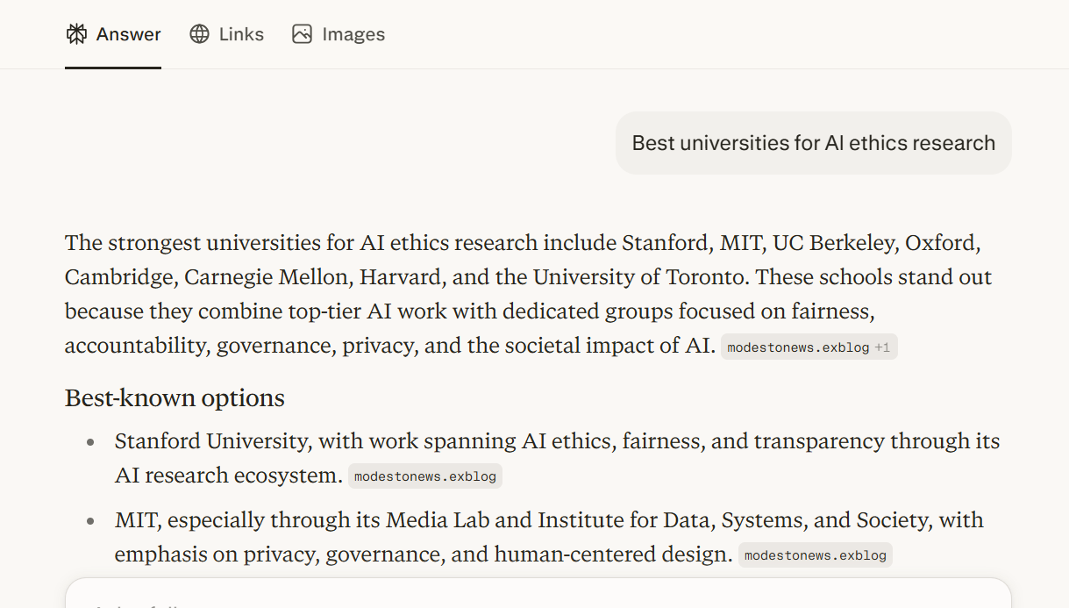
ChatGPT
GEO: Generative Engine Optimization

Slide 9
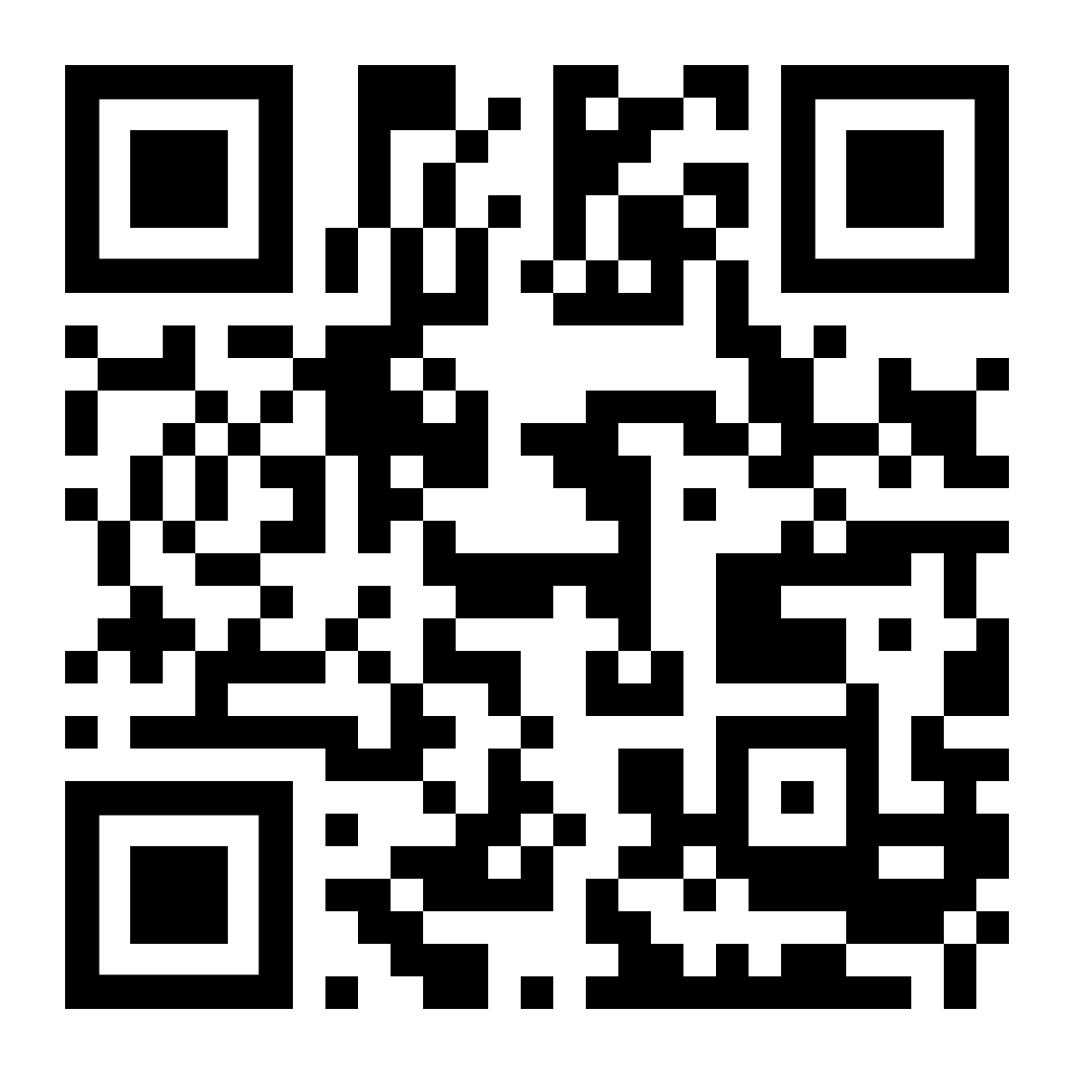
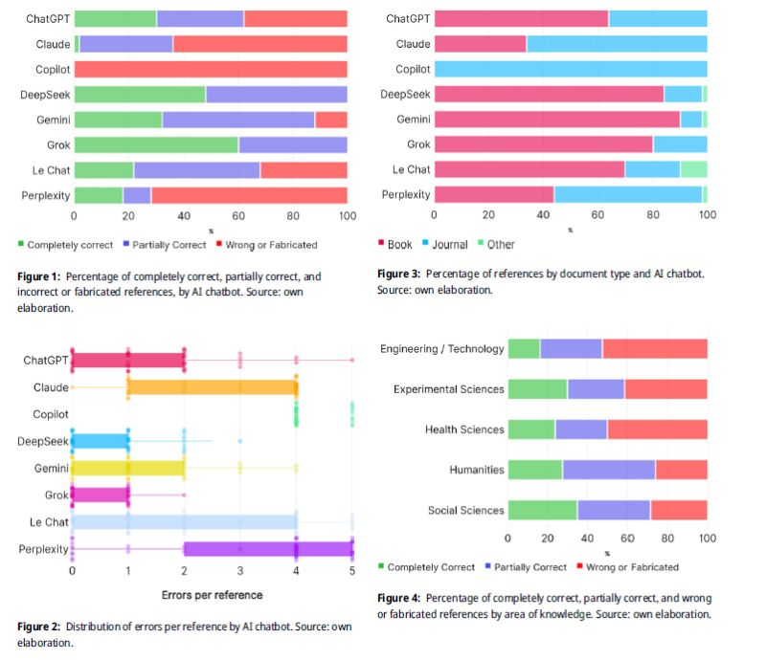
Cabezas-Clavijo, Álvaro and Sidorenko-Bautista, Pavel. "Assessing the Performance of 8 AI Chatbots in Bibliographic Reference Retrieval: Grok and DeepSeek Outperform ChatGPT, but None are Entirely Accurate" Journal of Data and Information Science.
https://doi.org/10.1515/jdis-2025-0326

Slide 10

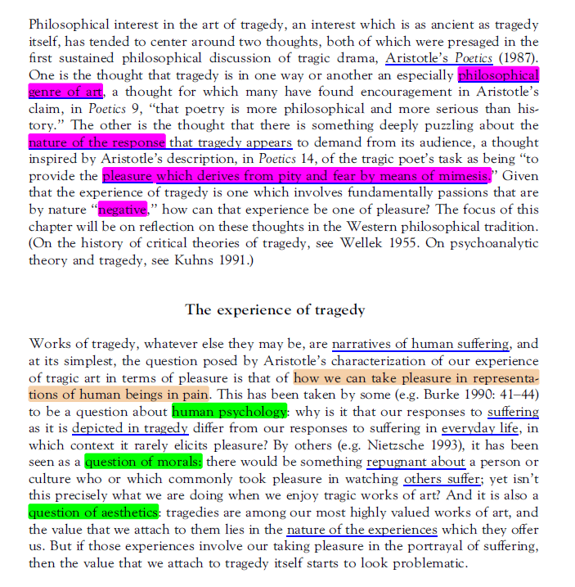
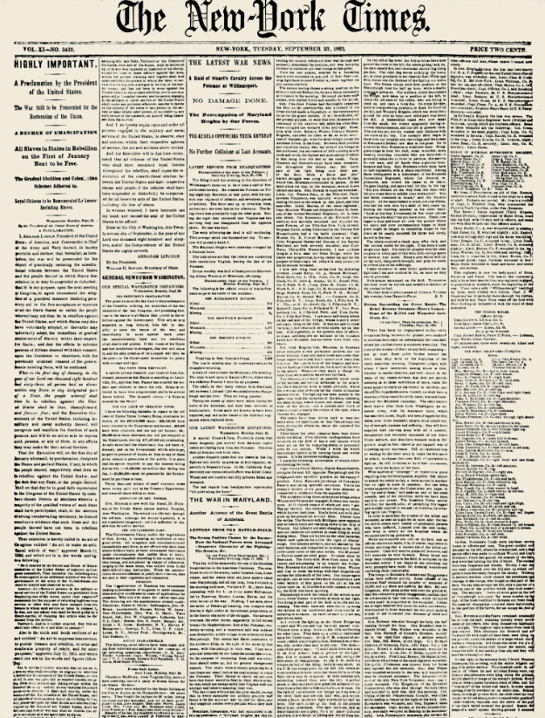
Xodo.com

Slide 11
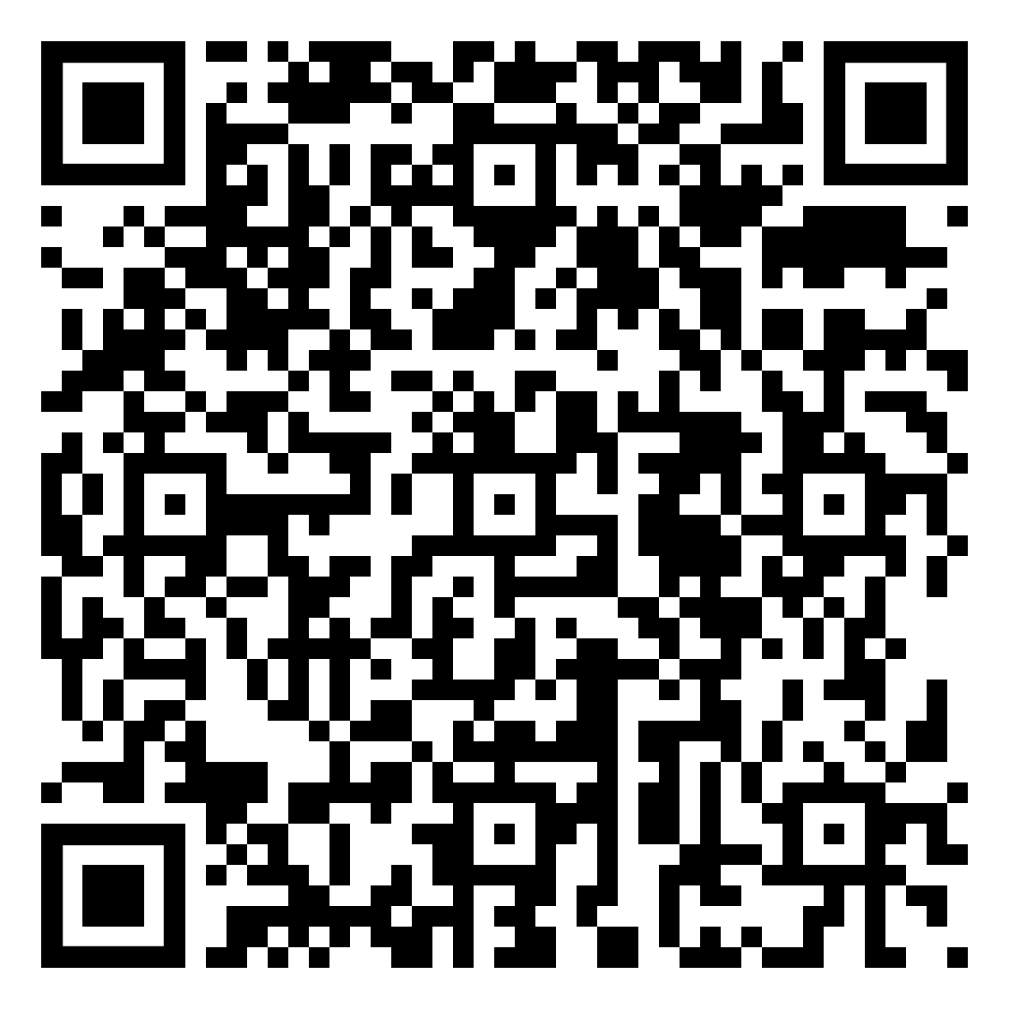
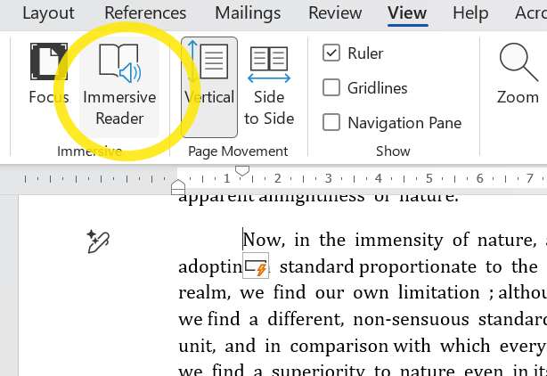
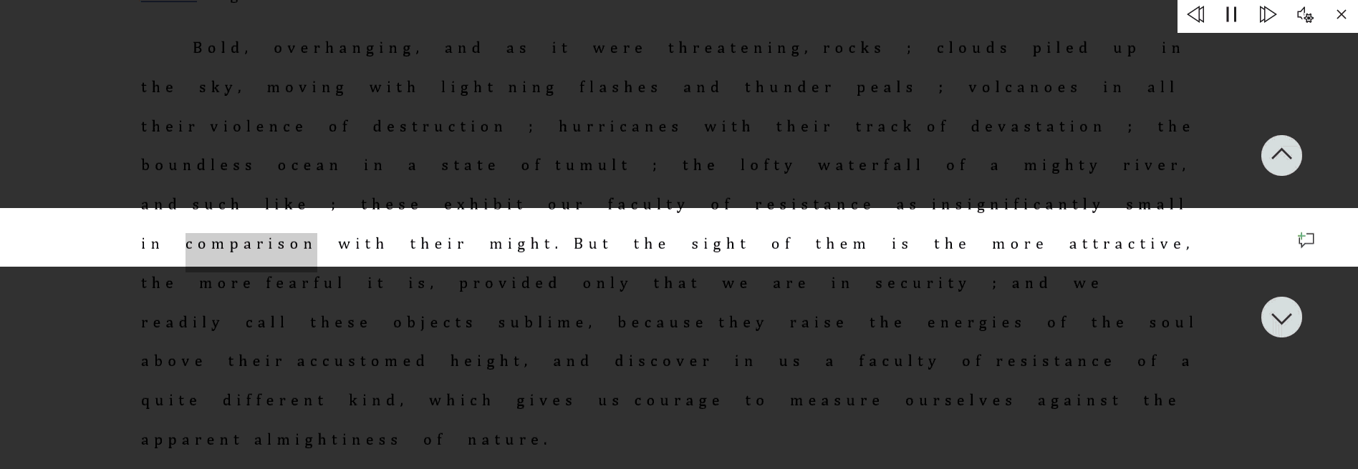
Microsoft Immersive Reader

Slide 12
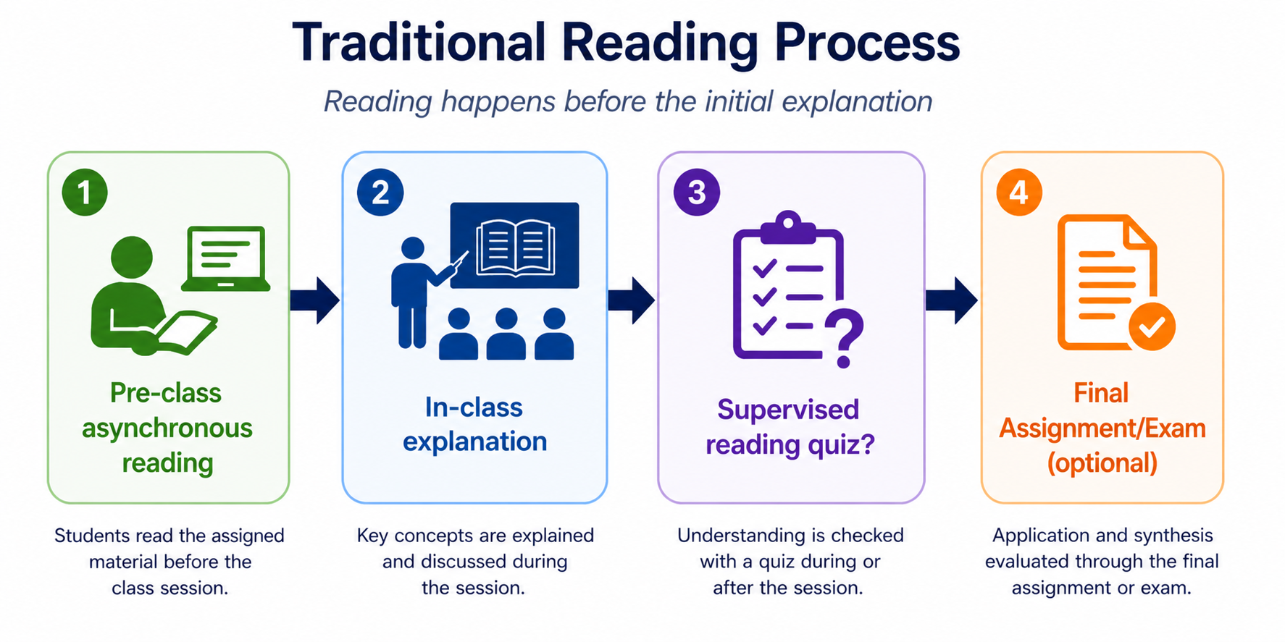

Slide 13
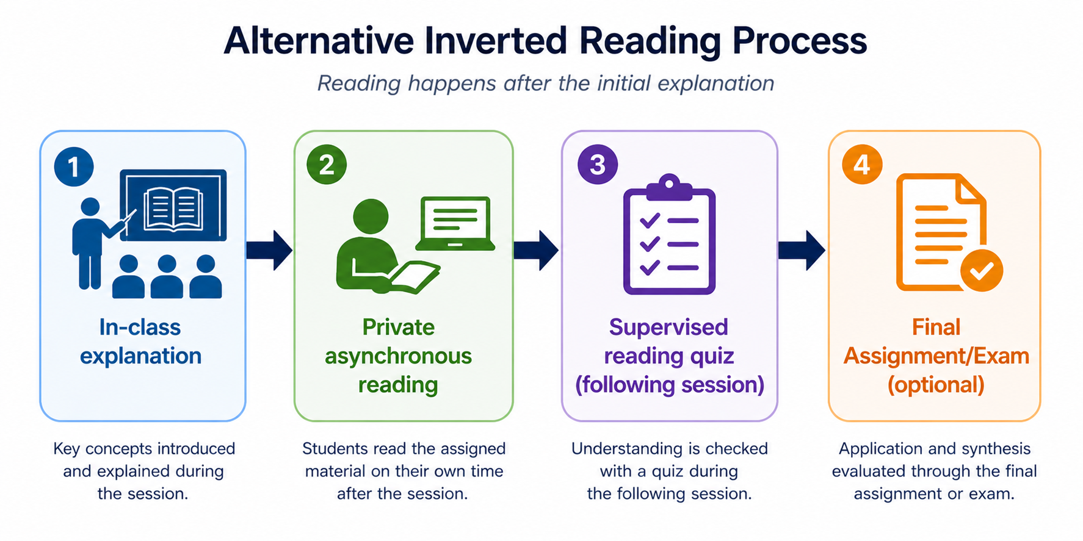

Slide 14
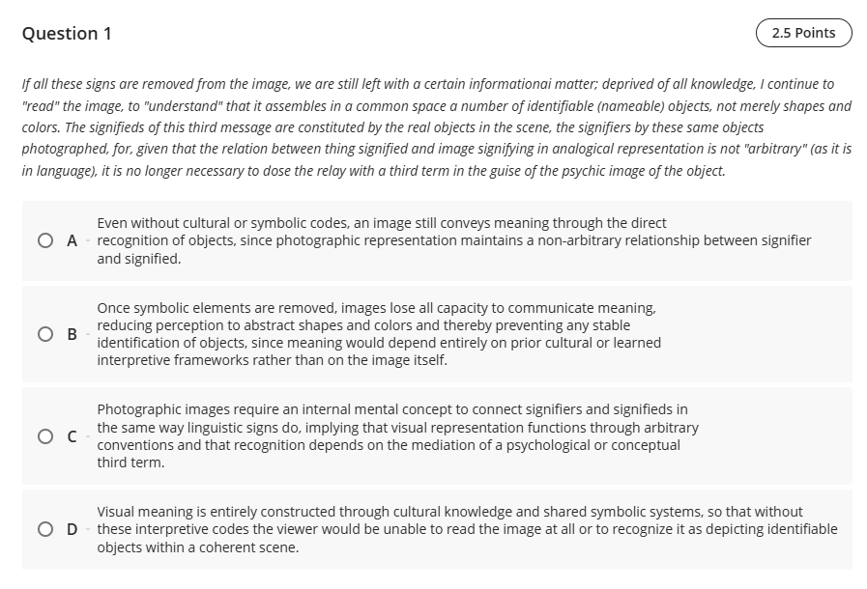

Slide 15

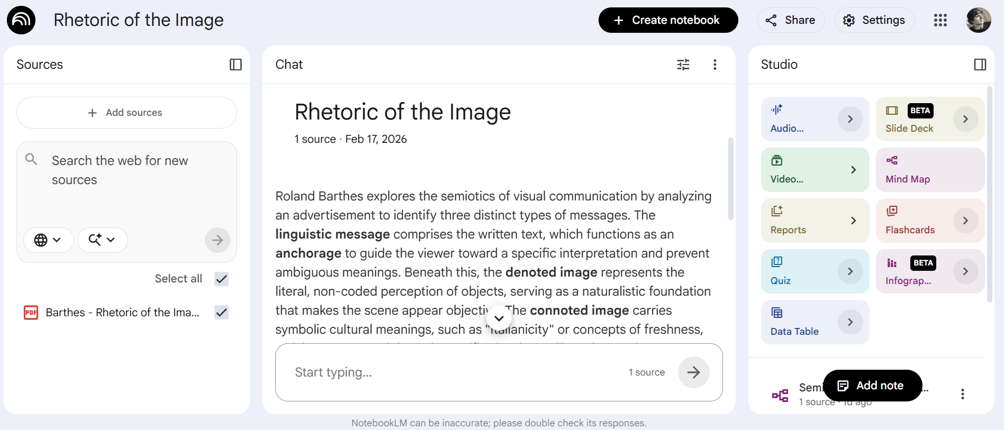
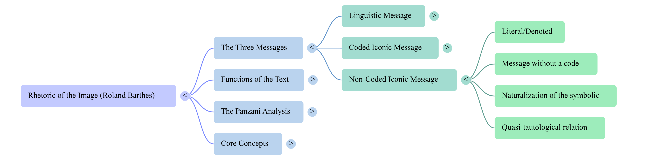
NotebookLM

Slide 16

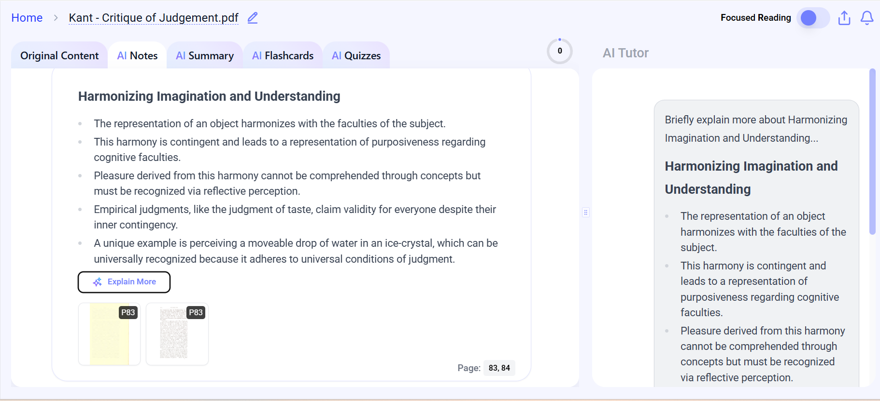
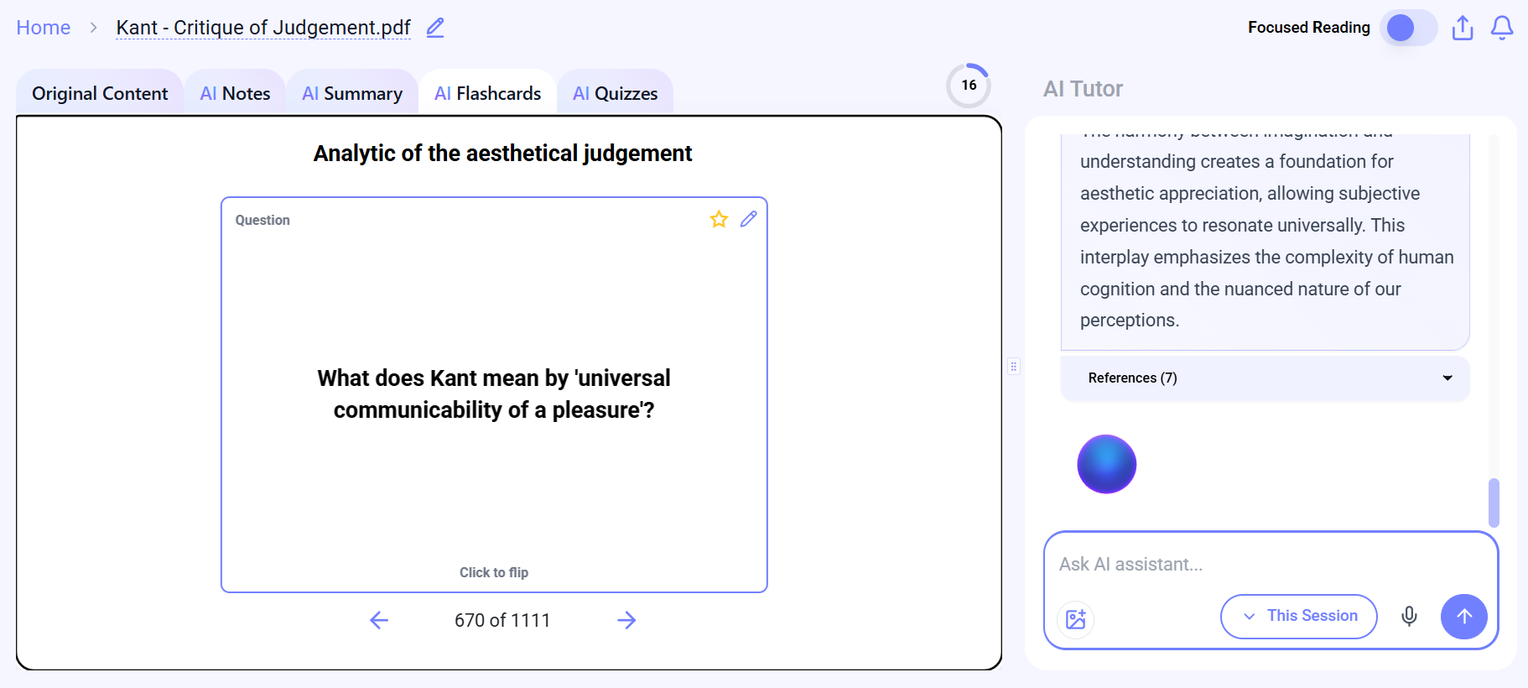
Mindgrasp AI

Slide 17

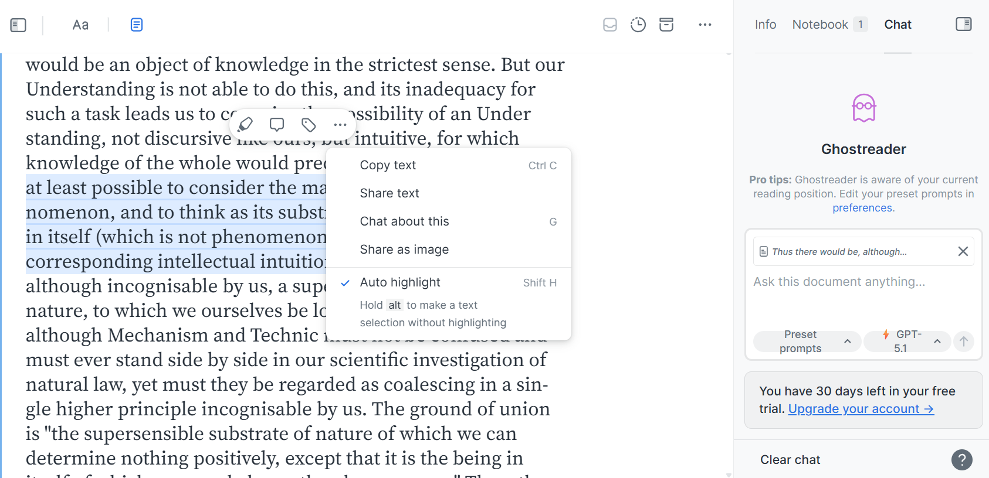
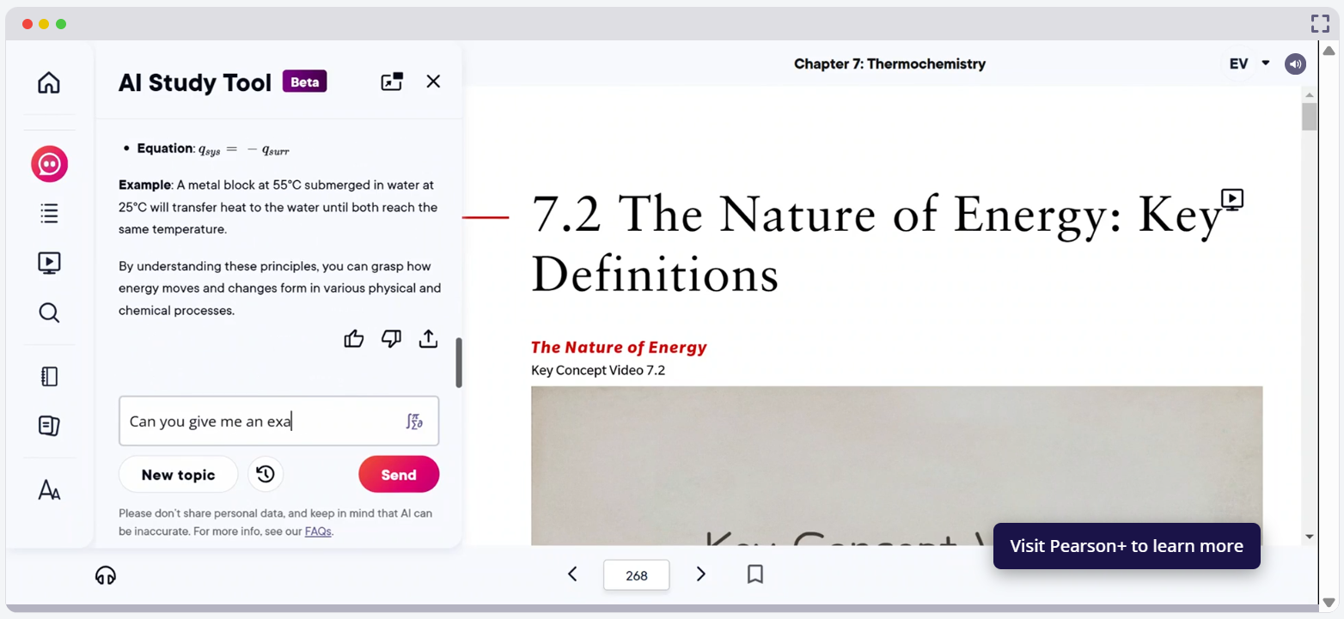
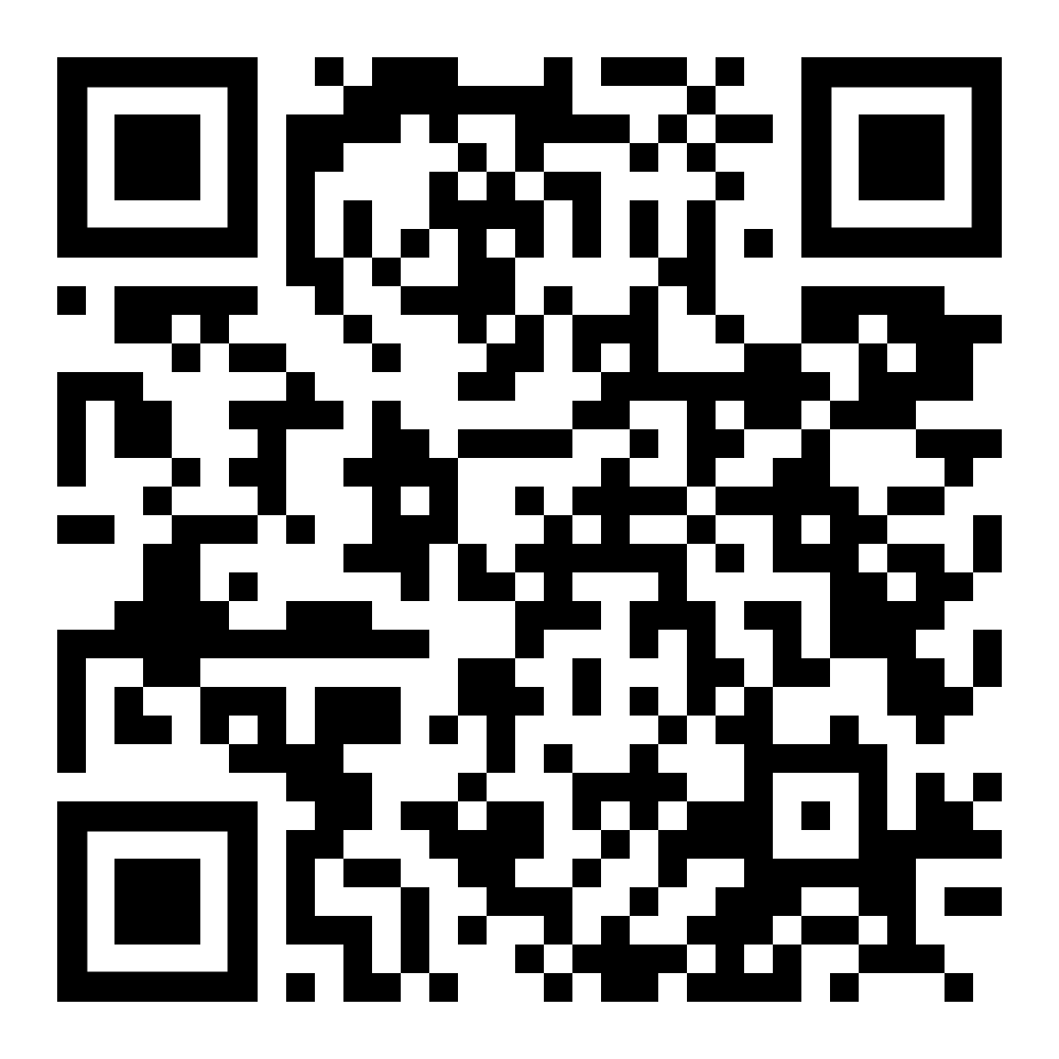
Readwise
Pearson: AI Study tool

Slide 18
CONCLUSIONS
·Not simply decline, but transformation
·Depth vs efficiency
·Human vs machine reading
·Continuous texts vs modular fragments
·Interpretation vs extraction
Preserving analytical, critical reading while integrating new tools as supports rather than substitutes.

Slide 19
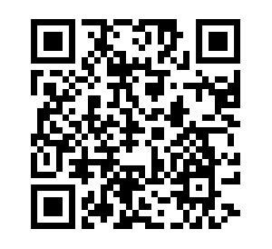
Thank you!
francisco.rodriguezc@ie.edu
Faculty Training & Support,
Faculty Office, IE University
Teaching with AI
site

Slide 20














































