Slide 1
Is Your LMS Gradebook Holding Your Grading Practices Back?
Cathy Ishikawa
Notes:
Hi! I’m Cathy Ishikawa and I’m a lecturer in the Biological Sciences Department at California State University Sacramento. I am grateful for this opportunity to share some ideas about grading and gradebooks.

Slide 2

This presentation is part of the Accessibility Track, which is sponsored by
Notes:
Thank you to Original Syndicate for sponsoring the Accessibility Track!

Slide 3
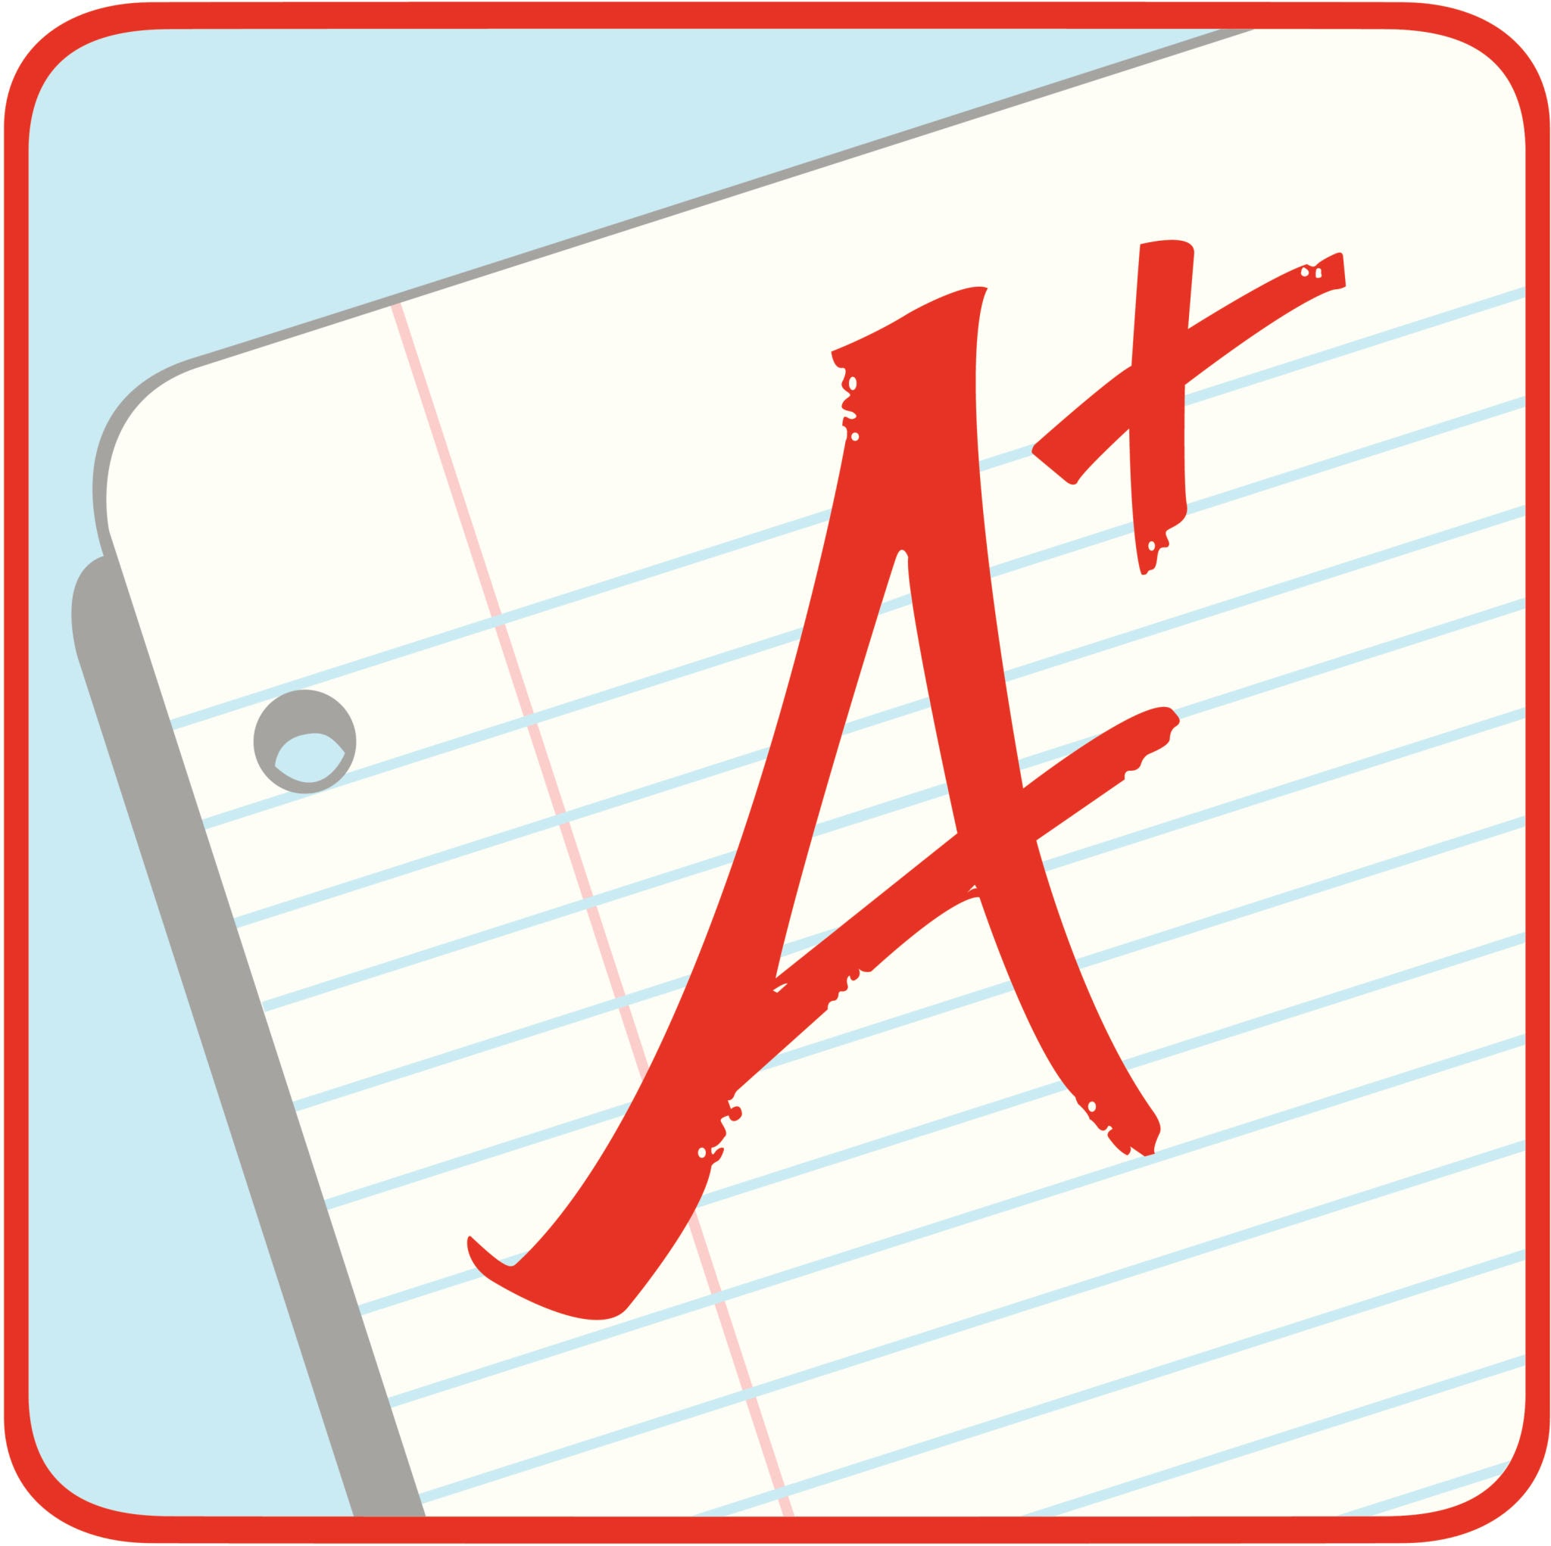
Why give grades?
15-second reflection
What are grades for?
What are they supposed to represent?

Slide 4

My grading goal
Grades reflect skills and knowledge students leave my class with
Notes:
My goal may be different than yours–you may see grades as more of a motivational tool or a way to rank students, but I want my grades to reflect students’ skills and knowledge after taking my class. I basically want grades to indicate how well students met the learning goals for the class.

Slide 5
Accessible & Equitable Grade System
Meeting Learning Goals
Grade
1
2
3
Notes:
Given that goal, I see an accessible and equitable grade system as one that allows students meet the learning goals using a path that works for them. This path might be short and straight to the point like student 1 on the left–this is the student who would probably succeed regardless of grading structure. On the other hand, the path might be messier like student 3 on the right–there might be some misunderstandings early on, or the student might miss some classes because of a chronic condition, or their neurodivergent brain may take them on some unexpected side quests. An accessible grading system will allow some flexibility for different journeys to meeting learning goals.

Slide 6
“Grading for Growth”
Various styles: ungrading, specifications, standards-based
Common characteristics
  retries and revision
  descriptive categories rather than points
Resource page for more information
Notes:
I like Clark and Talbert’s catch-all name of “Grading for Growth” to describe different alternative grading systems that align with this idea of allowing for multiple paths to success. All of the grading for growth approaches involve multiple opportunities to meet learning goals, either through retries or revision. They also often use descriptive categories rather than points, to encourage a learning mindset rather than a point-collecting mindset.

Slide 7
Standards-based grading with Learning Mastery gradebook
Issues with transparency
  Extra navigation required
  Awkward progress tracking on student and instructor end
  Students expect a total grade column
Notes:
Let’s get to the title of the talk…Here’s an example of my gradebook holding me back. I use a standards-based approach in my Ecology lecture and lab, where students have a list of skills and knowledge to demonstrate, and they had multiple opportunities to demonstrate them. I have kept things relatively simple, with a “met” or “not yet” rating system and a final grade calculated based on the number of standards met. Canvas has a Learning Mastery gradebook for this type of grading, but there are some practical challenges. The first is that Learning Mastery is not the default gradebook, and switching to it is non-intuitive. Second, once we get into the correct gradebook, the system for tracking standards is visually clunky, especially for students. And my number one challenge was that students would still try to track their grades in the regular gradebook view–they were really conditioned to do that because in other courses they could go to the course grade total column and see their current grade. After the fact, a lot of students appreciated the approach, but during the semester, the gradebook caused both students and me undo stress–it held us back from enjoying the benefits of the system.

Slide 8

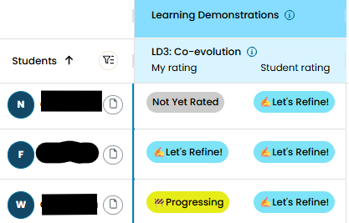
Can a gradebook encourage new grading practice?
Notes:
Here’s a contrasting story. I beta tested the Learning Portrait grading platform with my Plants and Civilization class. I was initially attracted to how easy it was for students to track progress with the descriptive categories. But the gradebook is also designed to facilitate student self-rating, and has an option for having students rate themselves based on your feedback before they see your rating. I could see the metacognitive value for that, and I figured that since it was an option in the gradebook, I might as well try it. Interestingly, we actually agreed most of the time, and when there was a difference it open the door to further discussion. So this was an example of a gradebook nudging me to try something new instead of tethering me to old ways of doing things. I hadn’t really thought about how my gradebook could be pushing me in one direction or another before!

Slide 9
Invitation to reflect
To what degree does your current grading system truly reflecting learning?
How does your LMS grading system influence your choices?
What would your dream LMS gradebook look like?

