Slide 1



From the Classroom
to the Studio
Integrating Podcasting into Assignments
Ana Flávia Boeing Marcelino - anaflavia@uchicago.edu | afb9@illinois.edu
Research Associate · UChicago Portuguese Language Program
Mohammad Ahmed | ahmed10@uchicago.edu
Academic Technology Solutions · UChicago

Slide 2
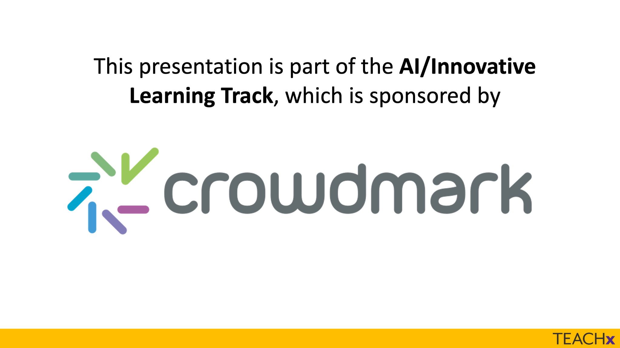

Slide 3
Today's Session at a Glance
PART 1 · 15 MIN
Pedagogical Foundations
▶ NOW
Ana Flávia · Why podcasting? How does it work in the classroom?
PART 2 · 15 MIN
Technical Setup
Mohammad · Recording, editing & publishing tools
HANDS-ON · 60 MIN
From Script to Studio
Planning → Recording → Sharing → Celebrating

Slide 4
“
Our goals:
Explain the pedagogical benefits of podcasting as an experiential and collaborative learning activity;
Design a scaffolded podcast assignment aligned with course learning outcomes;
Apply workflows for recording, editing, and publishing student podcasts using low-barrier technologies;
Facilitate student collaboration by designing group assignments with structured roles for the production processes;
Adapt podcast-based projects to diverse disciplines, class sizes, and instructional contexts.

Slide 5
Where This Comes From
UChicago - across the university
28
Portuguese Language
French Language
Science Communication
Clinical and Translational Science
Polish Language
Global Studies
Italian Language
Humanities studies
Anthropology
Spanish Language
MBA
Independent Study/ Senior Thesis
Courses
296+
Participants
16
Unique Faculty

Slide 6
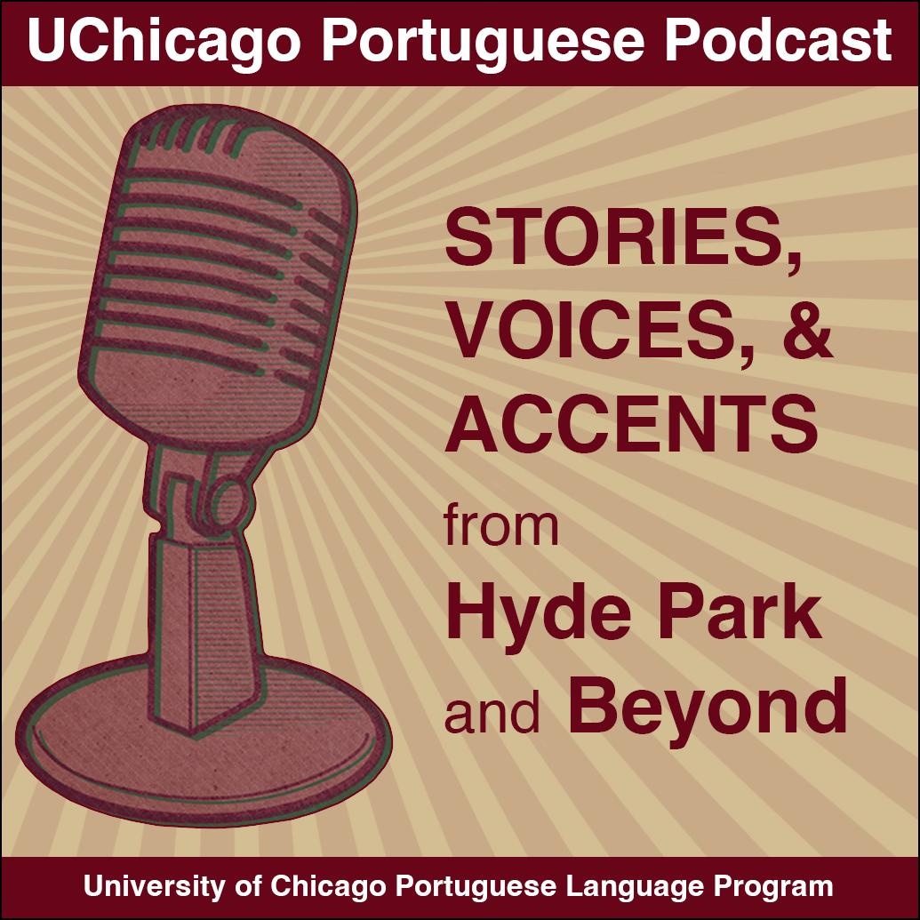

Where This Comes From
UChicago Portuguese Podcast
7
A classroom-tested model across multiple courses and proficiency levels:
PORT 103, 122, 145, 201, 205, 206, 215
32 students + 13 community interviewees
12 interview episodes (~20 min each)
Published on Spotify for Creators
Courses
45+
Recorded at UChicago's Reg podcast studio, co-designed with Academic Technology Solutions.
Participants
12
Episodes

Slide 7
“
Think-Pair-Share (5 min)
In groups share your experiences with podcasts:
what do you listen to
have you produced/participated in any podcast series/episode
what podcast format would be interesting as a "real-life" task in your field
Choose a speaker to report to the big group, find a consensus for one recommendation based on your group's experiences.

Slide 8
Why Podcasting? The Pedagogical Case
Authentic Communication
Student Agency & Ownership
Students communicate for a real audience — not just the instructor. Real stakes drive genuine language use and preparation.
Learners choose topics, interview guests, and shape their own narrative. They become producers, not just consumers.
Collaborative Knowledge Production
Multimodal Literacy Development
Group roles — researcher, interviewer, editor — mirror real-world professional dynamics and foster interdependence.
Students develop listening, speaking, research, synthesis, and genre awareness simultaneously.

Slide 9
Theoretical Roots: TBLT & Experiential Learning
TBLT Framework
Experiential Learning
Task-Based Language Teaching (Ellis, 2009; Skehan, 1996)
Primary focus on meaning, not just form
A communicative gap to fill (information, opinion, narrative)
Students rely on their own linguistic & non-linguistic resources
Clearly defined outcome beyond language use
Skehan's three-stage framework: pre-task → task → post-task
Experiential Learning (Kolb, 1984)
"Learning is the process whereby knowledge is created through the transformation of experience"
PRÁXIS (Freire, 1970): the cyclical process of reflection and action
Moving from passive reception → active creation

Slide 10
What Students Actually Do: Skills in Action
Language skills
Fluency under pressure (can't choose when to speak), vocabulary activation, pronunciation awareness, strategic rephrasing when stuck.
Research & synthesis
Investigating guest backgrounds, tracing themes, preparing questions — moving beyond memorized answers.
Collaboration & role design
Structured roles: researcher, interviewer, narrator, editor. Each student contributes based on strengths.
Critical listening & genre awareness
Analyzing model podcasts, learning turn-taking, topic-switching, intros/outros, pacing
Transferable professional skills & career readiness
Communicating, networking, interviewing, storytelling — skills they'll use beyond the classroom

Slide 11
“
The physical location spurs a shift in mentality — if you had asked us to record on our own, most students would have just prepared lines and read a script. Having to record in a studio made it a much more organic conversation.
Definitely! I was very focused and I learned that when I am fully focused, my fluency improves.
The most enjoyable part was the fact that it felt like a new professional experience. The equipment was all so professional and it felt very real. It was interesting to see how something like a podcast is produced.
Student Feedback — UChicago Portuguese Podcast
Feedback Questionnaire · Spring Project · 45 participants

Slide 12
Scaffolding the Assignment: A Step-by-Step Design
BEFORE the Mic
DURING & AFTER the Mic
Preparation Phase (before recording)
Explore podcast as a genre: structure, themes, elements (podcasts in your field as classroom material)
Analyze a model episode together (form and content)
Practice intros, turn-taking, topic-switching, wrap-up strategies
Research guest background; draft episode structure
Practice and evaluate your intro in class (small group sessions, office hours, TAs)
Discuss rubrics (collaborative, formative assessment model)
Sign media release forms (if project is public)
Production & Reflection Phase
Recording session (studio or portable device)
Post-production: editing in Audacity, publishing on platforms
In-class listening experience with structured reflection (or at home evaluation)
Peer evaluation and self-assessment rubric
Grading: preparation + participation + reflection, not linguistic perfection

Slide 13
Adapting to Your Context
Any Discipline
Any Tech Level
Language classes, social sciences, STEM, professional programs — podcasting works wherever students need to communicate, research, and collaborate.
Phone + free app = enough. A studio is a motivational bonus, not a requirement. Low-barrier entry is by design.
Any Class Size
Any Proficiency Level
Small seminars: one group per episode. Large lectures: assign roles; different groups cover different angles of the same theme.
Beginners interview classmates in target language. Advanced learners interview community members. Adjust scope, not the pedagogical logic.

Slide 14
TAKEAWAYS
The Pedagogy, in Brief
▸
Podcasting is a task — it targets a real gap, a real audience, and a real outcome beyond language use.
▸
Scaffolding is the key: genre analysis, preparation sessions, structured roles, and low-stakes practice before the mic goes on.
▸
Authenticity drives motivation — students rise to the occasion when it feels real.
▸
Any discipline, any class size, any tech level. The principles are transferable.
UP NEXT · Mohammad walks you through recording, editing & publishing — from phone to Spotify.

Slide 15
Today's Session at a Glance
PART 1 · 15 MIN
Pedagogical Foundations
Ana Flávia · Why podcasting? How does it work in the classroom?
PART 2 · 15 MIN
Technical Setup
▶ NOW
Mohammad · Recording, editing & publishing tools
HANDS-ON · 60 MIN
From Script to Studio
Planning → Recording → Sharing → Celebrating

Slide 16





The Nuts and Bolts…
Plan the podcast
2) Collect Source Material
3) Edit the podcast
4) Share the podcast

Slide 17
Plan the podcast
Opening
2) Main Content
What is the Focus/ Topic Question?
Is there a narrator? What is her or his role?
Will you interview anyone? Using what questions? Where will it be?
Will the podcast include storytelling?
What stories will be included?
3) Summary
4) Soundtracks
What ideas do you have for the beginning and ending of the podcast?
Will the podcast include sound effects?
Will there be music? Intro? Outro?

Slide 18
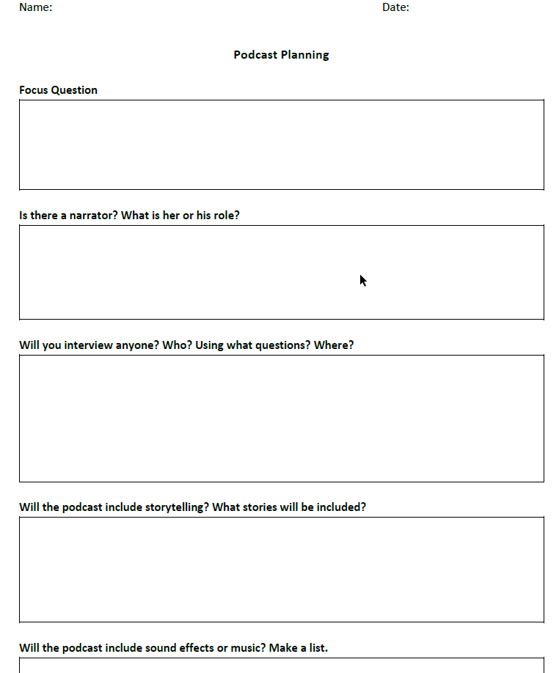

Plan the podcast
NYT Guide
Use and share the Planning form from the NYT with your students.

Slide 19
Collect Source Material
Mobile Apps
Zoom
Riverside.fm
Dolby On
Spotify for Creators
Zoom guide on recording
RØDECaster Pro II
Recording Tips
Six inputs for connecting microphones, instruments and line-level devices
Dual USB-C interfaces
Built-in wireless
$699
Find a quiet space.
Place the microphone about 6 inches from your subject’s mouth.
Do a test recording and make adjustments based on it.

Slide 20
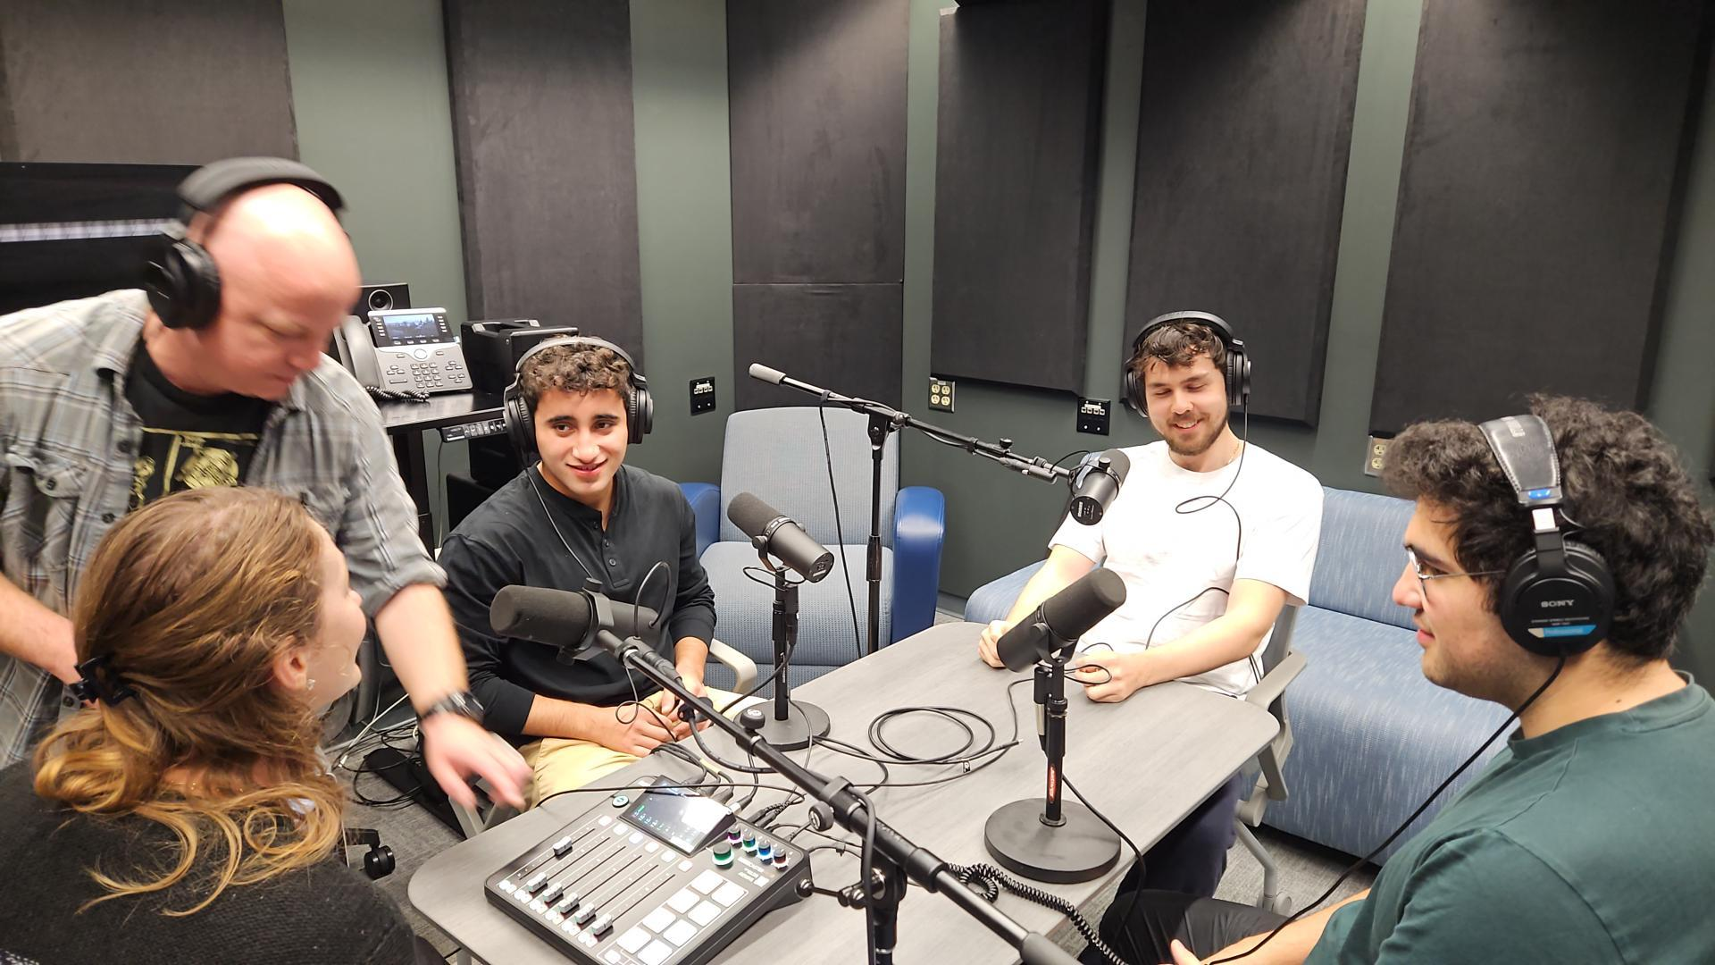
Our Studio Process
Process
Plan with faculty 1 semester ahead, objectives, assignment, dates, headcounts, groups, rounds, etc.
Class orientation.
Students practice independently.
Student make reservation.
Techs setup the recording session and
review best practices.
Students record takes.
Techs transfer files to the students.
Students edit the final product and submit.

Slide 21
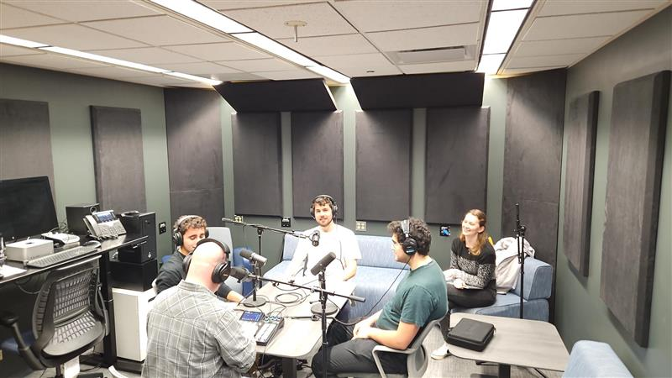
Edit the Podcast
Timing
The editing process can be very time consuming!
Set expectations with Rubrics
Editing Software
Audacity (free): works on Window, Mac, and Linux
GarageBand (for Mac users): works on desktop and phone
Tutorials galore on:
LinkedIN, Youtube, company sites.
Freeeeeeeeeee stuff!
  Bensound
  Freesound
  www.premiumbeat.com
  www.audiojungle.net
  www.audiohero.com

Slide 22

Share the Podcast
Canvas (or whatever LMS)
Podcast Services
Assignment Submission
Canvas guide: How do I enable a podcast feed for a discussion in a course?
Leverage Discussion Boards.
Soundcloud
Spotify
Apple Podcast
Google Podcast
Blogs
Celebration! 🎈
WordPress blog
Canvas Org site.
Celebrate what your students have made 🥳
Podcast listening party? 🎉
Chance to offer feedback?

Slide 23
Tips and Tricks
Set expectations
Rubrics
Limit your student’s production time.
Do some experiments on your own! Examples help!
Communicate your expectations & grading scheme clearly. Rubrics!
Length
Audio quality: How clear of a recording?
Content
Structure & engagement
Delivery
More Rubrics
Even more Rubrics
Professor Melih Levi’s rubric for Human Being And Citizen Podcast Assignment.
Emphasis was placed upon close reading of the text and presenting it in a new way.
Technical aspects of podcasting were not weighed as heavily as reading and presenting.
Example Podcast Rubric from readwritethink.org
Example 3 from Georgetown University
Bloom’s Digital Taxonomy

Slide 24
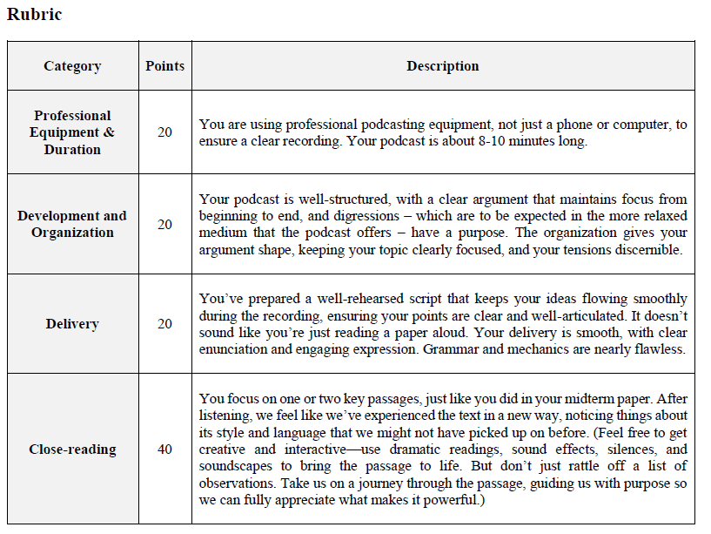
Tips and Tricks

Slide 25
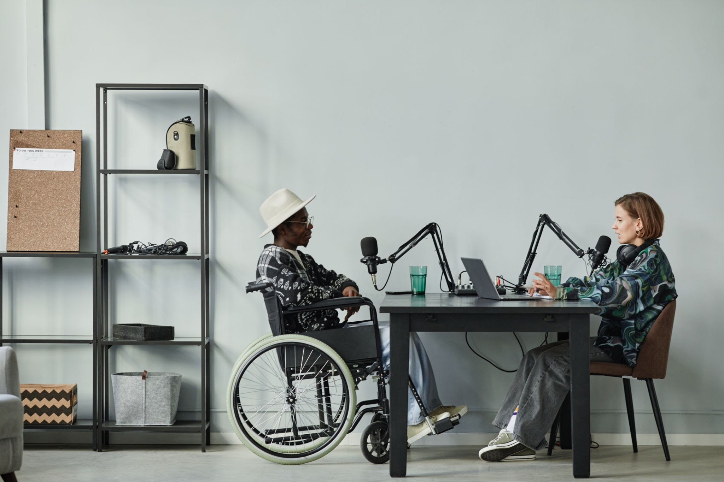
Accessibility
Accessible Platforms
Accessible podcast websites
Accessible media players
Alternative methods
Provide a transcript
Provide captions on video components

Slide 26
Today's Session at a Glance
PART 1 · 15 MIN
Pedagogical Foundations
Ana Flávia · Why podcasting? How does it work in the classroom?
PART 2 · 15 MIN
Technical Setup
Mohammad · Recording, editing & publishing tools
HANDS-ON · 60 MIN
From Script to Studio
▶ NOW
Planning → Recording → Sharing → Celebrating

Slide 27
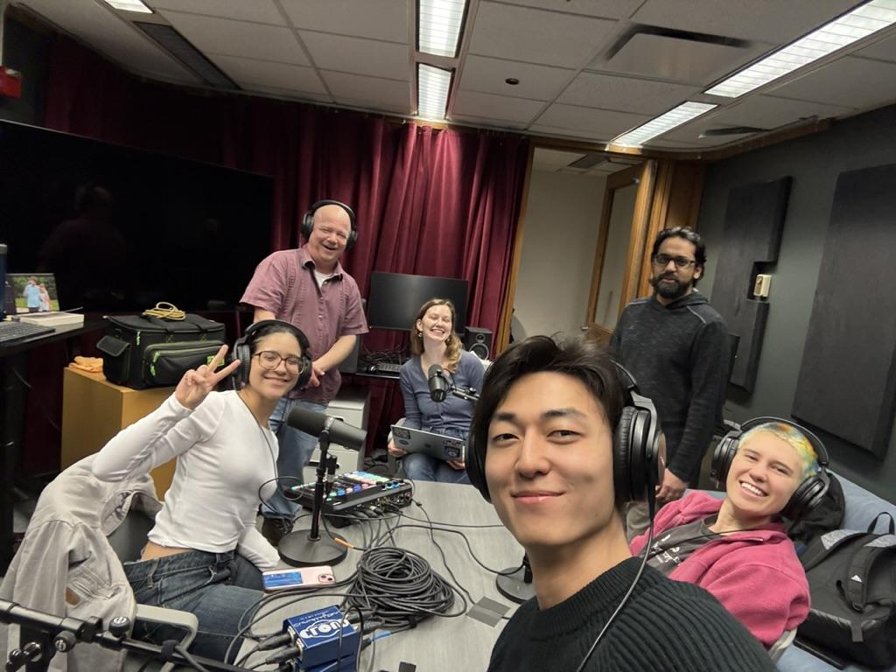
Podcast!
Break into groups of 4 people.
Choose a topic.
Plan your podcast.
Practice! Do a dry run.
Record a short 5 min podcast.
Rotate groups
Debrief with your team.
Discuss how you will use it in class.

Slide 28
Prompts & Focus Questions
TeachX
2) Getting to know your team
How was your TeachX experience? What have you learned? What are you going to take back to your department/ university?
Introduce yourself and your team. Ask general questions about what they do and where they are from?
3) How do you think AI will impact T&L
4) Make your own question
Note on Performance Anxiety
Do you think AI will have a negative or positive impact on teaching and learning? How do you feel about using AI in your classroom? Where do you think we will be in 10 years?
Experiment and choose your own topic!

Slide 29
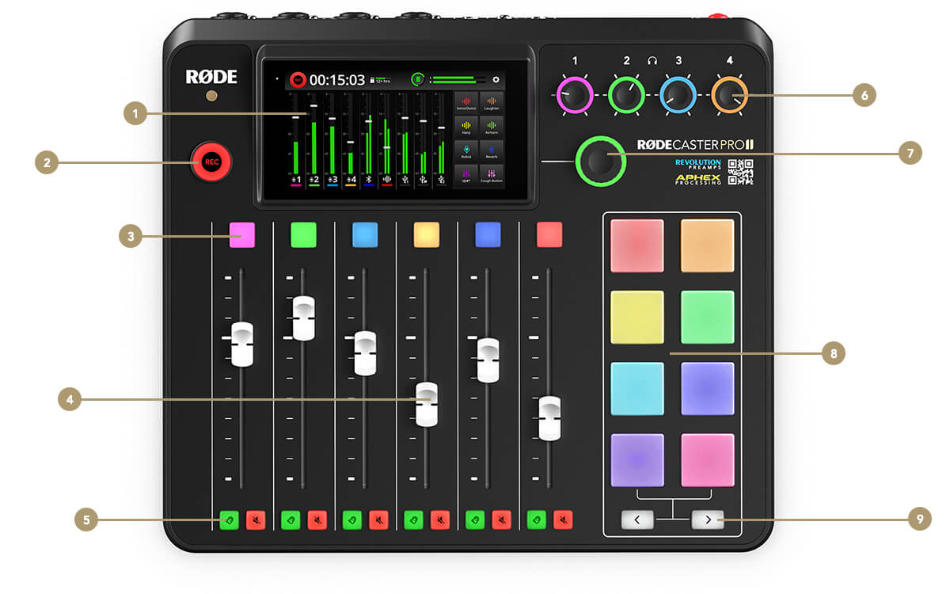
RØDECaster Pro II
5.5" HD Touchscreen
Record Button
Channel Buttons
Channel Faders
Listen and Mute Buttons
Headphone Output Controls
Rotary Encoder
SMART Pads
Bank Switching Buttons

Slide 30




Questions & Answers! And Resources!
What is the airspeed velocity of an unladen swallow?
What is the meaning of life, the universe, and everything?
QR code for this slide deck.
QR code for the Resource Sheet
Notes:
Based on studies of the European barn swallow, the airspeed velocity of an unladen swallow is approximately 11 meters per second, which is about 24 miles per hour (mph) or 39 kilometers per hour (km/h). This measurement represents a typical cruising speed for the bird. https://style.org/unladenswallow/
42

