Slide 1






Tech Time ‘26
Scan,Track, Grow
Dallas Griego
https://canva.link/scantrackgrow

Slide 2




Hello!
Agenda:
Introduction
The “Why”
Examples
Workflow Walkthrough
Hands-On Practice

Slide 3

Introduction
  20 years in education- 1st year as an Ed Tech
  Family: Married, 1 son, 2 dogs
  Hobbies: reading, watching baseball, traveling and shopping
“Technology will not replace great teachers, but technology in the hands of great teachers can be transformational.” — George Couros

Slide 4





Data Dilemma
Scattered binders, lost tracking sheets, and backlogged progress monitoring.
The Friction
The Shift
The Reward
On-the-spot QR codes launch customized, protected forms. Staff can scan with a phone or computer to instantly record data.
Automated dashboards compile records to ensure simplified progress recording.

Slide 5

One Tool, Many Uses
Behavior Tracking
Attendance Tracking
IEP Progres Monitoring
PBIS Check-Ins
BIP/BSP Data Collection
Event Registrations
FBA Observations
Professional Development Feedback
SAT/Intervention Documentation
Student Check-Ins
Student, Staff, Parent Surveys
Exit Tickets
Classroom Observations
Academic Progress Checks

Slide 6
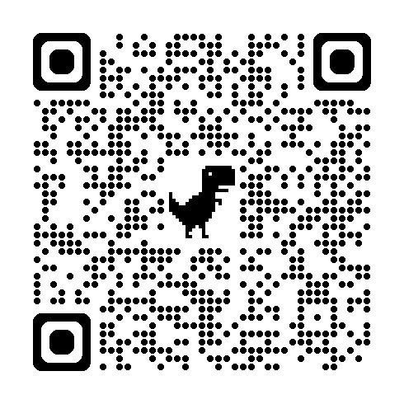

Mickey Mouse
Overview
QR Code
The student demonstrates difficulty with transitions at the beginning and end of the school day and benefits from consistent routines, clear expectations, and adult support during these times. The student's current IEP goals are focused on improving independence and success during these daily transitions. Additionally, the student's IEP includes math goals designed to strengthen foundational mathematical skills and improve problem-solving abilities.

Slide 7
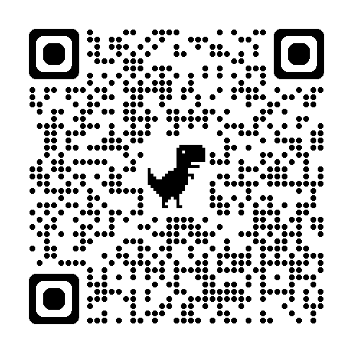

Spongebob Squarepants
The student demonstrates challenges with self-advocacy and self-esteem, often requiring encouragement and support to express their needs, build confidence, and engage independently in academic tasks. The student's current IEP goals are focused on increasing self-advocacy skills and fostering greater confidence in the classroom. Additionally, the student's IEP includes reading and writing goals targeting decoding and encoding skills to improve foundational literacy and overall academic performance.
Overview
QR Code

Slide 8
Google Form How To
Step One
Step Two
Step Three
Create Form
Open forms.google.com and click the blank plus icon to start a fresh tracking sheet.
Link Sheets
Go to the “responses” tab and click the green “Sheets” icon to route your entries into a live spreadsheet.
Structure Fields
Structure your form to directly align with the data you are collecting.

Slide 9
QR Code How To
This method allows you to be both the owner and a responder.
  Open your completed Google Form in Google Chrome.
  Click the Share button in the upper-right corner of the form.
  Select Copy link to copy the form's URL.
  Paste the link into a new browser tab.
  Click the three dots in the upper right corner.
  Click cast, save and share and then create QR code.
  Download or save the QR code to share with others.
  To submit your own response, open the Google Form using the copied link or scan the QR code with your phone.
  Complete the form and click Submit. Your response will be recorded just like any other respondent's.

Slide 10





Other Resources
Click Me!
Please make a copy before editing any forms.
Special Thanks to Katy Vigil and Lisa McCartney for creating and sharing these resources.

Slide 11
Thank you!
Have a great day!

