Slide 1
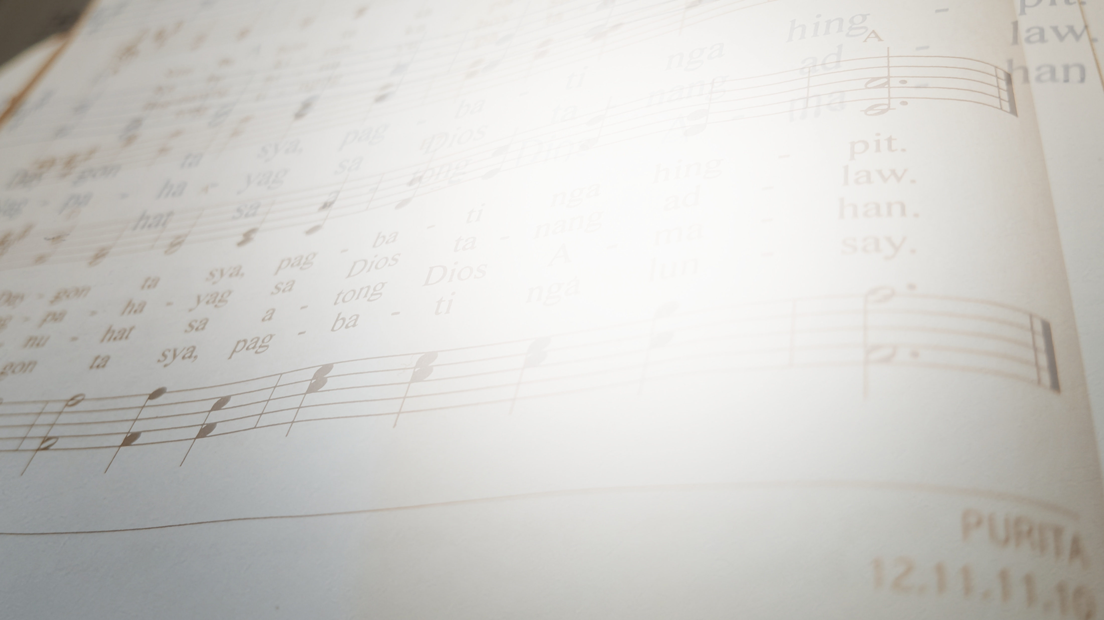


MELODIES OF KINSHIP:
The
MAQUISO
Tune Tree
Jean Cuanan-Nalam

Slide 2
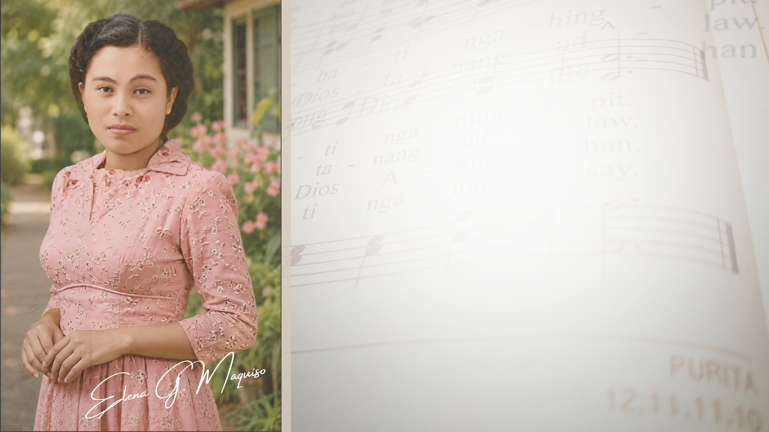
INTRODUCTION
Elena Granada Maquiso, a prolific Cebuano hymnwriter in the Philippines, never married nor had children and, therefore, did not establish a conventional family tree. Instead, she created what may aptly be called a “family tune tree.” This discovery emerged during the course of my dissertation research, when I began noticing that many of her musical compositions bore human names. Upon comparing these tune titles with her genealogical records, I discovered that 65 percent of them exactly matched names found within her family lineage.

Slide 3
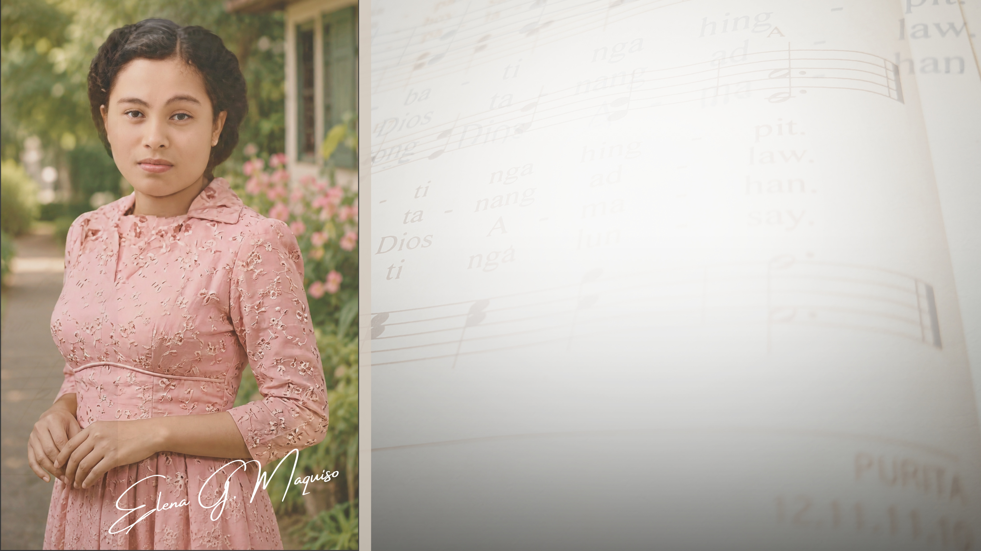

INTRODUCTION
I initially hypothesized that the remaining 35 percent represented nicknames or informal variations of family names. Further details regarding this remarkable “tune tree” were later confirmed during an online interview with her nephew, Besben Maquiso, on October 15, 2020.

Slide 4
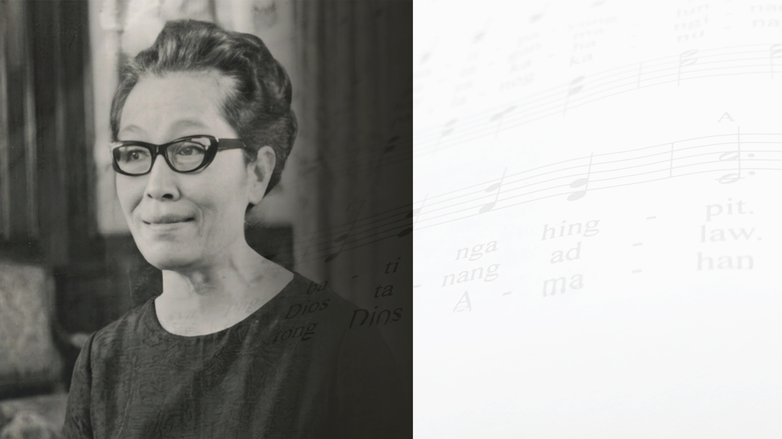
BIOGRAPHICAL SKETCH OF MAQUISO
  Born in Guindulman, Bohol, on July 9, 1914.
  Parents:
    Remegia Timbal Granada
    Juan Diano Maquiso
  Siblings:
    Bienvenido
    Magdalena
    Leonardo
    Juanito

Slide 5



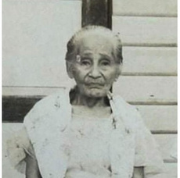
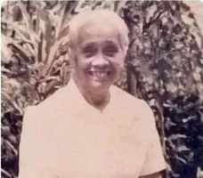
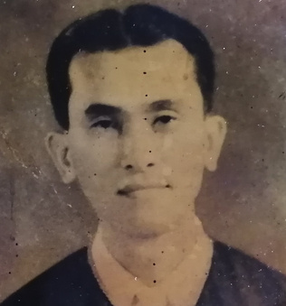
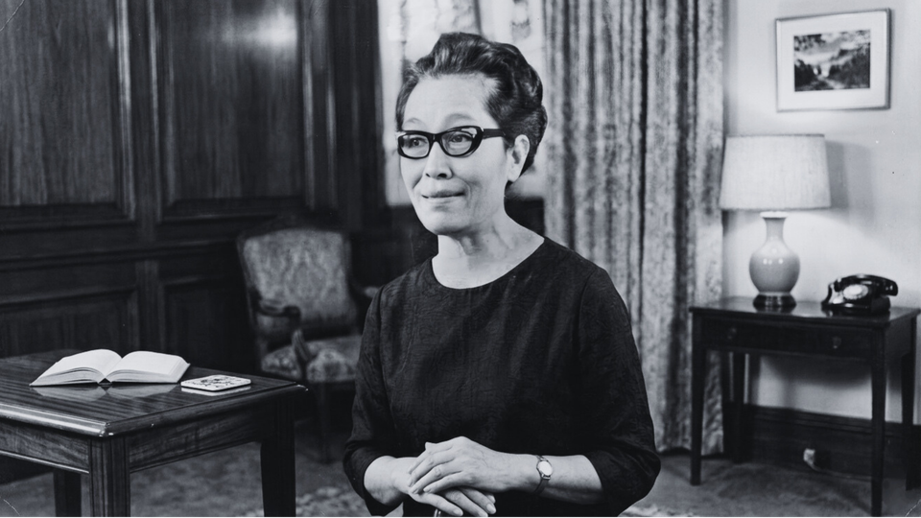
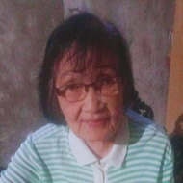
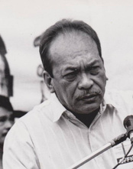
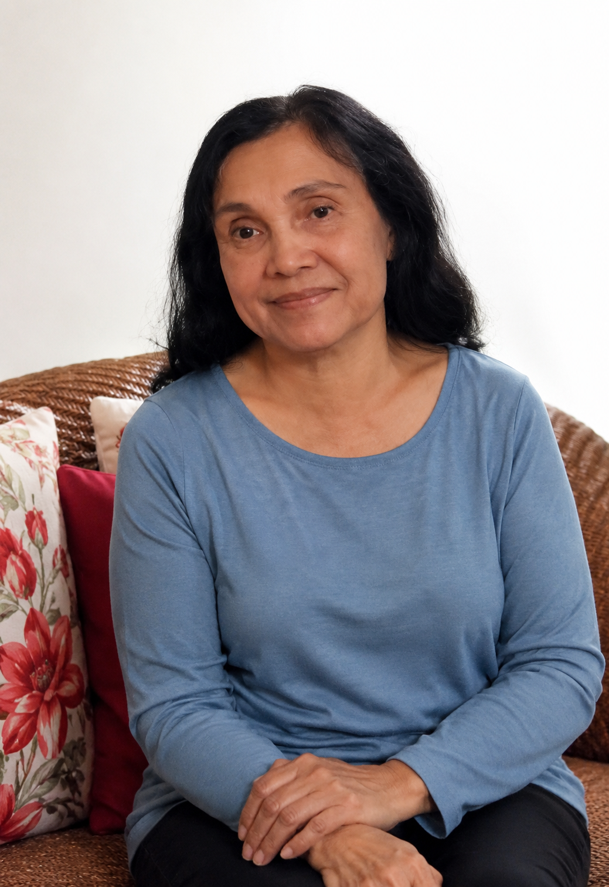
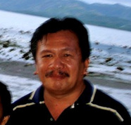
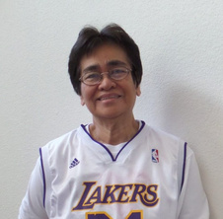
FIGURE 1.0 MAQUISO FAMILY TREE
Ella Frances Thompson
(Foster mother)
Juan
Remegia
Bienvenido Sr.
Magdalena
Leonardo
Juanito Christopher
Elena
Gypsophila
Mike Melchizedek
Porferio
Elizabeth
Purita (Rae)
Emmanuel
Bienvenido Jr.
Besben
Carlito
Nelson
Yolamie
Selah
Fe

Slide 6

FROM BOHOL TO MINDANAO
  Elena’s father, Juan Diano Maquiso, became a member of the Moncado group, founded by Hilario Camino Moncado.
  The family’s move from Bohol to Misamis Oriental may have been connected to Juan’s involvement in the religious sect.
  Mindanao was known as the “Land of Promise.”
  The family settled in Tangub, Misamis Oriental, where they found better life opportunities.
  Juan later established a restaurant that became the biggest restaurant in Tangub at that time.

Slide 7
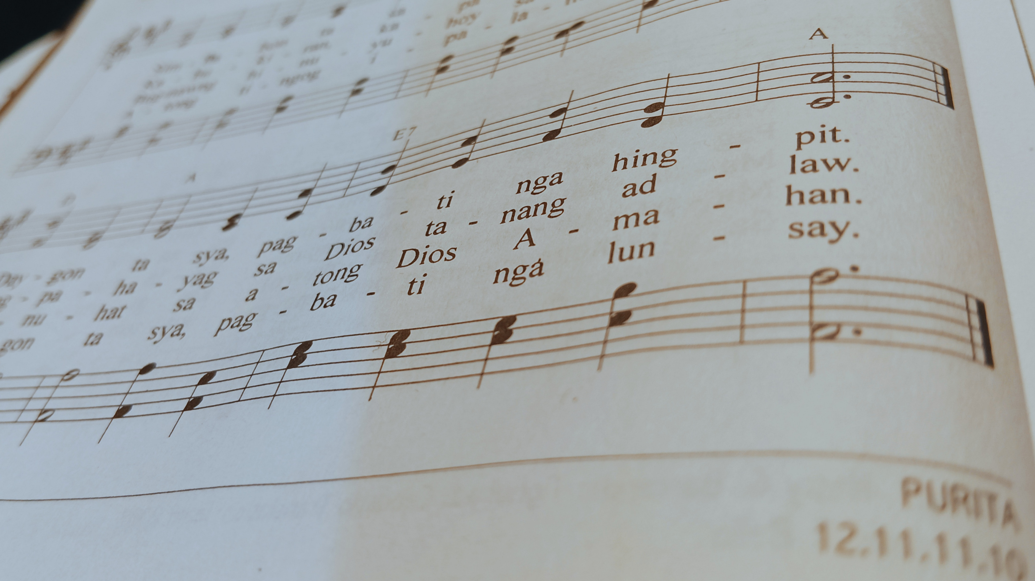
EDUCATION & FORMATION
  Elena attended secondary school in Dansalan, Lanao (now Marawi City).
  As a working student, she met Ella Frances Thompson (1901–2010), an American missionary.
  Thompson became a significant influence in Elena’s life.

Slide 8
HIGHER EDUCATION
  Bachelor of Arts, Silliman University (1948)
  Bachelor of Christian Education, Silliman University (1949)
  Master of Arts in Religious Education, Hartford Seminary Foundation (1951)
  School of Sacred Music, Union Theological Seminary
  Certificate in Advanced Religious Studies (1958)
  Doctoral Program in Religious Education (1961)

Slide 9

PURITA AND ELLA FRANCES THOMPSON
Purita
  During World War II, Elena’s sister-in-law was killed while nursing her baby.
  Elena raised Purita and treated her as her biological daughter.
Ella Frances Thompson
  Supported Elena’s education at Silliman University.
  Enhanced Elena's piano playing.
  Also supported Purita's education and career.
One important non-biologically related person in Elena’s life is Ella Frances Thompson.

Slide 10

“TIYA NANING” AND THE BIRTH OF THE TUNE TREE
  Fondly called “Tiya Naning” by her nieces and nephews.
  Taught her hymns during family reunions.
  Family members sang these hymns in devotions and worship services.
  Described as strict, yet compassionate and loving.
  Expressed her affection through music by composing hymn tunes for family members.

Slide 11
“TIYA NANING” AND THE BIRTH OF THE TUNE TREE
Such deep is her affection that she expressed them in musical form by composing hymn tunes for each member of her family, nieces and nephews included.

Slide 12


TABLE 1.0
MEMBERS OF ELENA MAQUISO’S FAMILY AND THEIR CORRESPONDING TUNE NAMES
Full Name | Relationship to Elena | Hymn Tune
Remegia Granada Maquiso | Mother | REMEGIA
Juan Diano Maquiso | Father | JUAN
Bienvenido Maquiso | Brother | BIENVENIDO
Magdalena Maquiso Lagare | Sister | MAGDALENA

Slide 13
TABLE 1.0
MEMBERS OF ELENA MAQUISO’S FAMILY AND THEIR CORRESPONDING TUNE NAMES
Full Name | Relationship to Elena | Hymn Tune
Elena Maquiso | Herself | ELENA
Leonardo Maquiso | Brother | LEONARDO
Juanito Christopher Maquiso | Brother | JUANITO
Gypsophila Maquiso | Niece | SOPHIE

Slide 14
TABLE 1.0
MEMBERS OF ELENA MAQUISO’S FAMILY AND THEIR CORRESPONDING TUNE NAMES
Full Name | Relationship to Elena | Hymn Tune
Mike Melchizedek Maquiso | Nephew | MILKIE
Bienvenido Maquiso, Jr. | Nephew | BENJUNIOR
Besben Beb Maquiso | Nephew | BESBEN
Porferio Maquiso Lagare | Nephew | YOYONG

Slide 15
TABLE 1.0
MEMBERS OF ELENA MAQUISO’S FAMILY AND THEIR CORRESPONDING TUNE NAMES
Full Name | Relationship to Elena | Hymn Tune
Elizabeth Maquiso Lagare | Niece | INDAYBETH
Carlito Maquiso Lagare | Nephew | CARLITO
Nelson Maquiso Lagare | Nephew | NELSON
Fe Maquiso Lagare | Niece | FE

Slide 16

TABLE 1.0
MEMBERS OF ELENA MAQUISO’S FAMILY AND THEIR CORRESPONDING TUNE NAMES
Full Name | Relationship to Elena | Hymn Tune
Purita (Rae) Maquiso | Niece | PURITA
Emmanuel Maquiso | Nephew | IKE
Yolamie Maquiso | Niece | YOLAMIE
Selah Maquiso | Niece | SEELA
Ella Frances Thompson | Foster Mother | FRANCES

Slide 17
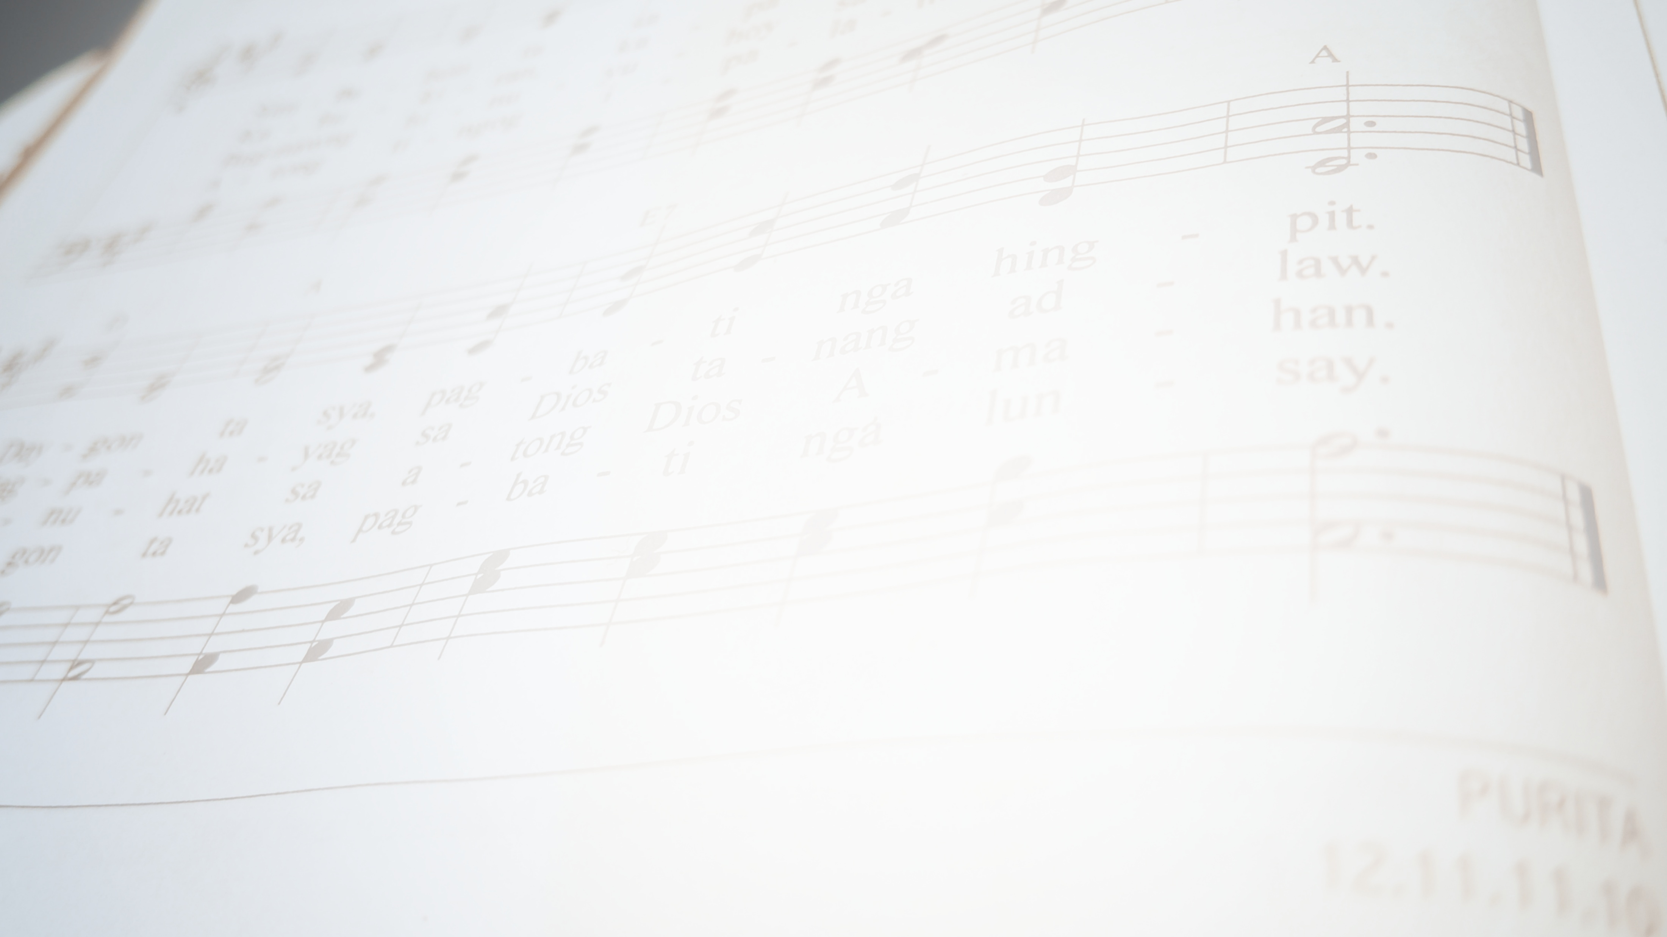
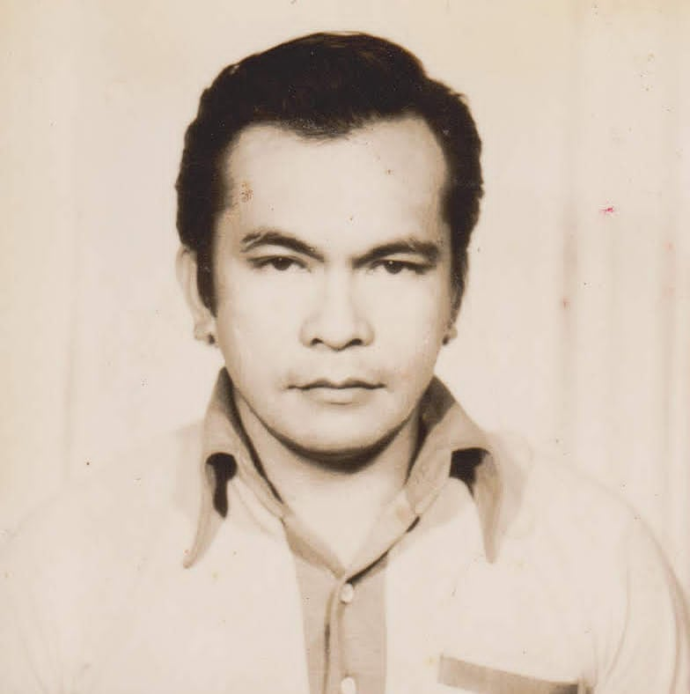
FIGURE 2.0 MAQUISO FAMILY TUNE TREE
FRANCES
(Foster mother)
JUAN
REMEGIA
BIENVENIDO
MAGDALENA
LEONARDO
JUANITO
ELENA
SOPHIE
MILKIE
YOYONG
INDAYBETH
PURITA
IKE
BENJUNIOR
BESBEN
CARLITO
NELSON
YOLAMIE
SEELA
FE

Slide 18


As of writing, Fe and Gypsophila, are the only surviving nieces of Elena Maquiso. Like Juanito Christopher, his brother, Elena did not marry. Instead, she devoted her life to the ministry, to her job, to her tasks, to her projects, and to her research, a commitment that is worth appreciating and worth emulating. Gypsophila says it better: “Tiya Naning was a godly woman; she loved God with all her heart. She loved the Cebuanos and she devoted all her life in the development of Christian values and for the work of the Lord.”

Slide 19

MAQUISO’S WORKS IN
CHURCH MUSIC
Elena Maquiso’s deep love for family was reflected in her dedication to her work, particularly in church music, which formed the core of her prolific output. Her strong attachment to her native Cebuano language shaped her compositions, as she sought to provide vernacular church materials for Cebuano-speaking communities in the Visayas and Mindanao. Through the Rural Publication Center, many of her hymns were published, most notably in the 1974 Cebuano hymnal Alawiton sa Pagtoo, which featured her 153 original Cebuano hymns.

Slide 20
MAQUISO’S WORKS IN
CHURCH MUSIC
Text and Tune: |  | 87 hymns
Text only: |  | 36 hymns
Tune only: |  | 30 hymns
TOTAL HYMNS: |  | 153 hymns
All 21 hymn tunes were published in the 1974 Alawiton sa Pagtoo (ASP) but the family tunes PURITA, REMEGIA, and MAGDALENA first appeared in the 1963 East Asia Christian Conference Hymnal (EACC).
12 out of the 21 hymn tunes appeared in the Hymnal of a Faith Journey (HFJ), the common hymnal of the United Church of Christ in the Philippines, published in 2002.

Slide 21


TABLE 1.0
MAQUISO FAMILY TUNES AND HYMNAL SOURCES
Hymn Tunes | EACC # (1963) | ASP # (1974) | HFJ # (2002)
REMEGIA | 134 | 202 | 302, 394
JUAN |  | 172 | 204
BIENVENIDO |  | 73
MAGDALENA | 197 | 181 | 276
ELENA |  | 233 | 190
LEONARDO |  | 125 | 301
JUANITO |  | 72
SOPHIE |  | 61 | 133
MILKIE |  | 39
BENJUNIOR |  | 220 | 32
BESBEN |  | 19 | 56

Slide 22

TABLE 1.0
MAQUISO FAMILY TUNES AND HYMNAL SOURCES
Hymn Tunes | EACC # (1963) | ASP # (1974) | HFJ # (2002)
YOYONG |  | 243
INDAYBETH |  | 22 | 57
CARLITO |  | 63 | 128
NELSON |  | 194
FE |  | 226
PURITA | 108 | 5 | 4
IKE |  | 140
YOLAMIE |  | 43
SEELA |  | 44
FRANCES |  | 142 | 262

Slide 23

TUNE NAMES
Maquiso created hymn tunes using names of her family members either as real first names or as nicknames.
The use of real names:
  REMEGIA
  JUAN
  BIENVENIDO
  MAGDALENA
  ELENA
  LEONARDO
  JUANITO
  BESBEN
  CARLITO
  NELSON
  FE
  PURITA
  YOLAMIE
  SEELA (typo error?)
  FRANCES
The use of nicknames:
  Gypsophila to SOPHIE
  Mike Melchizedek to MILKIE
  Proferio to YOYONG
  Elizabeth to INDAYBETH
  Emmanuel to IKE

Slide 24
CHARACTERISTICS OF THE TUNES
  In terms of keys:
  Tunes in minor keys – 33% (REMEGIA, MAGDALENA, SOPHIE, INDAYBETH, FRANCES, NELSON, SEELA)
  Tunes in major keys – 48% (JUAN, ELENA, LEONARDO, BENJUNIOR, BESBEN, CARLITO, BIENVENIDO, PURITA, MILKIE, YOLAMIE)
  Tunes that modulate – 19%
  2 tunes, YOYONG & FE, modulate from a minor key to its relative major
  2 tunes, IKE & JUANITO, modulate from a minor key to is parallel major key

Slide 25
CHARACTERISTICS OF THE TUNES
  2. In terms of meter:
  a. Quadruple meter – 48%
  b. Triple meter – 38%
  c. Duple meter – 14
  3. Melodic contour is wave-like, and some tunes are
  arpeggiated
  4. Slow harmonic rhythm
  5. Commonly used chord progression is I-IV-V
  6. The use of harmonic minor scale in its melodies

Slide 26




LET US SING!
Of the twenty-one family hymn tunes from the Alawiton sa Pagtoo, only 12 appeared in the Hymnal of a Faith Journey with English translations.

Slide 27

LET US SING!
Of the twenty-one family hymn tunes from the Alawiton sa Pagtoo,
only 12 appeared in the Hymnal of a Faith Journey with English translations.
Ang buluhaton sa Imong gingharian/ Work in your kingdom | REMEGIA | HFJ 302
The Lord’s return | REMEGIA | HFJ 394
Paglaum ka, O Cristong maluloy-on/ You are my hope, O Christ of great compassion | JUAN | HFJ 204
Atong Dios sa katuigan/ God of all eternity | MAGDALENA | HFJ 276

Slide 28

LET US SING!
Of the twenty-one family hymn tunes from the Alawiton sa Pagtoo,
only 12 appeared in the Hymnal of a Faith Journey with English translations.
Ang amo nga panimalay/ O bless our family, dear God | ELENA | HFJ 190
Ang Imong iglesya, O Dios/ The church is Your people, O God | LEONARDO | HFJ 301
Misidlak ang kahayag/ The light glimmered brightly | SOPHIE | HFJ 133
Salamat, O Ginoo/ We thank you, God, Creator | BENJUNIOR | HFJ 32

Slide 29
LET US SING!
Of the twenty-one family hymn tunes from the Alawiton sa Pagtoo,
only 12 appeared in the Hymnal of a Faith Journey with English translations.
Sa kaadlawon ginapamukaw/ As dawn is breaking | BESBEN | HFJ 56
Magmata sa kaakohan/ Rising up to meet the challenge | INDAYBETH | HFJ 57
Kalangitan ang nagahugyaw/ All the heavens are celebrating | CARLITO | HFJ 128
Ang Dios dalaygon/ O praise our great God | PURITA | HFJ 4

Slide 30

LET US SING!
Of the twenty-one family hymn tunes from the Alawiton sa Pagtoo,
only 12 appeared in the Hymnal of a Faith Journey with English translations.
Ning takna sa among paghandum/ In this hour of solemn remembering | FRANCES | HFJ 262

Slide 31
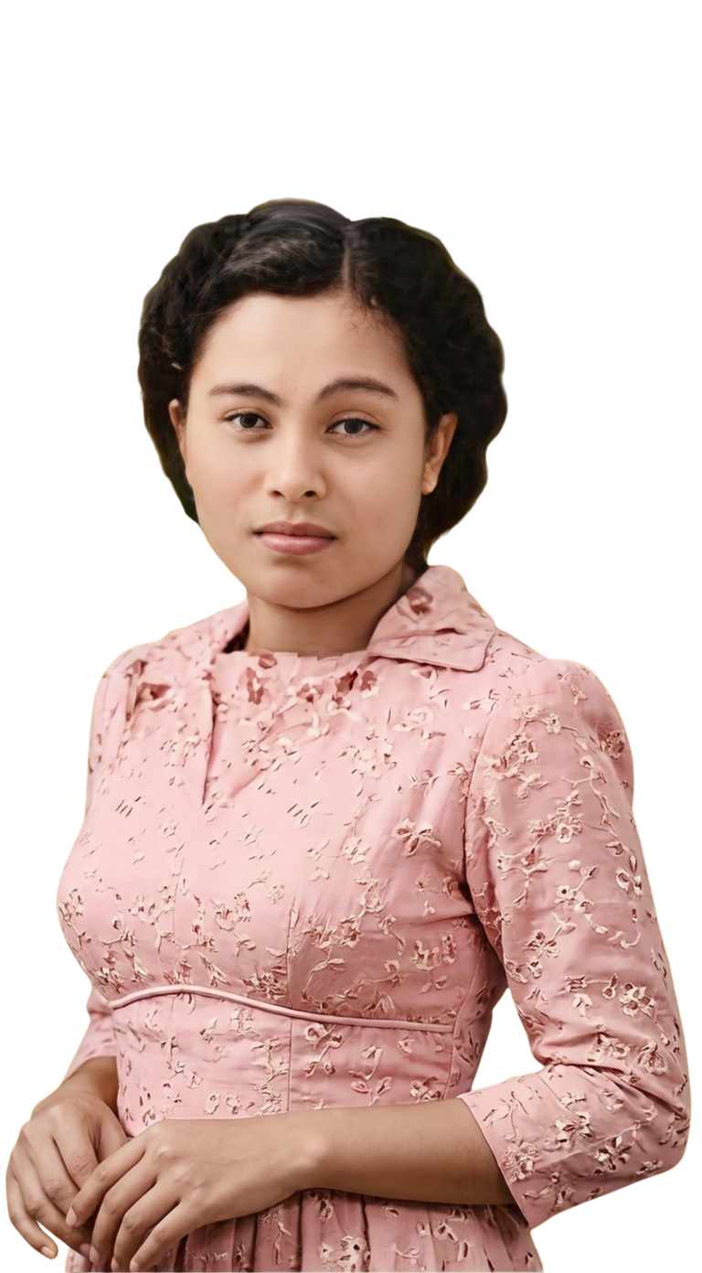
CLOSING WORDS
Elena Granada Maquiso’s “tune tree” stands as a remarkable testimony to how music can preserve memory, deepen kinship, and embody faith. Though she did not establish a family through marriage or children, she nurtured generations through her ministry, scholarship, and indigenous hymnody, immortalizing the names and lives of her loved ones in musical form. Her family tunes reveal not only her affection for her family, but also her artistic vision of connecting identity, spirituality, and community through Cebuano church music.
Elena G. Maquiso

Slide 32
CLOSING WORDS
More than personal compositions, these hymns became living expressions of worship within the United Church of Christ in the Philippines and among Cebuano-speaking congregations. Through her melodies, Maquiso transformed family relationships into enduring songs of faith, ensuring that both her loved ones and her legacy continue to resonate in the hearts of worshippers and scholars alike.
Elena G. Maquiso

Slide 33
Elena G. Maquiso

Slide 34
MELODIES OF KINSHIP:
The
MAQUISO
Tune Tree
Jean Cuanan-Nalam

