Slide 1
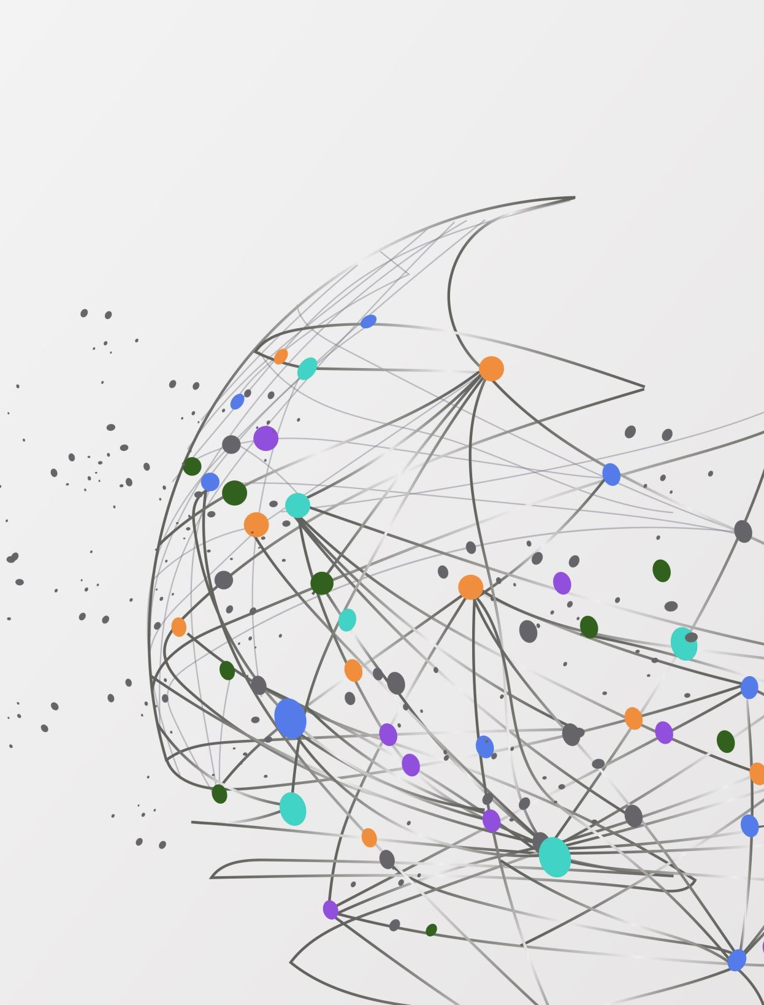
Are We the Problem?
Website Usability & User Experience Testing in the Academic Library
Bethany Howard & Mica Myers
Mica

Slide 2
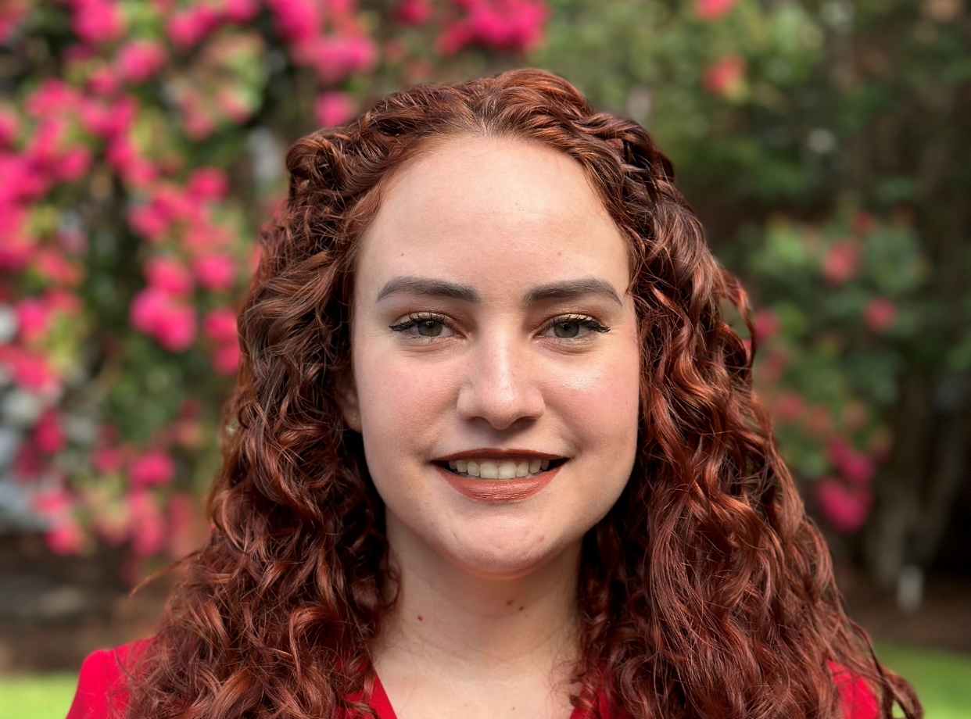
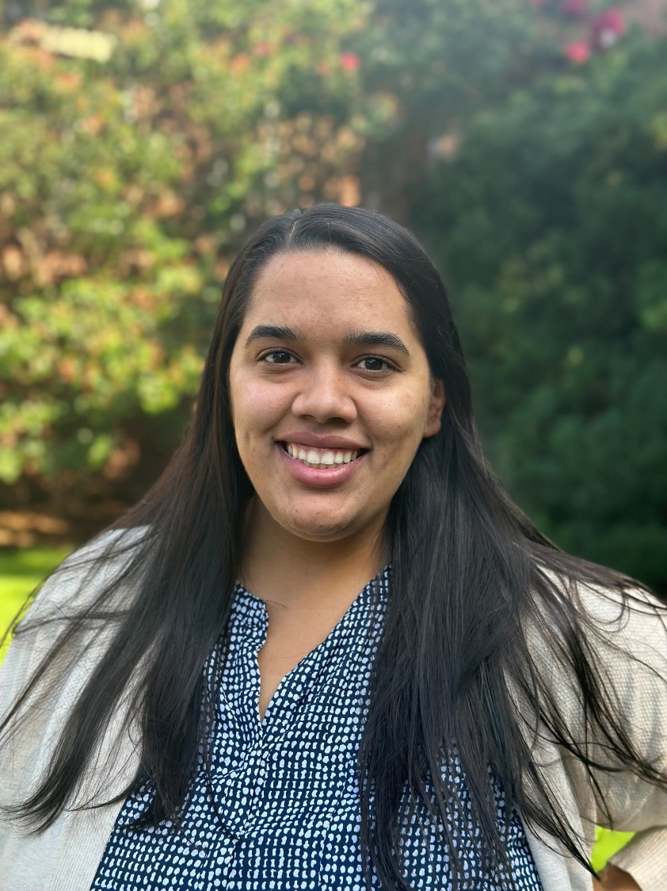
About Us
We are librarians at McKee Library.
McKee Library is an academic library on the campus of Southern Adventist University, located in Chattanooga, Tennessee
Mica

Slide 3
From the Literature
Excellent searchability is highly prioritized. (Gupta et al., 2024)
Users expect to be able to search library resources from main search bar.
(Crenshaw & Johnson, 2024)
Single search bar model suggested.
(Dease et al., 2020)
Users want the most popular items featured.
(Citation Tool, Google Drive)
(Dease et al., 2020)
Users don’t often scroll to the bottom of a page.
(Wells, 2024)
Users are attracted to a tab named “Services”. (Rennick, 2019)
Students want help: Chat or contact info should be featured.
(Overduin, 2019)
Users want to access their personal accounts from the main page.
(Desmarais & Louderback, 2020)
Database tab is heavily used. (Wells, 2024)
Library terms like “Research Guides” can be difficult for students to understand.
(Vargas, 2020)
Mica

Slide 4

Where did we start?
Let’s take a look.
Mica

Slide 5
Preliminary Thoughts
Concerns
Search Bar and Directory are separate.
Databases are not present on main page.
Excuses
We have extra departments to incorporate.
We don’t have full control or ability.
Positives
We have a chat and contact information visible on our main page.
We have a services page featured on our main page.
Mica

Slide 6
Study Planning
Literature Review
IRB Approval
ARC Funding
Study Materials
Consent Forms
Questionnaires
Surveys
Recruitment Materials
Usability Software Selection
Software Purchase-Loop 11
Gift Cards for Staff/Faculty Participants
Bethany

Slide 7
Study Components
Library Team Survey
Anonymous Survey
Website Usability and User Experience Testing
Card Sorting
Bethany

Slide 8
Library Team
Survey
Bethany

Slide 9
2 Librarian participants
Qualitative questionnaire
"Expert" exploration of ideal library website features
Comparison of library websites
2 Local public universities
1 Local private university
1 SDA university library
McKee Library
Library Team Survey
Bethany

Slide 10
Library Team Survey
Design elements
Emphasize library services over general university elements/links
Avoid unnecessarily large features that may cause visual clutter
Research resources over help services
Minimalism
Condensed menu options
Less information is better
Search our Site versus Search Catalog/OneSearch differentiation issues
Top tabs with drop-downs versus side bar navigation, due to sidebar display issues on mobile or small devices
Bethany

Slide 11
Anonymous Website Survey
Bethany

Slide 12

Anonymous Survey
19 anonymous participants from anywhere in the world
Link to survey listed on the home page and in the sidebar navigation
Website rating
  Overall experience
  Searching efficacy
  Website navigation
Qualitative comments
Bethany

Slide 13
Bethany

Slide 14
Qualitative Anonymous Survey Results
Chat feature is helpful
Renewal options are hard to find on the website
Renewal emails contain confusing instructions
Too much scrolling required to find items
Bethany

Slide 15
Website Usability &
User Experience Testing
Mica

Slide 16
Surveys:
Demographics
Mica

Slide 17
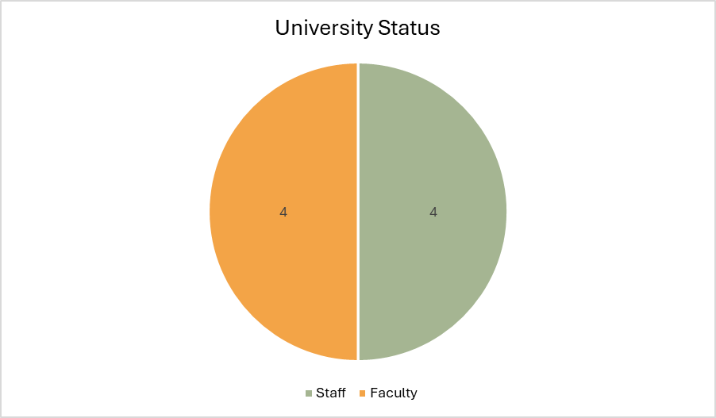
Faculty Responses
Mica

Slide 18
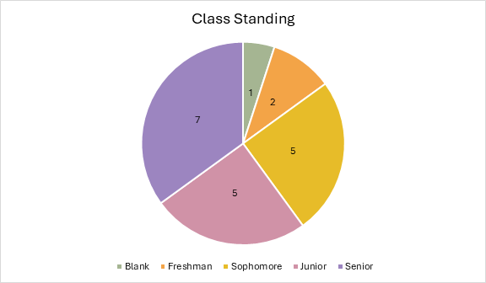
Student Responses
Mica

Slide 19
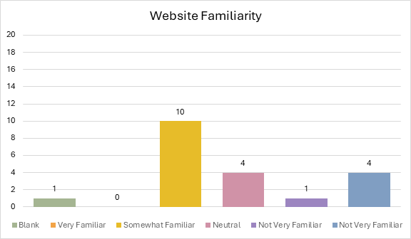
Student Responses
Mica

Slide 20
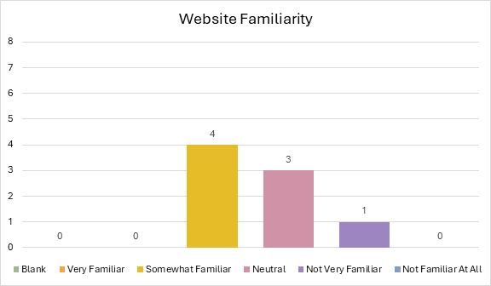
Faculty Responses
Mica

Slide 21
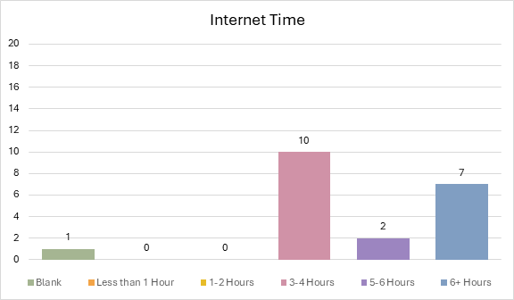
Student Responses
Mica

Slide 22
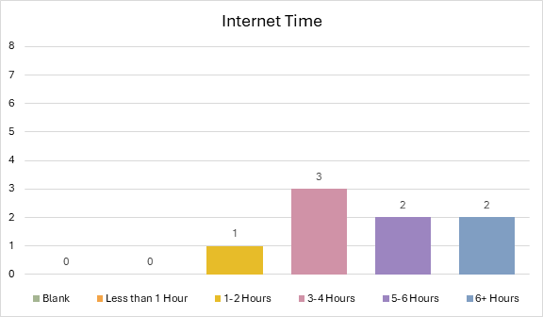
Faculty Responses
Mica

Slide 23
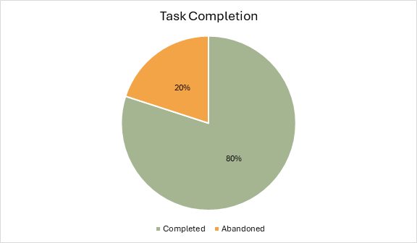
Student Responses
Mica

Slide 24
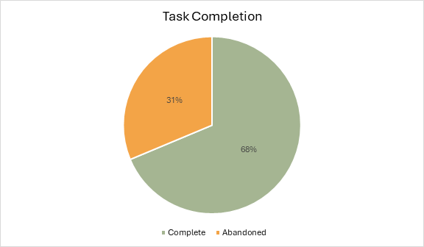
Faculty Responses
Mica

Slide 25
Quantitative
Student Results
Average Task Duration: 1 Minute 27 Seconds
Average Page Views/Task: 6.15 Page Views
Book Search Task-100% Complete, 0% Abandoned
Research Guides Task-75% Complete, 20% Abandoned, 5% Blank
Writing Center Hours Task-60% Complete, 30% Abandoned, 10% Blank
Printing Task-85% Complete, 15% Blank
Optimal Task Duration: 24 Seconds
Optimal Page Views/Task: 2.75 Page Views
Mica

Slide 26
Quantitative Faculty/Staff Results
Average Task Duration: 2 Minutes
Average Page Views/Task: 5.725 Page Views
Book Search Task-75% Complete, 25% Abandoned
Research Guides Task-62.5% Complete, 25% Abandoned, 12.5% Blank
Writing Center Hours Task-62.5% Complete, 25% Abandoned, 12.5% Blank
Printing Task-75% Complete, 12.5% Abandoned, 12.5% Blank
Optimal Task Duration: 24 Seconds
Optimal Page Views/Task: 2.75 Page Views
Mica

Slide 27
Surveys:
Final Results
Bethany

Slide 28
Student Responses
Bethany

Slide 29
Faculty Responses
Bethany

Slide 30
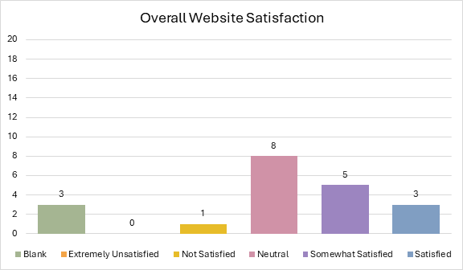
Student Responses
Bethany

Slide 31
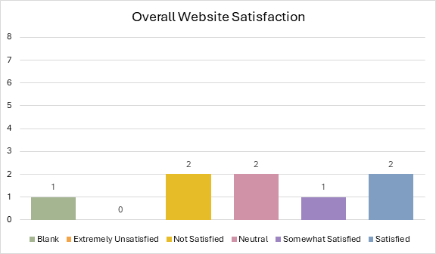
Faculty Responses
Bethany

Slide 32
Qualitative
& Video
Feedback
Search Functions
OneSearch is treated like a Google Search in terms of wording and scope
Finding a book with OneSearch is usually doable for users
SAU search bar is attractive to users to find items with varying success
SAU search bar suggests irrelevant staff members for library searches
Similar books/genre limiters are not being used
Simple filtering for date or item type is being used
Familiarity
Lack of familiarity in understanding library records, especially location/call number
Lack of familiarity in what a research guide is or where to find it
Lack of ability to distinguish between a journal versus a journal article versus a database
Marked lack of familiarity with the existence and usage of journal locator tool and A-Z Directory
Bethany

Slide 33
Qualitative & Video Feedback
Hours
Writing Center Hours are difficult to find and should be on the WC page
Users expect to find hours on the About page
Printing
Wireless printing portal does not match library aesthetics but does work well for new users
Printing not on Services for Faculty
Side bar menu
Side bar navigation not as successful due to lack of scrolling functionality
Side bar navigation not heavily used as expected
Many steps to find items
Bethany

Slide 34
Card Sorting Patterns
Focus: What did they change?
14 submissions
Mica

Slide 35
Card Sorting Patterns
Focus: What did they change?
About the Library
CHANGES
Directory (5)
Games (2)
Wireless Printing (2)
Study Spaces and Technology (2)
Reading and Viewing Lists (2)
Renew Materials (2)
Featured Collections
New Books
ILL
Original List (9)
News, Events, and Exhibits (9)
Campus Research Day (5)
Digital Exhibits (5)
Therapy Dog Visits (5)
Give Now (8)
Visitor Information (9)
Mica

Slide 36
Card Sorting Patterns
Focus: What did they change?
Collections
CHANGES
Physical Media (4)
Scientific Models (3)
Streaming Media (3)
Databases (2)
Directory
Reading and Viewing Lists
Knowledge Exchange
Study Spaces and Technology
Digital Exhibits
Original List (10)
Course Specific Lists (6)
Featured Collections (9)
Games (4)
New Books (8)
Special Collections (10)
Libby (Overdrive) (5)
Southern Journals (7)
Mica

Slide 37
Card Sorting Patterns
Focus: What did they change?
Help, Research, & Resources
CHANGES
Course Specific Lists (5)
Libby (Overdrive) (4)
Games (2)
Campus Research Day (2)
Therapy Dog Visits (2)
Featured Collections
Writing Center
New Books
Tutoring Center
Collections
Special Collections
Visitor Information
Original List (10)
Databases (6)
Directory (3)
Interlibrary Loan (7)
Knowledge Exchange (6)
Reading & Viewing Lists (6)
Renew Materials (7)
Research Coaching (9)
Research Guides (9)
Physical Media (2)
PowerNotes (6)
Scientific Models (4)
Streaming Media (2)
Study Spaces and Technology (3)
Wireless Printing (6)
Mica

Slide 38
Card Sorting Patterns
Focus: What did they change?
Tutoring Center
CHANGES
Hours (2)
Original List (8)
Schedule an Appointment (8)
Writing Center
CHANGES
Hours (2)
Research Coaching
Original List (8)
Schedule an Appointment (8)
Mica

Slide 39
Card Sorting Patterns
Focus: What did they change?
News, Events and Exhibits (3)
Digital Exhibits (3)
Campus Research Day (2)
Therapy Dog Visits (2)
Give Now
Streaming Media
Physical Media
SAU Journals
Visitor Information
Study Spaces and Technology (2)
Streaming Media(2)
Scientific Models (2)
Powernotes (2)
Libby(Overdrive)
Digital Exhibits (2)
ILL
Wireless Printing
Physical Media
Knowledge Exchange
Mica

Slide 40
Solutions
Post WC & TC hours on the WC & TC pages
1
Add library, WC, & TC hours to "About" page
2
Incorporate research guides into One Search: limiter, tab, search drop-down menu
3
Explore research guides display in OneSearch on search results and on the full text link options
4
Divide "Help, Research, and Resources" sidebar navigation into "Research" and "Services" options
5
Reconsider "Collections" sidebar navigation
6
Make renewal options more prominent
7
Create a button to click in renewal email versus long instructions
8
Bethany

Slide 41
Solutions
Original Drop-Down Menu
About the Library
News, Events, and Exhibits
Campus Research Day
Give Now
Visitor Information
Collections
Course Specific Lists
Featured Collections
Help, Research, & Resources
Interlibrary Loan
Tutoring Center
Schedule Appointment
Therapy Dog Visits
Digital Exhibits
Games
New Books
Special Collections
Libby (Overdrive)
Southern Journals
Databases
Directory
Knowledge Exchange
Reading & Viewing Lists
Renew Materials
Research Coaching
Research Guides
Physical Media
PowerNotes
Scientific Models
Streaming Media
Study Spaces and Technology
Wireless Printing
Writing Center
Schedule Appointment
Bethany

Slide 42
Solutions
Potential Drop-Down Menu
My Library Account
About the Library
Contact Us
Hours
Study Spaces
News, Events, and Exhibits
Art in the Library
Digital Exhibits
Services
Interlibrary loan
Knowledge Exchange
PowerNotes
Research Resources
Collections
Databases
Research Guides
Streaming Media
Directory
Give Now
Visitor Information
Campus Research Day
Library Calendar
Newsletters
Therapy Dog Visits
Research Coaching
Study Spaces
Tutoring Center
Wireless Printing
Writing Center
Course Specific Lists
Libby
Reading & Viewing Lists
Research Coaching
Bethany

Slide 43
Limitations
Sample Size
Expert Librarian Survey
In Person Study
Study Error
Research Guide Number
User Familiarity Differences
Loop11 Software
Library Website
Mica

Slide 44
Future Research
In Depth Statistical Analysis
Long-term Click Count Analysis
Examining AI and OneSearch Integration
Mica

Slide 45
References
Crenshaw, C., & Johnson, M. (2024). Improving the Student Search Experience in LibGuides. Information
Technology & Libraries, 43(4), 1–23. https://doi.org/10.5860/ital.v43i4.16971
Dease, N., Villaespesa, E., & MacDonald, C. M. (2020). Working together: Using student-
driven UX projects to improve library websites. College & Undergraduate
Libraries, 27(2–4), 397–419. https://doi.org/10.1080/10691316.2021.1888838
Desmarais, B., & Louderback, P. (2020). Planning and Assessing Patron Experience and Needs for an
Academic Library Website. Journal of Library Administration, 60(8), 966–977.
https://doi.org/10.1080/01930826.2020.1820283
Gupta, S., N., M., Sharma, S., Raj, P., & Gupta, S. (2024). Enhancing the User Experience
with UX/UI Principles in Library Websites. Library of Progress-Library Science,
Information Technology & Computer, 44(3), 9457–9770.
Overduin, T. (2019). “Like a Robot”: Designing Library Websites for New and Returning
Users. Journal of Web Librarianship, 13(2), 112–126.
https://doi.org/10.1080/19322909.2019.1593912
Rennick, B. (2019). Library Services Navigation: Improving the Online User Experience. Information
Technology & Libraries, 38(1), 14–26. https://doi.org/10.6017/ital.v38i1.10844
Vargas Ochoa, I. (2020). Navigation Design and Library Terminology: Findings from a User-
Centered Usability Study on a Library Website. Information Technology &
Libraries, 39(4), 1–15. https://doi.org/10.6017/ital.v39i4.12123
Wells, M. D. (2024). Enhancing User Experience in Small Academic Libraries: Leveraging Matomo
Analytics as a UX Design Tool. Christian Librarian, 67, 18–29.
Mica

Slide 46

Questions?
Questions?

