Slide 1

Connecting with
Tennessee Government Information in the Digital Age
Perveen Rustomfram, Renée Register, Alex Taylor
TNLA 2026

Slide 2
TN Depository Library System
The six members of the Tennessee Depository Library System are responsible for collecting and maintaining comprehensive collections of state government publications. Tennessee Code requires that each of the following libraries receive and maintain copies of publications produced by every agency of Tennessee State Government.
Tennessee Depository Libraries
Tennessee State Library & Archives
University Libraries, University of Memphis
University of Tennessee, Knoxville Library
Memphis Public Library
East Tennessee State University Library
Tennessee Legislative Reference Library

Slide 3

TN publications and the Law
Tennessee Code Annotated (TCA)
Title 12, Chapter 6
outlines agency and library responsibilities related to collecting and preserving State publications.
State agencies must provide one copy of printed and electronic publications to each
depository library.
Depository publications include:
annual reports
statistical reports
periodic and special reports
public and private acts
many other publications
Publications collected by depository libraries
do not include:
ephemeral materials (business cards and flyers)
publications created for internal use (handbooks and manuals)
materials not distributed outside the agency (internal newsletters)

Slide 4
Challenges
Steady flow of documents to the depositories
Number of copies to be sent (one not two)
Ephemera--notices and internal use documents
Agency contacts change
Keeping up with agency shifts

Slide 5
Mitigation Strategies
Role of TNLA Advisory Committee on State Documents
Suggesting modifications for smooth functioning
Advocating for changes in the law (2016-2019)
Baseline of depository documents
SOS monthly list of documents
Point person at TSLA
Current effort--Letter from State Librarian to Tennessee agencies
ADA Title II final rule--April 24, 2026 deadline extended to 2027

Slide 6

History of the
Tennessee State Library & Archives Digital Tennessee Collection
In 2006, the Library & Archives began collecting state publications in digital format using Archive-it.
In 2023, we implemented the Digital Commons platform to house state agency publications and other digital resources. We named the new repository Digital Tennessee.

Slide 7
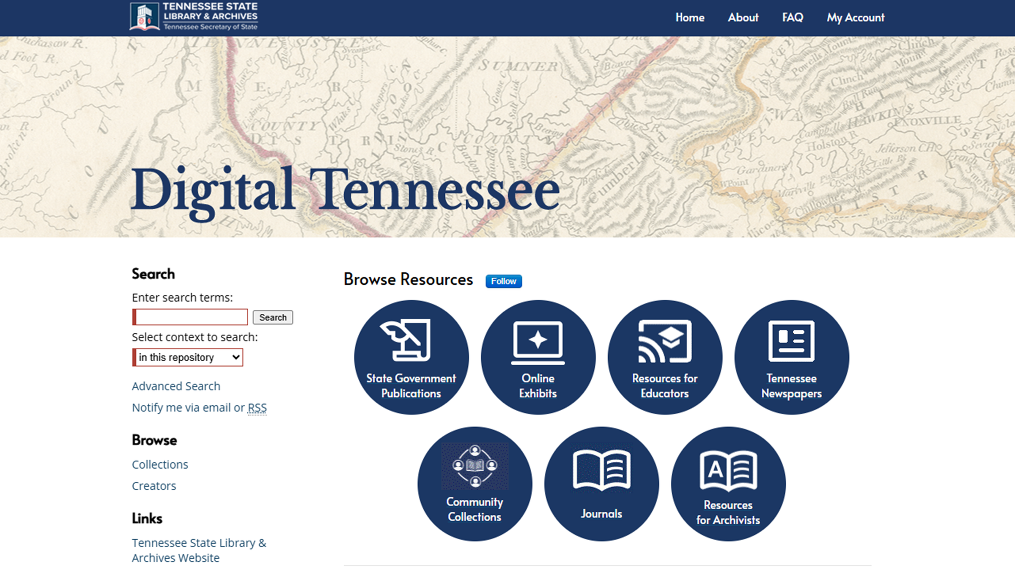

Slide 8
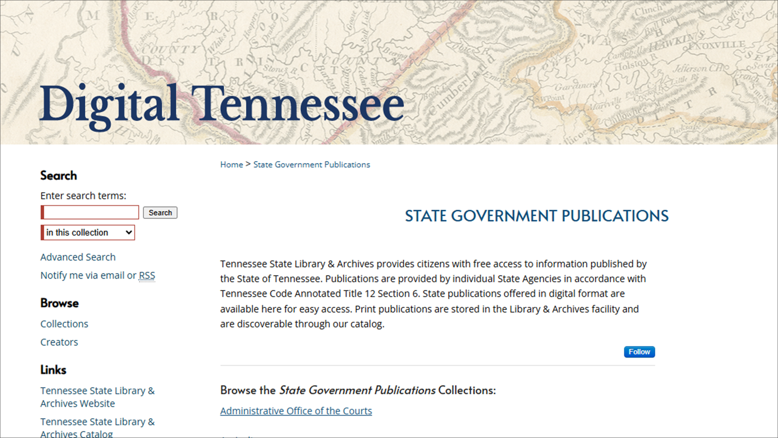

Slide 9
Scope of Collection
The Digital Tennessee repository now holds over 4,500 items.
It contains all available digital publications from 45 state agencies.
The collection includes all digital publications originally housed on Archive-it, all digital publications also available on individual agency websites, and ongoing addition of newly published State digital materials.

Slide 10
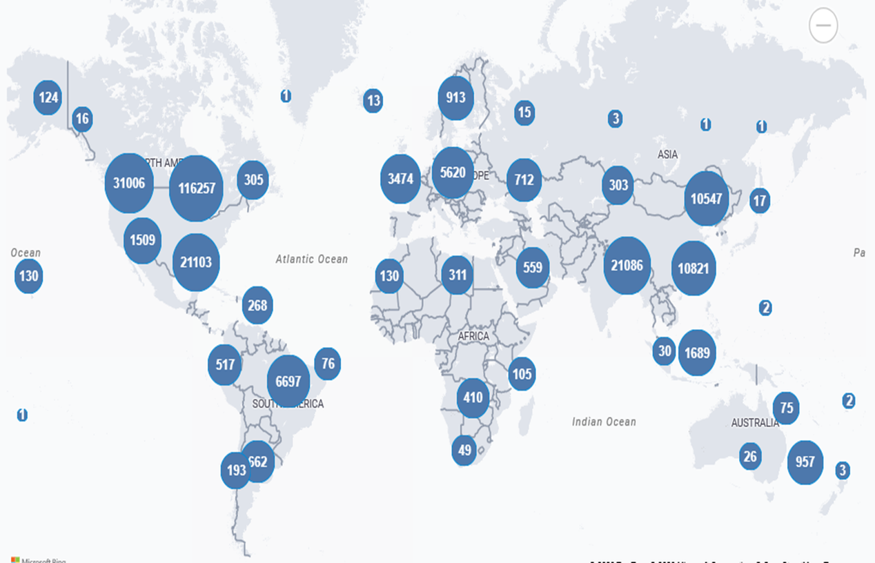
Metrics
Statistics since implementation:
237,161 page hits
84,765 downloads
189 countries

Slide 11
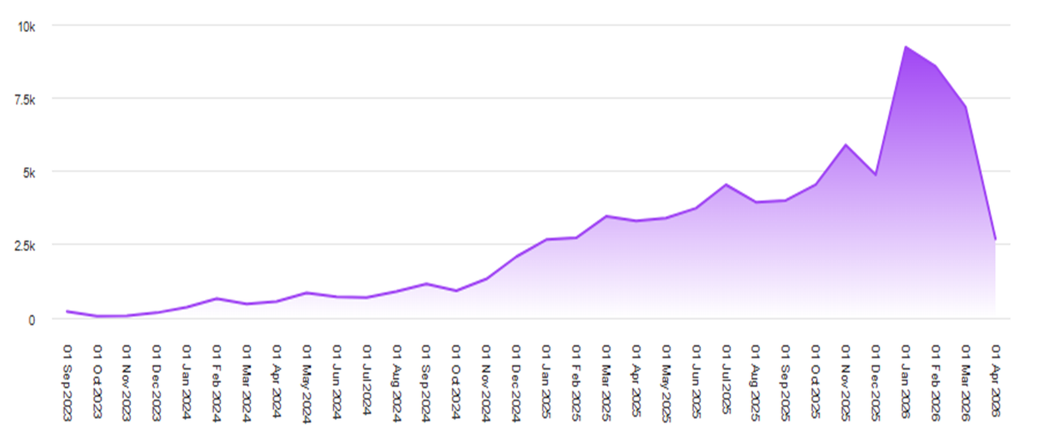
Analysis
This graph captures metadata page hits since 2023.
Usage grew and hit a peak earlier this year. We intend to promote the site so that usage increases.

Slide 12

History of TN Publications on UofM Digital Commons
Digital Commons platform--2020
Scope of Collection

Slide 13
Who is this for?
English 1020 students
UofM students and faculty in departments such as Criminal Justice, Health Sciences, Education, Social Justice, Social Statistics
Other researchers
Government institutions
The Public

Slide 14
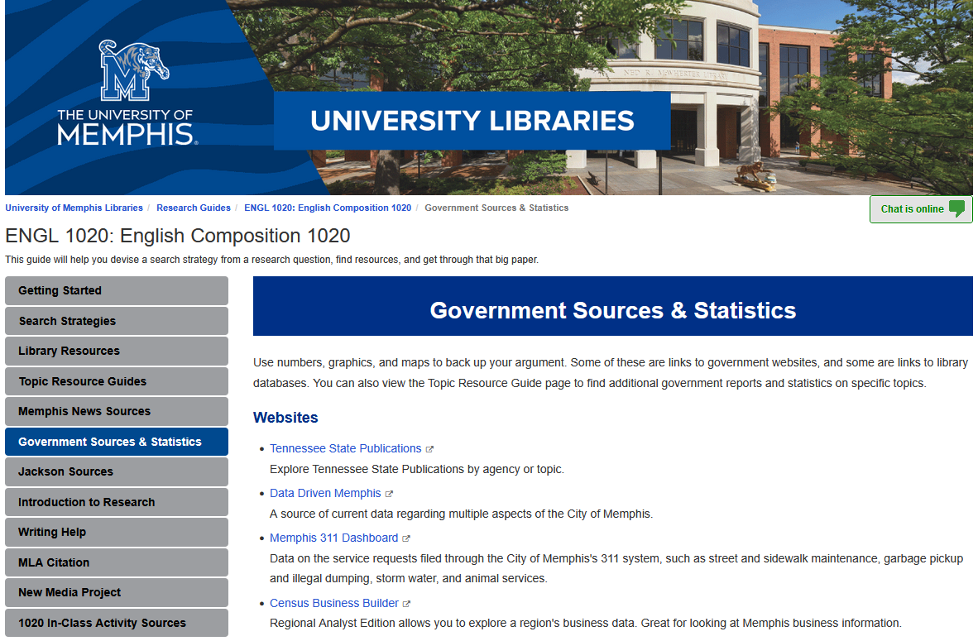

Slide 15
Organization
Departments, commissions, boards and offices on a single landing page
Most agencies have nested galleries for the types of report
Browse by topic

Slide 16
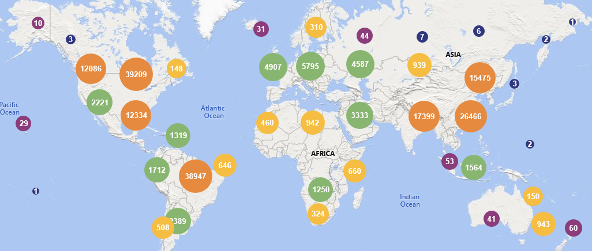
Metrics
3,665 documents uploaded
199,386 downloads
worldwide
readership
distribution

Slide 17
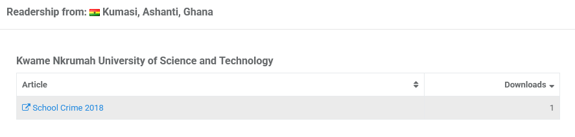
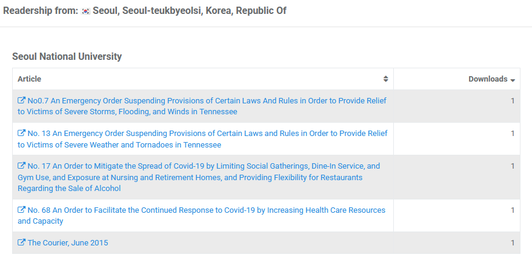
Metrics

Slide 18
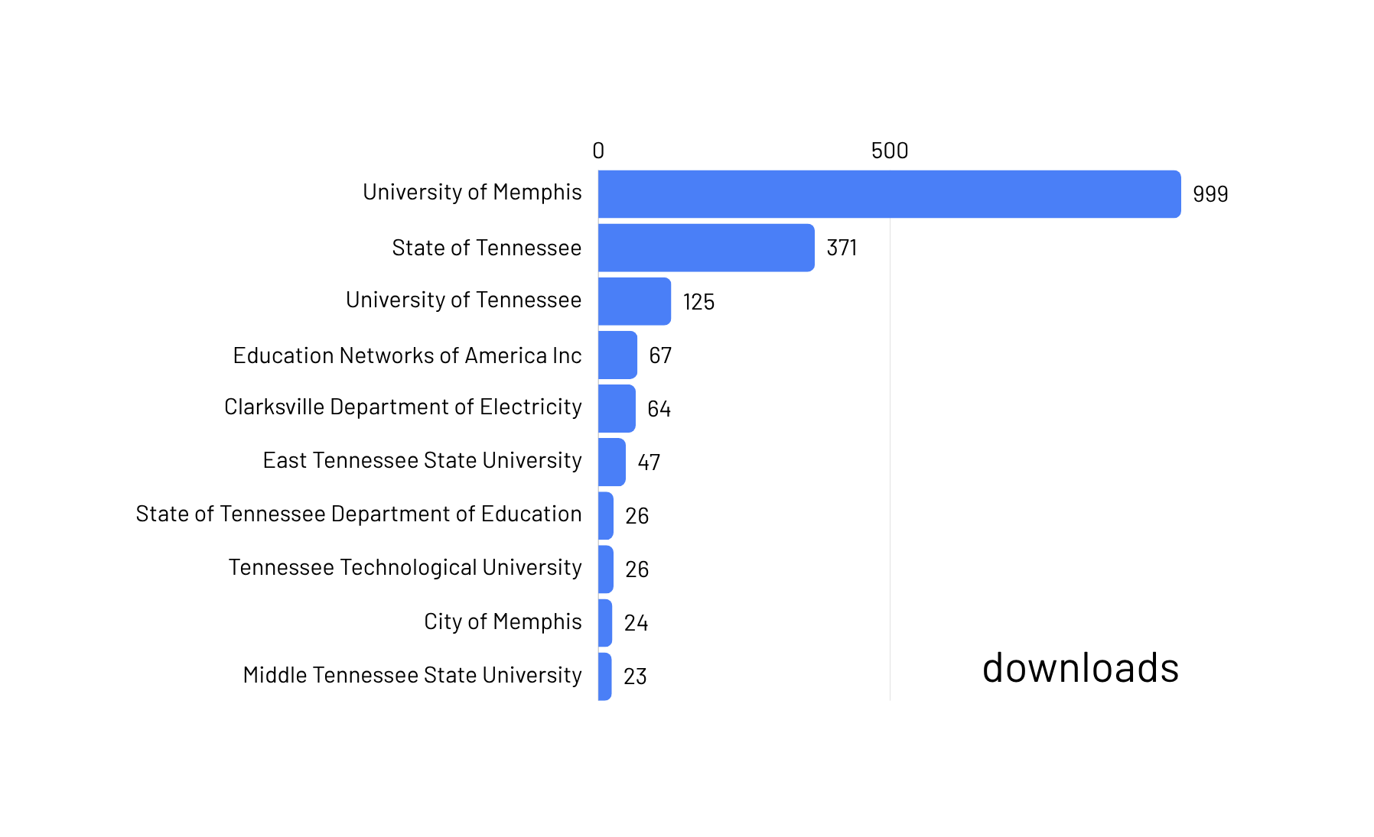
Who is using this?

Slide 19
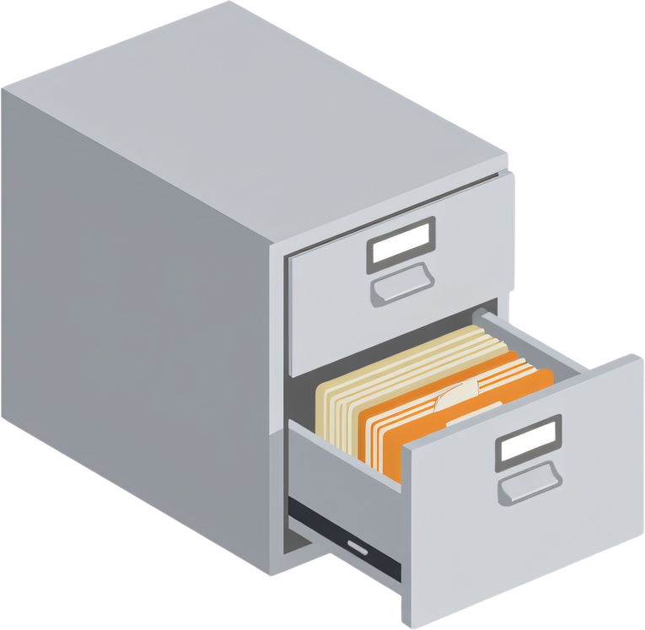
Administration
Receiving: direct emails, Secretary of State (SOS) lists
Selecting
Processing workflow documentation
Long-term storage

Slide 20
Future Plans
Add agencies
Add Topics
Improve SEO (descriptions, keywords, LCSH)
Promote service

Slide 21



Contact Us
Renée Register
Tennessee State Library
and Archives
Renee.Register@tnsos.gov
615.253.3462
Perveen Rustomfram
Ned R. McWherter Library
University of Memphis
prstmfrm@memphis.edu
901.678.8203
Alex Taylor
Ned R. McWherter Library
University of Memphis
taylor97@memphis.edu
901.678.5475

Slide 22
Thank you

