Slide 1

Get on Board!
Rollin' on Down the Line
as an Exemplar for Engaged Reading, Collaborative Engagement, and Student Research
Renee’ Critcher Lyons and Helen Kampion

Slide 2

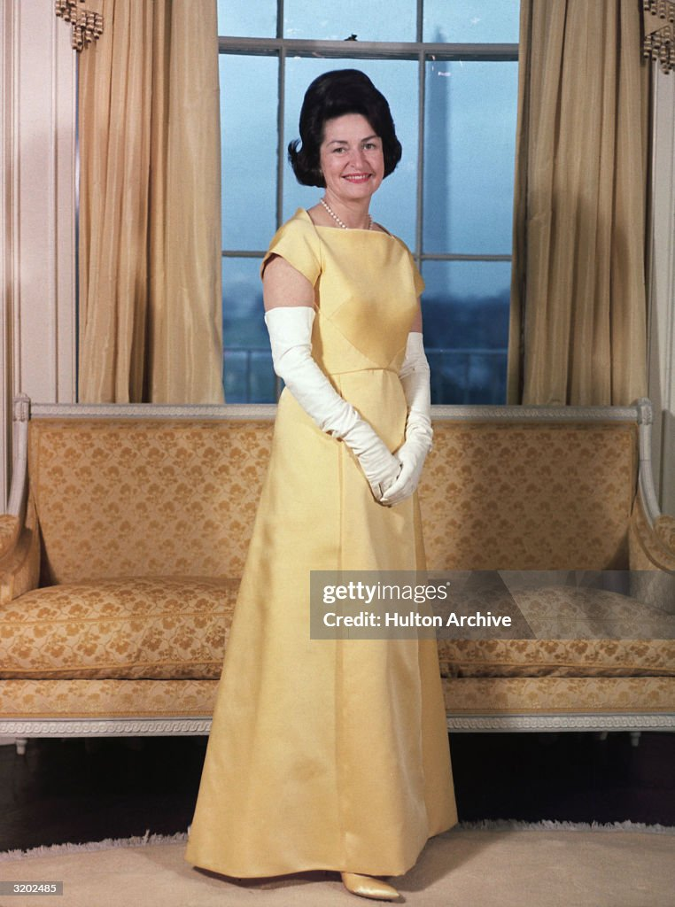

EAST TENNESSEE STATE UNIVERSITY
SCHOOL LIBRARIANSHIP
Author of three books
Author of varying articles for National Children’s Book and Literacy Alliance
Author of scholarly articles in Children and Libraries, YALS, Educational Innovations, and New Review of Children’s Literature and Librarianship – also Tennessee Literacy Journal

Slide 3
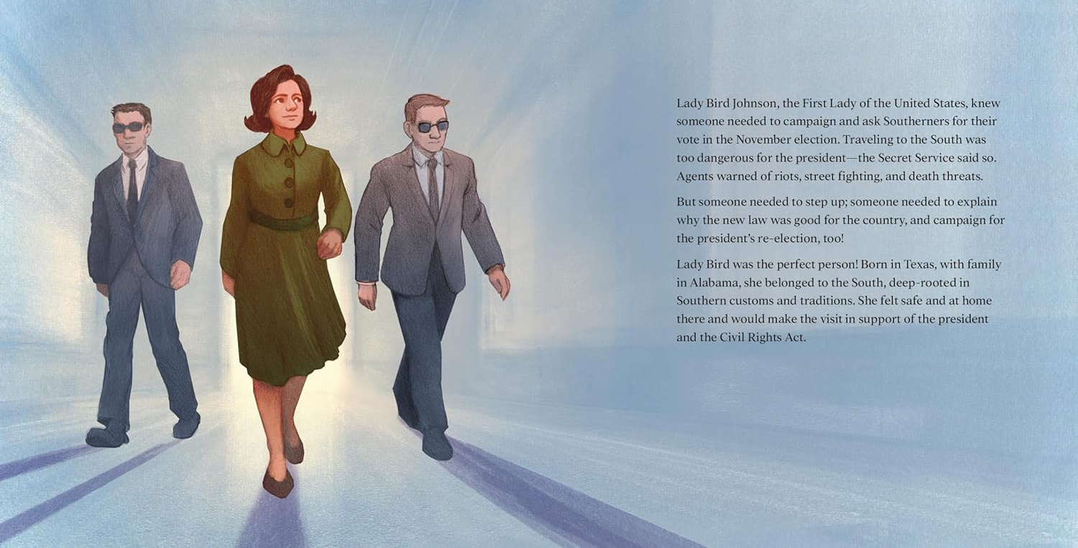

Slide 4
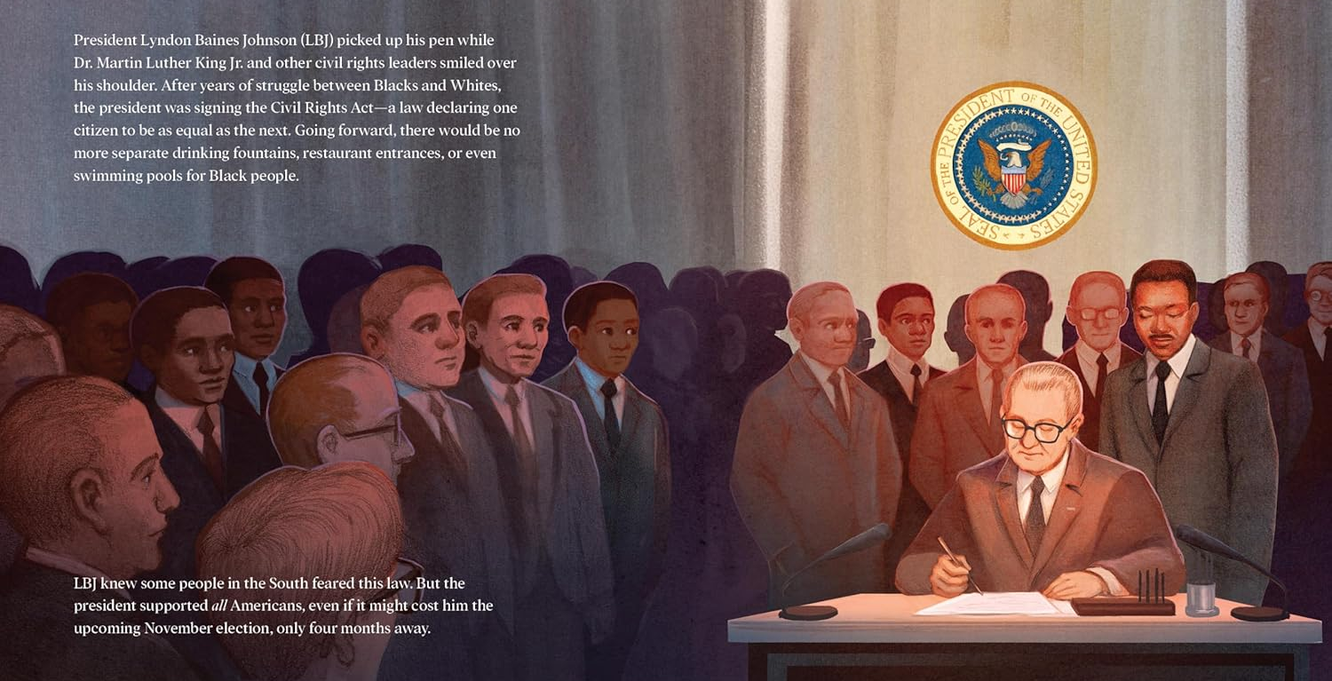

Slide 5
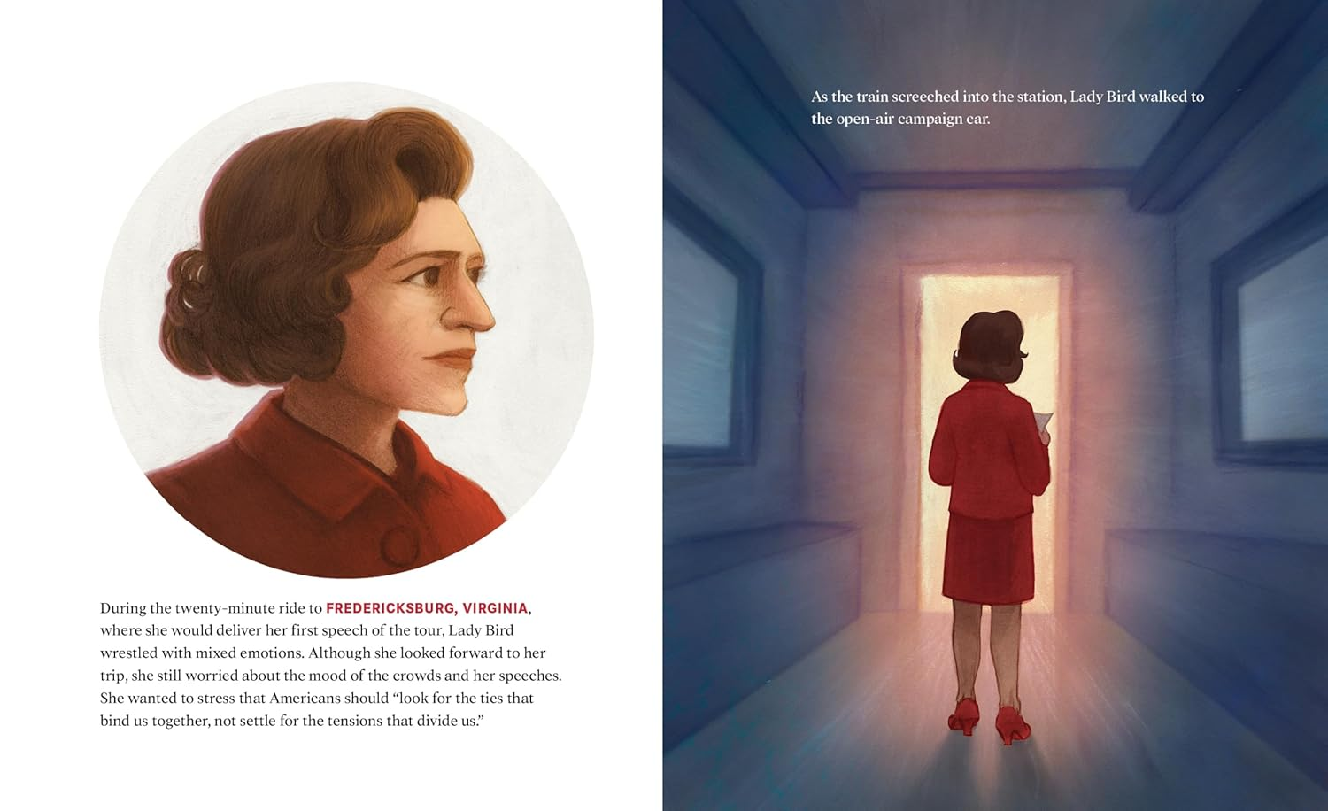

Slide 6
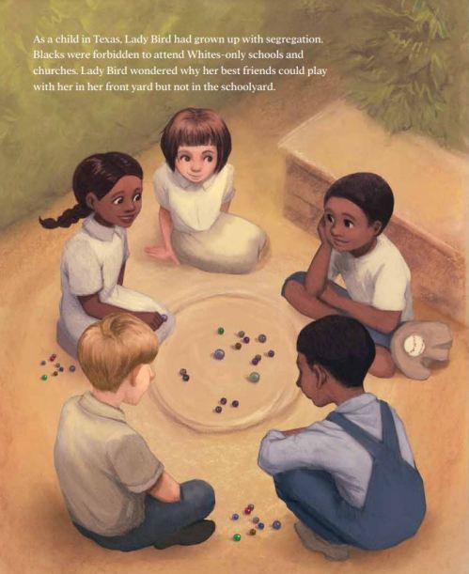

Slide 7
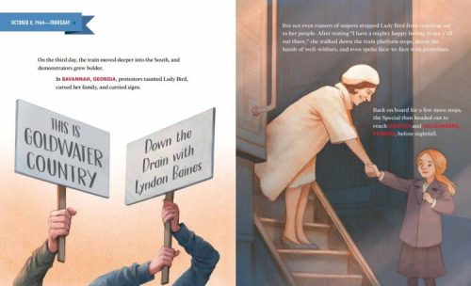

Slide 8
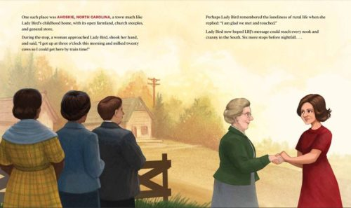

Slide 9
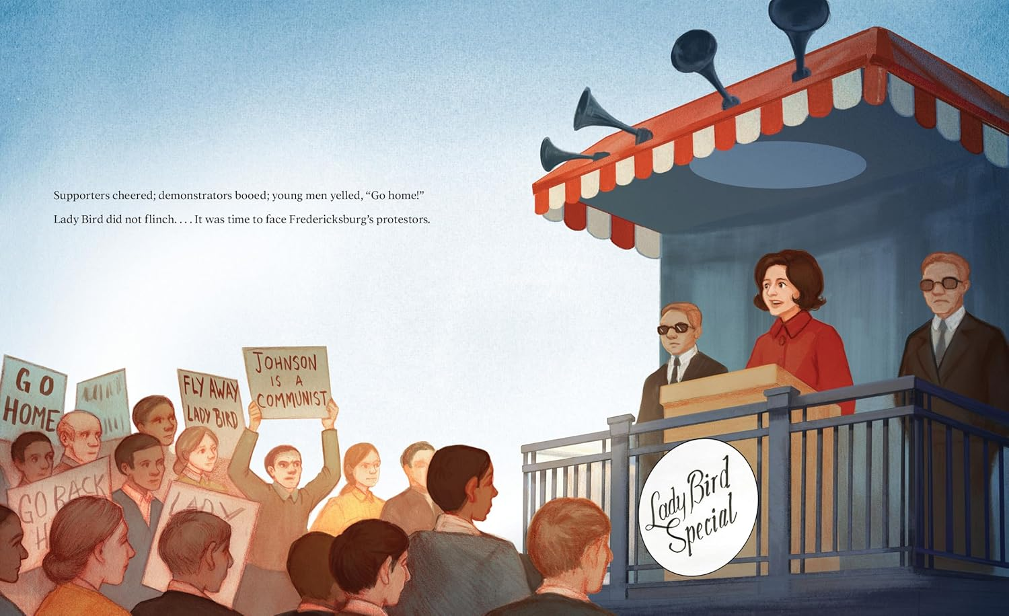

Slide 10
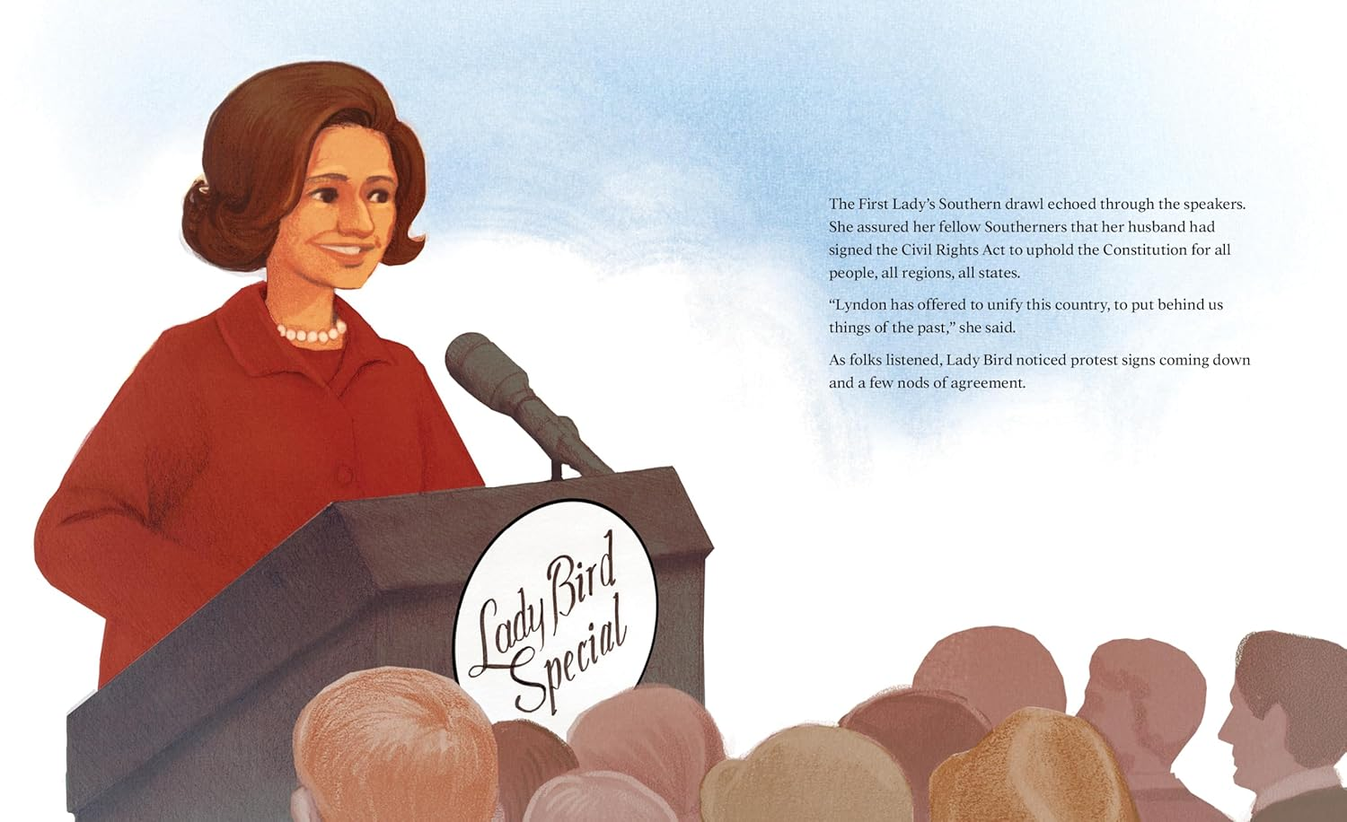

Slide 11
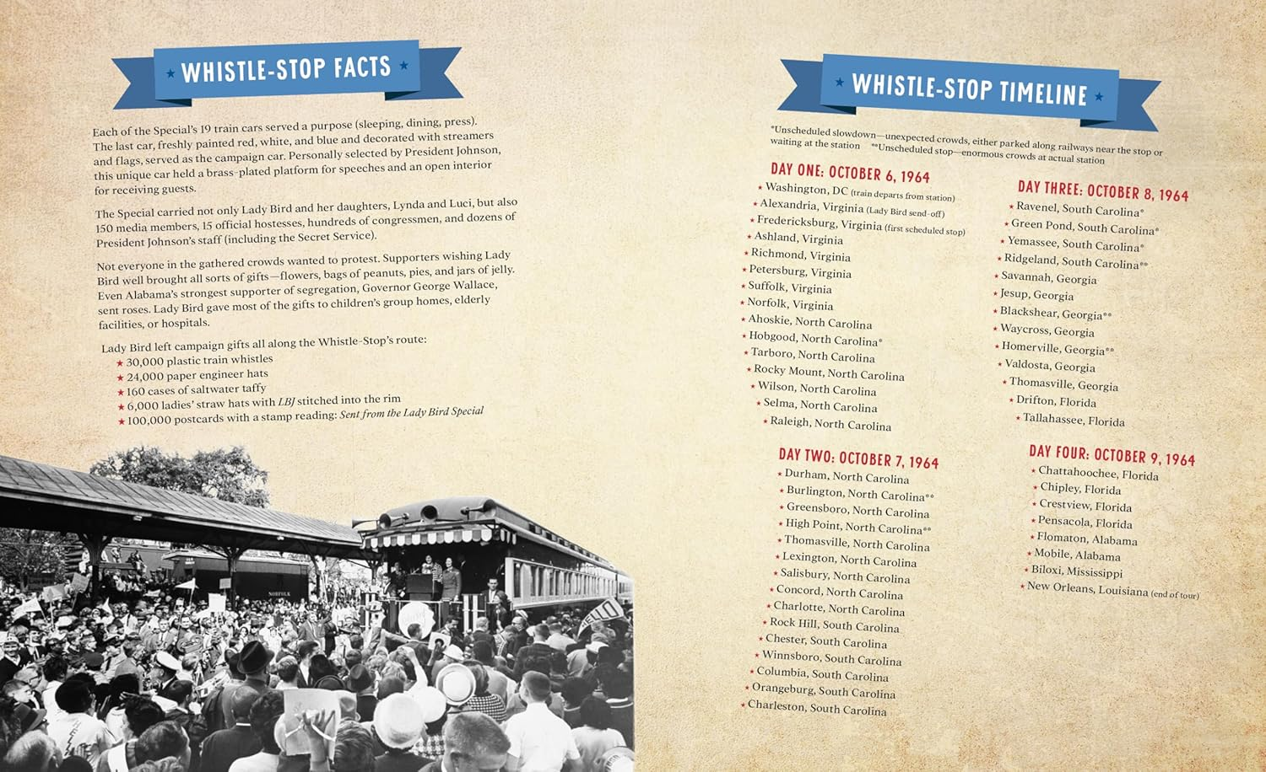

Slide 12


Read-om!
Engagement!
CHILDREN’S CHOICE
Cover
Characters
Sunglasses!
Lady Bird’s “style” – language, gutsy!, Southern
Train! All Aboard!
Recognizable city names
Hushpuppies, grits, and black-eyed peas
Children are included!
Neat facts
What would your students be attracted to?
What would they ask me as the author?
Employee
Relations
Notes:
How many have read the book or know its story? Summary.
By table groups, answer these last two questions. Share out. Do the drawing for the two 30-minute “meet the author” meetings after.
Show full spread of cover illustration; Did I miss anything? What would your students be attracted to?

Slide 13
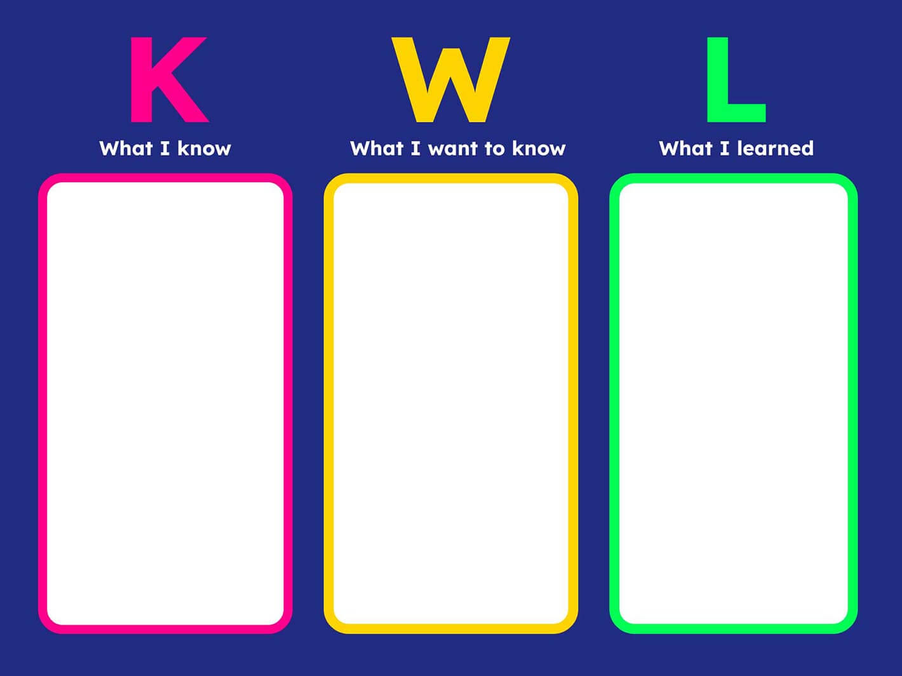

ENGAGEMENT AND RESPONSE
TIED TO CURRICULUM
Identify: who is Lady Bird? How was she a good citizen on the Tour? Show incidences in Rollin’ that reveal these and utilize a KWL before and after discussion (what you know, what you want to learn, as a group, what you learned, as an individual assessment).
Discuss: How will you adopt these characteristics in your own life? Continue the discussion throughout the school year as to stories of “adoption.”
1.18 Define citizenship, and recognize traits of good citizens, such as respecting the rights of others, voting, following laws, etc.
2.RL.KID.3 Describe how characters in a story respond to major events and challenges.
Notes:
Reading Response and Character Building
How many of your students know Lady Bird? What would they want to know? Will it be bravery? Or voting rights? Or participatory democracy?

Slide 14
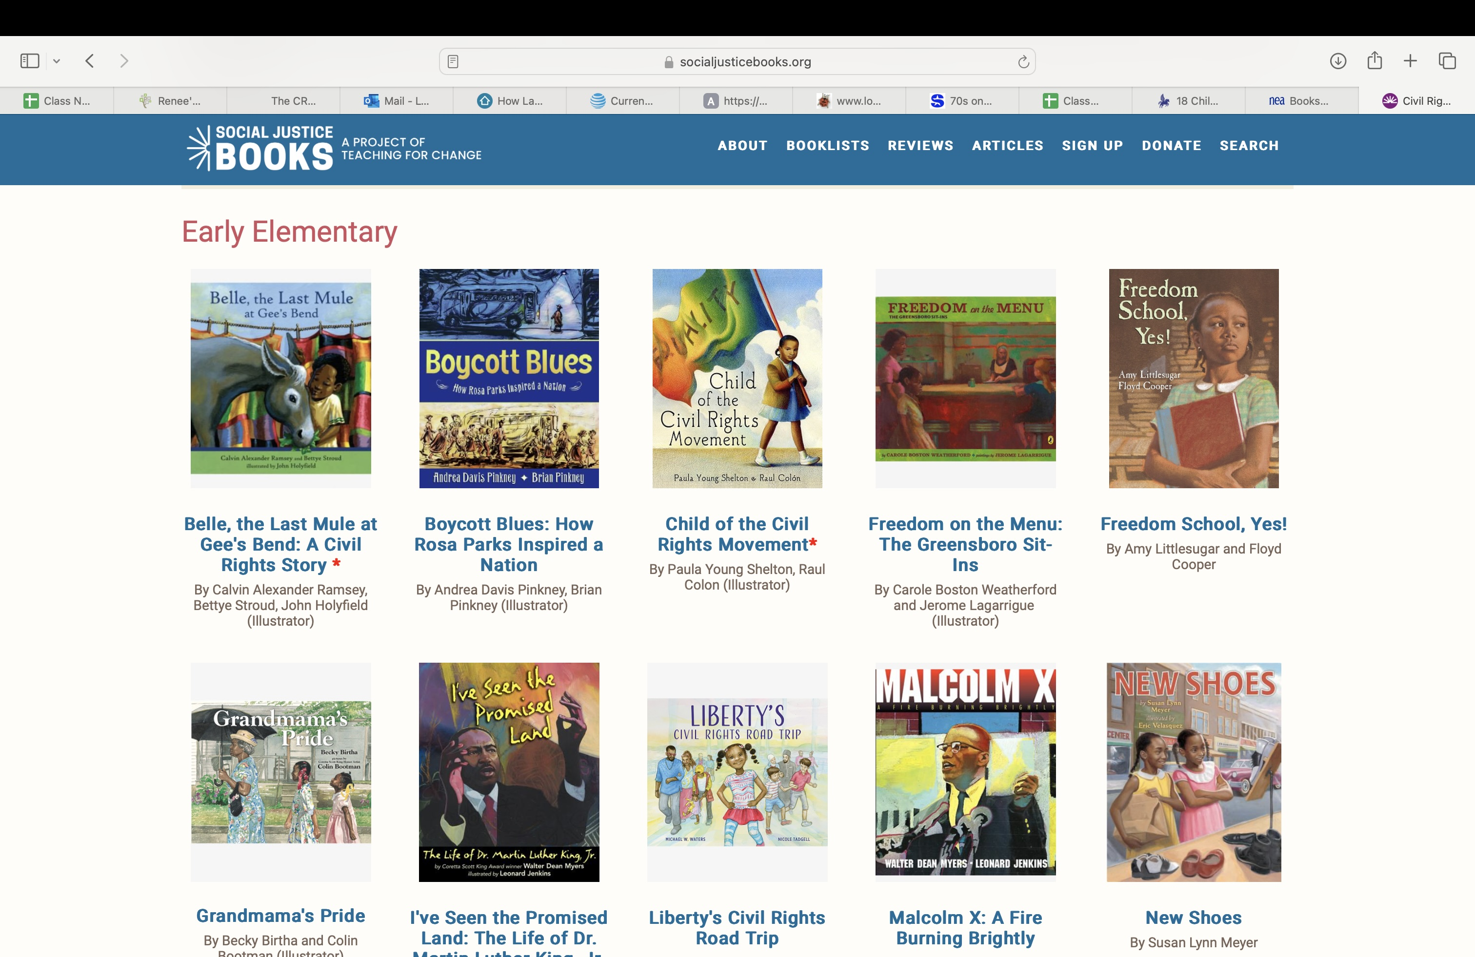

Conduct a read-aloud of Civil Rights books found in the collection – one each week. Have a “special time” to visit the library for such read-aloud. Books will concentrate on the contents of the Act, with discussion and/or reading response activities to follow.
https://socialjusticebooks.org/booklists/civil-rights-teaching/classroom/
Employee
Relations
HOW WILL YOU, THE LIBRARIAN, ENGAGE READERS?
Notes:
Tell about slide itself – reading promotion. Ask for other reading promotion ideas after explaining this one. Suggest “47” read-alouds in 4 days, with Rollin being read to entire student body beforehand and placed on streaming video or school announcements. Then, have us visit over Zoom.

Slide 15
https://sleepingbearpress.com/teaching_guides/566
Teaching Books
Notes:
Publishing companies website – a fantastic teacher’s guide to use for collaboration

Slide 16

COLLABORATION WITH READING INSTRUCTORS
3.RI.CS.4 Determine the meaning of
words and phrases in a text relevant to a
grade 3 topic or subject area.
2.RL.CS.4 Describe how words and
phrases supply meaning in a story, poem,
or song.
VOCABULARY!
Employee
Relations
Use Sleeping Bears teacher’s guide and pre-made list and graphic organizer to determine meaning and to sharpen library skills!
Find it on Teaching Books!
Notes:
How many of you collaborate with your elementary teachers? Total ___
Reading ___
ELA _____
Social Studies _____
Which of these words will you need to use to find meaning (your students do not know)?

Slide 17
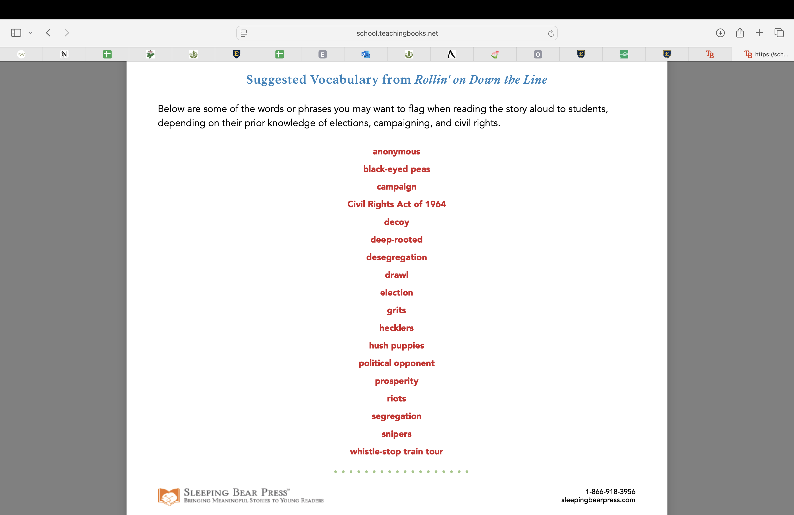

Slide 18
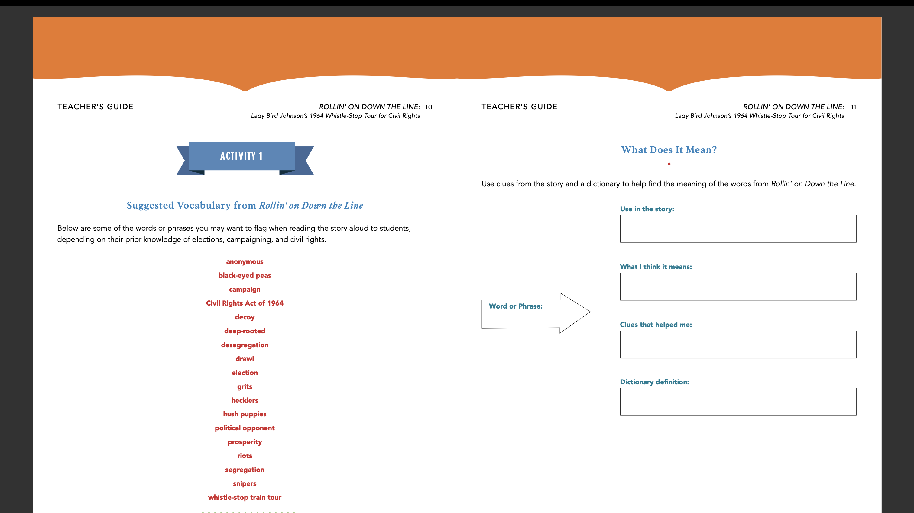
Notes:
How many still work with dictionaries? What digital dictionaries do you like best (for your colleagues)?

Slide 19
ELA COLLABORATION
3.RI.IKI.7 Use information gained
from illustrations and the words in a
text to demonstrate understanding
2.RI.IKI.7 Identify and explain how
illustrations and words contribute to and
clarify a text.
3.RI.RRTC.10 Read and comprehend stories
and informational texts at the high end of the
grades 2-3 text complexity band
independently and proficiently.
Employee
Relations
ENGAGED DISCUSSION!!
Notes:
How many of you still believe in discussion and conversation?

Slide 20
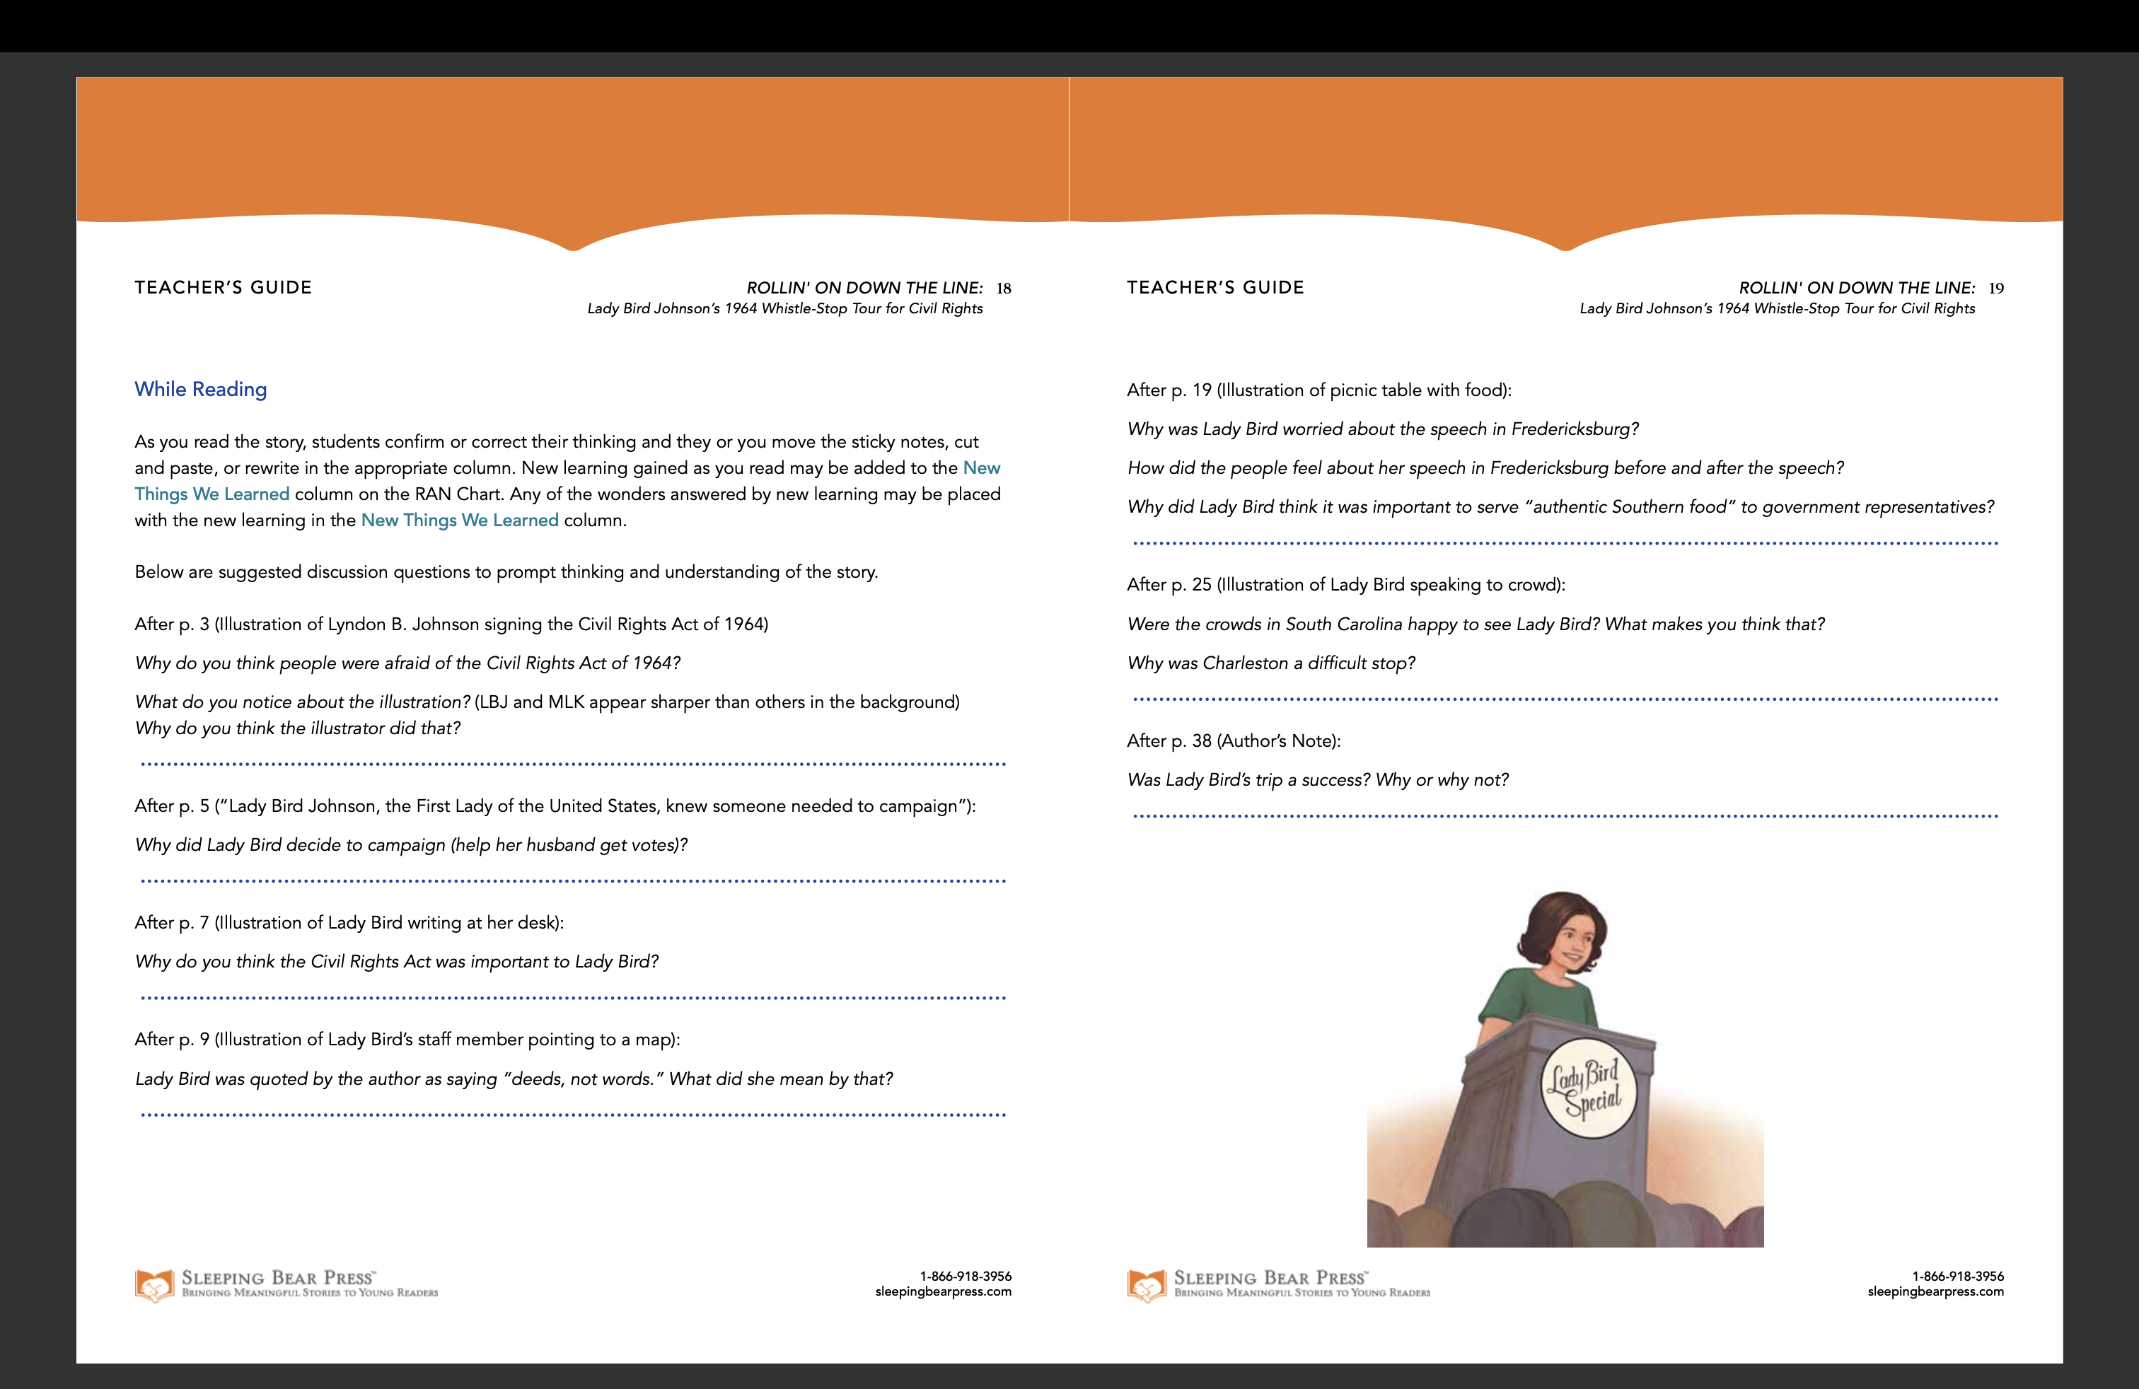

Slide 21
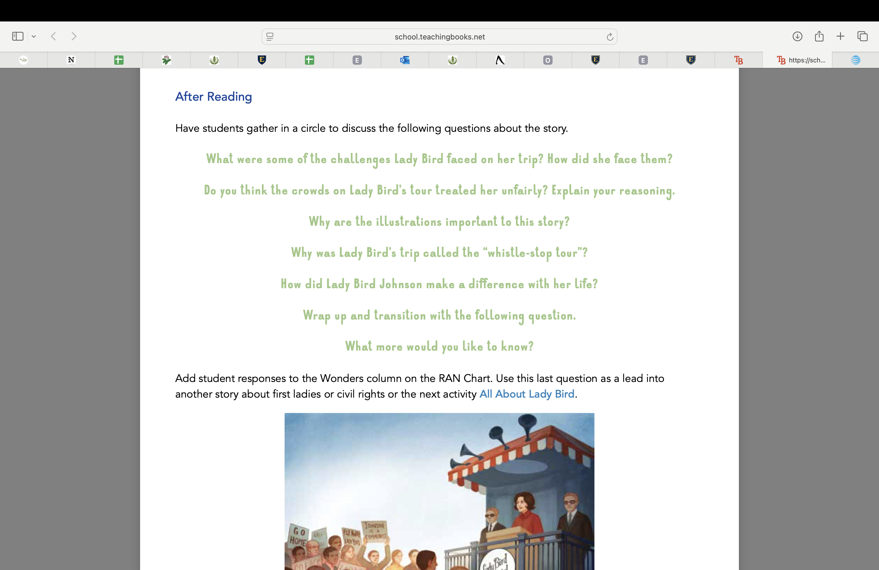
Notes:
What is one question you would include from what you have learned about the book so far? Socratic circles?
Do you create instructional or teacher guides? How do you feel about this guide from Sleeping Bear so far?

Slide 22
ELA COLLABORATION
2.W.TTP.1 Write opinion pieces on topics or texts.
a. Introduce topic or text.
b. State an opinion.
c. Supply reasons to support the opinion.
d. Use linking words to connect the reasons to the opinion.
e. Provide a concluding statement or section.
2.W.TTP.3 Write narratives recounting an event or short sequence of events.
a. b. c. Include details to describe actions, thoughts, and feelings.
Use time order words to signal event order.
Provide a sense of closure.
Employee
Relations
WRITE A BIO-POEM, ABOUT LADY BIRD OR ANOTHER HISTORICAL CHARACTER
NCBLA EMPOWERING YOUNG WRITERS
https://thencbla.org/empowering-young-writers/
Notes:
Would bio-poems be excellent to go along with wax museums? ;-)

Slide 23
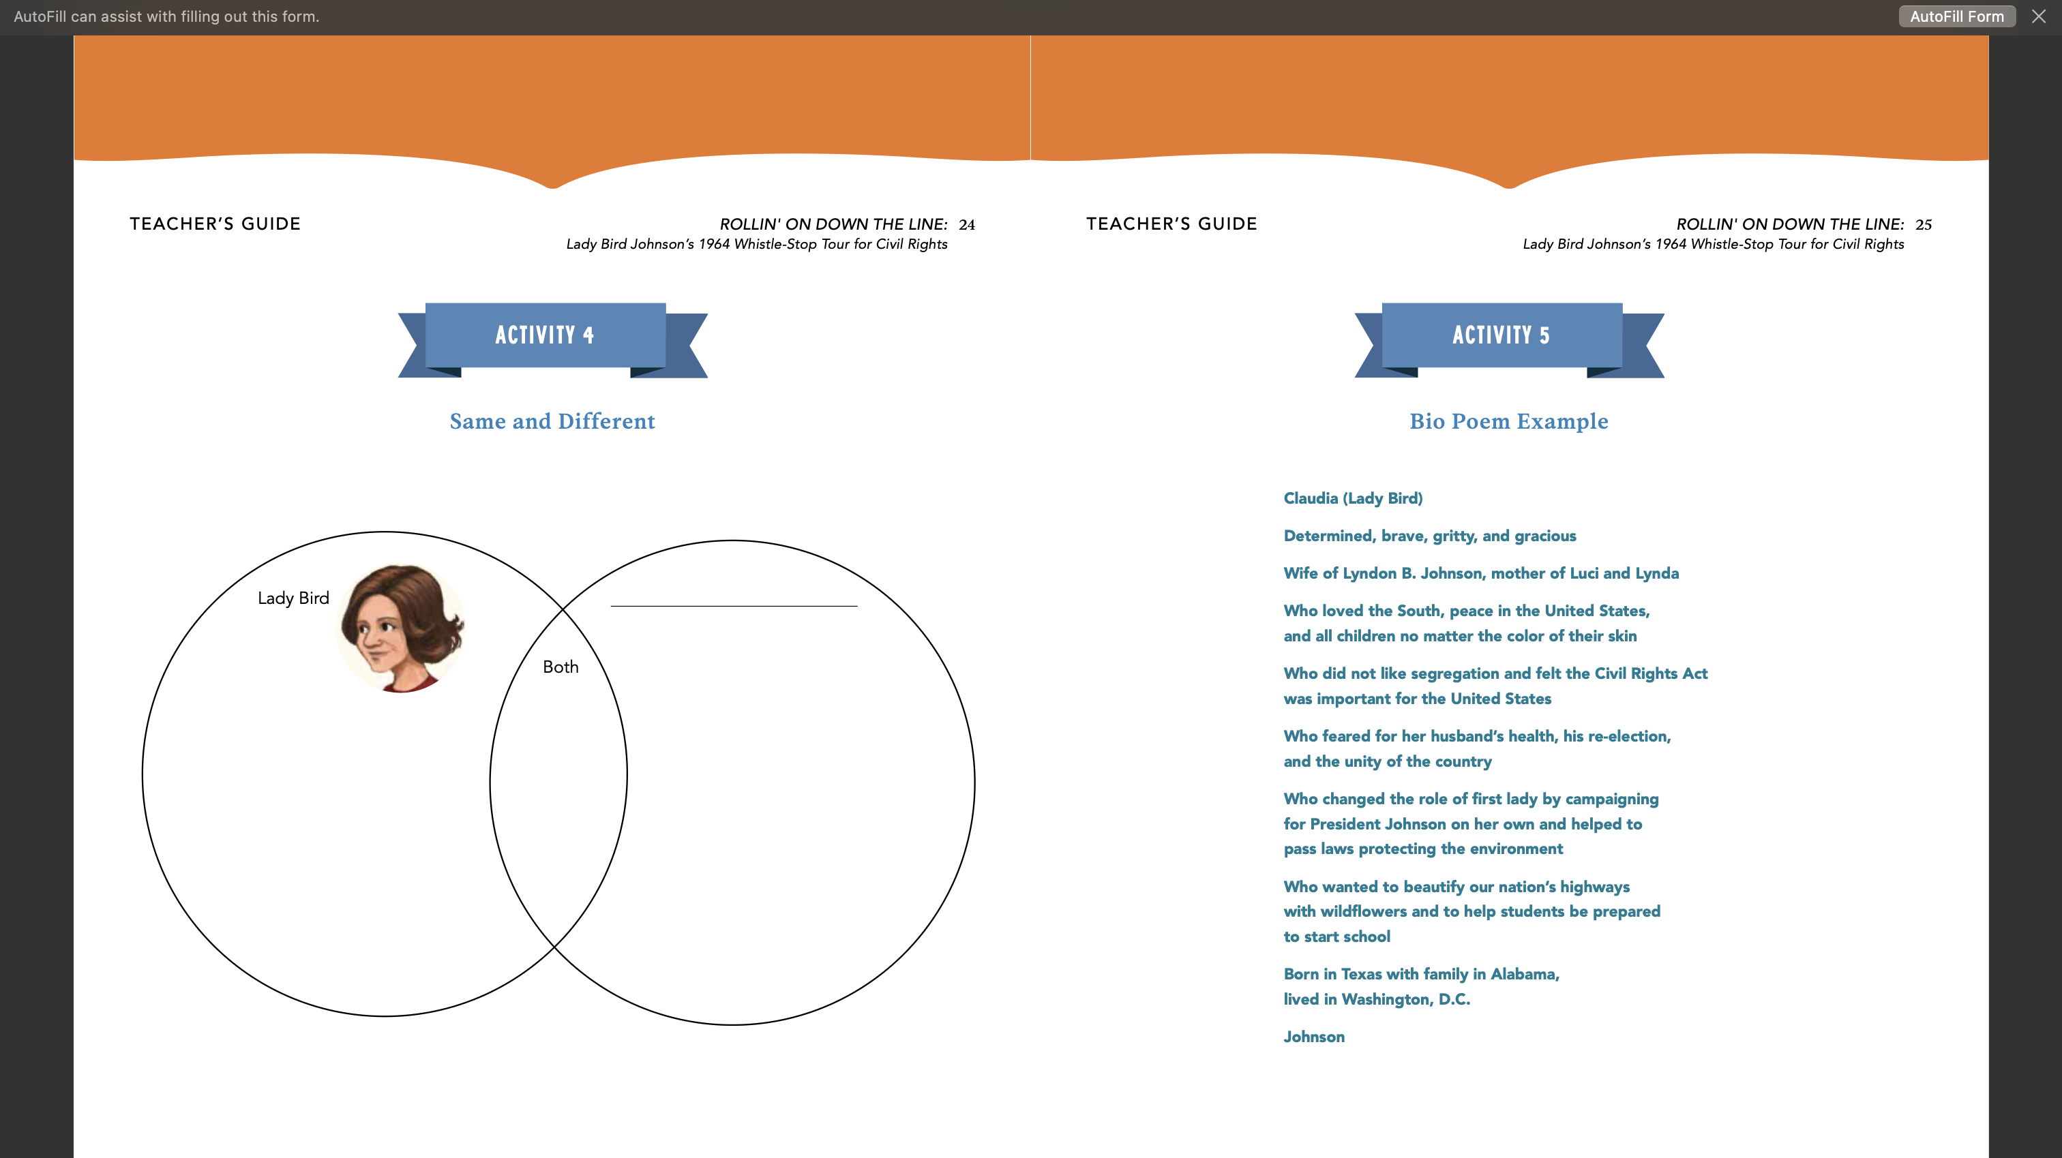
Notes:
Notice the sandwiching of her name. Interdisciplinary.

Slide 24
RESEARCH FIRST!!
3.W.RBPK.7 Conduct short research projects that build general knowledge about a topic.
Employee
Relations
Notes:
How many of you use trade non-fiction for research, or promote it for research?
What have you found about an increase in engagement as relates to research? In one study, 75% said it was better because it made them “wonder.”

Slide 25
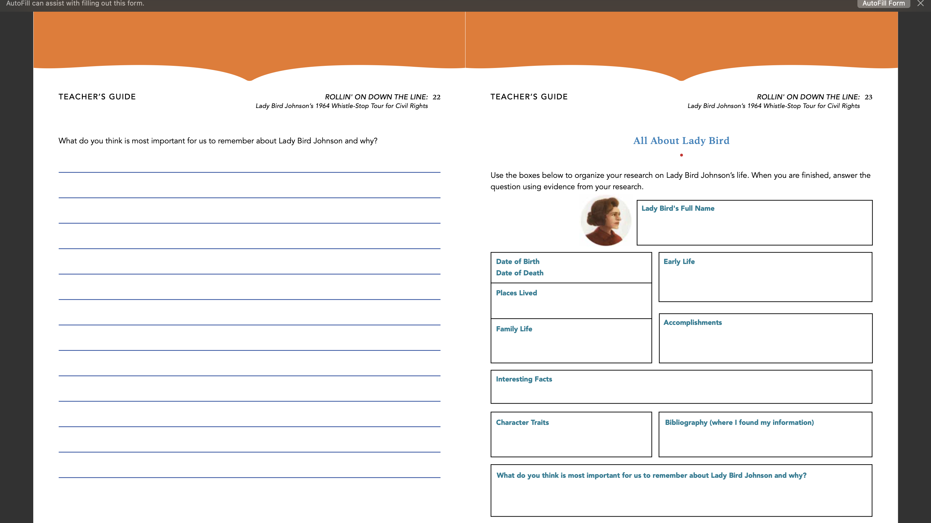
Notes:
Discuss with a partner who your students would like to write about who is also found in this book?
Lyndon Baines Johnson, Martin Luther King, Jr., Barry Goldwater, Bill Moyers, Lynda Johnson, Luci Johnson

Slide 26
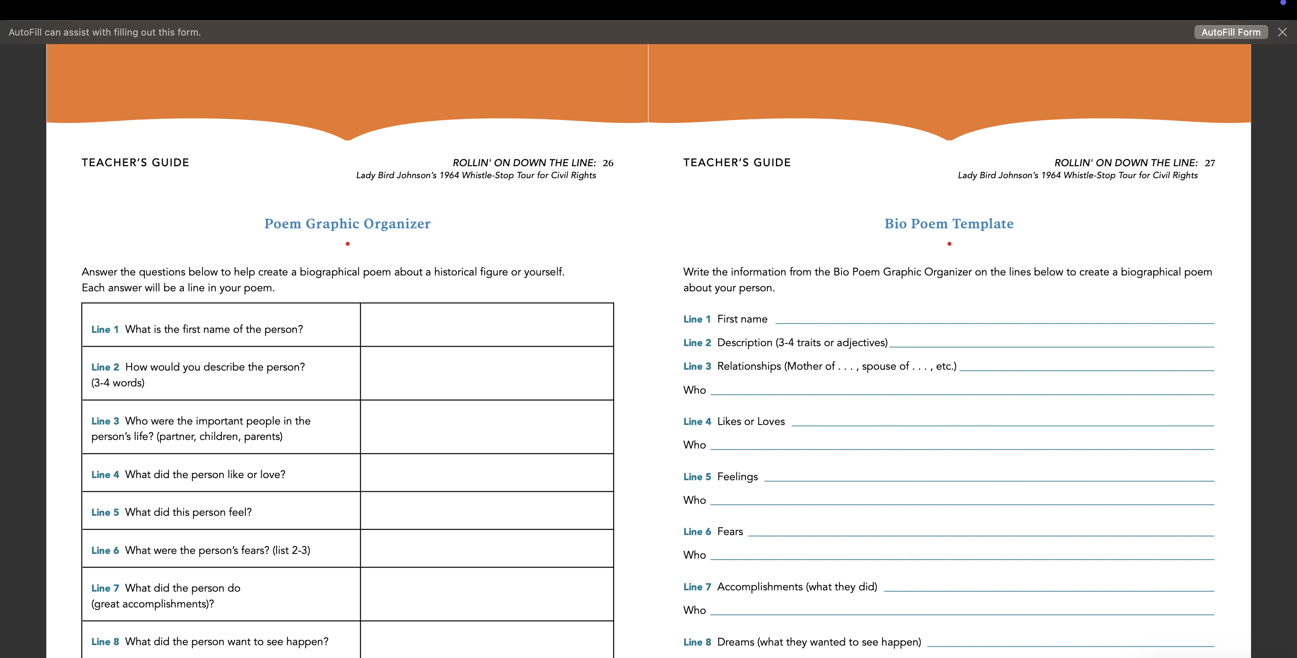

Slide 27
ILLUSTRATION, TIMELINES
3.RI.IKI.7 Use information gained
from illustrations and the words in a
text to demonstrate understanding
f t t
2.RI.IKI.7 Identify and explain how
illustrations and words contribute to and
clarify a text
4.VA.R1.A Determine the main idea of an image, and explain how it is
supported by key details.
3.VA.R1.B Speculate about processes an artist uses to create a work of
art.
DRAW AN ILLUSTRATION AS TO LADY BIRD’S LEGACY
Employee
Relations

Slide 28
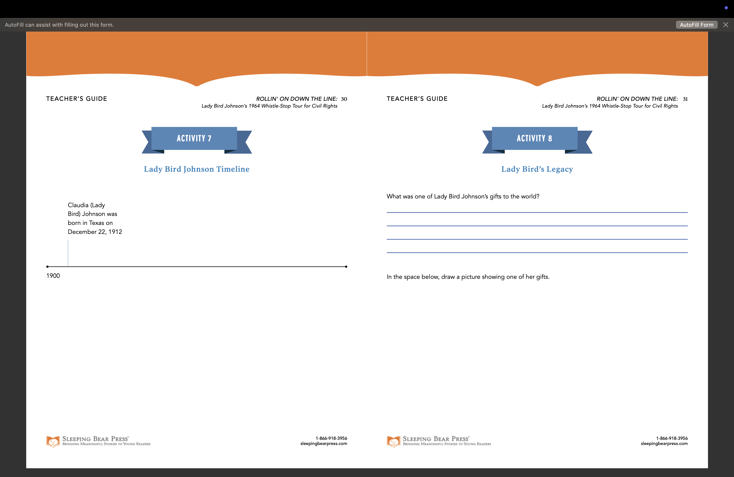
Notes:
What would you draw?
What did the illustrator think was her gift? The author?
Comments from Erin as to how she came to form an image of Lady Bird’s legacy.

Slide 29
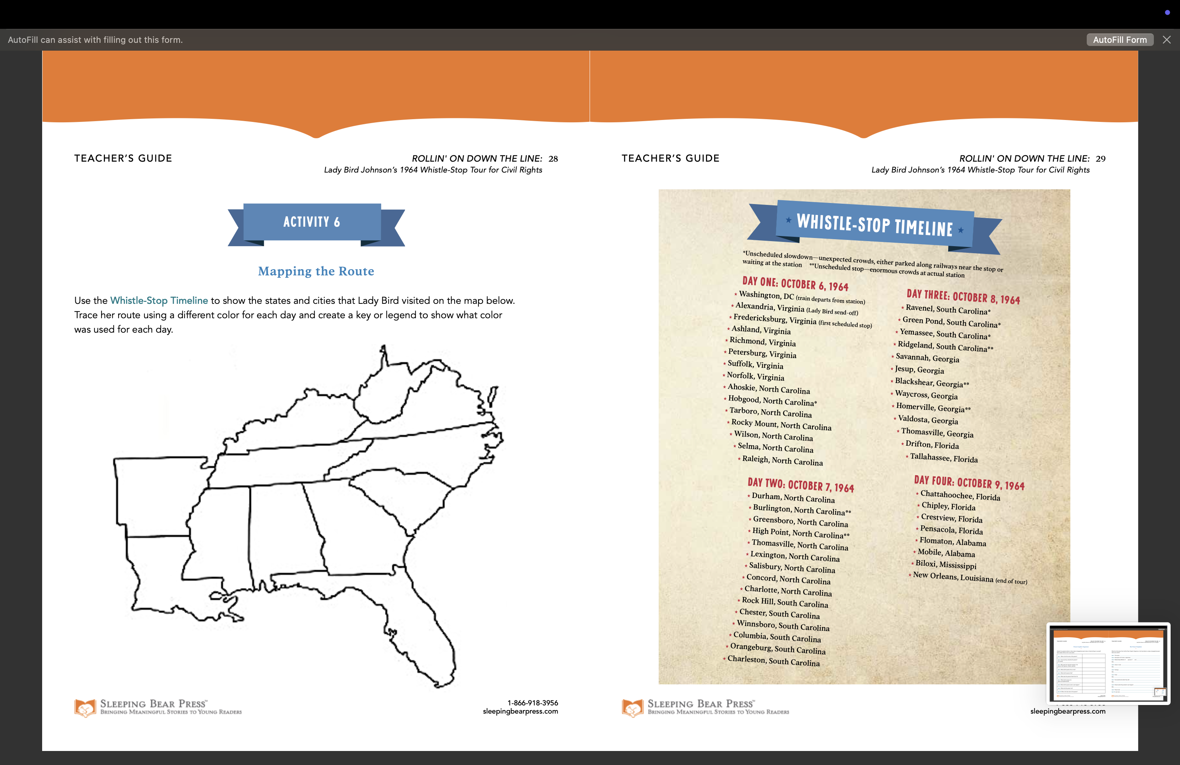
Notes:
What color would your students choose for Tennessee? Can that segue into social studies?
Do you use timelines as ready reference? How many insist on using timelines in collaborative efforts that involve research? How is the timeline conducive to understanding the themes of this book? How does Erin believe you can segue from art to other subjects? Or provide interdisciplinary offerings?

Slide 30

SOCIAL STUDIES!!!
Describe the principles embedded in the Constitution, including (T.C.A. § 49-6-1028):
• Purposes of government (listed in the Preamble)
• Separation of powers
• Branches of government
• Checks and balances
• Recognition and protection of individual rights (in the 1st Amendment)
UTILIZE PRIMARY SOURCES!!
AND OUR NATION’S LIBRARY!!
Employee
Relations
Notes:
What better book to discuss individual rights? Or , the purposes of Government?

Slide 31
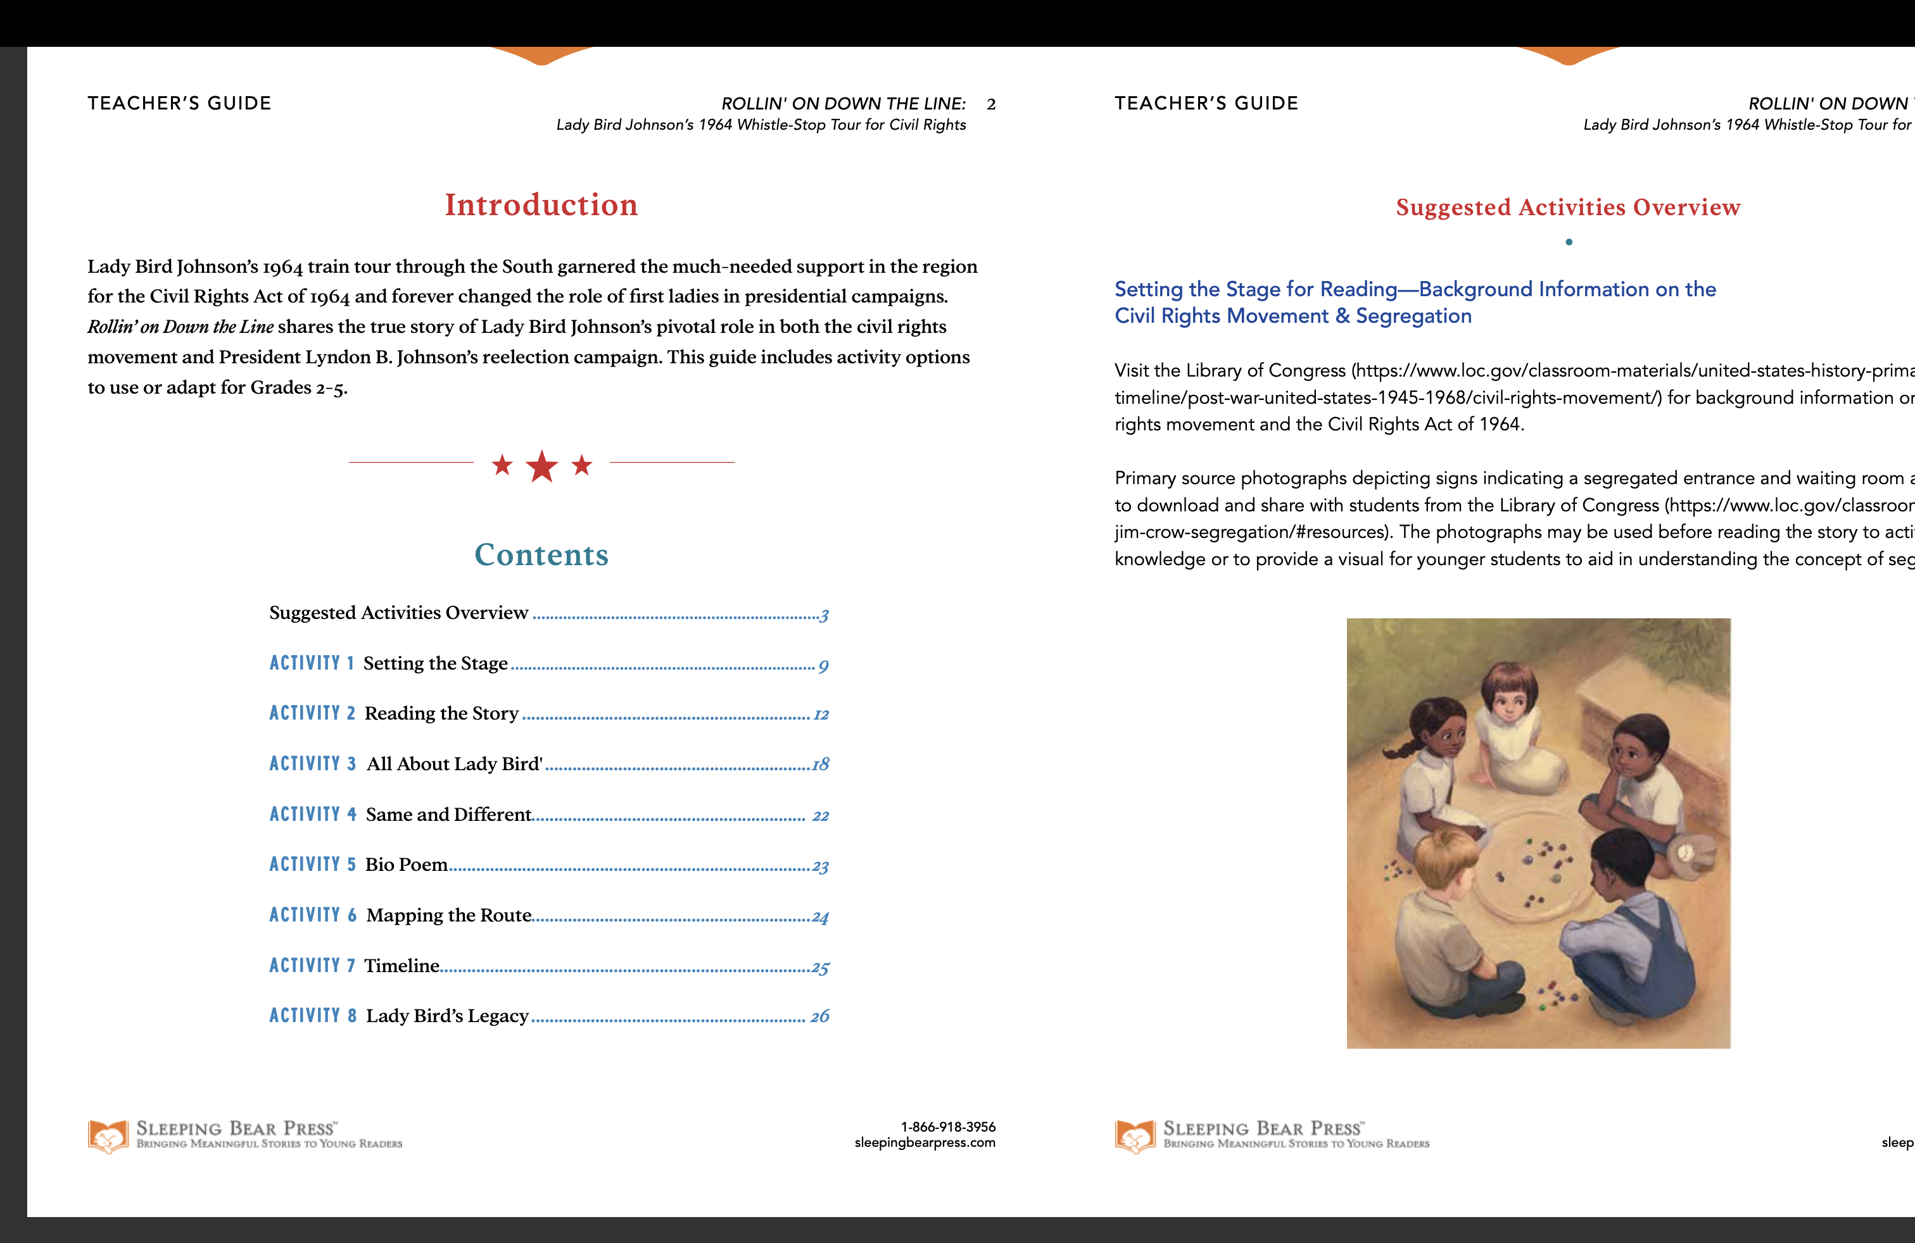
Notes:
What would some of your discussion questions entail?

Slide 32
SOCIAL STUDIES!!!
1.18 Define citizenship, and recognize traits of good citizens, such as respecting the rights of others, voting, following laws, etc.
1.19 Explain that voting is a way of making choices and decisions.
2.25 Identify the rights and responsibilities of citizens of the U.S.
STUDY LADY BIRD AS AN EXAMPLE OF A GOOD CITIZEN!!
Employee
Relations
Notes:
Just the best! Fearless! Other ways to describe her citizenship?

Slide 33
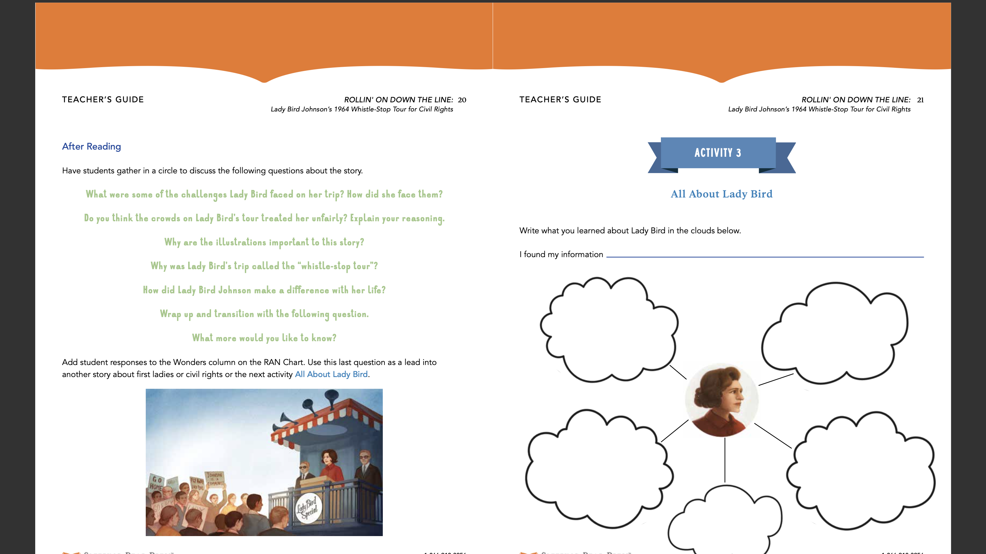
Notes:
Once both of these ideas are complete, what did you learn she knew about our system of government and the Constitution and the rights of others?
For example, freedom of speech, respect, kindness, empathy, listening skills, knowing her own rights.
Honesty, respect, bravery

Slide 35
Good citizenship
How was Lady Bird respectful per book? Does it take courage to be respectful? Complete a Venn Diagram showing respect, courage, and both.
https://www.canva.com/design/DAGUOvFBVzw/8YqKgm58ESYRbgQbeWPl9g/edit?utm_content=DAGUOvFBVzw&utm_campaign=designshare&utm_medium=link2&utm_source=sharebutton
Employee
Relations
Notes:
Give example from the book?
What would Lady Bird have said about the current state-of-affairs and exhibiting good citizenship?

Slide 36




MOVIE DAY!
Participation in government by educating oneself about the issues
Consider how Lady Bird helped educate the public, per the book, and then:
1. Video group for "What did she teach?"
2. Video group for "What did she have to overcome to teach?"
3. Video group for "What character traits did she display, with examples from book?”
4. Video group for “What were the outcomes?”
Come back together during a certain period and play the group videos. Host a movie day!
Use: Animoto
1. Template - https://animoto.com/builder/templates/recommended/educational-presentation
2. Customize - https://animoto.com/resources/tutorials/animoto-video-quick-start-guide
Notes:
What fun! Project-based learning. Products for the general good.

Slide 37

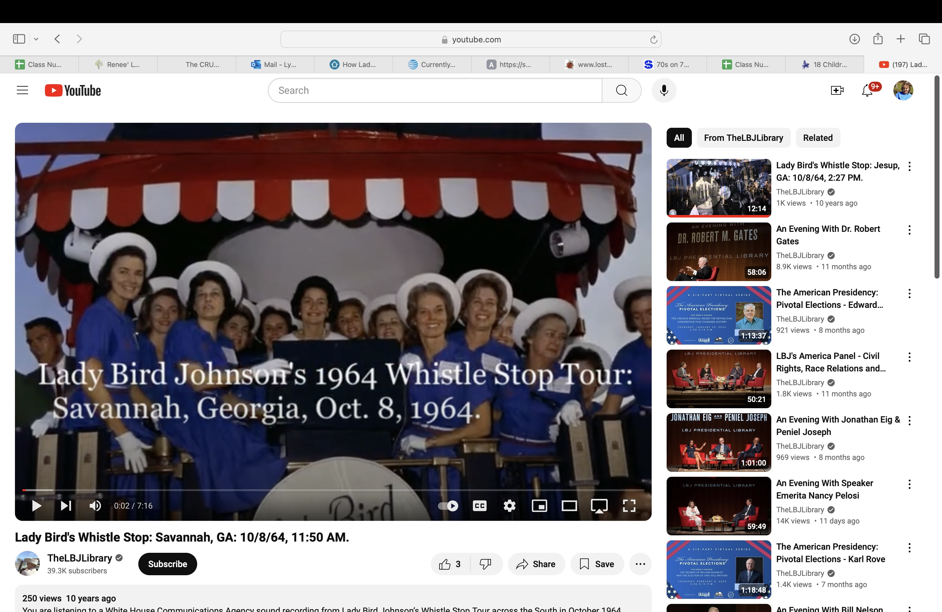
Character Traits
Play a primary source, such as Lady Bird’s speech in Savannah, LISTEN closely, and write a paragraph on how Lady Bird practiced consideration for attendees. Share on a common website and allow time for peer response and comments on said instructional technology.
Savannah speech: https://www.youtube.com/watch?v=H7DmM7CU7RQ (Also collaborate with librarian to understand primary sources).
Use Padlet: https://padlet.com/trcritcher/how-did-lady-bird-johnson-s-actions-demonstrate-consideratio-jtuigekh3xlvreba
Notes:
Empathy and good traits are just as important as academic subjects. Can catch more flies with honey than vinegar.

Slide 38
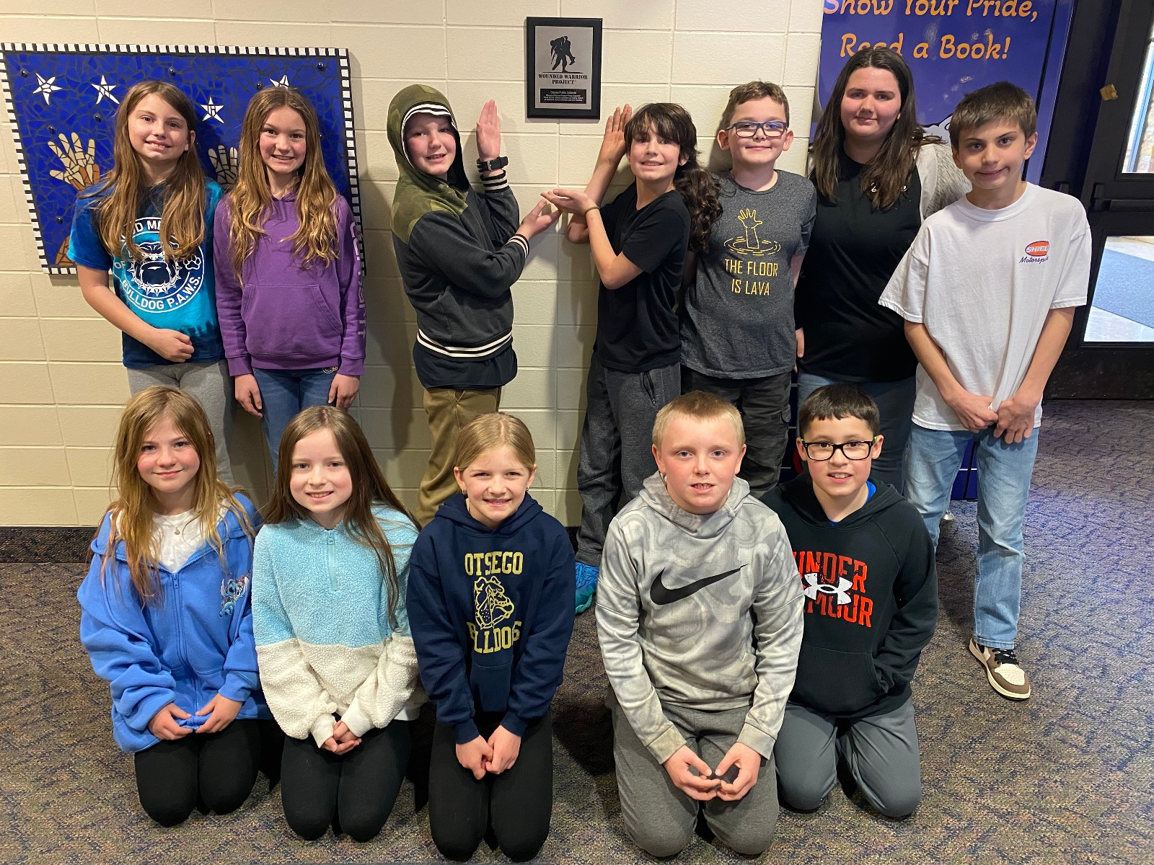

THE COMMON GOOD
Demonstrate responsibility and courage for the common good.
Adopt a program or project to support (such as Wounded Warrior Project – Honor Their Courage). Hold discussions on a monthly basis as to how the class is contributing to the common good. Keep records and plot the classroom trajectory of service.
Use National Center for Education Statistics “Kid Zone: Create a Graph”
https://nces.ed.gov/nceskids/createagraph/
Notes:
How would ALL children be included? As we see, inclusion is so important to mental health?

Slide 39
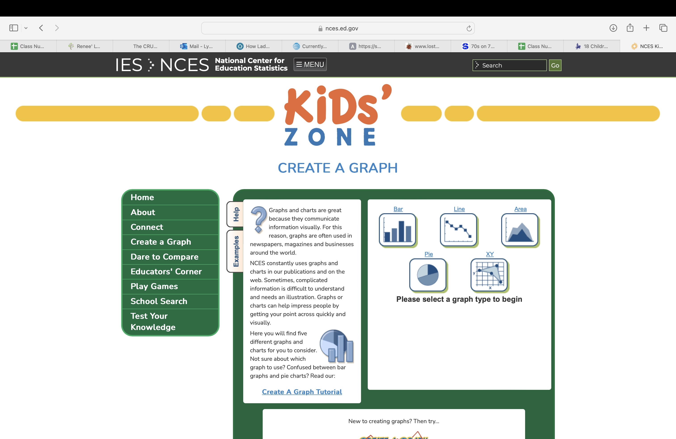
Title
Notes:
Did you think to incorporate math into a social studies topic? Would this include the “nerd” or “math brain?”

Slide 40
HAVE A BLAST WITH LADY BIRD!!
TENNESSEE LIBRARIANS!
TENNESSEE STUDENTS!

