Slide 1
Personable Professionalism
How to Be Approachable While Maintaining A Professional Presence

Slide 2
Welcome
To an interactive discussion on personable professionalism.
Dana Richardson
Macon County Public Library System
Notes:
How many of you are academic? School? Public? Directors? Branch Managers? Support Staff?

Slide 3
Why did you become a librarian?
Love of:
Books?
Reading / Literacy?
People?
Or
You needed a job?
Notes:
This decision is personal to us, but not the people we serve. Personal reasons are involved on everyside, but it doesn’t make the transaction or situation personal. But, our perception and perspective can make it personal or professional. How does it become personal to them?
Though a personal relationship can develop.

Slide 4
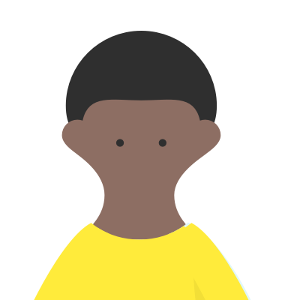

Personal
of, affecting, or belonging to a particular person rather than to anyone else.
of or concerning one's private life, relationships, and emotions rather than matters connected with one's public or professional career.
Notes:
Having observed me during the conference, what have you learned about me? What are my physical description? How does your perception of me influence your perspective and behavior towards me?

Slide 5
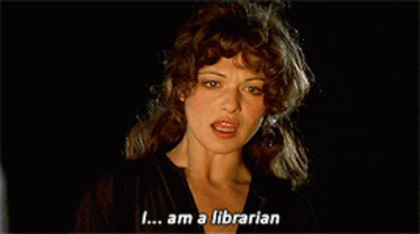
Evie ~ The Mummy

Slide 6

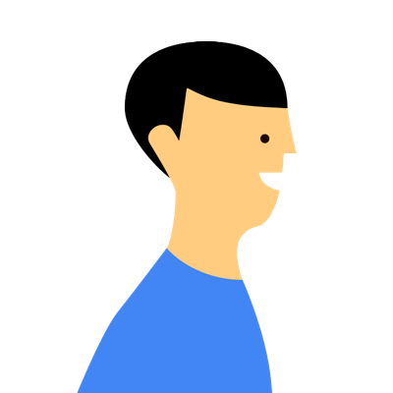
Personable
(of a person) having a pleasant appearance and manner.
Notes:
What are you saying without using words.? Body Language. How well do you represent the orginization that you work for? Your appearance, your speech, your attitude?

Slide 7
Approachable
friendly and easy to talk to.
(of a place) able to be reached from a particular direction or by a particular means.
Notes:
Do students, patrons, colleagues, or staff feel that they can come to you for anything? Or do they look for someone else to get the assistance they need?

Slide 8
Professional
engaged in a specified activity as one's main paid occupation rather than as a pastime. (Note: pastime = hobby)
worthy of or appropriate to a professional person; competent, skillful, or assured.

Slide 9

Approachable Communication
Empathetic Interaction:
Exhibiting emotional intelligence,
understanding others' perspectives,
and demonstrating consideration for others.
People want to feel seen, heard, and understood.
Linkedin
Notes:
Take time to listen. To discern the situation. To speak with clerity and understanding.

Slide 10
Relationships
Libraries bridge community relationships.
We help connect others…
while maintaining appropriate professional boundaries.
Notes:
The story of Cole, Jeanna, & Julia gave a connection to Melinda who now works for the library, teaches our Needle Nook Club, Cricut Classes, and is starting a book club.

Slide 11
Perception vs Perspective
Perception is often how we see the world,
while
Perspective is the lens through which we make sense of it.
Notes:
I’m going to share a personal story from my profession. Cole / Jeanna / Julia

Slide 12
Perception
Perspective
Can be chosen:
Stepping back to gain perspective helps challenge your own perceptions
Is limited:
It is subjective and can be faulty based on past experiences
Notes:
Upon my return, her perspective changed causing her perception of the job we do to alter. Personal experiences can change how we conduct ourselves professionally.

Slide 13
Conditions
Parameters
Is used to describe a state or situation that affects something else
Think Procedures
Refers to a variable or factor that influences a process or calculation.
Think Policies
The Content Authority - Condition vs Parameter: Differences And Uses For Each One
Notes:
When we have to work within the parameters lined out in the polices we are given, the conditions will determine the process and procedures we have to navigate to resolve the situation. Example: Overdue Items - learn their car was stolen, house burnt down, was in the hospital…

Slide 14
“It wasn’t … personal.” … Joe Fox
You’ve Got Mail
Notes:
It’s hard when you “know” a student, patron, or staff on a personal level and they feel that this entitled them to “special treatment”. And yet…

Slide 15
“Whatever else anything is, it ought to begin by being personal.”...Kathleen Kelly
You’ve Got Mail
Notes:
It’s personal on both sides…It’s personal to you because it’s YOUR job, the profession you personally chose. It’s YOUR friend. Or someone who has blurred the professional lines and sees you as a friend so it’s personal to them and you should understand their situation or respect the relationship.
So how do you resolve the situation without damaging the relationship while not compromising your professionalism?

Slide 16
Personable Professionalism
“...the art of combining competence, accountability, and ethical standards with warmth, empathy, and approachable communication. It builds trust and fosters positive relationships without sacrificing respect or boundaries. This style enables authentic, effective, and collaborative work environments.”
Linkedin

Slide 17
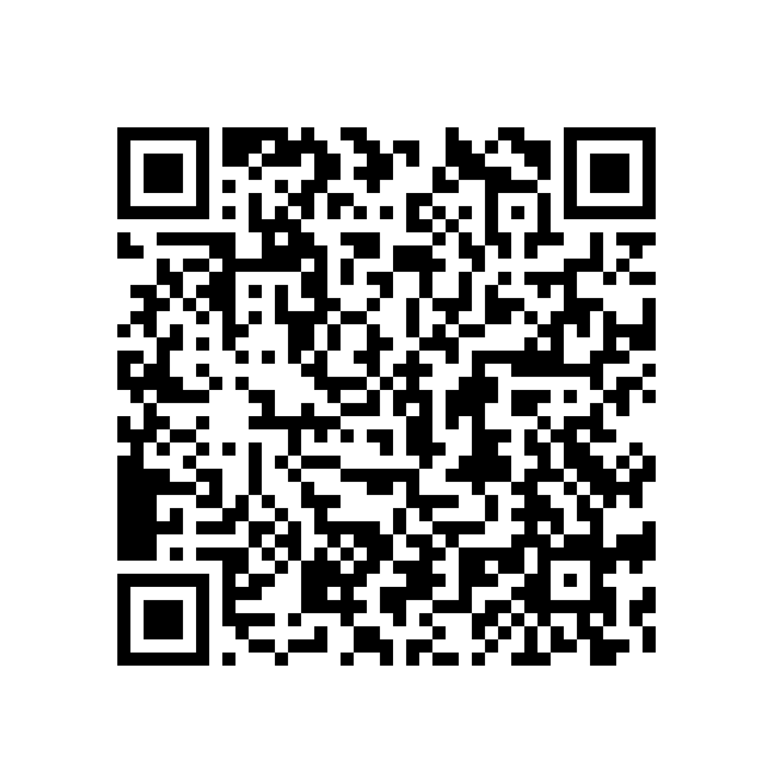
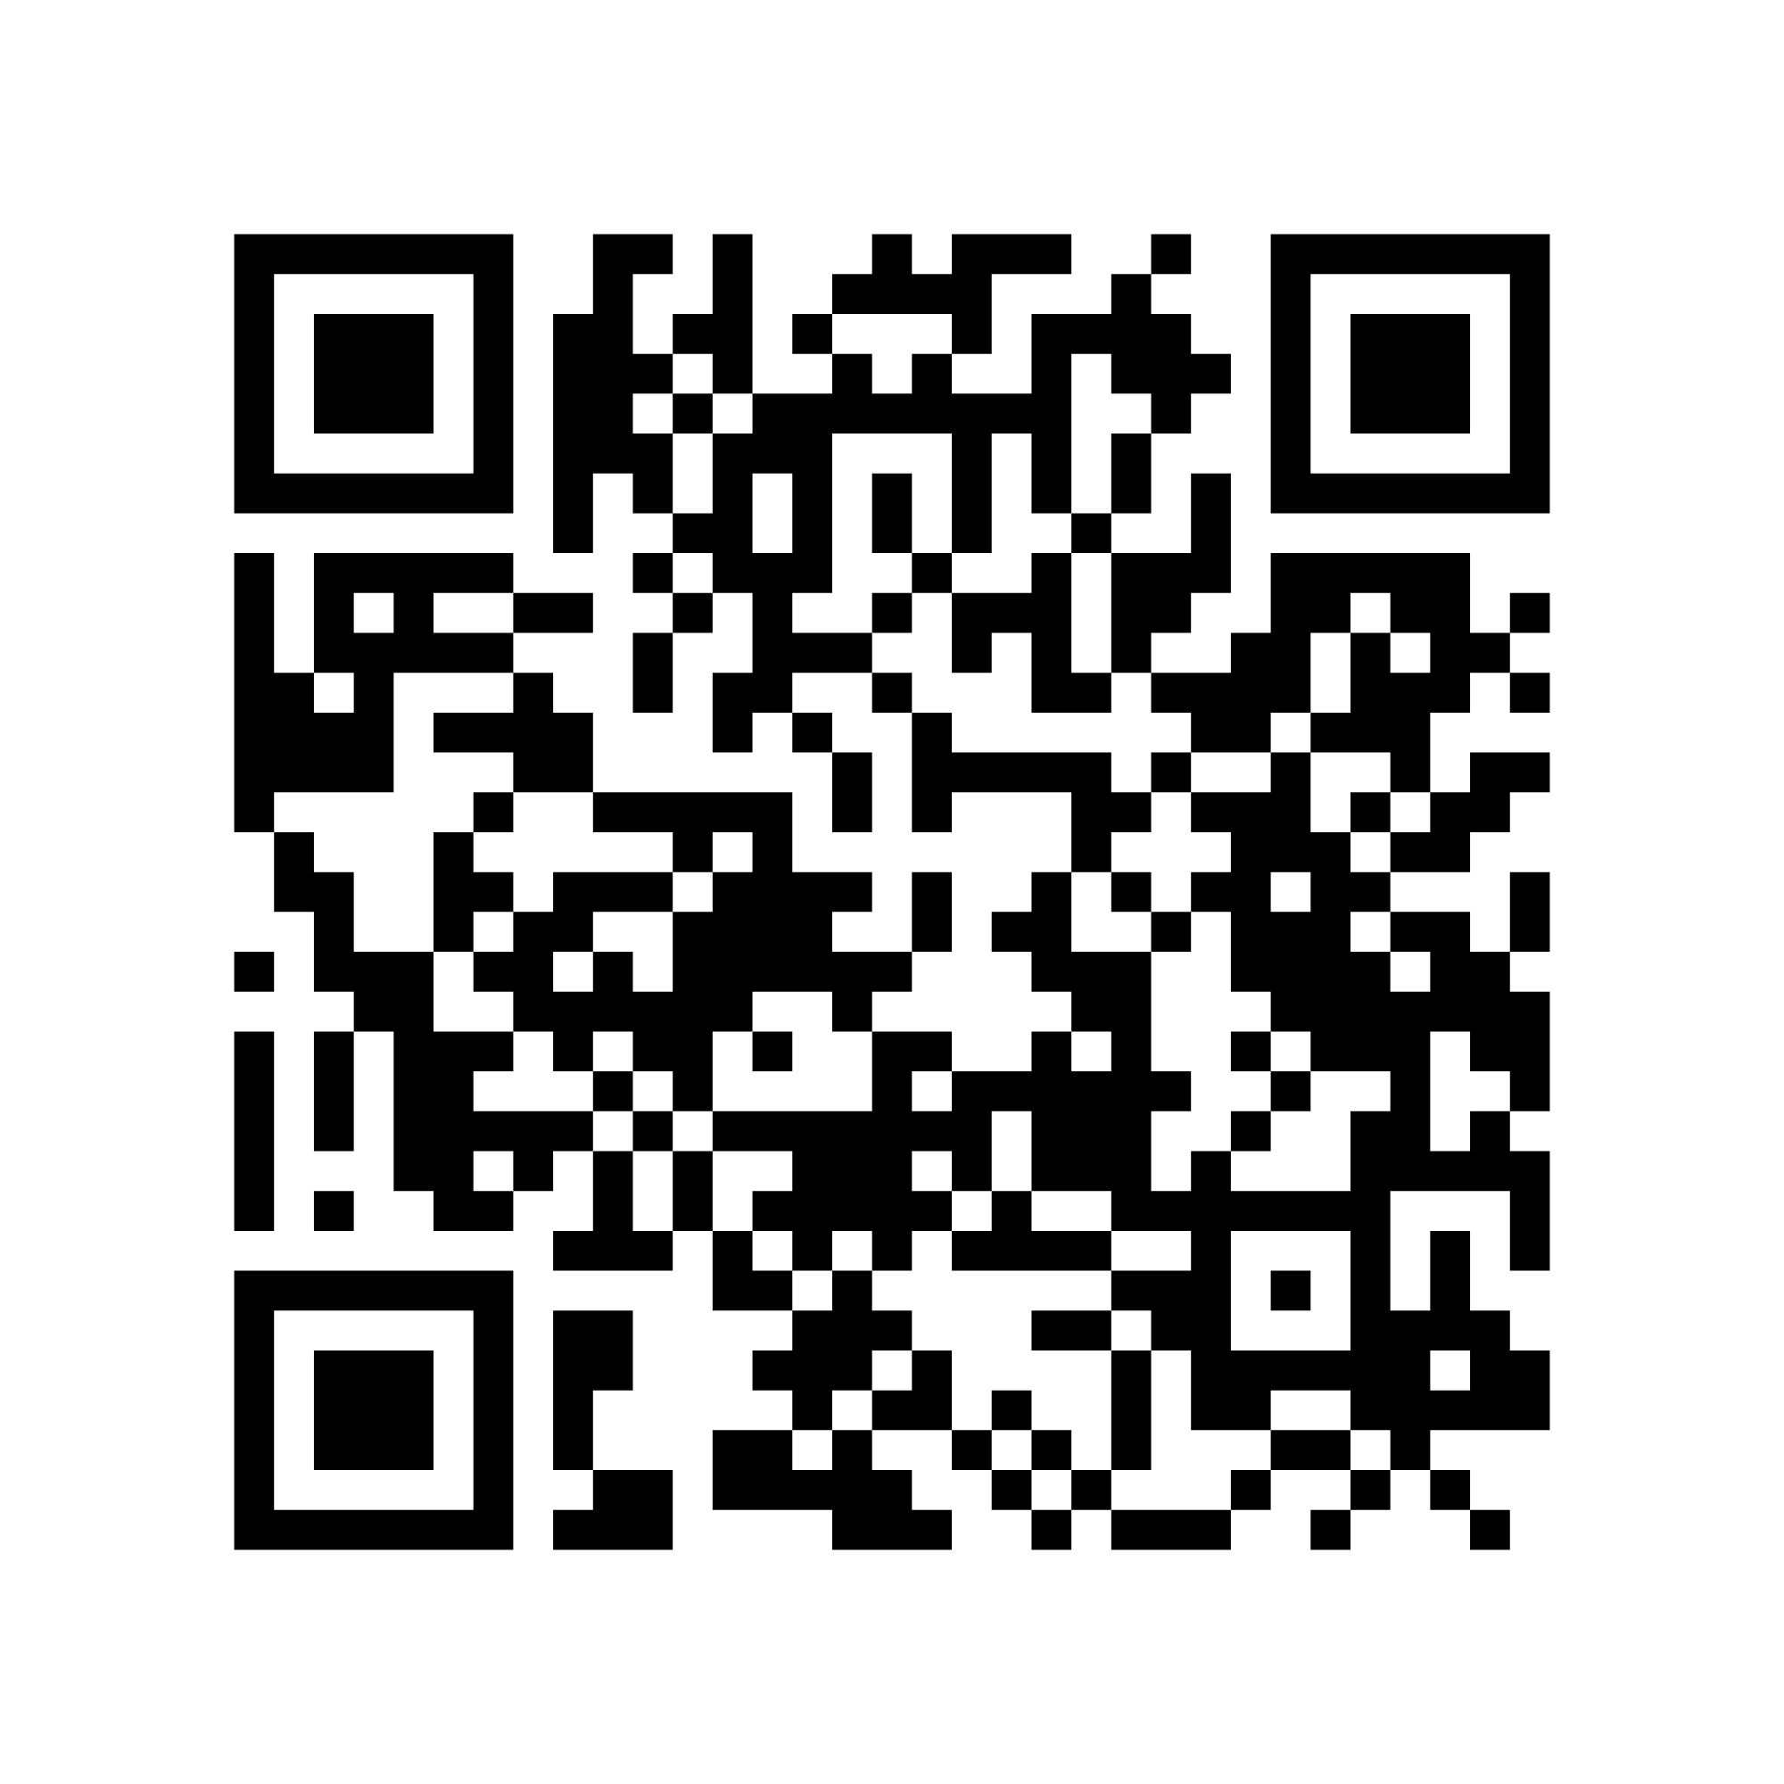
Sources Used
LinkedIn
The Content Authority
Personable vs Professional
Condition vs Parameter: Differences And Uses For Each One

Slide 18
Thank you!
Dana Richardson
Macon County Public Library System
drichardson@macontn.org / 615.666.READ {7323}

