Slide 1
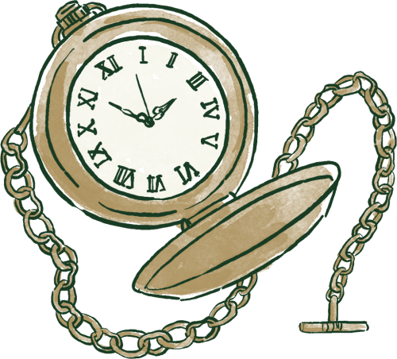





UNIVERSITY OF TENNESSEE AT CHATTANOOGA
BRIDGING STORIES AND COLLECTIONS
•
• SAMANTHA FREEMAN • KEANI KING •
TNLA 2026

Slide 2

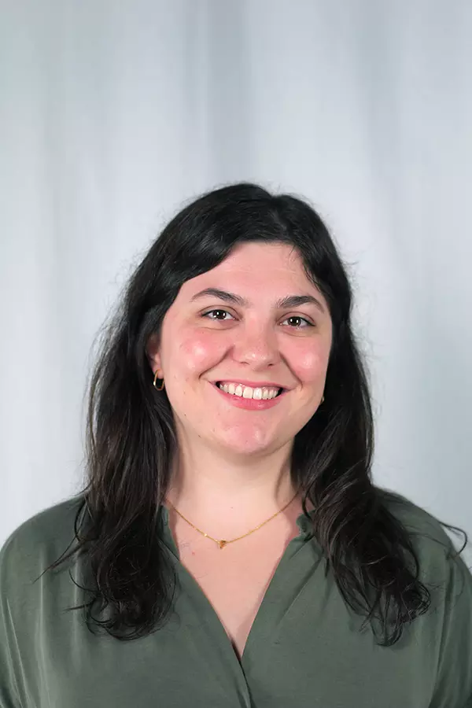

WHO WE ARE
Cataloging and Metadata Librarian
Collections Management Librarian

Slide 3



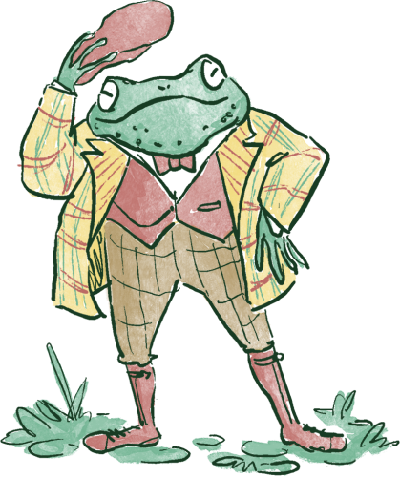
WHAT ATTENDEES WILL LEARN:
PRESENTATION OVERVIEW
Collection Assessment Framework
AGENDA:
Project Overview
Metadata Cleanup
Assessment and Planning
Inventory Process
Acquisitions and Weeding
Outreach
Adapting to your library
Lessons Learned

Slide 4
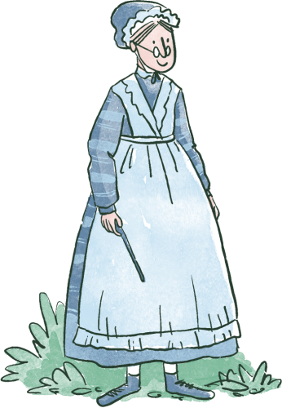
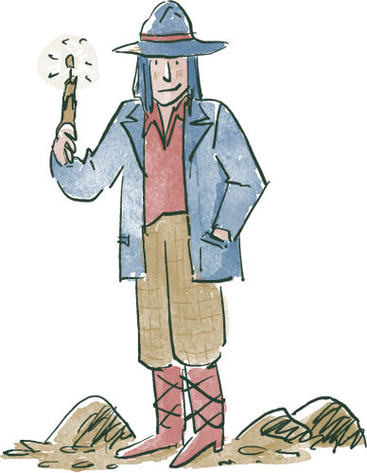
PART 1: PROJECT CONTEXT

Slide 5
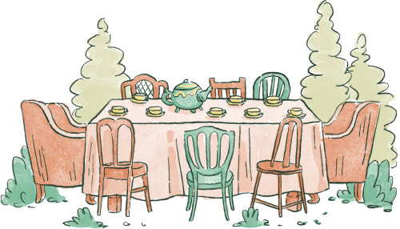
WHAT WE DO
SUPPORT...
Library Mission
The UTC Library connects our community with the information, skills, and resources needed to discover, create, and share knowledge. We provide access to high quality services and materials in a welcoming environment that supports the journey toward academic success and lifelong learning.
12,060 students (as of Fall 2025)
Doctoral Universities: Moderate Research Activity
Department Mission
The mission of the UTC Library Acquisitions and Content Management team is to be thoughtful stewards of quality information resources through the deliberate acquisition, description, organization, maintenance, and promotion of a holistic and ever-evolving collection to enhance profound learning opportunities for the UTC community.
$4.1 million Operating Budget for Library

Slide 6
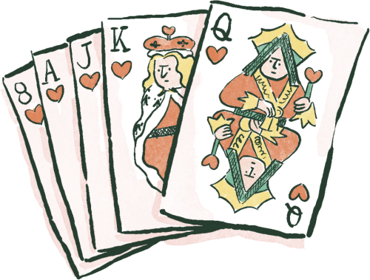
PART 2: PROJECT DESIGN AND PLANNING

Slide 7
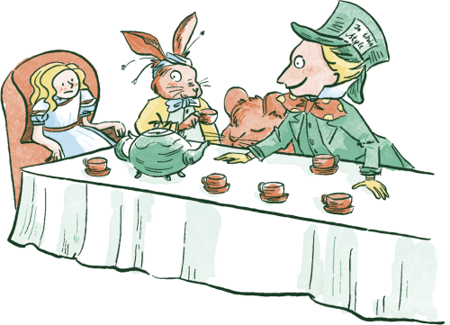
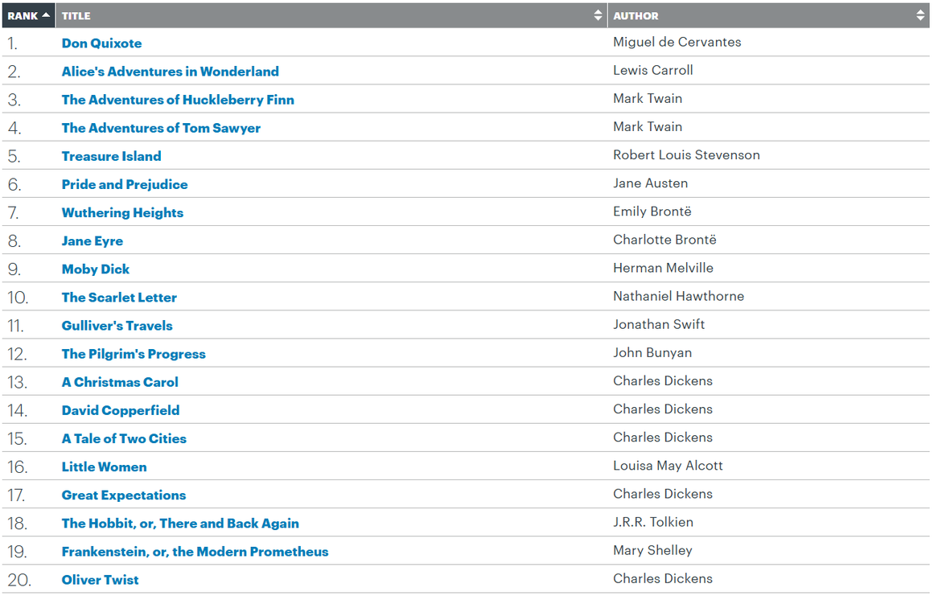
OCLC “THE COMPLETE 500” LIST
Creates a framework for collection assessment around shared cultural literacy, canon titles, and foundational curriculum support
from: https://www.oclc.org/en/worldcat/library100/top500.html

Slide 8

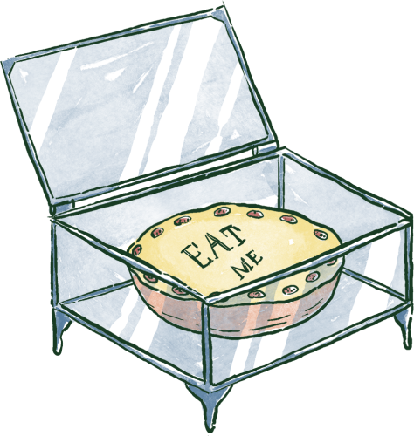

COLLECTION REALITY CHECK
Starting point: small scale, fun, engaging
AGING PRINT COLLECTION
CIRCULATION TRENDS
MISSING TITLES
  How do we balance canon, our evolving curriculum, and what our community wants?
How do we support search and retrieval from catalog that is consistent and accurate?
What should every academic library own in terms of “classic canon”?

Slide 9

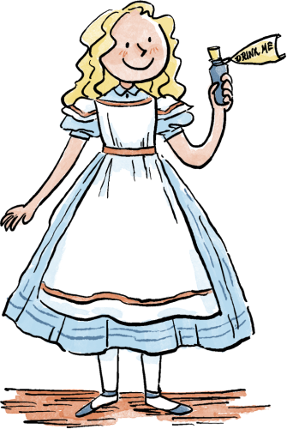

GETTING STARTED
GOALS & LIMITATIONS
INVENTORY
COLLECTION
PLAN
  Acquisition and weeding strategy
Core literary works
  Identify title gaps
Patron needs versus universal lists
Print versus digital access
  New versus existing materials

Slide 10

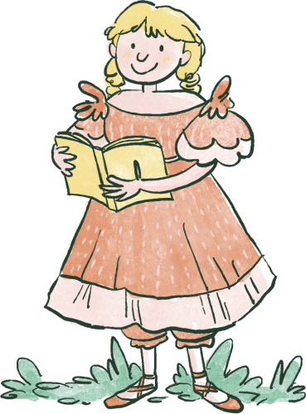
PART 3: THE INVENTORY PROCESS

Slide 11
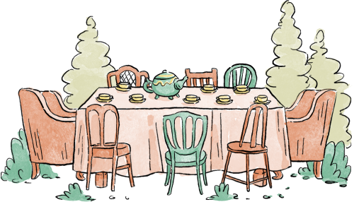

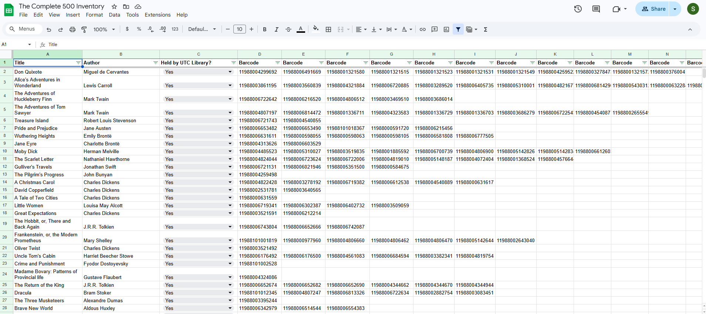
PREPARING THE DATA
Comparing the Complete 500 list to our inventory
TITLES
ISBN MATCHING
EDITIONS

Slide 12

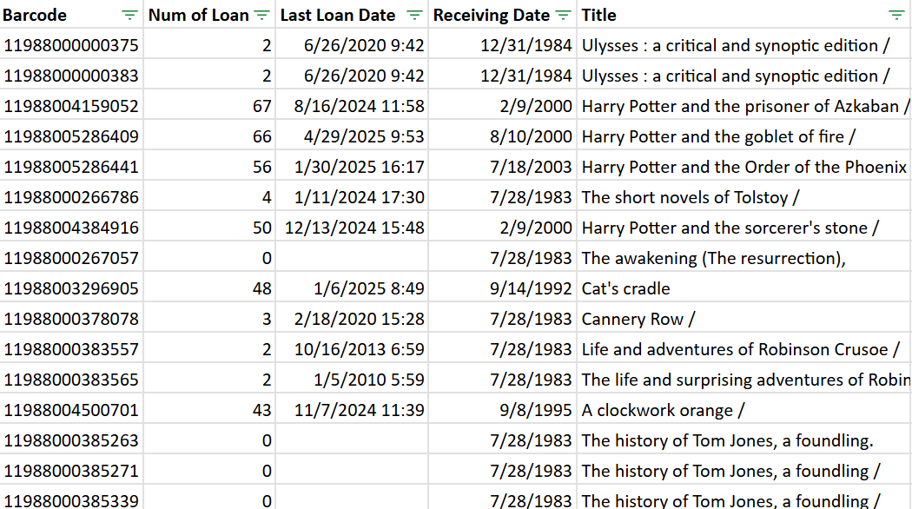


PROJECT SCOPE
INVENTORY WORKFLOW
Useful:
  Analytic reports
  Excel spreadsheets
  Referencing OCLC list
  Existing Weeding Policy
Limitations:
  Time constraints
  Formats

Slide 13
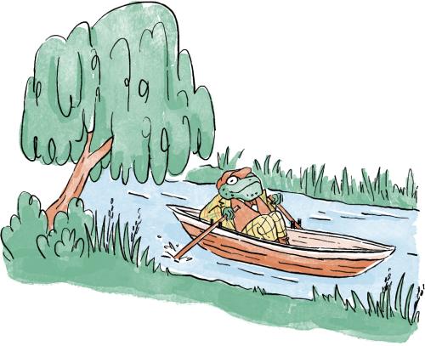
PHYSICAL SHELF INVENTORY
STUDENT ASSISTANT ROLE
CHALLENGES AND LIMITATIONS
CATALOG
ISSUES
  Pulling books
  Condition assessment
  Displays
  When providing list of titles to pull, place call # in order
  Communicating with the public
  Prioritize replacement copies
  Multi-volume inconsistencies
  Limited access points
  Call number discrepancies
  More titles in catalog than on shelf and vice versa
  Workflow guidance document for ease of use
  Facilitate access!

Slide 14
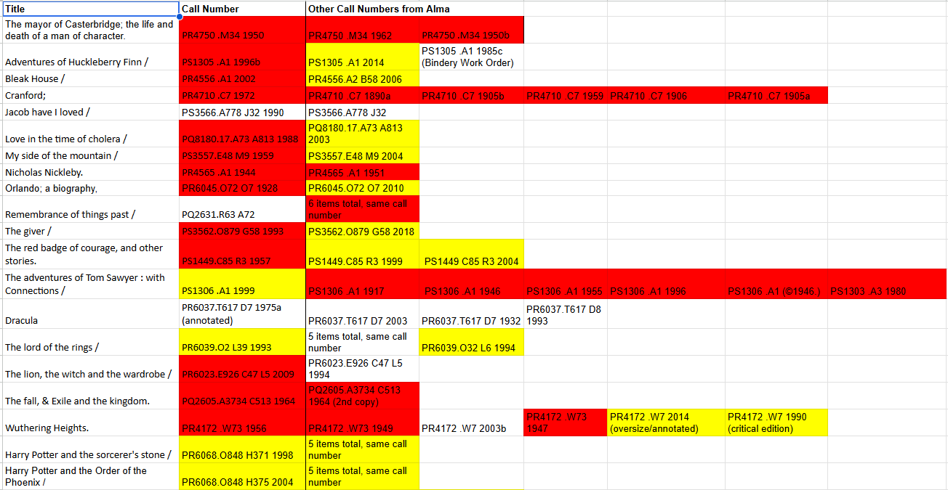
CROSS CHECKING THE CATALOG
CATALOG SURPRISES
  red= in catalog, but not found on shelf
  yellow=found on shelf

Slide 15

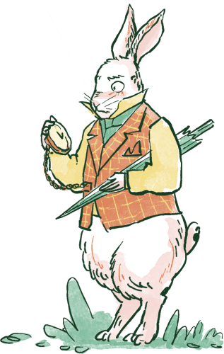
PART 4: WEEDING AND ACQUISITION STRATEGY

Slide 16
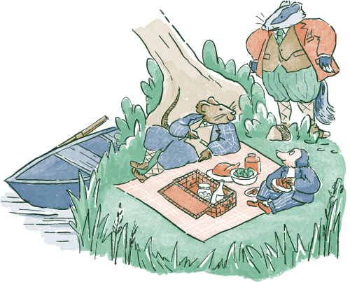
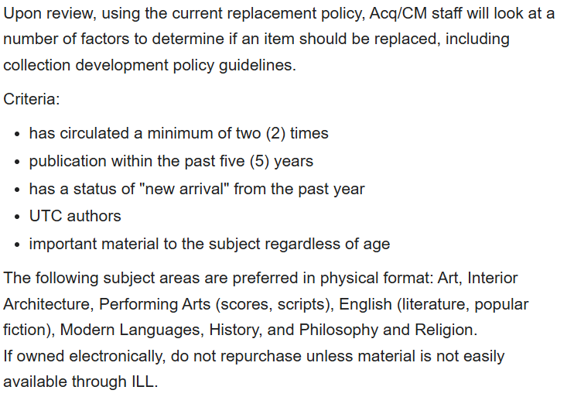
DEVELOPING WEEDING CRITERIA
and Replacement Policy
We looked at...
CONDITION
SUPERSEDED ED.
LOW CIRC

Slide 17
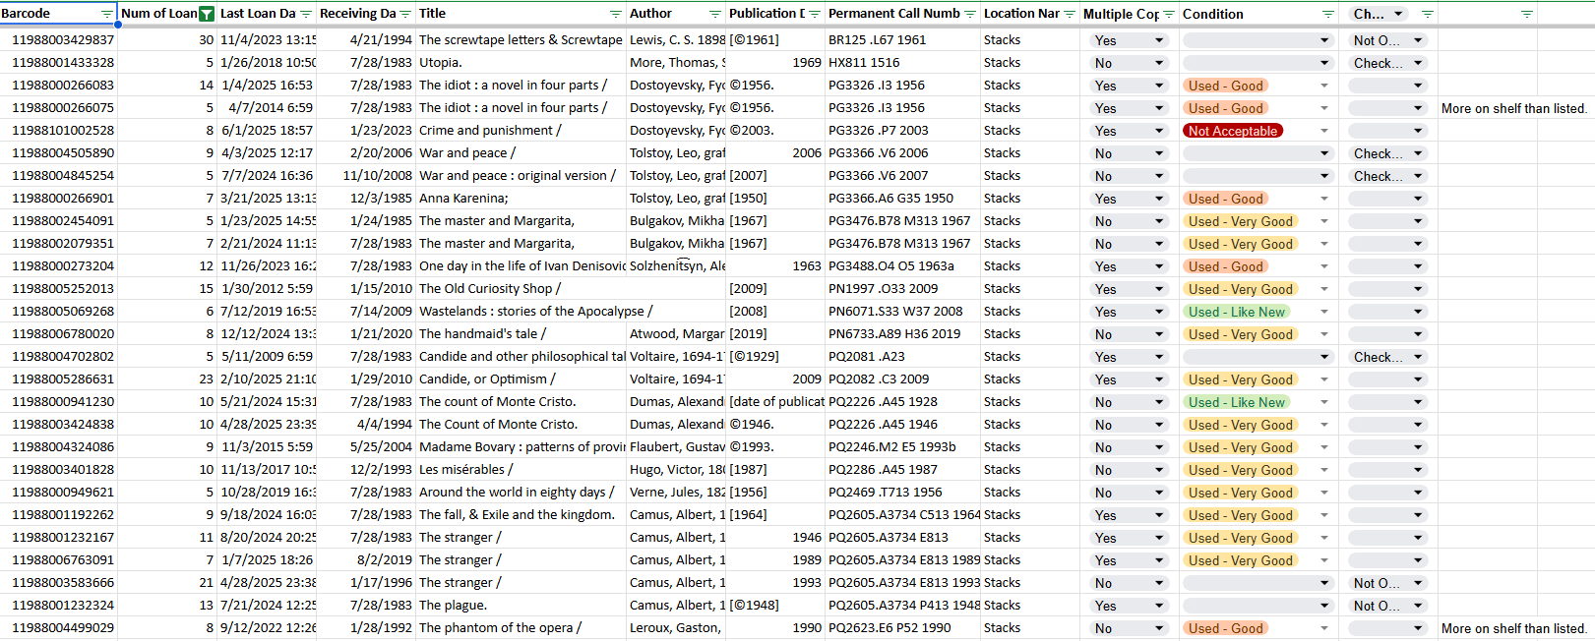
CROSS CHECKING THE CATALOG
CONDITION ASSESSMENT

Slide 18
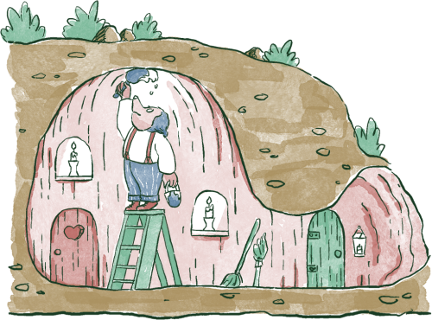
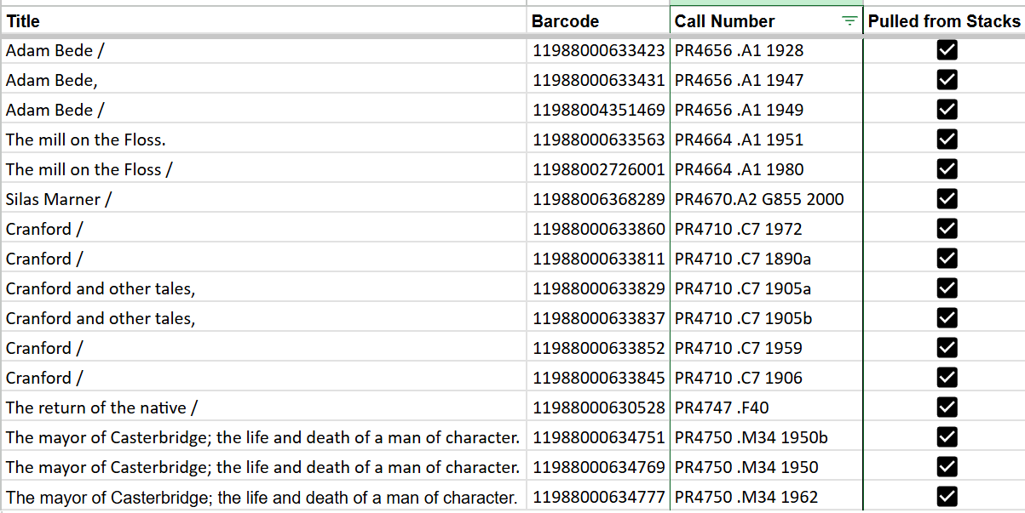
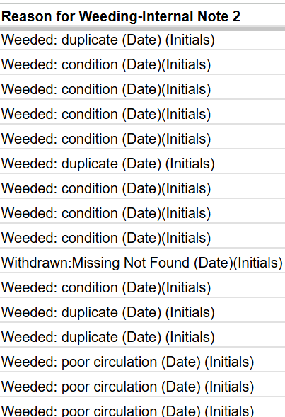
BATCH WEEDING
Cataloging approach when working at scale

Slide 19
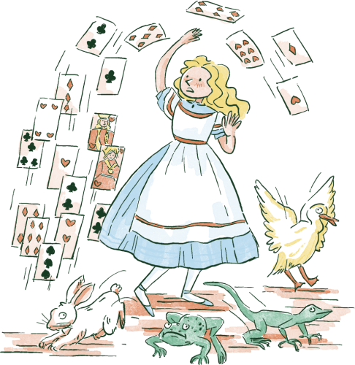
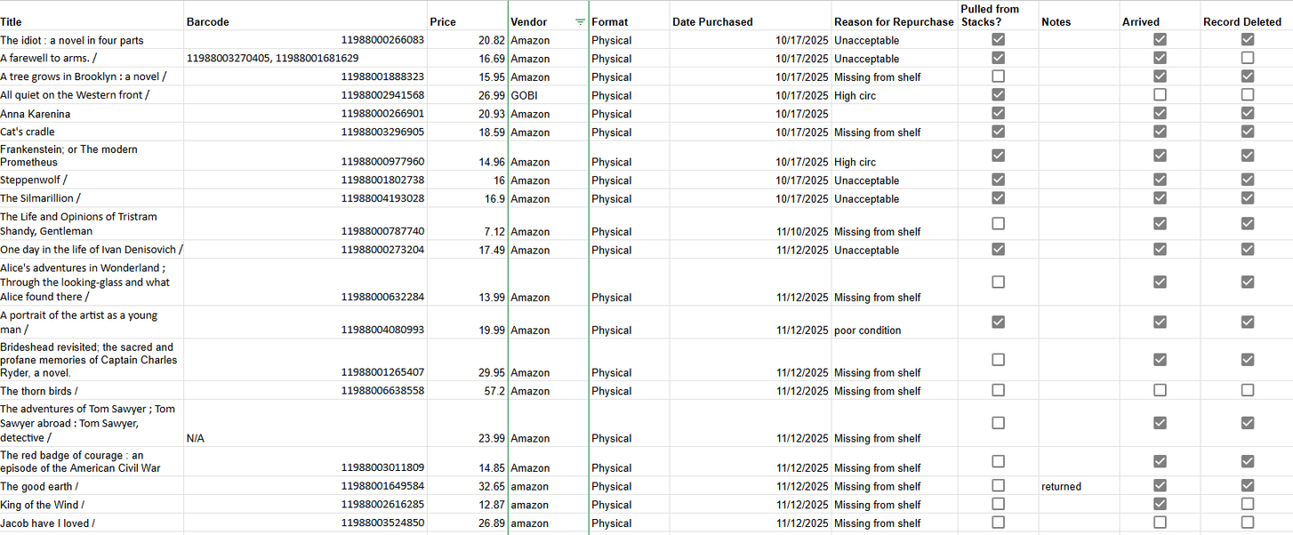
PURCHASING STRATEGY
Purchasing spreadsheet
ALLOCATED BUDGET
REPLACEMENT VS WEEDING

Slide 20

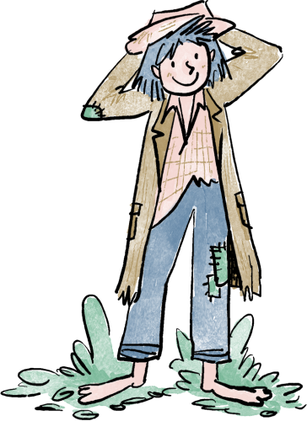
PART 5: IMPACT, ENGAGEMENT, OUTREACH, OH MY!

Slide 21

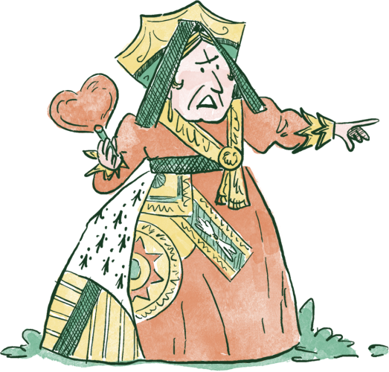
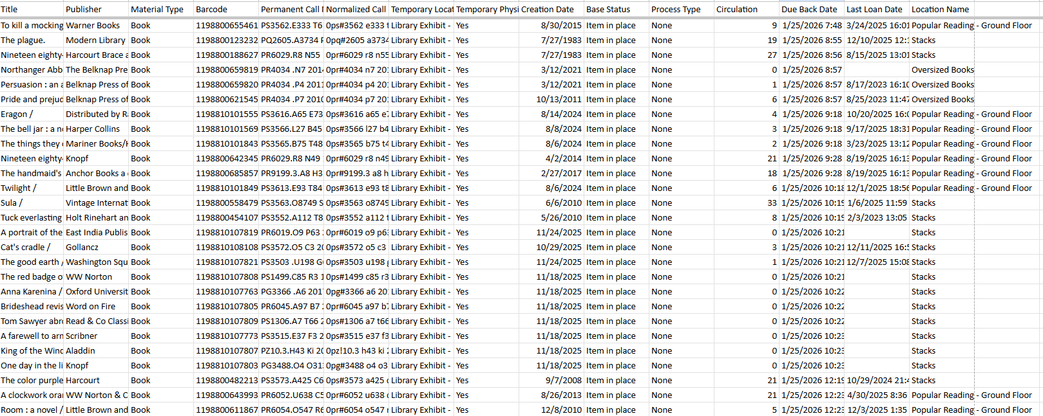
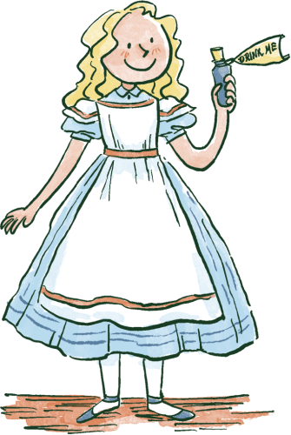
PHYSICAL EXHIBIT PULL LIST
  Pull list (pictured): 57 total physical books
  Circulation stats are a useful metric for collection assessment!

Slide 22
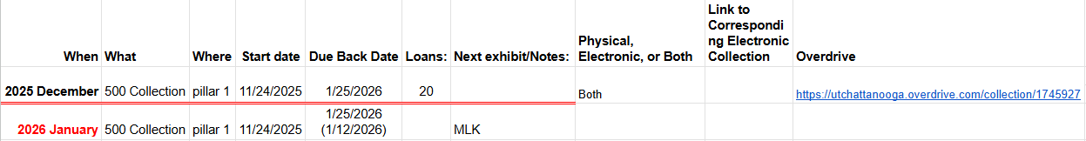
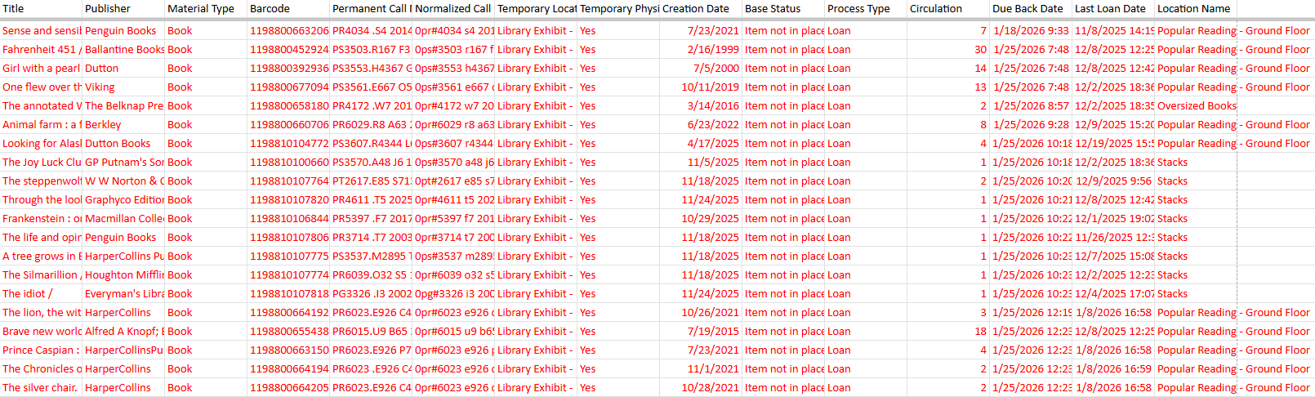
CIRCULATION STATISTICS
  Physical item check outs from 11/24/25-1/12/25

Slide 23
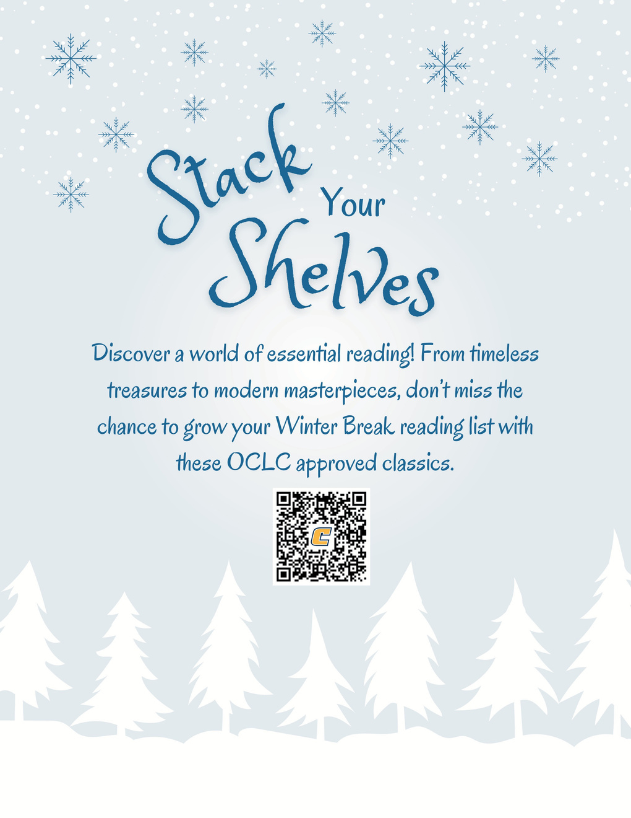
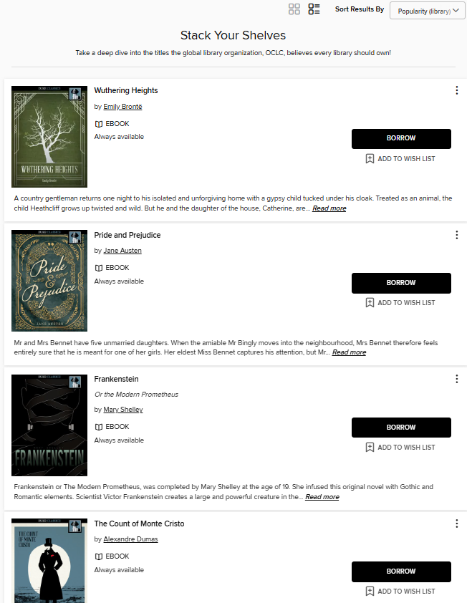
ONLINE EXHIBIT

Slide 24
IMMEDIATE OUTCOMES:
1
Cleared up shelf space by getting rid of duplicates and purchasing digital copies.
2
  Cleaned up catalog by following metadata standards for new items and updating records of older collection items.

Slide 25


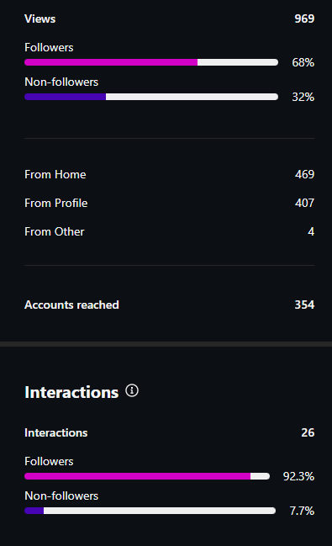
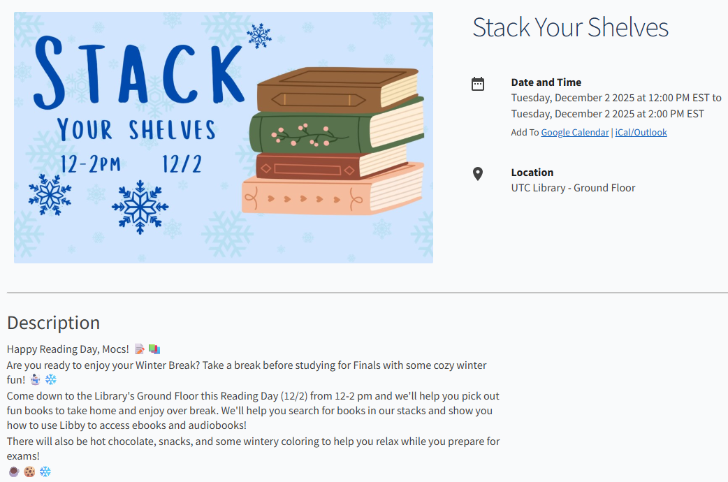
SOCIAL MEDIA POST
EVENTS CALENDAR
METRICS

Slide 26



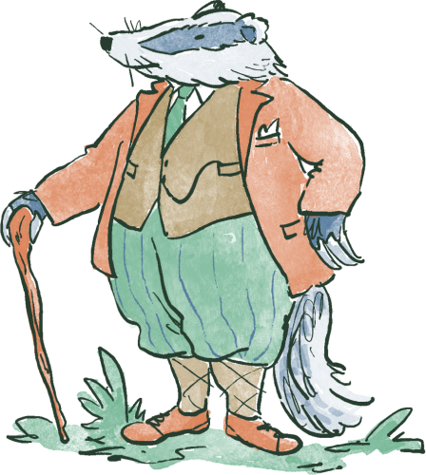
PART 6: KEY TAKEAWAYS

Slide 27
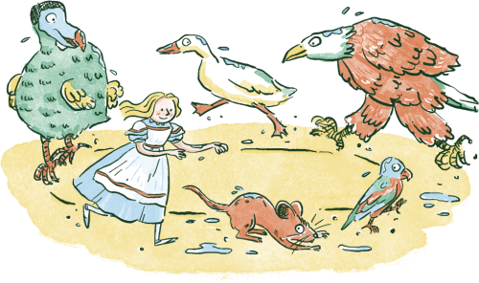
ADAPTING TO YOUR LIBRARY
Collection assessment follows an approach that is...
SCALABLE
ADAPTABLE
DATA-DRIVEN
  Choose benchmark list
  Define scope
  Designated display area
  Collaborative library-wide and interdepartmental approach
  Assign roles
  Create deliverables
  Patron feedback
  Programming, promotion, and outreach
  Track circulation data
  Communicate outcomes

Slide 28
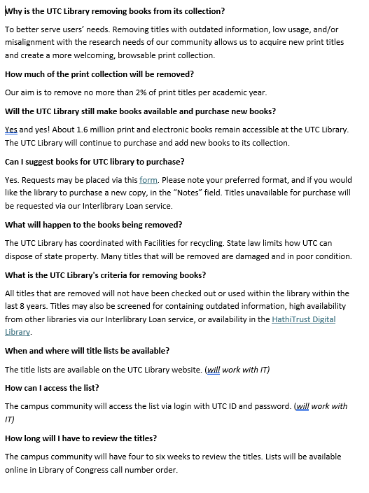
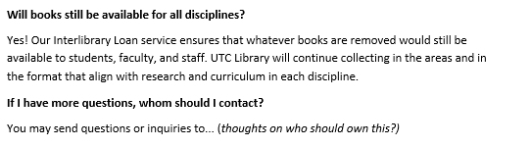
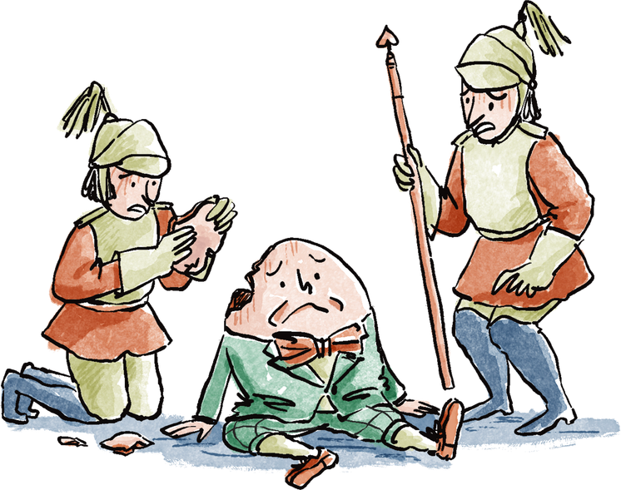
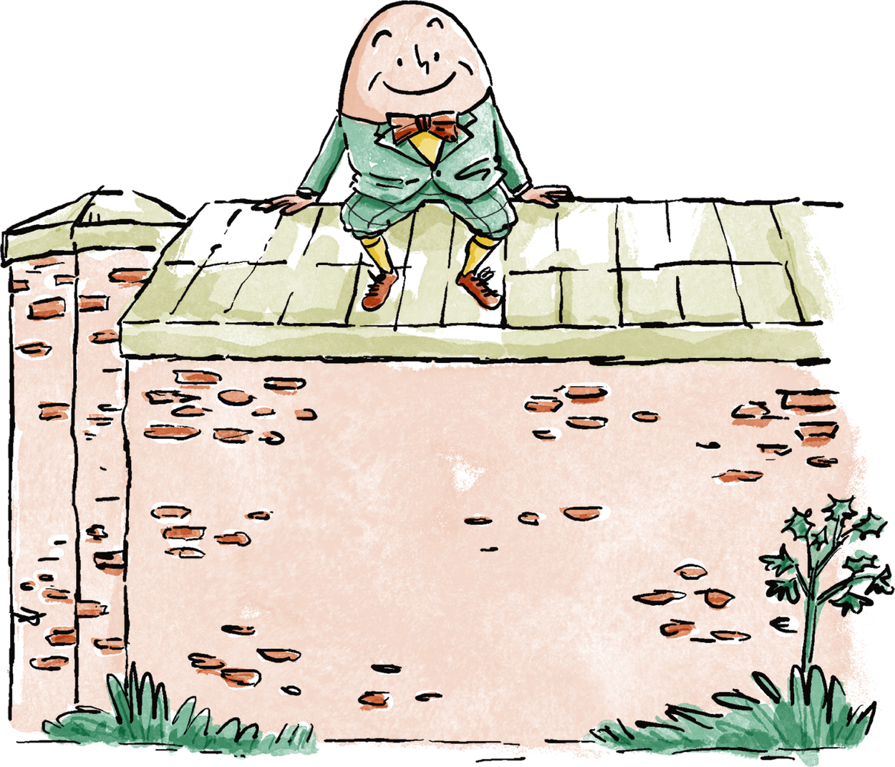

LESSONS LEARNED - COMMUNICATION

Slide 29
REFLECTIONS
  Assessment work is not just weeding
  Project management workflows moving forward--documentation is key
  Stories connect collections to communities!

Slide 30
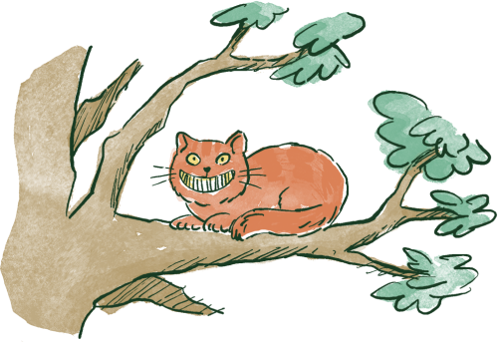
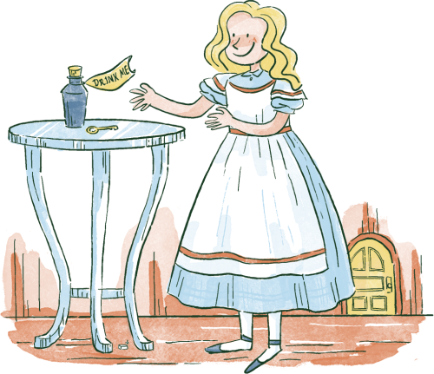
  Thanks for listening to our story!
Samantha Freeman
  email: samantha-b-freeman@utc.edu
Keani King
  email: keani-king@utc.edu

