Slide 1



Hosting a Pokémon club at your library
Kimberlee Byrge & Kelsie Herrell
Norris Community Library

Slide 2

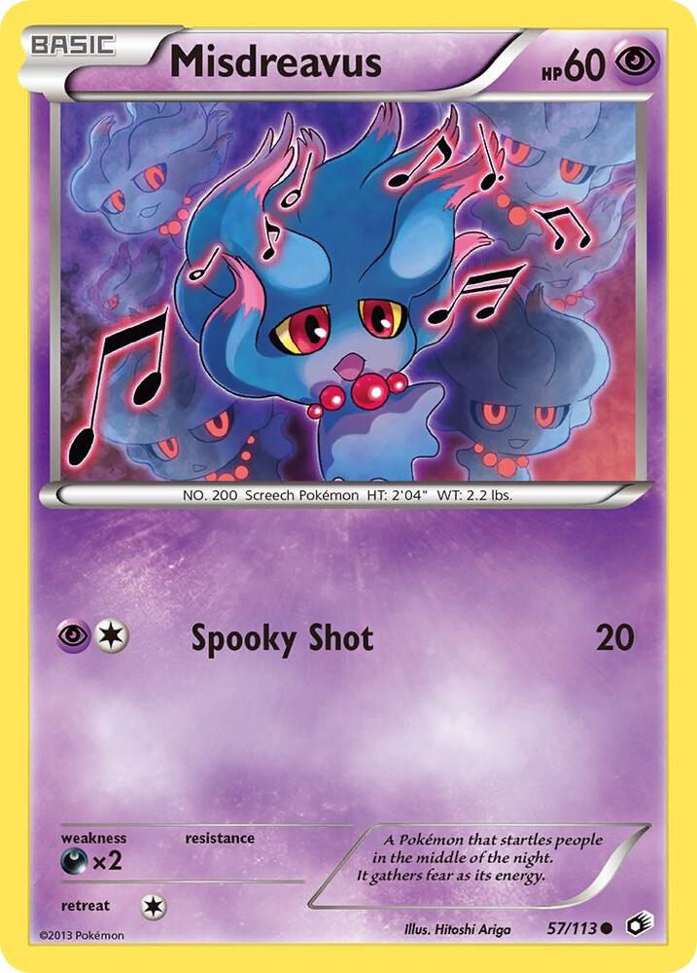
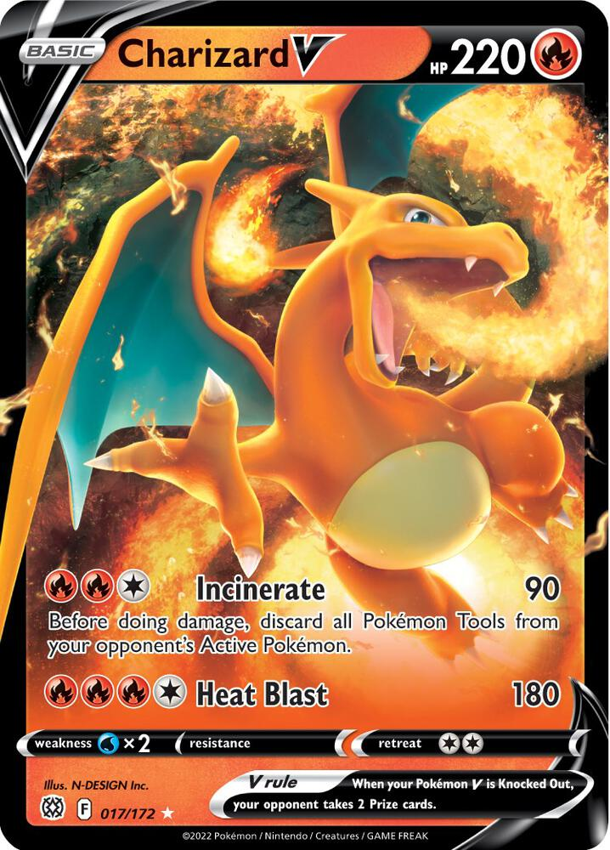
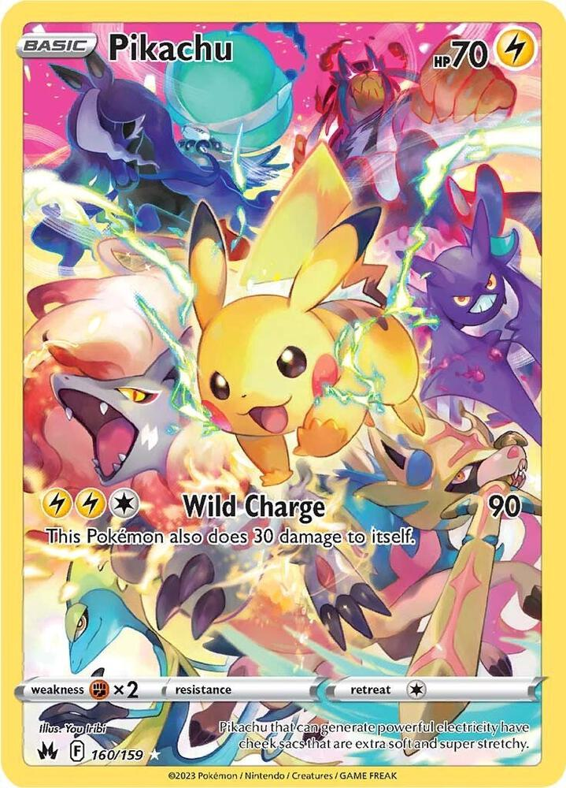
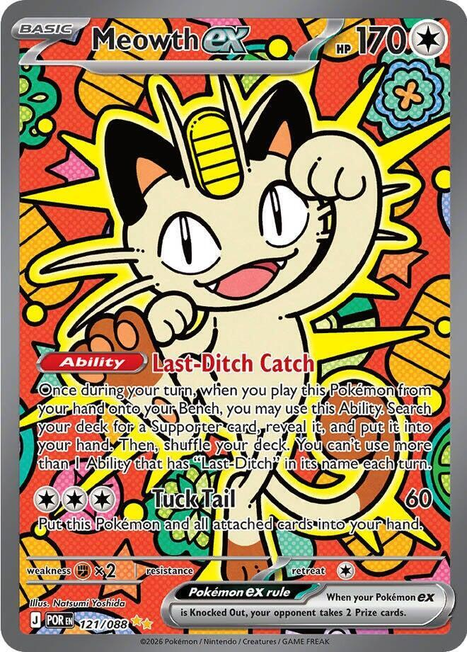

Getting Started:
What is Pokémon?
Convincing your boss
Develops negotiation/bartering skills
Provides a safe space to engage in the hobby in a frequently financially predatory market
Kids are excited for it
Determining your schedule

Slide 3


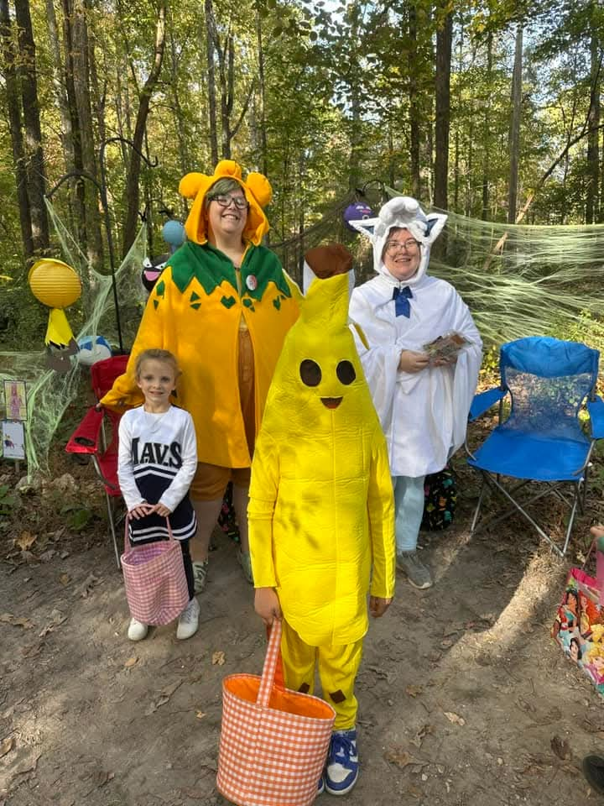
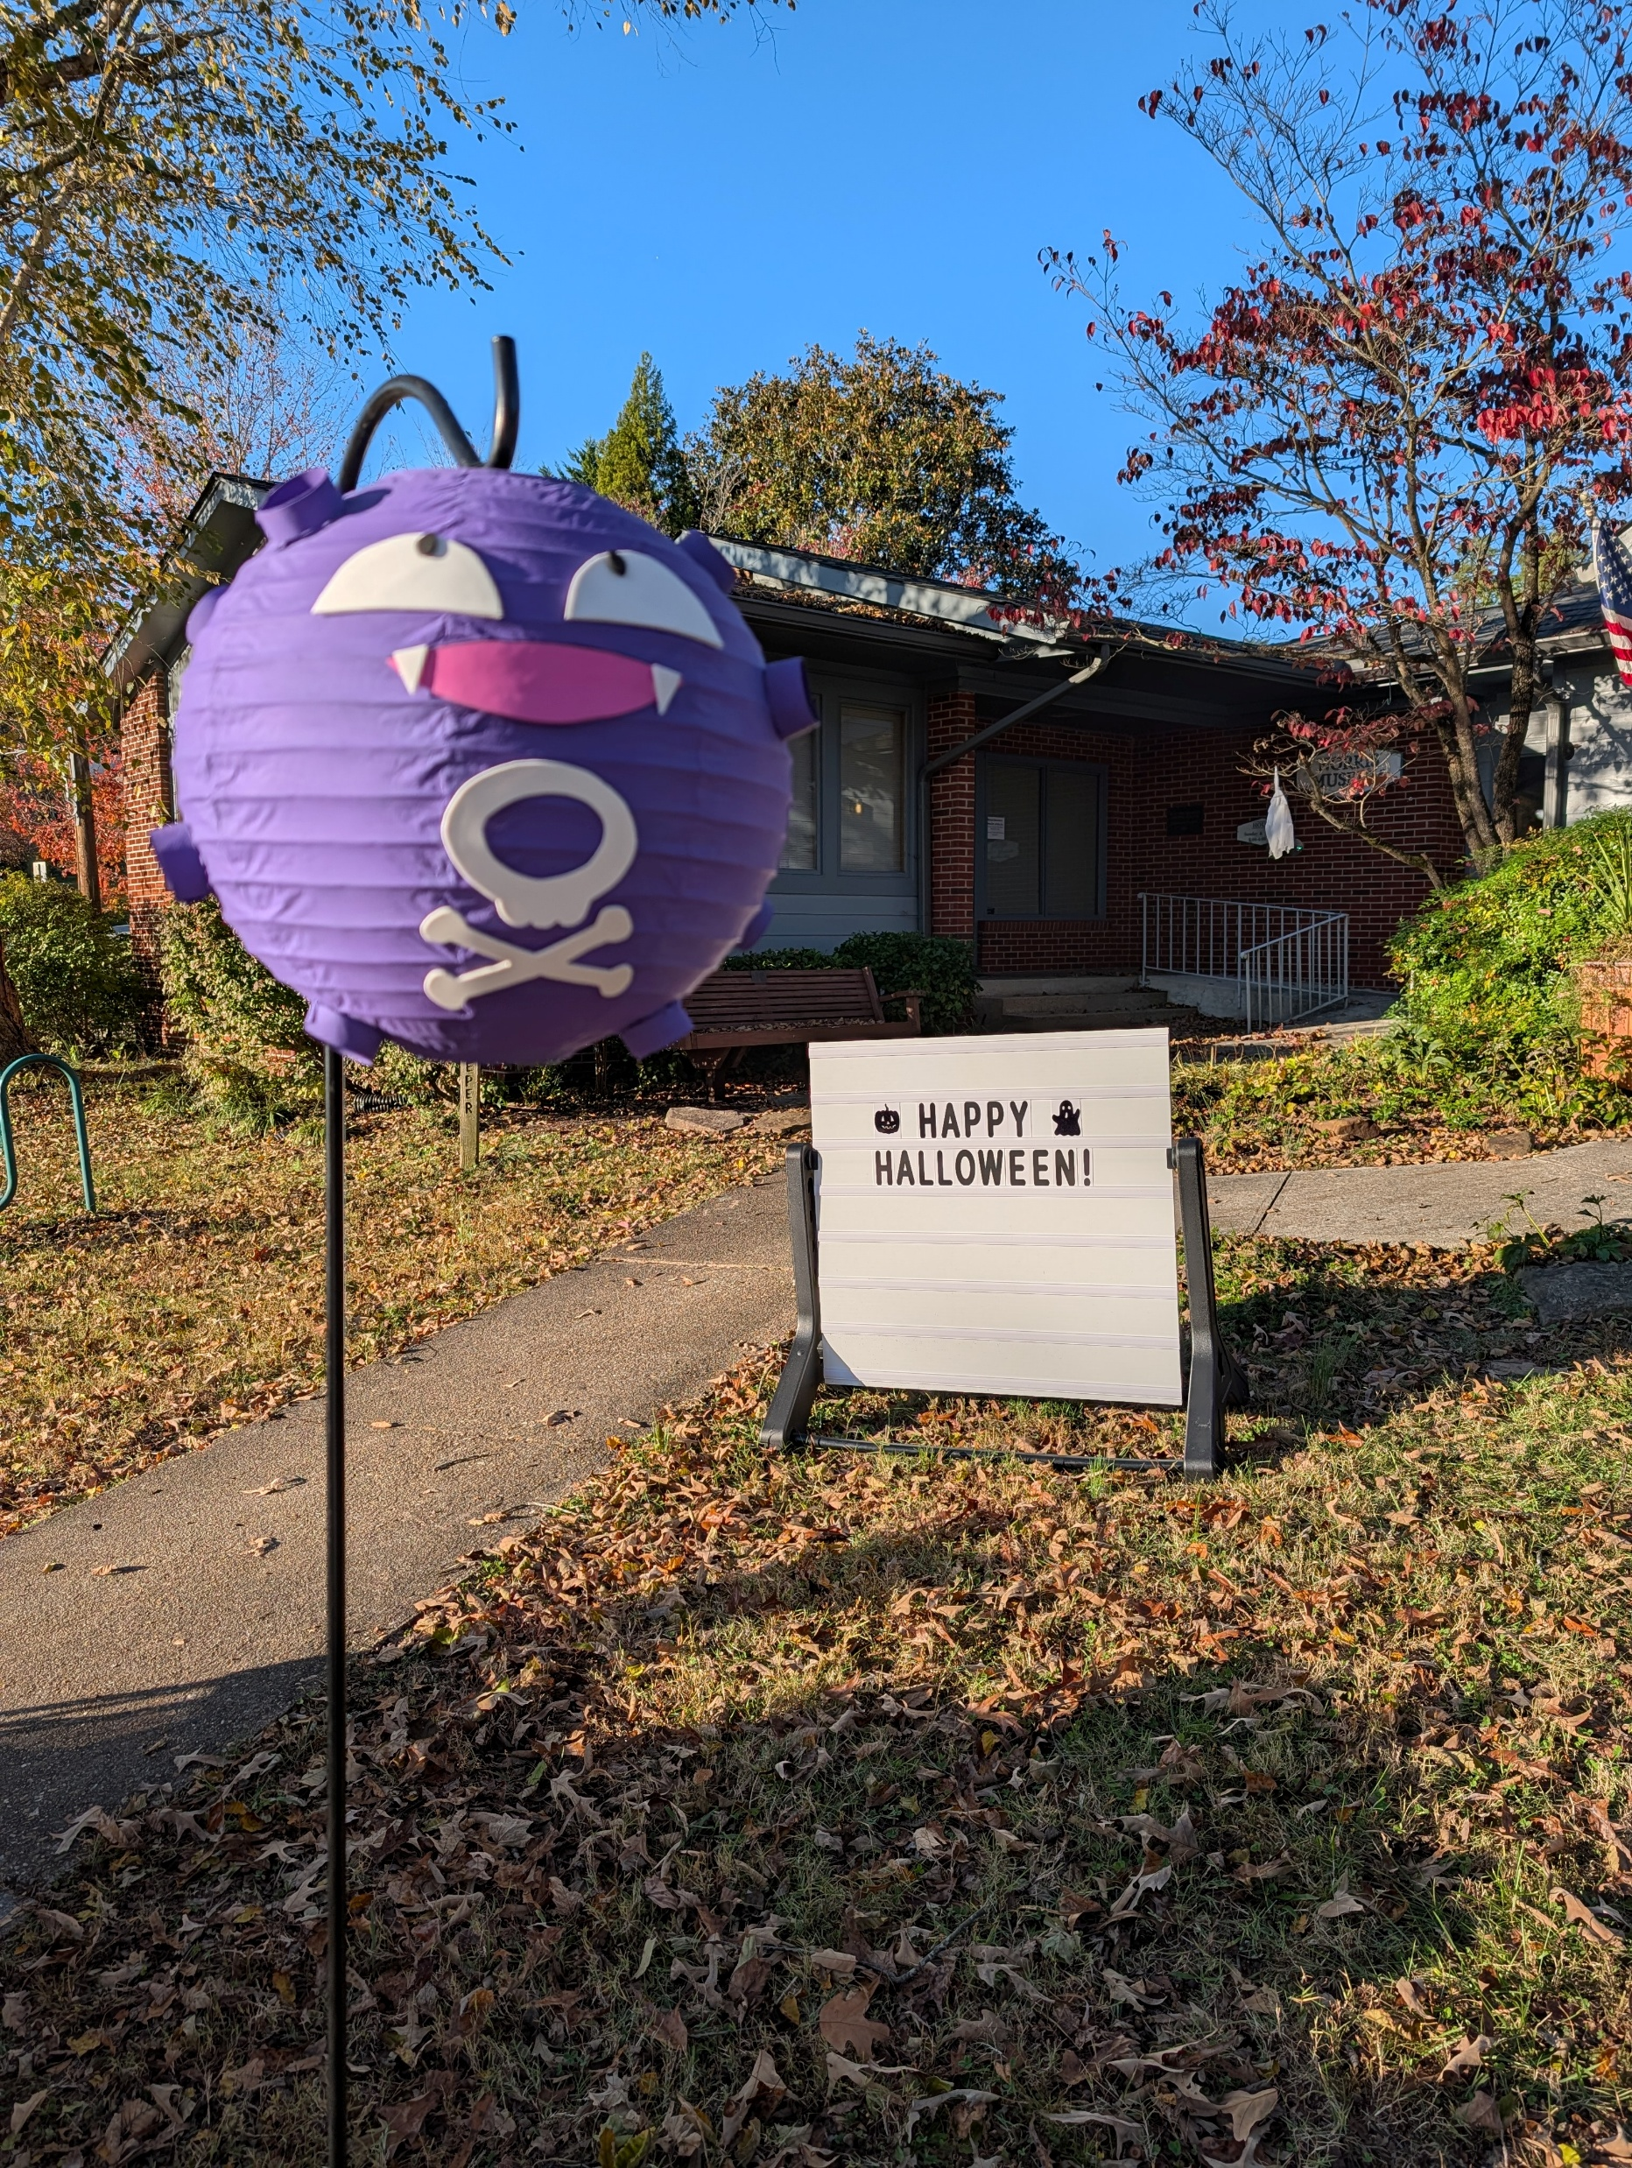
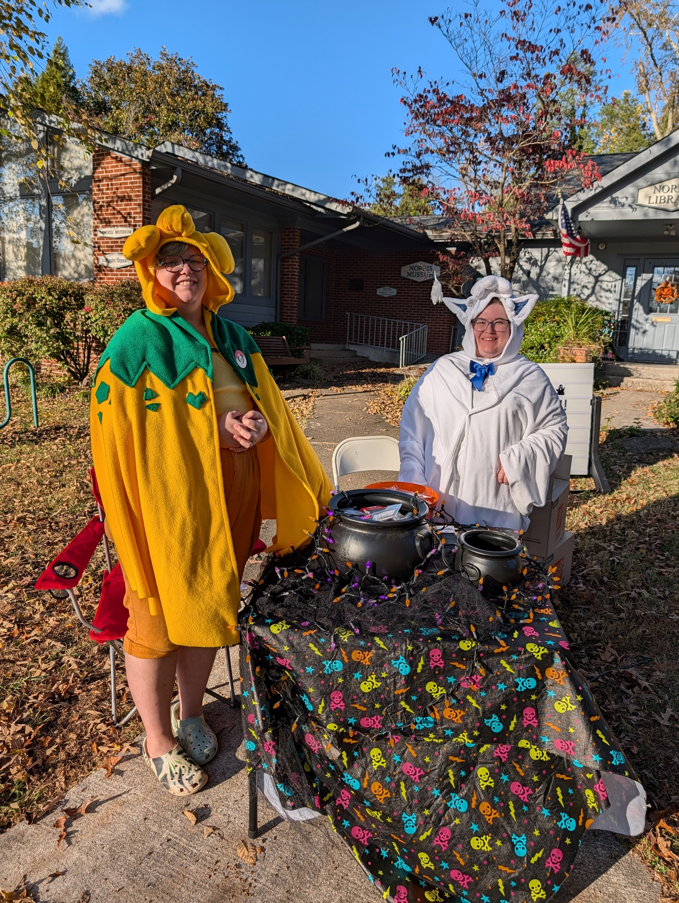
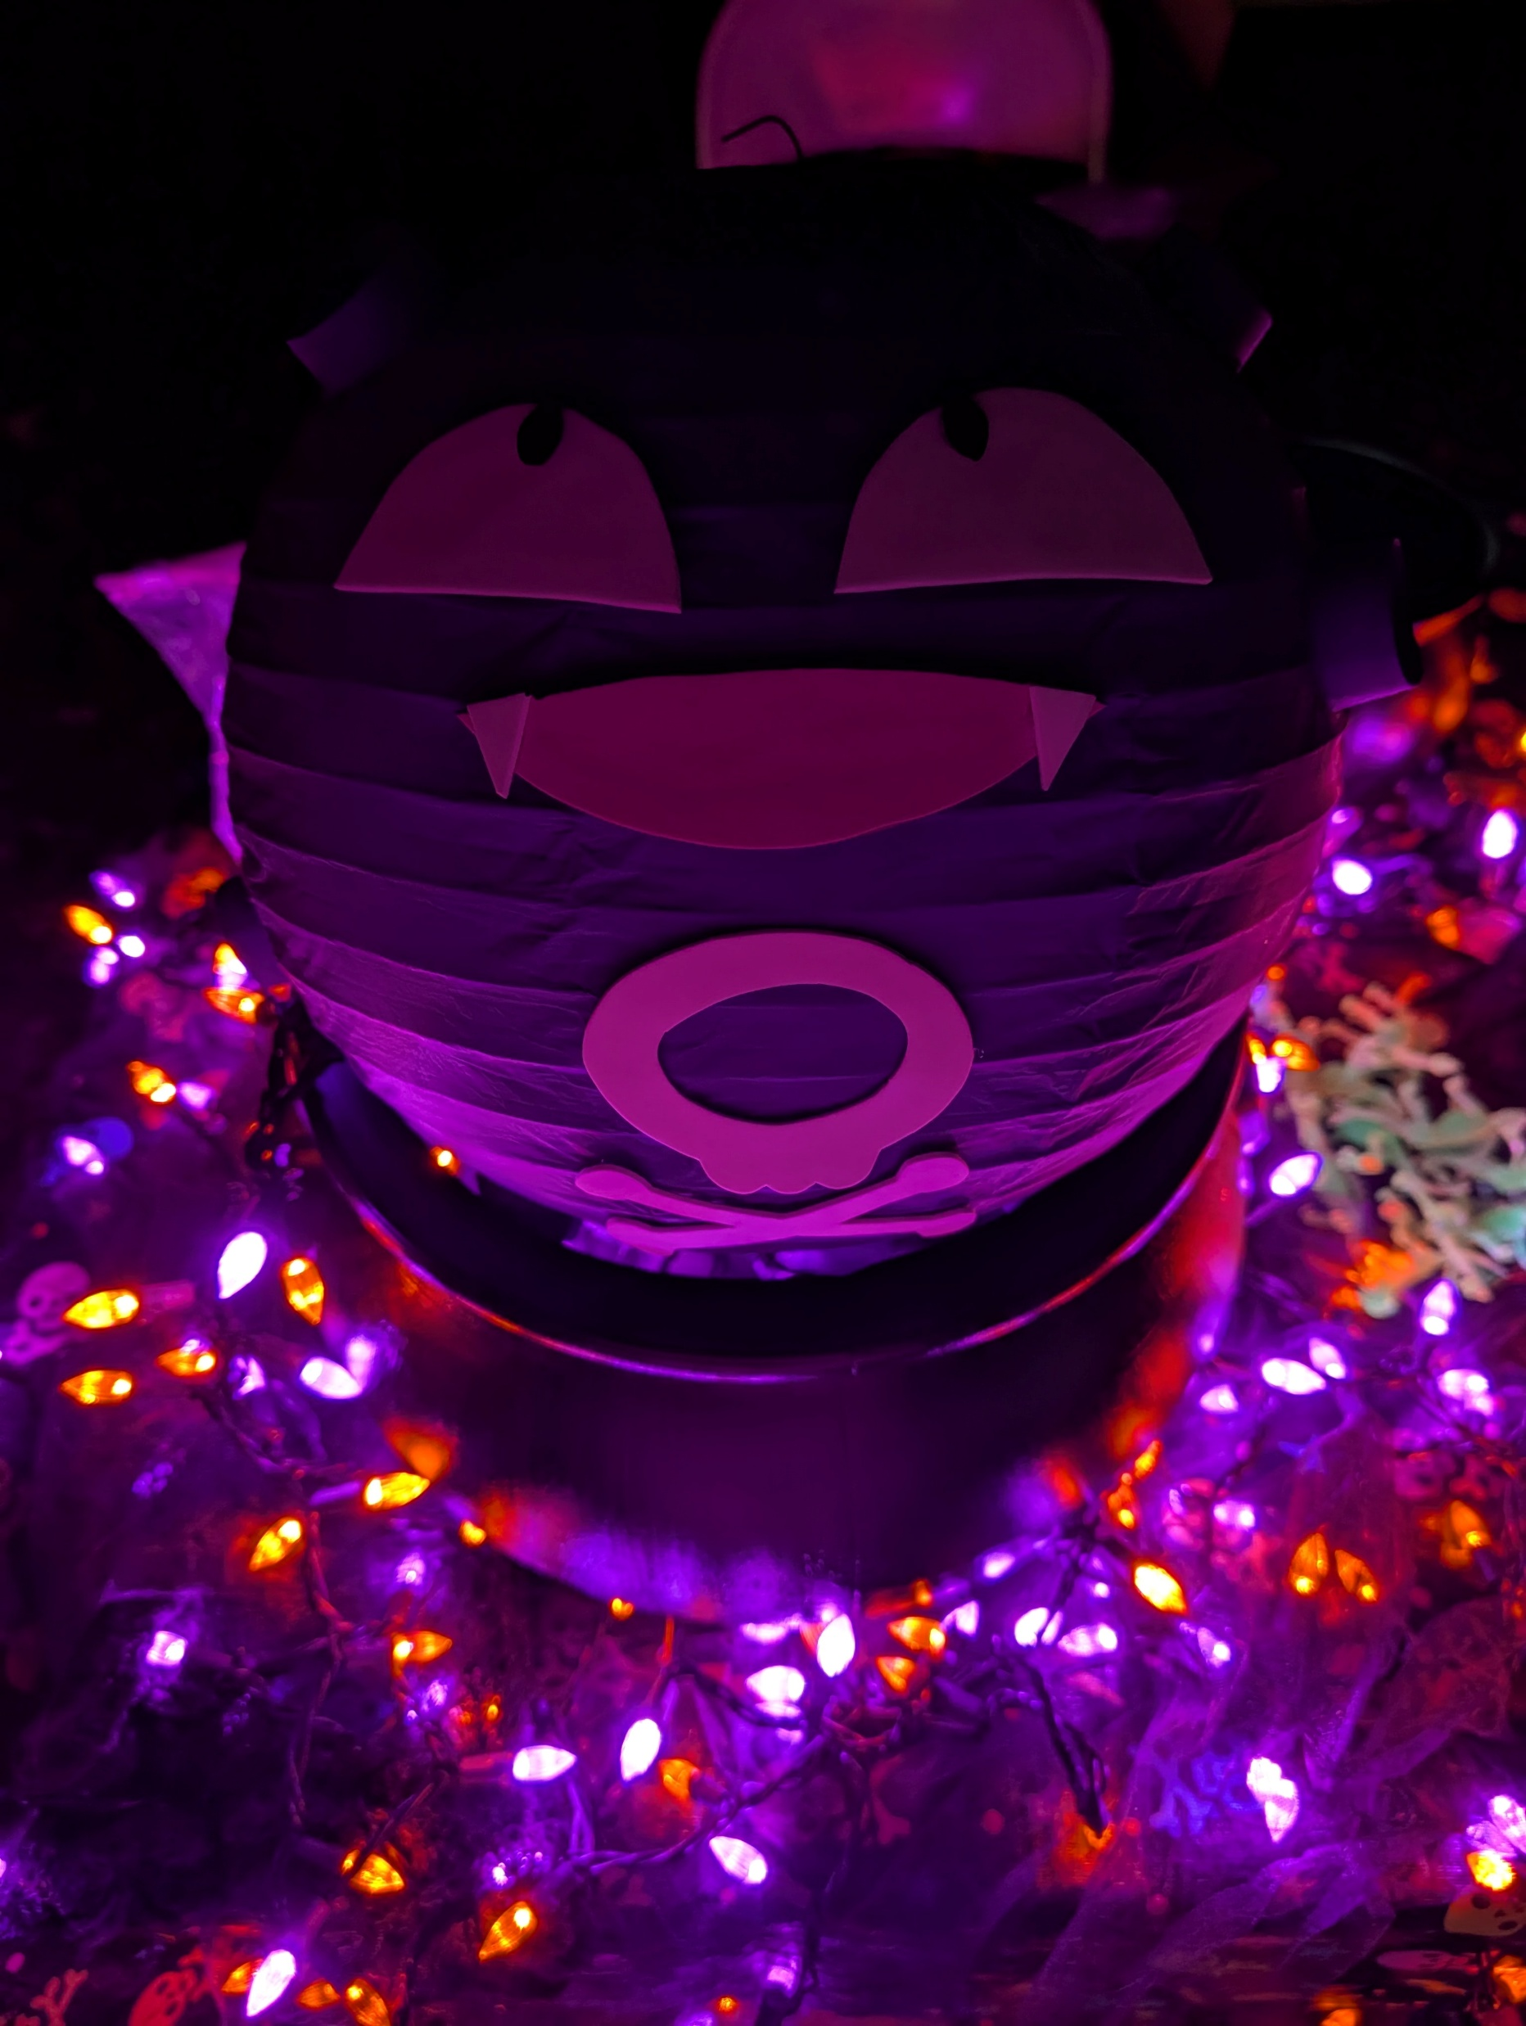
Promotion:
Notes:
We started program Aug 2024, since then we’ve had 625 total participants.

Slide 4
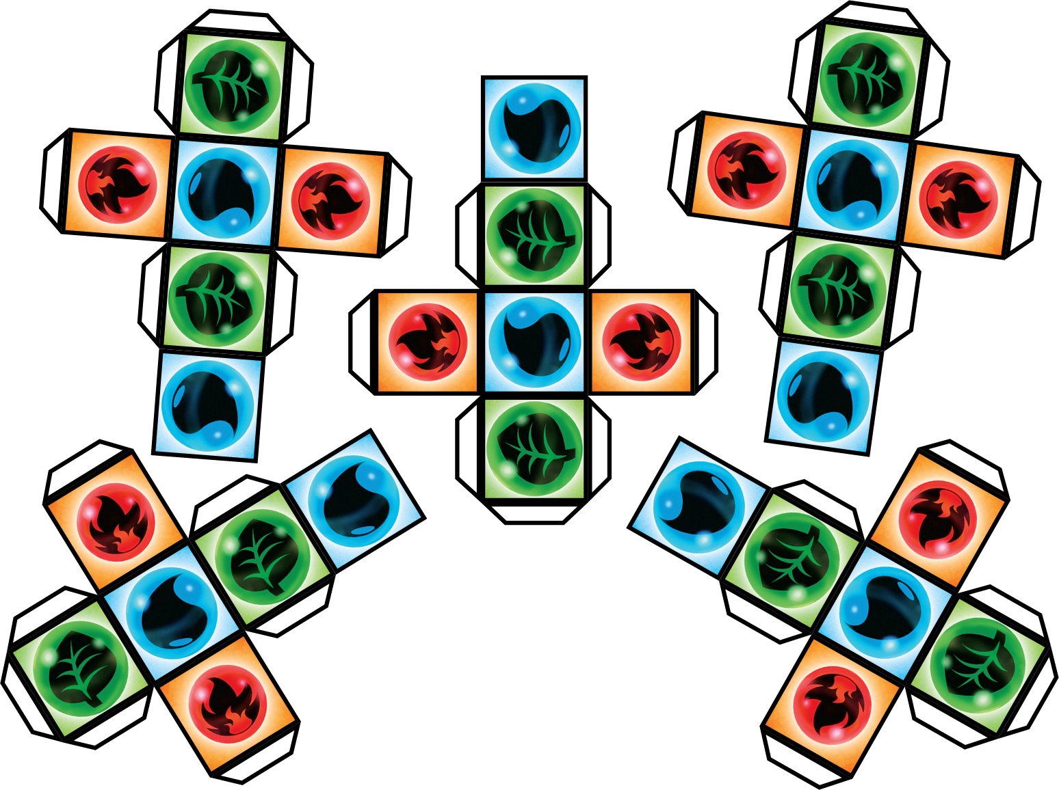
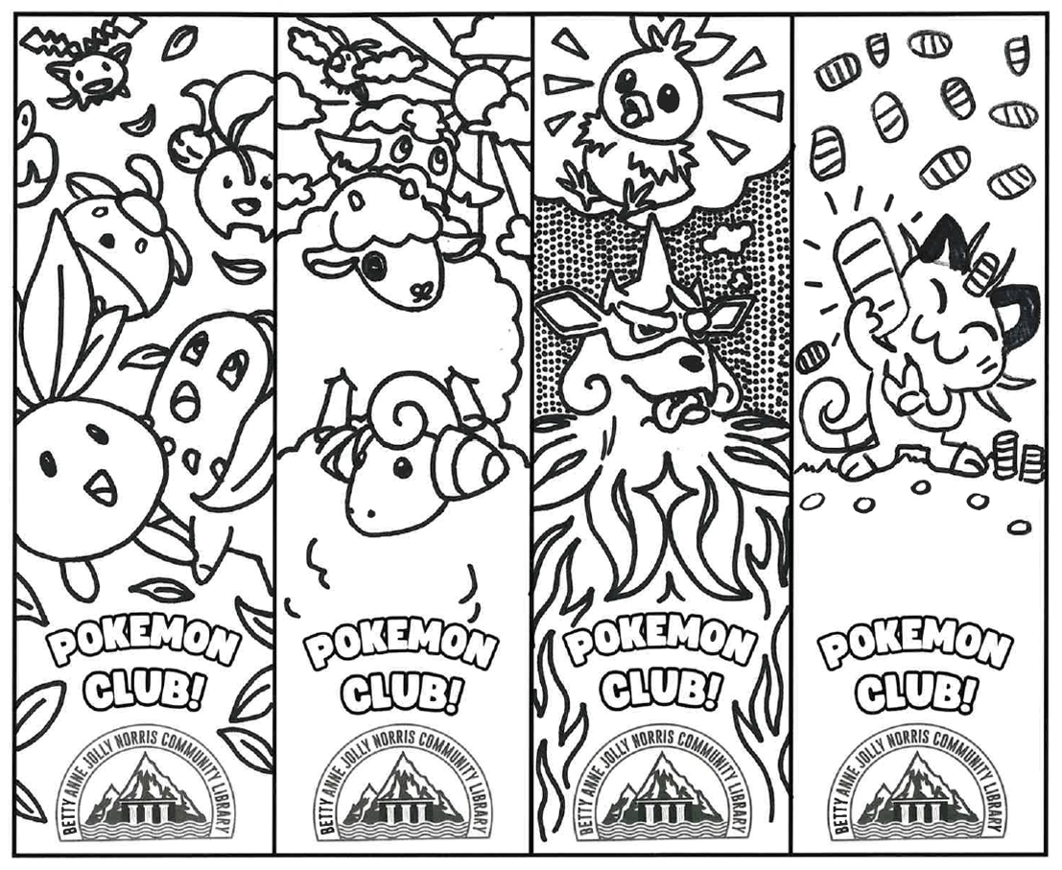
Program
Activities:
Trading cards
TCG tournaments
Pokémon popularity contests
Design your own card
Arts & crafts
Catch a wild Ditto
Badge battles
Memory
Trivia
Pokémon Academy

Slide 5

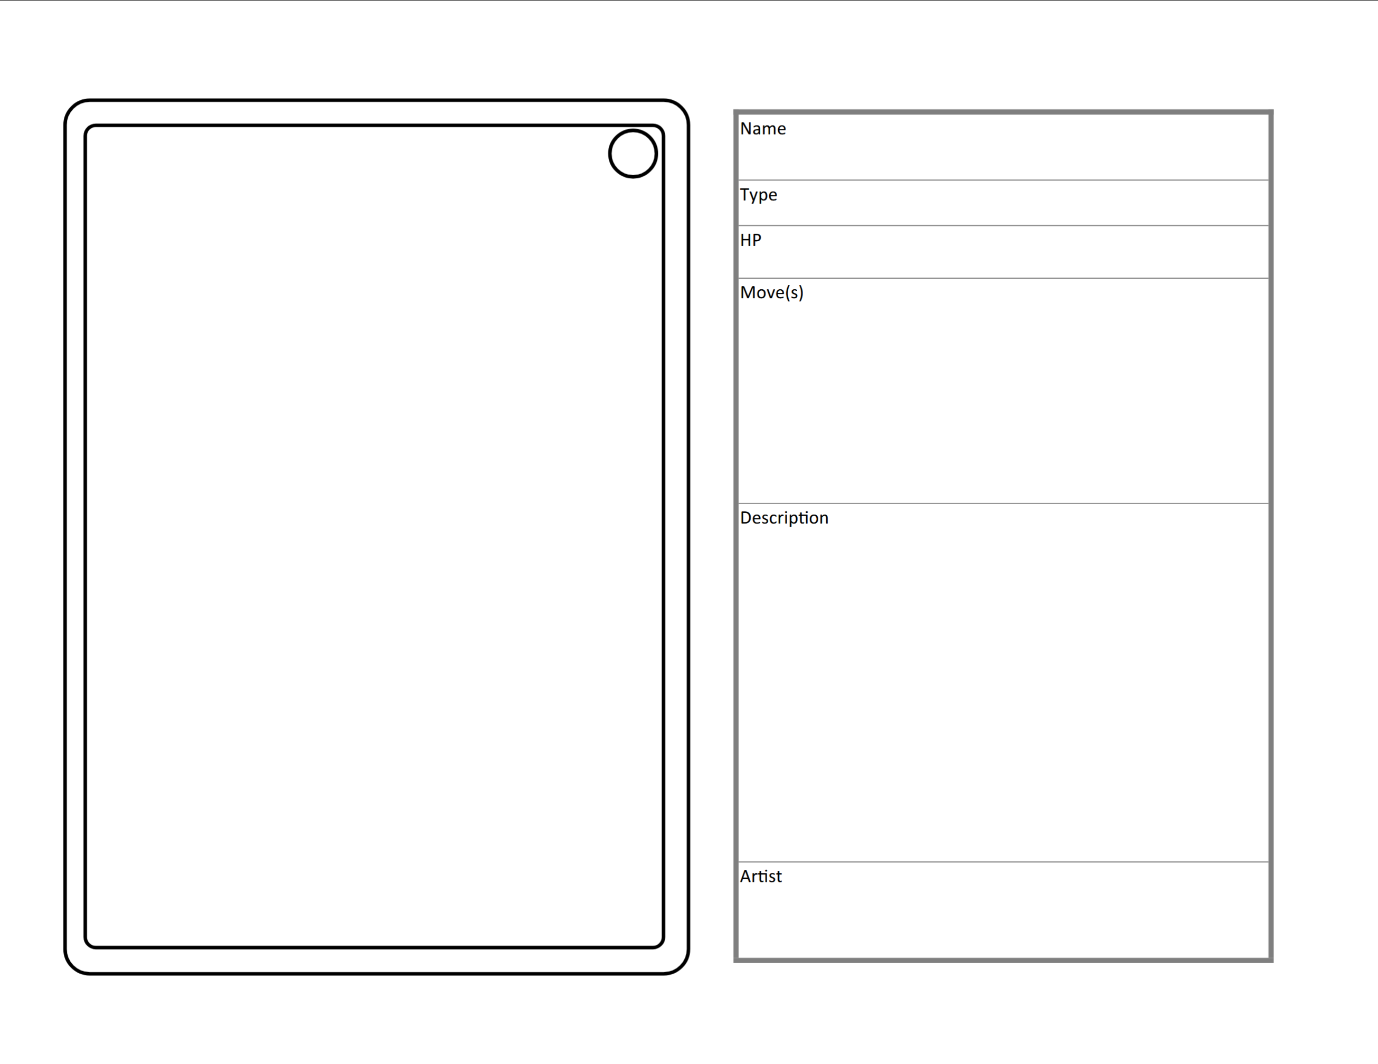
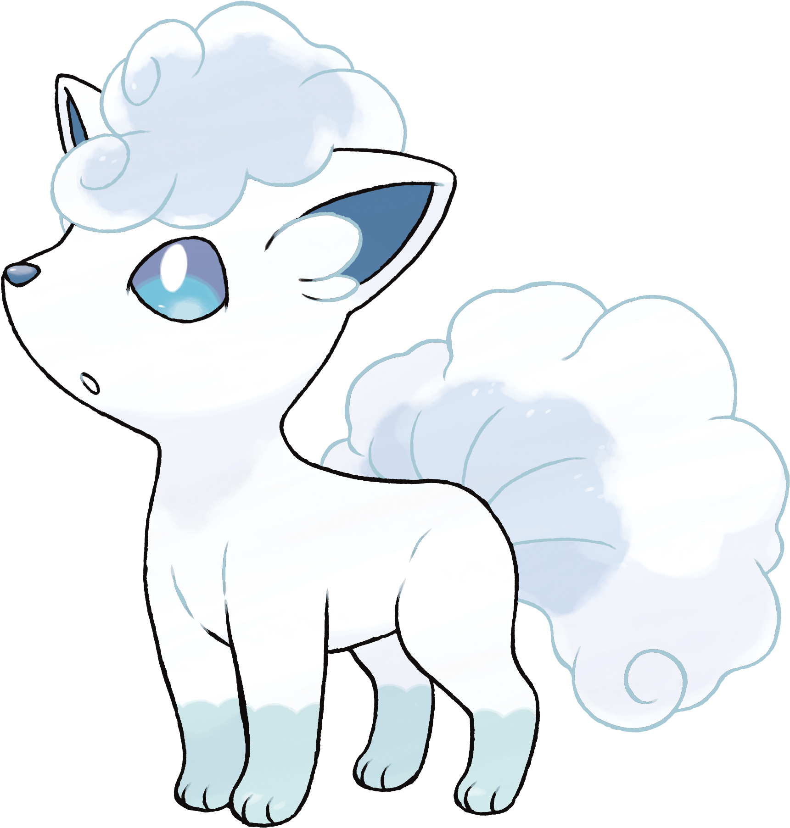

Slide 6


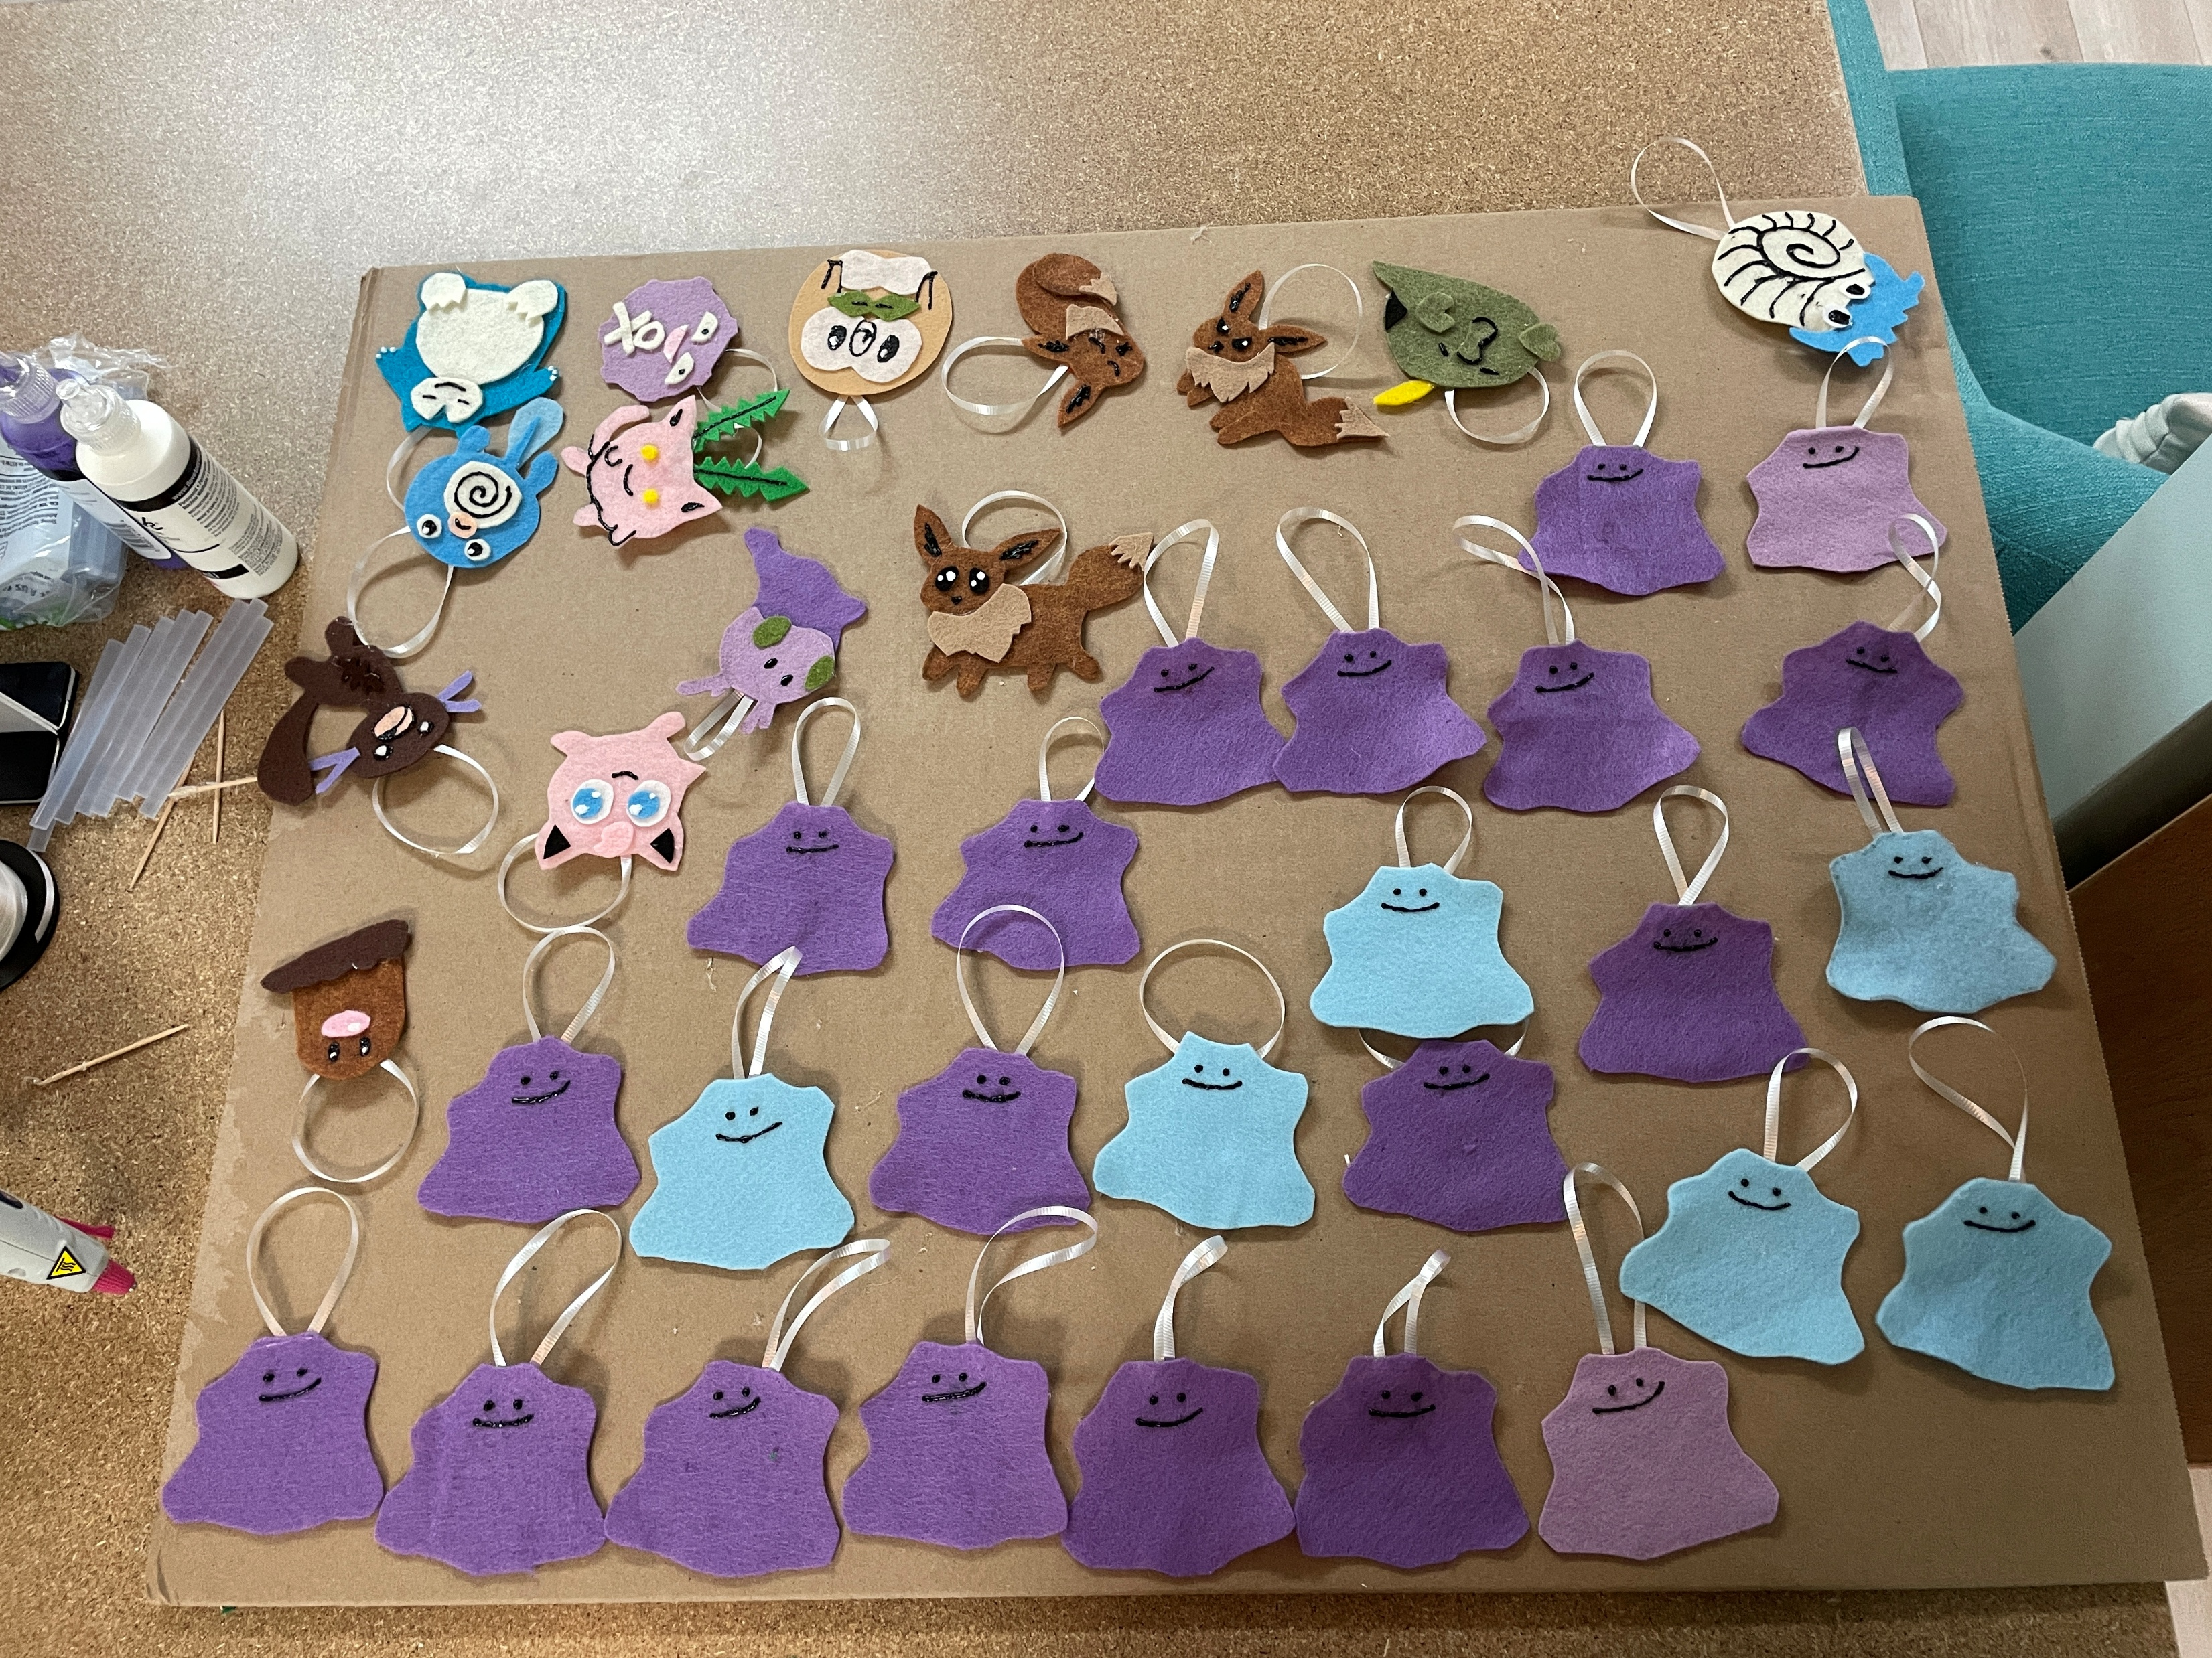
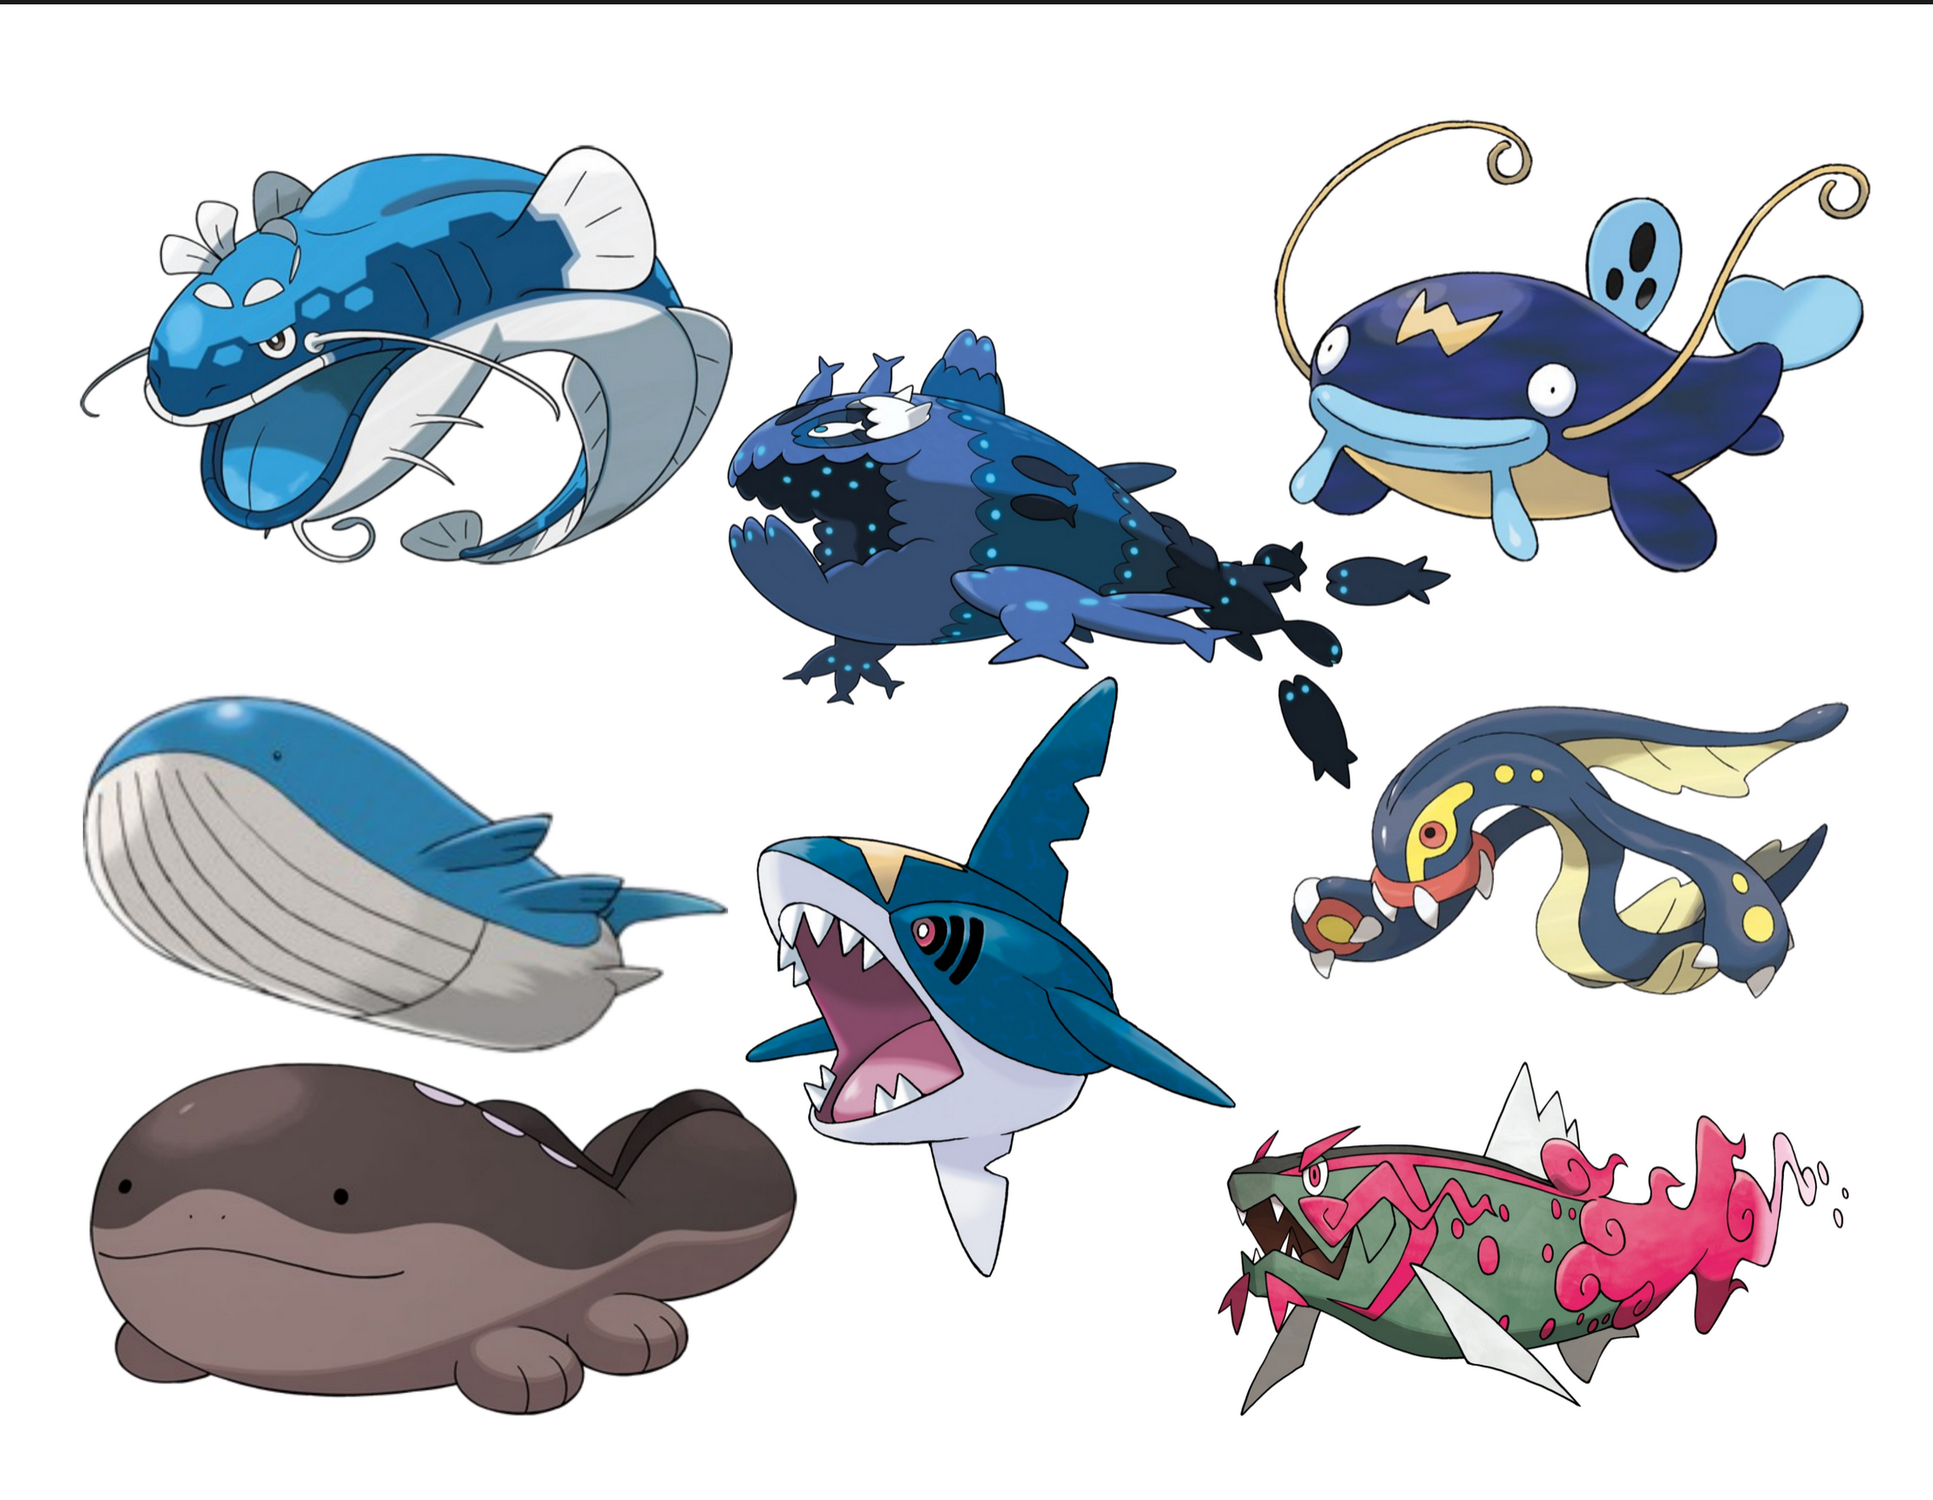

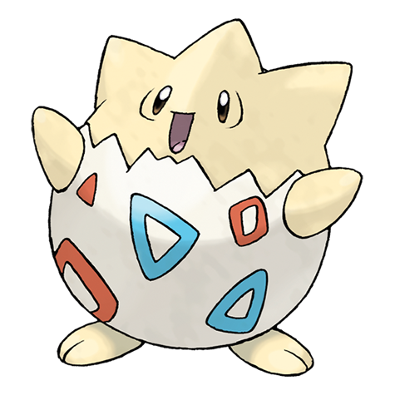

Program
Activities:

Slide 7
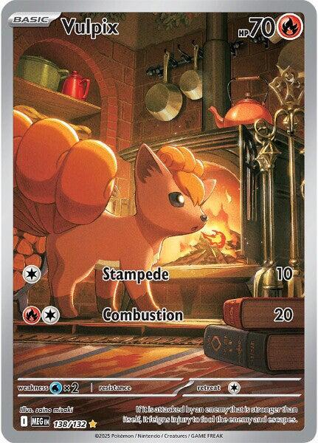
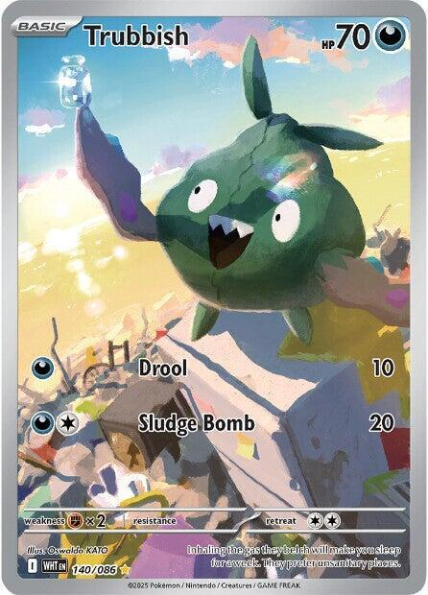
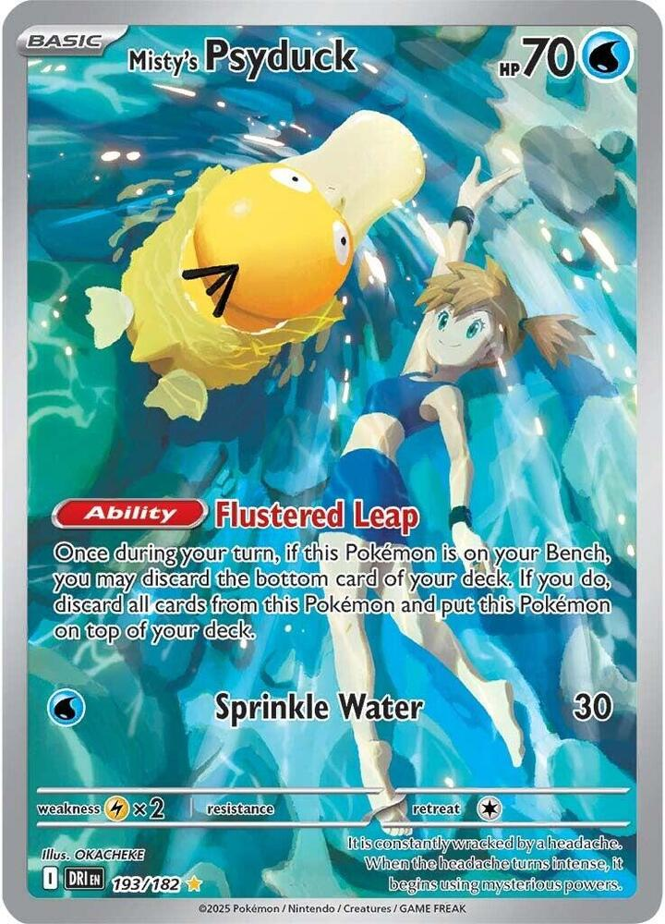
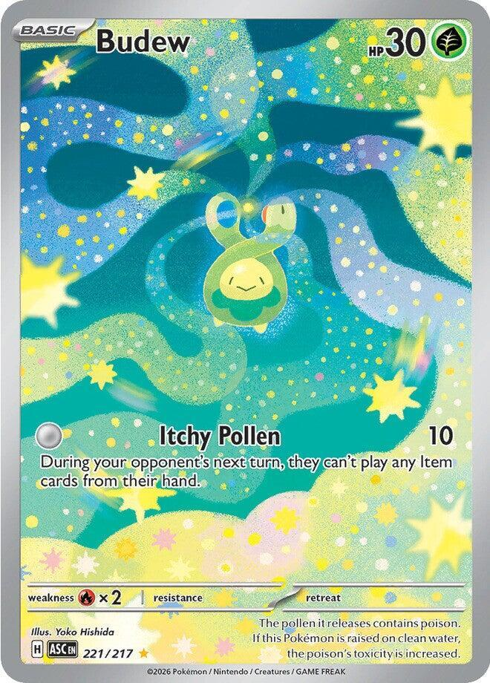
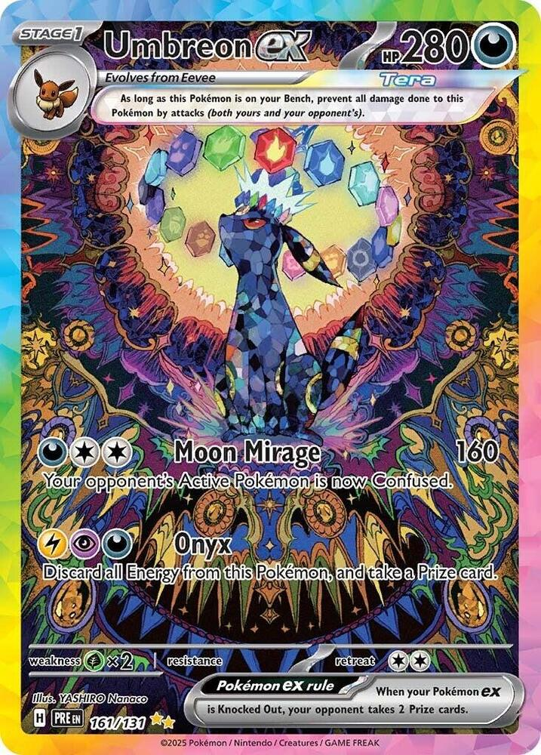
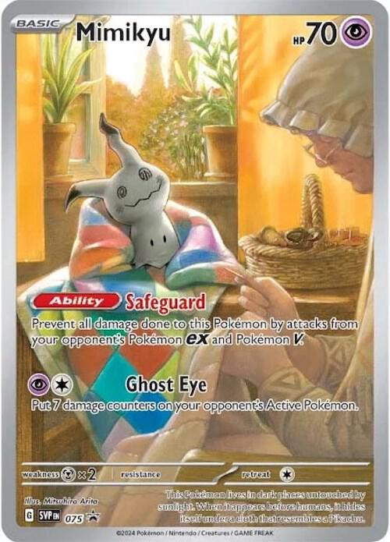
Trading Tcg:
All trades are reversible
Kids must initiate trades
Trading for any cards “worth monetary value” should be monitored by staff
Nobody should feel pressured to trade
Fake cards can be traded if both parties know they are fake.
Everyone must keep track of their belongings
Guardians must be aware that trading happens at Pokémon Club

Slide 8
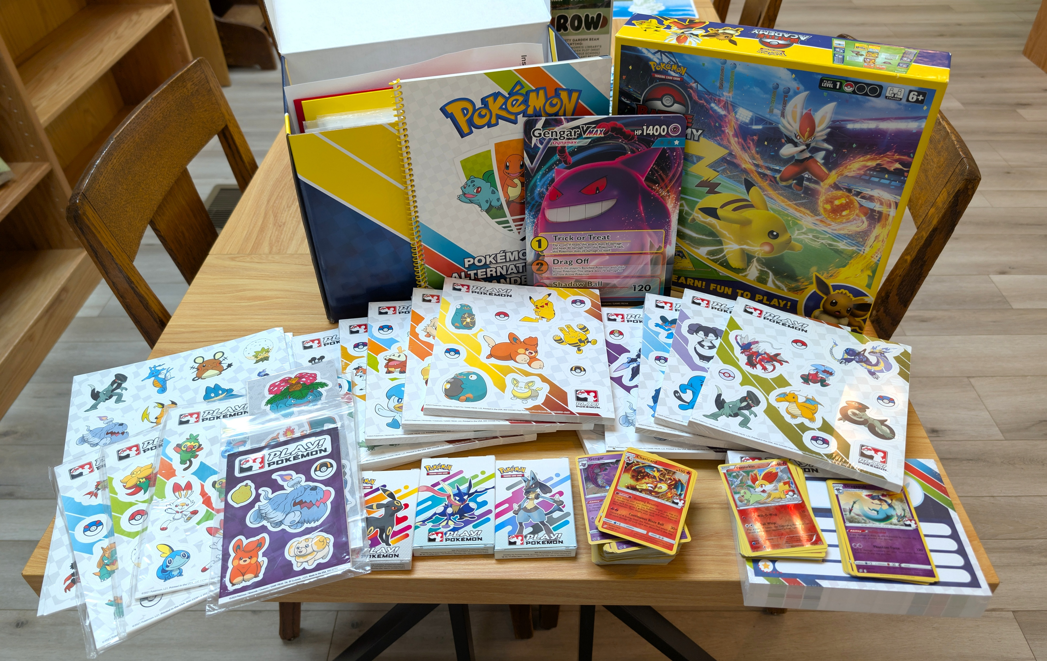

ALA Partnership:
ala.org/pokemon
Must be a member of ALA to participate
Pokémon professor
Copyright

Slide 9

Resources:
Pokémon.com: Official website, expansion lists/release dates, free printable activities, streaming locations
Bulbapedia: for general Pokémon information and image sources
Pokémon Database: Pokémon sprites
Pokécard Generator: Make your own Pokémon cards for free
Serebii.net: Images and Pokémon cards (full lists)
Tcgplayer.com: A card marketplace good for checking the current value of a card

Slide 10


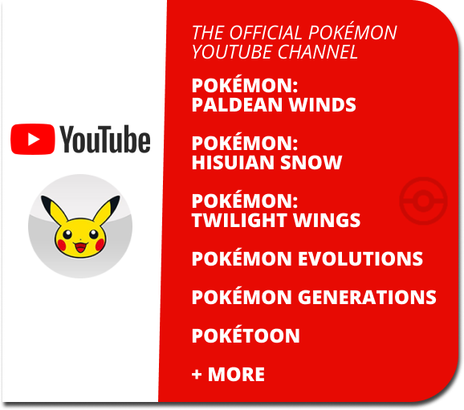
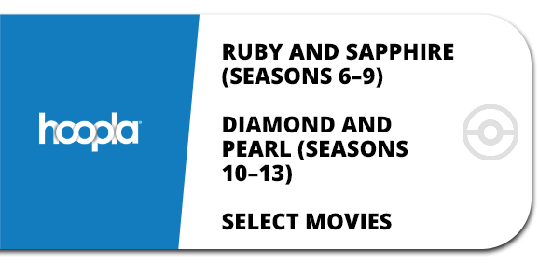
Resources:

Slide 11
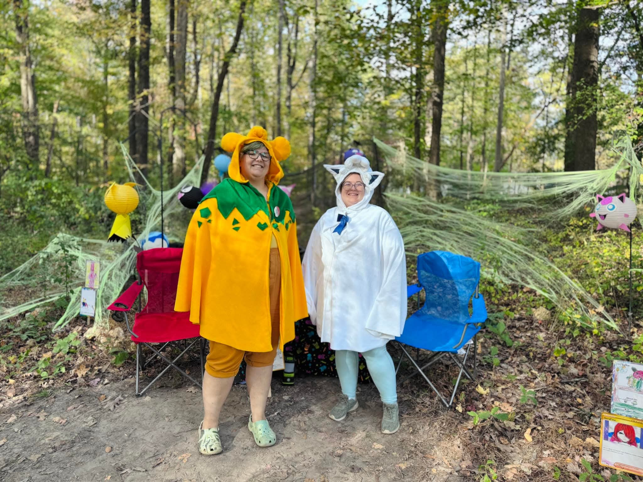
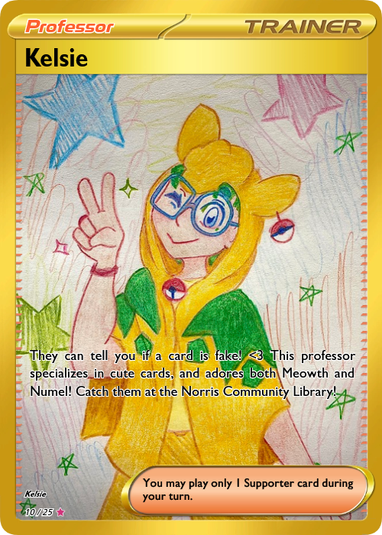
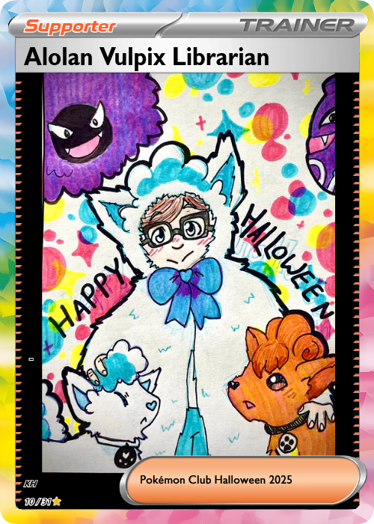
Contact us:
Kimberlee Byrge: director@norriscommunitylibrary.com
Kelsie Herrell: kherrell@norriscommunitylibrary.com

