Slide 1

Kodomomuke: Manga for Children
Scot Smith
Assistant Professor of Practice
School of Information Sciences
The University of Tennessee-Knoxville
April 23, 2026

Slide 2
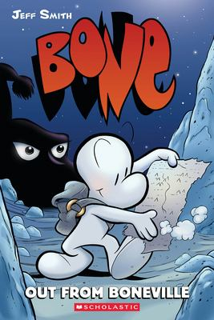
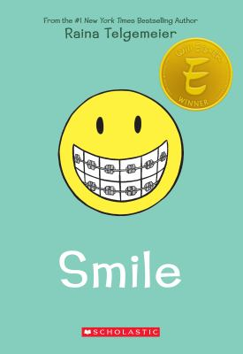
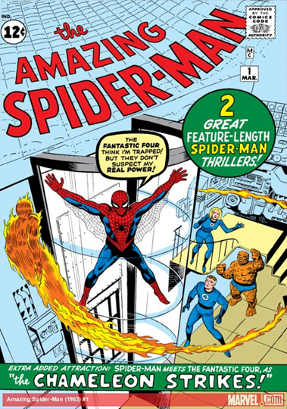
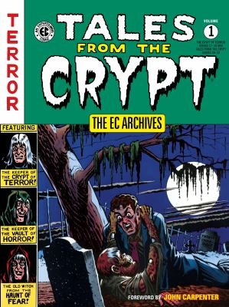
My Complex History with Comics
My love of Comics started with the Funny Pages in the Sunday newspaper.
I was a voracious reader of superhero comics as a child and tween until I was not.
Tales from the Crypt were a personal favorite as a tween.
I came back to Comics when graphic novels became popular with my middle school students.
I started reading manga when I created a course on Comics and graphic novels and while serving on ALA committees.
I am Comics enthusiast because no one can be an expert on all formats of the medium.

Slide 3



Comic or Graphic Novel??
Comics (Big umbrella term—always with a capital C for me): Story told or information presented through images enclosed within panels and usually accompanied by words in bubbles and/or boxes and is read/viewed sequentially. Comics is the medium.
All graphic novels are Comics, but not all Comics are graphic novels.
Manga is a format within the medium
Notes:
Beatrice

Slide 4

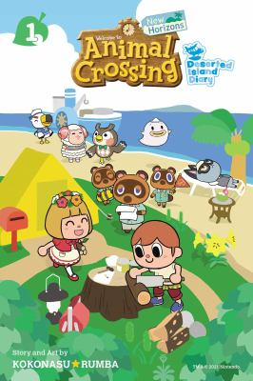
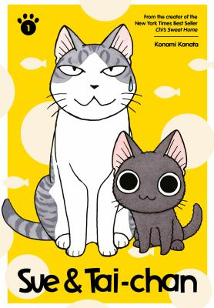
My Tried and True Definition of a Graphic Novel
A graphic novel is a long-form fictional narrative told with sequential art and text in bubbles or balloons and through juxtaposed panels.
Haters goin’ hate: “Graphic novels are not “real” books,” “graphic novels are baby books,” “graphic novels are too easy to read,” and “graphic novels don’t “grow” reading skills of children.”
Notes:
Tim and Martha

Slide 5
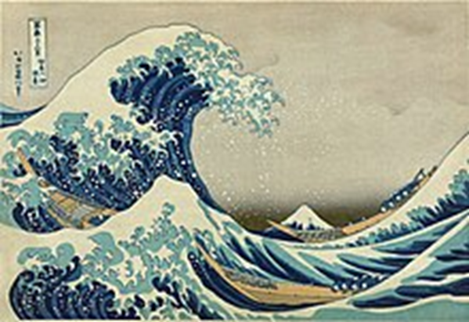
A Very Brief History of Manga
In 1814, Hokusai published a work called Hokusai manga.
This is one of the first examples of the use of the term manga in Japanese art.
Simply translated, manga means whimsical pictures.
Kibyoshi (adult), akahon (children)
Cartoonist Kitazawa Rakuten is considered one of the founders of modern manga. He drew editorial cartoons and created comic strips (Jiji Manga) in the early 1900s before he launched the satirical magazine Tokyo Puck.

Slide 6
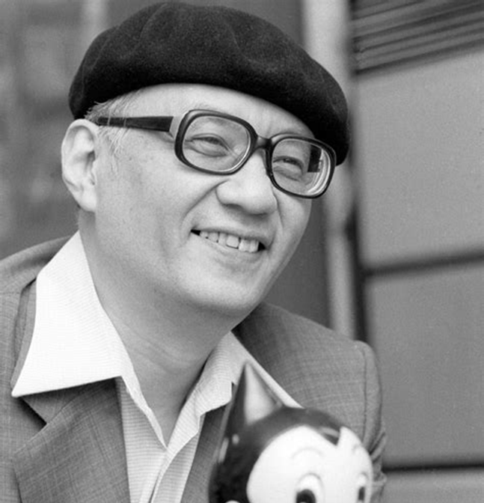
A Very Brief History of Manga
In the early 1900s, manga flourished in Japanese newspapers, magazines, and journals until the Great Depression.
Chapters of manga series were serialized monthly in magazines & journals.
After the war and during the US occupation, the Japanese were introduced the animated films of Disney as well as American comics from the Golden Age; that leads to the development of akahon (known as red books because of their color of their covers) for children
Osamu Tezuka--the god of manga. Astro Boy, Princess Knight, and Jungle Emperor (Kimba the White Lion). Published his first manga in 1947. Involved in over 700 manga series and more than 60 animated films.
Anime was born in 1956 when Toei Animation started its own studio to compete with Disney in Japan. Tezuka started Mushi Production in 1962. Speed Racer and Astro Boy are syndicated to American audiences in the 1960s.

Slide 7
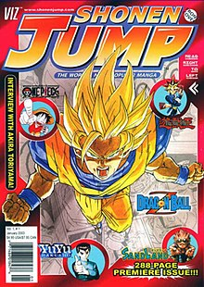
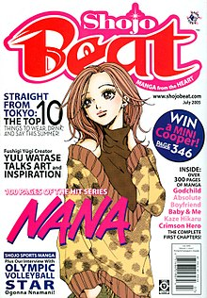
History of Manga

Slide 8
A Brief History of Manga
Annual sales of manga in Japan reached 1.34 billion volumes during the mid-1980s.
Comic-cons and comic shops started to spread the popularity of manga and anime in the US during the late 1980s and early 1990s.
Toonami (Cartoon Network, 1997), video games (Nintendo, Digimon, Mario, Zelda, Sonic), and card games (Pokémon and Yu-Gi-Oh!) in the 1990s.
In 2021, US sales of manga surpassed 24.4 million volumes.
90% of public libraries and high school libraries currently include manga in their collections.
From a survey in SLJ, 64% of library workers say that manga is the most popular format of Comics among teen patrons.

Slide 9
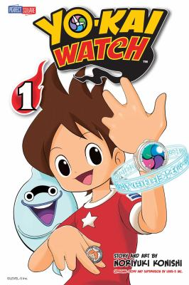


Common Vocabulary
Manga is the comic; Anime is the video.
The creators of manga are called mangaka.
A single volume of a manga is called a tankōbon.

Slide 10
Tankōbon
Manga is traditionally published as chapters (not issues like Western superhero comics) that are serialized in journals and magazines (or online in digital format) and then collected as volumes called tankōbon.
Tankōbon translates into independently appearing book.
A tankōbon is the same size of an American trade paperback, roughly 200 pages and uses low quality paper and H & P binding.
Between 5 and 10 chapters per tankōbon.
Some American publishers have released omnibus editions of popular titles—typically three tankōbon contained in each omnibus. 3-in-1

Slide 11
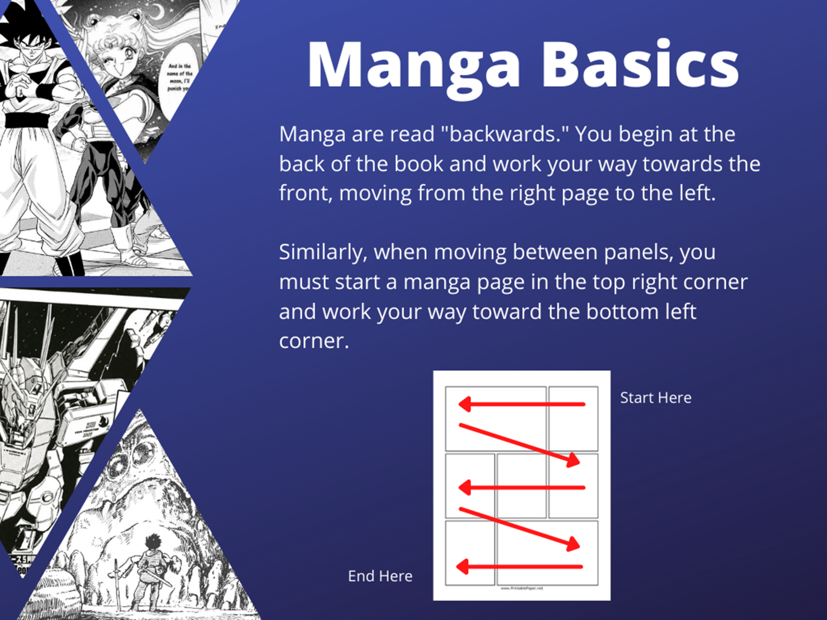
How to Read Manga

Slide 12
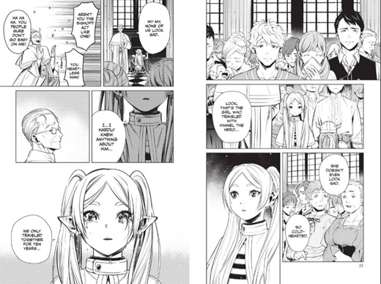
How to Read Manga
6
5
1
3
1
2
2
8
7
4
3
9

Slide 13
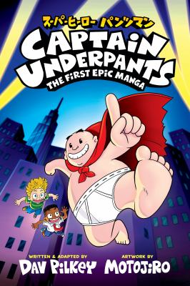
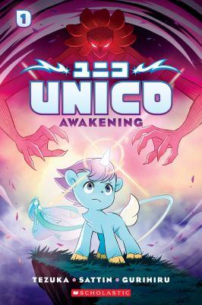
#Notmanga

Slide 14
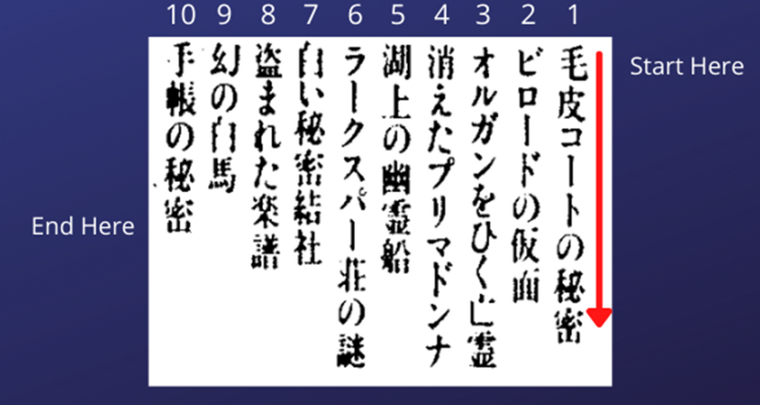
Manga Basics
Manga seldom uses color (except for the cover)….black and white illustrations with various shades of gray.
Japanese uses three alphabets: Kanji (Chinese symbols), Hiragana (Japanese syllabary for native words) , and Katakana (Japanese syllabary for foreign words & onomatopoeia) ….all three are often used as untranslated montages within the panels….
In case you did not know, Japanese is written vertically and read from right to left, top to bottom.

Slide 15
Manpu & Onomatopoeia
Manpu = Emanata, Manpu = Iconography
Manga typically uses fewer words to tell the story than Western comics—the images carry more of the narrative weight and the development of characters.
Manpu is the grammar of manga—how the artist conveys meaning without the use of words.
Mangaka (the creators of manga) will also draw symbols and/or have words “emanate” from the characters.
Manga also features “floating text” or “loose lettering”—single words or short phrases not contained within captions, bubbles, or balloons.
Movement, emotions, feelings, and thoughts are expressed through manpu….slow down and look carefully at the images.
Onomatopoeia is used much more frequently in manga….Japanese contains over 1,000 onomatopoeias, many of which have no English equivalent (Sweating, for example).
Some of the onomatopoeia operate as parts of a montage—they are integral to the art within the panel….

Slide 16
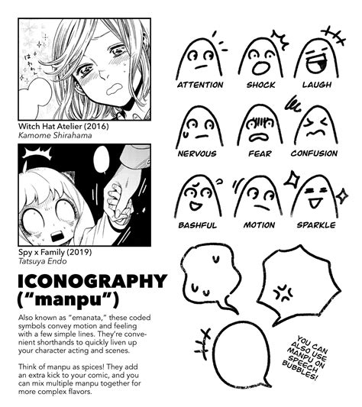
Manpu

Slide 17
Manga Basics
Unlike Western comics, the creator in manga often but not always writes & illustrates the story.
Backgrounds often convey meaning and create atmosphere….dark background may indicate a flashback scene
Motion lines are essential in manga….Manga as a form of sequential art employs the power of line to create meaning….remember no color
Balloons and bubbles indicate volume, emotion, and thought.
Characters with: Large emotive eyes, unique hair, small mouths that will change size to exaggerate emotional responses (visual hyperbole), tiny noses.
In some panels, the characters will change size and shape to express feelings….think of this change as an emotional or visual hyperbole….
Eastern storytelling is also different—Western stories are usually linear & chronological; Eastern stories often are non-linear. Being there as opposed to getting there.

Slide 18
Types (Demographics for?) of Manga
Kodomomuke: Published for & marketed to children....
Shōnen: Marketed to tween and teen boys
Shōjo: Marketed to tween and teen girls
Seinen: Men’s (Ages 18+) manga
Josei: Women’s (Ages 18+) manga
Youth services librarians—remember that adult manga can be very adult. Comics are NOT for all ages.

Slide 19
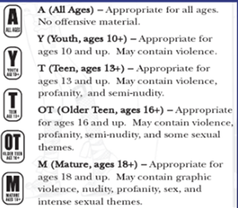
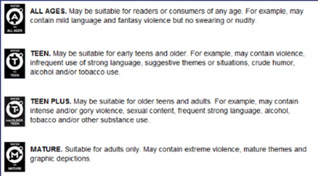
Age-Range Recommendations
The two major publishers of manga--VIZ Media, Kodansha--include ratings on the back covers of each tankōbon.
These ratings often conflict with age-range recommendations from professional review sources (if you can find the reviews) and vendors.
Children, tweens, and teens want to read up…….librarians need to be aware of content, especially for those titles rated 16+, Older Teen, or Teen Plus.
Viz Media Kodansha

Slide 20
Kodomomuke
Kodomomuke: Intended for children (literal translated)
Appropriate for all ages but read primarily by children 10 and under.
Major genres: Adventure fantasies, light-hearted slice of life stories, and humorous tales about pets and animals.
Strong commercial connection between kodomomuke and popular video games and anime.
Themes run toward the didactic and moralistic.
Stories are episodic.
Chibi: Japanese slang for short; it references an art style where the characters are typically drawn with large heads and small bodies.
Kawaii—Japanese for cute

Slide 21



Slice of Life

Slide 22
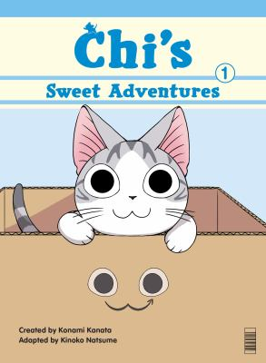

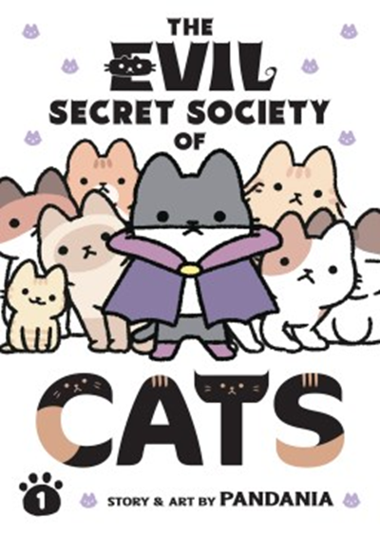
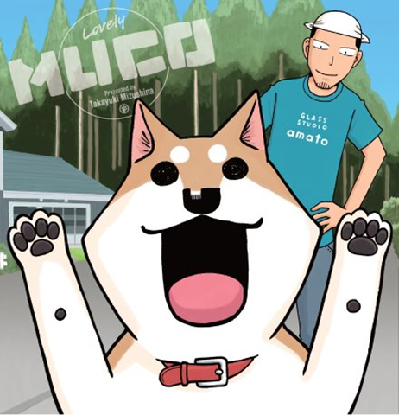
Animal Stories

Slide 23
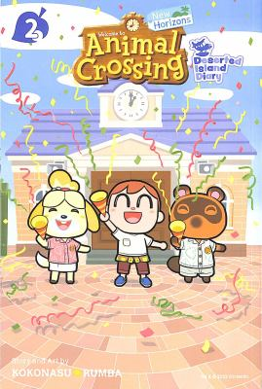
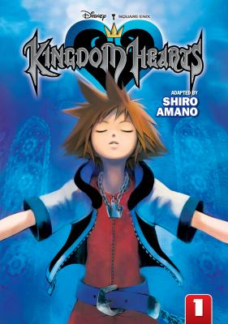
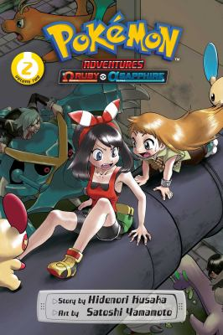
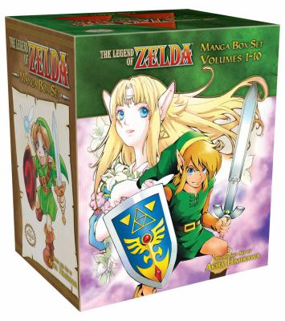
Video Games

Slide 24
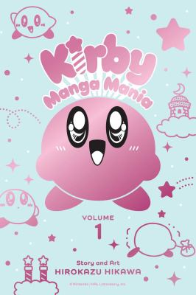
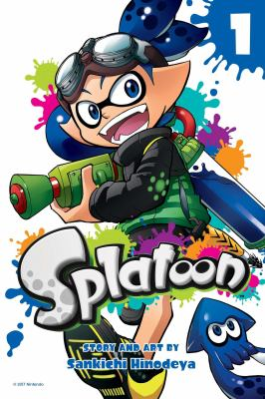
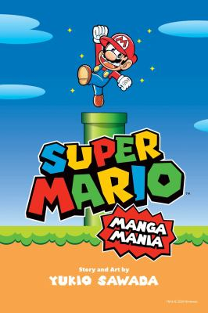
Video Games

Slide 25
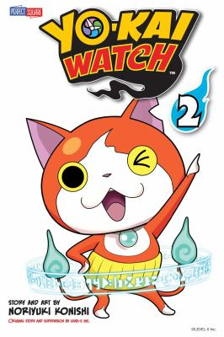
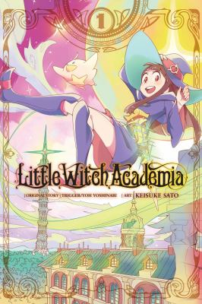

Fantasies

Slide 26
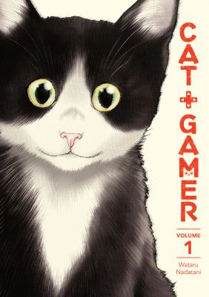
Why Manga?
Wildly popular with today’s readers (drives circulation stats)
Multimodal reading (retraining the brain)
Teaches important lessons
Visual and graphic literacy
Introduces children to manga (lifelong learners)
Supports ELL and readers with disabilities
Style of art

Slide 27
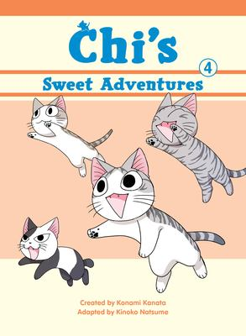
Issues
Lack of professional reviews
Binding issues (durability)
Stigma
Classification and cataloging
Shelf space
Series maintenance
When in doubt? Shelf in YA

Slide 28

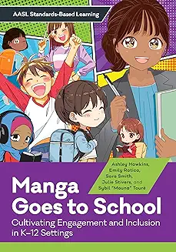
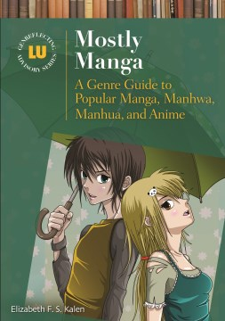

Bibliography

Slide 29
Time for Questions
Scot Smith
ssmith40@utk.edu

