Slide 1

Bridges for Children’s Literature
Children’s Book Awards in the Southeastern United States
Heidi Busch
Head of Circulation Services
Paul Meek Library
University of Tennessee at Martin

Slide 2
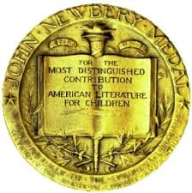

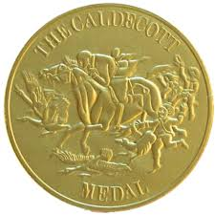
Book awards for Juvenile Literature
Notes:
We are all familiar with book awards for children’s literature. Including the Newberry, Caldecott, and Printz awards. I was doing a presentation during Children’s Book Week in 2023 about the Tennessee Volunteer State Book Award when someone asked me if every state has it’s own award? I wasn’t sure, so I started to do some research.

Slide 3
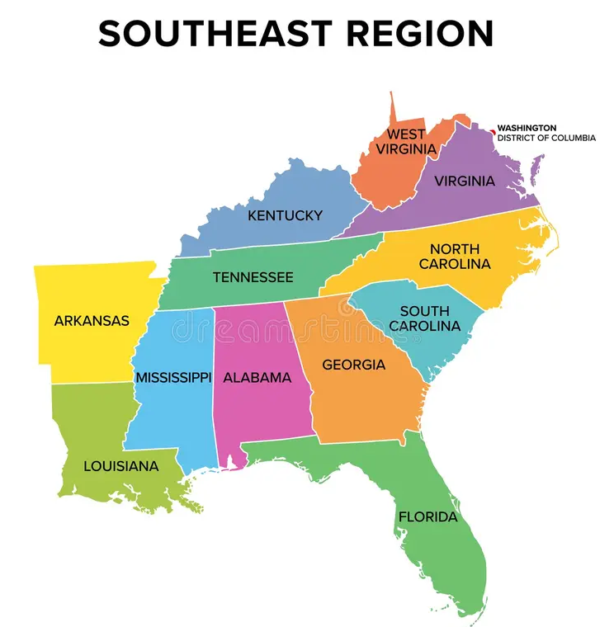
Notes:
The answer is yes; most states do have an active book awards program. Decided to limit to just the southeast region of the United States. I wanted to know what types of books the region was celebrating and how they developed their programs.

Slide 4

Alabama – Yellowhammer Book Award
Notes:
The first state, alphabetically of course, is Alabama. When I started this research, I had listed the Camillia Children’s Choice Award being given by the Alabama Education Department. When I went back to locate some graphics for this presentation, I could not find much about the Camillia Award again and realized that it had stopped in 2023. This award was originally just for young adult materials but added the Picture book and middle grade books in 2024. This award is presented by the Alabama School Library Association.
Books are nominated by school librarians in three categories, Picture Books, Middle Grade, and Young Adult. There are 10 nominated titles in each category.
Students read the books and vote in April. Winners and honor books for each category are announced in May.

Slide 5



Arkansas - Arkansas Diamond Primary Book Award, Charlie May Simon Book Award, Arkansas Teen Book Award
Notes:
Diamond Primary - established in 1998. K-3, Charlie May Simon – recognizes Mrs. John Gould Fletcher (Pen Name Charlie May Simon) in 1971, Both awards have books that are selected by a reading committee Students must have read or have read to them at least three books. Ballot forms are sent to all schools in early May and voting lasts for one week. Concern has been expressed that librarians may not be able to purchase enough books for students to have access to the minimum of three books, so if they can only read one book and love it, they can vote for that book. Arkansas Teen Award – 2008 books are nominated by the public. Nominated books are read and voted on by teacher and librarians to create two grade level lists one for 7-9th and 10-12th. 5 books per level selected by copyright date. Teens vote and voting is open from end of September to September. Teachers and librarians collect the votes and submit votes by title to the committee. Students can also submit their own ballots. One award annually and one honor book

Slide 6



Florida - Sunshine State Young Readers Award Jr., Sunshine State Young Readers Award, Florida Teens Read
Notes:
All administered by FAME – Florida Association for Media in Education. Jr. is for students pre –school to 2nd grade, SSYRA – 2 divisions 3-5, 6-8. Teens – 9-12. Jr. and SSYRA– books are nominated by the public and a committee selects 15 titles. These books must be published in the previous three years, fiction only, and have received a favorable review in a major book review publication (Kirkus, SLJ) Students must read or have read to them 3 books. Students vote in February to April and the winner is announced in mid April. Teens – Committee School librarians on committee select books, current or previous 2 years publication, and then narrow down to 15 titles in Spring using student opinions and reviews. Voting by students in February- April with winner decided in April. Notice on all websites stating that these programs are voluntary and no student is obligated to participate. Also states that this is not intended to be a collection development tool.

Slide 7

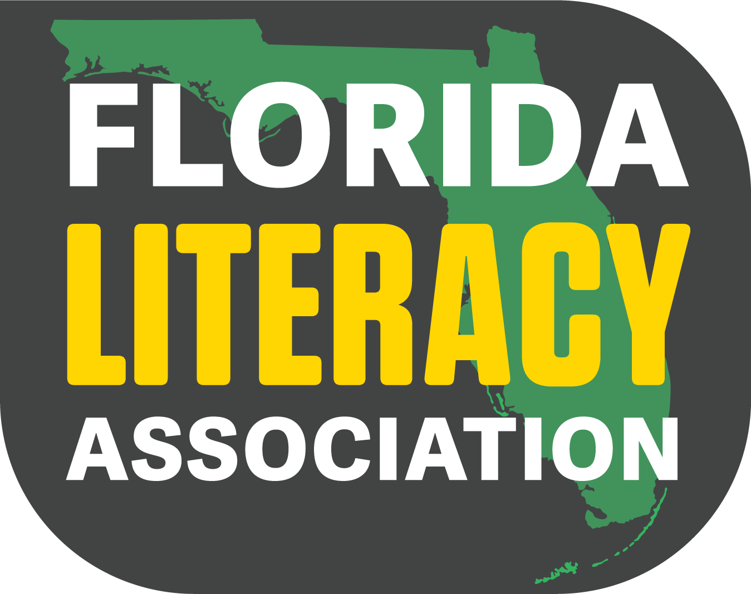
Florida - Florida Book Award, Florida Literacy Association Children’s Book Award
Notes:
FL book award – Florida State University Libraries with the involvement of the State Library and Archives of Florida, Florida Library Association, Florida Humanities, Florida Center for the Book, Midtown Reader, and the Word of the South Festival. - several categories – Young Children, Older Children, Young Adult. Gold Silver bronze awards winners receive $1000.00. Books are nominated by authors, publishers, literary agents and the public. Books must have current copyright year. AI and LLM books not accepted. Submit a $60 fee and provide books to 2-3 jurors. Authors must be Florida residents. Submission window August to January. Winners announced in March and presented in April. Winning books on display at governor’s mansion and I the Florida State University's Stozier Library. Florida Literacy Association – Elementary Grades PreK-2 and 3-5. 10 Books per category are selected. September to March students read at least 7 of the 10 books and vote for favorite. Winner is selected in April. There are lesson plans and resources available for the books which follow Florida state statutes.

Slide 8

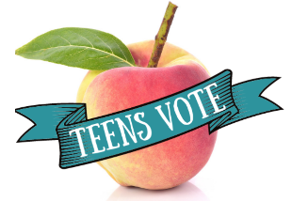
Georgia – Georgia Children’s Book Award
Georgia Peach Teen Reader’s Award
Notes:
Georgia Children’s Book Award- Established in 1968 through the Mary Frances Early College of Education and the University of Georgia. Picture books K-4, middle grade 4-5, Grade 6-8 9- 10 books nominated. Teachers and librarians select books. These people serve a three year term. Tean Readers’s Choice - Georgia Library Media Association, Georgia Library Association and Georgia Public Library Service. Titles are researched by reading committee members who serve a minimum of one term to maximum of three years unless they lead the committee for a 4th year. Need to apply to be on the committee before March to be voted into membership. 20 books are chosen, fiction, nonfiction, adult books may be nominated. looking for diverse books. Nominated titles have to receive the support of 50 % or more of the committee members 6+. Voting is done in high school and public libraries by students. Librarians collect the votes and submit them by the second week in March. The Peach and two honor books are announced at the Kennesaw State University Conference on Young Adult Literature.

Slide 9

Kentucky – The Bluegrass Award
Notes:
Kentucky Association of School Librarians Divisions Preschool, K-2, 3-5,6-8,9-12. Books are selected by committee Minimum 6 members max of 15. Through an application process. School public librarians, teachers, University faculty, bookstore representatives, retired teachers and librarians. May subdivide into selectors and readers. Selectors read books, determine nominee list. Readers read books and score the books. May face removal for nonparticipation. Each committee considers a minimum of 25 books to select final list of 10 books per committee. Published in last 3 years. Previously nominated can’t be included. Only the first title in a series. Must be a variety of genres. Any category may have picture books if grade appropriate. Nominations done by Feb 1. Schools, libraries, parents and community organizations select books appropriate for the needs of their patrons Students read and vote for favorite. Read at least two to vote. Library determines the voting process All ballots counted on site and submitted to an online tally sheet in March. Votes are counted during the first week in April. KLA offers a book grant for school libraries to assist the library with getting the titles.

Slide 10


Louisiana – Young Readers Choice Award, Teen Reader’s Choice Award
Notes:
Sponsored by the Institute of Museum and Library Services (IMLS), the Louisiana Center for the Book, the Louisiana Library and Book Festival Foundation, the Louisiana Chapters of Delta Sigma Theta Sorority, inc., and the State Library of Louisiana Founded in 1999 with first award given in 2000. Young Readers has three divisions, K-2, 3-6, 6-8. Teens 9-12. Books are nominated by committee members. Published in the previous three years only the first book in a series considered or if it can be read as a stand-alone book it may also be considered. Must be printed in the US, but the author does not need to be a U.S. citizen. Publishers may send review copies. Each nomination list has between 12 and 15 titles. Committee members must apply to serve – teachers or librarians. Students must live in the state and can vote for their favorite once they have read or listened to three or more titles 2 or more for Teen readers during the summer and fall of the year previous to voting. Voting happens December to May 1 with winners announced mid May. The secretary of state of Louisiana will loan voting machines to school librarians for voting.

Slide 11

Mississippi – Magnolia Book Award: Children’s and Teen’s Choice Award
Notes:
Established in 2010. sponsored by the School of Library and Information Science at the University of Mississippi, the Mississippi Library Commission, the Mississippi Library Association, and the de Grummond Children’s Literature Collection. Selection committees made up of librarians and teachers who currently work with children in the state of Mississippi. Nominations for books any genre or format published in the last 2 years. Must be reviewed in at least 2 professional journals. Books that won a national award are not eligible, but honor books may be considered. Author or Illustrator must be living. Suggestions must be made by September 30. Four grade categories Final lists are short, PreK-2 =12 books, 3-5 =10 books, 6-8 = 8 books, 9-12 = 5 books. Voting done in February at schools, libraries, and bookstores. Winners announced in April at Fay B Kaigler Children's book festival. Voting sites have the opportunity to win a free registration to the festival $250 for the individual and $250 for the library.

Slide 12

North Carolina – Children’s Book Award
Notes:
Presented by the North Carolina Library Association Youth Services Division. Divided into two ranges– Picture Books for lower elementary and Junior Books for upper elementary. Books can be nominated by children from November – March of each year. Must have a copyright date within the last 4 years of the award year. Committees of school and youth services librarians in the state pick either list to be on a committee for and must be familiar with all the books on the nomination list. The committee selects 10-12 books to form the voting list. Students must read or have read to them 5 picture books or 3 junior books to vote. Voting takes place in March – April. Students can vote online using a Google form or using a paper form of book covers or a bookmark list and then librarians will compile and submit all votes.

Slide 13

South Carolina – Book Award
Notes:
Sponsored by the South Carolina Association of School Librarians. Started in 1976 with one division Children in grades 3-6. Young Adult (9-12) added in 1980, Junior in 1993 (6-9) and Picture Book (K-3) in 2003. Books are nominated by members of the book awards committees as well as outside nominations. Committee members read between 100-200 books a year, depending on category. Committees meet 5 times per year and are expected to participate in the annual conference held in March. Book committee members are expected to create book trailers, encourage bookmarks and banners and do book talks at the conference. Books can be fiction or nonfiction – cannot be Newbery or Caldecott winners but may be honor books. Must be written by an American author and must be listed in the most current edition of Books in Print. Copyright date within current year, previous or forthcoming year. No negative reviews. Only one title from an author will be included and when an author wins, they must wait three years to be nominated again. Children in PreK-12 vote on the list of 20 nominated titles. Read minimum of 5 books from Picture or Children’s minimum of 3 books from Junior or Young Adult list. School Media Specialist should sponsor but may also be teacher or administrator. Sponsor should have the support of administrator, provide info to participants read the books to determine if nominated books are accessible for inclusion based on book selection policy and encourage reading by selecting the best books from the list. Schools must purchase at least 50% of the titles on each list to participate.

Slide 14

Tennessee - Volunteer State Book Awards
Notes:
Sponsored by Tennessee Library Association and Tennessee Association of School Librarians. Started in 1978 Tennessee Children’s Book Award for Grade 4-6. 1988 expanded to all grades K-3, 4-6, 7-9,10-12. Renamed Volunteer State Book award. 1992 Three awards Primary, Intermediate, Young Adult. 2012 added the Middle School division. Books are chosen by librarians and educators who work with students. Only titles published in the current year by authors in the United States. One book per author in final list. Anthologies, textbooks, self-published or digital only titles are not eligible. Final list of 20 books per level read by a minimum of 5 members of the committee. Students may vote for books read or listened to three of the titles on the list. School library media specialist or public librarian will collect the votes and submit digital ballots via the VSBA website. Voting takes place in March – April. The book with the most votes in each division is named the winner and the author is invited to come to Tennessee to receive their award.

Slide 15


Virginia – VA Reads and Virginia Reader’s Choice Awards
Notes:
VA Reads – sponsored by the Virgina Association of School Librarians was established in 2019 with books that celebrate diversity, providing windows mirrors and sliding glass doors. There are currently 4 categories, Picture books, Chapter books, Middle School, and Young Adult. VaASL members are encouraged to be part of the committees as well as those people who are in a library certificate or graduate school program. On the application form they are asked if they are a member of a Title One school or students receive free or reduced lunch as a way to balance the committee membership. Any student, teacher, or librarian in VA is encouraged to nominate books. 10 books are selected at each level. Students who have read three books may vote for their favorite book. Librarians host the elections and submit the ballot for their location online. Winners are selected in May and are invited to speak at the VaASL Conference.
Virginia Reader’s Choice Awards – Sponsored by the Virginia Literacy Association in association with Virginia Association of School Librarians, Virginia Library Association, and the Library of Virginia Youth Services. Award started in 1981 with books awarded at the elementary level. In 1987 added Middle School and High School. Currently 4 levels: Primary, Elementary, Middle School and High School. Books are selected through nomination process by people on Committees outside nominations accepted in November. People apply to be on the committee in August. Books must be noteworthy and published within three years prior to the ballot. Books must be appropriate to their level. Nominated books are announced in the spring. Students who have read 4 of the nominated titles in their level. Students can vote for one book at each level and may vote for books at more than one level. Voting occurs between March 1 and April 30 each year. A responsible adult collects the votes and one tally sheet per program level is submitted from each library. The total number of votes must not be greater than the number of people eligible to vote from that location

Slide 16

West Virginia – Children’s Choice Award
Notes:
Established in 1981 and ended in 2013. Administered through the West Virginia Children’s Book Committee until 2007 and then by the West Virginia Center for the Book until 2013. No further information was found about the award despite repeated emails to the West Virginia Library Commission.

Slide 17
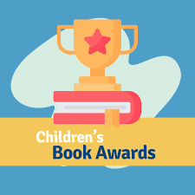
Summary
Notes:
I learned a great deal through this research. It’s good to know that most states in our region have awards for children’s literature. Most are coordinated by Library Associations or Literacy associations. Delighted to learn that most states follow the same format for selection that we do in Tennessee and that we tend to all select very similar books out of the many that are published each year.

Slide 18

Questions and Comments
Heidi S. Busch
Associate Professor/Head of Circulation Services
170 Paul Meek Library
University of Tennessee at Martin
731-881-3078
hbusch@utm.edu

