Slide 1
Public Library Partners with Schools to Pump Up Lexile Levels
Dana Juriew
Spring Hill Public Library Director
Knoxville Convention Center 300B
April 22, 2026 1:10 pm

Slide 2
Today’s Agenda
Walk-through of Volunteer Orientation
Pros and cons of working with a partner agency
Materials needed
Recruitment methods
Q&A

Slide 3
Spring Hill Elementary School Raider Readers
Spring Hill Public Library
and
Boys & Girls Clubs of Southcentral Tennessee
Spring 2026

Slide 4
Inspiration for the program
Lori of Laketon
Dana and Destiny … and Down Days
Two dudes and lots of “Buddy”s

Slide 5
Free Voluntary Reading (Krashen & McQuillan)
Children read more when they have more access to books. The more access the child has, the better the child’s reading ability.
The best predictor of performance on tests in which children have to understand what they read is how much self-selected reading they have done.
Children can acquire more than a third of their academic vocabulary by reading a million words of light fiction.
Children who read 30 minutes a day can do that in less than a year.

Slide 6
We are merely here to facilitate this!
Our job is to get kids interested in and excited about reading.
We do this by building their confidence in their reading abilities.
We challenge them to try new things, while also letting them enjoy comfort reading.
We are a sounding board for their reactions, impressions and feelings, as well as their comprehension. (Hint: It’s all tied together!)

Slide 7
5 Ws for comprehension for Reluctant Readers
Who are the main characters? I don’t remember. Who was your favorite character? Did he have any friends?
What happened in the story? I don’t remember. What was your favorite part of the story? I didn’t like it. It was boring. What made it boring? What would have made it better?
What do you think your character learned during the story? {Shrug.} How did they react when ______happened? Why did they do that?
When did the story take place? Where did the story take place?
Draw a picture from the story.

Slide 8
Self-selection of titles
Continually discuss which books or types of books might interest the child.
Do not worry about their reading lexile level.
Comfort reading is more than okay!
Make notes and suggestions in your folder to help Dana select titles for your student.
Titles, authors, series, subjects, styles or genres

Slide 9
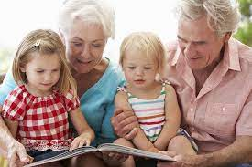

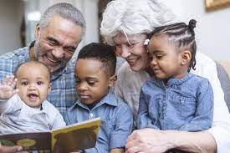
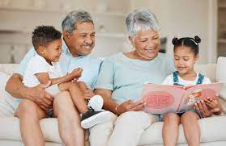
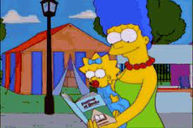
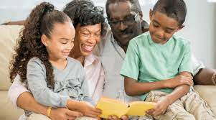
Tell us about your children or grandchildren and their early reading experiences

Slide 10
Your challenges:
We are here to boost the confidence and morale of this student. Making comparisons is not healthy in this moment.
Therefore, you may not talk about your grandchildren, or any other children than the one in front of you. Do not even say, “My grandchild was a reluctant reader too, but…”
Do not ask if the child’s guardians read to them at home, or if they read aloud to their guardian. It just might not be feasible in their situation.
You are fulfilling that role and we are grateful!
For an hour you are the center of each other’s world. This is why continued attendance is important.
They will look forward to seeing YOU!
Notes:
You can let them talk to you about their personal lives if they initiate the conversation, otherwise, please don’t ask.

Slide 11
Regular or Sub?
Regular commitment requires a half-hour to an hour each week (Wednesdays at 4 pm) from February to the beginning of April.
Subs will fill in for you as needed!

Slide 12

THANK YOU!

Slide 13
My original plan, and what really happened
Contact administrators, both in schools and at district
Present pilot program for inclusion during intervention or enrichment time
Have access to lexile levels at beginning and end of program
Evaluate program and processes
Repeat and replicate
Give in and give up? WALLS

Slide 14
Pros of Partnering, or Partnering with Pros
Boys & Girls Club parents were looking for more academic programming
BGC has structure in place, takes care of discipline and focus
BGC does background checks and covers general liability
BGC has funds that can be used if needed
BGC can provide volunteers BGC=BridGeConstructed!

Slide 15
Cons
BGC lost access to lexile data
BGC was not granted access to the school library
Program limited to only Club Kids, not all who are needing intervention

Slide 16
Making Lemonade
When short on volunteers, convert super readers into teacher helpers
Bringing the public library to the school sells the big library as a resource
Loss of lexile data removes any hope of scientific study (YAY! and phew)
Materials required are cheap
Books are free
Labor is free
Backpacks and folders are cheap -- donations are welcome!

Slide 17
Materials
14 3/4" x 17 1/4" Personalized Large Neon Canvas Drawstring Backpacks - 12 Pc. | Oriental Trading
Space Age Totes - 18 x 13 x 12", Red S-133R – ULINE
Plastic folders with pockets
Plastic name badges
*Library cards – limited access without parental permission

Slide 18
Questions?
Library Volunteers Spark a Lifelong Love of Reading in Spring Hill’s Youth - boys & girls clubs of south central Tennessee
Thank you, again!

Slide 19
References Provided
Krashen, Stephen D. “School Libraries, Public Libraries and the NAEP Reading Scores.” School Library Media Quarterly, Summer 1995, pp. 235-237.
Krashen, Stephen. “Reader Reply.” School Administrator, March 2020. p. 4.
McQuillan, Jeff. “Reader Reply.” School Administrator, March 2020, p. 4.
Both of these researchers deserve a deeper dive into their relaxed approaches to literacy in general.
Notes:
(

