Slide 1
Back Pocket
Programming
Kate Greene Smith
TN State Library & Archives
Jennifer Kring
Cleveland Bradley County Public Library
Jenny Claiborne
Martin Public Library

Slide 2
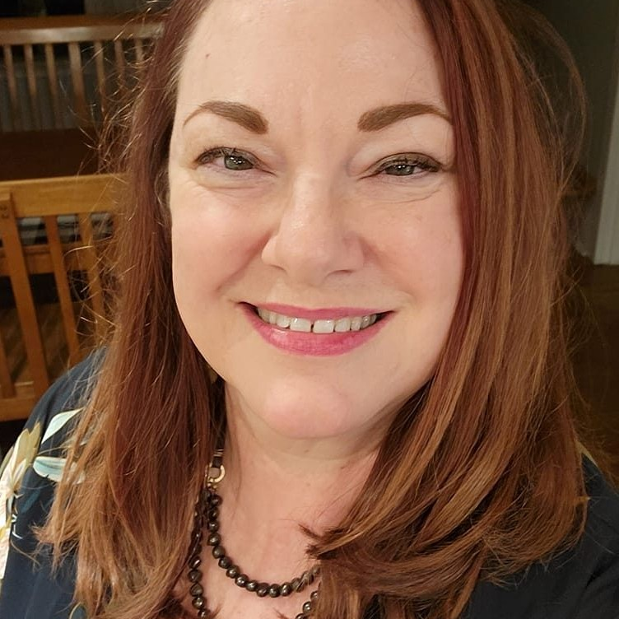

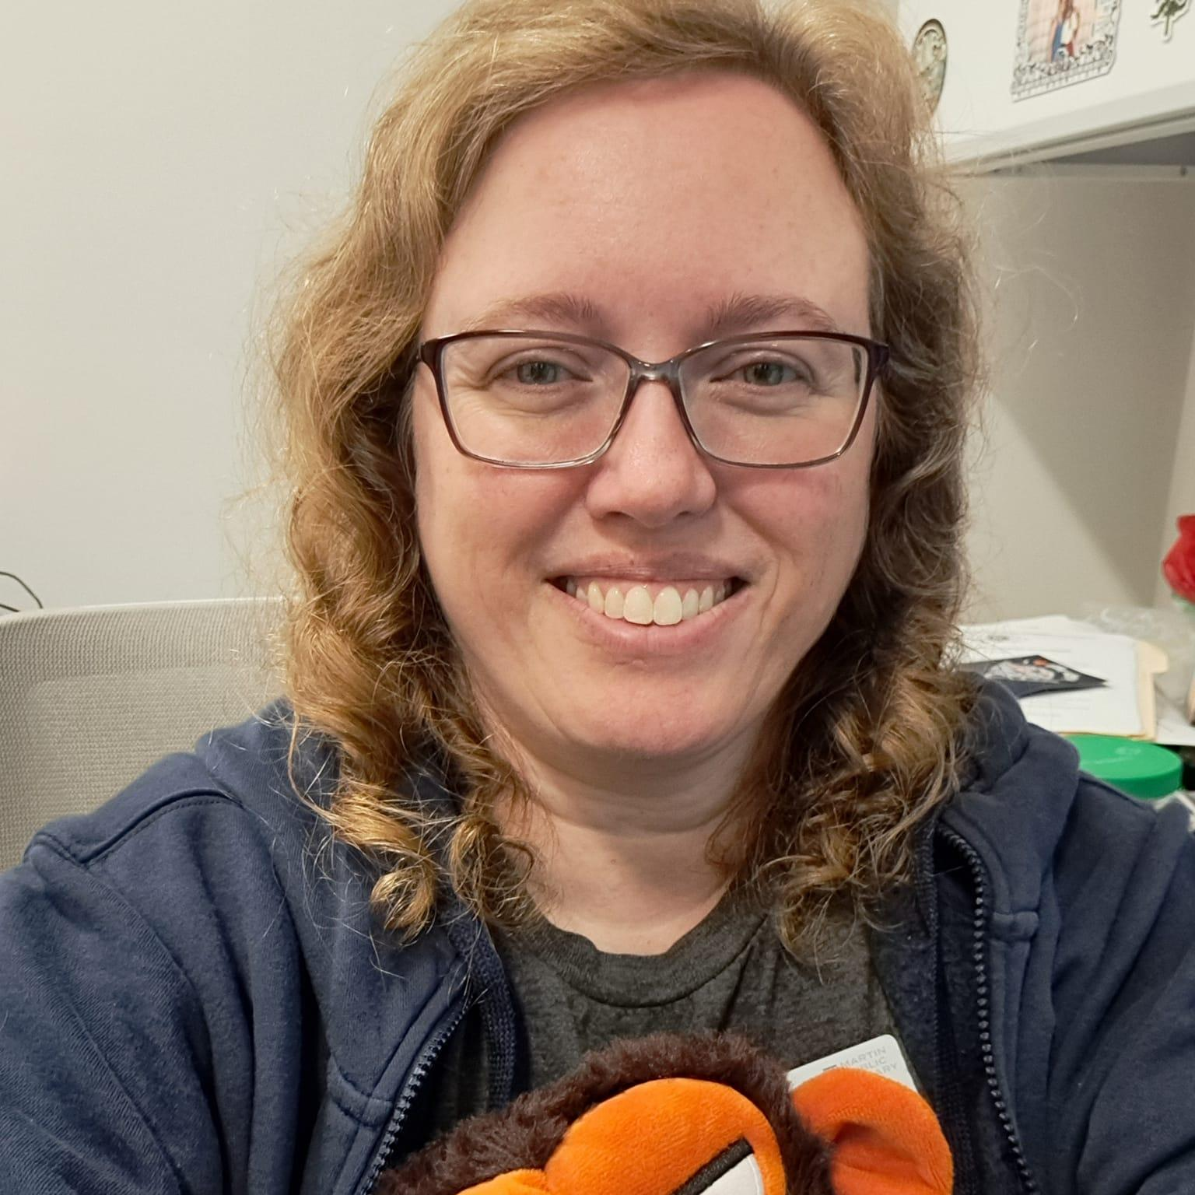
Who are we? And what do we know?
Kate Greene Smith
Jennifer Kring
Jenny Claiborne
TN State Library & Archives
Cleveland Bradley County Public Library
Martin Public Library
Kate has been the Youth Services & Special Projects Coordinator at TSLA for almost 10 years now. She loved coming up with fun ideas for her Girl Scout troops for 16 years.
Jennifer is the Youth Services Supervisor at CBCPL. She has 5 years library experience with patrons of all ages and is thrilled to bring the joy of learning to her library families.
Jenny has been the Youth and Children’s Services Director at MPL for over 10 years. She loves creating engaging programs and dreaming up ideas to inspire young patrons.

Slide 3
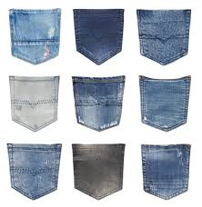
What is back pocket programming?
A sewing program using the back pocket from recycled blue jeans?
2. A card deck of ideas you can fit in your back
pocket?
3. A library scavenger hunt where all the clues are
found in the back pocket of the book - where
the book due card used to live?
Notes:
MMMMMAAAAAAPP! Wrong! Back pocket programming is none of these things!

Slide 4
So what IS back pocket programming?
Notes:
SO what IS back pocket programming? It’s the fun idea that’s easy to implement when your regularly scheduled programming has gone wrong. A speaker hasn’t shown up or staff are sick or not enough people turned up to make what you’d planned work. It’s also the passive programming you can use any time you’d like. They are programs you can pull out any time, anywhere, and require little preparation or staff engagement

Slide 5
The benefits of backpocket programs
Notes:
Programs don’t have to be time consuming or expensive
Passive programming is self-directed or lightly guided programming -
patrons can pursue on their own terms
Can be done on a come-and-go basis
Don’t require supervision from library staff
Useful, low-stakes entry points for new librarians
Demystifies the entire library space for customers
An easy way to get to know teens
Start out using whiteboards and tip-jar polling at reference
Learn the interests of young patrons
Gets people to stay longer in the library, which means they are exposed to more opportunities

Slide 6
How do you gauge success?
Notes:
First, don’t worry about it. Not on Public Library Survey
Count stickers given out
Count written answers on board
Count votes
Write a narrative - when a kid does a scavenger hunt in the library, they walk through new parts of the library. They have to interact with a staff member. Patrons discover new interests or collections.

Slide 7
Types of programs
1
2
3
4
Collaborative art projects
Community collections/
Show and tell
I Spy Container
Livecams & interactive displays
Notes:
Collaborative art projects
Coloring posters
Stick-together posters
Bookmark creation station
Paper flowers - tissue paper + pipe cleaners
Magnetic poetry
Community collections/show and tell
Origami Community Zoo
Origami cranes (hang from ceiling)
Recipe library - host cook-off, pot luck, cooking class; connect with local grocery
I Spy Tank
Fish tanks
Large jars and containers
Windows
Bottles
Livecams and interactive displays
Sci Starter has wonderful projects to implement at the library
Fat bear month voting
Nest cams and vote to name hatchlings,
Rubik’s cube station with stop watches, whiteboard for times

Slide 8
1
5
2
6
3
7
4
8
Activity name
Photo booths
Activity name
Mini contests
Activity name
Polls
Activity name
Play dates
1
9
2
10
3
11
Activity name
Building materials
Activity name
Scavenger hunts
Activity name
Readers Advisory engagement
Notes:
Photo booths
Theme for season
Upcoming program related
Cutouts
Encourage promotion of library programs on social media - don’t forget a hashtag
Mini contests
Special spot photo contests - patrons can do at home too
Literary pets photo contests - patrons can do at home too
Book-themed tissue box
Sticky-note waffle/local topic/book themed drawing contest
Word invention contest
Spooky story contest
Word of the Week Giant Dictionary Challenge
Play dates
You pick theme, date, time - just provide the place
Have special toys, books available
Provide ages & stages developmental information
Early literacy hints, ring booklets, how to sign up for kidcentral mailing list
Advertise at local childcare centers, Head Start, pediatrician offices
Polls
Whiteboards
This or That voting station
Post its on wall
Cotton balls dropped into transparent jars
Slips of paper into clear box
Readers’ advisory activities
Blind date with a book
Slips of paper for people to write a review, attach to the book
Have one book on display, encourage
Scavenger hunts
In building
Out of building
Around town on social media
Themed hidden images
Book character hunts
Item scavenger hunts
Library tour hunt
Consider ages for audience, frequency, prizes (stickers, bookmarks, brag tag)
Create team based challenges that promote collaboration
Building materials - space for creation
Marble run mazes
Dominoes
Keva planks
Legos

Slide 9
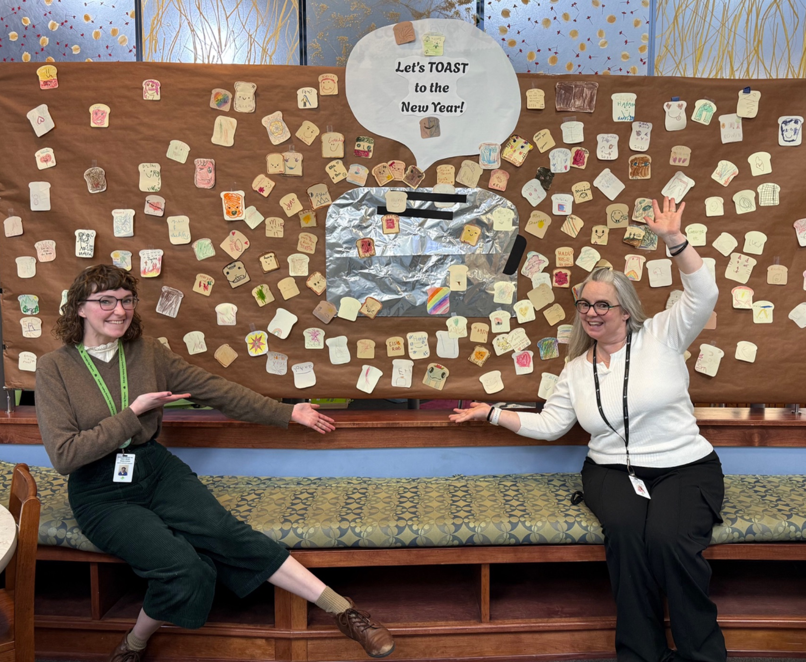
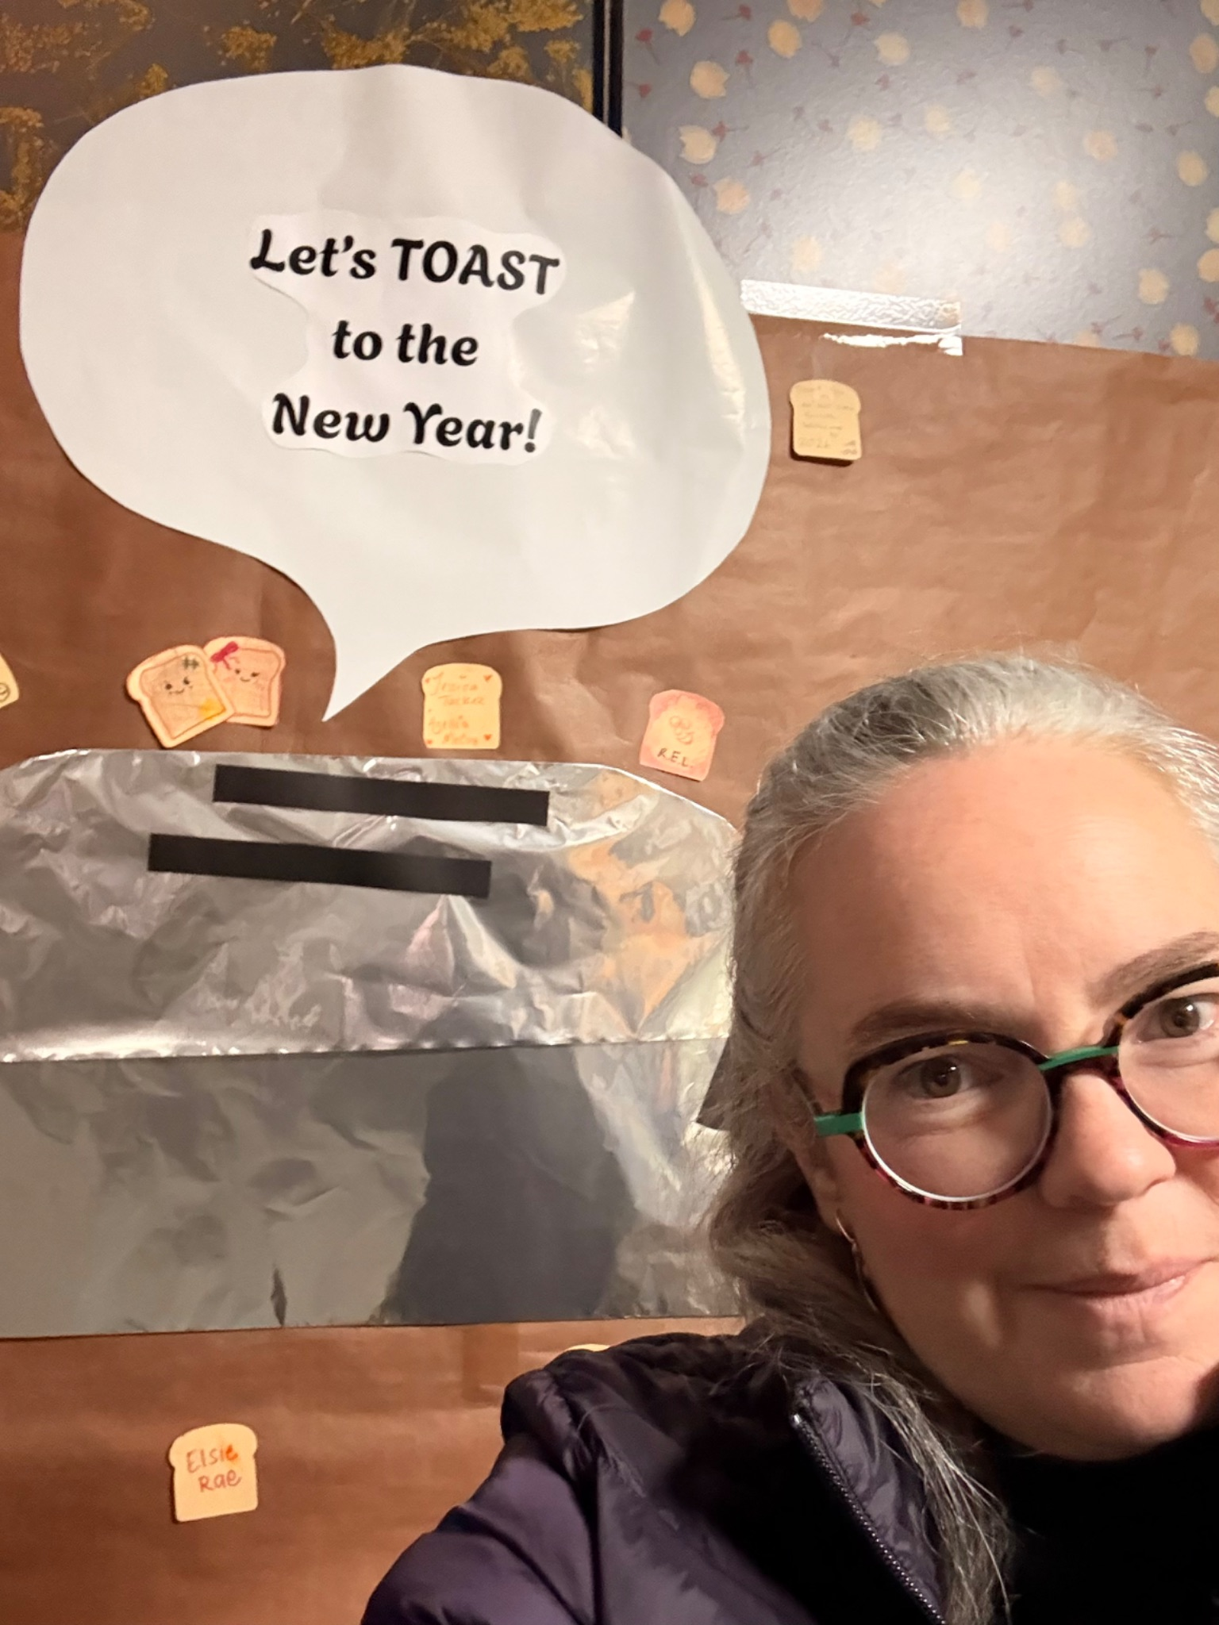
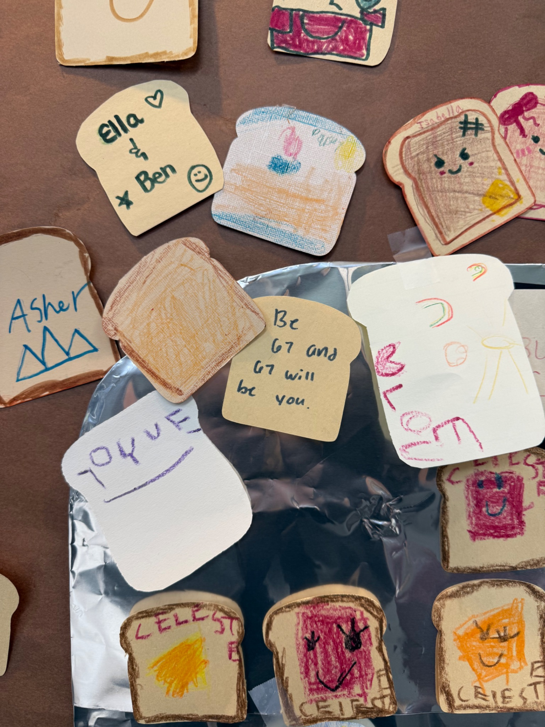
An invitation to contribute…
Our CBCPL conversation wall!
We invite little friends to add a name or picture to our wall. Here is January’s “toast the New Year” wall of good wishes!
95% Passive
Notes:
Preparation for these fully passive activities is minimal. These activities can be incorporated into your library environment via a bulletin board or added to the library exterior of your desk. We simple provide a little sign inviting patrons to contribute to our wall with a picture or sentiment written or colored on the cut outs or ‘toast’ provided. These types of visuals invite all our patrons to contribute to the space and cultivate a sense of ownership and comfortability within the library.

Slide 10
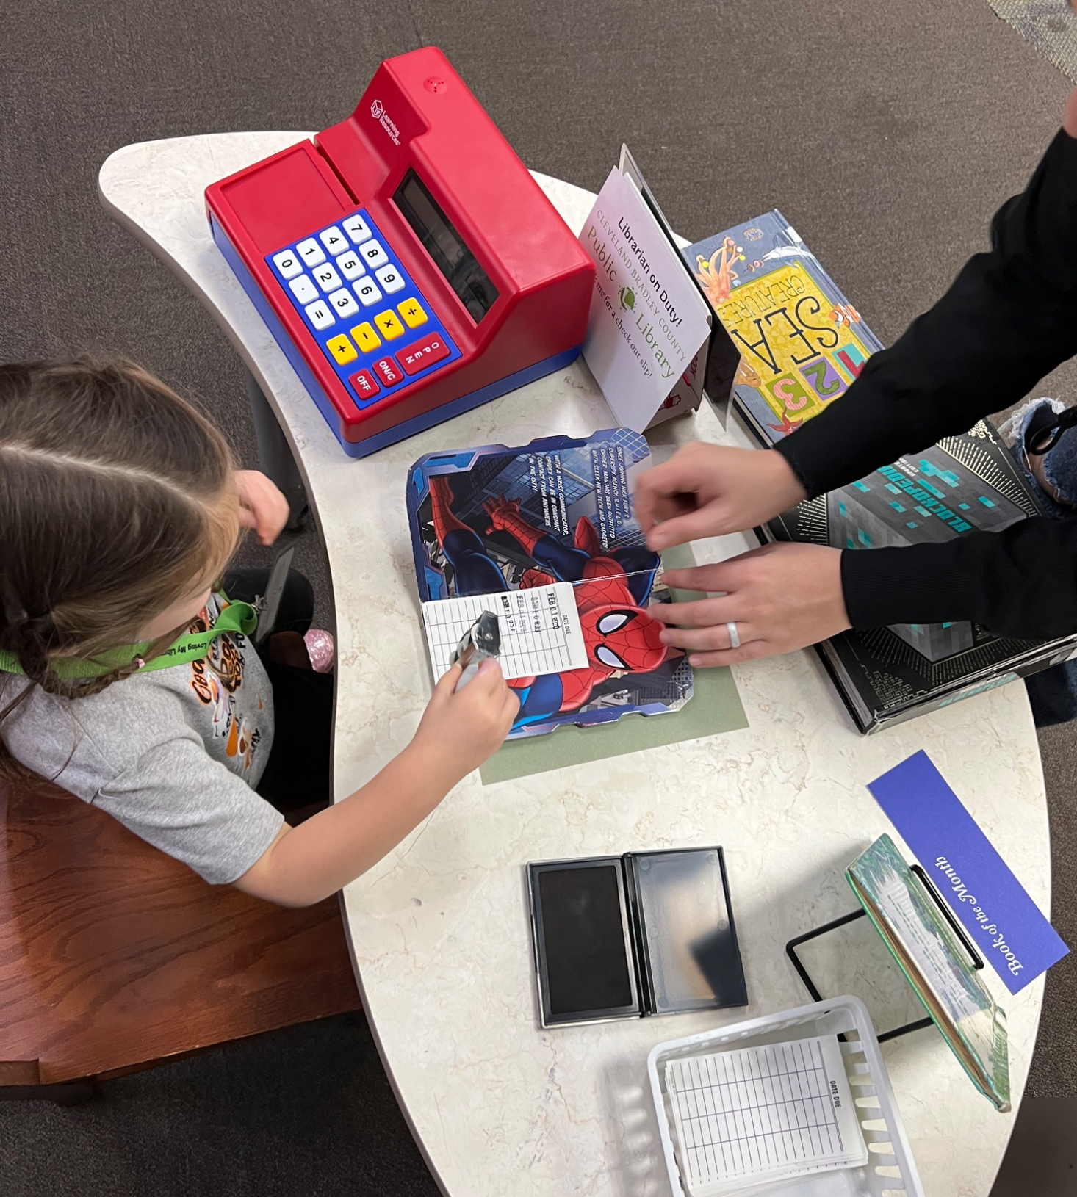
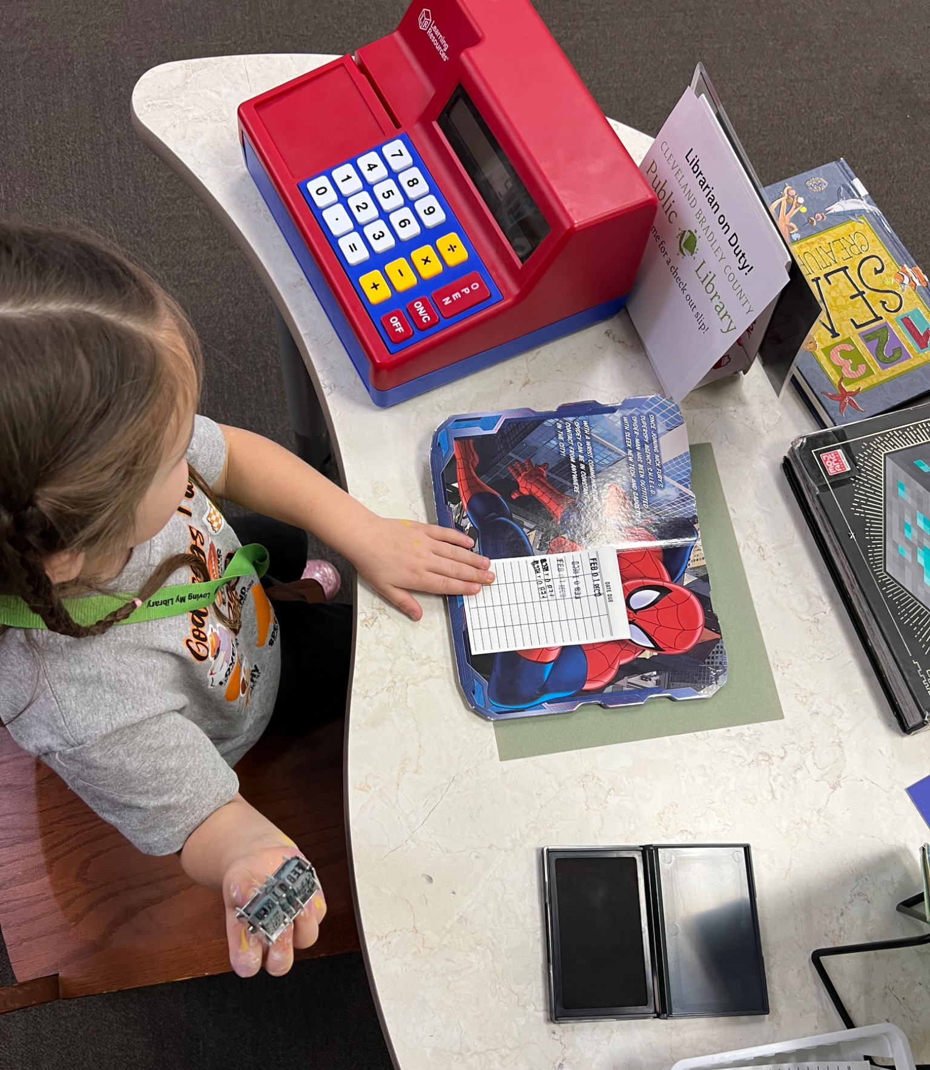
An invitation to play…
CBCPL imaginative playscapes!
Pictured here is our Junior Librarian work station complete with name tag, stamps, and open hours sign positioned beside our desk!
95%
Passive
Notes:
These activities can be incorporated into your library environment by simply transforming a small table scape into a retro library check out desk, complete with name badge, register and check out cards and stamps. We simply provided a little sign inviting patrons to play library with the materials provided. These types of activities invite our smallest patrons to pretend and cultivate a playfulness within the library.

Slide 11
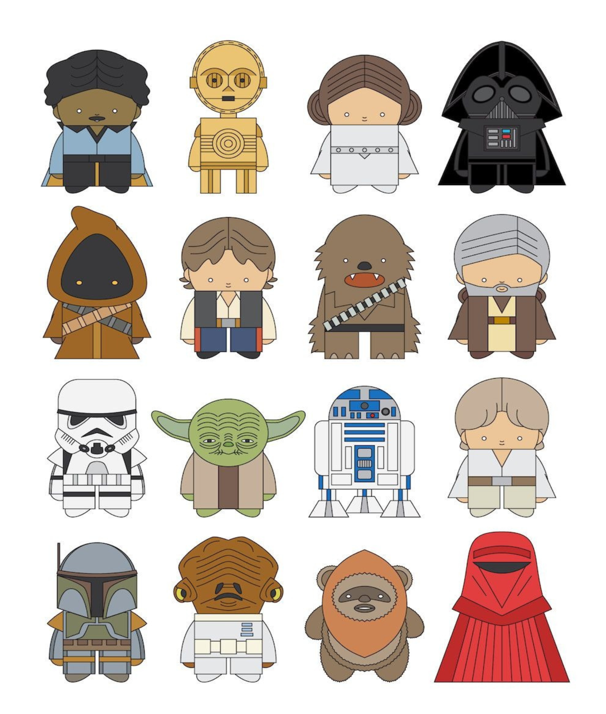
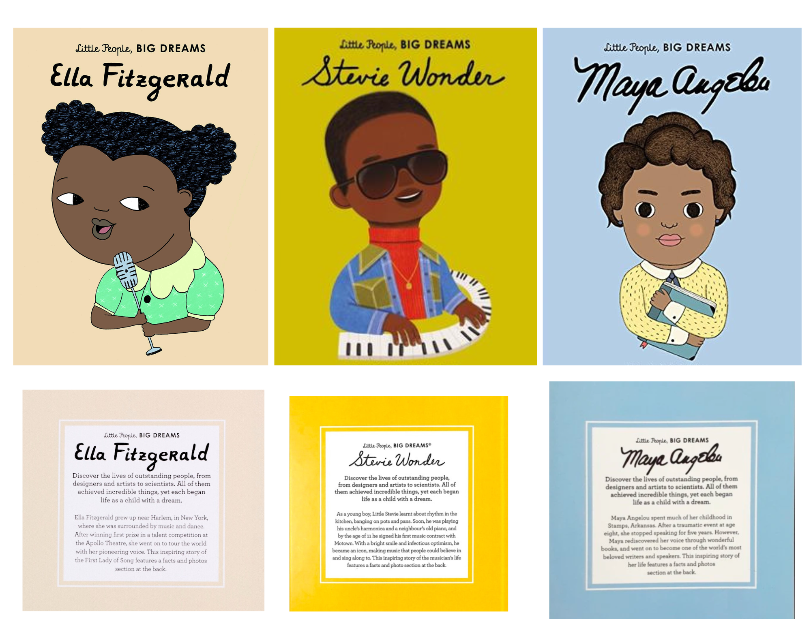
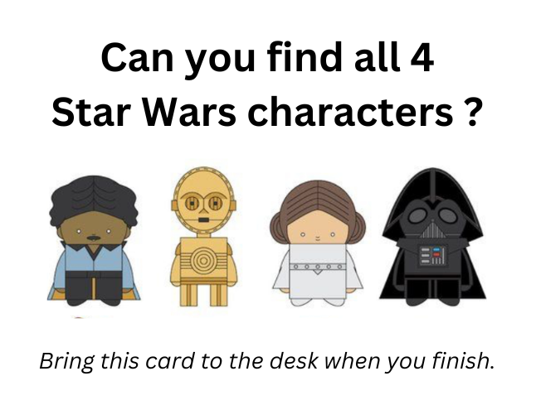
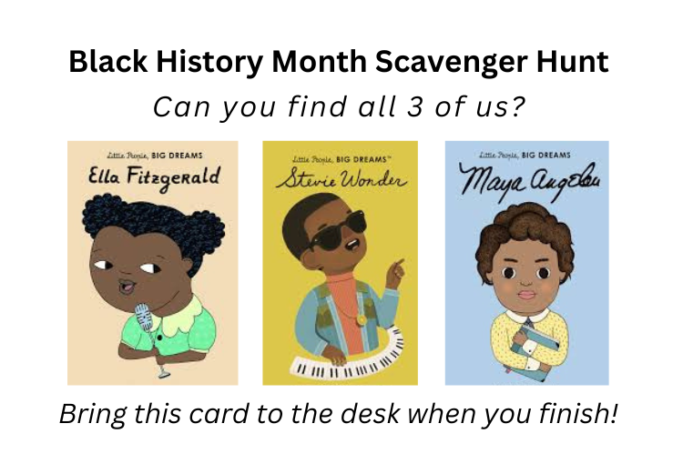
An invitation to explore…
CBCPL monthly Scavenger Hunt games!
These “games” secretively educate our kids on the different sections of the library while learning about history or notable cultural icons.
75%
Passive
Notes:
These scavenger hunts require a bit more preparation, but are wildly popular and have become highly anticipated favorites amongst our little friends. For this activity we provide laminated game cards with 3 characters to be marked off via dry erasers. There is a little sign at the desk that instructs the players to search for these characters, mark off them off as they find them (learning our library sections as they go) and then turning the card in for a treasure chest prize. Many of these scavenger hunts celebrate national holidays or events.

Slide 12
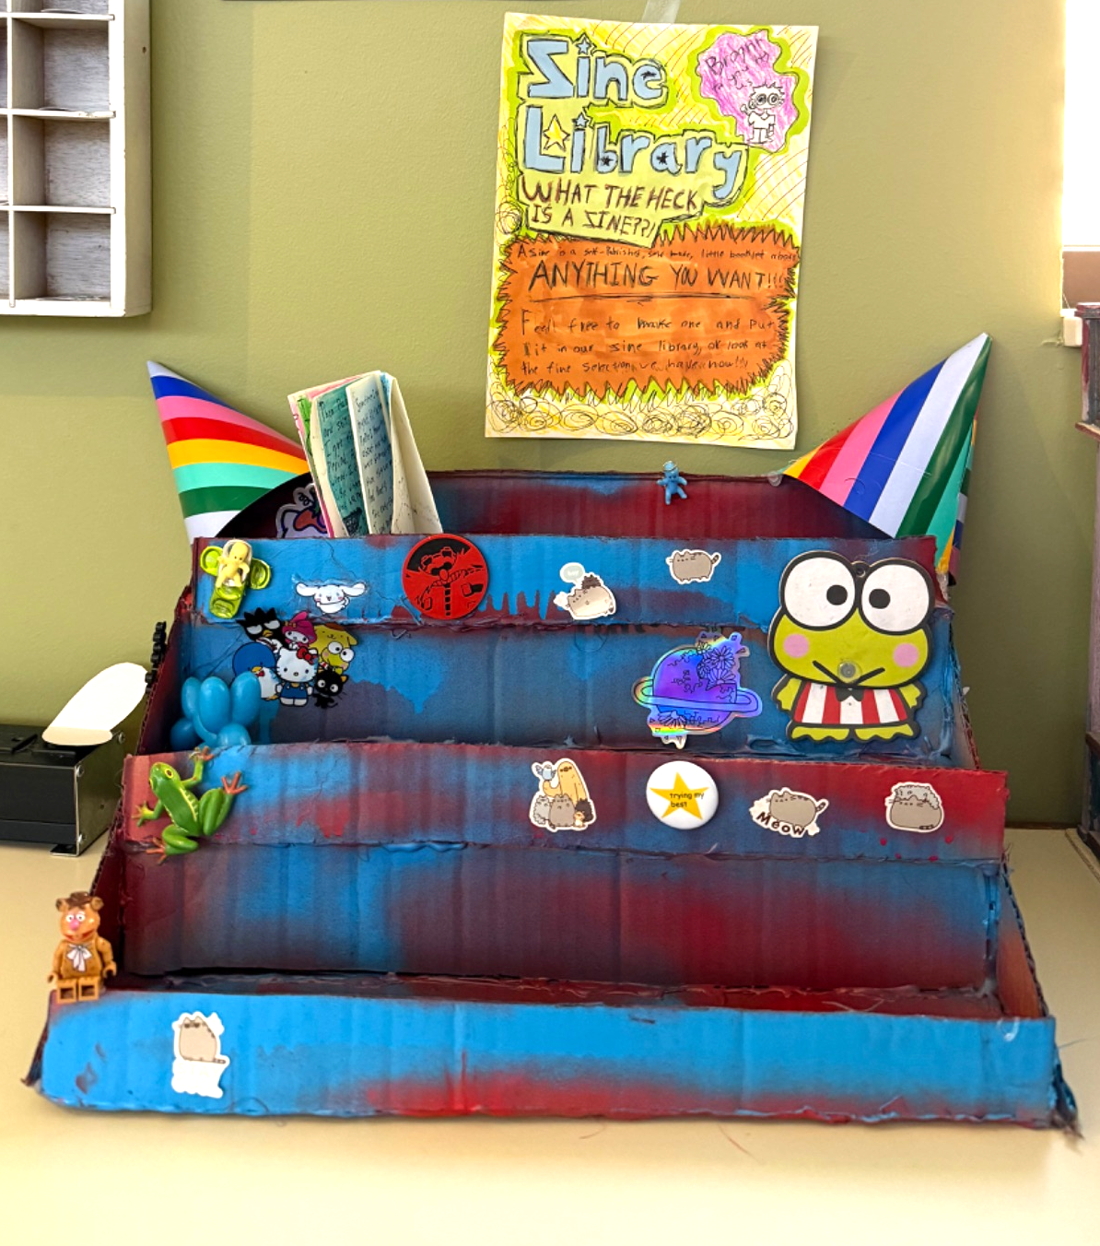
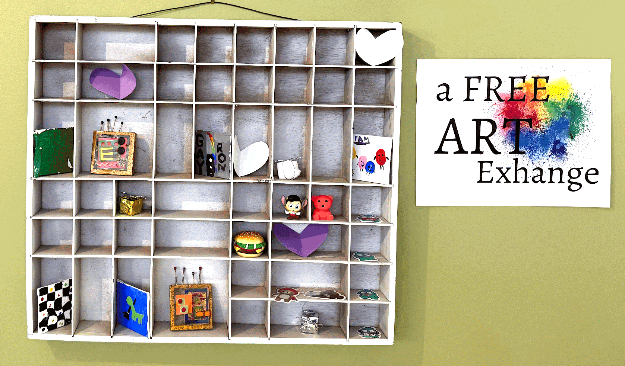
An invitation to trade…
The CBCPL Teen Zone art Exchange!
A make and take Gallery for mini-masterpiece exchanges and Zine Library sharing.
100% Passive
Notes:
These make and take type galleries encourage a safe and easy way for patrons to interact with one another while preserving their privacy. These are wonderful tools that require initial setup, but reap a tremendous return in patron activity and appreciation.

Slide 13
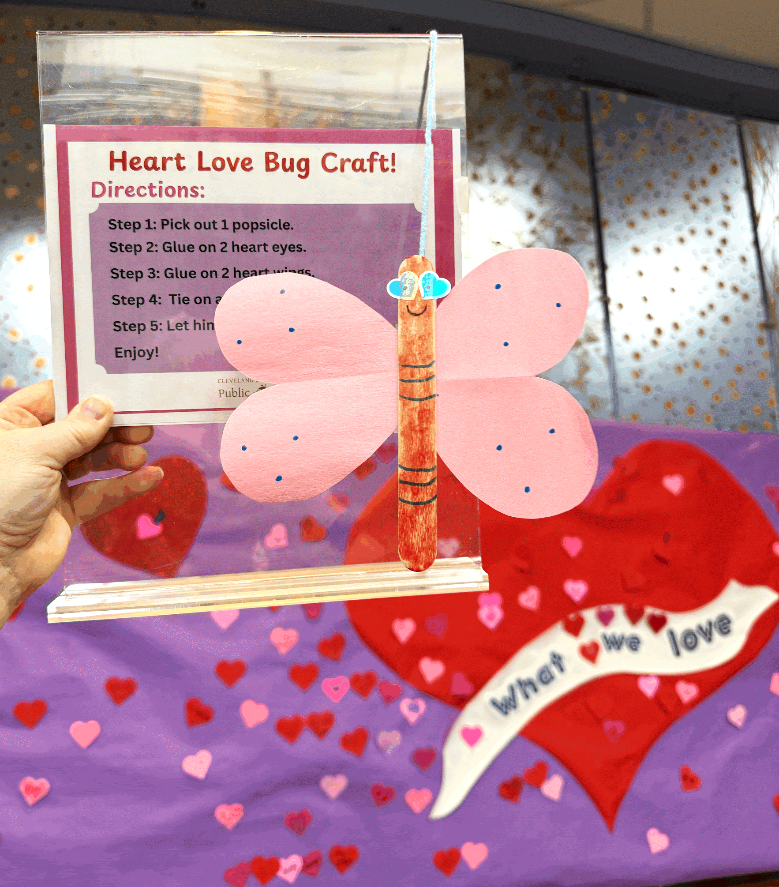
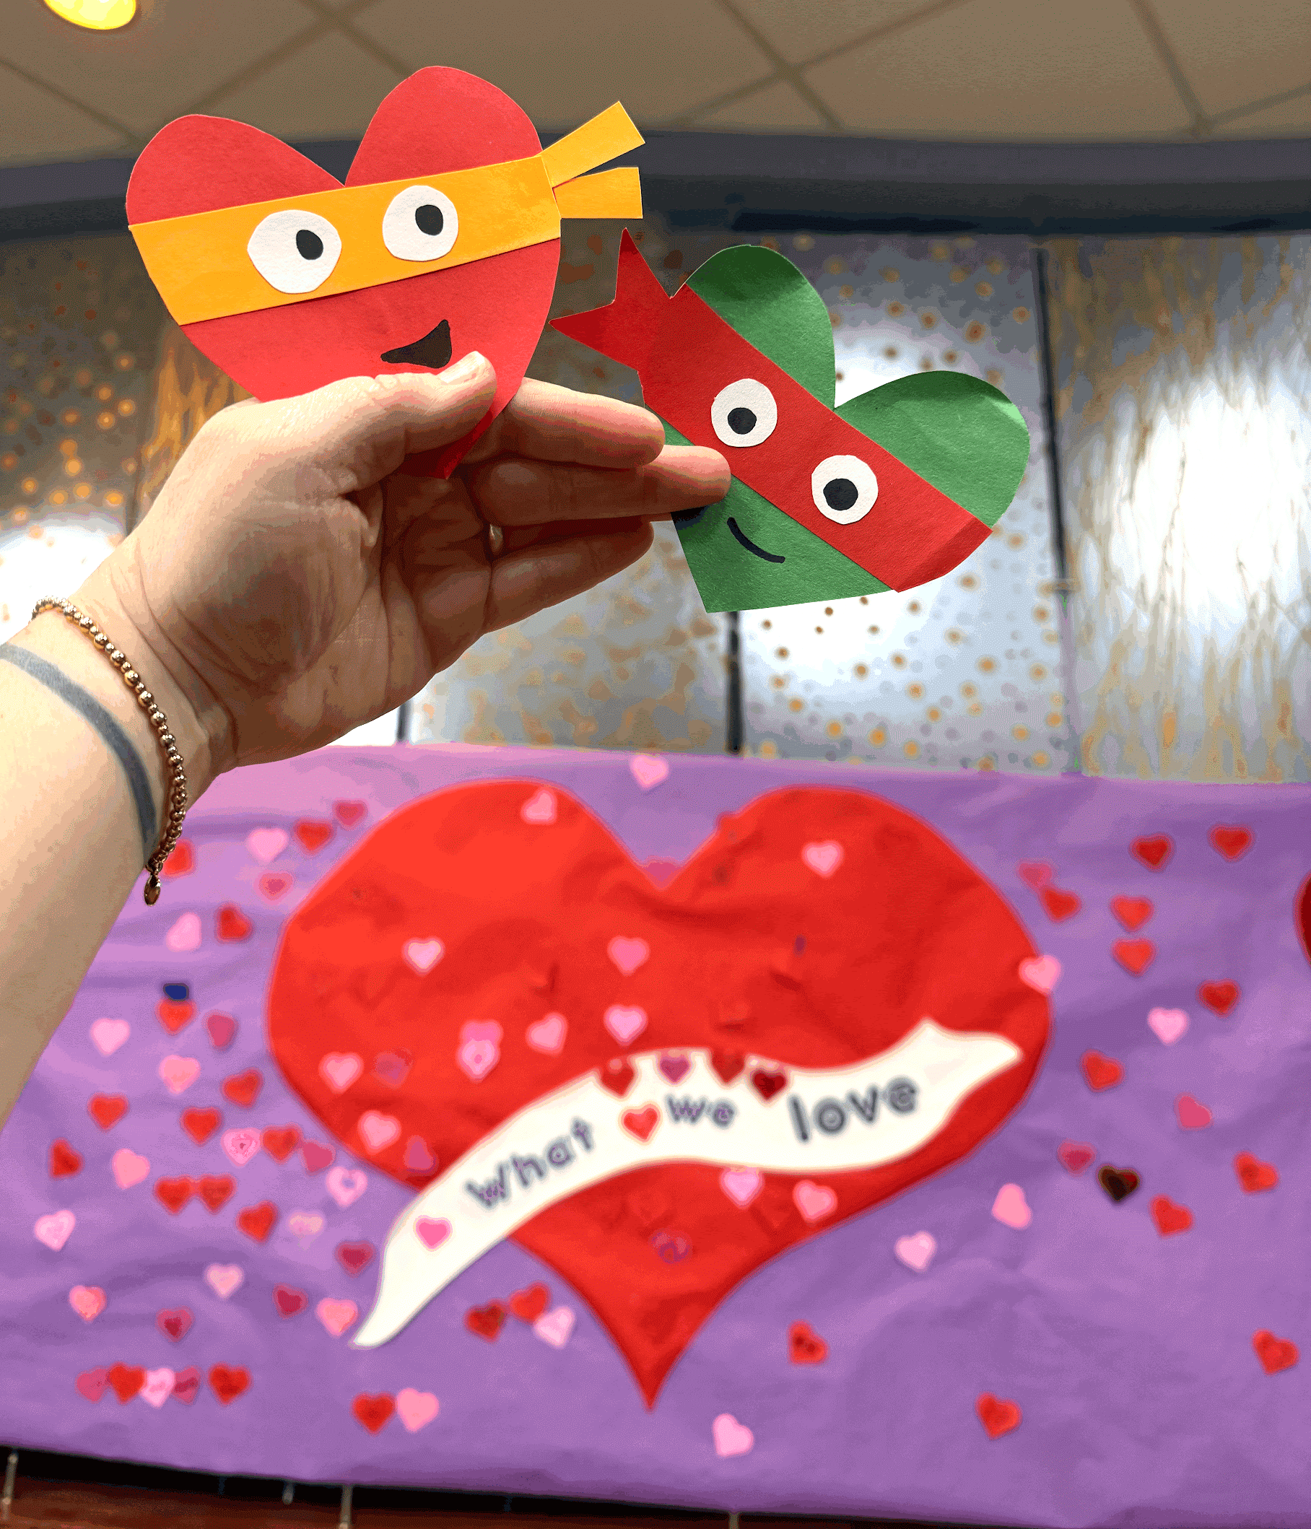
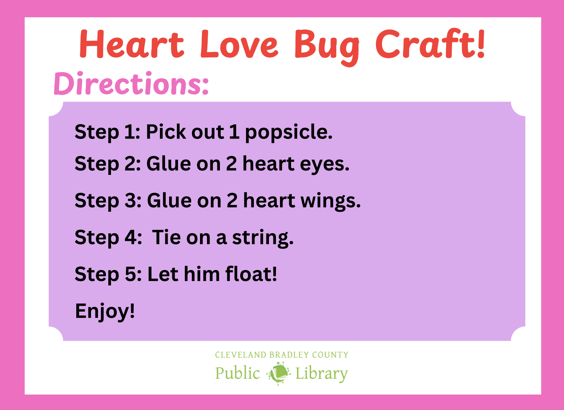
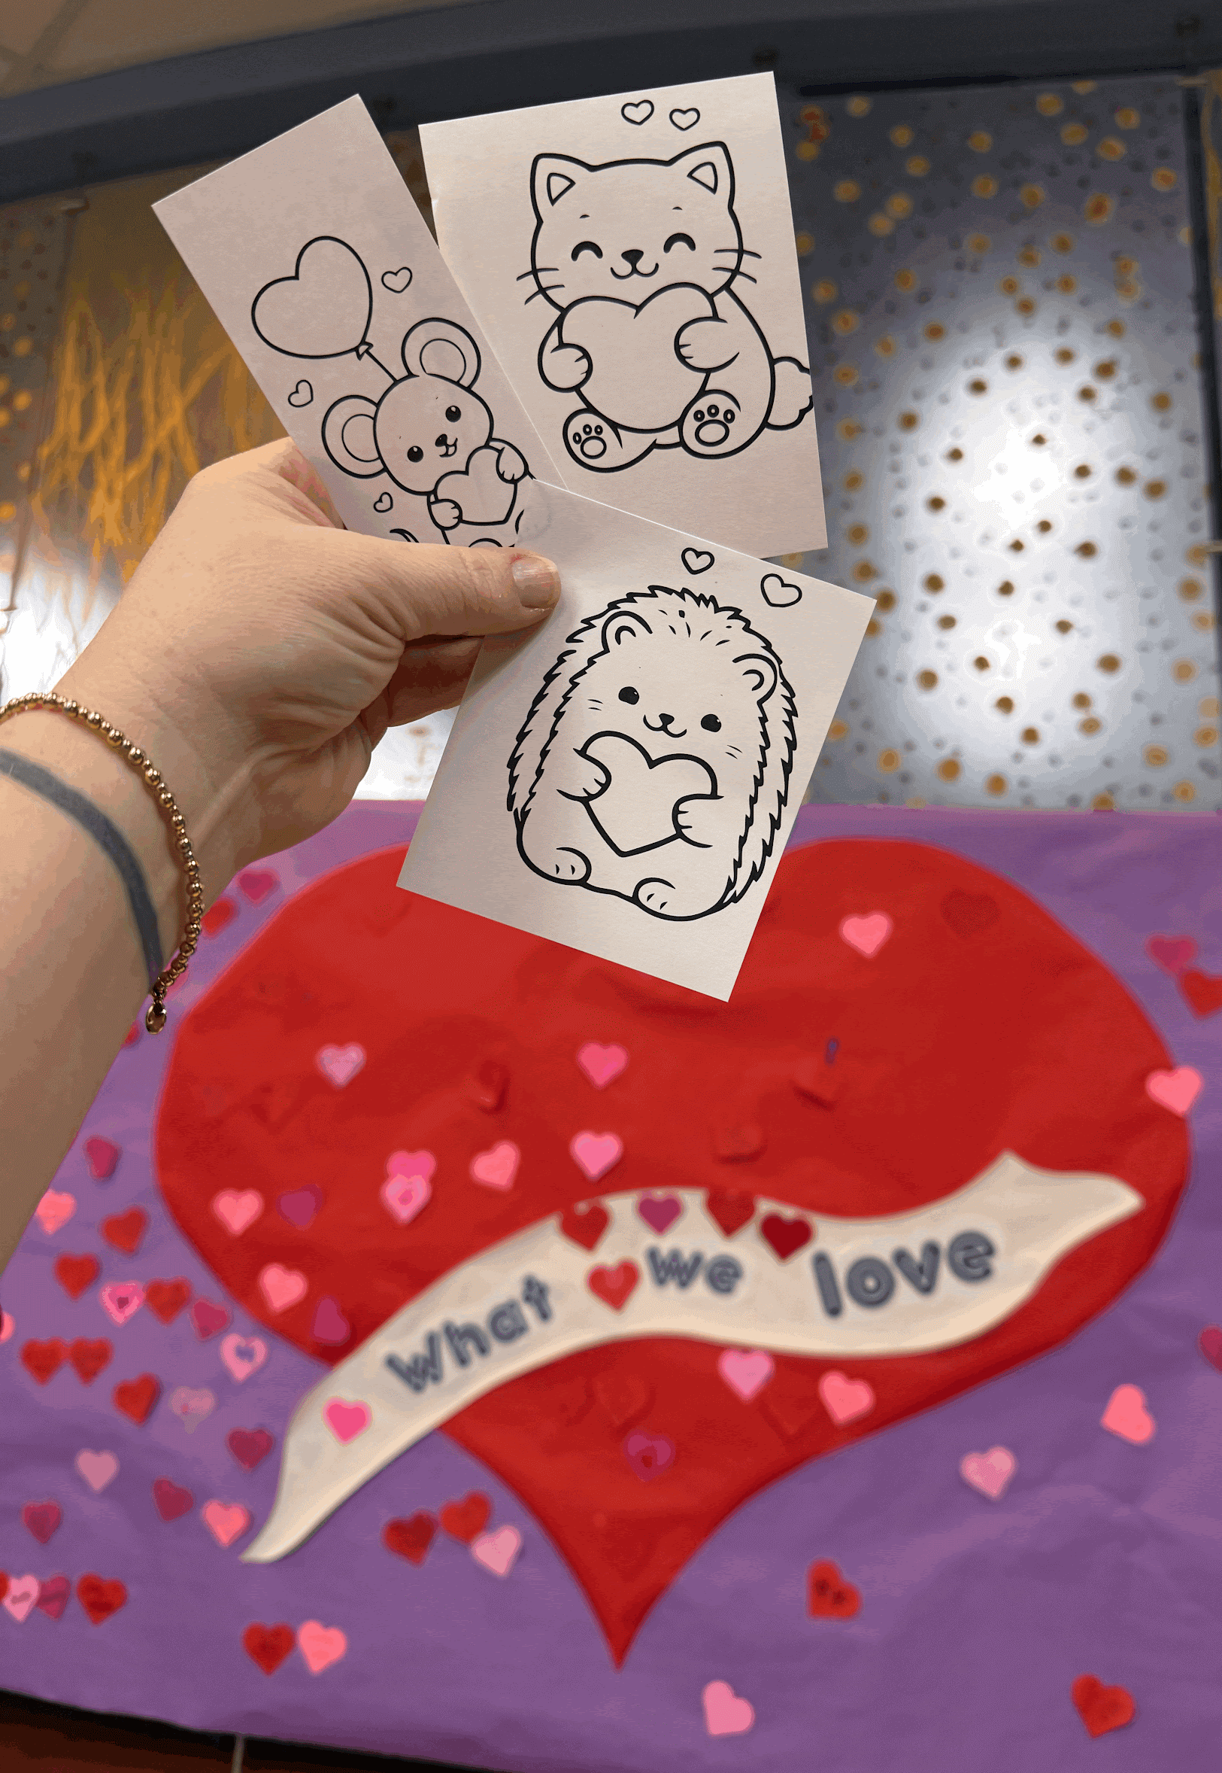
An invitation to create…
A CBCPL Valentines Craft-a-palooza!
Every Craft-a-palooza table is supplied with crafts and directions available for patrons to create at their convenience.
80% Passive
Notes:
For these creative activities we provide a table with 3 different crafts and all the supplies to create them. The table is set up from open to close and has materials, an example and a little instruction guide for each craft. These are available for patrons to make at their convenience and come in really handy during high traffic times like Spring and Fall Breaks.

Slide 14
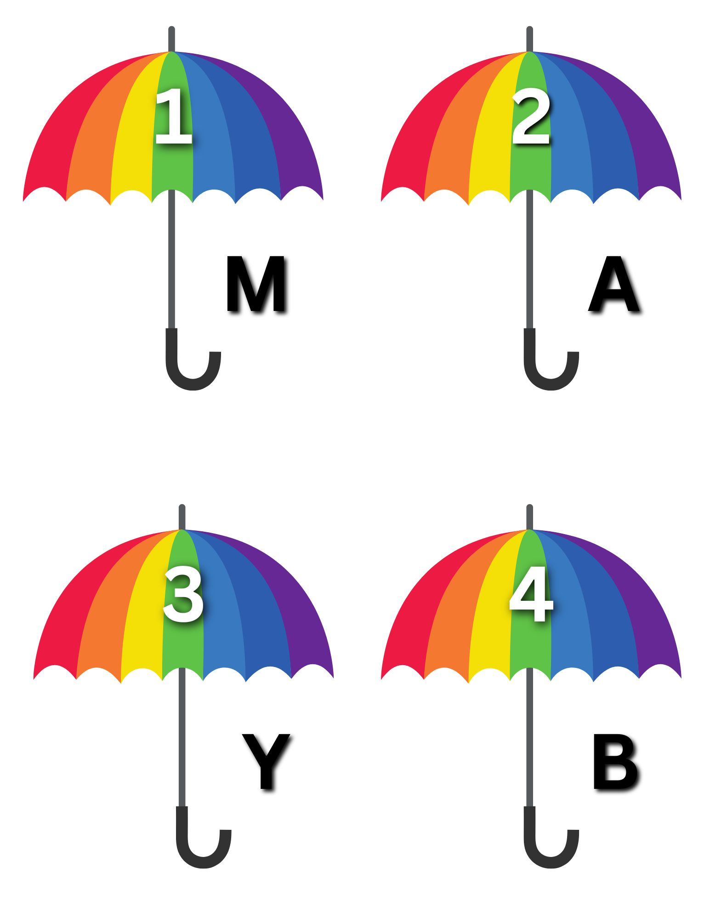
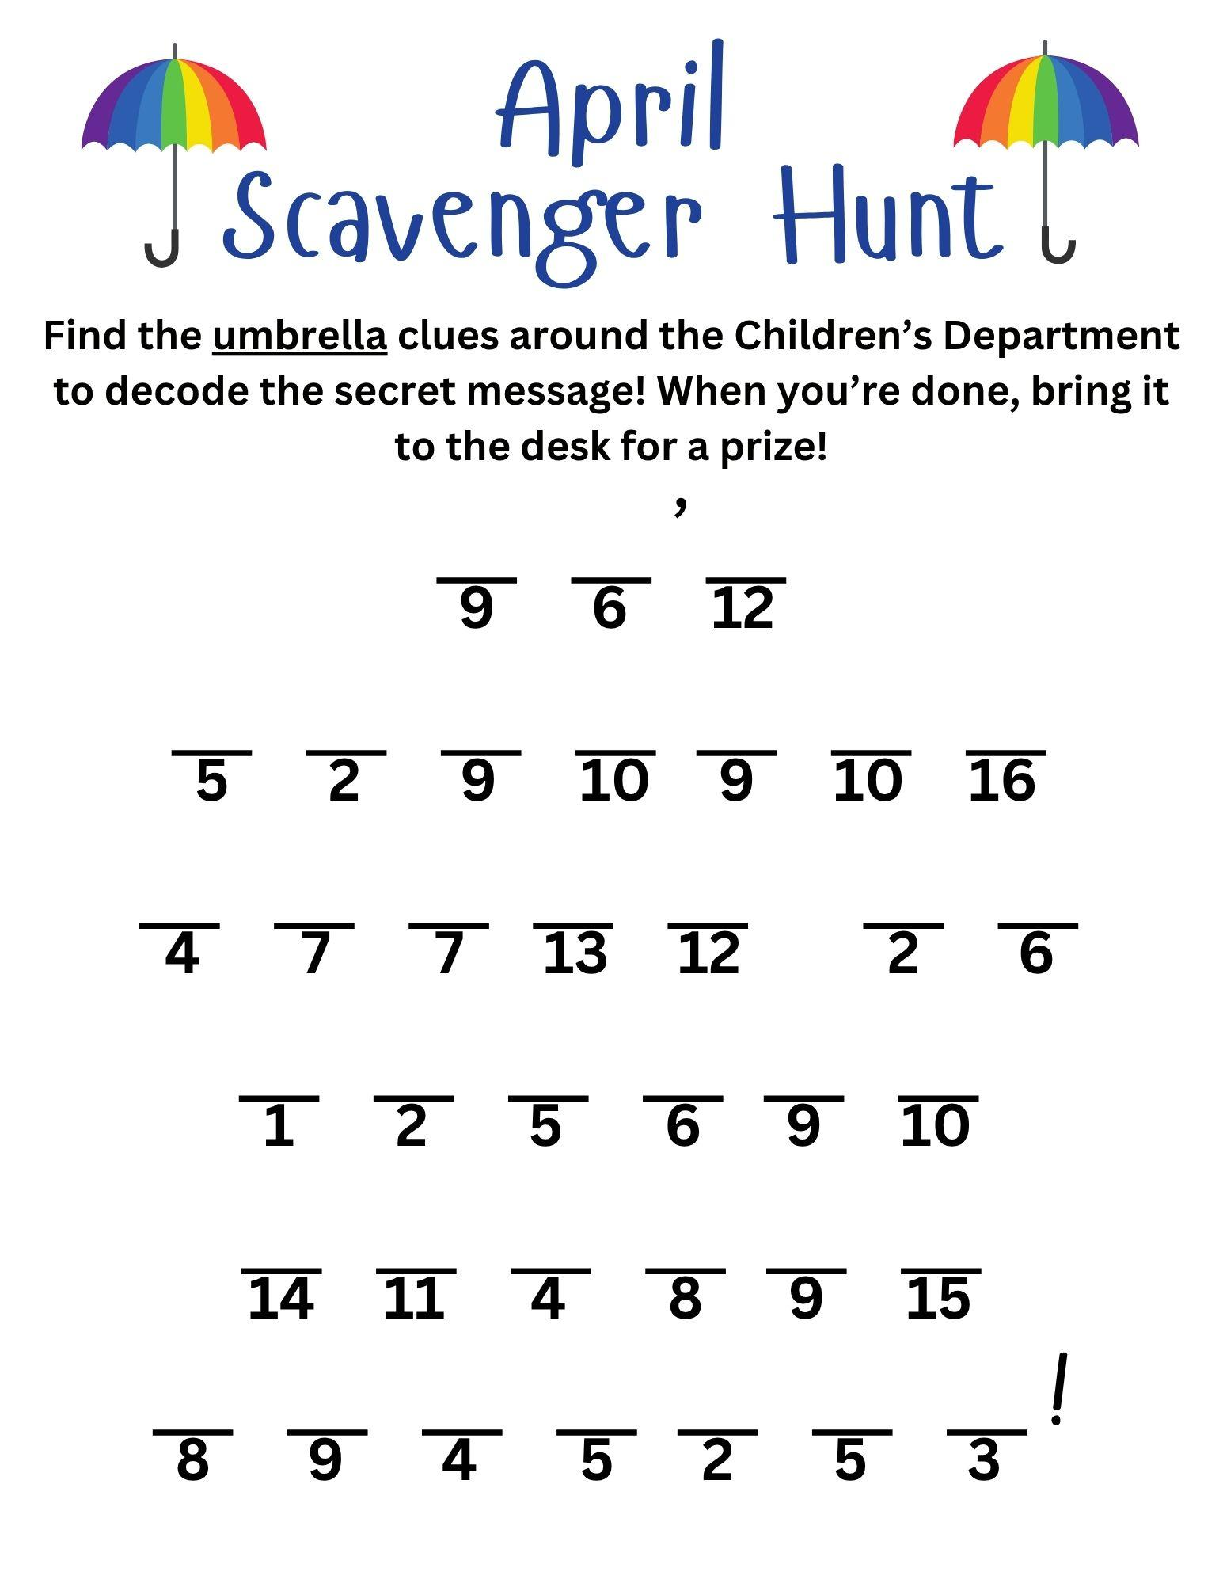
Monthly Scavenger Hunt
Helps with letter and number recognition
Bring attention to different areas of the Children’s Department
All ages are able to participate
Small prizes awarded for finished page
April’s Hidden Message: “It’s Raining Books at Martin Public Library!”

Slide 15
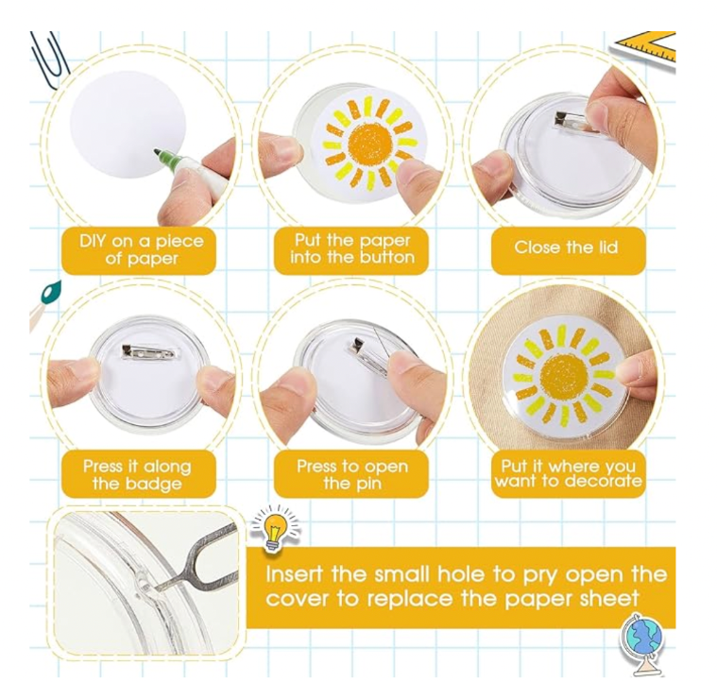
Snap Buttons
Buy in bulk on Amazon (100 buttons for $28.99)
Easy for all ages
  Use stickers for young children
  Allow older children to draw/create their own
Easy to change design
Snap buttons have been one of our most popular quick crafts!

Slide 16
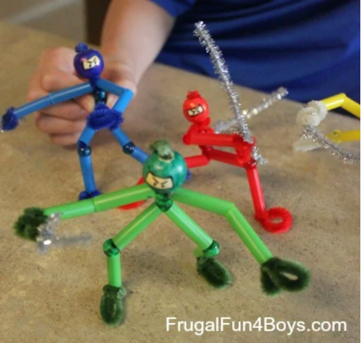
Pipe Cleaner Ninjas
Cheap and easy
  Regular straws
  Pony beads
  Pipe cleaners
  Wooden beads
Great for small groups
Can be prepped and ready to use
Smaller children need a little more guidance.

Slide 17
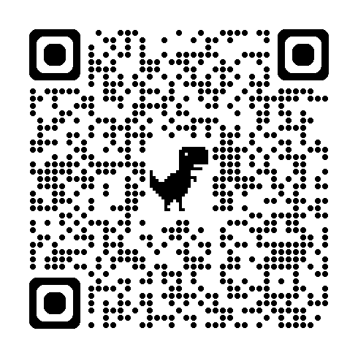
Useful resources
Notes:
Sources:
Lisa Bubert, “DIY to the Rescue: 10 Librarian-tested passive programs,” SLJ, Aug. 29, 2024.
Kelly Jensen and Jackie Parker, “Reaching teens subversively through passive programming,” Programming Librarian, March 29, 2015.
Jamie Wright, “Passive Programming int he middle school library,” Ideas for Learners, March 29, 2025.
Blogs: Backpocketprograms.wordpress.com
Programming Librarian programs
https://expectmiraculous.com/2016/10/06/readers-advisory-quirky-questions-and-crowdsourcing-ideas/

Slide 18
Thank you!
Kate Greene Smith
kate.smith@tnsos.gov
Jennifer Kring
jkring@clevelandlibrary.org
Jenny Claiborne
jclaiborne@martinpubliclibrary.org

