Slide 1
PebbleGo:
Don’t Take it For Granite!
TNLA Conference 2026
Andrea Zielke

Slide 2
Agenda
PebbleGo Overview
Examples in the library/classrooms
Educator resources
Ways to connect PebbleGo to students
Supporting Summer Reading

Slide 3

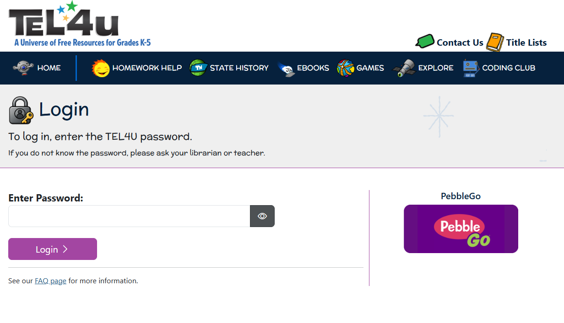
TEL Schools: New Authentication
New TEL Schools Portal
https://students.tntel.info/
Elementary password – read
  TEL4U.org is active
Middle password – learn
High password – research
www.tntel.info

Slide 4

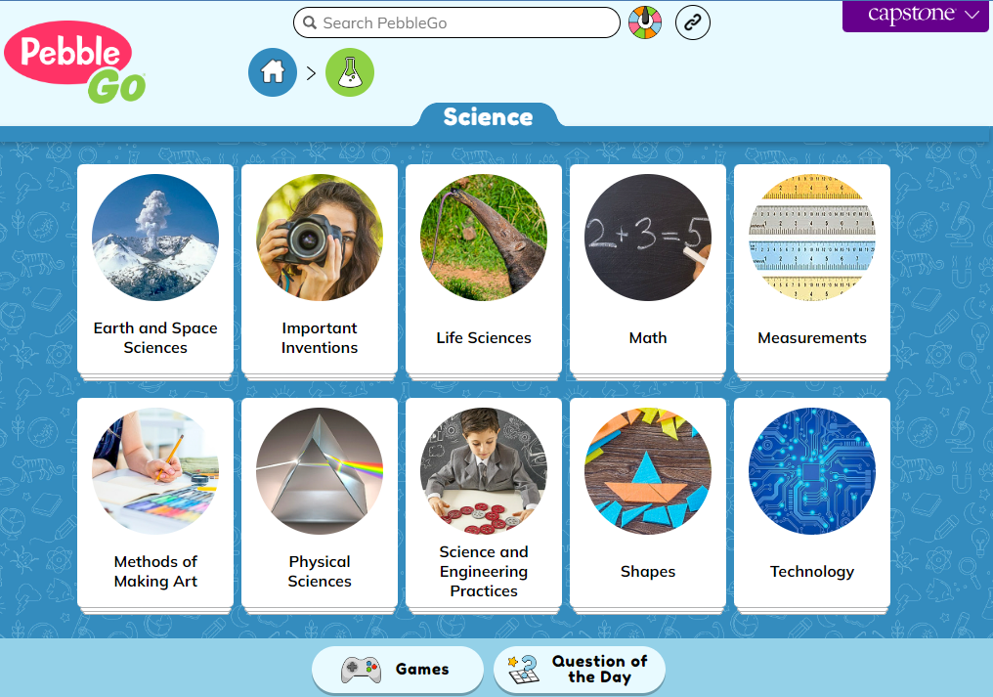
What is PebbleGo?
PebbleGo is a Kindergarten –
3rd Grade learning database
Safe online curricular content designed for elementary students
Packed with informational articles and ready-made activities
Allows early and emerging readers a chance to hone their research skills with ease

Slide 5
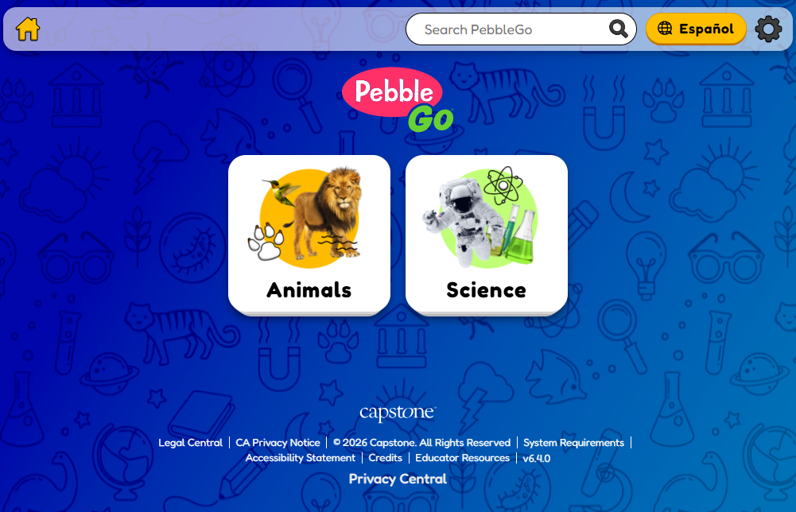
PebbleGo Modules
TEL provide statewide access to:
Science
Ciencia
Animals
Animales
All Modules are access through
the same link

Slide 6
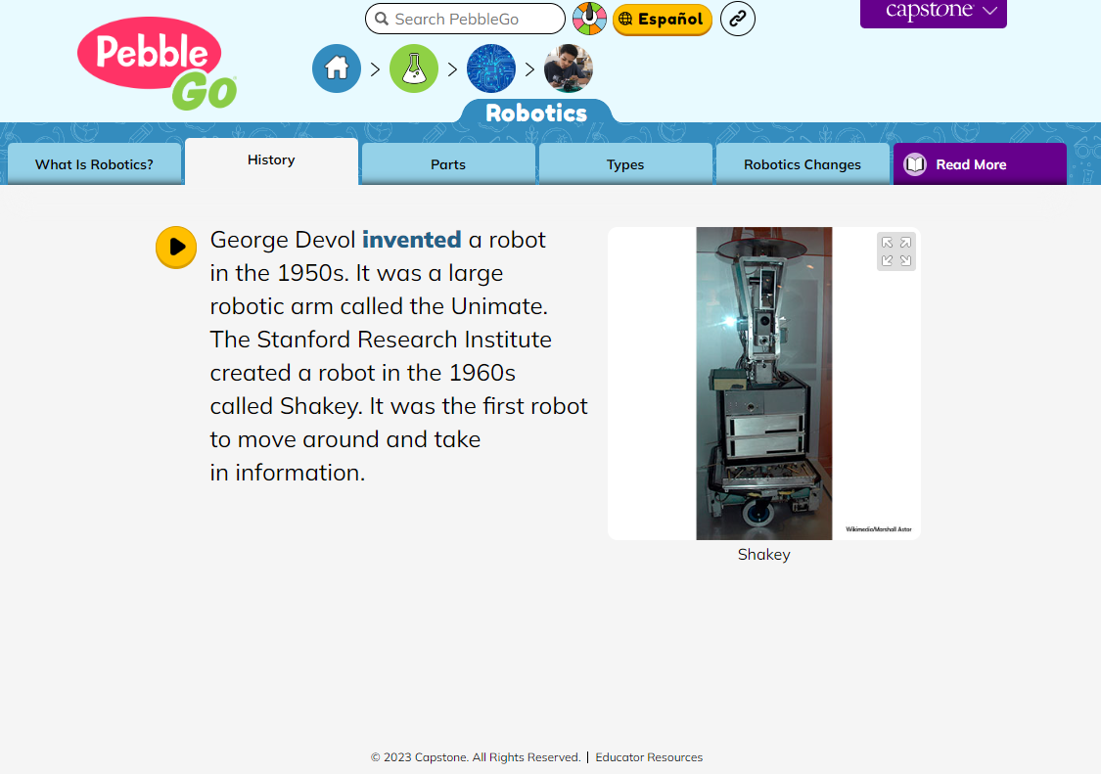
PebbleGo Features
Content includes text articles, audio, images, and video.
Users can hover over a topic tile to hear it read aloud.
Articles are chunked into easy-to-read short passages.
Large Photos/ Images are included to visually support the text.

Slide 7
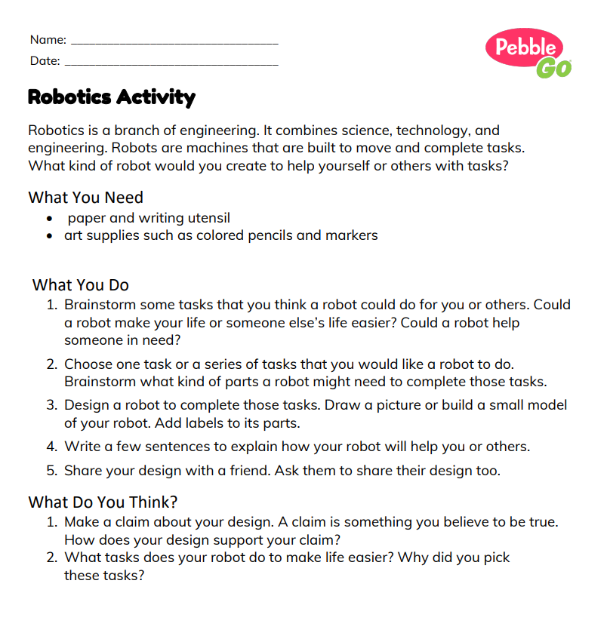
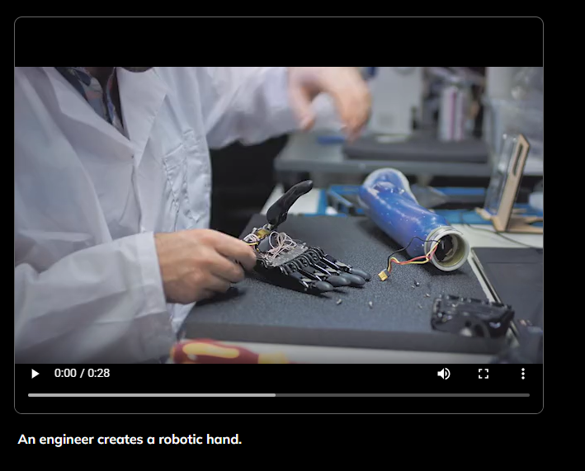
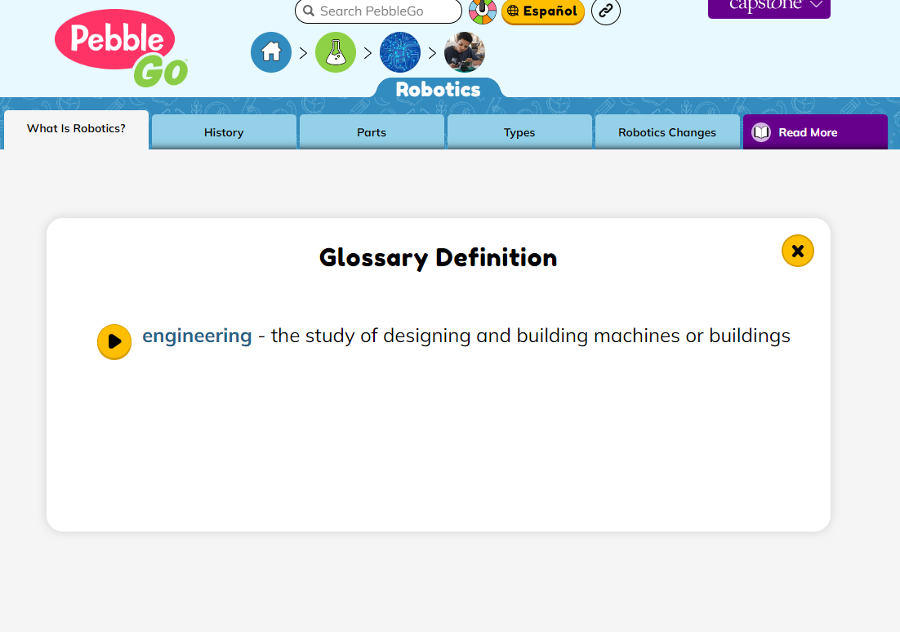
More PebbleGo Features
Video snippets are provided to illustrate key concepts.
Definitions can be accessed from within articles.
  Activities are available to reinforce what information was presented in each article.

Slide 8
Let’s Jump into PebbleGo

Slide 9
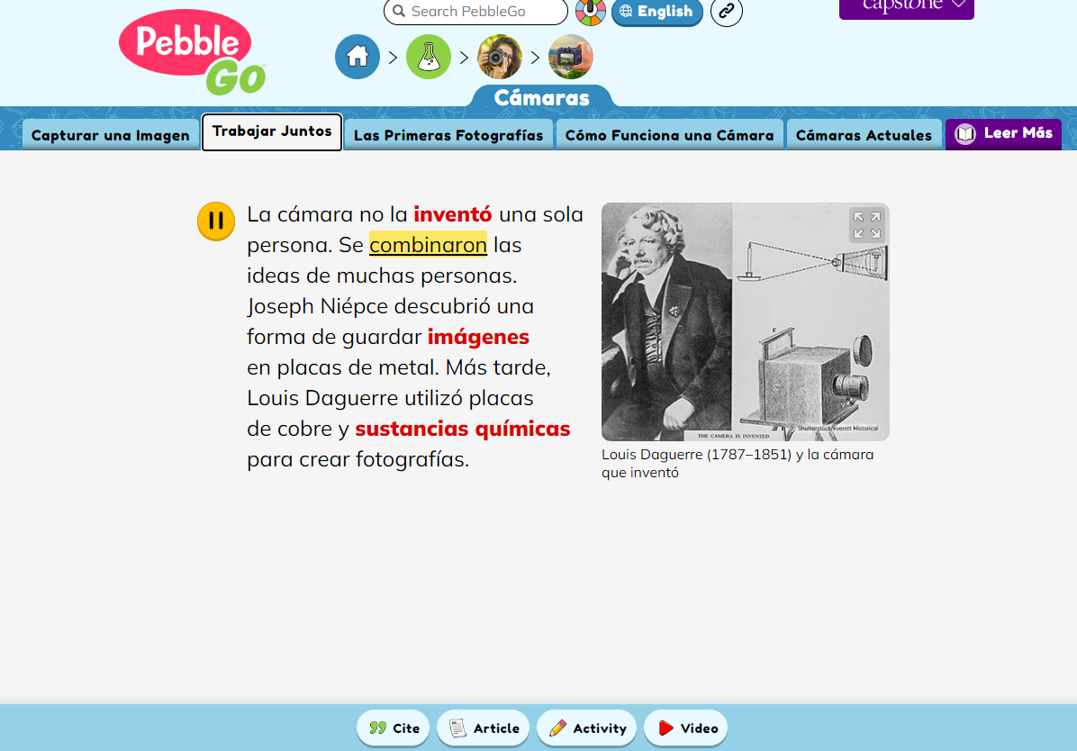
How are librarians using PebbleGo?

Slide 10
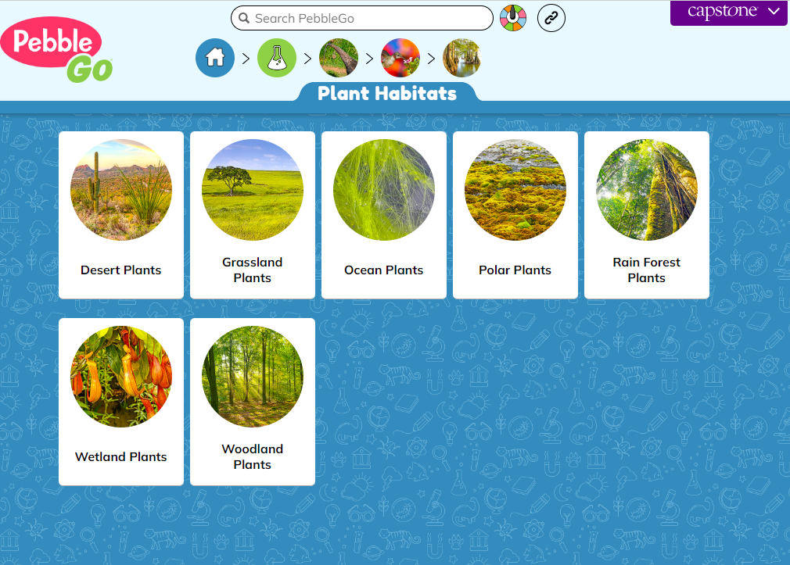
Online Research/Independent Research
Introduction to online research
Focus on Independent Research
Teaching research skills
“We use PebbleGo with whole-group to gain background knowledge and also use it to do independent research”

Slide 11
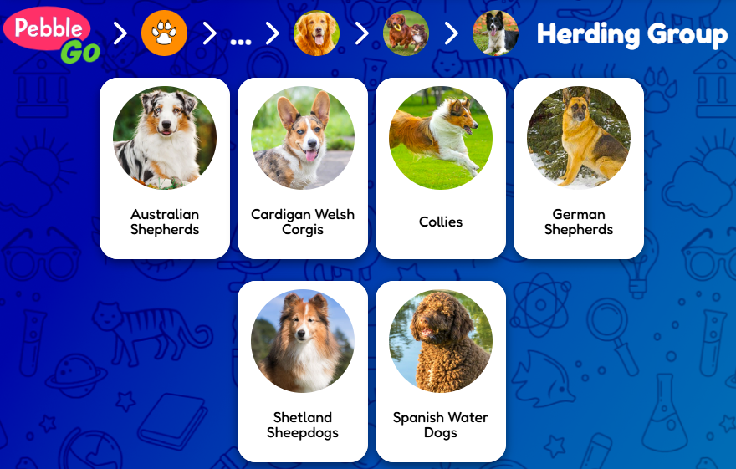

Nonfiction Source
Integrate research about books/lesson being taught
Connect it to the read aloud in the library
Highlight videos

Slide 12
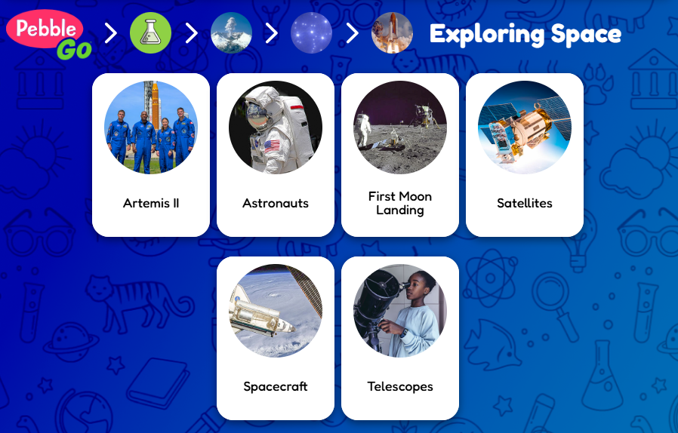
Connecting to today’s news
Use Social Studies to look up countries and states in the news
“This is my all-time favorite database that TEL has added! We use it all the time and it is amazing. Science and social studies were the perfect choices to begin with because that is something where classroom teachers really struggle to find a resources to teach in the elementary grades”

Slide 13
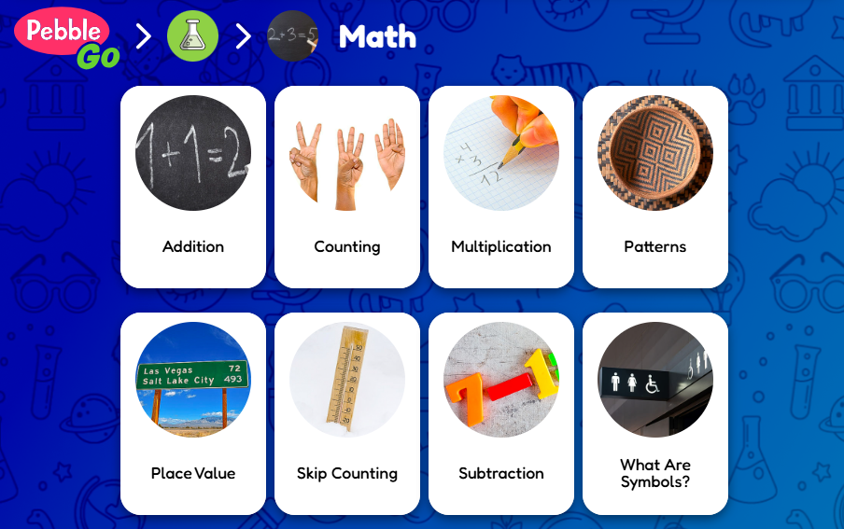
RTI/Special Education/ESL/Visually Impaired Students
Utilize the read aloud features
Easy to use on all devices
With the consistent interface, PebbleGo can be used to show how to navigate technology
“The classroom teachers, special education teachers and ESL teachers use it daily. It’s used to enhance their Science programs.”

Slide 14
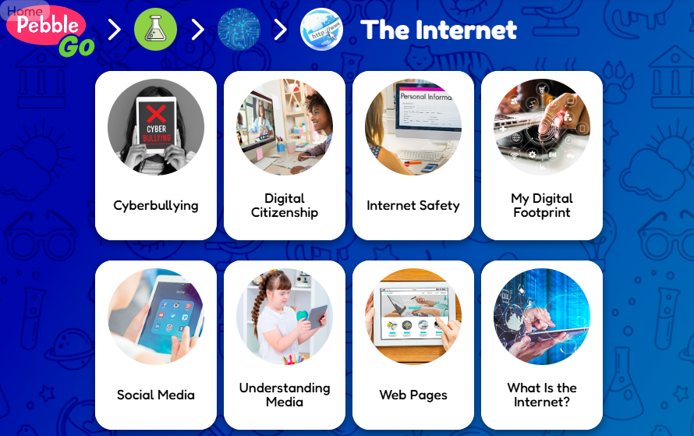
Introduce Digital Citizenship
Cover topics like Internet Safety, Digital Footprint, and Cyberbullying

Slide 15
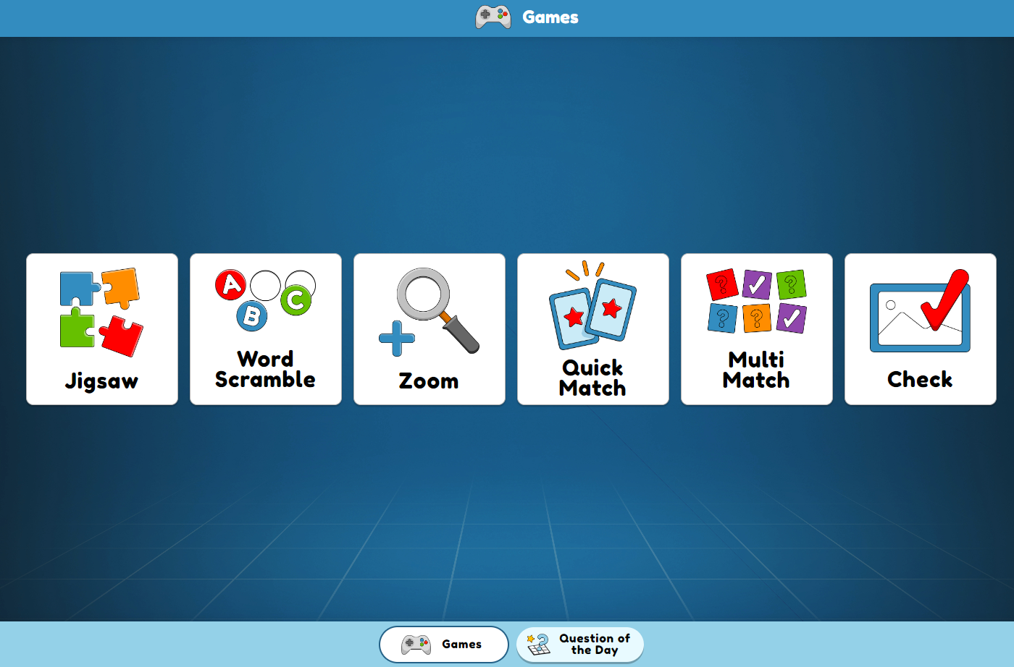
Incentive Time!
Games and activities are great for good behavior/staying on task
Question of the Day – nice bell ringer activity

Slide 16
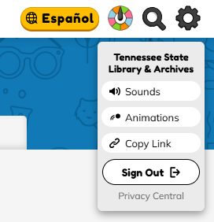
Set up a PebbleGo Choice Board
With TEL resources, you can’t share the link in the browser –
PebbleGo – Top Right Gear – use the Copy Link option

Slide 17
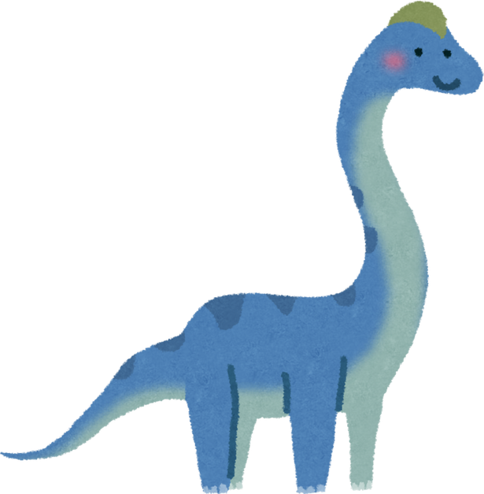
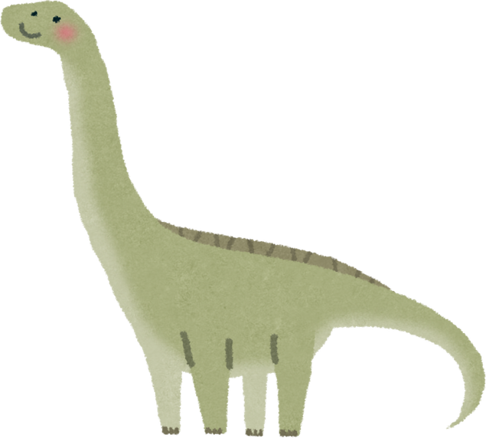
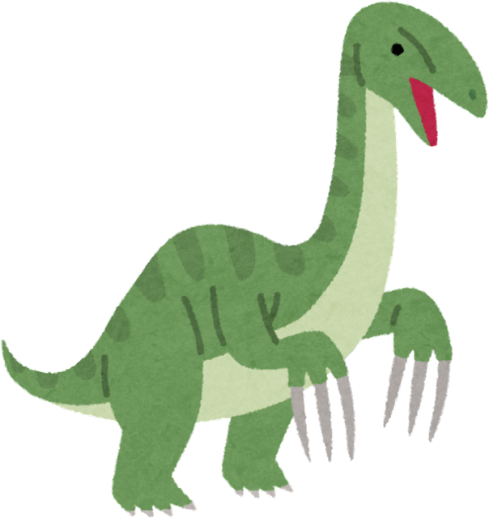
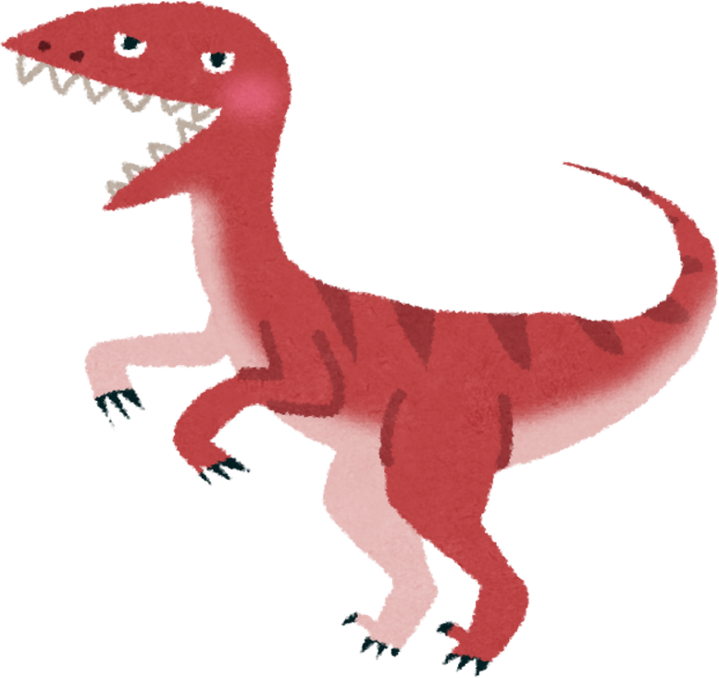
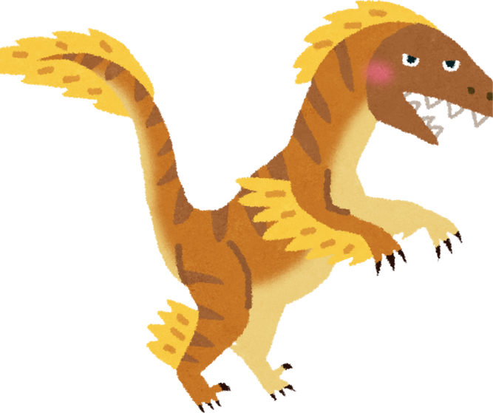
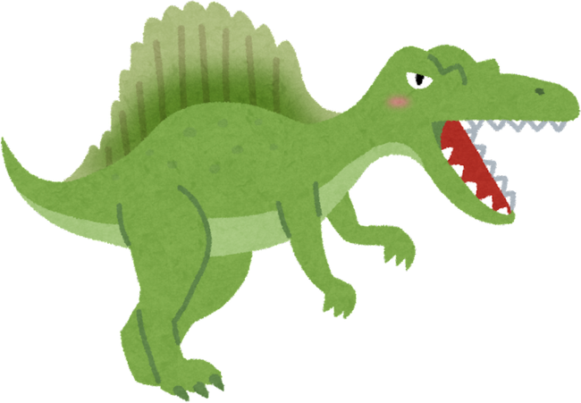
Which dino would be a good pet?
BRACHIOSAURUS
APATOSAURUS
THERIZINOSAURUS
Select a dinosaur and find 3 facts about why your choice would make a good pet!
VELOCIRAPTOR
SPINOSAURUS
DEINONYCHUS

Slide 18
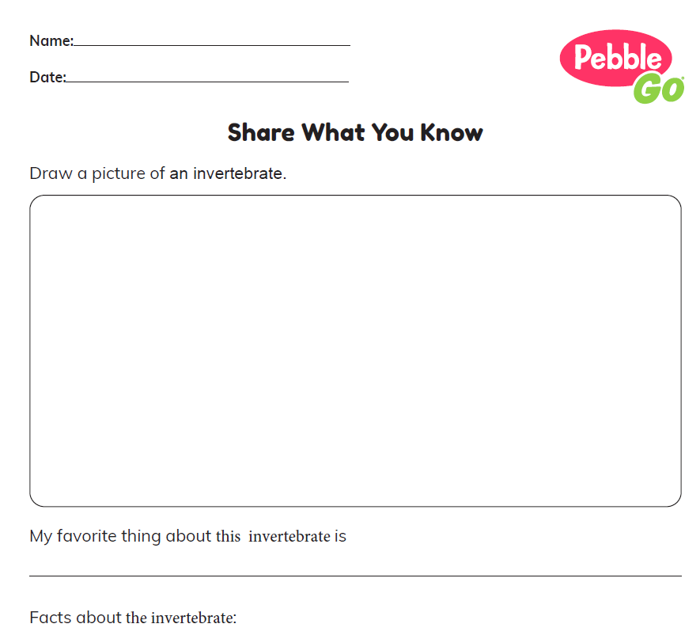

PebbleGo Premade Activities
See handouts for Invertebrate Activity
Animals>> Invertebrates >> Select Invertebrate>>Activity button
*worksheet modified - not animal specific
www.tntel.info
Notes:
It has resources grouped into six categories: homework help, state history, ebooks, games, look it up, and coding club.

Slide 19
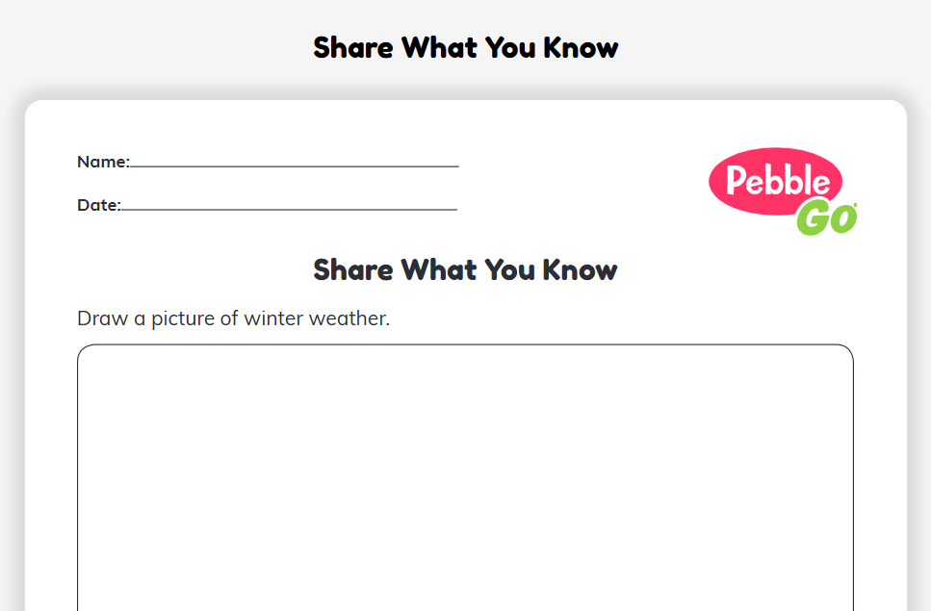
PebbleGo Station Idea
Pick out an interesting Invertebrate
on PebbleGo Animals.
Use the information found on PebbleGo complete the Share What You Know worksheet.
www.tntel.info
Notes:
It has resources grouped into six categories: homework help, state history, ebooks, games, look it up, and coding club.

Slide 20
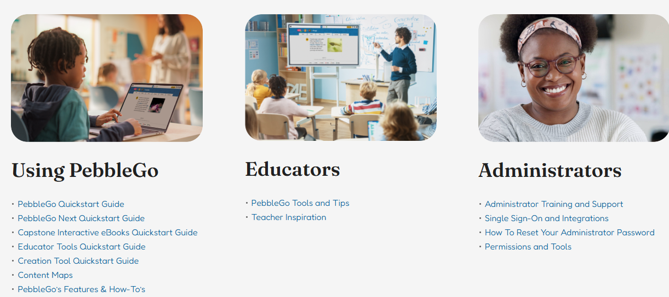
Educator Resources
https://www.pebblego.com/resources

Slide 21
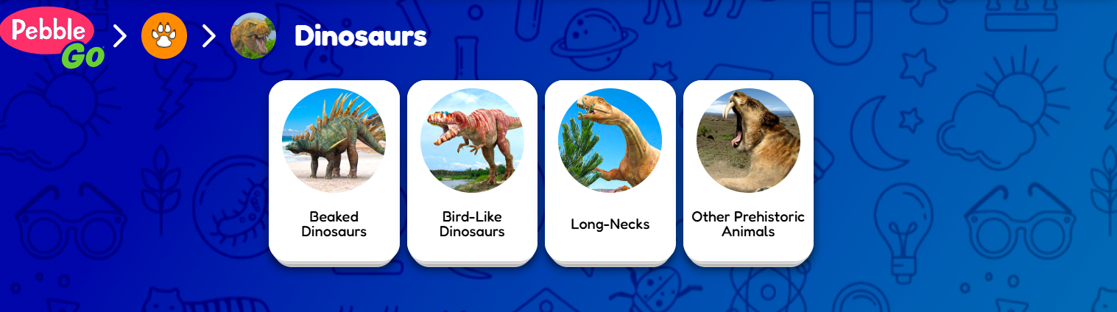
Supporting Summer Reading
PebbleGo Animals -- > Animals
www.tntel.info
Notes:
It has resources grouped into six categories: homework help, state history, ebooks, games, look it up, and coding club.

Slide 22
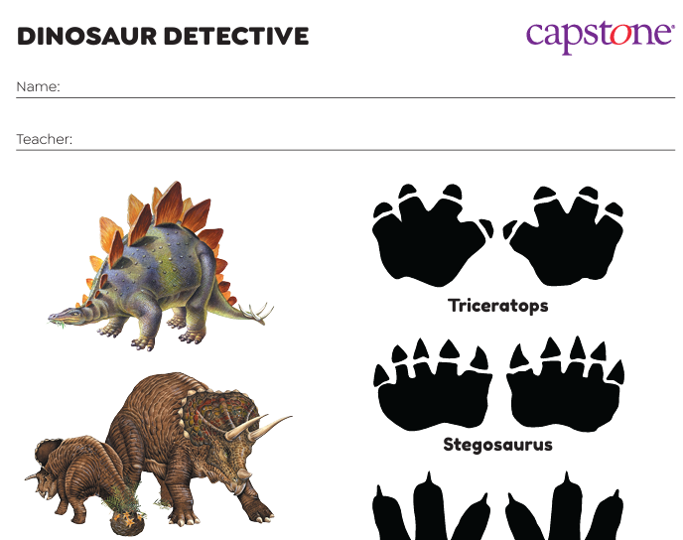
Dino-mite Databases Ideas
Battle of the Dinosaurs
Be a Dinosaur Detective
Dino Dinner Matching
Dinosaur Crossword
Dinosaur Food Web
Dinosaur Maze
Dinosaur Name Pronunciation Guide
Dinosaur Research
Dinosaur Word Find
www.tntel.info
Notes:
It has resources grouped into six categories: homework help, state history, ebooks, games, look it up, and coding club.

Slide 23
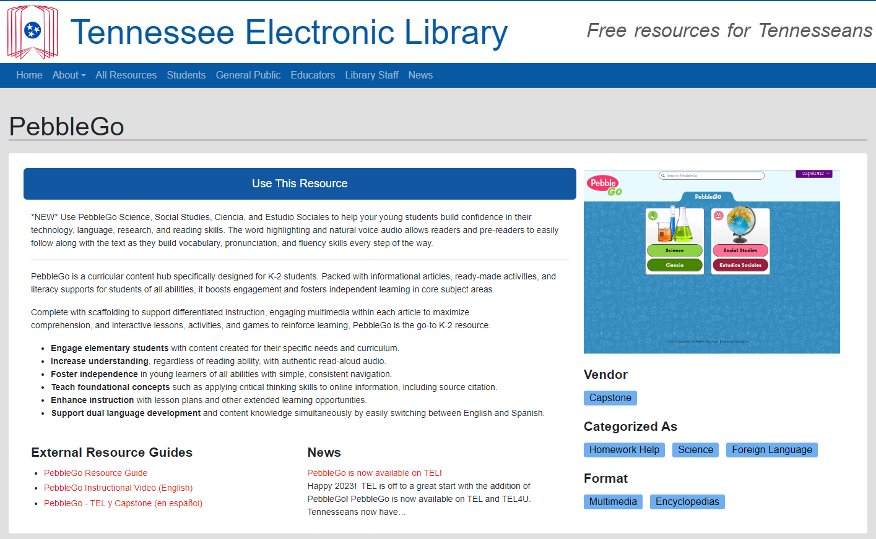
How can I access PebbleGo?
PebbleGo is located on -
TEL4U.org
Tntel.info
Create school specific links
  collects school usage
  great for use with Classlink/Google
  ability to disable articles

Slide 24
PebbleGo Additional Resources
Educator Resources - https://www.pebblego.com/resources
PebbleGo/TEL Partner Page – https://www.pebblego.com/tn-welcome-page
  Includes great intro videos for use at board meeting!
Content Maps
  PebbleGo Animals
  PebbleGo Animales
  PebbleGo Science
  PebbleGo Ciencia

Slide 25
Questions?
www.tntel.info

Slide 26
Contact Info
Andrea Zielke
TEL Administrator
615-532-4627
andrea.zielke@tnsos.gov
www.tntel.info

