Slide 1


ऐं
DIVINATIONS Org
Intiative
Conferences, Events, Courses
On Jyotiṣa Veda Vedāṅga Astronomy Astrology Vastu Palmistry Tarot Occult Mysticism
ॐ
https://divinationsorg.thinkific.com/
SonalVedicEssence.com
©All Rights Reserved.Sonal Sachdeva

Slide 2

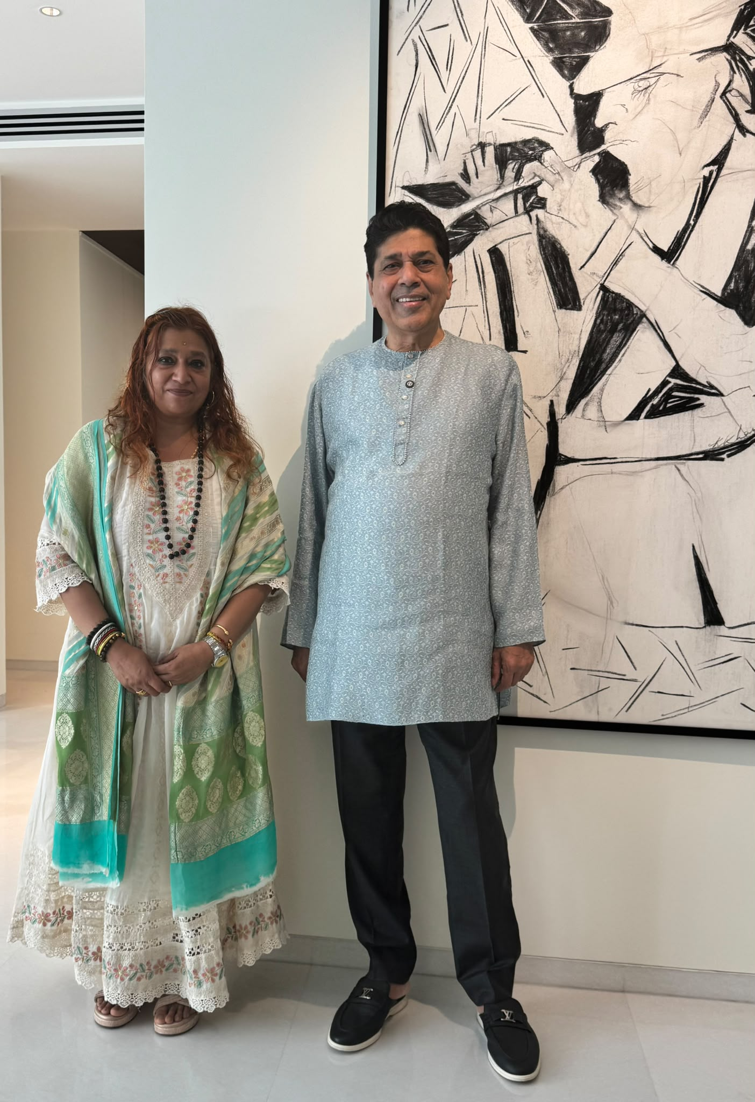
ॐ
And gratitude and utmost gratefulness to all my teachers Vedanta and Jyotisha
Pt Sanjay Rath
Smt Sarbani Rath
Uma Shankarji of Siddhar
Tradition of Palani, Southern India
Swaminiji B and Swamiji of
Arsha Vidhya of Pujya Guruji
Dayananda Saraswati

Slide 3
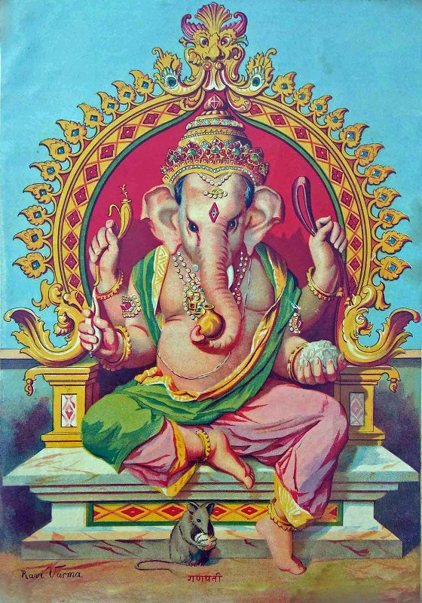
Gaṇeśa Mantra
गणानां त्वा गणपतिं हवामहे कविं कवीनामुपमश्रवस्तमम्।
ज्येष्ठराजं ब्रह्मणां ब्रह्मणस्पत आ नः षृण्वन्नूतिभिः सीद सादनम्॥
gaṇānāṁ tvā gaṇapatiṁ havāmahe kaviṁ kavīnāmupamaśravastamam|
jyeṣṭharājaṁ brahmaṇāṁ brahmaṇaspata ā naḥ ṣṛṇvannūtibhiḥ sīda sādanam||
O Ganapati, To You Who are the Lord of the Ganas, we Offer our Sacrificial Oblations, You are the Wisdom of the Wise and the Uppermost in Glory, You are the Eldest Lord and is of the Nature of Brahman; You are the Embodiment of the Sacred Pranava Om, Please come to us by Listening to our Prayers and be Present in the Seat of this Sacred Sacrificial Altar.
प्रणो देवी सरस्वती वाजेभिर्वजिनीवती धीनामणित्रयवतु।
praṇo’ devī sara’svatī | vāje’bhir vājinīvatī | dhīnāma’vitrya’vatu ||
gaṇeśāya’ namaḥ | sarasvatyai namaḥ |
śrī gurubhyo namaḥ | hariḥ oṃ ||

Slide 4
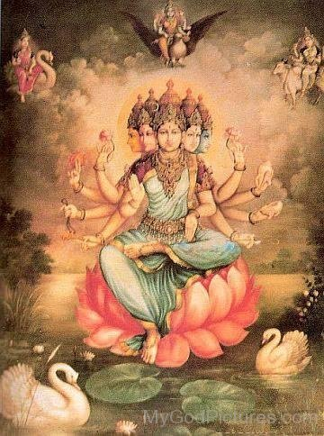
श्रीगणेशायनमः | Shri Ganeshay Namah
श्रीजानकीवल्लभो विजयते | Shri JanakiVallabho Vijayte
श्रीरामचरितमानस | Shri RamCharitManas
प्रथम सोपान | Descent First
श्री बालकाण्ड | Shri Bal-Kanda
चौपाई 17.4| | Caupāī 17.4
जनकसुता जग जननि जानकी। अतिसय प्रिय करुनानिधान की॥
ताके जुग पद कमल मनावउँ। जासु कृपाँ निरमल मति पावउँ॥4॥
janakasutā jaga janani jānakī. atisaya priya karunā nidhāna kī..
tākē juga pada kamala manāvauom. jāsu kṛpāom niramala mati pāvauom..
Janaki, daughter of Janaka and mother of the universe and the most beloved consort of Sri Rama, the Fountain of Mercy, I seek to propitiate the pair of Her lotus feet, so that by Her grace I may be blessed with a refined intellect.
Instead of the Gayatri this is a Excellent option -

Slide 5
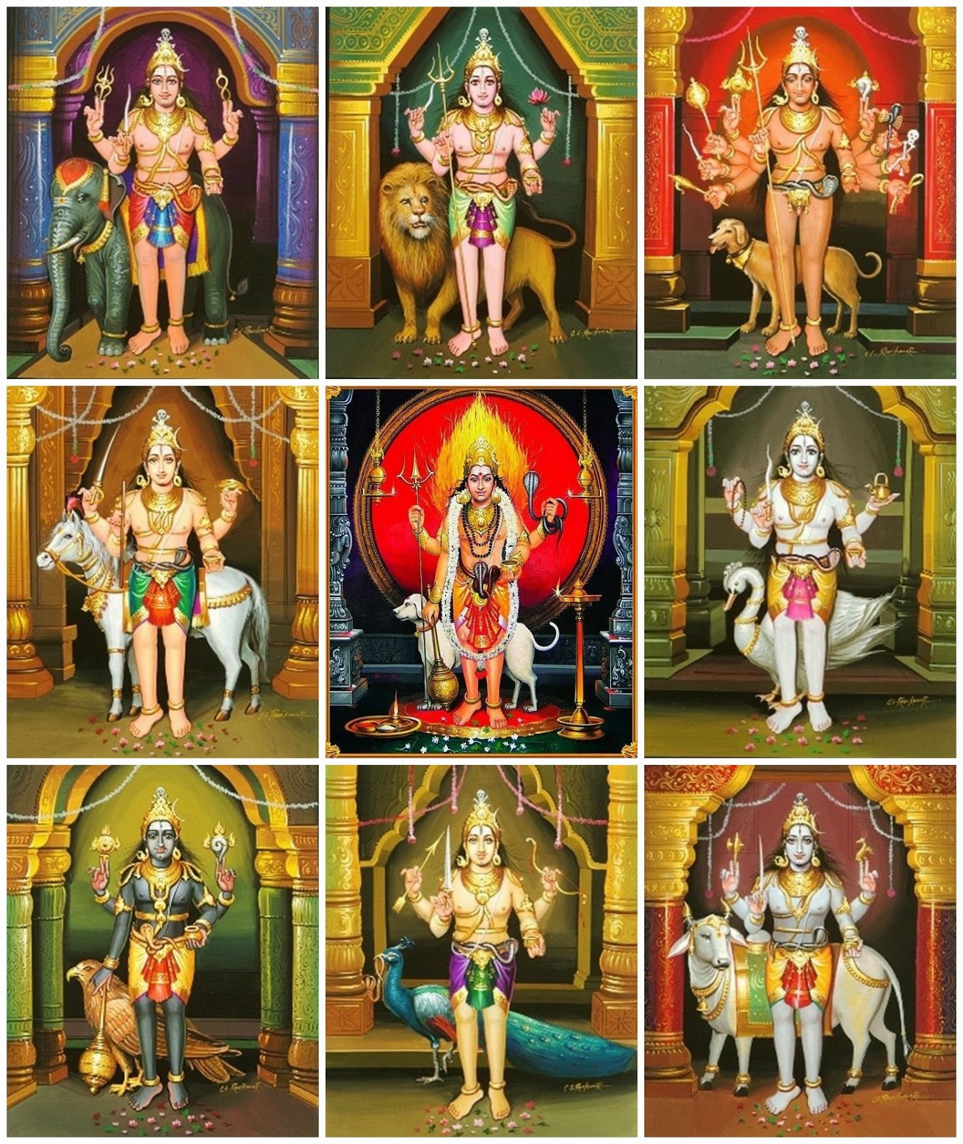
ऐं
The Ashta Bhairavas (अष्टभैरवः) are eight primary forms of Bhairava who govern the eight directions of space and guards devotees from all kinds of danger.
oṁ aṣṭabhairavāya namaḥ
|| ॐ अष्टभैरवाय नमः ||
Eight primary forms of Bhairava are:
Asitāṅga Bhairava (असिताङ्ग भैरव) – Dark Bhairava
Ruru Bhairava (रुरु भैरव) – Wild Bhairava
Caṇḍa Bhairava (चण्ड भैरव) – Fierce Bhairava
Krodha Bhairava (क्रोध भैरव) – Angry Bhairava
Unmatta Bhairava (उन्मत्त भैरव) – Mad Bhairava
Kapāla Bhairava (कपाल भैरव) – Skull-Bearing Bhairava
Bhīṣaṇa Bhairava (भीषण भैरव) – Intimidating Bhairava
Saṃhāra Bhairava (संहार भैरव) – Destructive Bhairava
ॐ
©All Rights Reserved.Sonal Sachdeva

Slide 6
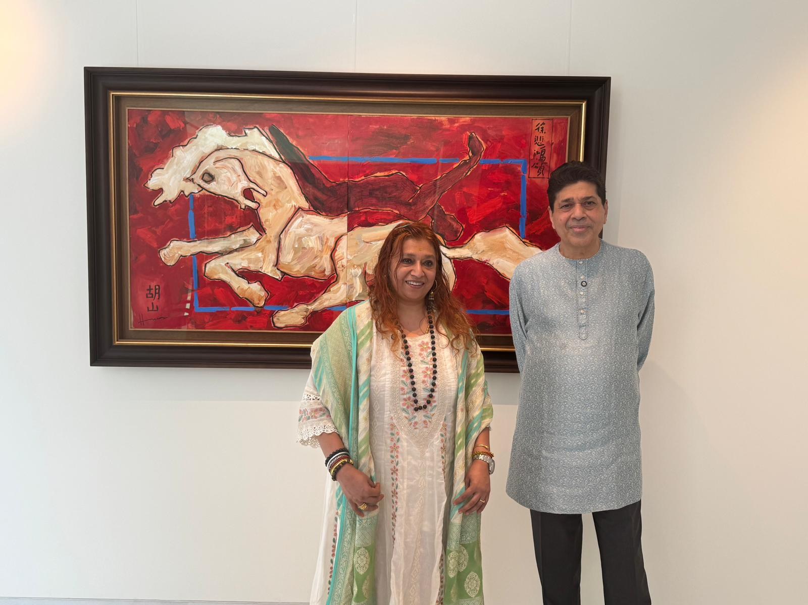
SonalSach108@gmail.com
Telegram Group https://t.me/Sonvaa
ॐ
Karmic Calling and Success in Endeavours
True Heroes in your Chart : - Understanding the interplay of Yogi, Yoga and Karaṇa Lord of Pañcāṅga
Afflictions in Pañcāṅga – Yogi planet and the Yogas in Pañcāṅga (Five Limbs of time – the Indian Ancient Almanac) help in overcoming major afflictions such as Dagdha Rashi (burnt signs) etc. We look in depth at the Yoga of Pañcāṅga
Please Note – This is ongoing Research Project and by no means a final. As per experience and exposure more information will be added and fine tuned. In-depted to quite a few Teachers of Jyotish and their Gurus who learned from Siddhars and ancient Tamil Texts.

Slide 7
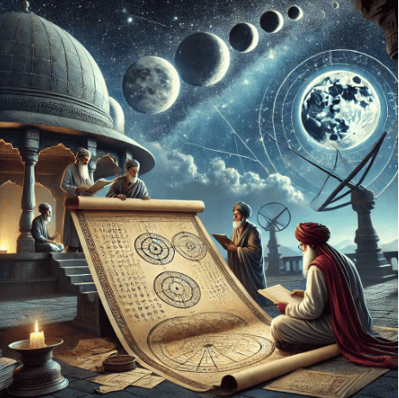
The five angas of the Pañcāṅga a include
Tithi, Vara, Nakshatra, Yoga and Karaṇa
Indian Almanac – The Pañcāṅga dates back over 3,000 years, deeply connected to Vedic astrology (Jyotish Shastra). The Rigveda (circa 1500 BCE) contains hymns referring to celestial movements, and one of the earliest texts dedicated to timekeeping is the Vedanga Jyotisha (circa 1400 BCE), which laid the foundation for astronomical calculations in Hinduism.
Festivals, events, Eclipses, Death Ceremonies, Marriages, House buying/constructions/renovations, fasting/healing, wars, ridding of debts, astral travel, dreams are just a few uses of the Indian Almanac – The Pañcāṅga a , which is really the play of the Luminaries only, Surya Sun and Chandra Moon.
Instead of the Gayatri this is a Excellent option -

Slide 8
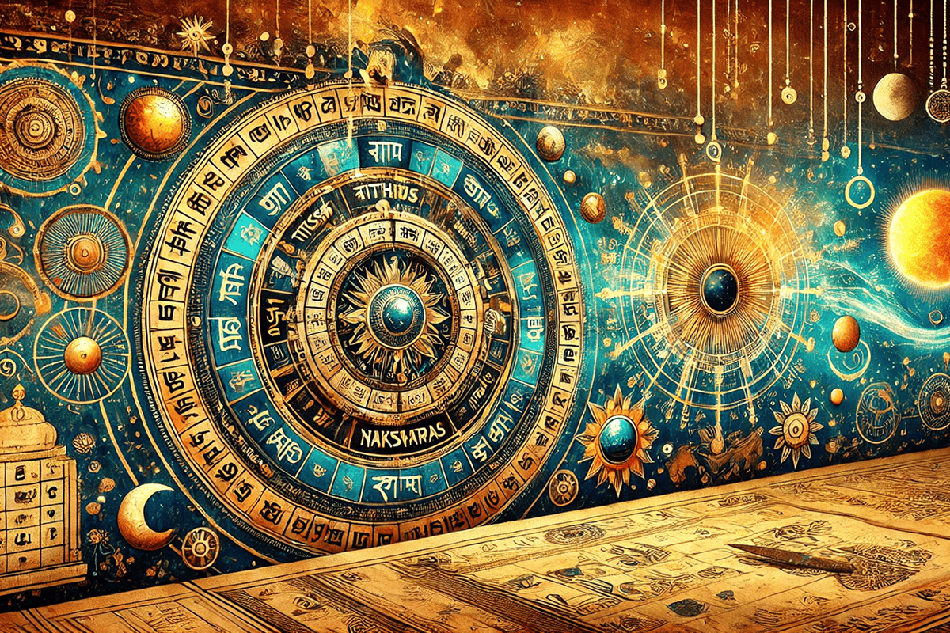
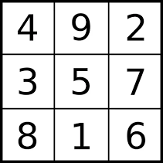
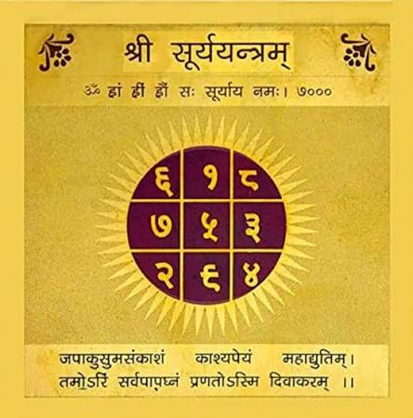
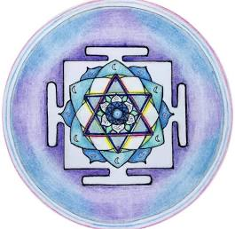
The five angas of the Pañcāṅga a include
Tithi, Vara, Nakshatra, Yoga and Karaṇa
उ॒द्यन्न॒द्य मि॑त्रमह आ॒रोह॒न्नुत्त॑रां॒ दिव॑म् । हृ॒द्रो॒गं मम॑ सूर्य हरि॒माणं॑ च नाशय ॥
udyann adya mitramaha ārohann uttarāṃ divam | hṛdrogam mama sūrya harimāṇaṃ ca nāśaya ||
English translation:
“Radiant with benevolent light, rising today and mount into the highest heaven, do you O Sun, remove sickness of my heart, and the yellowness (of my body).”
Śaunaka treats this as a mantra dedicated to the Sun to remove sin, heal disease, be an antidote to poison and as a means of obtaining present happiness and final liberation
चन्द्रमा मनसो जात: Chandramā manaso jātaḥ –– The Moon was born from the mind of the Cosmic Being. Atharvaveda 11.4.3
Instead of the Gayatri this is a Excellent option -
Rig Veda 1.50.11

Slide 9
The five Limbs angas of the Pañcāṅga
include
Tithi, Vara, Nakshatra, Yoga and Karaṇa
तिथेश्च श्रियमाप्नोति वारादायुष्यवर्धनम्।
नक्षत्राद्धरते पापं योगाद्रोगनिवारणम्॥
करणात् कार्यसिद्धिः स्यात् पञ्चाङ्गफलमुत्तमम्।
एतेषां श्रवणान्नित्यं गङ्गास्नानफलं भवेत्॥
Knowing the Tithi, one obtains ‘riches’, [knowing the] Vāra (day), one’s lifespan
increases. [Knowing the] Nakshatra destroys Sins papa,
[knowing the] Yoga relieves from ailments,
[knowing the Karaṇa] one achieves success in his/her
endeavours—such is the lofty fruit of listening to the Panchānga (every day).
By listening to all of these every day, one accrues the merit of bathing in the Ganga!
Instead of the Gayatri this is a Excellent option -

Slide 10
Pañcāṅga in Sanskrit means Panch, five and Anga is limbs of Time
LIMBS OF Pañcāṅga | AREAS OF LIFE
Vara is the Day of the week you are born | Life Force , Life Energy; Agni’ Fire in the belly; Knowledge o Vara prolongs longevityas it has to do with one’s energy levels
Tithi (Soli-Lunar Angle) | Marital Relationships, Long-term Relaationships, passions , Love life. Also, Prosperity and Abundance
Kāraṇa = Approx Half a Tithi | Karma - Activity to sustain us, Our Work in Society, Achievements and Success in Endeavours
Nakshatra (27 Fixed Star Constellations of the Moon) | Disease, Body Ailments, Emotional Nature - Removes and overcomes Sins
Yogas / Combination | General Relationships, the company one keeps, social circles, spiritual Realms, immunity from diseases and longterm ailments
These limbs are primarily used to select auspicious timing for everyday living. Calculations are based on Sun and the Moon. Most
Importantly the combination between the two luminaries.

Slide 11
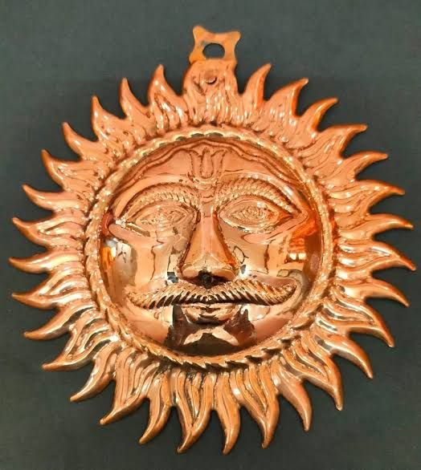
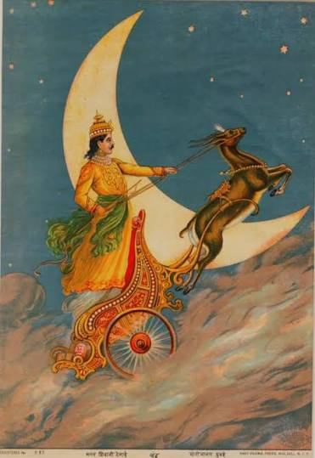
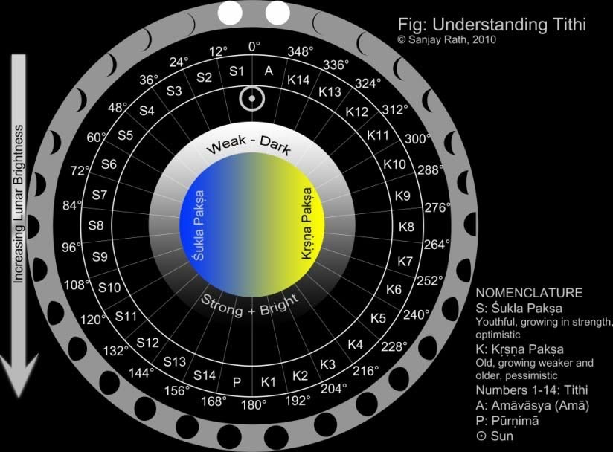
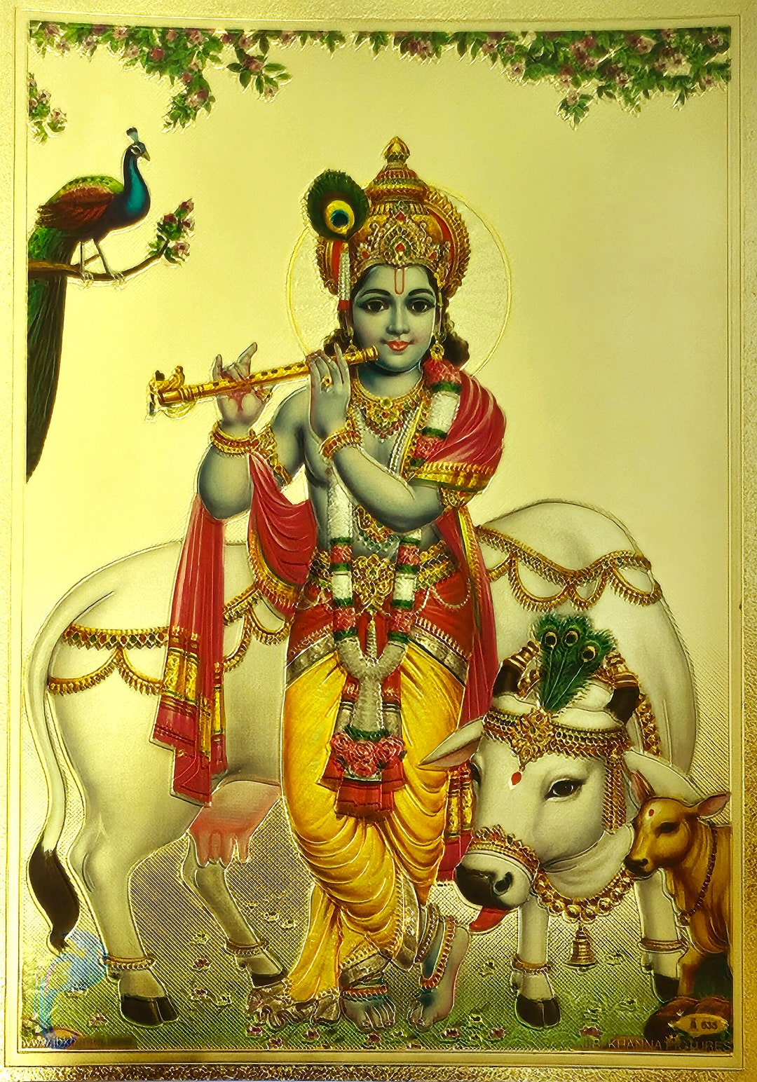
ॐ
Amavaya New Moon
Tithi is one of the key limbs amongst five to be used for dating birthdays events etc Lord Krishna was born on the Ashtami tithi (eighth lunar day) of the Krishna Paksha (waning phase of the moon) in the Hindu calendar month of Bhadrapada at midnight. This sacred lunar day marks the celebration of Krishna Janmashtami
Shukla paksha
Krishna paksha
Pornima Full Moon

Slide 12
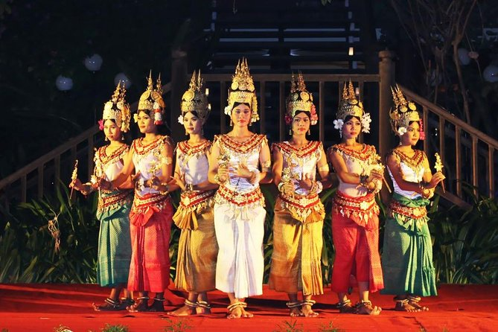

ॐ
Kāraṇa (कारण) refers to the “(supreme) cause” (of all the world, according to the Netratantra of Kṣemarāja: a Śaiva text from the 9th century in which Śiva (Bhairava) teaches Pārvatī topics such as metaphysics, cosmology etc.
That is supreme strength, that is supreme amṛt (nectar) .The highest of splendors is highest light of light. The divine Lord is the supreme cause (kāraṇa—kāraṇaṃ param)
of all the world.
Karaṇa is that which causes and also effects. In dance it causes and effects the aṅgahāra (a dance sequence). It is a helper or companion and hence instrumental in effecting action. It suggests motion and hence it is no wonder that it is the very name of a treatise on the motion of planets by Varāhamihira
Kāraṇa (कारण) is the name of a deity who was imparted with the knowledge of the Kāraṇāgama by Sadāśiva
The kāraṇa-āgama, refers to one of the twenty-eight Siddhāntāgamas - The Śaivāgamas represent the wisdom that has come down from lord Śiva, received by Pārvatī and accepted by Viṣṇu. karaṇa has its root in kṛñ meaning a doer, maker, causer, doing, making, causing, producing, helping, promoting, the act of doing and the doer. The work karaṇa also has all the above meanings.

Slide 13
No | Tithī` | Śukla | Planet | Devatā | No. | Tithī` | Kṛṣṇa | Planet | Devatā
S1 | pratipada | 12° | Sun | Agni | K1 | pratipada | 192° | Sun | Agni
S2 | dvitīya | 24° | Moon | Dhātṛ | K2 | dvitīya | 204° | Moon | Dhātṛ
S3 | tritīya | 36° | Mars | Gourī | K3 | tritīya | 216° | Mars | Gourī
S4 | caturthī | 48° | Mercury | Gaṇeśa | K4 | caturthī | 228° | Mercury | Gaṇeśa
S5 | pañcamī | 60° | Jupiter | Ahi (Sarpa) | K5 | pañcamī | 240° | Jupiter | Ahi (Sarpa)
S6 | ṣaṣṭhī | 72° | Venus | Guha (Kārtikeya) | K6 | ṣaṣṭhī | 252° | Venus | Guha (Kārtikeya)
S7 | saptamī | 84° | Saturn | Ravi (Sūrya) | K7 | saptamī | 264° | Saturn | Ravi (Sūrya)
S8 | aṣṭamī | 96° | Rāhu | Maheśa | K8 | aṣṭamī | 276° | Rāhu | Maheśa
S9 | navamī | 108° | Sun | Durgā | K9 | navamī | 288° | Sun | Durgā
S10 | daśamī | 120° | Moon | Antaka (Yama) | K10 | daśamī | 300° | Moon | Antaka (Yama)
S11 | ekādaśī | 132° | Mars | Viśva | K11 | ekādaśī | 312° | Mars | Viśva
S12 | dvādaśī | 144° | Mercury | Viṣṇu | K12 | dvādaśī | 324° | Mercury | Viṣṇu
S13 | trayodaśī | 156° | Jupiter | Kāma | K13 | trayodaśī | 336° | Jupiter | Kāma
S14 | caturdaśī | 168° | Venus | Īṣa | K14 | caturdaśī | 348° | Venus | Īṣa
S15 | pūrṇimā | 180° | Saturn | Chandra | K15 | amā | 360° | Rāhu | Pitṛs
Tithi = (Moon Longitude - Sun Longitude) / 12 . If the calculated result is greater than 15, we have to substract 15 from the result. The net result is Tithi

Slide 14
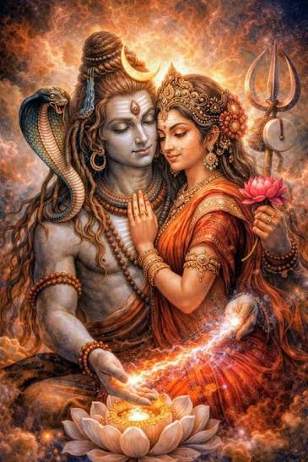
ॐ
EXAMPLE OF MONTHLY Pañcāṅga
In Pañcāṅga, derivation of Karaṇa करण is half of a tithi. Hence there are 60 karaṇas in a lunar month of 30 tithis. The karaṇas for astrological use have been given different names which are eleven in number.
It can be further classified as the following:
The seven movable carakaraṇas are:
Bava,
Bālava,
Kaulava,
Taitila,
Gara,
Vaṇija,
Viṣṭi,
The four Fixed sthirakaraṇas are:
Śakuni,
Catuṣpāda,
Kimstughna,
Nāga

Slide 15
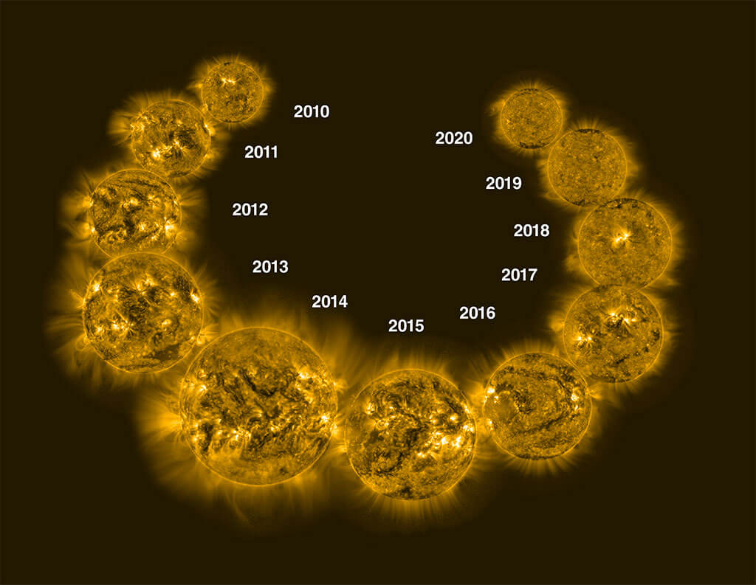
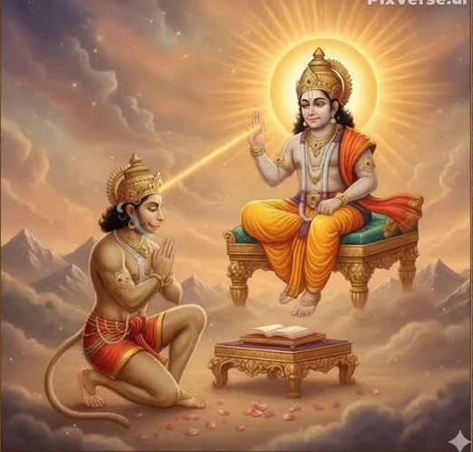
ॐ
Why EkaDasha eleven Kāraṇa ? As Kāraṇa has a lot to do with our ‘karma’ work success, it is the karma doer, it is natural it will have links with Surya Sun.
The solar cycle is the cycle that the Sun’s magnetic field goes through approximately every 11 years.
Our Sun is a huge ball of electrically-charged hot gas. This charged gas moves, generating a powerful magnetic field. The Sun's magnetic field goes through a cycle, called the solar cycle.
Every 11 years or so, the Sun's magnetic field completely flips. This means that the Sun's north and south poles switch places. Then it takes about another 11 years for the Sun’s north and south poles to flip back again.
All Rights Reserved @Copyright Sonal Sachdeva

Slide 16
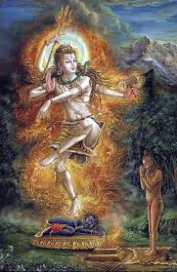
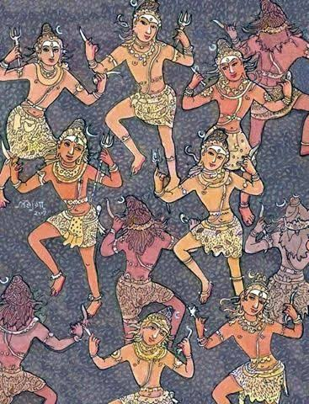
Connection of 11 Karaṇas and Ēkādaśa Rudra
ॐ
Rishi Kashyap went to Lord Shiva, anxious about daityas demons. Lord Shiva said, he would bless Devi Surabhi with Eleven Expressions as Ekadasa Rudras (Eleven Rudras) to wipe out the Daithyas engaged in the tortures by the Demons.
The 11 Ēkādaśa Rudra were: Mahādeva;
Śiva;
Mahā-rudra;
Śaṅkara;
Nīlalohita;
Īśāna-rudra;
Vijaya-rudra;
Bhīma-rudra;
Devadeva;
Bhavodbhava;
Ādityātmaka Śrī Rudra
The final component of the calendar is the set of eleven karaṇas. They are effectively equivalent to half a lunar day each.
All Rights Reserved @Copyright Sonal Sachdeva

Slide 17
ॐ
Tithi | Karaṇa
pratipada | 1 Kimstughna 2 Bava
dvitīya | 3 Balava 4 Kaulava
tritīya | 5 Taitula 6 Garija
caturthī | 7 Vanija 8 Vishti
pañcamī | 9 Bava 10 Balava
ṣaṣṭhī | 11 Kaulava 12 Taitula
saptamī | 13 Garija 14 Vanija
aṣṭamī | 15 Vishti 16 Bava
navamī | 17 Balava 18 Kaulava
daśamī | 19 Taitula 20 Garija
ekādaśī | 21 Vanija 22 Vishti
dvādaśī | 23 Bava 24 Balava
trayodaśī | 25 Kaulava 26 Taitula
caturdaśī | 27 Garija 28 Vanija
pūrṇimā | 29 Vishti 30 Bava
Four of the karaṇas occur only once in each lunar month, and there are seven that repeat in a cycle through the other days of the month.
The karaṇas are simply halves of a lunar day – there are two to each lunar day, and they therefore represent the time between successive separations between the Sun and Moon in multiples of 6°.
Shukla Paksha is the bright half of the lunar month when the moon is waxing (growing from a new moon to a full moon).

Slide 18
ॐ
Tithi | Karaṇa
16 K. Pratipat | 31 Balava 32 Kaulava
17 k Dvitiya | 33 Taitula 34 Garija
18 k Tritiya | 35 Vanija 36 Vishti
19 Chaturthi | 37 Bava 38 Balava
20 Panchami | 39 Kaulava 40 Taitula
21 Shashti | 41 Garija 42 Vanija
22 Saptami | 43 Vishti 44 Bava
23 Ashtami | 45 Balava 46 Kaulava
24 Navami | 47 Taitula 48 Garija
25 Dashami | 49 Vanija 50 Vishti
26 Ekadashi | 51 Bava 52 Balava
27 Dvadashi | 53 Kaulava 54 Taitula
28 Trayodahsi | 55 Garija 56 Vanija
29 Chaturdashi | 57 Vishti 58 Shakuni
30 Amavasya | 59 Chatuspada 60 Naga
Krishna Paksha Waxing cycle follows the same sequence except it has the uniqueness of Amavasya – 4 karanas – Happens once a month, and the ,most famour of course is Dipawali – Festival of lights and Maha Shivaratri
Traditional texts often view fixed Karanas as malefic or unsuitable for starting new, major ventures, although through remedial measures it can be mitigated….
decreases in size from a full moon to a new moon—is called Krishna Paksha
12 x 5 – 60; 56 (7 charaKaraṇa repeated 8 times = 56 + 4 Sthira Karaṇa = count to 60 Karaṇas ;

Slide 19
ॐ
Karaṇa Nath, Adi Devata, Animal and most influential/crucial Bhava
Weekday Lord | Karaṇa | Karaṇa Nath | Adi-Devata | Lucky Animal | House Bhava
1.Sun | Bava/bhavam | Mars | Indra | Lion | Leo (5)
2.Moon | Bālava | Rahu | Brahma | Tiger | Taurus (2)
3.Mars | Kaulava | Saturn | Varaha/Varahi | Pig | Capricorn(10)
4.Mer | Taitila | Venus | Pitrs | Donkey | Libra(7)
5.Jup | Gara/Karasai | Moon | Bhu/Bhoomi Devi | Elephant | Sagittarius(9)
Auspicious Karaṇa Bhava, Bālava, Taitila, Gara,Kouvalum

Slide 20
ॐ
Karaṇa Nath, Adi Devata, Animal and most influential/crucial Bhava
Weekday Lord | Karaṇa | Karaṇa Nath | Adi-Devata | Lucky Animal | House Bhava
6.Ven | Vaṇija/Vanasai | Sun | SriDevi | Cow/Ox | Taurus(2)
7.Sat | Visti/Bhadra | Ketu | YamaDharmaraj | Cock | Aquarius11
8.Rahu | Śakuni | Saturn | Vishnu | Crow | Aquarius(11)
9. | Catuṣpāda | Jupiter | Manibhadran | dog | Pisces(12)
10. | Nāga | Rahu(Visa) | Adi Sesha | Snake | Cancer(4)
11. | Kimstughna | Mercury | VayuDeva | Worms/insects | Virgo(6)
Middling Karaṇa Vanija/Vanasai ~ Catuṣpāda

Slide 21

ॐ
Karaṇa Nath is of huge importance – make or break you life.
Observe very carefully. Where there is bound to be dissatisfaction. He is the hero, as any issues with tithi, tithi lord, it is Karaṇa Nath and the devata will be the save the day.
Nakshatra of Karaṇa Nath will do very good! Whichever planets gets connected to the Karaṇa Nath, those planets it is karaka for, those bhava/Houses will prosper. Results to be judged by that planet conjoining it. Karaṇa Nath is going to tithi Shunya/Dagdha Rasi
and if it Going to 6th , 8th or 12th then there will be huge issues in work and jobs.
Karaṇa is Vayu tattva, although most take it as Prthvi tattva.
10th lord – karakas Mercury, Sun, Saturn – Hence another ‘secret of the Sidhars’
For career success see 10th from Shani

Slide 22
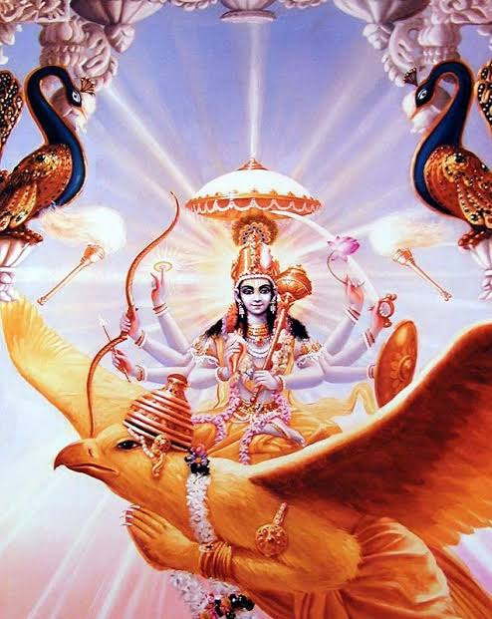
ॐ
Bava Karaṇa & Karaṇa Nath Characteristics
Bava – Indra is the Kāraṇa Nathhighly creative; desire filled; able; artistic; in essence Rajasik - good for kings and worldly individuals with a practical mind. . The lion is considered to be the symbol of Kāraṇa , hence also called the ‘Simha Kāraṇa m’ (Lion) - means testicles, sperm, creativity and so on. They are always self-centric.. They don’t know when to talk and when not to talk.They will extra care for children and live for them. Even a single damage to their reputation they will leave that place or relationship.
They will chase their enemies and win over them, either by smooth talk or outright defeat.
This Kāraṇa is good for all Chara deeds (such as journey, daily duties, business etc.) and also for Sthira deeds such as sowing seeds, sexual intercourse, for putting foundations, stonework,, worship, temple creation and so on.
Spiritually predisposed and interested in the work of dharma-karma, and make full effort to any task. Associated with state of childhood. Individuals born in the Bava are liberal, rich and happy.
Weekday Lord | Karaṇa | Karaṇa Nath | Adi-Devata | Animal | House Bhava
1.Sun | Bava | Mars | Indra | Lion | Leo (5)
Bhuśuṇḍī (भुशुण्डी) or Bhuśaṇḍī.—A weapon, apparently a kind of fire arms or rocket

Slide 23
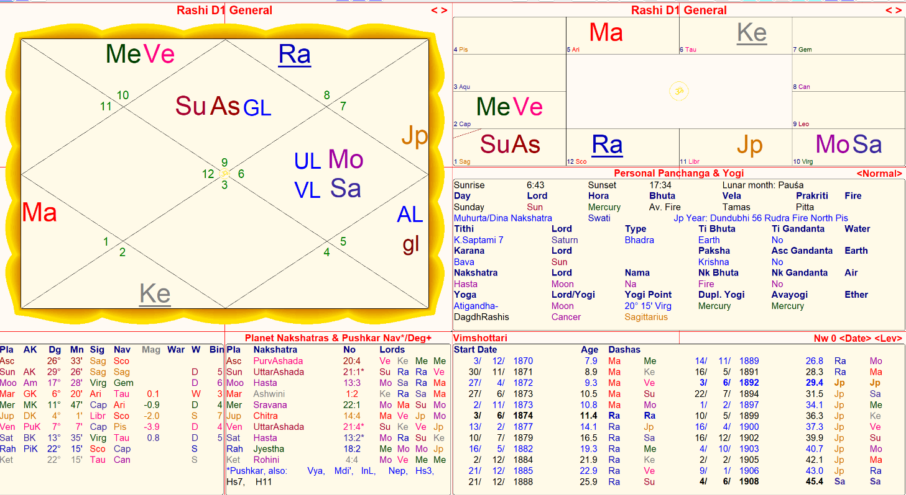

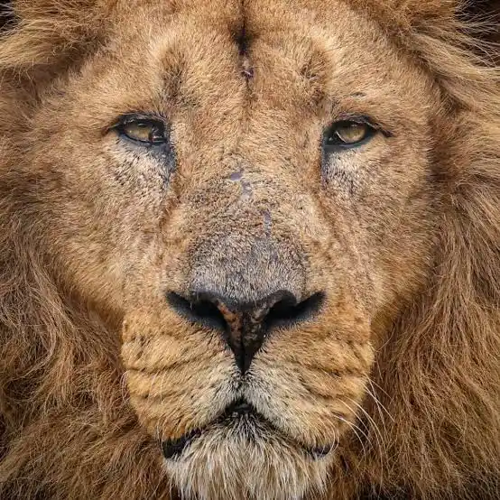
ॐ
Karaṇa Nath is mars –
Results given by Saturn
Parivartana with mercury
Yogi is Moon – at virgo
Nov 1881 he met his teacher
Rahu-Saturn ; He established
Rama Krishna Mission 1897
Jupiter – mercury
Weekday Lord | Karaṇa | Karaṇa Nath | Adi-Devata | Animal | House Bhava
1.Sun | Bava | Mars | Indra | Lion | Leo (5)

Slide 24
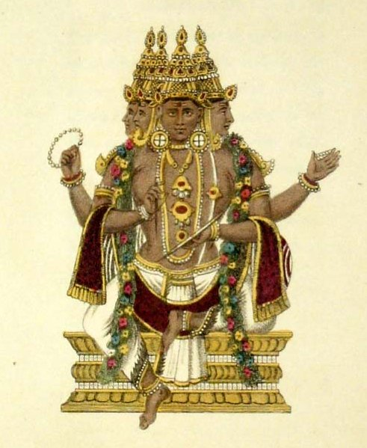
2.Bālava Karaṇa & Karaṇa Nath Characteristics
ॐ
2.Bālava – ‘PuliKāraṇa m’ (Leopard). - means Brahmin lady, female horse (mare), slave girl, prostitute and so on. This is good for Yajna, Homa (fire worship), study of Veda, the puranas, scriptures. Also great for all kinds of Santi Karma. Highly spiritual in nature, they are very much into worship and spend their time visiting pilgrimage places. good at observing people and finding things. If rahu and its rashi dispositor in good position will give good results. Rahu in taurus also will give superb results. Police, defence forces, etc will suit them.They would like to take up high level jobs. They would like to live on first floor or upper floors
Weekday Lord | Karaṇa | Karaṇa Nath | Adi-Devata | Animal | House Bhava
2.Moon | Bālava | Rahu | Brahma | Tiger | Taurus (2)

Slide 25
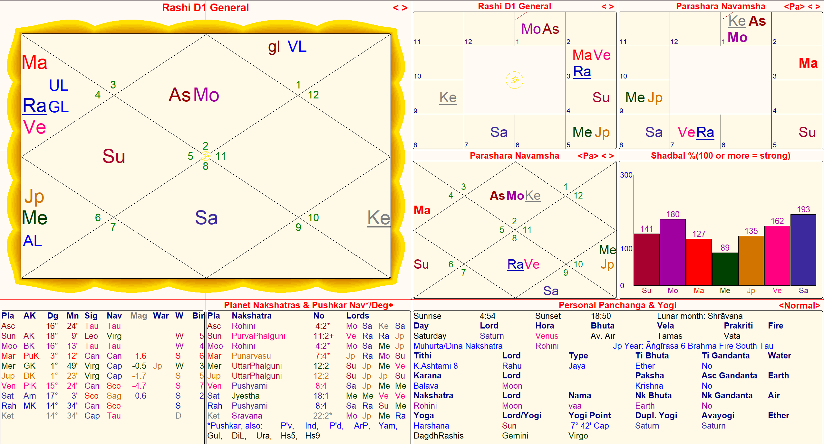
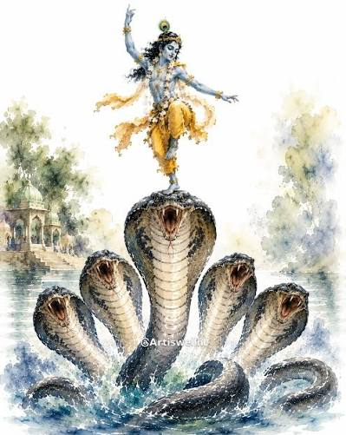
ॐ
Buddha Gati Dhi Dasha
89 years – bhagvad gita
Mercury ~2nd cycle
2.Moon | Bālava | Rahu is K Nath in Uccha | Brahma | Tiger | Taurus (2) Rasi is the most important

Slide 26
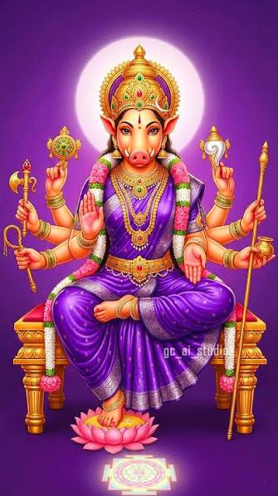
ॐ
3.Kaulava Karaṇa & Karaṇa Nath
3.Kaulava-traditional jobs; people who follow traditional jobs and
traditional Tantric worship; normal society people; villagers who value tradition. Good for common people. They will be heading the joint family.
After struggles, they will get house or property.
For koulava Kāraṇa people, if Saturn goes to 6, 8, 12 there will be one
miscarriage. They are somewhat adamant obstinate people.
They are always about their family and welfare of the family.
They are very good astrologer. with respect to child birth their predictions will be
superstrong. some bed comfort is lacking
Weekday Lord | Karaṇa | Karaṇa Nath | Adi-Devata | Animal | House Bhava
3.Mars | Kaulava | Saturn | Varaha/Varahi | Pig | Capricorn(10)

Slide 27
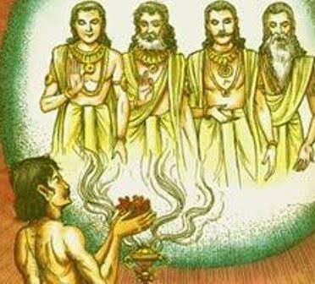
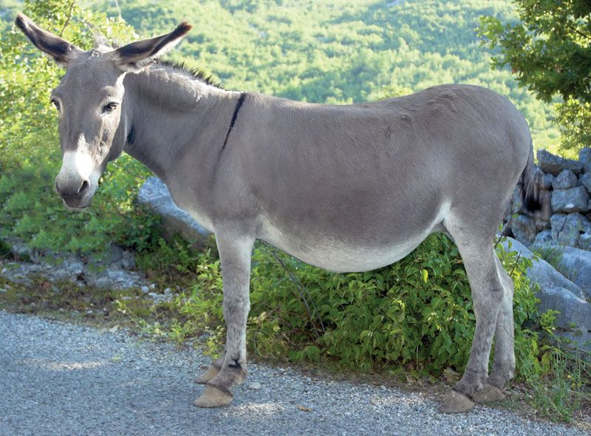
44.Taitila Karaṇa & Karaṇa Nath Characteristics
ॐ
known as 'Kazhuta Kāraṇam' (Donkey) , thus means getting awards, rewards or respect; patience. Taitila Kāraṇa is good for all activities related to king, authority, ornamentation, ornamenting the idols and revered ones and so on; for pledge taking, receiving position, charge taking etc. usually Taitila Kāraṇa is preferred. Good for awards and rewards; Good for celebrities, govt. servant, creatives, famous people. Mother will be adamant person ; Friday pooja will give good results.
Praying to Pitrus ancestors will give excellent results; Anything started on Friday will give good results; Either people born on Friday, there will be there or shukra nakshatra or rasi or lagna will be present in their family or close extended family
Weekday Lord | Karaṇa | Karaṇa Nath | Adi-Devata | Animal | House Bhava
4.Mer | Taitila | Venus | Pitrs | Donkey | Libra(7)

Slide 28
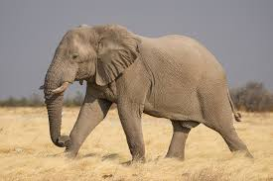
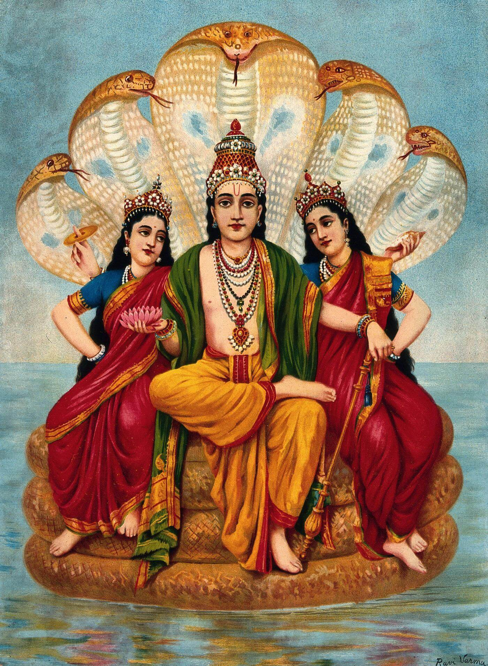
ॐ
5.Gara/karasai Karaṇa & Karaṇa Nath
'Gaja Kāraṇa m' (Elephant) - meaning hard, difficult, demanding more effort
and so on. In ancient past the jobs that were considered difficult are cattle / horse / elephant
breading, agriculture and rural business of grains, vehicle related and so on. hard-working; technicians; people who specialize in different areas of work which
needs continuous training and talent. Naturally if a person is also kataka lagna then there will be good prosperity but moon should not go to 6, 8, 12. Usually, life gives significant progress after 40. If Moon as a Lord of this Kāraṇa goes in 6th , 8,th or 12th then they should keep on take blessings from mother, else they will not able to prosper. Daily blessings from parents will take them to different level. They are very research minded, will not forget anything throughout life either memory wise or anything you do good or bad also they will never forget.
If moon goes to 6, 8, 12 either for them or people in the family there will be obesity or
cholesterol problem. Husband and wife will fight because of cooking.
5.Jup | Gara/Karasai | Moon | Bhu/Bhoomi Devi | Elephant | Sagittarius(9)

Slide 29
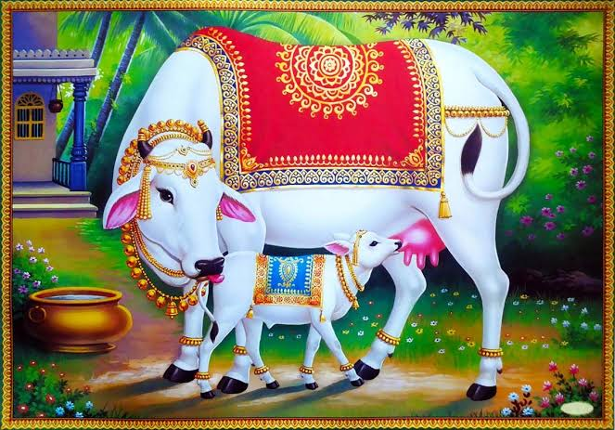
6.Vaṇija Karaṇa & Karaṇa Nath
ॐ
Vaṇija- ‘Surabhi Kāraṇa m’ (Cow) - meaning Phoenician, businessman or market; modern day English word ‘company’ (com-pany) – means ‘group business’.they can become famous person in their family. Whether that is famous is good or bad it will depend.Somehow after some struggle they will get into government or politics however Sun should not be in 6, 8, 12, badhaka or tithi soonya
Love marriage family. Regarding the elder children there will be some worries.
Teacher, doctor, vehicle, automobile in the family. They express themselves openly
Either they or their children will have head ache, spectacles.
Weekday Lord | Karaṇa | Karaṇa Nath | Adi-Devata | Animal | House Bhava
6.Ven | Vaṇija/Vanasai | Sun | SriDevi | Cow/Ox | Taurus(2)

Slide 30
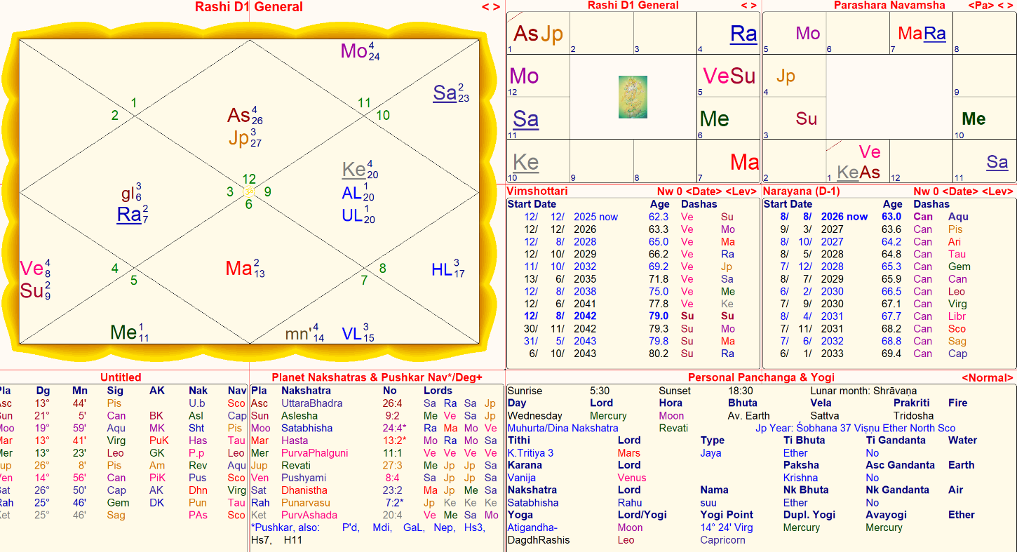

Slide 31
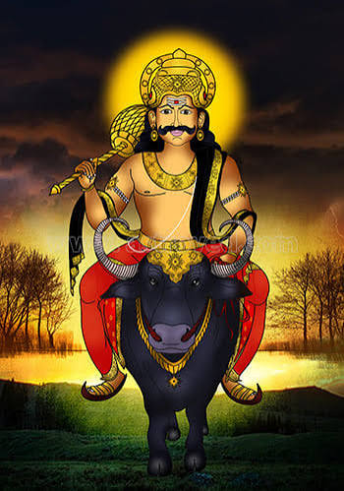
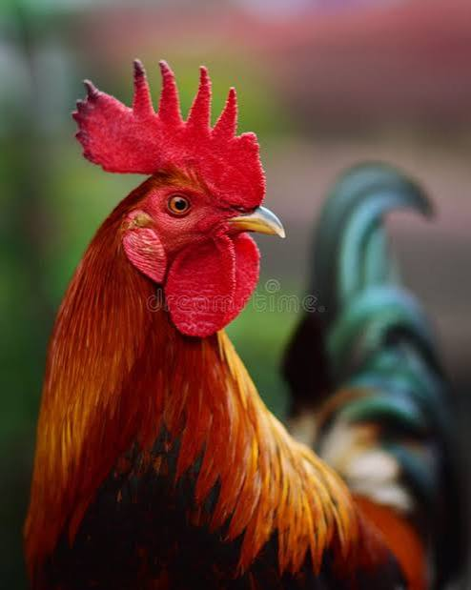
ॐ
7. Viṣṭi Karaṇa & Karaṇa Nath Characteristics
Viṣṭi – People who waste the time, money and energy of themselves and
others. It is not considered to be fortunate. Human beings born in this
Kāraṇa like fast things, are sensitive, intelligent, impulsive, different looking eyes, or sharp eyes, can indulge in bad deeds and their image also remains negative because of this. The Kāraṇa is considered to be ominous and is avoided in any auspicious work Vishti Kāraṇa is also known as “Bhadra” ; Ruled by Mrityu, people born in the Vishti Karana are known to be cruel, adventurous, and fierce by nature, and will likely excel in all their undertakings; Shoes/ sandals are always an issue with them. Misunderstandings with Father.
Weekday Lord | Karaṇa | Karaṇa Nath | Adi-Devata | Animal | House Bhava
7.Sat | Visti/Bhadra | Ketu | YamaDharmaraj | Cock | Aquarius11

Slide 32
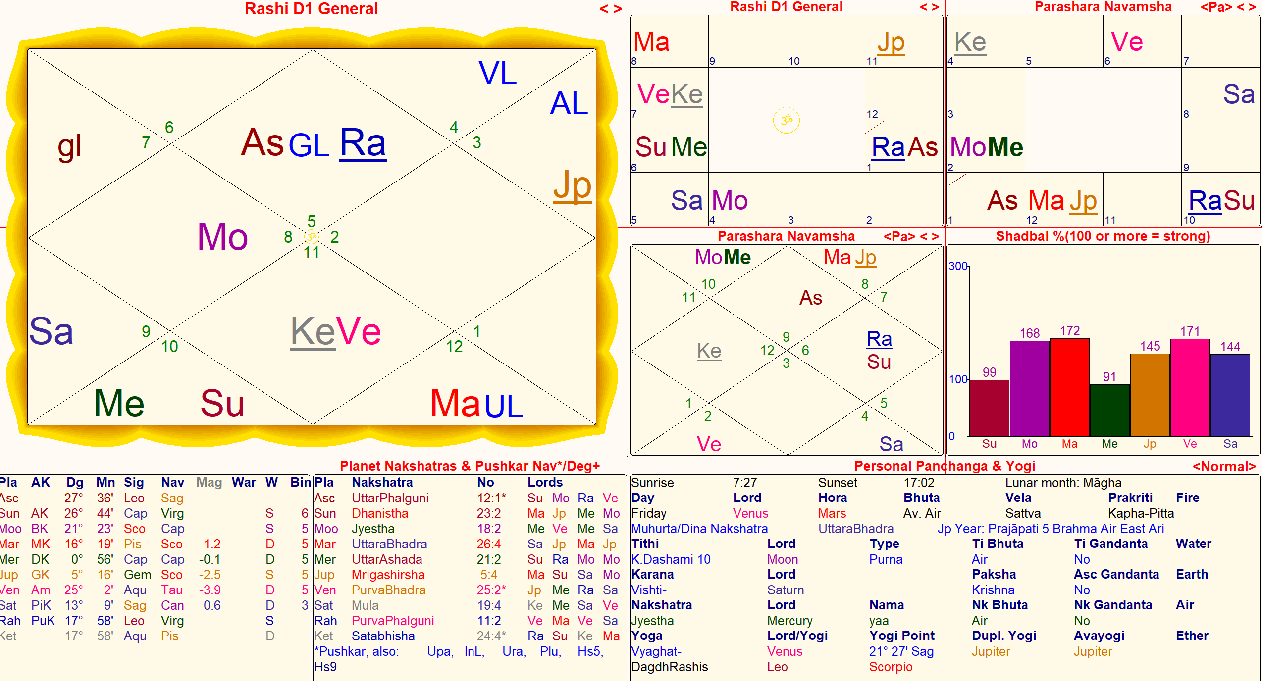
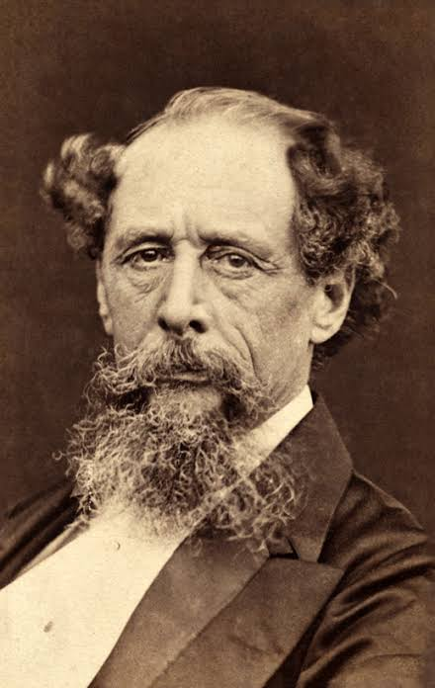
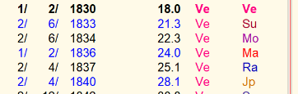
Charles Dickens Ketu – Kāraṇa Nath are conjoined kendra in perfect trine to jupiter.
ॐ
Pickwick papers established in 1836-1837, ketu venus
All Rights Reserved @Copyright Sonal Sachdeva

Slide 33
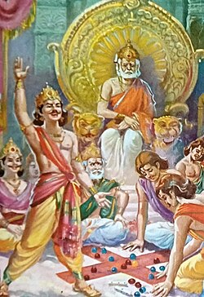
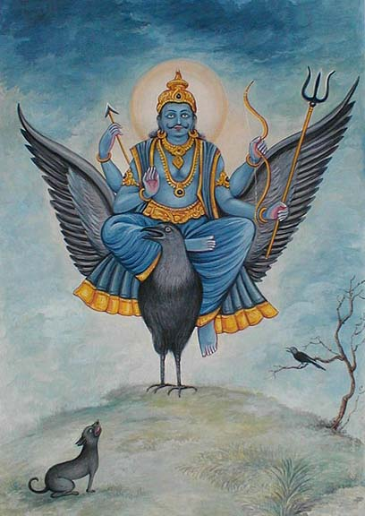
ॐ
8.Sakuni Karaṇa & Karaṇa Nath
Difficulty in getting along with their relatives.Sharp mind; interested in speculation; clever; politicians. Huge problems in their ancestry;
Manipulations, Dealings, What appears is not to be so. Becomes famous because of speech; Saturn bhukti/dasha will open up for them
Shakuni is also a key Character in Mahabharata – Uncle of Pandavas and Kauravas; Eye problems there; police, air planes, jails, wardens, occult, computers, chit fund, puzzles, dice etc Pray to Balaji and keep food for crows
Weekday Lord | Karaṇa | Karaṇa Nath | Adi-Devata | Animal | House Bhava
8.Rahu | Śakuni | Saturn | Vishnu | Crow | Aquarius(11)

Slide 34
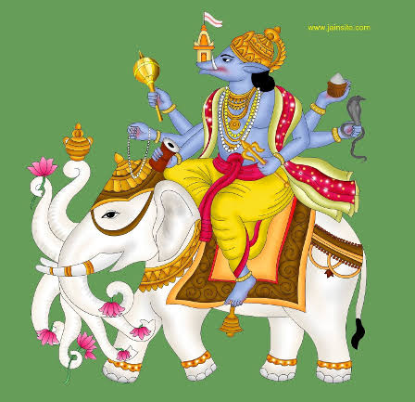

ॐ
9. Catuṣpāda Karaṇa & Karaṇa Nath
Catuṣpāda natives depend on how they are raised in early life, either addictive personality or good child. Good intelligence, occult knowledge, two marriages, separation, especially in male chart. Chit, share market, mlm, actor, music, securities, gold , veterinary services, good for acquiring property but if Jupiter is not in 6th or 8th. Devata Vaisiyam will happen for them easily, and more attached to mother and children. Father-in-law side dur maranam.vehicle accidents, literature, writing, blogging, Praying to bhariva will give good results in life…One Court litigation they have to face in life…
Weekday Lord | Karaṇa | Karaṇa Nath | Adi-Devata | Animal | House Bhava
9. | Catuṣpāda | Jupiter | Manibhadran | dog | Pisces(12)

Slide 35
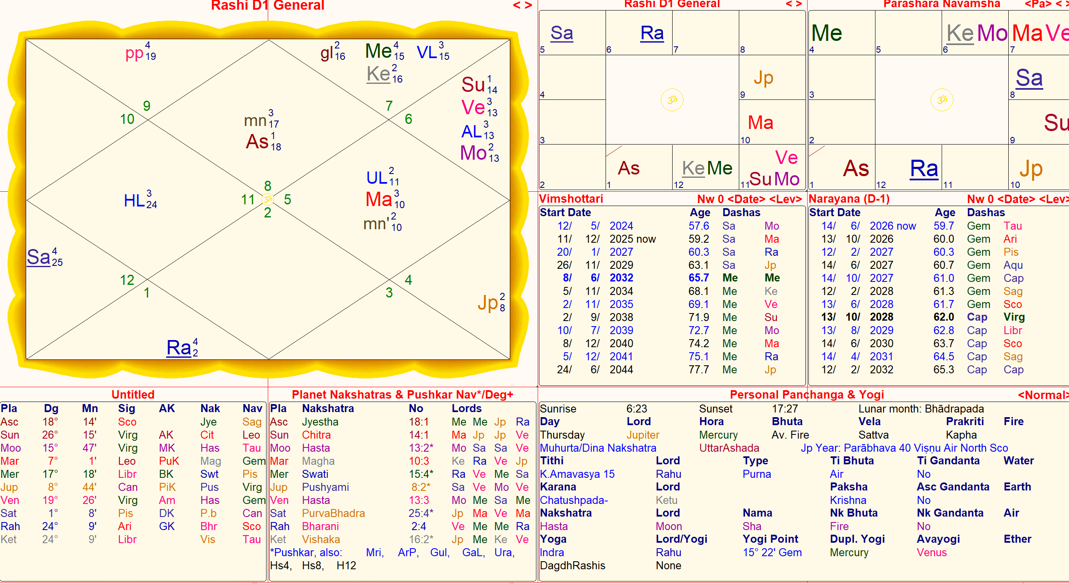
Margarita T, - Yoga Teacher Mother.
ॐ
All Rights Reserved @Copyright Sonal Sachdeva

Slide 36
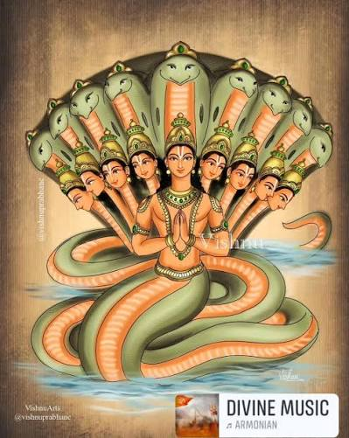
ॐ
10. Nāga Karaṇa & Karaṇa Nath Characteristics
Maybe a body deformity at birth; rebels; don’t value socially accepted paths -
but instead create their own paths –
If 2nd and 7th are spoiled, and 9th /11 become strong then two marriage
They like to follow traditional Tantric paths not accepted by current society; angry, destructive, able; fire-like, ‘the wild flower child ‘ kind of personality;Eye problems,dur maranam on wife side, children, separated from them, moreover some problem with them. Intelligent, occult,m drawing, painting, railways, astrology, transport, lorry, canrds, gambling etc;
Great digestion, they will manage very well; Great Vak siddhi, whatever they speak comes true.
Weekday Lord | Karaṇa | Karaṇa Nath | Adi-Devata | Animal | House Bhava
10. | Nāga | Rahu(Visa) | Adi Sesha | Snake | Cancer(4)

Slide 37
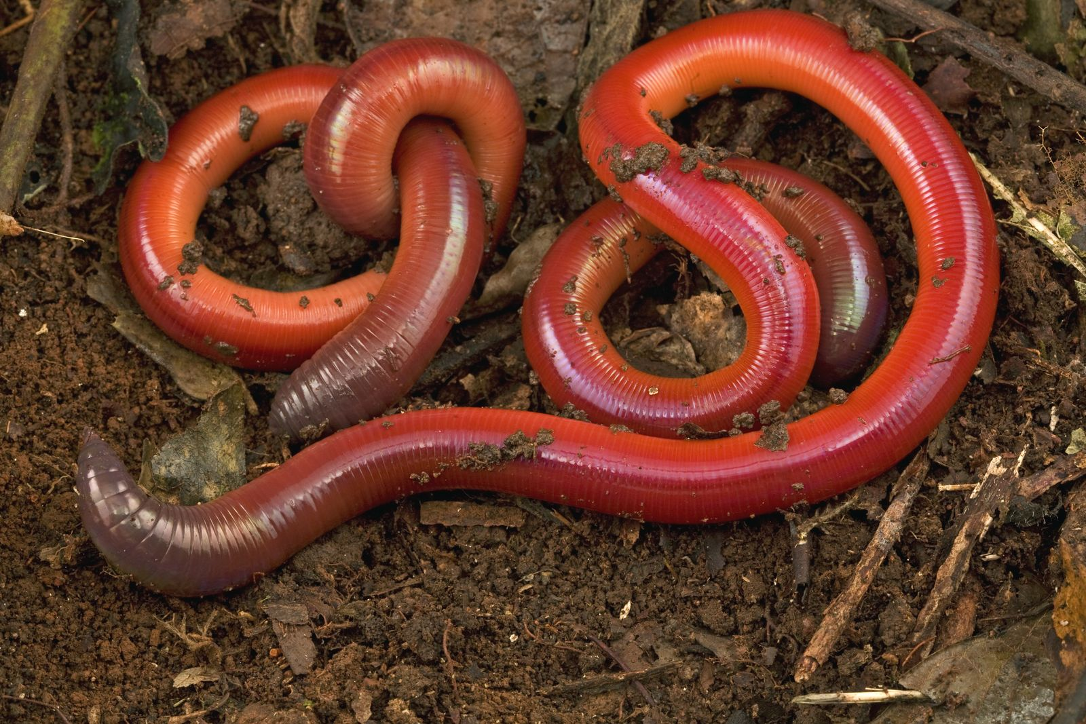

ॐ
11.Kimstughna Karaṇa & Karaṇa Nath
Kausthubha (Kimstughna) means sandal, gem or elephant; this is a Kāraṇa proper for
Sages and saints; especially those who follow traditional Tantric worship. The nature of the
native born in this Kāraṇa would be similar to the same.
Highly Attached to mother and used harsh words to them…
Blogging, media etc (Karaṇa Natha is Mercury;
House of Virgo) Ulcers gastric disorders are frequent
Mercury is retrograde, then problematic
If they buy a small property, only then they will see success…
If they kiss on Kimstugna, it is unforgettable ! And if they intimate, in the middle of this Karaṇa.
Excellent results of yogi graha and Karaṇa are same and their dasha will give great results.
Weekday Lord | Karaṇa | Karaṇa Nath | Adi-Devata | Animal | House Bhava
11. | Kimstughna | Mercury | VayuDeva | Worms/insects/lee | Virgo(6)

Slide 38
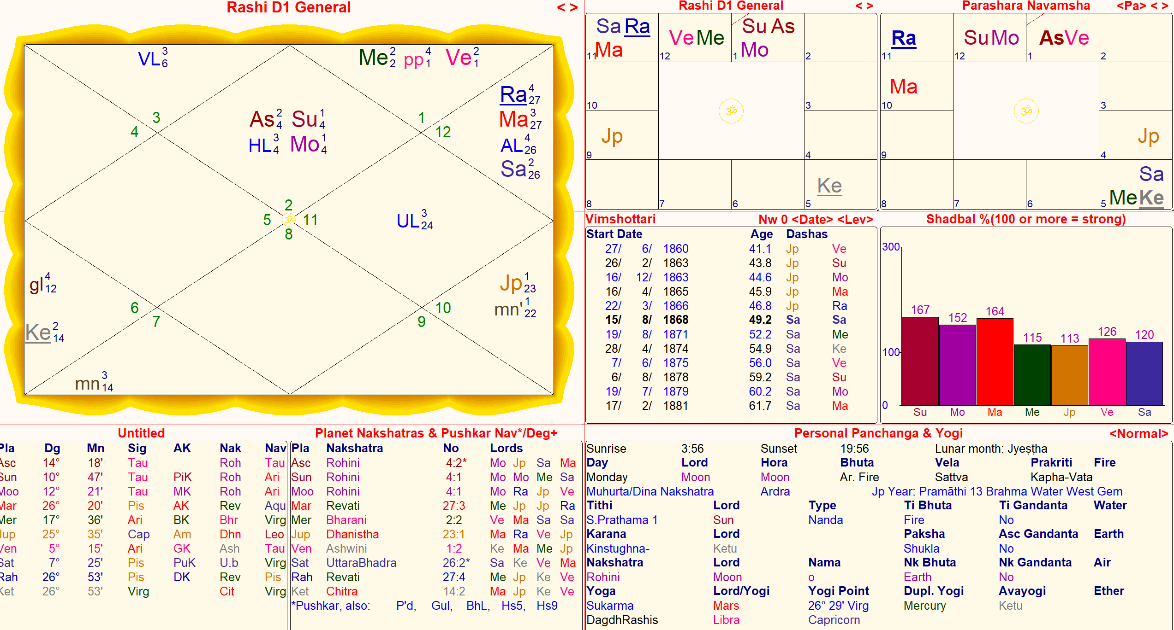
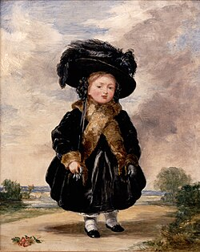
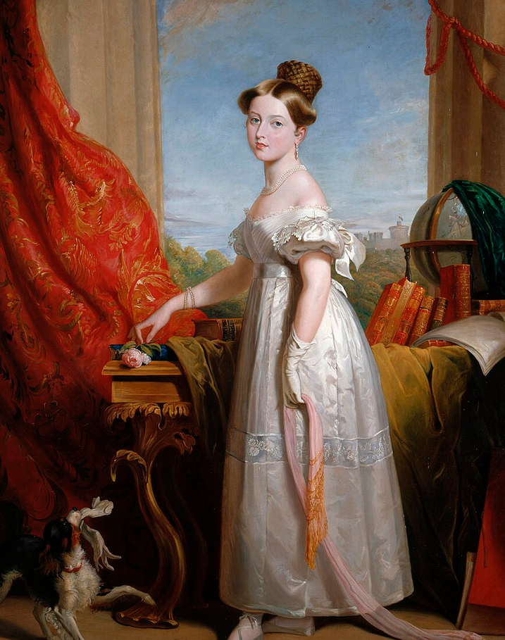
After the Indian Rebellion of 1857, the British East India Company, which had ruled much of India, was dissolved, and Britain's possessions and protectorates on the Indian subcontinent were formally incorporated into the British Empire. The Queen had a relatively balanced view of the conflict, and condemned atrocities on both side. Empress of India May 1st 1876
ॐ
Victoria later described her childhood as "rather melancholy".Her mother was extremely protective, and Victoria was raised largely isolated from other children under the so-called "Kensington System", an elaborate set of rules and protocols devised by the Duchess
All Rights Reserved @Copyright Sonal Sachdeva

Slide 39
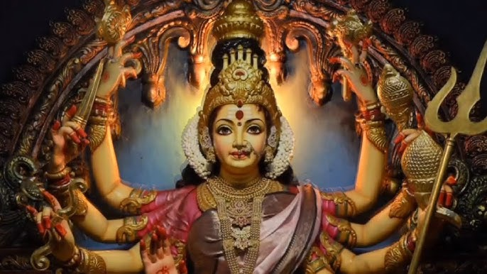

Yogam and Yogi – of Pañcāṅga
Snapshot of Karma, original Yoga and Mothers from all directions for protection
ॐ

Slide 40

ॐ
Yogam~Nithya Yoga
It is manifestation of the Nakshatras through the yoga.
Yogam is what works but what does not work for you, and it helps in Overcoming Ailments
27 Yogas are really the characteristics of Nakshatra hidden in them in subtle ways. The Yoga graha is one of the most important, it is like sapta Matrika the 7 mothers or the dasa mahavidhyas…
Karmically it cannot be changed

Slide 41
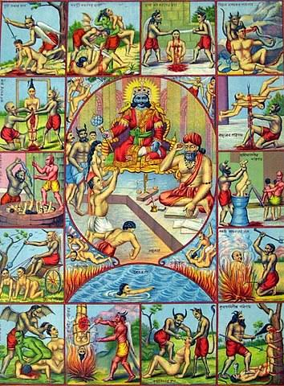

ॐ
As per Jaimini as well as Garuda Purana and various other Puranas, there are core 28 hells!
Śukadeva Gosvāmī describes the following twenty-eight hells: Tāmisra, Andhatāmisra, Raurava, Mahāraurava, Kumbhīpāka, Kālasūtra, Asi-patravana, Sūkaramukha, Andhakūpa, Kṛmibhojana, Sandaṁśa, Taptasūrmi, Vajrakaṇṭaka-śālmalī, Vaitaraṇī, Pūyoda, Prāṇarodha, Viśasana, Lālābhakṣa, Sārameyādana, Avīci, Ayaḥpāna, Kṣārakardama, Rakṣogaṇa-bhojana, Śūlaprota, Dandaśūka, Avaṭa-nirodhana, Paryāvartana and Sūcīmukha.
A person who steals another’s money, wife or possessions is put into the hell known as Tāmisra. A man who tricks someone and enjoys his wife is put into the extremely hellish condition known as Andhatāmisra. A foolish person absorbed in the bodily concept of life, who on the basis of this principle maintains himself or his wife and children by committing violence against other living entities, is put into the hell known as Raurava. Those who kill different animals and birds and then cook them are put by the agents of Yamarāja into the hell known as Kumbhīpāka, where they are boiled in oil. A person who kills a brāhmaṇa is put into the hell known as Kālasūtra, where the land, perfectly level and made of copper, is as hot as an oven. The killer of a brāhmaṇa burns in that land for many years. One who does not follow scriptural injunctions but who does everything whimsically or follows some rascal is put into the hell known as Asi-patravana. A government official who poorly administers justice, or who punishes an innocent man, is taken by the assistants of Yamarāja to the hell known as Sūkaramukha, where he is mercilessly beaten.
Calculation at the end of this presentation under ‘extra’

Slide 42
ॐ
How to Calculate Nithya Yoga:
Add longitude of the Moon to the longitude
of the Sun and divide it by 13 degrees 20 minutes to get the Nithya Yoga.
Nithya Yoga = (Longitude of Sun + Longitude of Moon) / 13°20′
Yoga | Sign | Nakshatra | Pada | Pada Start | Pada End
Yoga | Sign | Nakshatra | Pada | Pada Start | Pada End
Vishkambha | Cancer | Pushya | pada 1 | 93°20'00" | 96°40'00"
Vishkambha | Cancer | Pushya | pada 2 | 96°40'00" | 100°00'00"
Vishkambha | Cancer | Pushya | pada 3 | 100°00'00" | 103°20'00"
Vishkambha | Cancer | Pushya | pada 4 | 103°20'00" | 106°40'00"
Preethi | Cancer | Ashlesha | pada 1 | 106°40'00" | 110°00'00"
Preethi | Cancer | Ashlesha | pada 2 | 110°00'00" | 113°20'00"
Preethi | Cancer | Ashlesha | pada 3 | 113°20'00" | 116°40'00"
Preethi | Cancer | Ashlesha | pada 4 | 116°40'00" | 120°00'00"
Ayushman | Leo | Magha | pada 1 | 120°00'00" | 123°20'00"
Ayushman | Leo | Magha | pada 2 | 123°20'00" | 126°40'00"
Ayushman | Leo | Magha | pada 3 | 126°40'00" | 130°00'00"
Ayushman | Leo | Magha | pada 4 | 130°00'00" | 133°20'00"
Saubhagya | Leo | P.Phalguni | pada 1 | 133°20'00" | 136°40'00"
Saubhagya | Leo | P.Phalguni | pada 2 | 136°40'00" | 140°00'00"
Saubhagya | Leo | P.Phalguni | pada 3 | 140°00'00" | 143°20'00"
Saubhagya | Leo | P.Phalguni | pada 4 | 143°20'00" | 146°40'00"
Shobhana | Leo | U.Phalguni | pada 1 | 146°40'00" | 150°00'00"
Shobhana | Virgo | U.Phalguni | pada 2 | 150°00'00" | 153°20'00"
Shobhana | Virgo | U.Phalguni | pada 3 | 153°20'00" | 156°40'00"
Shobhana | Virgo | U.Phalguni | pada 4 | 156°40'00" | 160°00'00"
Atiganda | Virgo | Hasta | pada 1 | 160°00'00" | 163°20'00"
Atiganda | Virgo | Hasta | pada 2 | 163°20'00" | 166°40'00"
Atiganda | Virgo | Hasta | pada 3 | 166°40'00" | 170°00'00"
Atiganda | Virgo | Hasta | pada 4 | 170°00'00" | 173°20'00"
Sukarma | Virgo | Chitra | pada 1 | 173°20'00" | 176°40'00"
Sukarma | Virgo | Chitra | pada 2 | 176°40'00" | 180°00'00"
Sukarma | Libra | Chitra | pada 3 | 180°00'00" | 183°20'00"
Sukarma | Libra | Chitra | pada 4 | 183°20'00" | 186°40'00"
Dhriti | Libra | Swati | pada 1 | 186°40'00" | 190°00'00"
Dhriti | Libra | Swati | pada 2 | 190°00'00" | 193°20'00"
Dhriti | Libra | Swati | pada 3 | 193°20'00" | 196°40'00"
Dhriti | Libra | Swati | pada 4 | 196°40'00" | 200°00'00"
Shula | Libra | Vishakha | pada 1 | 200°00'00" | 203°20'00"
Shula | Libra | Vishakha | pada 2 | 203°20'00" | 206°40'00"
Shula | Libra | Vishakha | pada 3 | 206°40'00" | 210°00'00"
Shula | Scorpio | Vishakha | pada 4 | 210°00'00" | 213°20'00"
Ganda | Scorpio | Anuradha | pada 1 | 213°20'00" | 216°40'00"
Ganda | Scorpio | Anuradha | pada 2 | 216°40'00" | 220°00'00"
Ganda | Scorpio | Anuradha | pada 3 | 220°00'00" | 223°20'00"
Ganda | Scorpio | Anuradha | pada 4 | 223°20'00" | 226°40'00"

Slide 43
ॐ
Nithya Yoga:
Yoga | Sign | Nakshatra | Pada | Pada Start | Pada End
Vriddhi | Scorpio | Jyeshtha | pada 1 | 226°40'00" | 230°00'00"
Vriddhi | Scorpio | Jyeshtha | pada 2 | 230°00'00" | 233°20'00"
Vriddhi | Scorpio | Jyeshtha | pada 3 | 233°20'00" | 236°40'00"
Vriddhi | Scorpio | Jyeshtha | pada 4 | 236°40'00" | 240°00'00"
Dhruva | Saggitarius | Moola | pada 1 | 240°00'00" | 243°20'00"
Dhruva | Saggitarius | Moola | pada 2 | 243°20'00" | 246°40'00"
Dhruva | Saggitarius | Moola | pada 3 | 246°40'00" | 250°00'00"
Dhruva | Saggitarius | Moola | pada 4 | 250°00'00" | 253°20'00"
Vyaghata | Saggitarius | P.Shada | pada 1 | 253°20'00" | 256°40'00"
Vyaghata | Saggitarius | P.Shada | pada 2 | 256°40'00" | 260°00'00"
Vyaghata | Saggitarius | P.Shada | pada 3 | 260°00'00" | 263°20'00"
Vyaghata | Saggitarius | P.Shada | pada 4 | 263°20'00" | 266°40'00"
Harshana | Saggitarius | U.Shada | pada 1 | 266°40'00" | 270°00'00"
Harshana | Capricorn | U.Shada | pada 2 | 270°00'00" | 273°20'00"
Harshana | Capricorn | U.Shada | pada 3 | 273°20'00" | 276°40'00"
Harshana | Capricorn | U.Shada | pada 4 | 276°40'00" | 280°00'00"
Vajra | Capricorn | Shravan | pada 1 | 280°00'00" | 283°20'00"
Vajra | Capricorn | Shravan | pada 2 | 283°20'00" | 286°40'00"
Vajra | Capricorn | Shravan | pada 3 | 286°40'00" | 290°00'00"
Vajra | Capricorn | Shravan | pada 4 | 290°00'00" | 293°20'00"
Yoga | Sign | Nakshatra | Pada | Pada Start | Pada End
Siddhi | Capricorn | Dhanishtha | pada 1 | 293°20'00" | 296°40'00"
Siddhi | Capricorn | Dhanishtha | pada 2 | 296°40'00" | 300°00'00"
Siddhi | Aquarius | Dhanishtha | pada 3 | 300°00'00" | 303°20'00"
Siddhi | Aquarius | Dhanishtha | pada 4 | 303°20'00" | 306°40'00"
Vyatipata | Aquarius | Shatabhisha | pada 1 | 306°40'00" | 310°00'00"
Vyatipata | Aquarius | Shatabhisha | pada 2 | 310°00'00" | 313°20'00"
Vyatipata | Aquarius | Shatabhisha | pada 3 | 313°20'00" | 316°40'00"
Vyatipata | Aquarius | Shatabhisha | pada 4 | 316°40'00" | 320°00'00"
Variyana | Aquarius | P.Bhadrapada | pada 1 | 320°00'00" | 323°20'00"
Variyana | Aquarius | P.Bhadrapada | pada 2 | 323°20'00" | 326°40'00"
Variyana | Aquarius | P.Bhadrapada | pada 3 | 326°40'00" | 330°00'00"
Variyana | Pisces | P.Bhadrapada | pada 4 | 330°00'00" | 333°20'00"
Parigha | Pisces | U.Bhadrapada | pada 1 | 333°20'00" | 336°40'00"
Parigha | Pisces | U.Bhadrapada | pada 2 | 336°40'00" | 340°00'00"
Parigha | Pisces | U.Bhadrapada | pada 3 | 340°00'00" | 343°20'00"
Parigha | Pisces | U.Bhadrapada | pada 4 | 343°20'00" | 346°40'00"
Shiva | Pisces | Revati | pada 1 | 346°40'00" | 350°00'00"
Shiva | Pisces | Revati | pada 2 | 350°00'00" | 353°20'00"
Shiva | Pisces | Revati | pada 3 | 353°20'00" | 356°40'00"
Shiva | Pisces | Revati | pada 4 | 356°40'00" | 360°00'00"

Slide 44
ॐ
Yoga | Sign | Nakshatra | Pada | Pada Start | Pada End
Siddha | Aries | Ashwini | pada 1 | 0°00'00" | 3°20'00"
Siddha | Aries | Ashwini | pada 2 | 3°20'00" | 6°40'00"
Siddha | Aries | Ashwini | pada 3 | 6°40'00" | 10°00'00"
Siddha | Aries | Ashwini | pada 4 | 10°00'00" | 13°20'00"
Sadhya | Aries | Bharani | pada 1 | 13°20'00" | 16°40'00"
Sadhya | Aries | Bharani | pada 2 | 16°40'00" | 20°00'00"
Sadhya | Aries | Bharani | pada 3 | 20°00'00" | 23°20'00"
Sadhya | Aries | Bharani | pada 4 | 23°20'00" | 26°40'00"
Shubha | Aries | Krittika | pada 1 | 26°40'00" | 30°00'00"
Shubha | Taurus | Krittika | pada 2 | 30°00'00" | 33°20'00"
Shubha | Taurus | Krittika | pada 3 | 33°20'00" | 36°40'00"
Shubha | Taurus | Krittika | pada 4 | 36°40'00" | 40°00'00"
Shukla | Taurus | Rohini | pada 1 | 40°00'00" | 43°20'00"
Shukla | Taurus | Rohini | pada 2 | 43°20'00" | 46°40'00"
Shukla | Taurus | Rohini | pada 3 | 46°40'00" | 50°00'00"
Shukla | Taurus | Rohini | pada 4 | 50°00'00" | 53°20'00"
Brahma | Taurus | Mrigashira | pada 1 | 53°20'00" | 56°40'00"
Brahma | Taurus | Mrigashira | pada 2 | 56°40'00" | 60°00'00"
Brahma | Gemini | Mrigashira | pada 3 | 60°00'00" | 63°20'00"
Brahma | Gemini | Mrigashira | pada 4 | 63°20'00" | 66°40'00"
Yoga | Sign | Nakshatra | Pada | Pada Start | Pada End
Indra | Gemini | Ardra | pada 1 | 66°40'00" | 70°00'00"
Indra | Gemini | Ardra | pada 2 | 70°00'00" | 73°20'00"
Indra | Gemini | Ardra | pada 3 | 73°20'00" | 76°40'00"
Indra | Gemini | Ardra | pada 4 | 76°40'00" | 80°00'00"
Vaidhriti | Gemini | Punarvasu | pada 1 | 80°00'00" | 83°20'00"
Vaidhriti | Gemini | Punarvasu | pada 2 | 83°20'00" | 86°40'00"
Vaidhriti | Gemini | Punarvasu | pada 3 | 86°40'00" | 90°00'00"
Vaidhriti | Cancer | Punarvasu | pada 4 | 90°00'00" | 93°20'00"
Indra | Gemini | Ardra | pada 1 | 66°40'00" | 70°00'00"
Indra | Gemini | Ardra | pada 2 | 70°00'00" | 73°20'00"
Indra | Gemini | Ardra | pada 3 | 73°20'00" | 76°40'00"
Indra | Gemini | Ardra | pada 4 | 76°40'00" | 80°00'00"

Slide 45
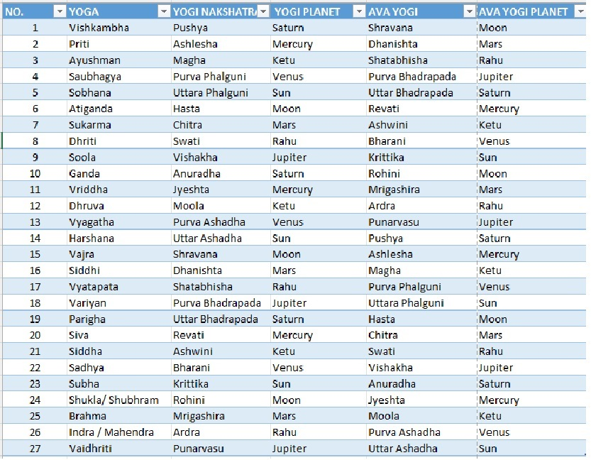











ॐ
Orange is Uttamanama yogam
Green is Madhayama
Blue – not good, needs remedials

Slide 46








ॐ

Slide 47
ॐ
Yogam – The classification based on Past karma – CarbonBlue print
Uttama Nama Yoga | Madhayam Yoga | Avayoga nama yoga
Priti | Ayushman | Vishkambha
Saubhagyam | Sukarmam | Atiganda
Shobhana | Dhriti | Sulam
Vriddhi | Dhruva | Gandam
Siddhi | Harshana | Vyagharta
Shivam | Vajra | Vyatipata
Sidham | Variyan | Parigham
Shubha | Sadhyam | Brahma
Subhram | Maiyendra, Indra(Maha indra) | Vaidhrti
Yogam wil tell you overall
Good karmas irrespective of the ‘state’ of Kundali not…
It is very clear-cut demarcation on benefits of Uttama
In Avayoga Daśā / Antara – you will land up
Loosing – ZERO Shunya !
In its dasha/antar
Boundary of life and purva
punya of your life and it manifests and gives a carbon copy of your previous life
Madhayam will be so-so but If the yogi planet is good then good results ensue
Falling down is painful;

Slide 48
ॐ
Yoga & Yogi Point
Whenever Ascendant Lagna is travelling in the Yogi point it will be highly beneficial for starting a business etc ; even if it is suffering combustion;
Yogi if caught in tithi Shunya rashi’s (In The Extras at the end of this presentation) then still will give good though less.
If yogi is connected to 6th, 8th and 12th, in spite of that will do great.
Yogam & Yogi
Each Yogi planet has a corresponding Avayogi planet
Sun as Yogi – Saturn as Avayogi
Saturn as Yogi – Moon as Avayogi
Moon as Yogi – Mercury as Avayogi
Mercury as Yogi – Mars as Avayogi
Mars as Yogi – Ketu as Avayogi
Ketu as Yogi – Rahu as Avayogi
Rahu as Yogi – Venus as Avayogi
Venus as Yogi – Jupiter as Avayogi
Jupiter as Yogi – Sun as Avayogi

Slide 49

ॐ
Viṣkambha: Yama; Most damage done by females in their house;it will be mother-in-law or sister-in-law.
Good Education, investment in business or loss,theft; Profession connect to speech, literature and teacher; Medical knowledge, bank, textile, garments, insurance; Issues with child birth or issues to child will be there. Early death in family, or some miscarriage or dur maranam. Highly hypersensitive and interest in occult, tantra. Property issue, or always an ongoing loan;love marriage in family. Native will have age difference or unhappiness in marriage; Not happy with mother but need blessings from their mother. Alpāyu , baldness etc; skin related issues, ligament, bone and heart related issue; friends they will benefit from; Litigation over some property, and father will look younger and some escape from gandam dosha.
Vishnu and kartikeya sadhana; no bad habits but if once addicted they can never come out of it;

Slide 50
ॐ
2. Prīti: Viśvedevāḥ; suffers with land issues, shalya dosa. the sibling of native , or grandfather will be subject to major mental health issue; Some one had a mental trauma through accident ;
3. Āyuṣmān: Moon; Life spoiled by bad companionship neecha people or tendency to do something bad, if they keep company of negative ; in Old age they should not be abroad. Else they will die of cancer etc.
4. Saubhāgya: Dhātā; Shukra will confer them with blessings. As the Yogi Point ; but cannot curse of others, they will have problem in progeny, and the generations consequently will not continue; they will search hi and lo but wont find it. Most family people born will be born in Sasti tithi, or asta nakshatra . putra dosha; What is putra dosha? Dosha is fault – flaw, and Putra is children/Sons. So, there may be issues in conceiving etc or children don’t happen, or miscarriage.

Slide 51
ॐ
5. Śobhana: Jīva (Bṛhaspati); All kinds of comfort in life, but the spouse, wife/workers
will suffer; Take extra care of heart, urea levels acid-kidney related , gastric troubles.
6. Atigaṇḍa: Moon; Durmarana in the family, for sure. Definitely the curse of maternal uncle or some kind of connection etc, or no maternal uncle; won’t have got grace of kula devata; never forget – should have no connection with maternal uncles etc – There may be issues if they do get married to maternal uncle’s daughters etc. Whatever skill, they should work within those for success.
7. Sukarmā): Indra; Yogi is Chitra Mars; Entire life spoiled by giving advice to others; don’t try to take a risk and do not invest in what you don’t know. They try do what you do not know;
8. Dhṛti: Varuṇa Good advisers and best counsellors and when it comes to their own life they will let go of those rules. And won’t follow their own advise. They like to change jobs;

Slide 52
ॐ
9. Śūla: Ahi; NO EGO ! Else they will fail.Exposed to all kinds of difficulty in life;
Responsibility should not be entirely placed on their shoulders. (Ahi (अहि) is a s
ynonym of Sarpa (“snake”), according to the Amarakośa.—The Sanatkumāra Saṃhitā (III.36cd-37ab) states that snakes are of two kinds, Nāgas and Sarpas. While the former can take any form they desire, the latter are those which glide. The Amarakośa (verses I.10.3-6) gives 33 synonyms for snake [viz. Ahi]. Snakes are said to reside in Nāgaloka which is located in the endless bowels of the earth with countless palaces, houses and towers, it is also known as pātālaloka.
10, Gaṇḍa: Agni; After Marriage his thought capacity will go mad, crazy, and bizarre. Complete change in personality. Due to own bad habits he will be subjected to suffering; For females, because of some wrong relationships with a man it will get spoiled.
11. Vṛddhi: Sūrya; Never get into arguments or fights; propensity to get into fights accidents etc. avoid; they will work in knowledge-based jobs (lot of scorpios work in those researchers, occult, ancient scriptures etc;
Description of the Yogas

Slide 53
ॐ
12. Dhruva: Bhūmi; They are having suffering out of karma, very strong karmic link to past, including the diseases they suffer; Diabetes, skin cancer, poisoning etc ;Skin related disease insect snake bites;
13. Vyāghāta: Rudra
Not so Truthful in the job they undertake; most important they will suffer for mistakes that they have not done .
14. Harṣaṇa: Brahmā (Ka); Karmas to related to mother and mother’s side this persons marriage / childbirth etc will be obstruction; Mother may have committed mistakes in past life; Strong karma pending for the native; if it is male, suffering because of female and vice versa; Mental disturbance.
Some parts of the body there may be problem;
example, person’s fathers sister husband has schizophrenia.

Slide 54
ॐ
15. Vajra: Varuṇa
By their own they will come up in life; Own self efforts and family and children will stay. Their children will be separated from them. From age 60 approx. stay separated. So last part of life they will have to be isolated. Amongst 3 generations, or equivalent to a murder would have taken place.
16. Siddhi: Gaṇeśa;
Will do secretly another job, (moon lighting). Applies to most political leaders, they will be doing other stuff, lobbying for others. Good for mediating for highly powerful people;
17. Vyatīpāṭa: Rudra; Severely affected by all the karmas of ancestors. Their birth in itself is curse of ancestors. Father affected or connection with ancestors will be impacted or His own life will go directionless or some person has mental health issue; Birth itself is curse of ancestors. Some person would have cheated regards temple related activity, Government property, or brothers wife (illicit relations) Needs to be meditated;
One day homam won’t work. One year or some long-term remedy;

Slide 55
ॐ
18. Varīyas : Kubera (Dhanada);
get trapped by powerful people; Reason is greed or jealousy.
19. Parigha: Tvaṣṭā,
Lot of mental stress, karma related diseases will affect these people;
20. Śiva : Mitra;
Panchami Ashtami people seen here; Blood related disorders are seen. usually intelligent, research minded , sharp but short temper. Important advise -
21. Siddha : Ṣaḍānana
Rahu dosha, naga dosham will work, especially prominent nodes, blocks in financial progress, all of them will be there; Sleep till late or won’t sleep at all.
22. Sādhya Sāvitrī, Fathers Don’t get a guide/mentor/Guru in life, as they cannot accept anyone. But they are excellent in their profession. Fathers side will be a durmarana in lineage.

Slide 56

ॐ
23. Śubha : Kamalā; Don’t keep people / staff at home. One of his own worker will stab him in the back;
24. Śukla Gaurī ; Rohini moon yogi; mercury avayogi;
No support of maternal uncle; ignored and harrasased by their own children. They should not teach secrets of knowledge , hence do not reveal secrets, as it will be decline of earning potential or fame.
25. Brahman : Nāsatyas – mental issues to native or Native itself.
26. Indra: Pitṛs: Mahendra, they will have all the comforts but they cannot enjoy them; Only after some expense their work will be done; Their life is affected by a female. Mostly member of family or sister or close friend. .Vyatipata, Amavasya pournima people born will be there, surrounded by these.
27. Vaidhṛtī: Aditi. – don’t take jobs karakaas of Sun.These people should never take jobs related to Sun. Ancestral/father’s job. Caught in charges, bribes. Etc . They struggle with government. They like isolation and darkness.

Slide 57



Yogam & Yogi
Sri Rama – Shobhana Yoga ruled by deity Brhaspati, which is in digbala, forming several yogas, including hamsa maha purusa yoga – Kaulava Kāraṇa – Strong, Mars is the Nath and so exalted – here we see
That the yogi graha is Surya and Avayogi graha is Saturn – (father, step mother) AL is in Aries Exalted Sun -UNDEFEATABLE
ॐ
5. Śobhana: Jīva (Bṛhaspati); All kinds of comfort in life, but the spouse, wife/workers
will suffer; Take extra care of heart, urea levels acid-kidney related , gastric troubles.

Slide 58

Queen Victoria
.
Victoria became queen in
1837, aged 18.
She married Prince Alber
t in 1840. Sadly, Albert died in 1861 at just 42 years old. Queen Victoria had four sons and five daughters Queen Victoria reigned for 63 years and 7 months.
During her reign, Queen Victoria expanded the British Empire, so much so that by the end of the century it would cover a fifth of the worlds surface.
The century also saw huge advancements across the fields of medicine, transportation, communication and industry. It saw inventions such as the telegraph, the bicycle, the internal combustion engine and the developments of antiseptic and anesthetics.
ॐ

Slide 59






Queen Victoria
She married Prince Albert in 1840 rahu Saturn – (Parivaratana Yoga)
Sadly, Albert died in 1861 at just 42 years old. ...
Karaṇa Natha is Mercury;
House of Virgo
ॐ
In 1877, British Prime Minister Benjamin Disraeli declared that the Queen was now Empress of India, sealing the relationship between Britain and India, and marking the beginning of the Queen’s love affair with the country.

Slide 60



Karaṇa Natha is Mercury;
House of Virgo Rahu – Jupiter 1937 she ascents throne ‘ Jupiter Mercury – Magnacarta announced
ॐ
Victoria became queen in 1837, aged 18.
Queen Victoria believed in the ideals of an empire, she was also concerned about the rights of the Indian people. In 1858 she issued a proclamation that became known as the “Magnacarta of the People of India”.
Britain would not look to expand on their existing territories in India, the rights of native Indian princes would be recognised, Britain would no longer look to exert its religious beliefs upon the Indian people.
;

Slide 61
Charles Dickens Ketu – Kāraṇa Nath are conjoined kendra in perfect trine to jupiter. Blacking Factory: At age 12, Dickens was forced to work 10-hour days in a squalid boot-blacking warehouse after his father was sent to Marshalsea debtor's prison.
ॐ
13. Vyāghāta: Rudra Not so Truthful in the job they undertake; most important they will suffer for mistakes that they have not done .
Pickwick papers established in 1836-1837, ketu venus
All Rights Reserved @Copyright Sonal Sachdeva

Slide 62

ॐ
October of 1853, the Crimean War broke out. The British Empire was at war against the Russian Empire for control of the Ottoman Empire. Thousands of British soldiers were sent to the Black Sea, where supplies quickly dwindled. By 1854, no fewer than 18,000 soldiers had been admitted into military hospitals.
At the time, there were no female nurses stationed at hospitals in Crimea. The poor reputation of past female nurses had led the war office to avoid hiring more. But, after the Battle of Alma, England was in an uproar about the neglect of their ill and injured soldiers;
sthirakaraṇas Kimstughna

Slide 63



Florence nightingale
ॐ
Kimstughna Kausthubha - means sandal, gem or elephant; this is a Karaṇa proper for Sages and saints; especially those who follow traditional Tantric worship.
Kimstugna Karaṇa Natha is Mercury;
House of Virgo ; Sun is the Yogi Graha – and Mercury is in ketu’s
Nakshatra and Ketu is in Surya

Slide 64



Ramakrishna Paramahamsa was an Indian Hindu mystic. He was a devotee of the goddess Kali, but adhered to various religious practices from the Hindu traditions of Vaishnavism, Tantric Shaktism, and Advaita Vedanta, as well as Christianity and Sufi Islam.
ॐ
Sri Ramakrishna met his first major spiritual guide, the female ascetic the Bhairavi Brahmani, in 1861, and his Vedanta guru, Totapuri, in 1865
Balava Karana – Rahu AK in Taurus and Ketu svakshetra in Digbala being yogi Graha , dispositor Mars (Ketu pati) is Exalted and dispositor as well as karaka is exalted

Slide 65


COURSES~WARD OFF EVIL
PRODUCTS
OVER 35 HOURS OF VIDEO MATERIAL COURSE on YOGAS
OF PANCHANGA
YOGAS OF PARASARA
NAKSHATRA and NAKSHATRA ADVANCE
Karaṇa Remedials – Make that Natha Strong and faith in the Yogi Graha and the corresponding deity
ॐ
COURSES
https://divinationsorg.thinkific.com/

Slide 66

ॐ
PRODUCTS
OF WEALTH, ALIGNMENT
AND PANCHANGA COURSES
divinationsorg.thinkific.com/
यस्त्विन्द्रियाणि मनसा नियम्यारभतेऽर्जुन ।
कर्मेन्द्रियै: कर्मयोगमसक्त: स विशिष्यते ॥ 7॥
yas tvindriyāṇi manasā niyamyārabhate ’rjuna
karmendriyaiḥ karma-yogam asaktaḥ sa viśhiṣhyate
those karm yogis who control their knowledge senses
with the mind, O Arjun, and engage the working senses I
n working without attachment, are certainly superior.
न हि कश्चित्क्षणमपि जातु तिष्ठत्यकर्मकृत् ।
कार्यते ह्यवश: कर्म सर्व: प्रकृतिजैर्गुणै: ॥ 5॥
na hi kaśhchit kṣhaṇam api jātu tiṣhṭhatyakarma-kṛit
kāryate hyavaśhaḥ karma sarvaḥ prakṛiti-jair guṇaiḥ
There is no one who can remain without action even
for a moment. Indeed, all beings are compelled to act by their qualities born of material nature (the three guṇas).
Bhagavad Gita Chapter 3

Slide 67
Karaṇa Remedial Temples
ॐ
Bava
Mookambika temple
Punnai Nallur mariamman
balava
⁠kalahasti
any snake head temple
kaulava
Srivanjiyam kumbakonam
⁠Varaha/varahi worship
taitula
Mahalaxmi tayar of srirangam,
trichy
Kanchi kamakshi amman
Karasai Gara
1.Madurai meenakshi
2.Annapourna
3. Chandra mouleswara
tiruvakarai
Vanisai
1. Tiruvannamalai
2. ⁠Palani
3. ⁠suryanar kovil Kumbakonan
Bhadra
Tiruchendur
Pillayarpathi
Rameswaram patanjali Siddar
Shakuni
Tirunallar
Kucchanoor saneeswara
Shirdi Sani singnapoor
Shankaran kovil
chatuspada
1.kala bhairavar worship on
Astami tithi
2.frequently visiting
Siddar jeeva samadi
Naga
Kalahasti
Kimstuganam
1. Guruvayur
2. ⁠panduranga pandaripura
3. ⁠Madurai Meenakshi
4. ⁠tirupati

Slide 68
COURSES
https://divinationsorg.thinkific.com
Thiri Sambrani (One year supply) to transform the negative energies of home
Karungali Mala (India Black Ebony) for all kinds of Mars issues
ॐ

Slide 69
ॐ
EXTRAS

Slide 70

ॐ
Tithī Shunya Every Sign has a ‘Burnt Tithi’ Dagdha Tithi – What ever the Solar-Lunar angle (Tithi) you are born in certain signs will get burnt.
Quite a painful placement until you come to terms with working with it

Slide 71
Pratipada & Dwadashi | Libra, Capricorn | Venus, Saturn
Dwitiya & Ekadashi | Sagittarius, Pisces | Jupiter
Tritiya | Leo, Capricorn | Sun, Saturn
Chaturthi | Taurus, Aquarius | Venus, Saturn
Panchami & Ashtami | Gemini, Virgo | Mercury
Shashthi | Aries, Leo | Mars, Sun
Saptami | Cancer, Sagittarius | Moon, Jupiter
Navami & Dashami | Leo, Scorpio | Sun, Mars
Trayodashi | Taurus, Leo | Venus, Sun
Chaturdashi | Gemini, Virgo, Sagittarius, Pisces | Mercury, Jupiter
Purnima & Amavasya | - | -
ॐ
Tithī Shunya

Slide 72

Tithī Shunya
Chaturthi, Trayodashi
4th 13th
Pratipada & Dwadashi | Libra, Capricorn
Dwitiya & Ekadashi | Sagittarius, Pisces
Tritiya | Leo, Capricorn
Chaturthi | Taurus, Aquarius
Panchami & Ashtami | Gemini, Virgo
Shashthi | Aries, Leo
Saptami | Cancer, Sagittarius
Navami & Dashami | Leo, Scorpio
Trayodashi | Taurus, Leo
Chaturdashi | Gemini, Virgo, Sagittarius, Pisces
KARAKAS RElationship
First House Self –
2nd House is 11th from 4th so elder brother of Mothers
3rd House is Siblings
4th Mother
5th Children
6th Mothers younger siblings
7th Self- Spouse/ relationships etc
8th Work of Siblings, Health, Mothers other children
9TH Father – Father figures, Marriage of Siblings
10th Mothers Mariage
11th Childrens Marriage/Spouse
12th Uncles/Aunts Marriages/ Work of Siblings;
Shashthi-6th
2.Taurus Vṛṣa [Vṛṣabha]
12.Pisces Mīna
2nd,, 11th,14th
1.Meṣa
Aries
3. Gemini Mithuna
Panchami & Ashtami
Chaturdashi
11.Aquarius Kumbha
4th
4. Cancer Karka [Karkaṭa]
Saptami 7th
10.Capricorn Nakra [Makara]
1st, 12th, 3rd,
9. Sagittarius Dhanus
Dwitiya, Ekadashia – 2nd,11th,7th.14th
5. Leo Siṁha 3rd,6th,9th,13th 10th
Tritiya
Shashthi
Navami,Dashami,
Trayodashi
7. Libra Tulā
Pratipada & Dwadashi
1st, 12th
6. Virgo – Kanya Kumāri
5th,8th,
14th,
Panchami & Ashtami
Chaturdashi
8. Scorpio Āli [Vṛścika] Navami & Dashami
9th, 10th

Slide 73
Yogam & Yogi
Calculation of the Nitya Yog is simple.
The heavens above is spherical, hence contain 360°, which divided by 27 constellations is equal to 13°20’. So, for each 13°20’, a Yog is formed.
Now, add the longitude of the Moon to the longitude of the Sun, divide it by 13°20’ and the consequent Nitya Yog is thus derived.
Moon degrees 9 degree taurus – 40 degree
Sun’s degrees 28 degrees cancer - 90x 28 degree cancer = 118
Sun + Moon is 158 degrees.
Step 2
Add 93 degree 20’ (pushya – constant for all the charts static yoga)
251 deg 20’ = mula 4th pada is the yogi pada – Ketu is the yogi graha
Avayogi is 15th nakshatra roughly depending on degrees
from Mula is – Ardra 2nd pada.
Moon is 9 makar – 279; Sun 14 degree Cancer = 104
104+279 = 383 , - 360 = to that add 93 degree = 116 degrees - in cancer in pushya last
ॐ

Slide 74
ॐ
Chapter 56.15 - Description of the Yogas (Joint motion)
DEITIES OF THE YOGA
211b-212a. The presiding deities of the 24 Yogas[1] are: (1. Viṣkambha): Yama; (2. Prīti): Viśvedevāḥ; (3. Āyuṣmān): Moon; (4. Saubhāgya): Dhātā; (5. Śobhana): Jīva (Bṛhaspati); (6. Atigaṇḍa): Moon; (7. Sukarmā): Indra; (8. Dhṛti): Varuṇa (Toya); (9. Śūla): Ahi; (10, Gaṇḍa): Agni; (11. Vṛddhi): Sūrya; (12. Dhruva): Bhūmi; (13. Vyāghāta): Rudra; (14. Harṣaṇa): Brahmā (Ka); (15. Vajra): Varuṇa (Toyapa); (16. Siddhi): Gaṇeśa; (17. Vyatīpāṭa): Rudra; (18. Varīyas): Kubera (Dhanada); (19. Parigha): Tvaṣṭā, (20. Śiva): Mitra; (21. Siddha): Ṣaḍānana, (22. Sādhya) Sāvitrī, (23. Śubha): Kamalā; (24. Śukla): Gaurī, (25. Brahman): Nāsatyas (26. Indra): Pitṛs: and (27. Vaidhṛtī): Aditi.
Effects of the yogas.
212b. The yogas, vaidhṛti and vyatīpātā are always highly catastrophic.
213-15a. The first half of Parigha is abhorred for all rites. In Viṣkambha and Vajra, the first three nāḍikās, in Gaṇḍa and Atigaṇḍa six, in Vyāghāta nine, and in Śūla five nāḍikās are to be rejected.

Slide 75
ॐ
Yogam & Yogi
Each Yogi planet has a corresponding Avayogi planet
Sun as Yogi – Saturn as Avayogi
Saturn as Yogi – Moon as Avayogi
Moon as Yogi – Mercury as Avayogi
Mercury as Yogi – Mars as Avayogi
Mars as Yogi – Ketu as Avayogi
Ketu as Yogi – Rahu as Avayogi
Rahu as Yogi – Venus as Avayogi
Venus as Yogi – Jupiter as Avayogi
Jupiter as Yogi – Sun as Avayogi

