Slide 1
Enhancing
Math Learning through Leadership Moves
April, 2026 ꞁ Banff, Alberta

Slide 2
Let’s try this
Work with a partner.
Come up with two numbers so that if you add the two numbers, the answer is 10 more than if you subtract those same two numbers.
E.g. NOT 10 and 20 since 10 + 20 is NOT 10 more than 20 – 10

Slide 3
By the way
Any number and 5 would work, e.g.
10 and 5
20 and 5
17 and 5….
– 5
+ 5
10

Slide 4
And now this
Work on your own and complete these additions and subtractions.
3004 – 127
2156 – 328
1003 – 126

Slide 5
Which …
involved more math thinking?
is more engaging?
brings out mathematical competencies like reasoning, problem solving, as well as skills?

Slide 6
We live in a society
With two different views about what math is
more fundamental.
What happens to students (and parents) when they are forced to switch back and forth between those views year after year?

Slide 7
For this not to happen …
We need leaders who ensure that the children in their charge receive clear and consistent instruction.
I will, as you will see, be arguing for one of those points of view- the one that brings out competencies as well as skills- that fosters mathematical thinking, problem solving and communication skills along with content knowledge.

Slide 8
Let’s talk about …
What those sorts of classrooms look like
How teachers can be encouraged to be part of the community that instills this consistent view.

Slide 9
Look fors
Rich mathematical conversations.
That requires posing interesting questions and requiring collaboration.
For example, a question like I posed to you at the beginning.
Or maybe this one:
I multiply two integers and the answer is 20 less than one of the integers. What could they have been?
E.g. – 19 x 1 OR – 6 x 4 OR 10 x – 3

Slide 10
Look fors
Or asking engaging questions like:
How many text messages do you think a 12 year old usually sends a month?
OR
How old do you think a person typically is when they’ve drunk 1000 litres of milk?

Slide 11
Look fors
Teacher use of visual tools and expectations that students use visual tools.
For example, use a picture to show why 7 x 2 is four more than 5 x 2?
0 2 4 6 8 10

Slide 12
Look fors
Student confidence-
How quickly do students give up?
(This, of course, requires teachers to ask students questions where they
can succeed.)
Do they try or ask for help right away?
(This, of course, requires teachers not to show but to ask probing questions.)
Do they show any confidence in suggesting an approach or an answer or are they hesitant?

Slide 13

Look fors- number sense being built
Relating math to real-world situations
Can a student decide which is a better buy and why?

Slide 14
Look fors- number sense
Recognizing that they have alternative strategies that might be better in one situation than another
What’s a smart way to figure out 299 + 399?
When else might you use that sort of strategy?

Slide 15
Look fors- number sense
Recently, when we asked students to show two different ways to do something, they had no idea what to do– that means they are not being exposed to that.
We ended up having to ask questions like these:

Slide 16
Two ways
Why might someone figure out 399 – 245 using this picture?
245 399

Slide 17
Two ways
Or why might someone figure out 399 – 245 using this picture?
399
245

Slide 18
Two ways
Or why might someone figure out 399 – 245 by calculating
400 – 250 instead?
Then what would that person have to do?

Slide 19
Look fors- number sense
Relating any mathematical situation to other known ones
How does knowing that 60% of 175 = 105 help you figure out 40% of it?
OR How does knowing that 400 ÷ 8 = 50 help you figure out
424 ÷ 8?

Slide 20
Look fors- number sense
Seeking to make sense of why
E.g. Why does it make sense that 25 x 44 = 1100?
OR why does it make sense that 19 + 7 = 20 + 6 without even referring to what the actual value is?

Slide 21
Look fors- number sense
Noticing and making appropriate generalizations
E.g. Why do you always end up with 0 if you multiply by 0?
OR Why is 2/3 x another fraction always less than that other fraction?

Slide 22
Look fors- number sense
Noticing and making appropriate generalizations
OR Does this strategy always work?
52
– 37
20 – 5
(50–30) – (7 – 2)

Slide 23
Look fors- number sense
Regularly estimating to solve math problems or to check whether calculated solutions make sense
E.g. Why can you only estimate to figure out how long it takes to drive somewhere?
OR
Why does this not make sense: 45 – 19 = 34?

Slide 24
Look fors in teacher instruction
Learning time used effectively
Lessons focused on meaningful and valuable learning goals
Teachers ensuring students speak enough,that they listen and they give appropriate feedback
Differentiation used regularly

Slide 25
In a school, there might be differences in teacher beliefs about
covering curriculum vs ensuring understanding

Slide 26
In a school, there might be differences in teacher beliefs about
Explicit instruction vs a combination of exploration and explicit instruction or the type of resources to use to achieve that

Slide 27
In a school, there might be differences in teacher beliefs about
The goal of competencies as being a critical learning outcome

Slide 28
In a school, there might be differences in teacher beliefs about
How hopeless it is with some students

Slide 29
In a school, there might be differences in teacher beliefs about
The use of activities that allow for alternative responses since they are too hard to mark

Slide 30
In a school, there might be differences in teacher beliefs about
Whether assessments can be based on conversations and observations and not just written data

Slide 31
In a school, there might be differences in teacher beliefs about
How much planning for lessons is really needed

Slide 32
What is a leader’s role in minimizing the impact of these differences on students?
There are a variety of things a leader can do to minimize this impact.

Slide 33
The premise: The teacher is the key- not curriculum.
We focus on teacher behaviours.

Slide 34
Use human behaviour
Play on the fact that humans generally like to please their bosses.
Make it clear what the “boss” wants.

Slide 35
Use human behaviour
Set reasonable, but high, expectations.
Offer support to achieve those expectations.
Be involved- don’t delegate, at least some times.

Slide 36
Build collaboration
To encourage thoughtful planning, encourage teachers to plan together and facilitate that with scheduling time for it.

Slide 37
Follow through
Set, for example, a goal that students will walk away with a given idea at the end of each lesson.
Have teachers articulate what those walk aways are.
Watch for one to which you are invited.

Slide 38
Follow through
Set, for example, goals related to regularly using manipulatives at all grades for most students, not identifying them as “only if needed”.
Check in by having teachers talk about what they’ve done or stopping in to see.

Slide 39
Follow through
Set, for example, goals related to the use of number talks.
Check in by having teachers talk about what they’ve done or stopping in to see.

Slide 40
Get parents on board
It is critical that parents are part of this process and are working in the same direction as staff.
Early in the year a math night is critical.
It needs follow-up, though.
I send notes home to parents quickly explaining the ideas the kids are learning. They could be quick videos. We could show them how to ask their kids to show their learning.

Slide 41
Professional learning
Provide, but expect, teachers to work on their pedagogical content knowledge.
It ‘s often part of a collegial effort, but not always.
Ask what they’re working on. Ask what you can do to support that.

Slide 42
Professional learning
Set, as a goal, that teachers familiarize themselves with alternative strategies for calculations to have options for students.
Check in about the success of some of these alternatives used.

Slide 43
Consistency in assessment practices
Assessment of learning is the parents’ view into what teachers value.
Consistency here is critical.
Ensure teachers focus their assessments as much on competencies as skills. Ask to see the assessments.

Slide 44
What I mean by assessing competencies
On a grade 4 multiplication assessment, we don’t see just:
5 x 45
4 x 321 etc.
But also

Slide 45
What I mean by assessing competencies
Without getting the answer, tell how you could know that 5 x 38 is 38 more than 4 x 38 without actually calculating both.
Create a problem you could solve by calculating 6 x 45.
Without just using a rule, tell why it makes sense that 45 x 10 = 450.

Slide 46
Consistency in assessment practices
Ensure teachers do not use timed tests.
Ensure teachers do not use only written data to figure in to evaluation.
Ensure teachers use most recent and best evidence, not all evidence.
Encourage teachers to find ways to ensure students really understand what they are being asked on a test, quiz, or task.

Slide 47
Differentiation
Every teacher has an obligation to differentiate regularly.
Ask what teachers are doing to accomplish this without giving up on students.
Are they using more open-ended questions?
Are they expecting thinking from all students?
Are they ensuring students who can do the “required” are pushed, too?

Slide 48
For example…
A grade 5 teacher is working on 2-digit by 2-digit multiplication but not everyone is ready and some already know how to do it.
He or she might set a task like:
Choose one of these tasks:
A: Show that you can find two numbers to multiply where the hundreds digit ends up being 5.
B: Come up with some slides that would show someone who doesn’t already know how to multiply two 2-digit numbers why we do it the way we do.

Slide 49
Self-scaffolding
Too many teachers scaffold too much.
Have discussions about ways to provide feedback that encourage students to self-scaffold.
Follow up by monitoring.

Slide 50
Monitoring Change
Encourage every teacher to choose 3 students (or more) to focus on to improve performance in math. Require evidence of steps taken and evidence (or not) of improvement after a period of a month.

Slide 51
Setting a climate
Naysayers tend to be louder only when they are in the majority.
Require everyone to participate in the efforts in their own way.

Slide 52
Setting a climate
For a period of time, make math the focus. You probably need at least a year.

Slide 53
Why early screening is not enough
One problem is that the screening doesn’t really suggest the required intervention.
But a second problem is whether the screening is measuring the right things.

Slide 54
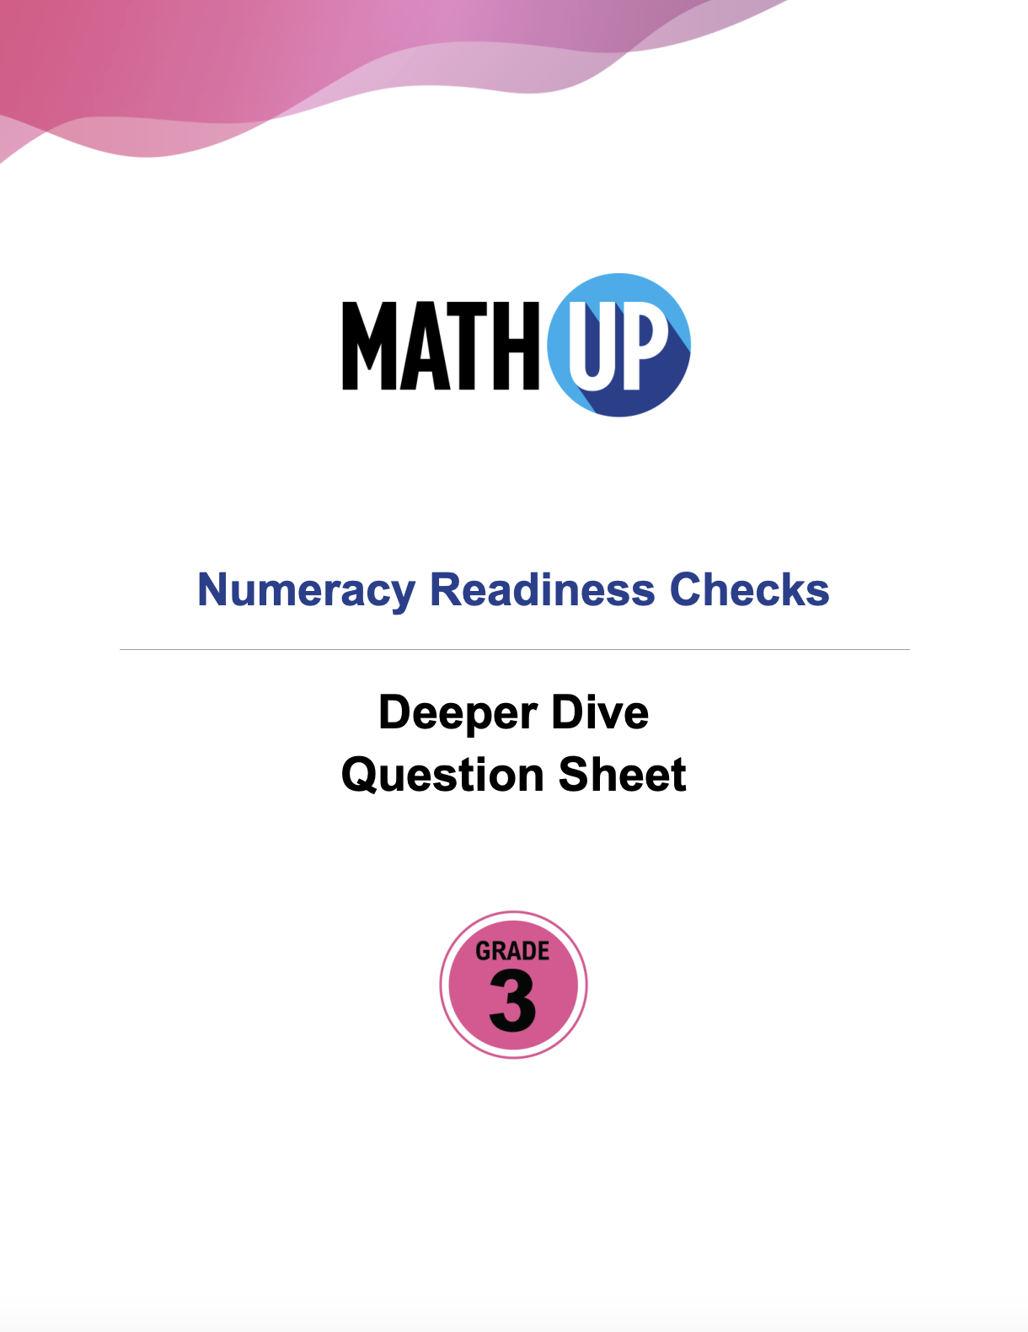
Look at some of the questions in this Grade 3 diagnostic
Notes:
https://mathupcaprod.blob.core.windows.net/media/l86f288m5Bwl7Ihx1r7XRBHx/uploads/teacherdoc/G3_NRC_DD_print_QuestionSheet.pdf

Slide 55
Why not the science of literacy approach?
This relates heavily to what you believe the goal of math instruction is.
We should all believe the goal is not just to perform calculations (calculators can do that). We need students who:
Know when to perform calculations
Can perform many calculations mentally
Estimate well and regularly check results estimating

Slide 56

An excellent piece on the problems with a ”science of math” approach
Notes:
https://www.mathedleadership.org/wp-content/uploads/2025/12/Position-Paper-2025-Strengthening-Research-informed-Decision-REV12-25.pdf

Slide 57
Some crucial messages
No quick fix or magic button
Planning of lessons is not about downloading activities.
It’s about serious reflection on the content and the children.

Slide 58

Any questions?
Download:

Slide 59

Your Board. Your Goals.
Our Support.
Every district is unique. Let’s discuss how today’s insights fit your specific curriculum needs.
Visit the Rubicon Booth to learn more about our latest Canadian-made digital platforms.
Notes:
https://www.rubiconpublishing.com/knowledge-hub/events/ulead-rubicon-campaign

