Slide 1
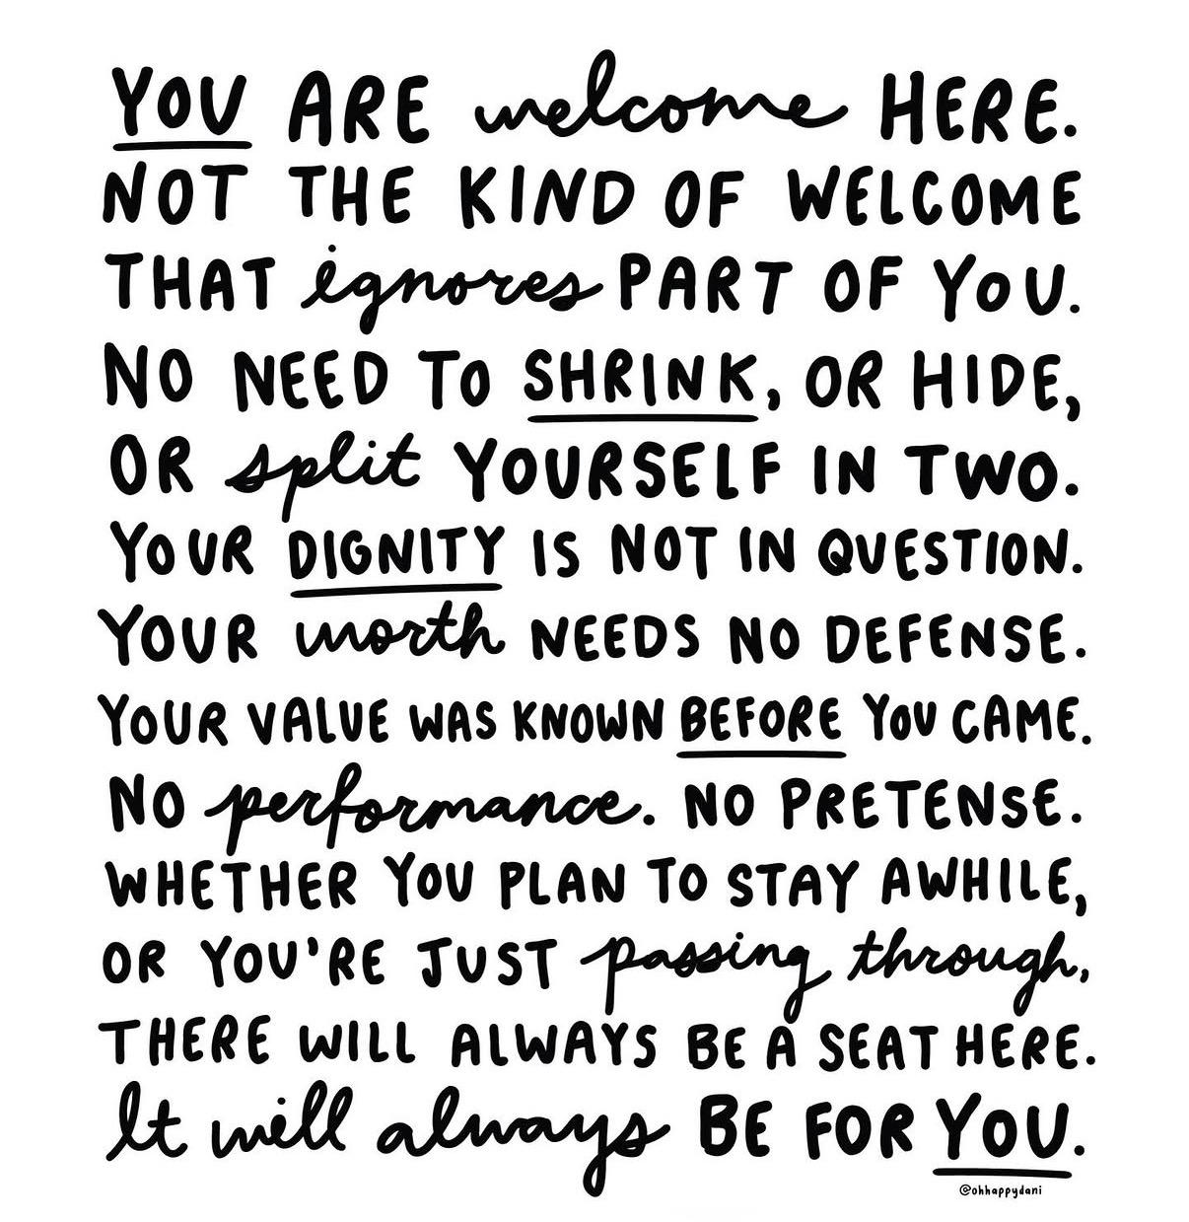
Welcome!
As you enter this space, this learning community, please think about this quote. Then if you’re exceptionally brave, go introduce yourself to someone and share your thinking with your neighbours!

Slide 2



Deepening a Culture of
Belonging
Cori Fraser, B.A, B.Ed, M.Ed. Edmonton Public Schools cori.fraser@epsb.ca
IG: @corifraser
LinkedIn: Cori Fraser

Slide 3
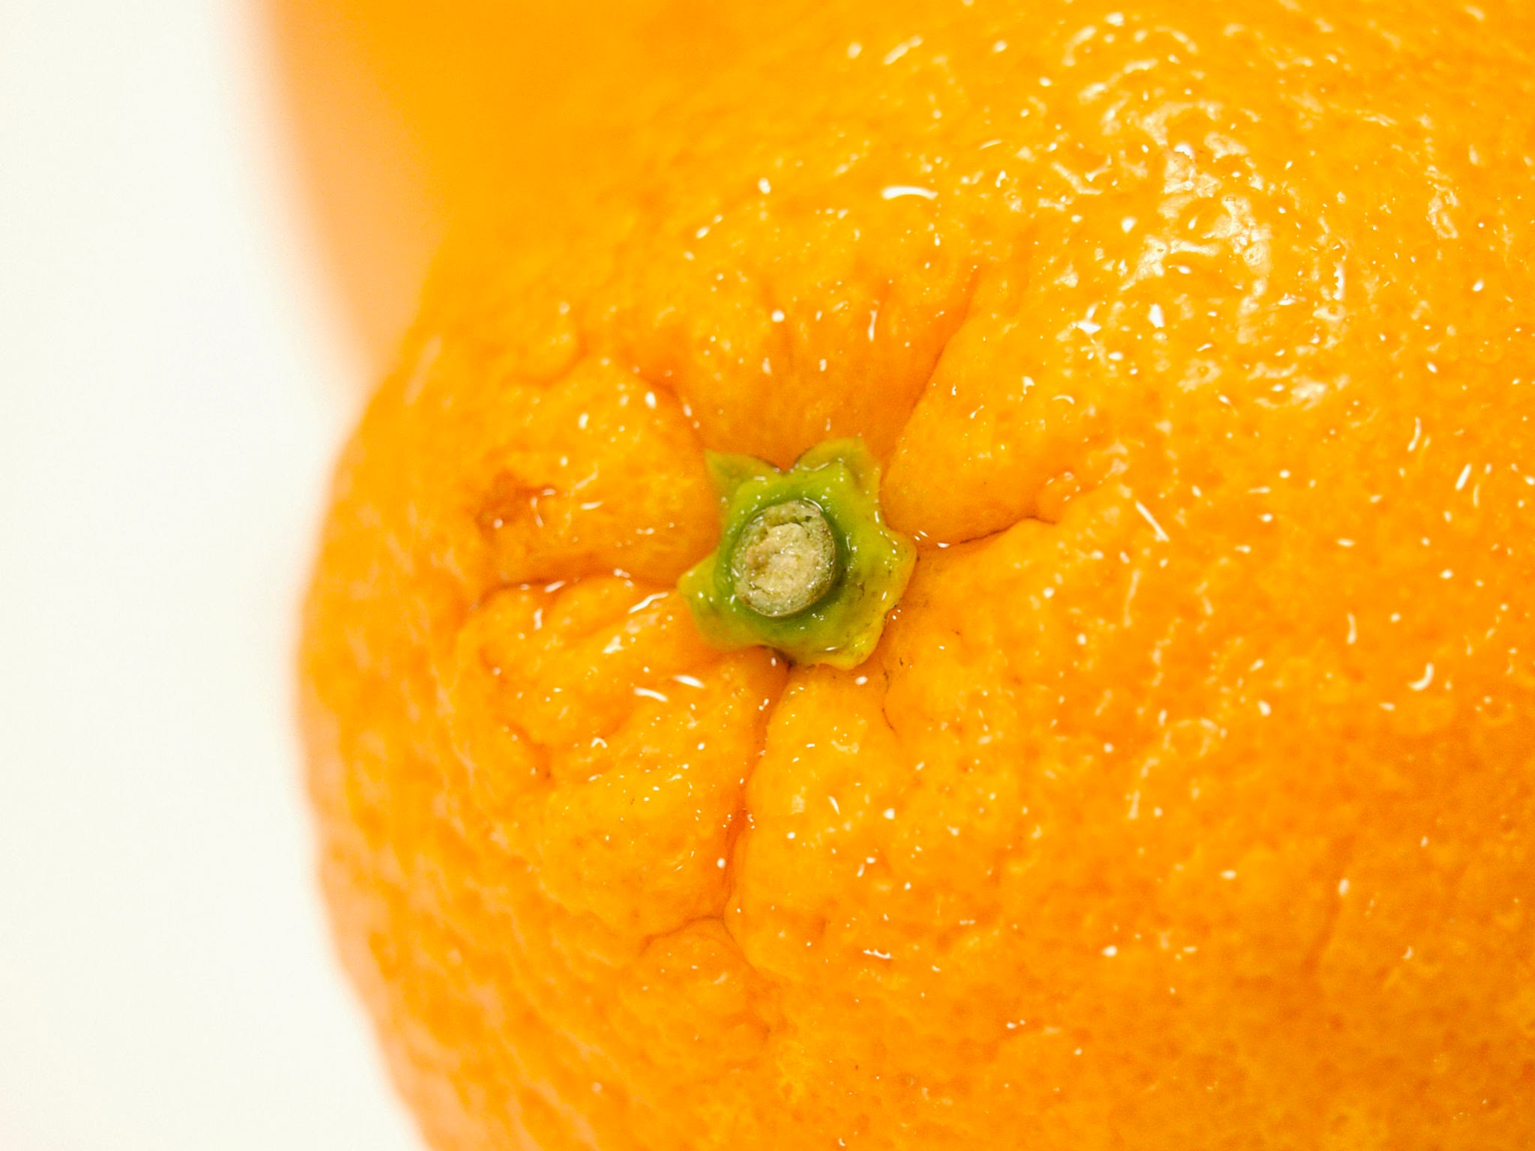
Common Language

Slide 4

Nouns + Verbs
Belonging. How I feel when I am safe, cared for, included.
To Belong. The action.
In this session, I want to move towards the verb. The action. The practices and actions we take to bring the councept of belonging to life.

Slide 5
GEOFFREY L. COHEN
“Research shows that when our sense of belonging is threatened even momentarily, we’re more likely to feel worse about ourselves, perform below our potential, behave impulsively, see others as hostile, and lash out defensively when provoked. On the other hand, even fleeting experiences of belonging, such as glimpsing pictures of people who care about us, can have far reaching benefits. They raise our sense of wellbeing and self-worth, improve our performance, lessen our defensiveness and hostility, increase our tolerance of outsiders, and make us more compassionate. We become more humane.”
BELONGING: THE SCIENCE OF CREATING CONNECTION AND BRIDGING DIVIDES (2022)

Slide 6
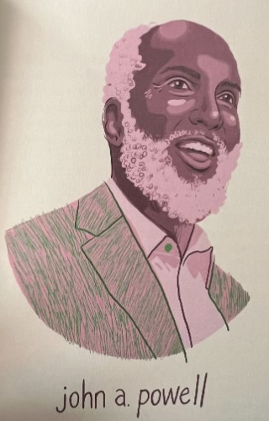

“Belonging means more than just being seen. Belonging entails having a meaningful voice and the opportunity to participate in the social and cultural structures. Belonging means having the right to contribute and make demands on society and political institutions.” -john a. powell

Slide 7
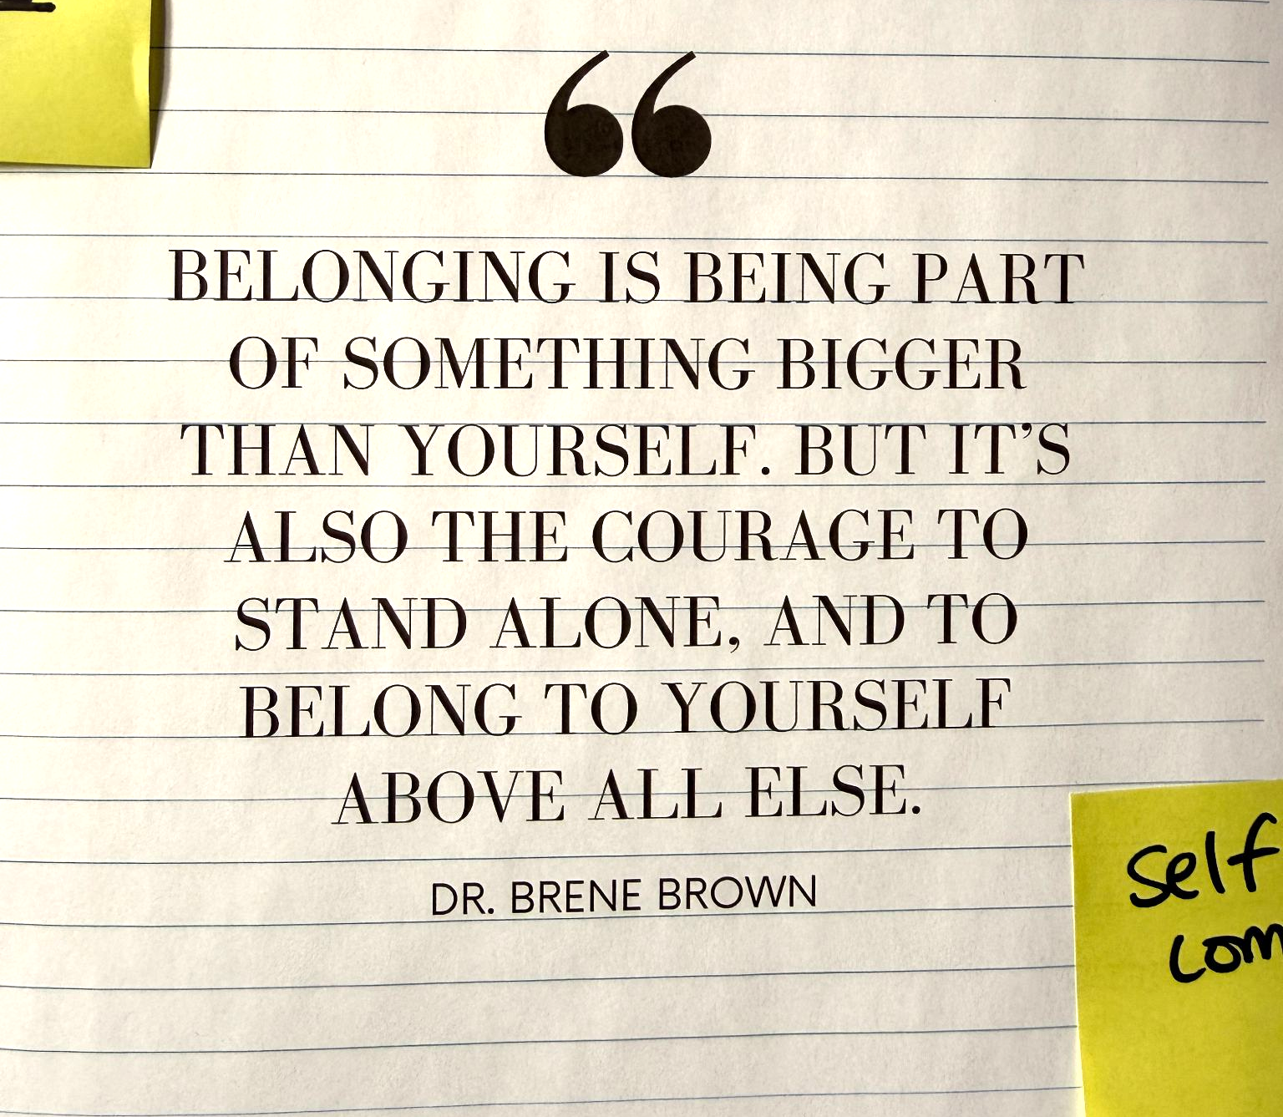
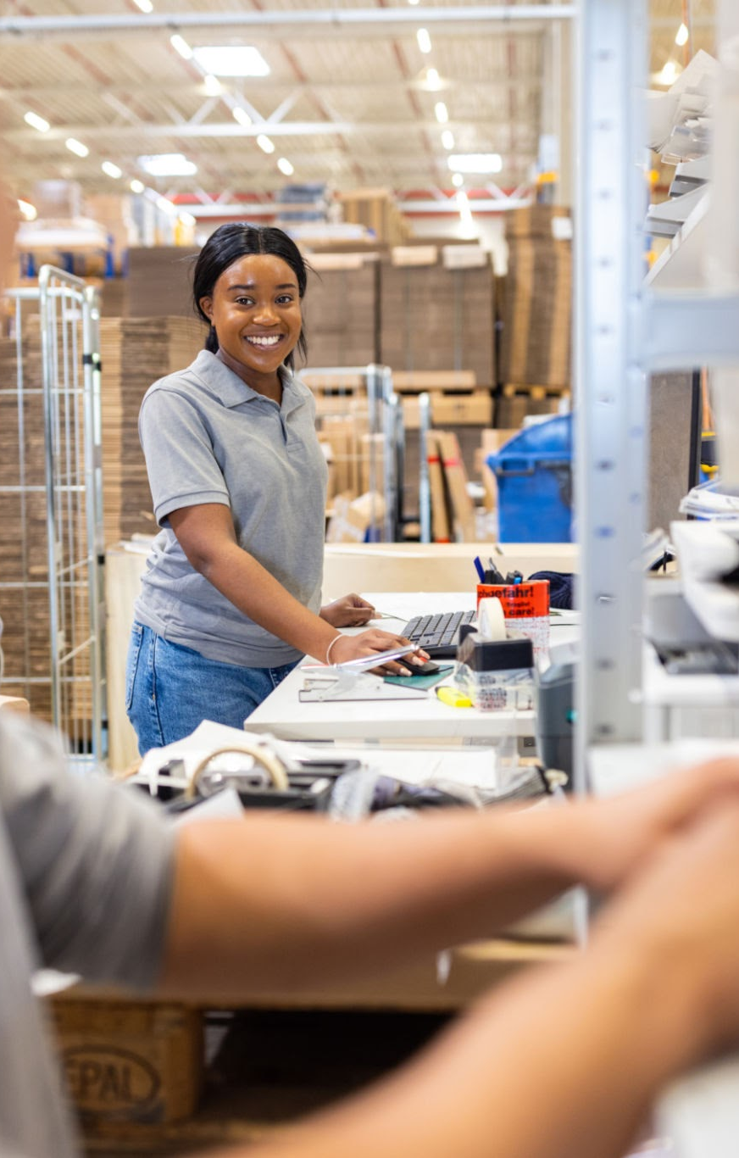
Dr. Brene Brown:
“The opposite of belonging is fitting in…true belonging never asks us to change who we are”

Slide 8
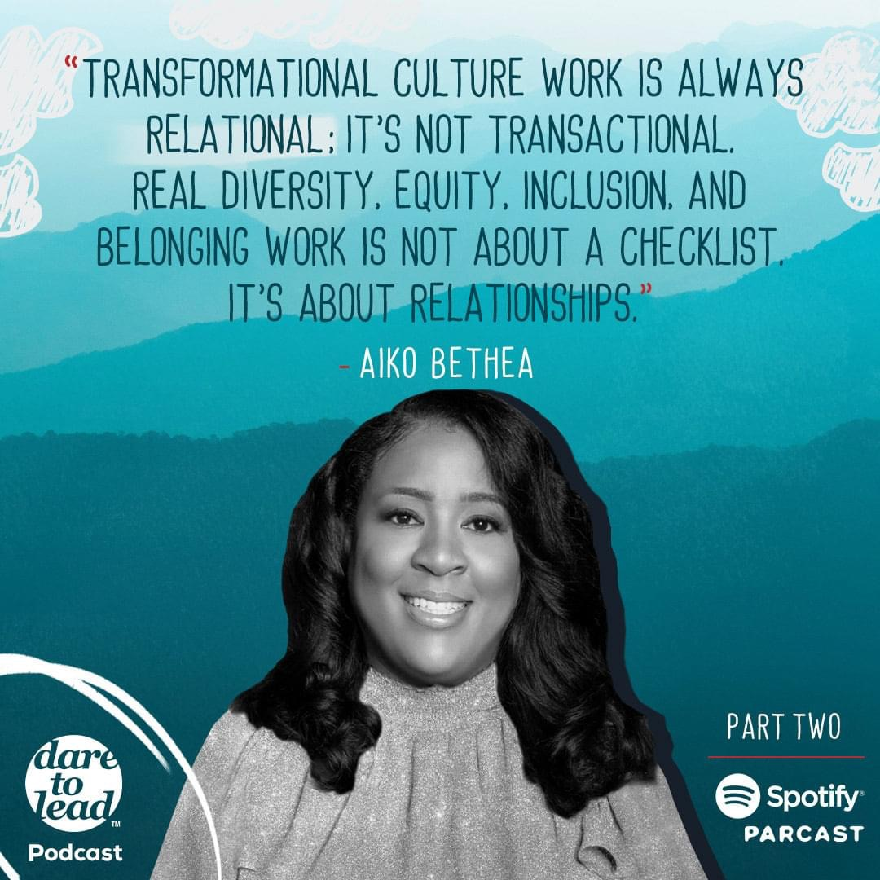

Slide 9

KEN WILLIAMS
“The reality is, diversity does not ensure belonging…(we) should aspire to create a culture where every student and every staff member feels appreciated, validated, accepted, and treated fairly; a culture where every students is provided with what they need, when they need it…”
RUTHLESS EQUITY (2022)

Slide 10
Three Stories

Slide 11
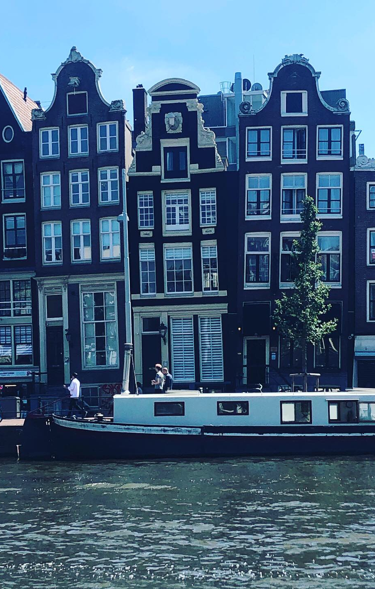
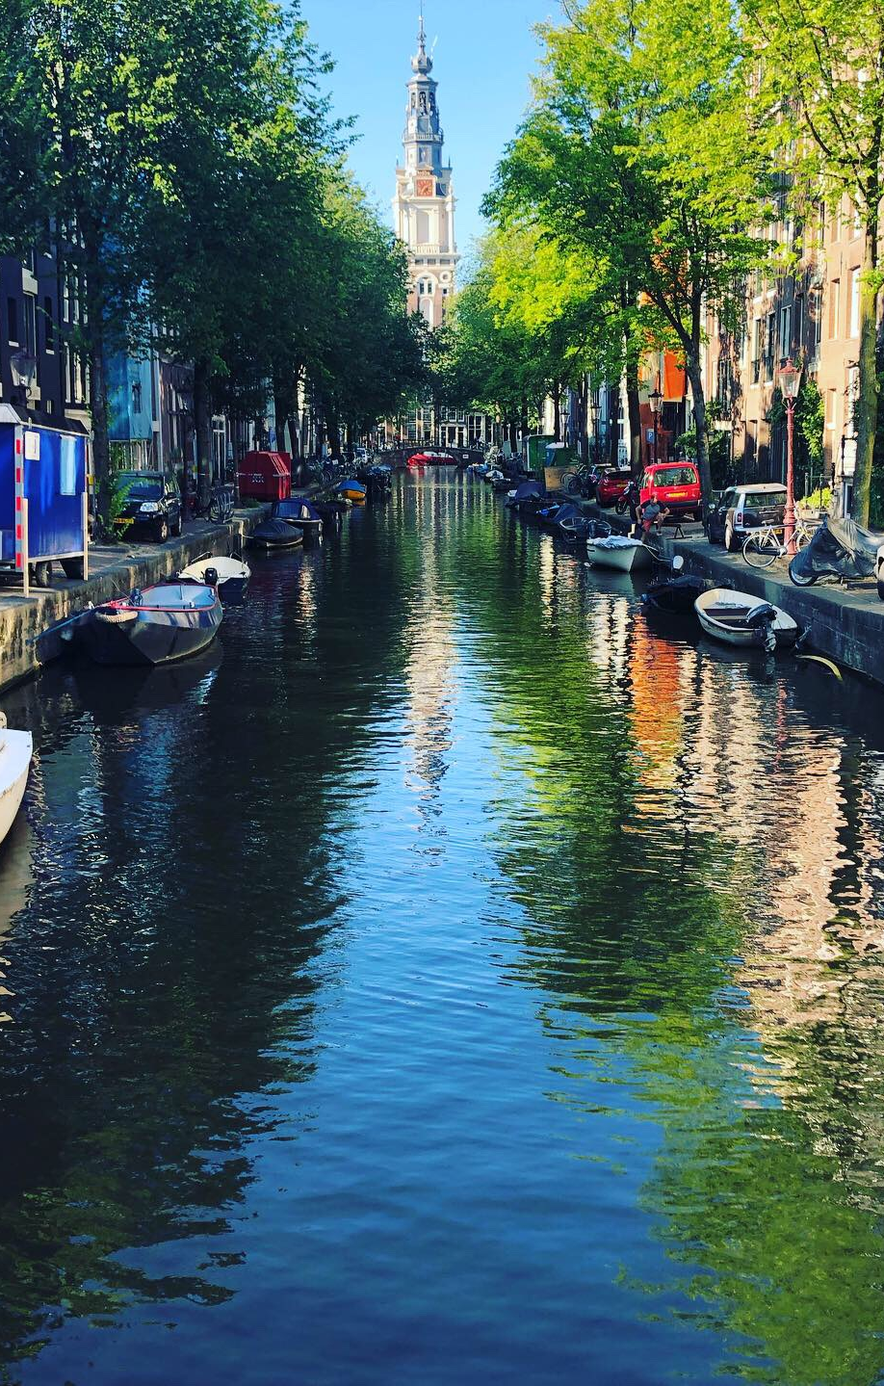
Story #1

Slide 12
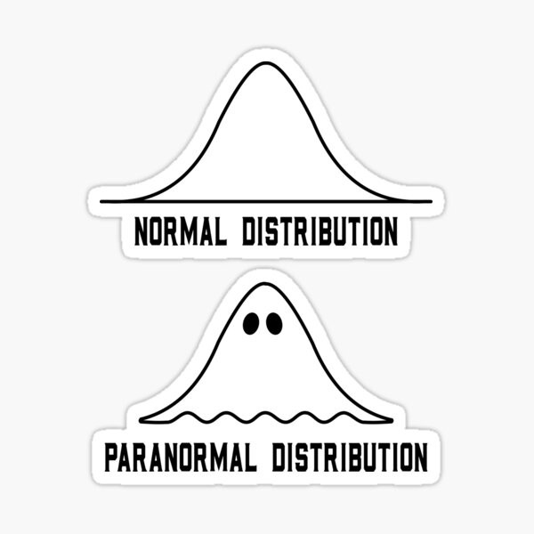
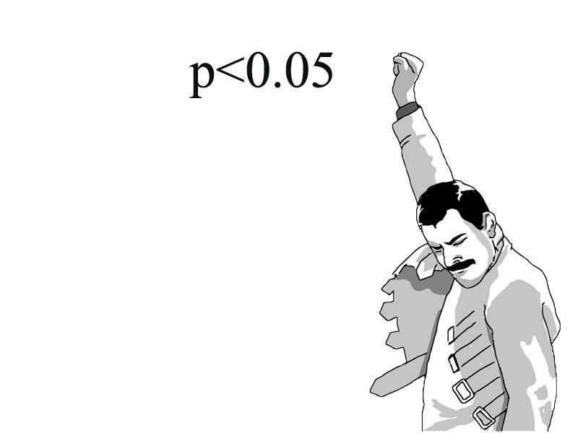
Story #2

Slide 13

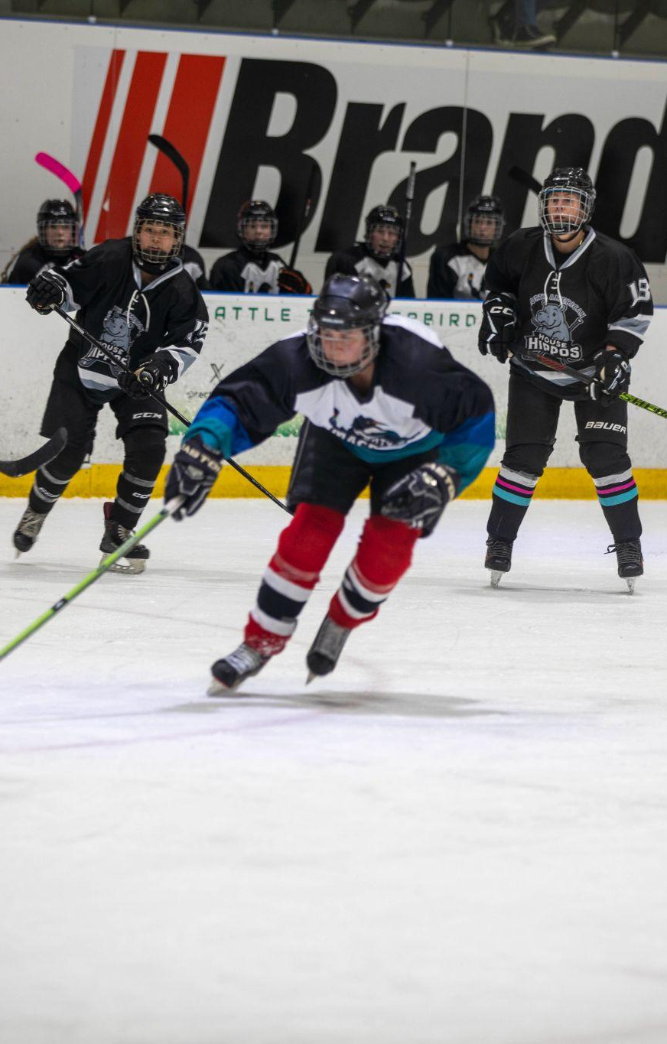
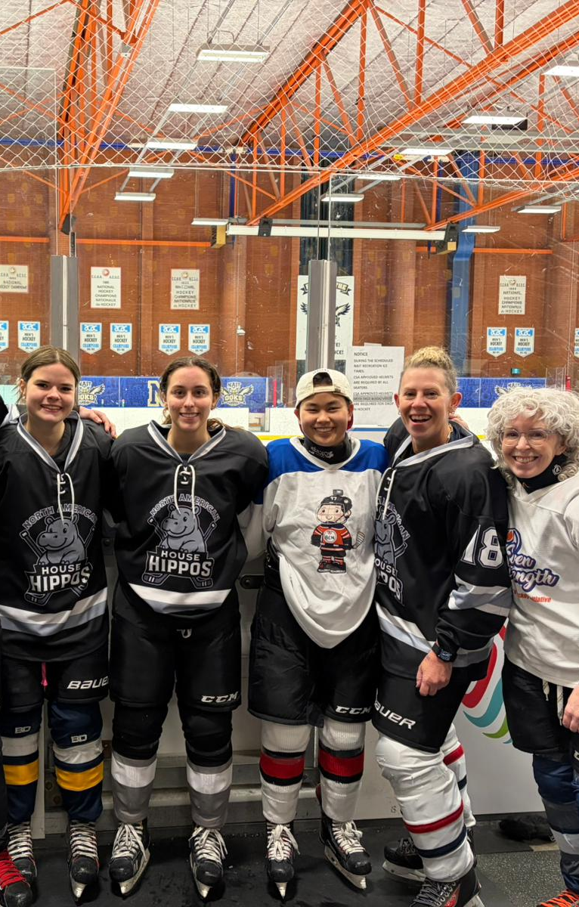
Story #3

Slide 14
Who am I? Who are We?

Slide 15
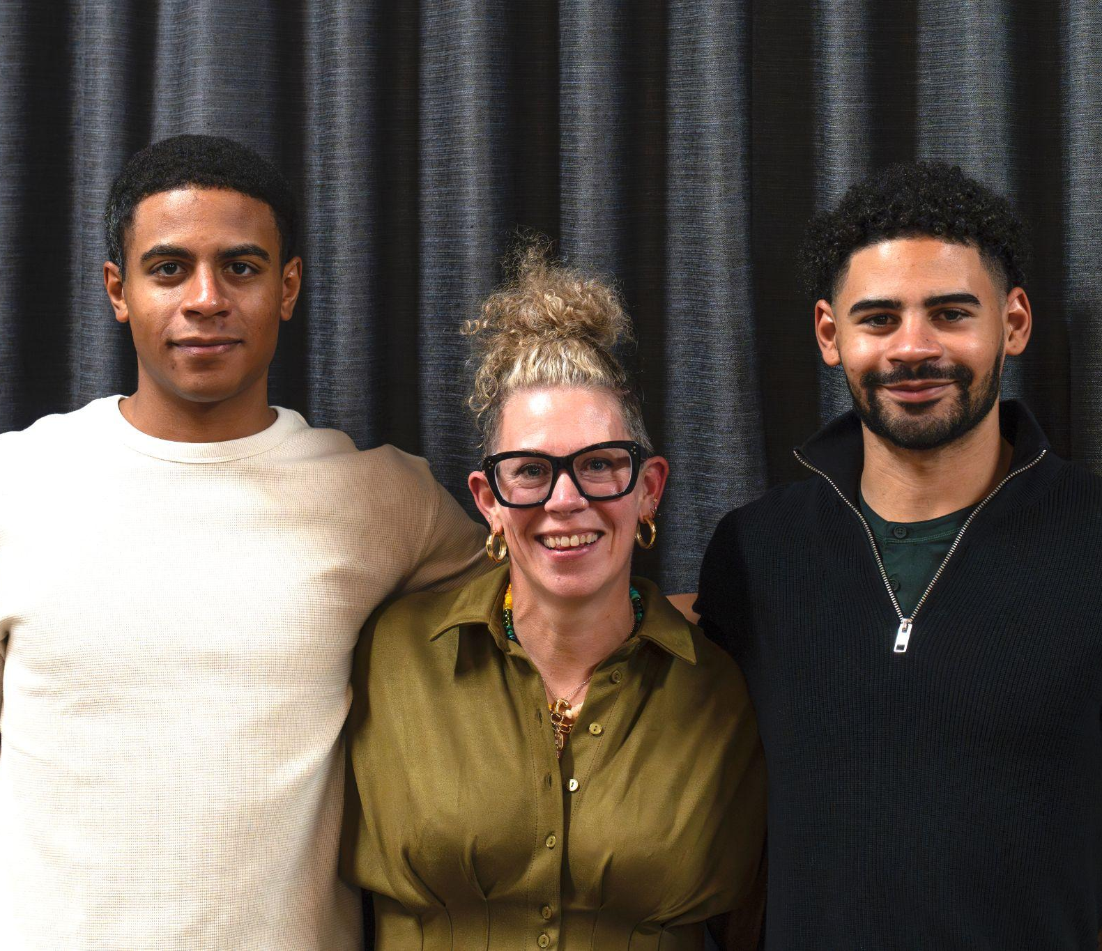
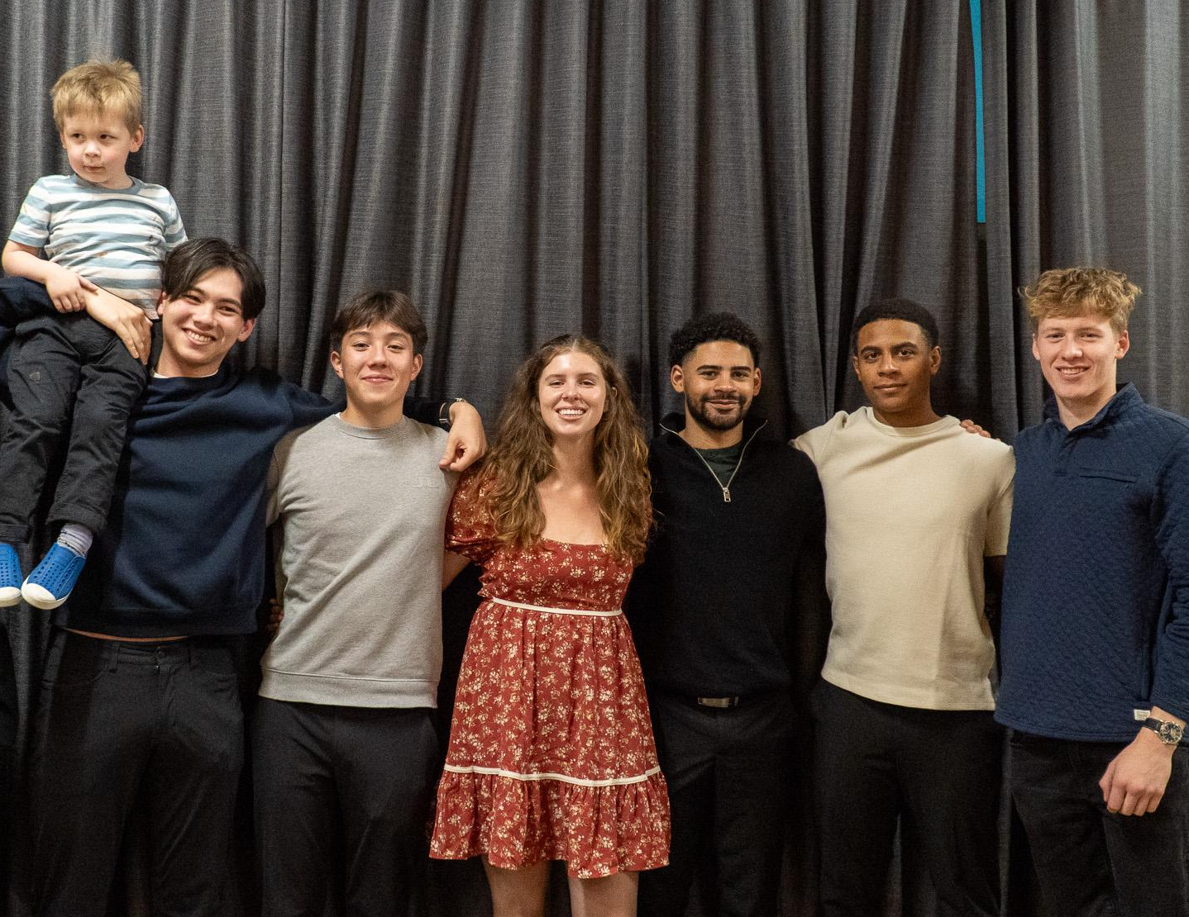
MY WHY

Slide 16
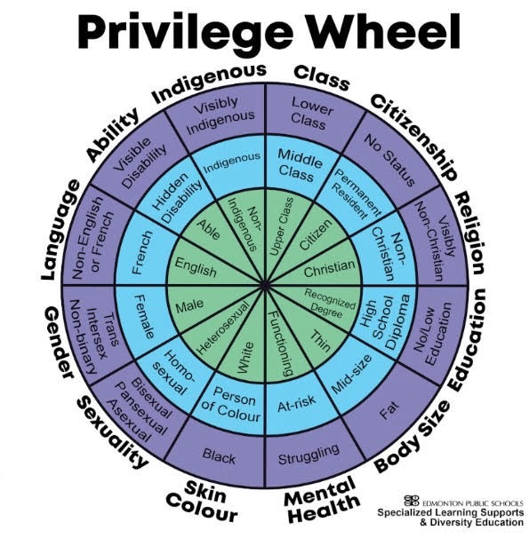

As you look at this wheel, where does your personal privilege sit? What is visible? What is invisible?
Why does this matter?

Slide 17
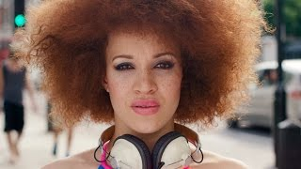

Slide 18
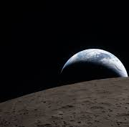
PAUSE + REFLECT
Compassionate curiosity. Be kind to yourself as you explore what you’re feeling.
Where is your comfort level in this moment? Ask yourself why you’re feeling comfort, discomfort, or any other emotion.

Slide 19
POSITIONALITY
What is positionality?
Positionality refers to an individual’s social, cultural, and personal context that creates their identity.
Every person has a unique position in society, shaped by gender, race, class, education, ethnicity, etc., that influences how they perceive and engage with the world.
Instagram: wedu.global

Slide 20
POSITIONALITY
I am the daughter of immigrant parents from the Netherlands. I am a first generation Canadian, first born in my family. I am white (blue eyes, blond hair, skin that burns the second the sunlight hits). I am a cisgender woman whose pronouns are she/her. Cori is my full name, not a nickname and I carry my birthright within my name. I have three degrees, I am old enought to be able to sing both the MASH theme song and drop Gilligan’s Island jokes. I am divorced. I have two adult children. I am a daughter, a mother, a sister, a partner, a school leader, a friend, and a teammate. I love whiskey and wine and I take my coffee black. I read mystery books, am a musician, and an athlete. And the last part of that sentance has taken me decades years to both say aloud, and believe.
…Oh, and I grew up in a cult.

Slide 21
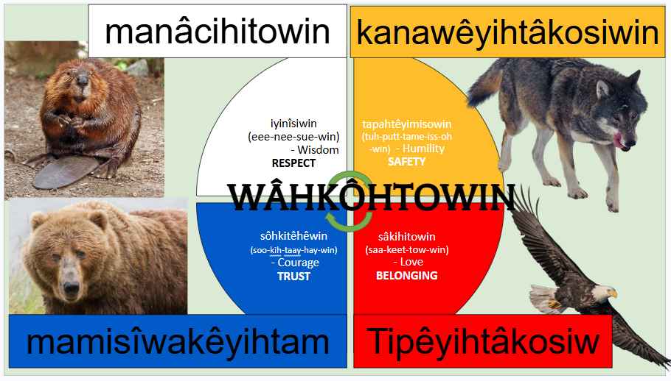
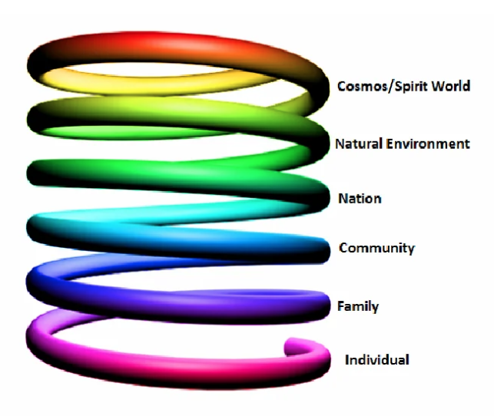
Cree Teachings vs Maslow
J. Gray, Teacher, Westmount Jr High

Slide 22
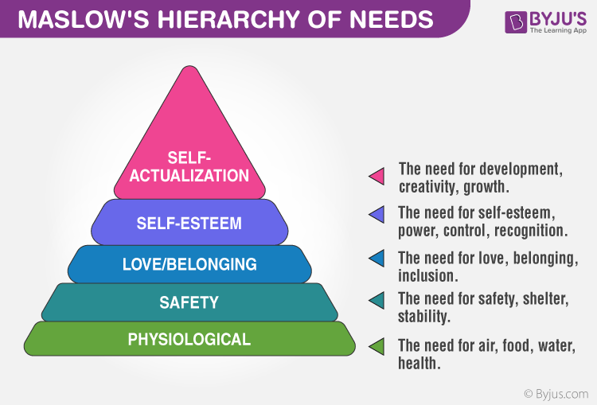
Cree Teachings vs Maslow

Slide 23
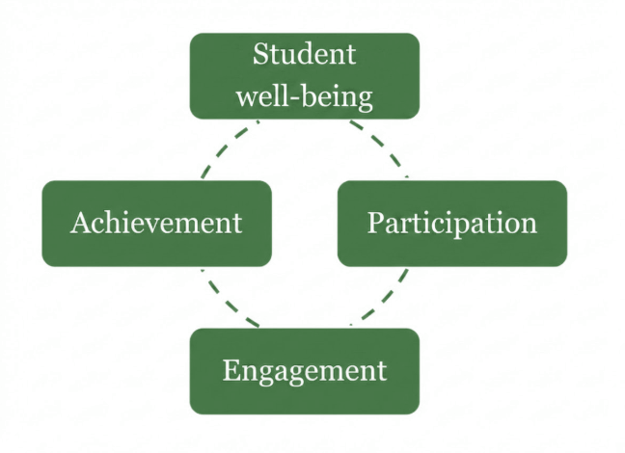
Cree Teachings vs Maslow
OECD: Promising Practices in Supporting success for Indigenous Students (2017)

Slide 24
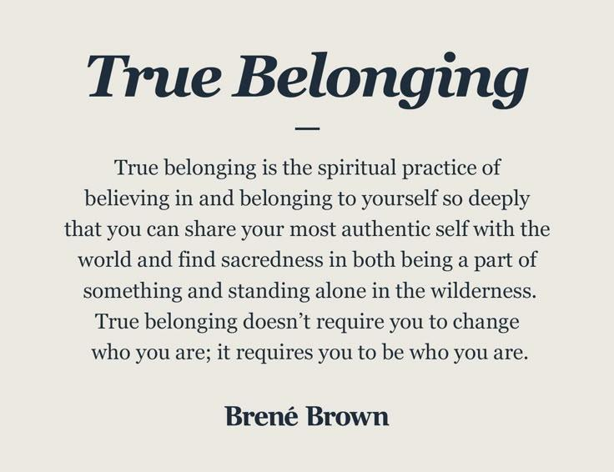

Slide 25
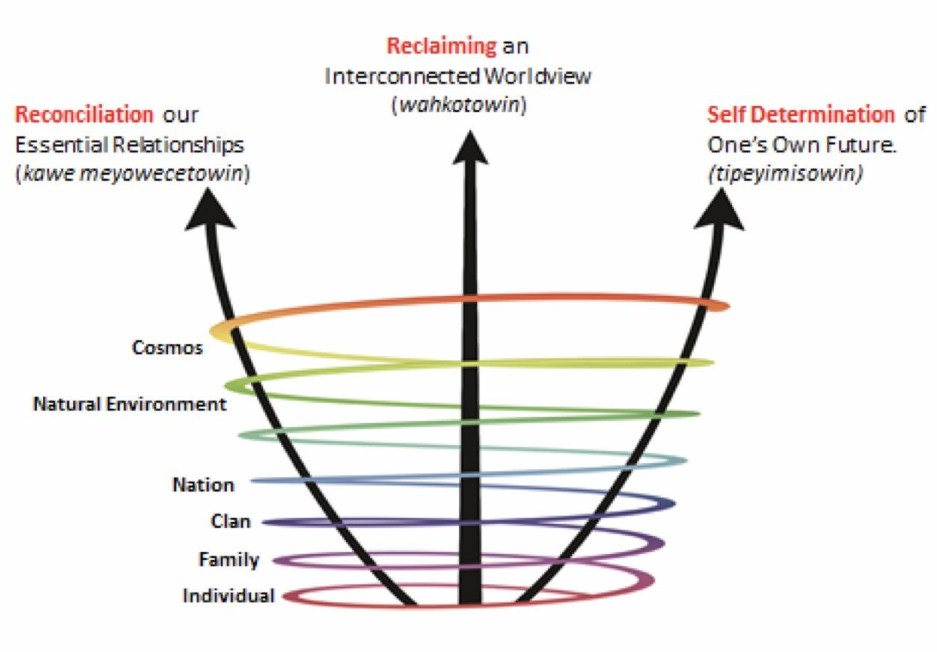

Slide 26
Practical Application

Slide 27
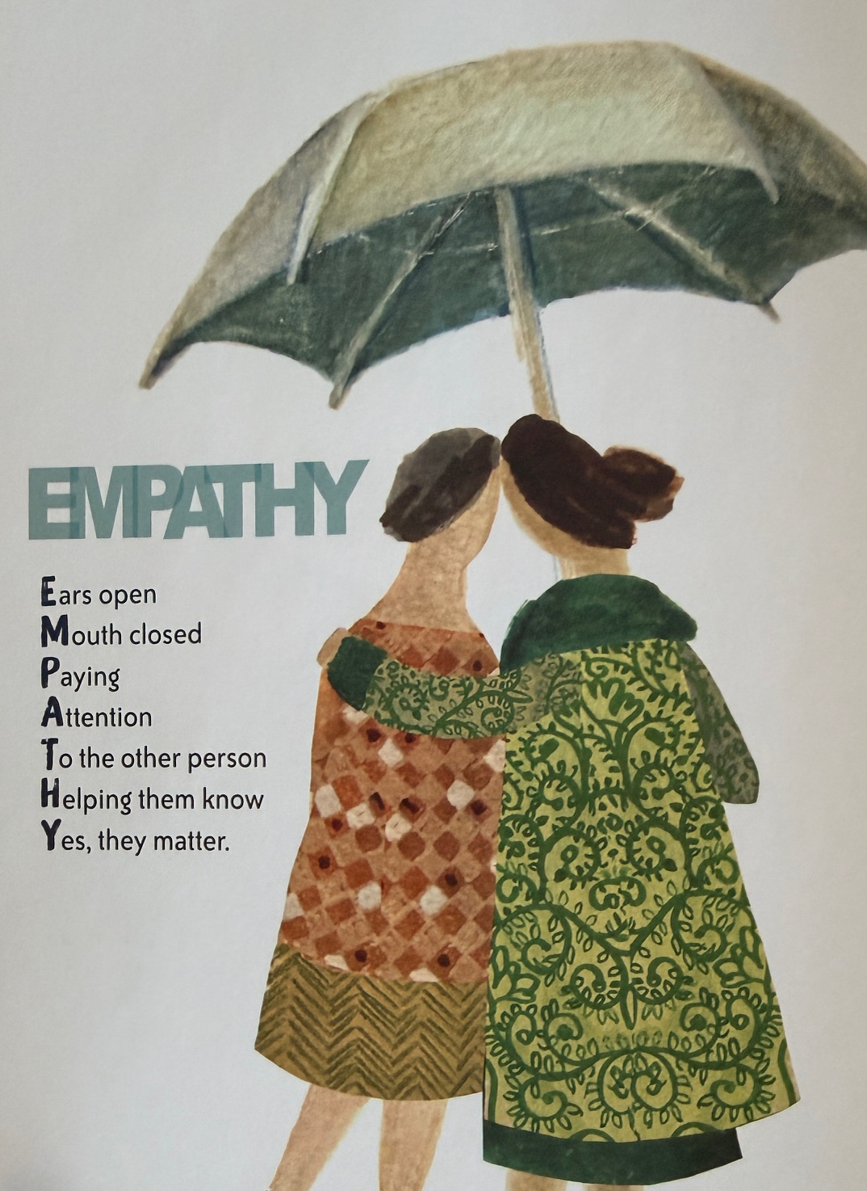
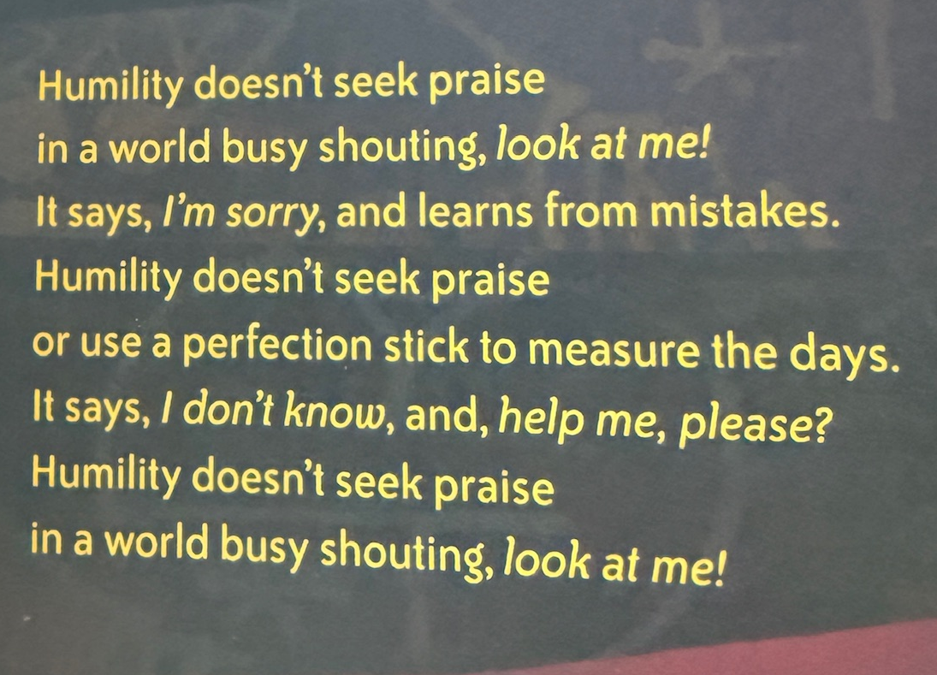

Slide 28
Building a Culture of Belonging
Belonging as Identity Windows & Mirrors Place Pedagogy Names | Belonging in Curriculum Afrocentric + Indigenous Perspectives Silencing
Belonging for Educators PGD Names | Belonging as Wellbeing Maslow OECD Report (2017)

Slide 29
KEN WILLIAMS
“The reality is, diversity does not ensure belonging…(we) should aspire to create a culture where every student and every staff member feels appreciated, validated, accepted, and treated fairly; a culture where every students is provided with what they need, when they need it…”
RUTHLESS EQUITY (2022)

Slide 30
CURRENT REALITY
Lots of movement forward since 2020: Division priorities centered on anti-racism, reconciliation, and mental health, more awareness of privildege and challenges that folks face.
A lot of movement backwards: Ministerial Orders, Bill 25, job action and Bill 2…just to name a few!
We have a responsibility to the LQS: Leading a Learning Community
creating an inclusive learning environment in which diversity is embraced, a sense of belonging is emphasized, and all students and staff are cared for, respected and safe

Slide 31
WORD ON THE STREET
What are folks saying?
Get rid of the checklists, the tokenism, and the burden of responsibility
One-on-one conversations: what does support look like?
Don’t be afraid to have the uncomfortable conversation
Awareness and intentionality
Don’t look at us as people of colour, but as just people
Believe us

Slide 32
Research Based Practices:
Trust
Trickle Down Wellness
Be Curious
Benevolence Honesty Openness Competency Reliability
When teachers are well, students are well. So one could surmise that the same is true for school leaders.
Rule 101 of coaching: ask questions, then be ready to listen. Walk alongside. People want to be and do their best.

Slide 33
Research Based Practices:
Culture over Checklists
Sponsorship
High Quality Meat Trays
Building culture is hard. Checklists are easy.
Culture starts with the adults.
Opening doors by putting your reputation on the line.
The effect of the “mini-me” bias.
Food doesn’t fix bad things, but food helps create relationships and helps with dysregulation.. Know your team (and what chocolate they like).
Food is a part of all cultures.

Slide 34
Story #1

Slide 35
Story #2

Slide 36
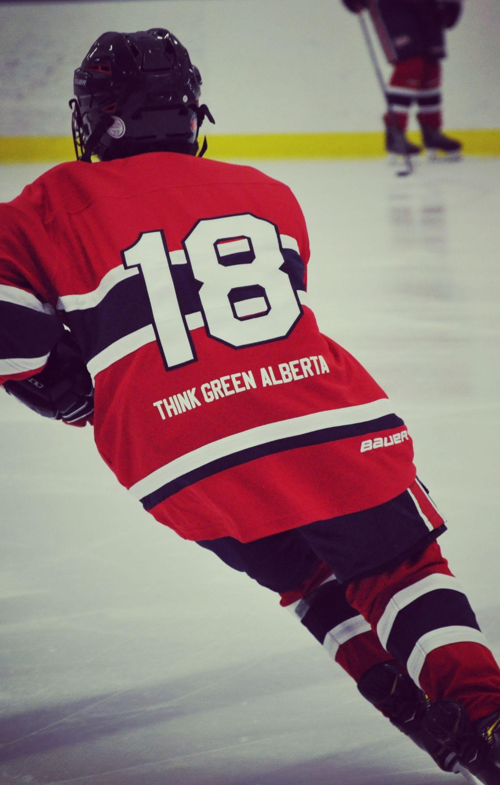

Story #3

Slide 37
GENEROSITY

Slide 38
Commit to Try
What’s one thing you heard or learned or read that you will commit to try? What will you commit to practice?

Slide 39
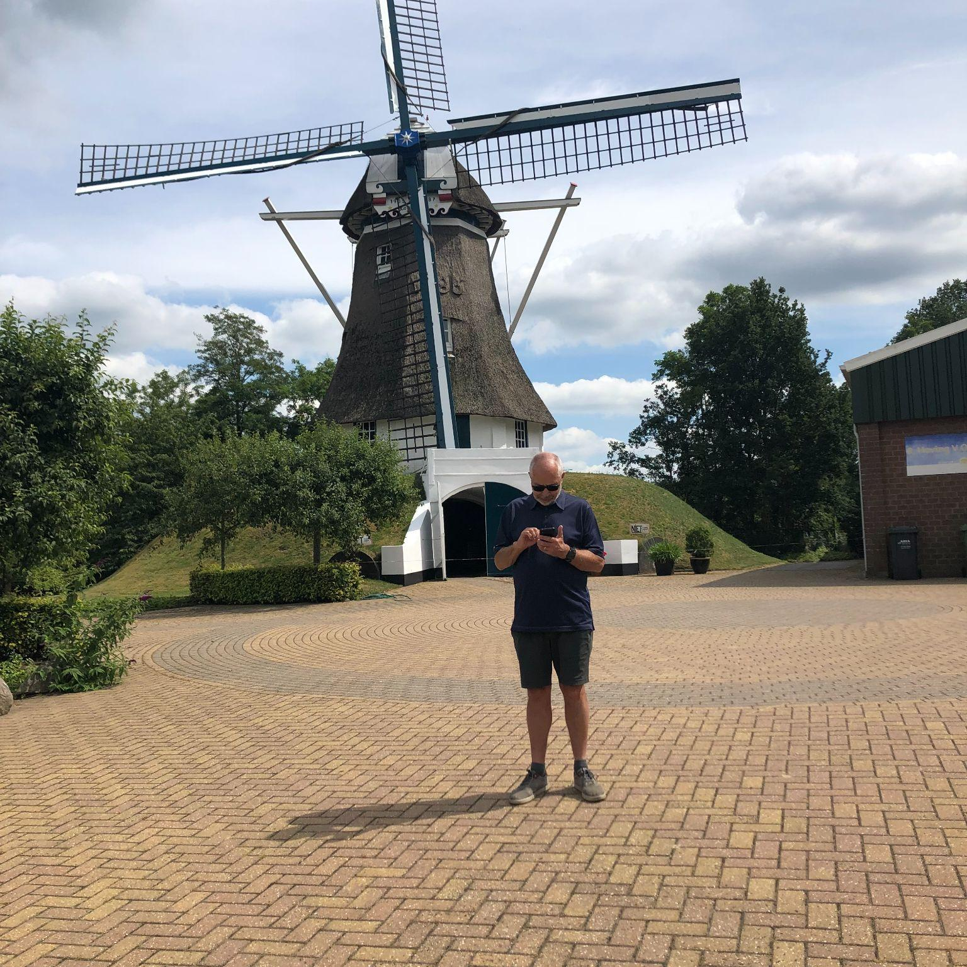
gezellig.

Slide 40
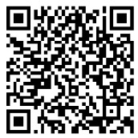
THANK YOU!
cori.fraser@epsb.ca

