Slide 1
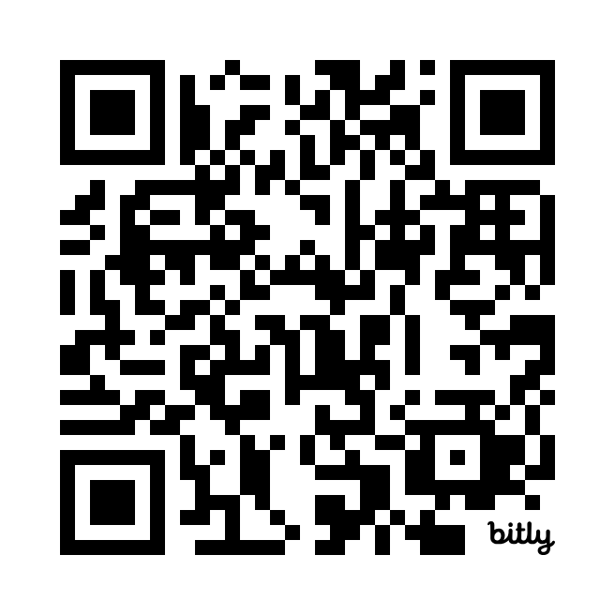
Leading the Way to Improved Literacy Outcomes-The Principals Pivotal Role
Denice Maedgen K-3 Literacy Specialist
denice.maedgen@schools.utah.gov
Perhaps a Subtitle or Additional Info
https://bit.ly/LITLEADER
Resource Folder
Notes:
https://drive.google.com/drive/folders/1FmnzDrKoEV3kw7WziDXAN2W1Of15Gl2x?usp=sharing
Not sure I like the download Kahoot, but I don’t know where else to put it. They can play from their computer if they rather when we get there. Whatever you think is best I am good with.

Slide 2
Learning Intentions
Discuss and reflect on the 5 common factors of successful literacy outcomes.
Provide tools and practice to observe and give feedback on literacy instruction.
Success Criteria
Deeper understanding of your role in leading literacy improvement efforts.
Develop a concrete action to implement evidence-based literacy practices in your school.
Notes:
5 mins 2-4

Slide 3
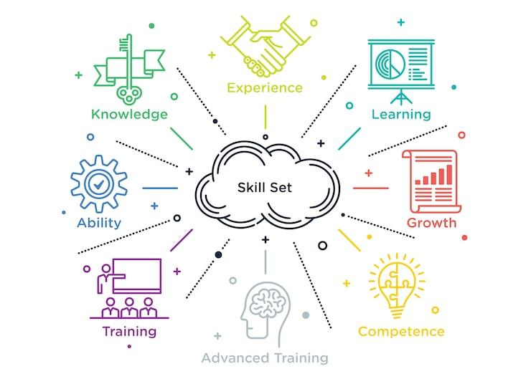
Leading the Way to Improved Literacy Outcomes-
The Principal’s Pivotal Role

Slide 4

Importance of Principal Leadership
5 Common Factors for Successful Outcomes
School Leaders monitoring implementation
School-wide and grade level goals
Literacy Coaches engaging in coaching cycles
120 minutes of uninterrupted literacy instruction
School leader has deep knowledge of literacy
Notes:
Denice 5
what does that mean to you?
What does the right leadership look like?
LIST-https://acrobat.adobe.com/id/urn:aaid:sc:va6c2:a1811533-5ffd-4b35-9ead-f0de06445d98
handout

Slide 5
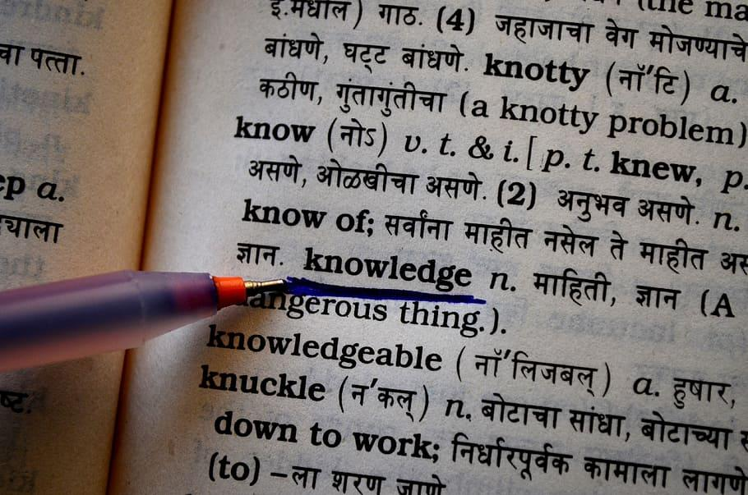

School leader has a deep knowledge of literacy
School leaders must understand the science of reading
and the components of effective literacy instruction.
Systematic & explicit instruction with active participation
Let’s take a little quiz
www.Khoot.it
Notes:
Courtney
10 minutes
The picture of kahoot is linked to the quiz so it needs to stay.
SOR quiz (Kahoot)
How did you do?
How can you increase your knowledge?
Ways to grow your knowledge: podcasts, Webinars, LETRS, books, reading universe

Slide 6





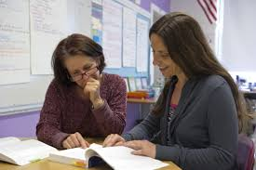
Ways to grow your knowledge
Podcasts
  Science of Reading
  Sold A Story
Webinars
  From the Science …
Reading Universe
UEN emedia ELA Hub
LETRS
Reading Rockets
Explicitinstruction.org
Literacy Coach
LEA Literacy Leader
Notes:
2025 from the science to the classroom https://www.youtube.com/playlist?list=PLtk_b3zV7zItbcT5tHTRnHWHfVthIxjPS

Slide 7
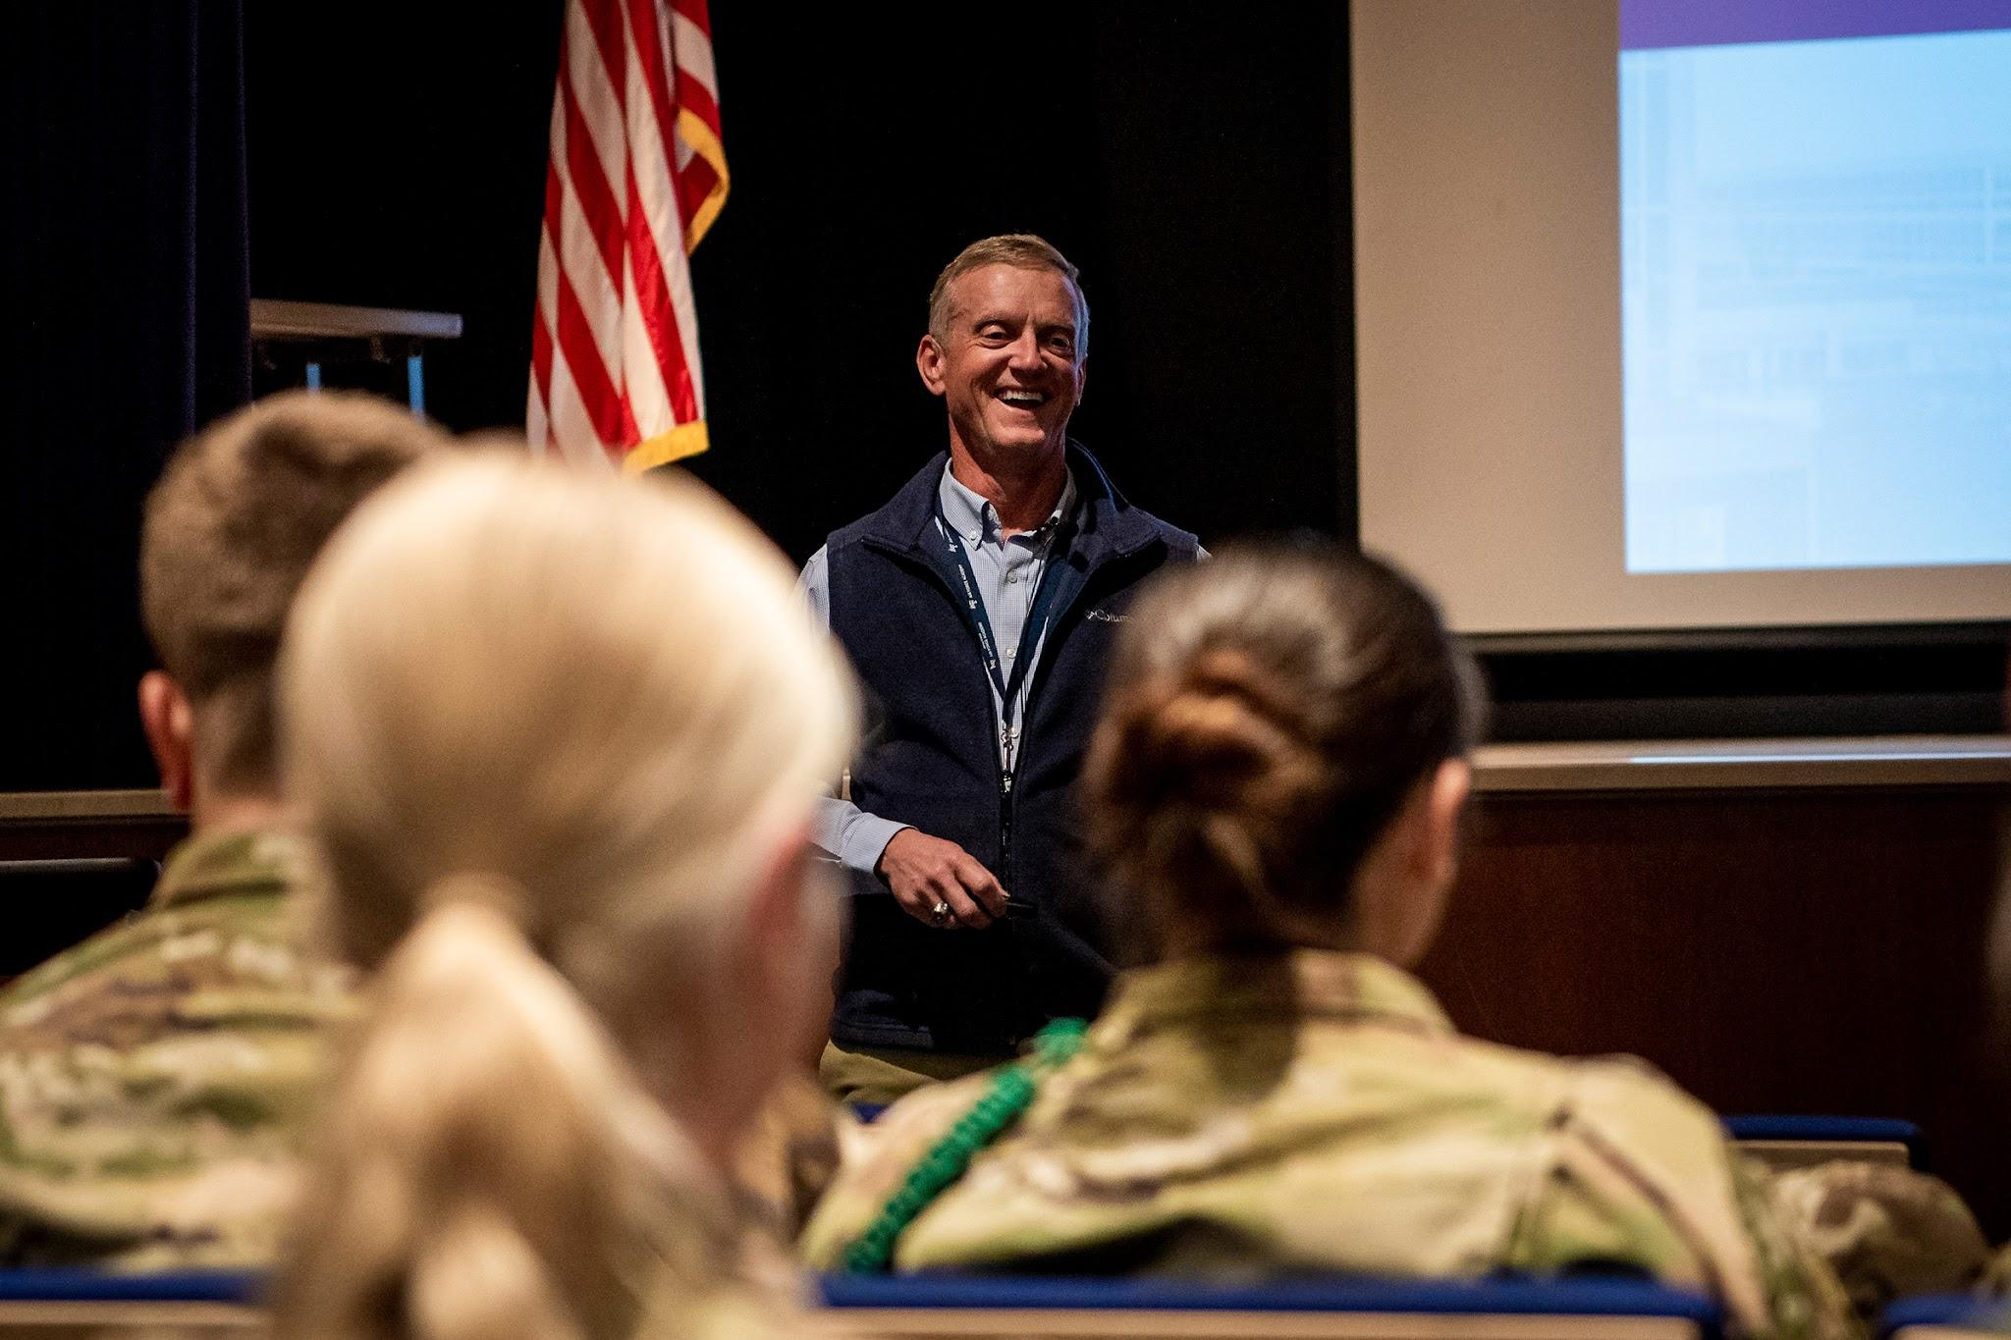
School Leaders monitor implementation
Principals are Instructional Leaders
Inspect what you expect
Job embedded professional learning should include follow-up and feedback
Let’s Practice
Notes:
15 Minutes- Christine
https://docs.google.com/document/d/1c6L34poRzrHjNI9SslmavFGNQJyRWxnSnghNbGO1s3U/edit?usp=sharing
Learning walk-
Videos
AOC
I do-then you do and share with a partner

Slide 8
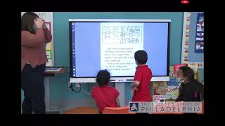
Notes:
Stop video at 4:45 mins

Slide 9
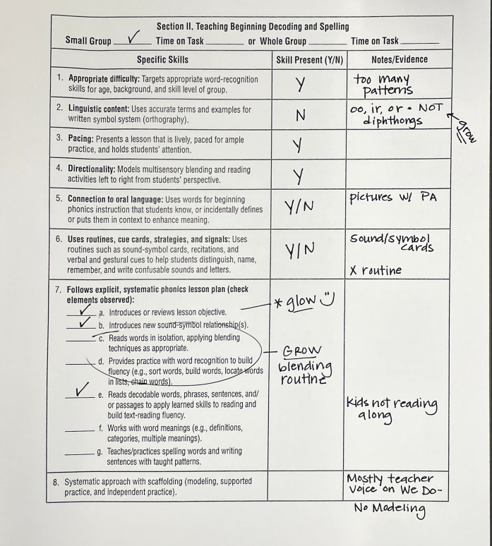
I do…
We do…
What coaching/feedback would we give this teacher?
Notes:
phonics page copied

Slide 10
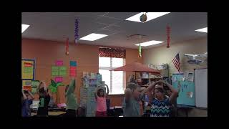

Slide 11
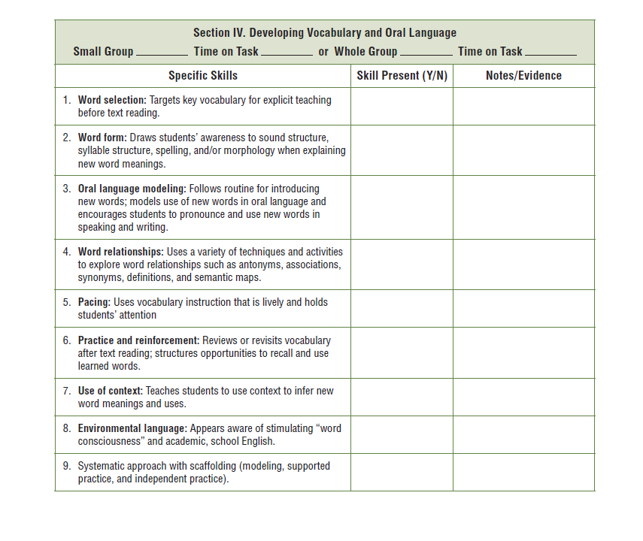
You do…
What coaching/feedback would you give this teacher?
Notes:
vocab page copied

Slide 12
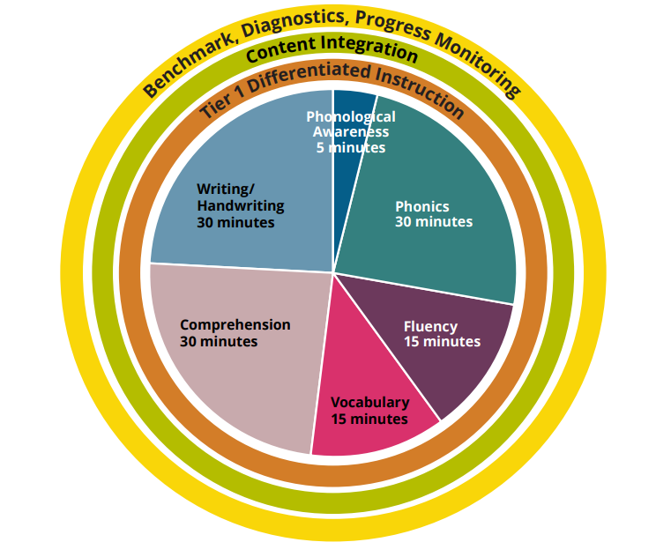

Key Components for Literacy Improvement
120 minutes of uninterrupted literacy instruction
System for Tier 1, 2 and 3 instruction with HQIM
School wide and grade level goals
System for data analysis and progress monitoring
Notes:
5 minutes
Action-look at schedule are you meeting 120 minutes
Show examples of milestones
Share-do you have a literacy SMART goal? Do you have a system for data analysis?

Slide 13
Literacy Coaches engaging in coaching cycles
What is the School Leaders role?
A strong collaborative relationship between the principal and the literacy coach is critical.
The relationship should be built on shared vision, goals, and clear expectations.
What is your vision? Expectations?
Do you meet regularly with your
coach?
Notes:
Denice 5 minutes
Write what your vision, goals and expectations are related to coaching
Share with your partner
Action: Set a time on your calendar to meet with your coach on a regular basis

Slide 14

Concrete Actions
Move from words to action
Increase literacy knowledge
Principal/Coach partnership
Set up schedule and tool for classroom observations
Master Schedule for 120 min literacy block
Instruction that is explicit and systematic with HQIM
School wide and grade level goals
Notes:
Denice 2 minutes
Write down what is your next step- what action are you going to take?

Slide 15
Review -5 Common Factors
School Leaders ___________ implementation.
School-wide and grade level _______.
Literacy ___________ engaging in coaching cycles.
120 minutes of _______________ literacy instruction.
School leader has deep knowledge of ___________.
It’s not about what's wrong it’s about what’s next…what’s next for you?
Notes:
Denice 2 minutes-mentimeter

Slide 16
Learning Intentions
Discuss and reflect on the 5 common factors of successful literacy outcomes.
Provide tools and practice to observe and give feedback on literacy instruction.
Success Criteria
Deeper understanding of your role in leading literacy improvement efforts.
Develop a concrete action to implement evidence-based literacy practices in your school.
Resource Folder
https://bit.ly/LITLEADER

Slide 17
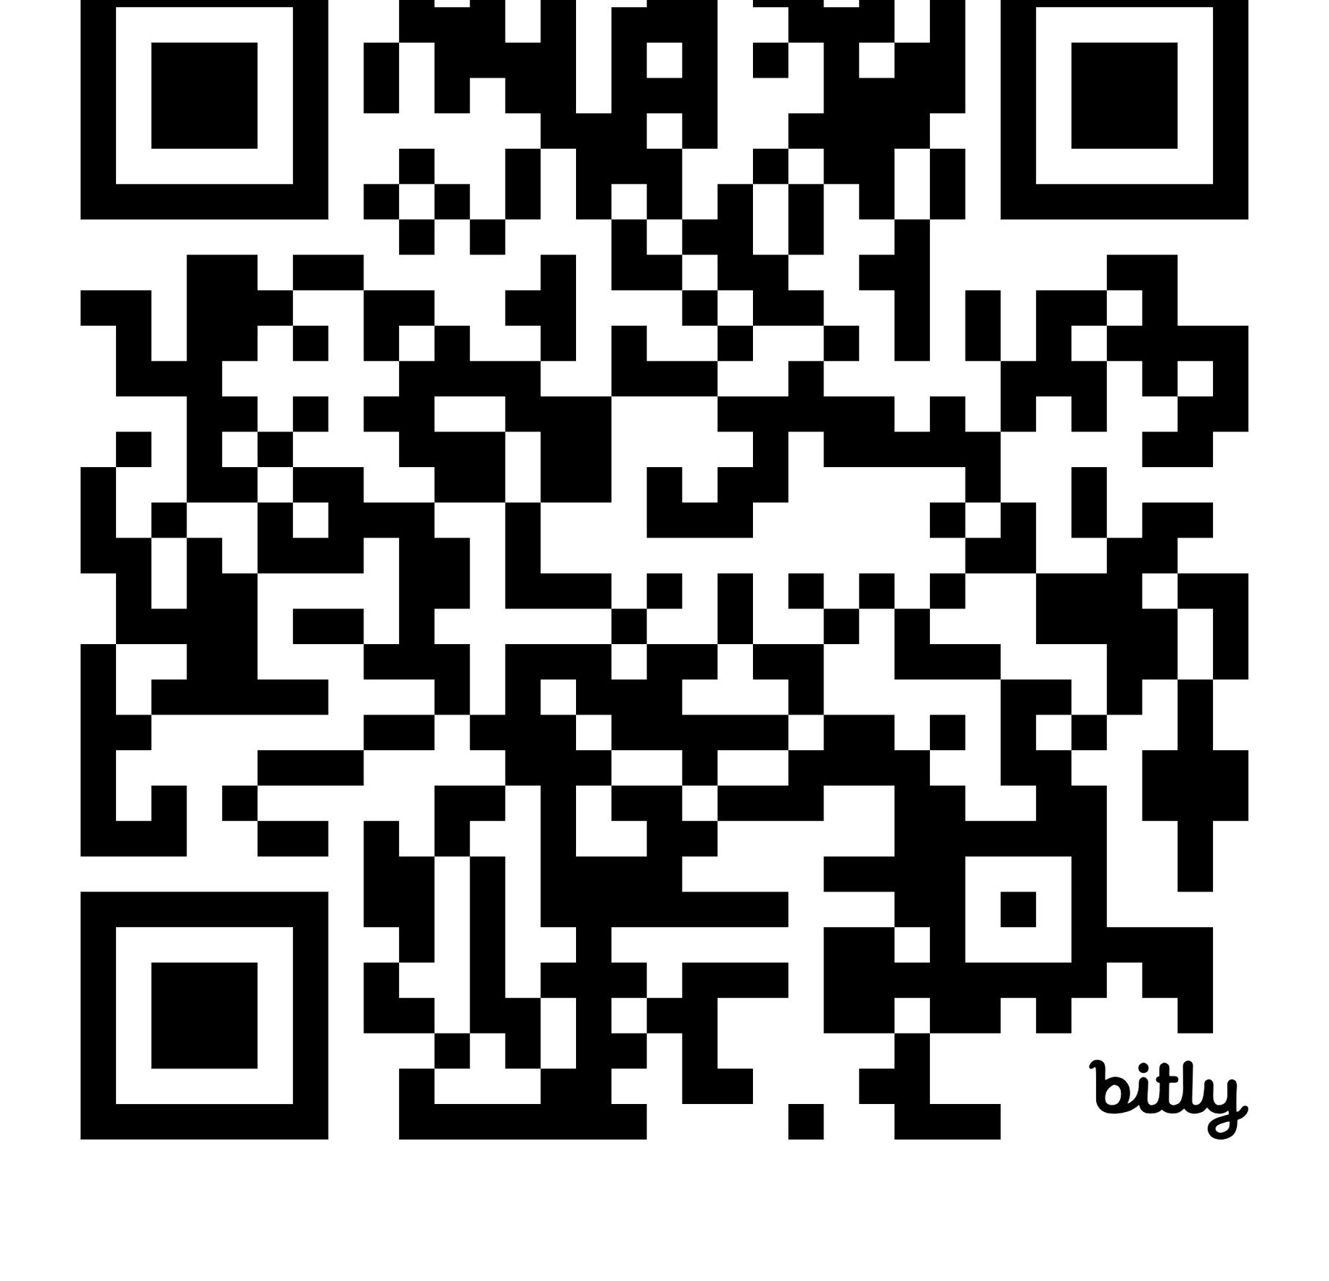
Feedback Survey
I would love to get your feedback about this session. Please complete this brief survey:
https://forms.gle/QEiQkaiw5cay3kL7A

