Slide 1
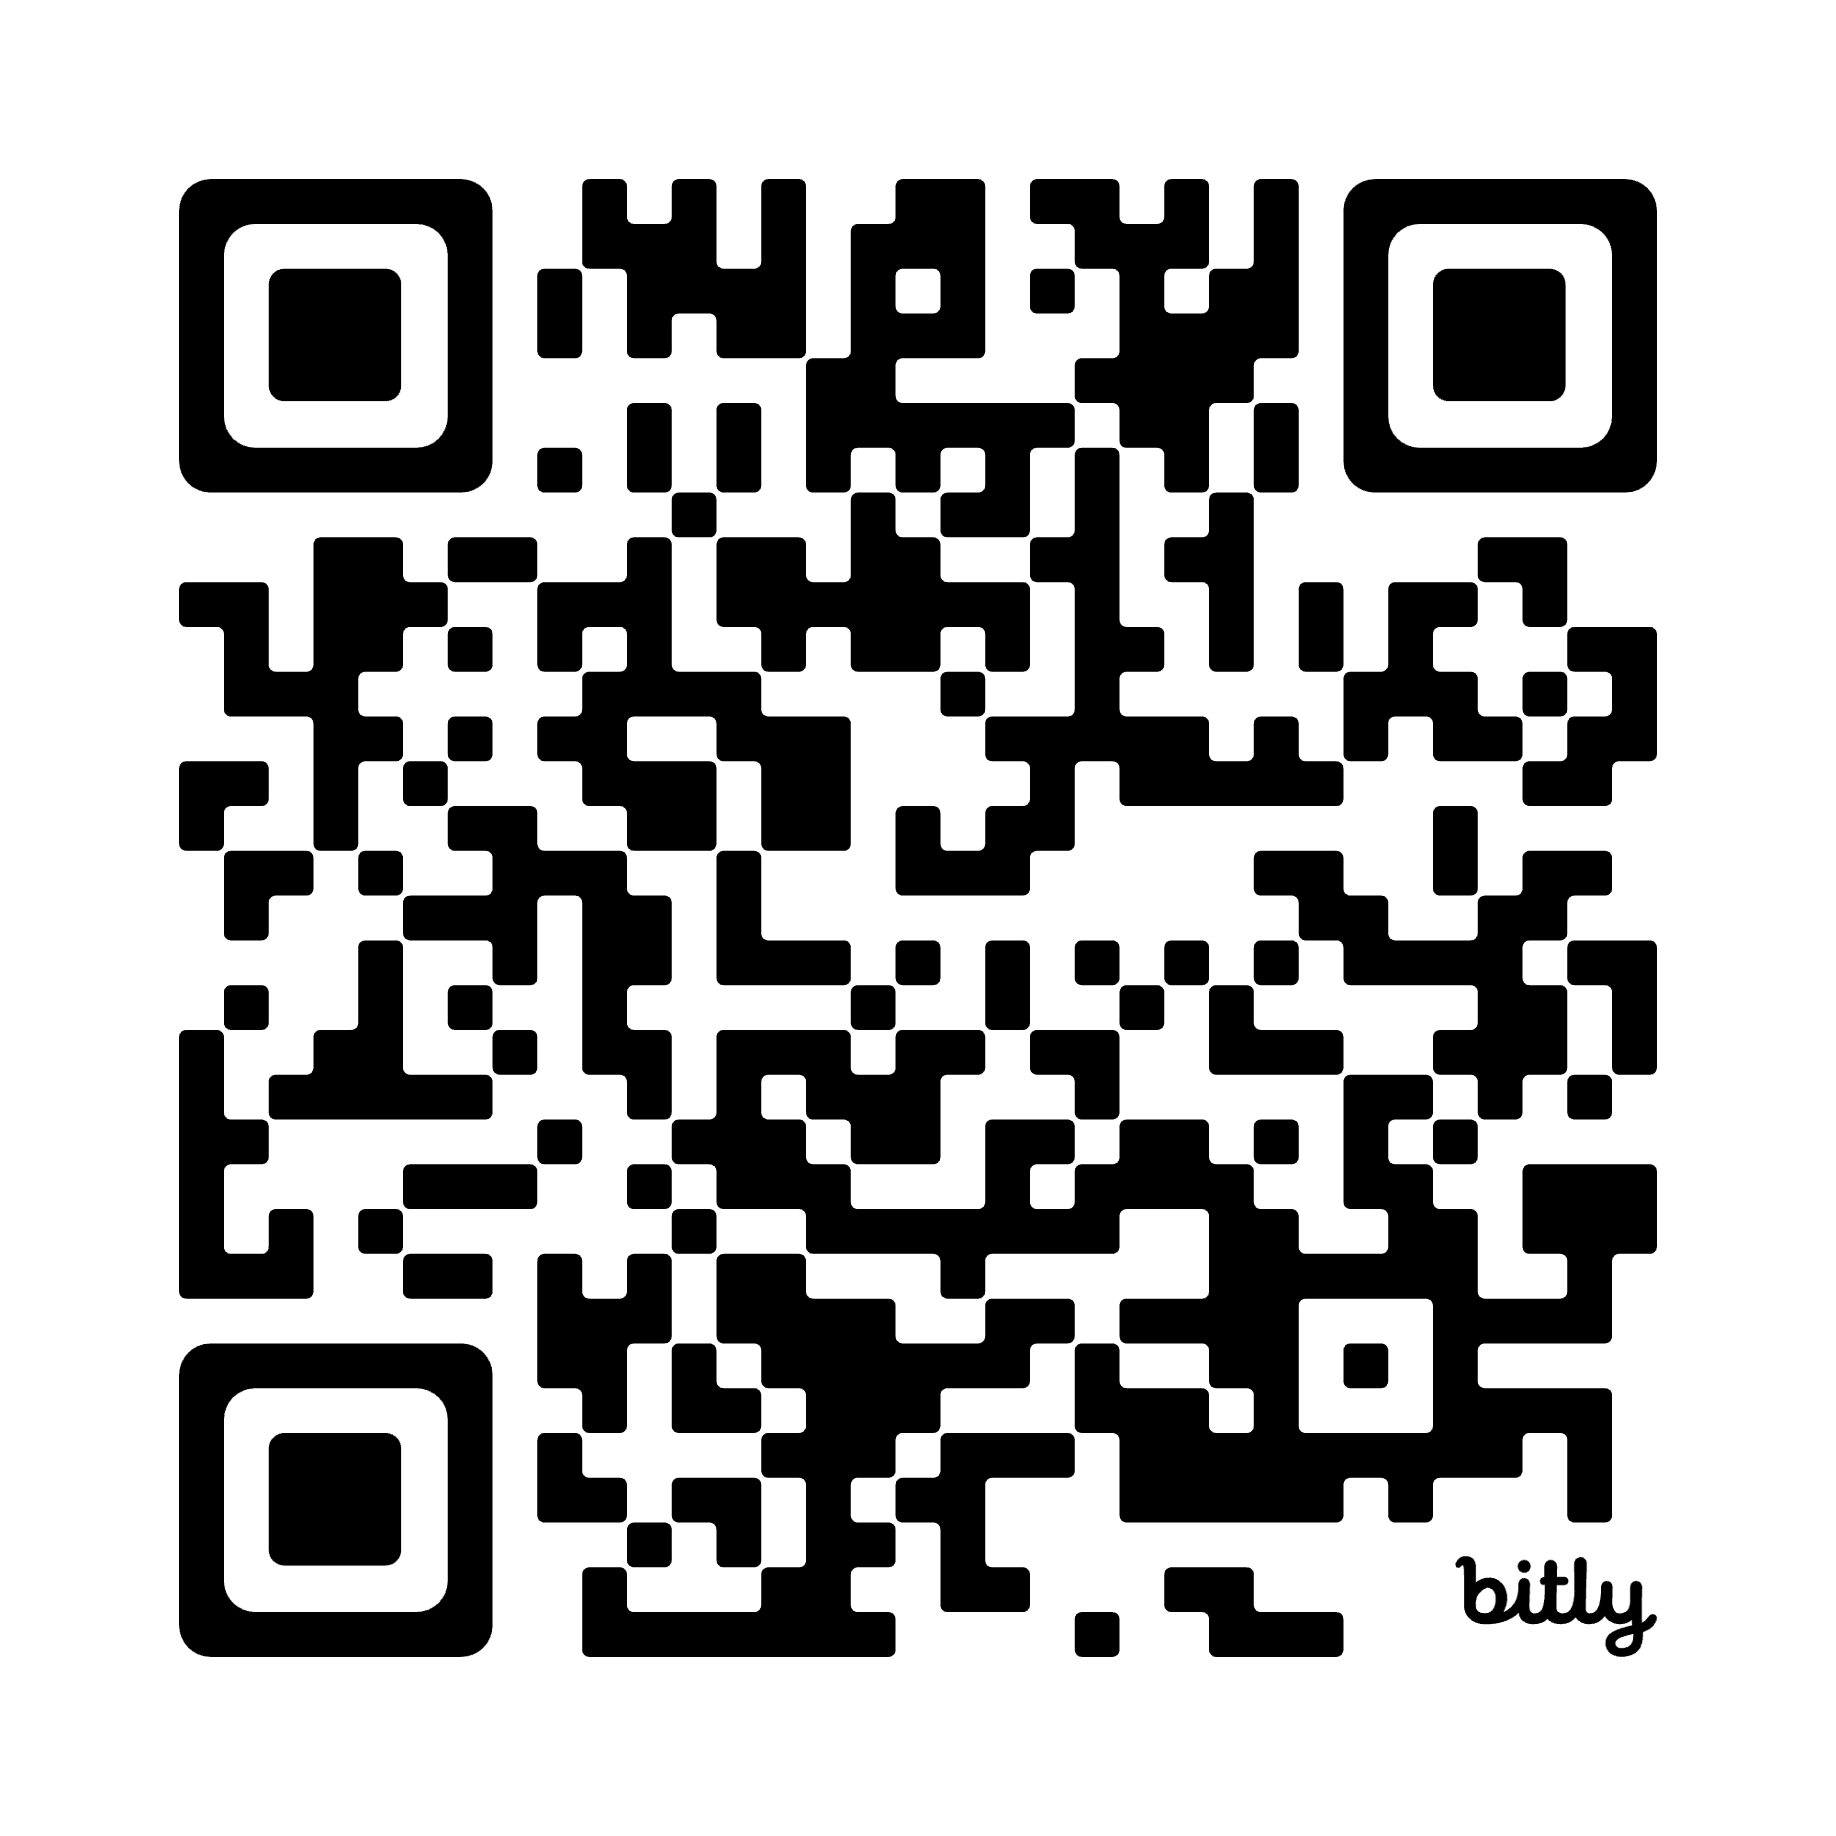

Teaching Ethnic Studies In Utah: New Requirements, Trusted Materials
Utah Rural Schools Association
July 10 2025
Presented by
Etiana Coley Mells
Dr. Wendy Rex Atzet
Scan for slide deck

Slide 2
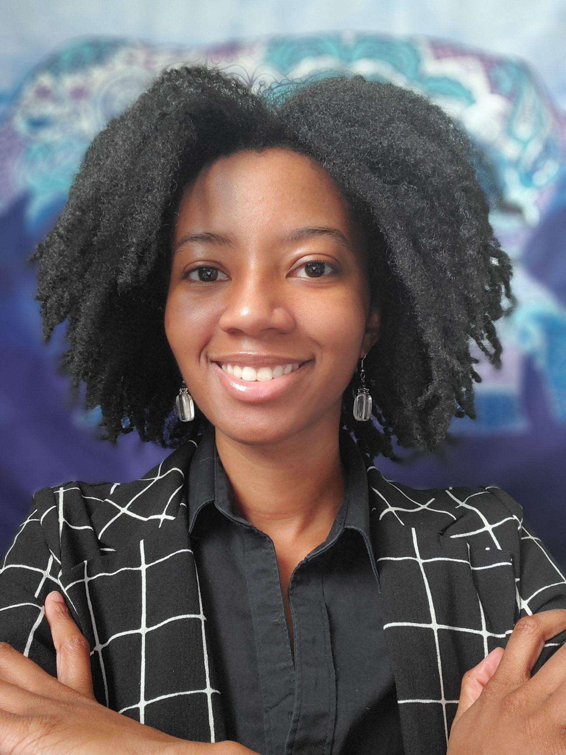

Presenters
Etiana Coley Mells
Ethnic Studies Education Specialist
Utah State Board of Education
Dr. Wendy Rex Atzet
K-12 Initiatives Manager
Utah Historical Society

Slide 3
AGENDA
Introductions
Utah Requirements for
Ethnic Studies and Equal Opportunity
Introduce Digital Resources
Ethnic Studies Resource Hubs @ uen.org
ILoveHistory.utah.gov
America 250.utah.gov
Guided Exploration
Resource Sets
Choose-Investigate-Share
Questions/Wrap Up

Slide 4
Utah Requirements
for Ethnic Studies
and Equal Opportunity Education
Core standards and curriculum requirements
Minimum criteria
Utah Ethnic Studies Commission recommendations
Prohibited discriminatory practices

Slide 5
Ethnic Studies Education
Utah Code 53E-4-204.1. core standards and curriculum requirements.
By December 31, 2027, an LEA shall select curriculum and instructional materials for teaching ethnic studies to students in kindergarten through grade 12.
An LEA shall modify or revise as needed the ethnic studies instructional materials and curriculum the LEA selects, to ensure alignment with core standards incorporating ethnic studies.
Tool: Language Crosswalk: 53E-4-204.1. and 53G-10-204.
Published Content Integration Crosswalks: 3rd - 6th grade

Slide 6
Minimum Criteria Related to Ethnic Studies Required to be Incorporated
Core Standards | Instructional Materials & Curriculum
Focus on the character traits described in Utah Code Section 53G-10-204. | Align with the core standards incorporating ethnic studies.
Ethnic Studies: the interdisciplinary social and historical study of how different populations have experienced and participated in building the United States of America, including the study of the culture, history, and contributions of Utahns of diverse ethnicities. | Focuses on shared identity and honoring unique cultural differences, including: that each individual student has unique characteristics; the common elements that unite Utahns; and respect for distinct socio-cultural identities.
Opportunities to recognize and incorporate histories, contributions, and perspectives of Utahns of diverse ethnicities. | Includes themes including cultural histories within the context of United States history and global history.
Increase cultural awareness.

Slide 7
Utah Ethnic Studies Commission
Recommendation 1:
The Utah State Board of Education (USBE) should carefully consider the use of ethnic studies in core standards and curriculum to ensure a narrowly tailored incorporation of age-appropriate opportunities that naturally arise through education without pretextual effort in courses, programs, or activities where ethnic studies is not a primary focus.
Recommendation 2:
The public education system should incorporate curriculum of people and cultures that reflect the state’s various demographics without commentary that seeks to violate the neutrality standard established in H.B. 261.
H.B. 261 also applies the same neutrality standard to prevent the public education system from prohibited discriminatory practices, assertions, and trainings. USBE should ensure that no state board, system, local education agency, or school action or policy violates this neutrality standard.

Slide 8
Prohibited Discriminatory Practices
Utah Codes 53G-2-105 and 53B-1-118 (H.B. 261)
An LEA may not: engage in prohibited discriminatory practices. (A -L )
An LEA shall ensure that all students have access to programs providing student success and support.
Nothing in this section limits or prohibits an LEA's authority to establish policies that are necessary to comply with state law.
An institution shall: develop strategies, including inviting speakers, to promote viewpoint diversity; and establish policies and procedures to include opportunities for education and research on free speech and civic education.
Notes:
Share print outs of the utah codes for: 53G-2-105, 53B-1-118, 53G-10-204, and 53E-4-204.1. (Etiana)

Slide 9
Resources For Utah Teachers
UEN Resource Hubs
I Love History
America250 Utah

Slide 10
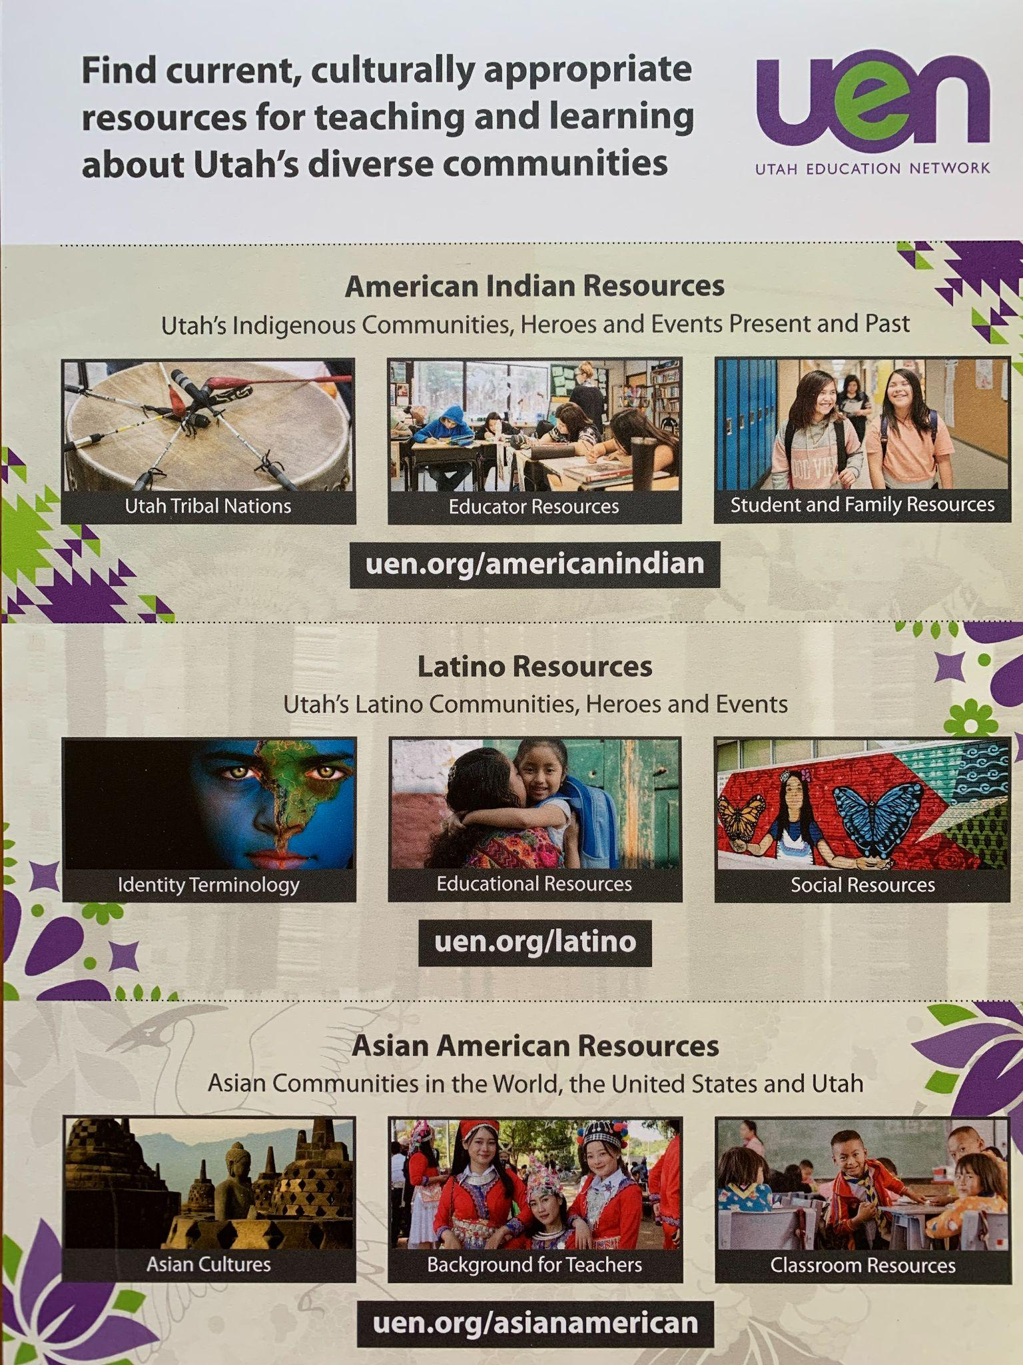
Ethnic Studies Resource Hubs
Now Online
American Indian/Alaska Native
Asian American
Latino
Coming Soon
African American
Native Hawaiian & Pacific Islander

Slide 11
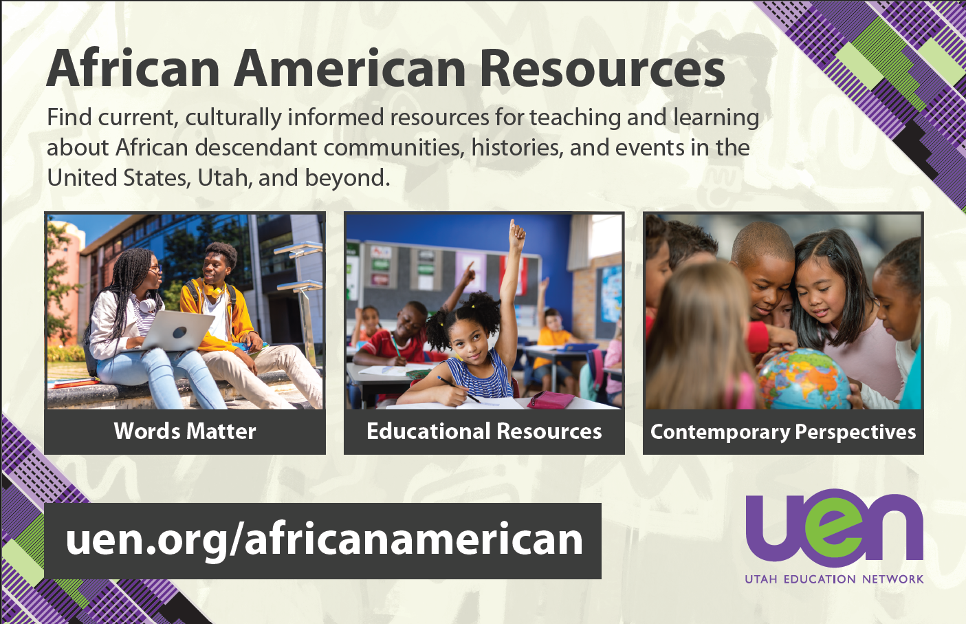

Slide 12
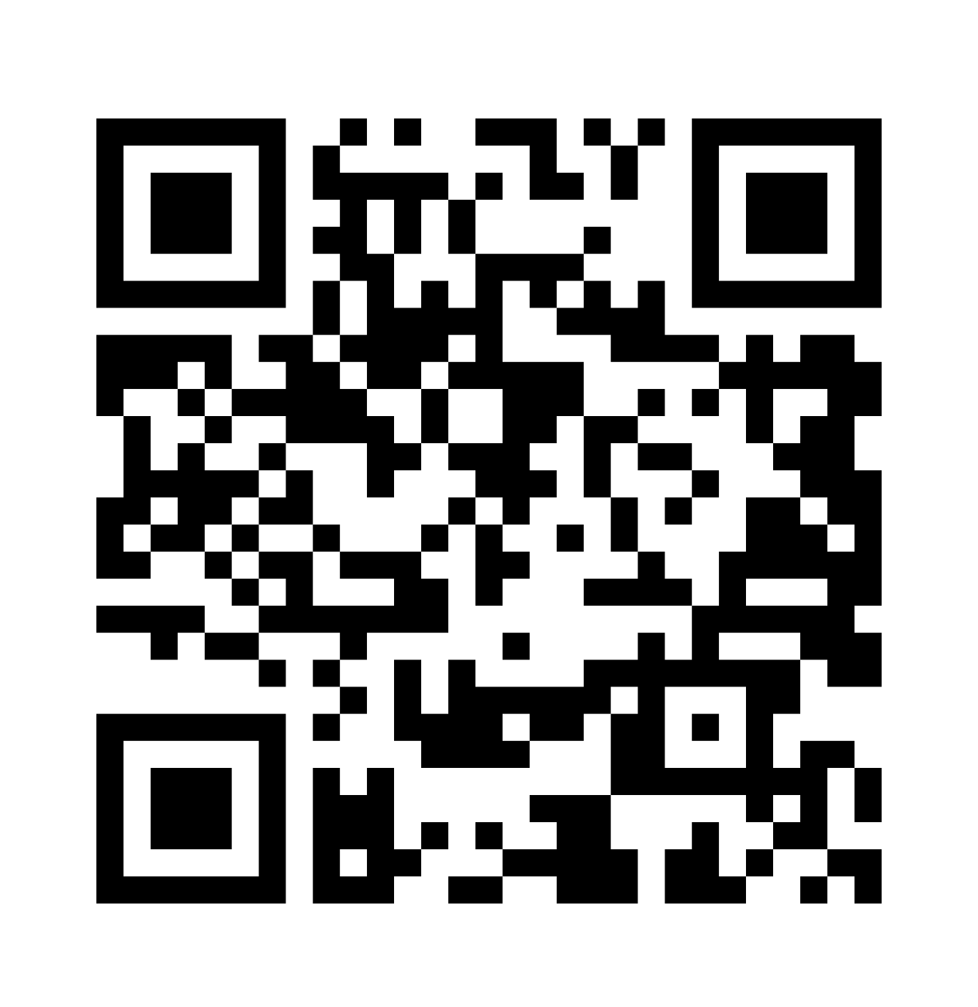
EXPLORE
Utah’s 5 Tribal Groups/8 Sovereign Nations
BYU ARTS Native American Curriculum Initiative

Slide 13
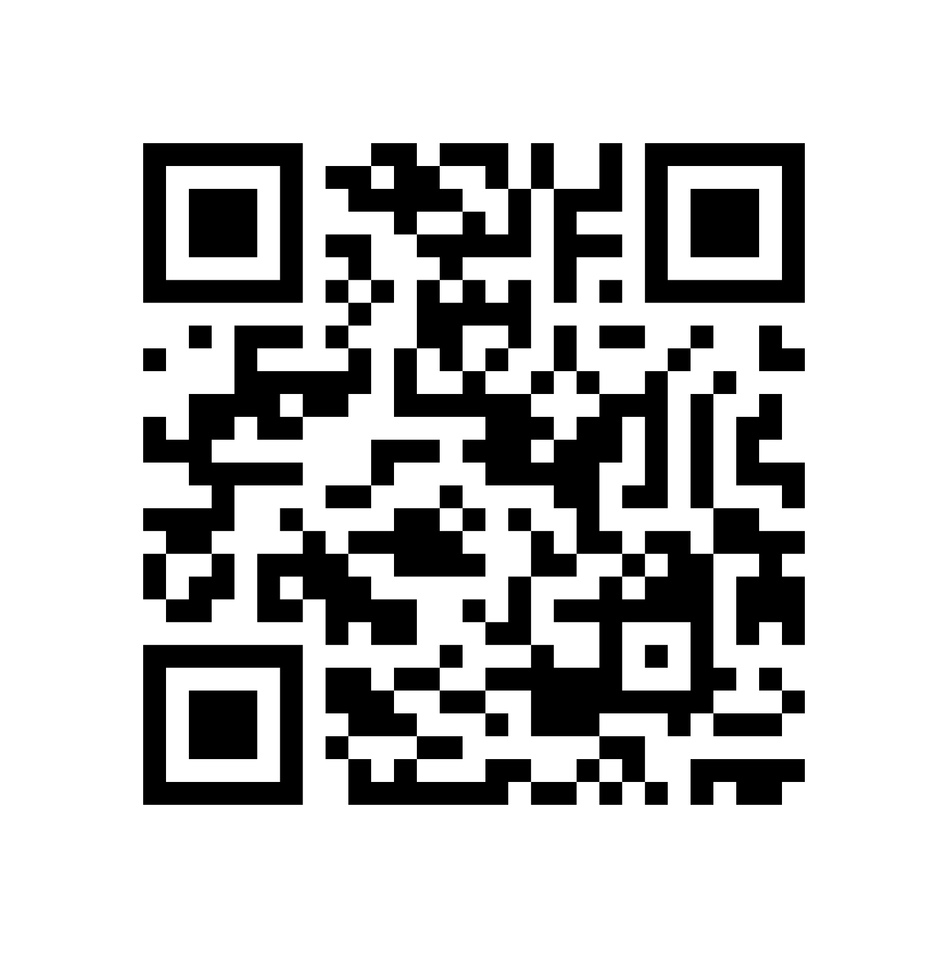
EXPLORE
Global Immigration
Utah Asian American Timeline, Peoples, Places

Slide 14
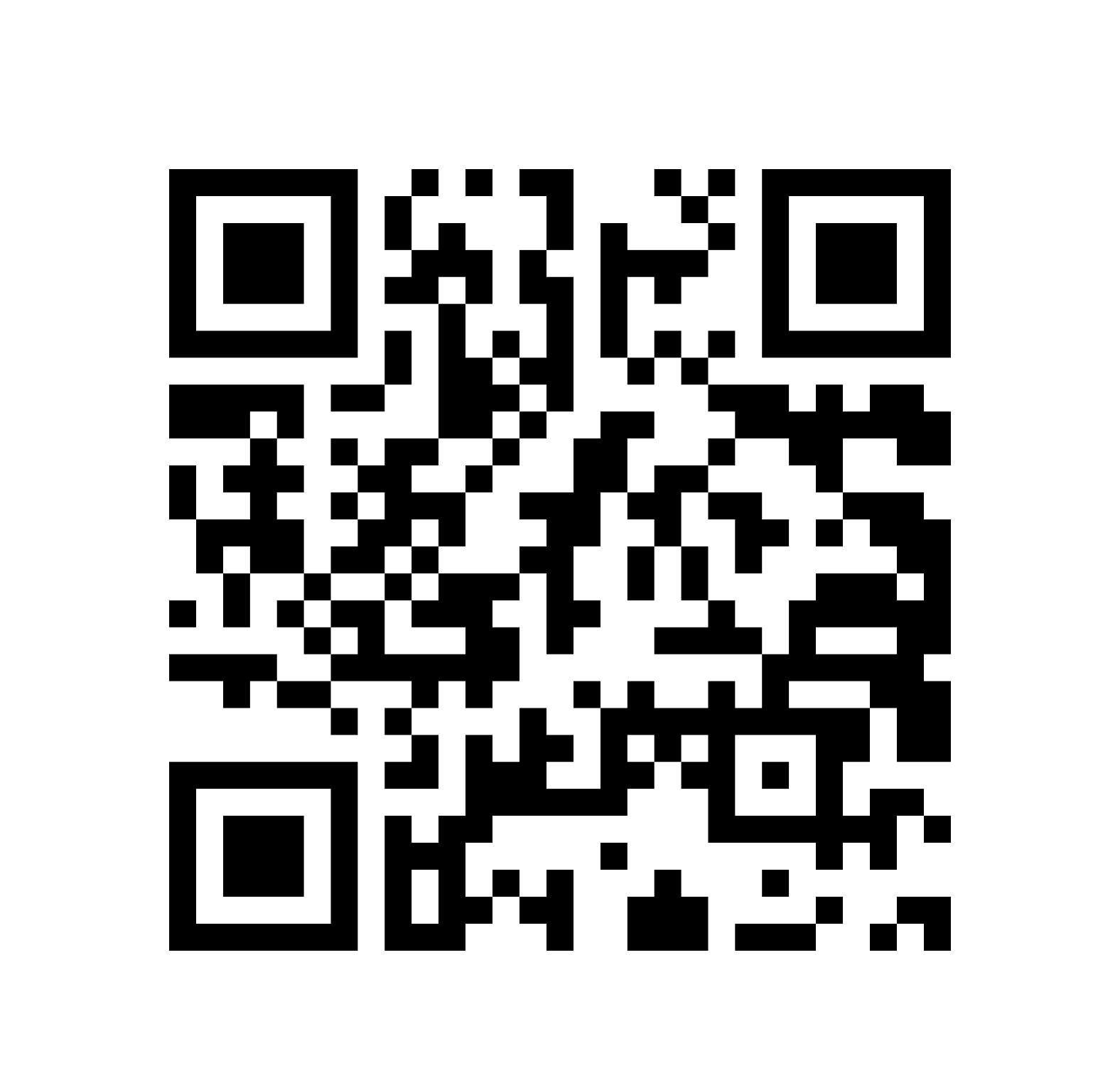
EXPLORE
Identity Terminology
Born from Corn Lesson Plan

Slide 15

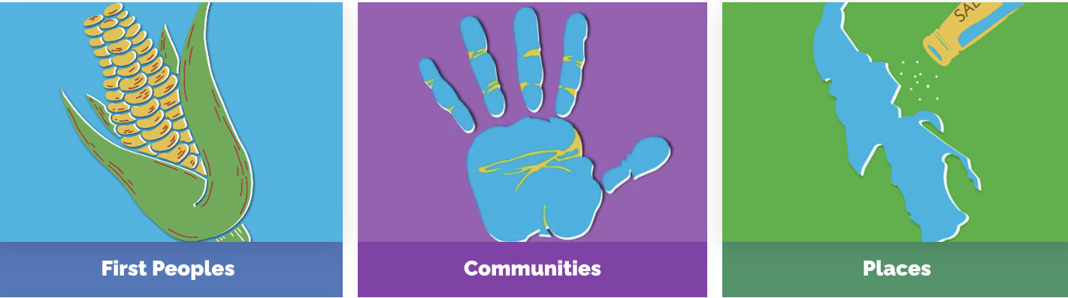
ILOVEHISTORY.UTAH.GOV

Slide 16



Slide 17


ILH Teacher Resources

Slide 18

Commemorating
1776
Declaration of Independence
We the People
Utah 1776
Domínguez and Escalante Expedition
Expedition 1776 “Flat Stanley” Explorers
Spanish, Mexican, New Mexican, Ute
GIS Story Map
Lessons
4th Grade Lesson
7th Grade Lesson
7th Grade Journal Writing Activity

Slide 19
Exploration
Time
Explore a set of resources from the deck (5 min)
Present a 1 minute share on your resource set (10 min)
How can you incorporate in your classroom this year? (5 min)

Slide 20
Greater Utah Indigenous Connections
Resource Hub: uen.org/AmericanIndian
Lesson Plans: Native American Curriculum Initiative @ BYU ARTS Partnership
Five Tribal Groups, Eight Tribal Nations
Native Americans Within Utah
Utah Environments through the Eyes of the Paiute (Paiute)
Avikaan Nuuche History: Creative Movement (White Mesa Ute)
Father Sky and Mother Earth (Navajo/Dine)
Viewing Water as a Gift (Confederated Tribes of Goshute)

Slide 21
Utah's African American Community
I Love History: Utah’s African American Communities
Article: Green Flake (Spanish version)
  Green Flake Lesson Plan
Article: Jane Manning James
  Jane Manning James Lesson Plan
Lesson Plan: Utah’s First African American State Senator
  2017 -- Interview with Utah's 1st Black State Senator Terry Williams
Notes:
Essential Question:
Why should we remember the past?
Learning objectives:
Students will be able to retell stories learned in class.
Through art making, dance, drama, etc.
Skills and Activities:
Analyzing a document-based inquiry, listening, speaking, building upon prior knowledge, making art, storytelling, and self-expression.
Guiding and Supportive Standards:
G: Standard 2.1.5 Identify the achievements of significant Americans, including those from local and other diverse perspectives, and explain their importance. (Social Studies)
S: Standard 2.R.5: Ask and answer questions such as who, what, where, when, why, and how to demonstrate understanding of key details in a text. (RL & RI) (ELA)
Essential Question:
Why should we remember the past?
Learning objectives:
Students will be able to retell stories learned in class.
Through art making, dance, drama, etc.
Skills and Activities:
Analyzing a document-based inquiry, listening, speaking, building upon prior knowledge, making art, storytelling, and self-expression.
Guiding and Supportive Standards:
G: Standard 2.1.5 Identify the achievements of significant Americans, including those from local and other diverse perspectives, and explain their importance. (Social Studies)
S: Standard 2.R.5: Ask and answer questions such as who, what, where, when, why, and how to demonstrate understanding of key details in a text. (RL & RI) (ELA)

Slide 22
Utah’s Pacific Islander Communities
I Love History: Pacific Islander Communities
Primary Source: The 1897 Petition Against the Annexation of Hawaii
BYU Capstone: Ke Kulanakauhale o’Iosepa by Palakiko Chandler
PBS Utah + Brighton High School: Aloha Iosepa
PBS Utah: Pioneers of Aloha
KSL: Utah artist plays big role in Disney’s ‘Moana’
NHPI Utah story maps and resource hub COMING SOON
Notes:
Essential Question:
Why should we remember the past?
Learning objectives:
Students will be able to retell stories learned in class.
Through art making, dance, drama, etc.
Skills and Activities:
Analyzing a document-based inquiry, listening, speaking, building upon prior knowledge, making art, storytelling, and self-expression.
Guiding and Supportive Standards:
G: Standard 2.1.5 Identify the achievements of significant Americans, including those from local and other diverse perspectives, and explain their importance. (Social Studies)
S: Standard 2.R.5: Ask and answer questions such as who, what, where, when, why, and how to demonstrate understanding of key details in a text. (RL & RI) (ELA)
Essential Question:
Why should we remember the past?
Learning objectives:
Students will be able to retell stories learned in class.
Through art making, dance, drama, etc.
Skills and Activities:
Analyzing a document-based inquiry, listening, speaking, building upon prior knowledge, making art, storytelling, and self-expression.
Guiding and Supportive Standards:
G: Standard 2.1.5 Identify the achievements of significant Americans, including those from local and other diverse perspectives, and explain their importance. (Social Studies)
S: Standard 2.R.5: Ask and answer questions such as who, what, where, when, why, and how to demonstrate understanding of key details in a text. (RL & RI) (ELA)

Slide 23
Utah’s Latino American Communities
I Love History:
Spanish Site: Me Encanta la Historia
Article: Utah’s Latino Communities
Resource Hub: UEN.org/latino
Terminology
Student and Family Resources
Lesson Plans:
Born from Corn Lesson Series, by Artés de Mexico en Utah
Presencia: Diversity in Latino Cultures

Slide 24
Utah’s Asian American Communities
Resource Hub: uen.org/AsianAmerican
Timeline
Utah's Asian American History Timeline
Geographies
Asian Regions
People & Places Within Utah's Asian American History
Communities
Acronyms and Identities
Immigration and Civil Rights

Slide 25
Chinese Railroad Workers in Utah
I Love History: Utah’s Chinese American Communities
Elementary 4th-5th grade
Coolies by Yin (Author), Chris Soentpiet (Illustrator) Ages: 7-10 years
Lesson Ideas for Use With the Picture Book Coolies, by Yin
MOCA Heroes: Chinese Railroad Workers, grades 4-6
Spike 150 Lesson Plans
https://spike150.org/legacy/
Secondary 7th - 8th grade
Chinese Railroad Workers in North America Project
Lesson Ideas for Use With the Picture Book Coolies, by Yin
Oral Histories and Interviews
Notes:
Essential Question:
Why should we remember the past?
Learning objectives:
Students will be able to retell stories learned in class.
Through art making, dance, drama, etc.
Skills and Activities:
Analyzing a document-based inquiry, listening, speaking, building upon prior knowledge, making art, storytelling, and self-expression.
Guiding and Supportive Standards:
G: Standard 2.1.5 Identify the achievements of significant Americans, including those from local and other diverse perspectives, and explain their importance. (Social Studies)
S: Standard 2.R.5: Ask and answer questions such as who, what, where, when, why, and how to demonstrate understanding of key details in a text. (RL & RI) (ELA)
Essential Question:
Why should we remember the past?
Learning objectives:
Students will be able to retell stories learned in class.
Through art making, dance, drama, etc.
Skills and Activities:
Analyzing a document-based inquiry, listening, speaking, building upon prior knowledge, making art, storytelling, and self-expression.
Guiding and Supportive Standards:
G: Standard 2.1.5 Identify the achievements of significant Americans, including those from local and other diverse perspectives, and explain their importance. (Social Studies)
S: Standard 2.R.5: Ask and answer questions such as who, what, where, when, why, and how to demonstrate understanding of key details in a text. (RL & RI) (ELA)

Slide 26
Utah’s Japanese American Community
I Love History: Japanese American Communities
Article: Kuniko Muramatsu Terasawa
PBS: Hoop Hero (Wat Misaka)
Article: Loving Day and the End of Utah’s Interracial Marriage Ban
Elementary 4th-5th grade
Obachan Told Me Gaiman, by Samantha Matsukawa
Secondary 7th - 8th grade
Journey to Topaz, by Yoshiko Uchida
When the Akimotos Went to War, by Matthew Elms
Notes:
Essential Question:
Why should we remember the past?
Learning objectives:
Students will be able to retell stories learned in class.
Through art making, dance, drama, etc.
Skills and Activities:
Analyzing a document-based inquiry, listening, speaking, building upon prior knowledge, making art, storytelling, and self-expression.
Guiding and Supportive Standards:
G: Standard 2.1.5 Identify the achievements of significant Americans, including those from local and other diverse perspectives, and explain their importance. (Social Studies)
S: Standard 2.R.5: Ask and answer questions such as who, what, where, when, why, and how to demonstrate understanding of key details in a text. (RL & RI) (ELA)
Essential Question:
Why should we remember the past?
Learning objectives:
Students will be able to retell stories learned in class.
Through art making, dance, drama, etc.
Skills and Activities:
Analyzing a document-based inquiry, listening, speaking, building upon prior knowledge, making art, storytelling, and self-expression.
Guiding and Supportive Standards:
G: Standard 2.1.5 Identify the achievements of significant Americans, including those from local and other diverse perspectives, and explain their importance. (Social Studies)
S: Standard 2.R.5: Ask and answer questions such as who, what, where, when, why, and how to demonstrate understanding of key details in a text. (RL & RI) (ELA)

Slide 27
Utah’s Greek American Community
I Love History: Greek American Communities
Lesson Plans:
Helen Z. Papanikolas - Growing Up Greek in Utah
Filling Your Plate - Greek Festival Food
Primary Source Set
Danger and Diversity in Utah’s Mining Country

Slide 28
Utah’s Middle Eastern American Communities
PBS: Egypt: A Taste of Arabian Music | Music Arts Toolkit Video
  Article: From Kurdistan to Washington, Jalal Kimia Connects Communities with the Daf Drum
PBS: Art in the Muslim World Lesson Plan
  Activity: Islamic Art and Geometric Design - The Metropolitan Museum of Art
UMOCA Education: What is Ramadan? Video
  PBS: Halal - Kosher Dining at Dartmouth Video
  First-ever Halal Food Festival hosted by Utah Muslim Civic League celebrates culture, connections Video
Article: I was given a chance that changed my life

Slide 29
Faith Based Communities in Utah
Baptist Buddhist
Catholic
Church of Jesus Christ of Latter-day Saints
Eastern Orthodox
Episcopalian Hindu
Indigenous Japanese Church of Christ
Methodist Muslim
Presbyterian Sikh
What religions are practiced in Utah?
Can you map them through histories of migration and diaspora?

Slide 30
Thank you for engaging with us!
Etiana Coley Mells
Utah State Board of Education
etiana.coleymells@schools.utah.gov
Dr. Wendy Rex Atzet
Utah Historical Society
wratzet@utah.gov

Slide 31
Session Description: Are you wondering how to incorporate Utah’s ethnic studies requirements in your classroom? Join us for an enlightening session to explore a range of culturally appropriate resources that connect Utah’s historic and contemporary immigrant communities.
Incorporating ethnic studies materials into your lessons offers valuable opportunities to share the experiences, cultures, and contributions of diverse ethnic groups in Utah. This includes Indigenous peoples, members of the LDS community, African Americans, Latinos, Pacific Islanders, and Asian Americans, both within Utah and beyond. Utilizing the Utah Historical Society’s I Love Utah History website and other educator resources, attendees will learn how to integrate trusted, curated content to explore the rich histories and contemporary communities of Utah's many cultures.
We will also delve into the UEN Ethnic Studies Resource Hubs to discover innovative ways to teach about various cultures, their history, and their contributions to building the United States of America.
This session will equip educators with the resources and background knowledge needed to create a classroom environment that connects the past with the present, honors and reflects the varied experiences of Utahns of diverse ethnicities, and celebrates Utah's vibrant cultural tapestry.
You will receive free, digital materials that will help you integrate culturally informed ethnic studies resources and inquiry-based learning strategies into your teaching practices.

