Slide 1
Utilizing the New Focused Graduation Pathway to Keep Students Engaged
Maybe One more bit of Text goes here to wrap it all up.
Perhaps a Subtitle or Additional Info
Stephanie Patton Tara Jarvie
Utah State Board of Education Wasatch School District
July 9, 2025

Slide 2

In this session, we will…
Share the “why”
Provide an overview of the Focused Graduation Pathway
Share resources
Answer your questions!

Slide 3

Why the Focused Graduation Pathway?

Slide 4

The challenge we face when students aren’t on track...and time is running out
Public Education aims to prepare students with academic knowledge, critical thinking, technology and problem-solving skills
and
Education
Promote personal and social development by fostering citizenship, equity, emotional well-being, inclusion, and lifelong learning.

Slide 5

Events Influencing Students' High School Completion Timelines
Traumatic
Mental
Life Events
financial need
Health
Limiting physical access or the ability to complete schoolwork
Adult
WORKING TO HELP SUPPORT FAMILY
SUPPORT
Educational Barriers
nontraditional
alternative routes
Academic Struggles
education
exploration
Credits lost in transitions
HOMESCHOOL, INTEREST BASED PROGRAMS (NOT COMPREHENSIVE)
NEEDING ADDITIONAL TIME AND SUPPORT THROUGHOUT THEIR K-12 EXPERIENCE
MOVING

Slide 6



Currently our options for students who reach their junior year and are significantly behind
Work Completion
DO AS MUCH AS YOU CAN AS QUICK AS YOU CAN OR WE CAN SEE IF YOU CAN TEST OUT.
TAKE THE GED AND MOVE ON.

Slide 7

What We Give Up in the
Transition to Credit Completion
Peers
Social Development
Caring
Post Secondary
ADULTS
RESOURCES
Positive Role Models
Connections
Mental Health
Experiences
Exploration
Careers, interests
Support

Slide 8
Focused Graduation Pathway
In our eagerness to complete tasks within a limited timeframe, it's comforting to know that the learning outcomes are measurable and aligned with a fundamental standard of skill proficiency.
FGP

Slide 9


An Overview of the Focused Graduation Pathway

Slide 10

Purpose
To keep students with low credits engaged in school
To provide students the opportunity to graduate with their cohort
To allow students to focus on preparing for postsecondary opportunities

Slide 11

Eligibility
Student must be at least 16 years of age
Student must be a junior or senior in high school
Student must remain enrolled in a K12 school
Student must be significantly deficient in credits
  Junior = 6 credits
  Senior = 3 credits
Student must have a 9th grade reading level

Slide 12

Credit is Awarded for Passing GED® test
Reasoning through Language Arts test
  Up to 4 language arts credits
Mathematical Reasoning test
  Up to 3 mathematics credits
Social Studies test
  Up to 3 social studies credits
Science test
  Up to 3 science credits
All credits are entered as pass/fail grades

Slide 13

What Does the Instruction Look Like?
Subject matter experts
Utilize other courses to keep students engaged and focused on postsecondary options

Slide 14

Steps
Create policy surrounding your school’s implementation of the Focused Graduation Pathway
Get the approval of the local school board
Submit an application to USBE
Implement the program

Slide 15

Initial Meeting with Student
To ensure students understand the expectations of the program
Get parental consent
Solidify that the FGP is the best option for the student
Remember participation in the FGP is voluntary!!

Slide 16

Reading Assessment
Ensures students will benefit from the program
Schools will propose how the assessment will be conducted in the application
What if a student doesn’t have a 9th grade reading level?
The school could work with the student to improve the student’s reading level
Utilize other options that would be more appropriate for the student

Slide 17

Testing
Can utilize the GED® Ready official practice test to ascertain readiness to test
Students will utilize existing Pearson VUE test centers
Application should include details on who will pay for the tests, the student or the program?

Slide 18

Adding Courses
New CACTUS Course Codes
  GED Math 07-07-00-00-400
  GED Science 08-05-00-00-400
  GED Language Arts Prep 06-01-00-00-400
  GED Social Studies Prep 09-09-00-00-400

Slide 19

Graduation
Student is counted as a graduate
Student walks at graduation
Student has a GPA with many opportunities available post graduation

Slide 20
Application Questions
LEA and School Name(s)
Administrators of the FGP
Local Board approved policy
Evidence of Board approval
Describe the referral process for students participating in the FGP, including:
  How will parent permission be collected?
  How will students be identified as potential candidates?
  Who will participate in the referral meeting?
  How will the program ensure students are significantly behind on credits?
Provide an overview of the FGP program. Include the following:
  Will students stay at their boundary school, or will one school provide the FGP for the entire district?
  Will participating students pay test fees or will the school?
  How will credit be assigned for passed GED tests?
  How will students be assessed to determine they are at a 9th grade reading level?
How will the FGP focus on connecting participating students to postsecondary and career opportunities?

Slide 21
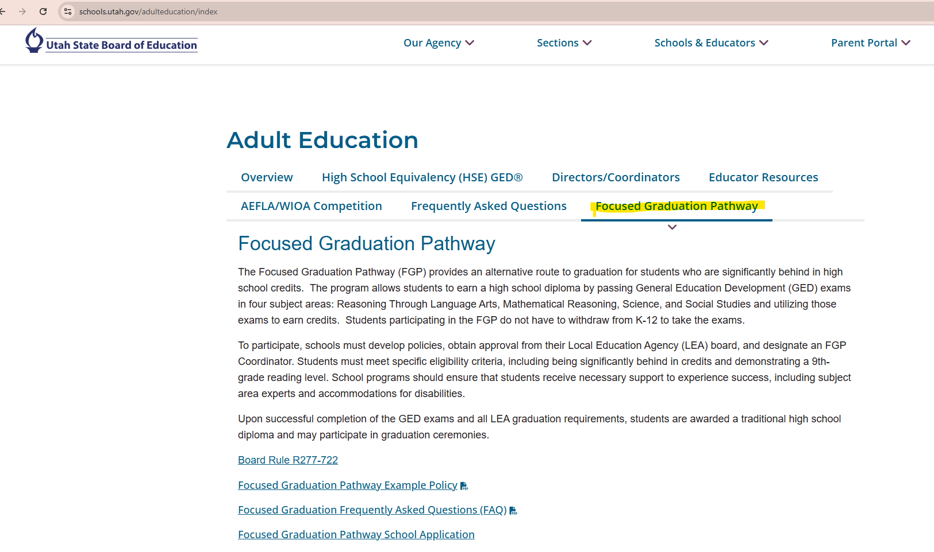
Webpage
Tab on https://www.schools.utah.gov/adulteducation/index
Link to application, sample policy, and FAQ document

Slide 22
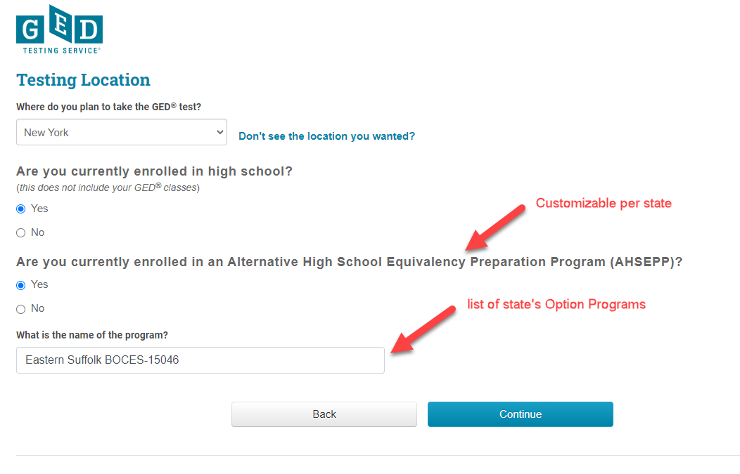
Student GED Account Creation

Slide 23

An Overview of the GED® test

Slide 24
Content Alignment
How is the GED® test aligned to specific content standards?
Developed by design to reflect college and career readiness standards
Crosswalks and external alignment studies demonstrate alignment between GED® Assessment Targets and CCR standards

Slide 25
The GED® test
Critical Thinking Skills: All content areas
Problem-solving Skills: All content areas
Close Reading Skills: All content areas
Evidence-based Writing Skills: Reasoning Through Language Arts

Slide 26
GED® test
Test | Time | Notes
Reasoning through Language Arts | 150 minutes | Includes 45 minutes for extended response (timed separately) and a 10-minute break
Mathematical Reasoning | 115 minutes | Part 1 – calculator not allowed; Part 2 – calculator allowed
Social Studies | 70 minutes
Science | 90 minutes
Notes:
Key Points
Available in English and Spanish
A wide array of accommodations available
Including zoom-text, alternate color palettes, Braille, screen reader, extended time, paper testing for special circumstances
The chart provides an overview of the time for each of the tests, as well as pertinent notes.

Slide 27

Overview of RLA Test
Content - Integrated reading and writing
  Close reading
  Clear writing
  Editing and understanding the use of standard written English (or Spanish) in context
Source texts – 75% nonfiction; 25% fiction
Passage length – 400-900 words
Range of text complexity, including texts at the college- and career-ready level
Technology-enhanced items and extended response
Notes:
Key Points
This slide provides a short overview of the content and context of the RLA Test. Review the information on the slide. For additional information, access the Assessment Guide for Educators Reasoning through Language Arts section.

Slide 28

Overview of Mathematical Reasoning Test
Content
  45% - Quantitative Problem Solving
    Number operations
    Geometric thinking
  55% - Algebraic Problem Solving
Texas Instruments - TI 30XS Multiview™ (calculator allowed on the second part)
Integration of mathematical practices
Formula page, symbols, and calculator page provided
Notes:
Key Points
This slide provides a short overview of the content and context of the Mathematical Reasoning Test. Review the information on the slide. For additional information, access the Assessment Guide for Educators Mathematical Reasoning section.

Slide 29

Overview of Social Studies Test
Content
  50% - Civics and Government
  20% - United States History
  15% - Economics
  15% - Geography and the World
Themes
  Development of Modern Liberties and Democracy
  Dynamic Responses in Societal Systems
Social Studies Practices – analyzing, thinking, reasoning
Technology-enhanced question items
Notes:
Key Points
This slide provides a short overview of the content and context of the Social Studies Test. Review the information on the slide. For additional information, access the Assessment Guide for Educators Social Studies section.

Slide 30

Overview of Science Test
Content
  Life Science – 40%
  Physical Science – 40%
  Earth and Space Science – 20% Themes
Themes
  Human Health and Living Systems
  Energy and Related Systems
Science Practices – reasoning and thinking scientifically
Question types - Technology-enhanced items
Notes:
Key Points
This slide provides a short overview of the content and context of the Mathematical Reasoning Test. Review the information on the slide. For additional information, access the Assessment Guide for Educators Mathematical Reasoning section.

Slide 31
The GED® test
Available in English and Spanish
Available accommodations include:
  Extended time
  Additional breaks
  Reader/recorder
  Private room
  Screen reader (JAWS)
  Many more
  Visit the GEDTS Accommodations Information Page
Notes:
Here is where we talk about online vs CBT and security etc for no chrome books and test experience

Slide 32
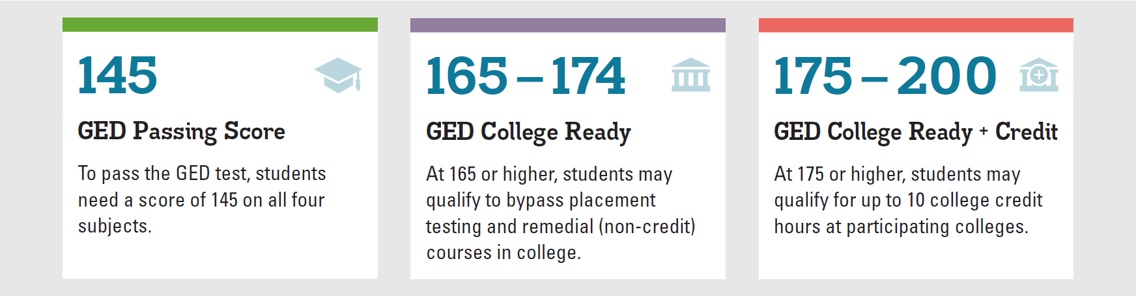
GED® test Score Levels
  GED College Ready scores improve the chances for college success.
  Learn more at GED.com/collegeready

Slide 33
GED® Ready: The Official Practice test
Realistic practice opportunity | Online and can be taken anywhere
Standardized and normed | Same norming and standardization study as the GED® test
Predictive | Tells students if they are likely to pass
Half-length | Half the length and can be stopped/started any time

Slide 34
Three GED® Ready Score Levels
Not Likely to Pass | Too Close to Call | Likely to Pass
100-133 | 134-144 | 145-200

Slide 35
Why the Focused Graduation Pathway?

Slide 36
Students who have struggled to Attend Due to Mental Health Struggles
Lexile
BEGINNING OF JUNIOR YEAR CREDITS
BEGINNING OF SENIOR YEAR CREDITS
1638
English
Math
Science
Social Studies
1.25
1.25
1.25
1.25
English
Math
Science
Social Studies
1.75
1.50
1.50
1.25
Prioritize
Priority: Being present as much as possible and participating in opportunities for social skill building.

Slide 37

We were able to prioritize what she needed the most and begin to prepare for the GED
She made it!!
She is enrolled in
college this fall.
Prioritize

Slide 38
Life Circumstances and Non-Traditional Pathway
Student 1
Student 2
SENIOR YEAR CREDITS
JUNIOR YEAR CREDITS
English
Math
Science
Social Studies
1.50
1.50
1.00
0.50
English(Honors)
Math
Science
Social Studies
1.25
1.25
1.25
0.50
Classes Taken:
Aviation
Engineering, CAD, Theater
GPA: 3.79
Credits: 14
Classes Taken: Humanities 1010 Communications 1020
Prioritize
Parent Passed Away
If they can’t walk they might as well take the GED now.
UNSURE HOW TO NAVIGATE POST SECONDARY & NEEDS A COMMUNITY
INVOLVED, TAKING COLLEGE CLASSES TUITION FREE

Slide 39
Neurodiverse and Financial Need
Student 3
Student 4
SENIOR YEAR CREDITS
SENIOR YEAR CREDITS
English
Math
Science
Social Studies
0.50
0.75
0.75
0.25
English(Honors)
Math
Science
Social Studies
2.75
1.50
2.00
2.00
Credits: 11:00
Classes Taken:
Robotics, STEM, Science and Engineering
Credits: 14.75
Classes Taken: Construction, Work Based Learning, Debate
Prioritize
Priority: Transition Services
Needs to work Full Time
IF ENROLLED CAN TAKE TECHNICAL COURSES FOR CERTIFICATION WITHOUT HAVING TO PAY TUITION.
NEEDS TIME FOR SUPPORTED EMPLOYMENT AND SOCIAL SKILLS BUILDING

Slide 40
How did we identify these students as candidates?
Data indicated that they had lost hope, or that, without substantial changes in their circumstances or expectations, graduation was unlikely for them.

Slide 41
"Hope is the greatest gift we can give students. When students lose hope, they begin to lower their sights. They stop reaching for what is possible and start settling for what feels reasonable—not what they deserve, and not what’s best for them."
“A person can survive almost anything, as long as they see the end in sight. But the absence of hope can hollow the strongest soul.”
— Unknown
Why?

Slide 42
There will always be students in need of extra time and support. One effective approach to create that additional time is by prioritizing proficiency with the Focused Graduation Pathway, allowing for a tailored focus on individual circumstances, priorities, and student goals.
Why?

Slide 43

Student and Educator Resources
Notes:
Key Points
The next few slides provide a quick overview of the GED® test.

Slide 44
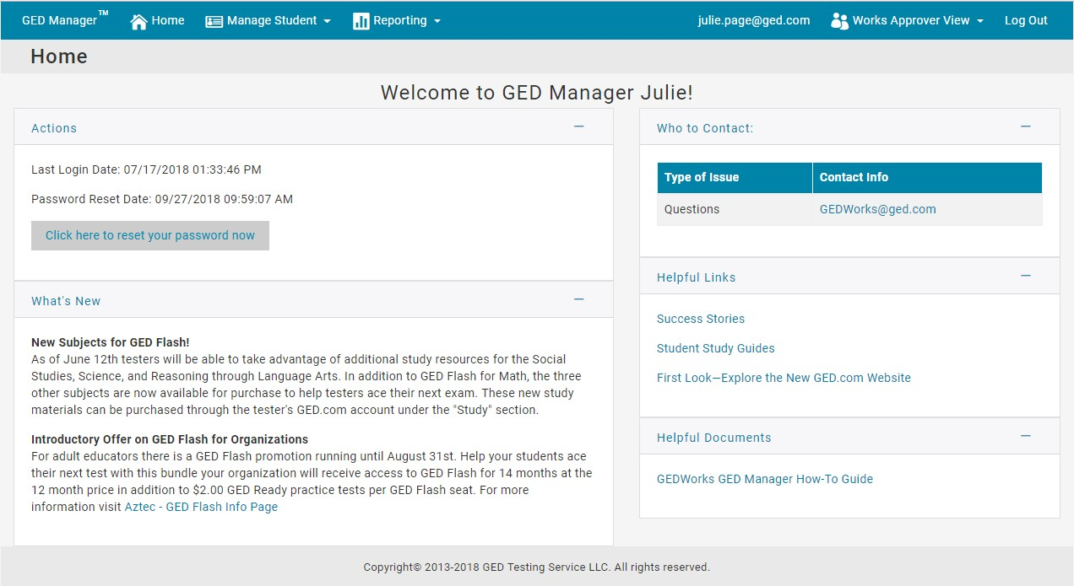
GED Manager
Your tool to Manage Students

Slide 45
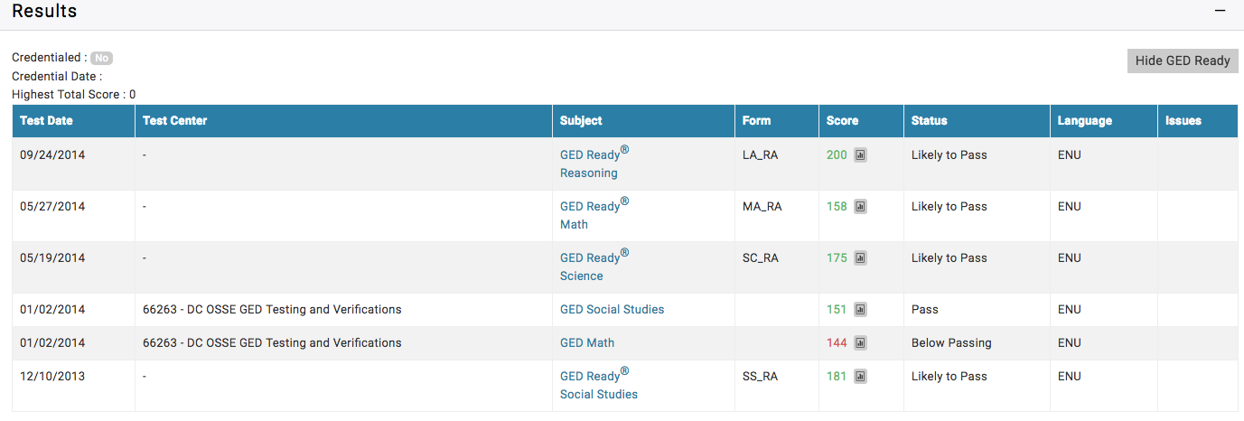
Scores and Score Reports
Click on “Hide GED Ready” to toggle (hide/unhide)
Links to the detailed score report
40

Slide 46
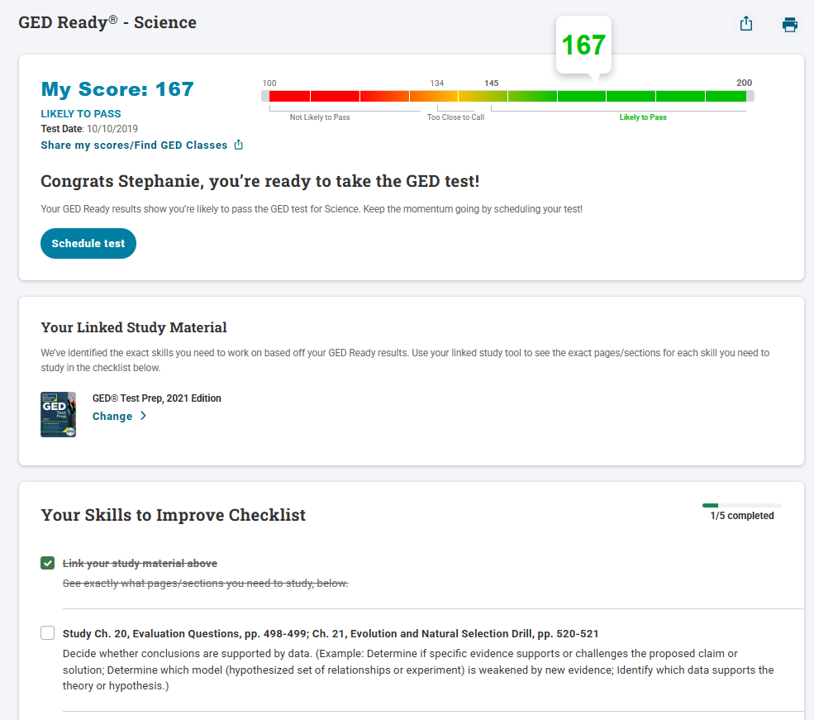
Score Reports
As a student checks off their progress, you will see it reflected here in real time

Slide 47

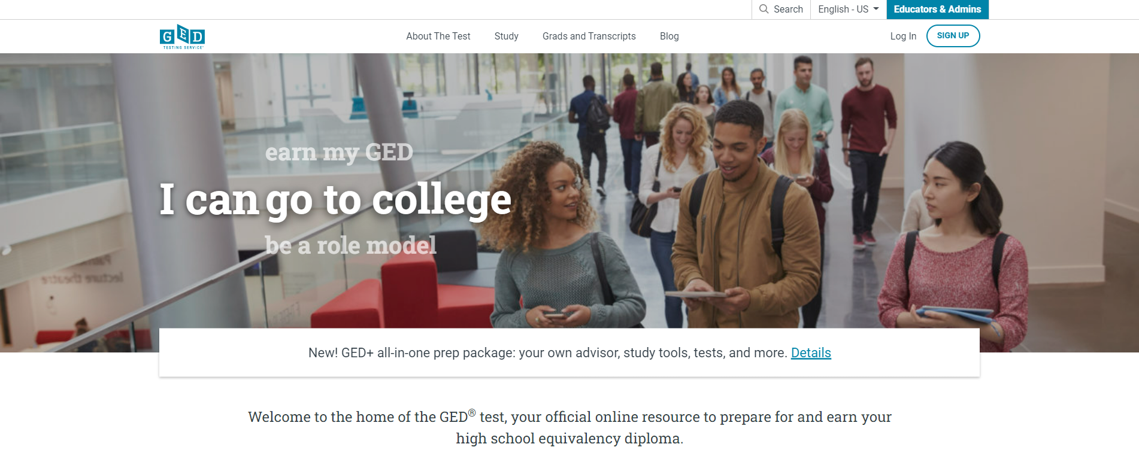

GED.com click on “Educators & Admins”

Slide 48
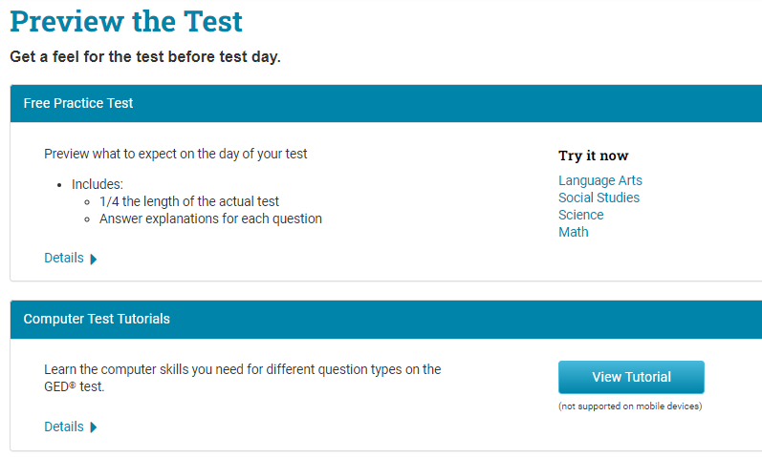
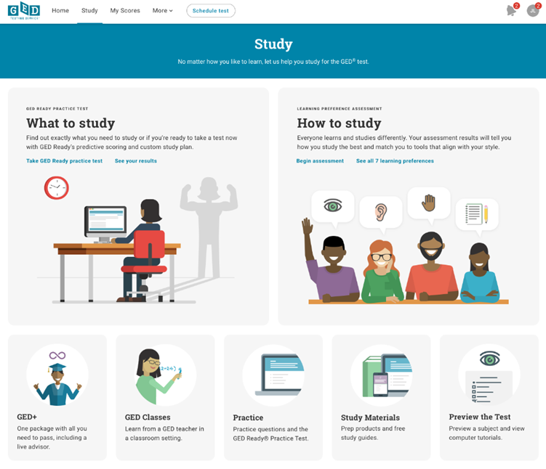
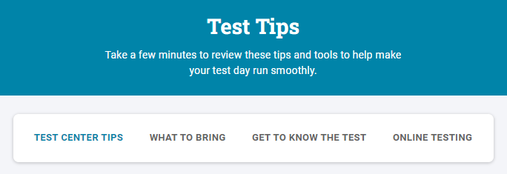
Resources and Tools for Students
Tutorials
  Test
  Calculator
Free practice test
Study guides
Videos
GED Ready® and free score report
Study tips
Learning preference assessment
And more!

Slide 49
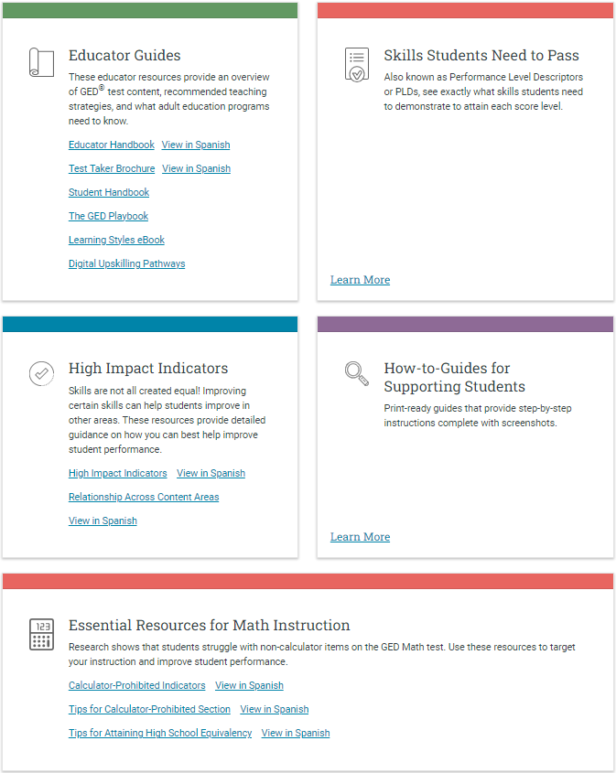

Teaching Resources
Covers all content areas
Item types
Assessment targets
Guidelines for how items are scored
More . . .

Slide 50
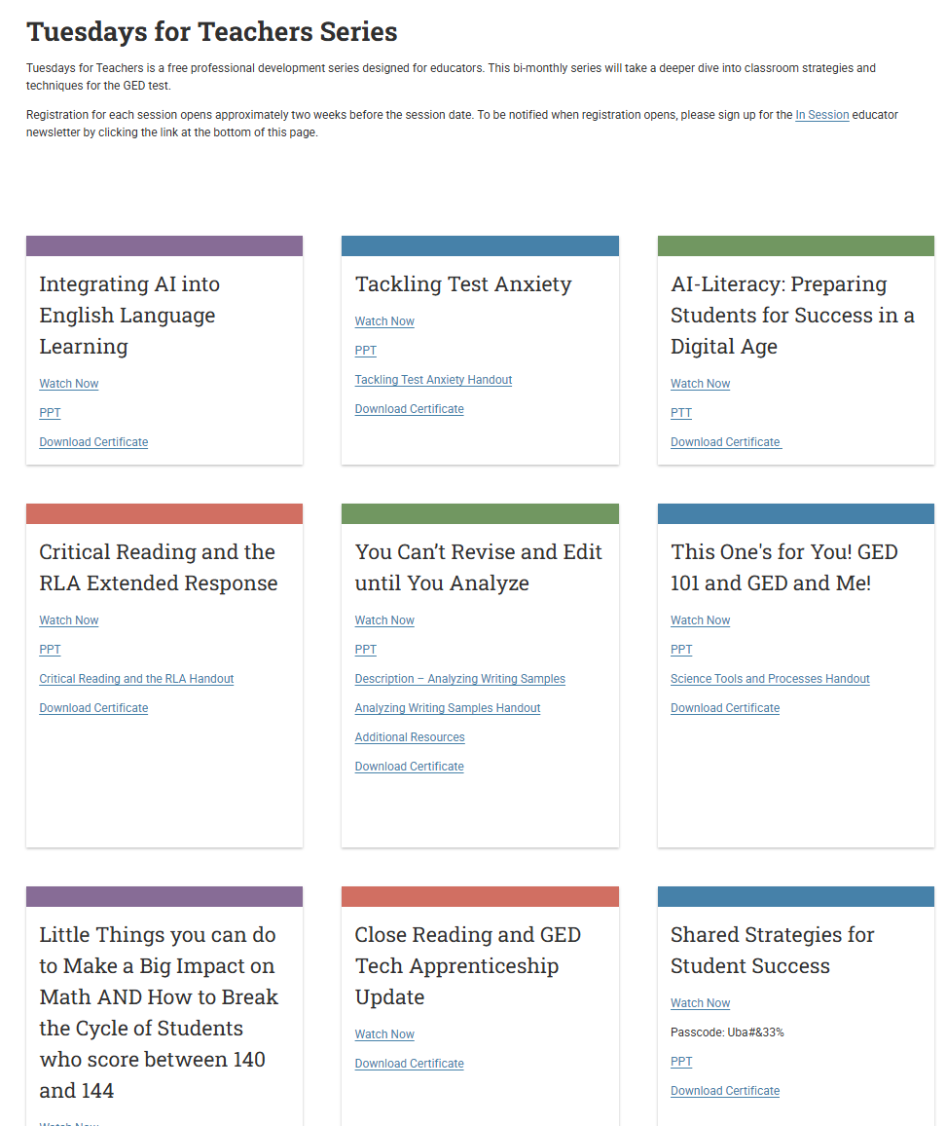
PD Sessions

Slide 51

Questions?
Stephanie Patton, USBE
  stephanie.patton@schools.utah.gov
  801-538-7989

