Slide 1
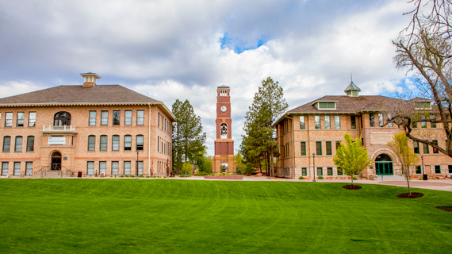
Leaving the Classroom for Leadership:
Lessons in First-Year Leadership from K-12
Doug Stump, Ed.D.
Southern Utah University

Slide 2
Doug’s Background
Director of Graduate Studies, Teacher Education and
Assistant Professor, Educational Leadership
18 years in K-12 teaching and leadership
14 years faculty and higher education
7 years Fortune 50 corporation prior to Education

Slide 3
Qualitative Research Study on Experiences of First Year Administrators
9 first-year administrators over 3 states
Series of interviews: start of the school year, last half of fall semester, early spring semester, and summer.
Transcripts were coded - analysis led to themes about how to understand these experiences

Slide 4
Qualitative Research Study on Experiences of First Year Administrators
What are the experiences of first-year administrators?
What challenges do first-year leaders experience?
What is it like to become a leader in the same place where you were a teacher?

Slide 5
Primary Themes
My relationships with those I work are changing
I no longer feel like I know what I am doing
My work is no longer about my classroom

Slide 6
The Push-Pull of Leader Opportunities -
Why Become a Leader?
Motives toward leadership:
Higher income
A particular position as career goal
Motivated by challenge and achievement
Teaching has become stale

Slide 7
The Push-Pull of Leader Opportunities –
Why Become a Leader?
What others see in future leaders:
There is an immediate need and someone identifies a candidate
An existing job is changing or going away

Slide 8
The Push-Pull of Leader Opportunities –
Why Become a Leader?
Why Doug moved into administration
The needs of rural schools

Slide 9
The Initial Ascent into Leadership
A combination of circumstances can lead candidates to step into positions for which they have not been formally trained or for which they feel unprepared.
The aim of this research is to help inform how better to induct leaders.

Slide 10
Challenges of Peer Leadership:
Relationships with those I work with are changing
Peer Leadership – move from peer teacher to administrator
Maintaining friendships while writing and/or executing policy
Setting boundaries from a position of authority with friends

Slide 11
Challenges of Peer Leadership
Being recognized as a leader among peers and students
Others are conditioned to go elsewhere for answers
Students and teachers who knew me as a teacher still see me as a teacher

Slide 12
Changes in Sense of Competency:
I no longer feel like I know what I am doing
Daily schedule and pace of work changes
Change in sense of purpose and immediate evidence that you are doing good
Move from an arena of high competency/expertise to an arena that is all new – feeling unprepared

Slide 13
I no longer feel like I know what I am doing
Understanding the systems
Aligning practice, procedure and pedagogy with mission, vision and values

Slide 14
I no longer feel like I know what I am doing
What am I expected to already know? Who can I ask for help?
Am I doing good for students?
Am I effective in the ways that matter to me, that inspired me to do this in the first place?

Slide 15
Shifts in Perspective of Work:
My work is no longer about my classroom
Broader responsibilities leads to broader perspective on issues and broader impact of decisions
Carrying the faculty perspective into leadership can be helpful – explaining your new perspective can be difficult

Slide 16
My work is no longer about my classroom
The learning curve of middle administration
In the middle means sometimes you have your back toward faculty and other times you have your back toward administrators

Slide 17
My work is no longer about my classroom
Shift in Role Clarity - Everyone is pretty clear about the duties of faculty, but not about administrators
Every time someone new steps into a leadership role, that role gets redefined

Slide 18
Deciding to move into Leadership
Understand the WHY – why do you want this?
Know yourself as a professional:
What strengths would you bring to leadership work?
Do you know your blind spots? Do you understand the aspects of your professional self that would need refinement in a leadership role?

Slide 19
Deciding to move into Leadership
Leadership Qualities
Fidelity to Mission
High EQ
All aspects of education are relationship driven
Collaborative, data driven decisions

Slide 20
Deciding to move into Leadership
Shift in Role Clarity - Everyone is pretty clear about the duties of faculty, but not about administrators
Every time someone new steps into a leadership role, that role gets redefined
Seek Clarity about your new role

Slide 21
Mentorship and Development
Connect with school administrators at this conference
Make connections outside of your school district
Ask for mentorship within your district

Slide 22
Committing to Leader Values
As an Educational Leader, I commit to:
Investing in trust with all stakeholders
Being consistent in character, conduct and conversation
Listening well
Marshaling resources and building consensus, even with those who may not feel part of the process
Making decisions that serve students and the school first
Clearly, compassionately speak truth and honesty in every situation
Be the face of the school (or department) to all
Commit to the principles of Do No Harm, Assume Good Intent

