Slide 1



Utah Microcredentials
A CHOOSE-YOUR OWN ADVENTURE IN PROFESSIONAL DEVELOPMENT

Slide 2



1
2
3
Join!
Play!
Share!
Go to usbe.midaseducation.com/microcredentials and
log in.
Let us know why you are here.
Share your questions and expertise.

Slide 3



A voucher
1
What you will get
Receive a voucher to earn your first microcredential for free.
How-to Doc
2
Get a document that walks you through the process, step-by-step, with pictures.
Voucher Guide
3
Get a document that shows you how to use your voucher.

Slide 4





What are Microcredentials?
Personalization
Time, Path, Pace, Place
Competency
Self-Direction
Utah’s PCBL Framework

Slide 5


USBE Credit (Lane Changes)
Why Earn a Microcredential?
Endorsements/APPEL
Leadership/
Digital Resume

Slide 6
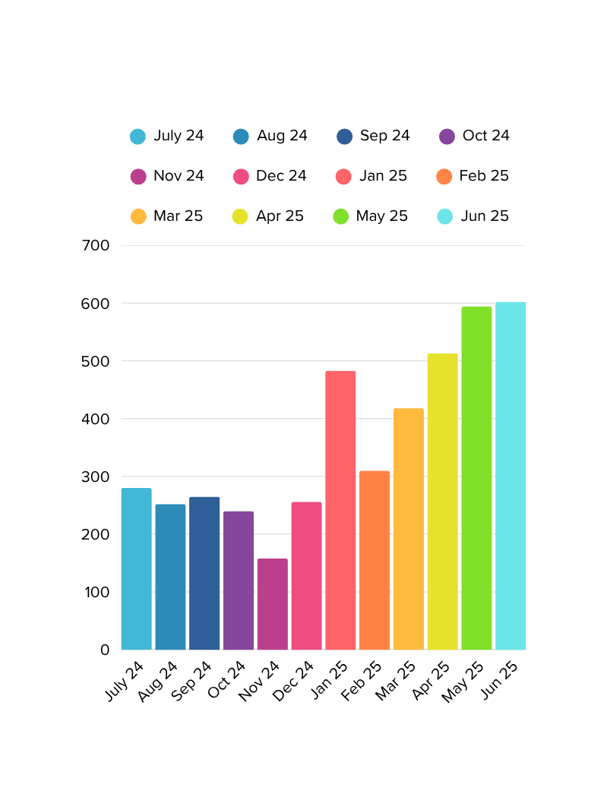

Total Microcredentials Actions Statewide 12 Month Summary
Current snapshot
Operational Microcredentials: 528
Microcredentials in Development: 91
Live Endorsements: 27
Endorsements Coming Soon: 1
MC Reviewers: 170

Slide 7

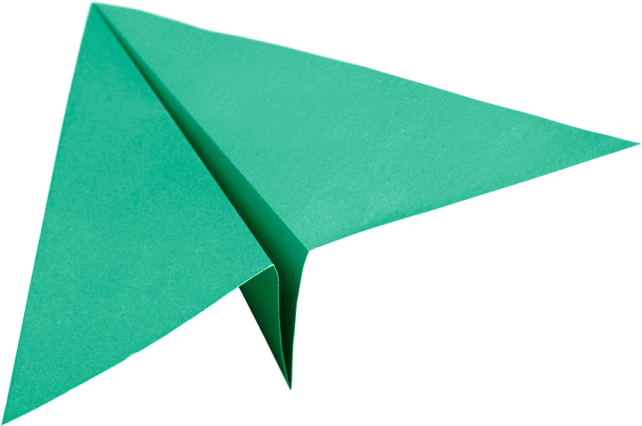


What should you expect?
Time to complete
What to submit
Grading timeframe and process
Rigor
Matters!

Slide 8

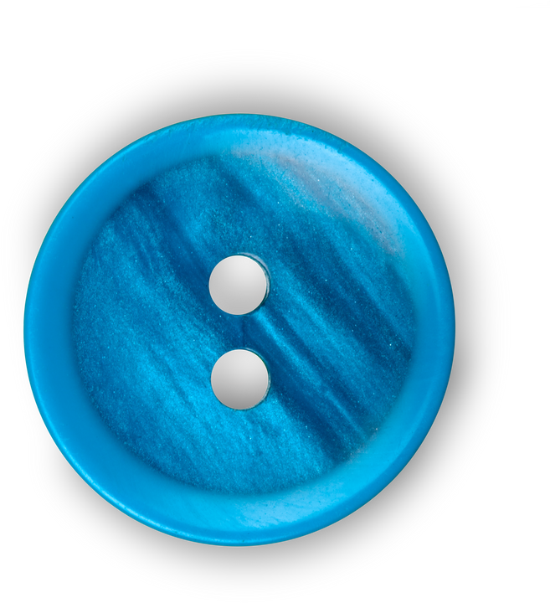


How Do I Earn Utah Microcredentials?
UEN Website
Find info, tutorials, and links
MIDAS Website
Log in to start earning microcredentials.

Slide 9

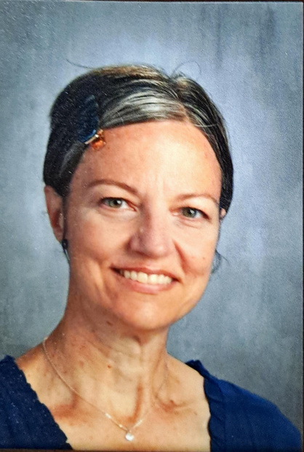
Contact
Amy Coray
UTAH MICROCREDENTIALS MANAGER
ACORAY@DSDMAIL.NET
801-402-5173

Slide 10
Thank You

