Slide 1
Building Foundations: Strategies for Successful Early Learning Instruction
Utah Rural Schools Association (URSA)
2025 Summer Conference
July 10, 2025
Notes:
Cristina
Thursday, July 10, 2025, 11:10 am - 12:10pmMDT, Room #142
This presentation, "Building Foundations: Strategies for Successful Early Learning Instruction," addresses the critical issue of opportunity gaps in early learning and offers strategies to improve educational outcomes for all students. It emphasizes the importance of shifting from a deficit mindset to one that recognizes and addresses the root causes of these gaps.
The presentation highlights the role of high-quality practices and individualized instruction in creating supportive and inclusive learning environments. It also highlights the importance of understanding cultural context, aligning curriculum with the Utah Core State Standards for Early Learning, and utilizing data-driven instruction to personalize learning and enhance teacher effectiveness.
By providing educators with actionable strategies and promoting a deeper understanding of the factors contributing to opportunity gaps, this presentation equips them to create successful learning experiences for all children, ultimately closing the opportunity gap and fostering a brighter future for Utah's youngest learners.

Slide 2

Welcome and Introductions
Notes:
Cristina

Slide 3
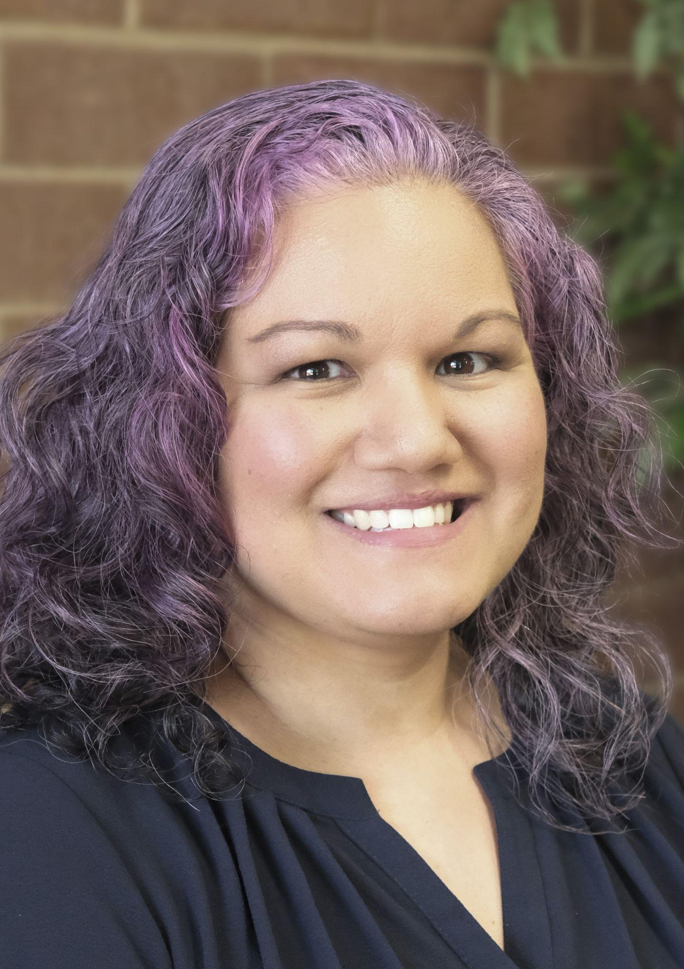
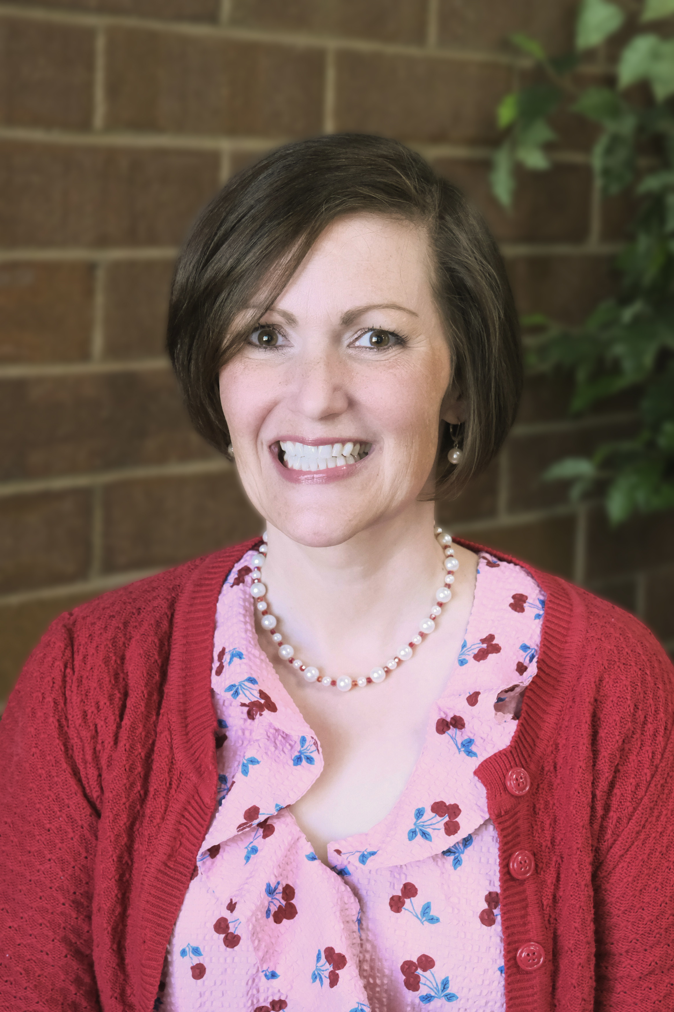
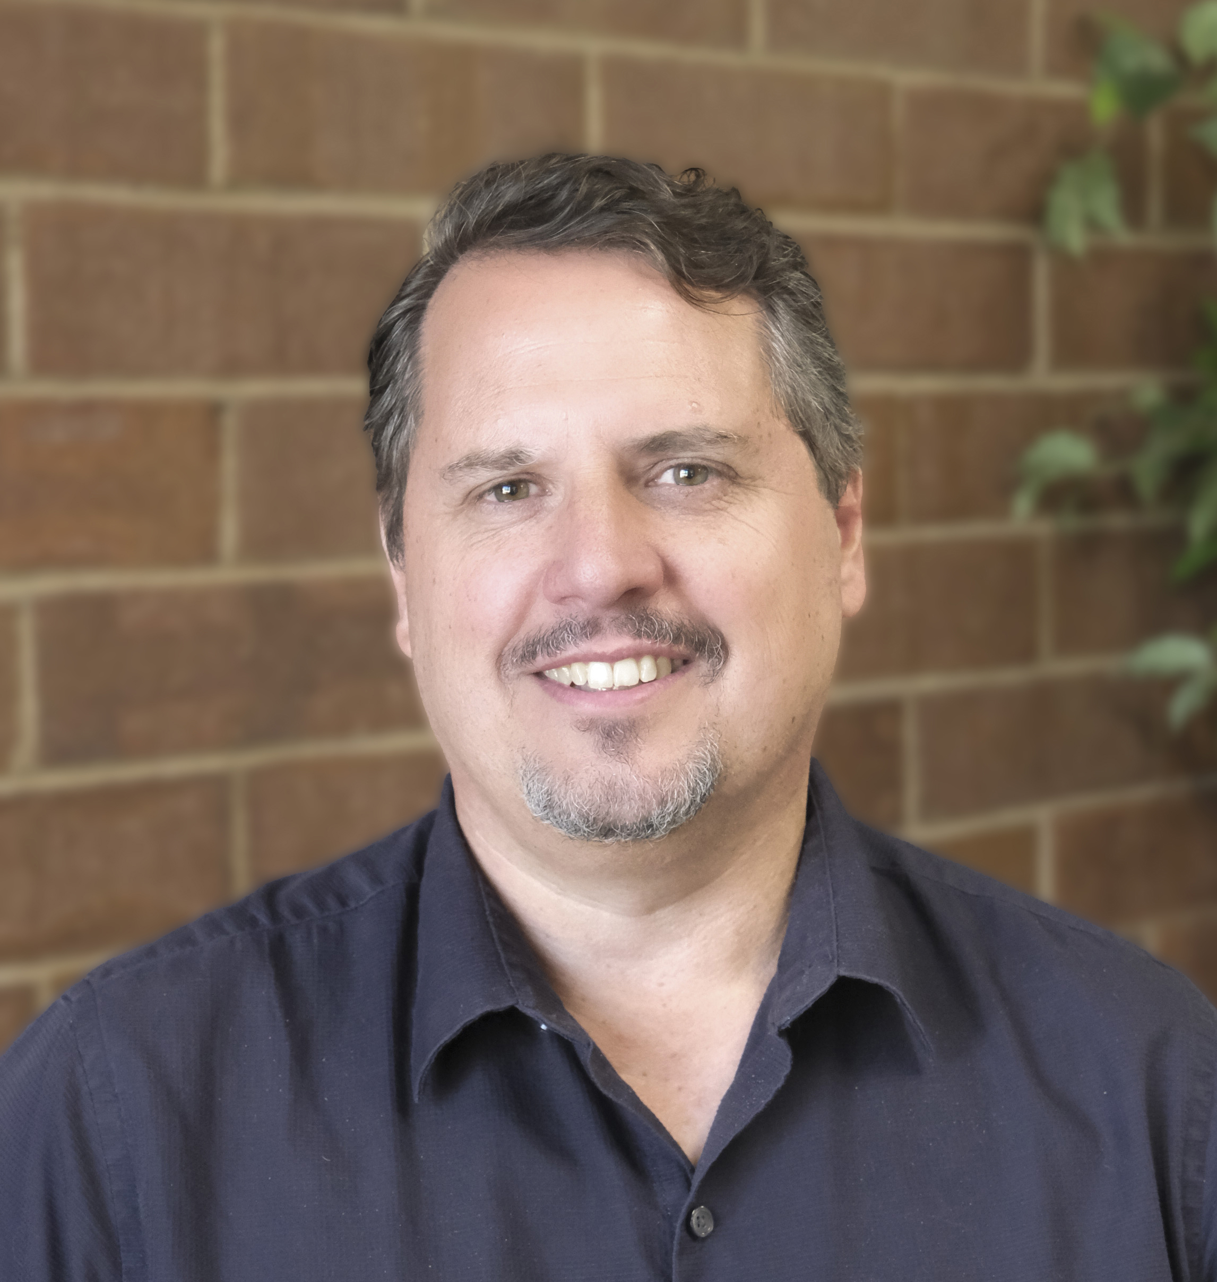
USBE Preschool Education Team
Cristina Barrera, M.Ed.
Katrina
Herd, Ed.D.
Jared
Lisonbee, Ph.D.
Notes:
Cristina
We all share background and experience
cristina.barrera@schools.utah.gov
katrina.herd@schools.utah.gov
jared.lisonbee@schools.utah.gov

Slide 4

URSA 2025 Resources Shared Library from USBE's Preschool Education Specialists (Scrible.com)
https://tinyurl.com/URSA2025PKResources
Notes:
Katrina

Slide 5
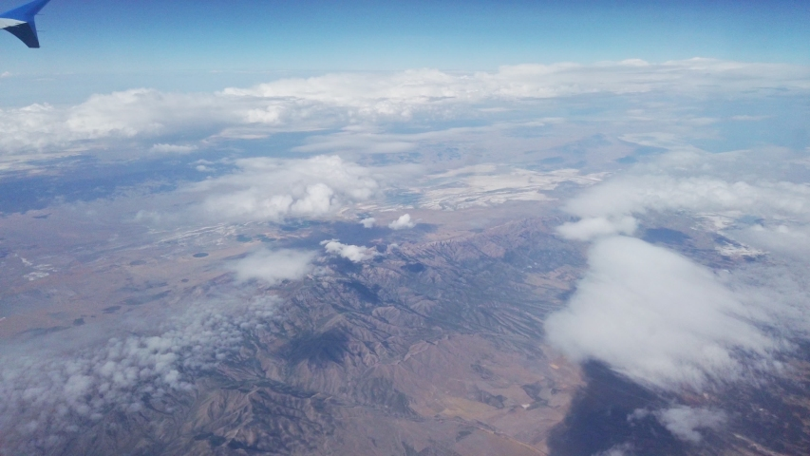
Overview
Notes:
Cristina

Slide 6

Learning Intentions
Understand the Utah Core State Standards for Early Learning for Ages 3-5.
Implement Developmentally Appropriate Practices (DAP).
Recognize the importance of individualized instruction.
Notes:
Cristina

Slide 7
Success Criteria
Participants will be able to:
  Articulate the key components of the Utah Core State Standards for Early Learning for Ages 3-5.
  Demonstrate the ability to implement DAP in their classrooms, fostering belonging, respecting individuality, and creating a safe environment for interaction and learning.
  Recognize the importance of individualized instruction and be able to adjust their teaching methods to meet the diverse needs of all students.
Notes:
Cristina
Utah Core State Standards for Early Learning for Ages 3 to 5
Estándares estatales básicos de Utah para el aprendizaje temprano para edades de 3 a 5 años (Spanish)
English Language Arts (ELA) Standards Core Guide Preschool Age-3 (2023)
English Language Arts (ELA) Standards Core Guide Preschool Age-4 (2023)
Utah State Standards P-12 English Language Arts (2023)

Slide 8

Mind the Gap:
Why Closing It Matters

Slide 9
2024 URSA: Understanding Opportunity and Success Gaps
Achievement gaps reflect disparities in academic outcomes.
Opportunity gaps indicate unequal access to resources and opportunities.
Success gaps lead to negative long-term educational outcomes.
Closing these gaps fosters better community development and individual growth.
Children from low-income families often start school at a disadvantage.
Notes:
This slide summarizes the critical concepts of achievement, opportunity, and success gaps, highlighting the importance of addressing these issues in education. It emphasizes the need for equitable resources, as children from disadvantaged backgrounds often enter school with significant gaps in readiness. Closing these gaps not only benefits individuals but also strengthens communities as a whole.

Slide 10

The Data on Success Gaps
Data-driven instruction improves student outcomes.
Data helps determine student needs and progress.
Data-driven instruction personalizes learning for each student.
Research-based strategies and practices improve teaching methods.
Ongoing professional development based on research and data improves teacher effectiveness.

Slide 11
Why is closing the gaps important?
Build brighter future.
  Offer better opportunities, grow to achieve career aspirations, choices to create best life.
Foster confident communities.
  Closing gaps reduces stigmas/beliefs negatively affecting communities.
Close additional gaps.
  Opportunity gaps run parallel to other inequities. Can be the source, like a network gap.
Notes:
Cristina
Brighter future…
This creates an enhanced quality of life, higher earning potential, and improvements within their communities.
Confident communities…
This gap doesn’t exist because an individual isn’t good or valuable enough and addressing this head-on would help communities and individuals believe in their own potential.
Close add’l
If addressed effectively, closing the opportunity gap would inevitably help bridge the others.

Slide 12

High-Quality Practices
Notes:
Transition: Reducing opportunity gaps by being the ones who “open the door” for at-risk students. Recognizing advantages and disadvantages across groups and working to open the doors for all students.
Implementing DAP, creating positive changes by being inclusive and understanding. DAP can lead to success beyond education.
Teachers need to know DAP to explain and advocate for joyful learning through play, AND support children’s learning
Advocate for high-quality practices with administrators and other stakeholders.
Key components of DAP are culture and equity. DAP cannot exist without them.

Slide 13
Developmentally Appropriate Practices
Acknowledge family expertise and value their input
Build strong relationships with families and communities
Be sensitive to family choices and goals for their child
Consider social and cultural context of child, educator, and program
Plan for DAP by considering commonality, individuality, and context

Slide 14
Effective Teaching Strategies
Implement differentiated instruction to meet diverse learning needs.
Scaffold learning by providing support and gradually releasing responsibility.
Foster a play-based learning environment.
Encourage active learning to promote hands-on experiences.
Utilize technology tools to enhance learning.

Slide 15

Individualized Instruction
High-quality practices acknowledge differences in learning.
Individualized instruction is key to meeting all students' needs.
Move away from one-size-fits all learning models.
Understand what contributes to learning differences.
Adjust teaching to meet all students' learning needs.

Slide 16

Utah Early Learning Standards
Foundation for ensuring learning in the classroom.
They drive high-quality instruction for all students and outline essential knowledge, concepts, and skills.
The standards are aligned to scientifically based content standards.
USBE updates standards regularly with field experts.
Parents, teachers, and local school boards control curriculum choices.

Slide 17
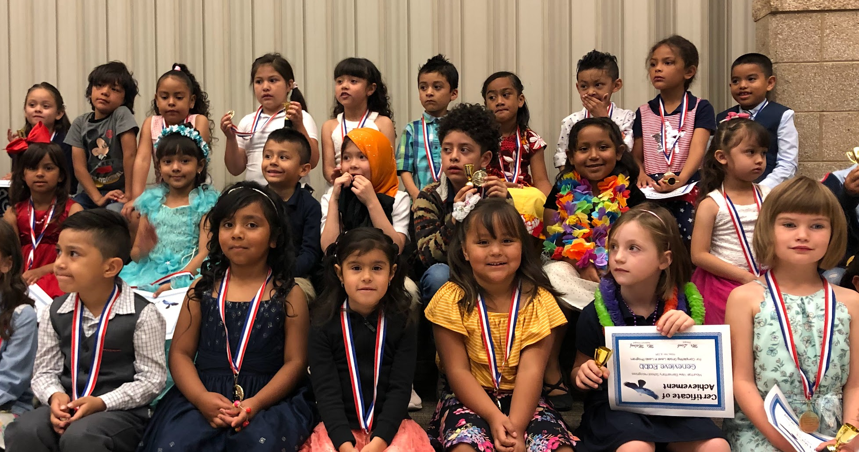
Educational Outcomes
Notes:
Katrina
Ask any parent, What are your hopes and dreams for your child?
Probably they won’t say “Show 80% growth in their reading scores from kindergarten to first grade.”
But they will say…
Achievement gap shows up by Age 3
Without addressing the achievement gap, the achievement gap grows over time

Slide 18




Funds of Knowledge
Write a nonfiction story about a boat.
Notes:
Katrina’s boat story

Slide 19
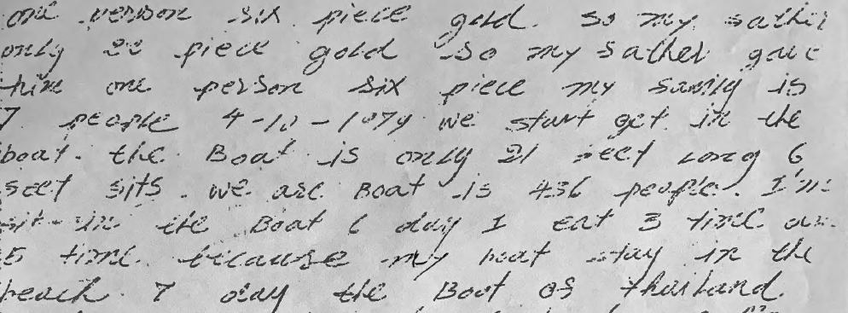
One person six piece gold. So my father only 22 piece gold. So my father gave him one person six piece my family is 7 people. 4-10-1979 We start get in the boat. The boat is only 21 feet long 6 feet sits. We are boat is 436 people. I’m in the boat 6 day I eat 3 time (over) 5 time because my boat stay in the beach 7 day the boat of Thailand.
Notes:
So what do we DO with this?
All students have funds of knowledge. It is our job as educators to (1) Discover their currency; (2) Understand where and how it fits in our classrooms, (3) Draw clear connections, (4) Give students time and opportunity to use their currency and increase their funds

Slide 20
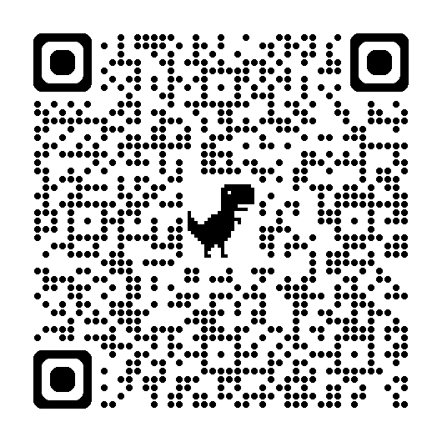
ACES, Risk & Protective Factors
Adverse Childhood Experiences (cdc.gov/aces/about)
Community Protective Factors
Children who have caring adults outside the family who serve as mentors or role models.
Children who have positive friendships and peer networks.
Communities where families have access to high-quality preschool.
Communities where families have access to safe, engaging after school programs and activities.
Communities where residents feel connected to each other and are involved in the community.
ACES Quiz (npr.org)
Notes:
ACES increase when risk factors are present. Protective Factors literally protect against risk factors, reducing the likelihood of ACES being perpetuated.
Educators ARE a PF
Knowing all this, holding space for risk factors AND funds of knowledge, what do we do next? Our first job is to acknowledge where these things show up in the data.

Slide 21
Aligning Instruction with Standards

Slide 22
Instructional Design
Lesson plan- Curious George: Sail a Boat
Grades: PreK-K
Children explore wind power and recycling by building toy boats from reused materials, inspired by a Curious George video.
They plan, predict, and experiment as they test their boats and brainstorm other ways to recycle in the classroom.
Notes:
https://utah.pbslearningmedia.org/resource/cg8.sci.lpsailboat/curious-george-sail-a-boat-lesson-plan/

Slide 23
Standards Alignment
Science: The Science standards are founded on what science is, how science is learned, and the multiple dimensions of scientific work.
Strand 3: Living Things
  Living things (humans, animals, and plants) depend on their surroundings to get what they need, including food, water, and shelter, to survive. Behavior patterns between parents and offspring can help humans and animals to survive.

Slide 24
Standards Alignment
Science: The Science standards are founded on what science is, how science is learned, and the multiple dimensions of scientific work.
Strand 3: Living Things
    Standard 3-4 yr.3.2
      Obtain and communicate information about the pattern between living things and the places where they live. Emphasize that living things need water, air, and resources, and they live in places that have the things they need to survive.

Slide 25
Instructional Design
Transportation: Uncovering America
Grades: PreK-K, K-2, 3-5
In this image set and suggested activities, students learn about how transportation has changed and developed over time, and they will practice thinking critically about modes of transportation.
How does transportation affect our daily lives?
What can we learn about transportation and travel from works of art?
Notes:
https://utah.pbslearningmedia.org/resource/transportation-lesson-plan/uncovering-america/

Slide 26
Standards Alignment
Lesson Plan Alignment Chart
Lesson Activities | Corresponding Utah Early Learning Standards
Watch a video about transportation and community helpers. | English Language Arts (ELA)
Discuss different modes of transportation. | Social Studies (SS)
Draw or build models of vehicles. | Fine Arts (FA)
Explore how transportation connects people and places. | Social Studies (SS)
Engage in observation and creative expression. | Lifelong Learning Practices (LLP)– Approaches to Learning
Use tools and materials to design and build vehicles. | Science (S)
Observe and describe how vehicles work. | Science (S)
Express understanding through drawing or writing. | English Language Arts (ELA)

Slide 27
Standards Alignment
Vertical alignment with Kindergarten?
First grade?
Second grade?
Third through fifth grade?
Notes:
Katrina

Slide 28

Final Thoughts?
Notes:
Cristina

Slide 29
Review: Learning Intentions
Understand the Utah Core State Standards for Early Learning for Ages 3-5.
Implement Developmentally Appropriate Practices (DAP).
Recognize the importance of individualized instruction.
Notes:
Cristina

Slide 30
Review: Success Criteria
Participants will be able to:
  Articulate the key components of the Utah Core State Standards for Early Learning for Ages 3-5.
  Demonstrate the ability to implement DAP in their classrooms, fostering belonging, respecting individuality, and creating a safe environment for interaction and learning.
  Recognize the importance of individualized instruction and be able to adjust their teaching methods to meet the diverse needs of all students.
Notes:
Cristina
Utah Core State Standards for Early Learning for Ages 3 to 5
Estándares estatales básicos de Utah para el aprendizaje temprano para edades de 3 a 5 años (Spanish)
English Language Arts (ELA) Standards Core Guide Preschool Age-3 (2023)
English Language Arts (ELA) Standards Core Guide Preschool Age-4 (2023)
Utah State Standards P-12 English Language Arts (2023)

Slide 31

Want to stay connected?
USBE Preschool Newsletter Sign Up
  In collaboration with Utah Education Network (UEN), we created an email subscriber list for all early childhood professionals across the state.
  Subscribe to stay up to date on early care & education happenings and professional learning opportunities.
Notes:
Cristina

Slide 32

2025 Utah Preschool Conference
Bridging the Gap:
Building Stronger Connections for Early Learning Success
This year’s free and virtual event invites early learning educators and professionals to come together for two days of powerful conversation, inspiration, and collaboration.
Notes:
Cristina

Slide 33
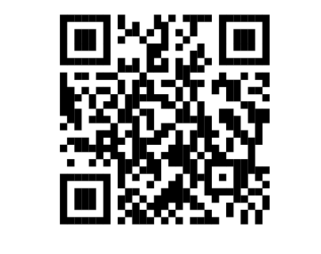

Joyful Journeys: Utah’s Preschool Community
This USBE private Facebook group is the go-to place for early childhood education professionals!
Notes:
Cristina

Slide 34
References
Reframing Educational Outcomes, CBE
Opportunity Gap
Success Gaps Toolkit
Why We Say “Opportunity Gap”...
Definitions of Key Terms, NAEYC
DAP Position Statement, NAEYC
DAP: K-3 Resources | NAEYC
Background for Advocates/Educators Supporting DAP
Utah Core Standards for Early Learning (Ages 3-5)
The Opportunity Gap Conversation
Notes:
Reframing Educational Outcomes: Moving beyond Achievement Gaps | CBE—Life Sciences Education
Opportunity Gap
Success Gaps Toolkit: Addressing Equity, Inclusion and Opportunity
Why We Say “Opportunity Gap” Instead of “Achievement Gap”
Definitions of Key Terms | NAEYC
Developmentally Appropriate Practice (DAP) Position Statement | NAEYC
DAP: K-3 Resources | NAEYC
Background for Advocates and Educators Supporting DAP
Utah Core Standards Early Learning (Ages 3-5)
The Opportunity Gap Conversation
https://ideadata.org/toolkits/resources/

