Slide 1
Writing Instruction for Grades K-2
URSA 2025
Christine Elegante: K-3 Literacy Specialist
Notes:
To be completely literate a child needs to be able to not only read, but also write. If we don’t explicitly teach them to write we are not setting them up for success.

Slide 2

Meet Your Presenters
Name: Christine Elegante
Employment: Utah State Board of Education, K-3 Literacy Specialist
Education: Bachelor of Science in Elementary Education, Master of Science in Curriculum and Instruction
Job History: Fourteen years teaching from preschool through sixth grade, five years at the Utah State Board of Education
When I’m not working: I enjoy traveling with my family.

Slide 3
Learning Intentions:
Success Criteria:
Understand the importance of writing.
Learn evidence-based strategies for teaching writing in the foundational grades..
Implement new practices in writing instruction.
Use evidence-based strategies for teaching writing in the foundational grades. .
Notes:
Assigning writing isn’t teaching writing. And having students write a lot is not teaching writing. That would be like putting a lot of books in a class for students and believing that they will magically begin to read.

Slide 4

“Combining reading and writing is part of the Science of Reading… If you want better reading scores, the Science of Reading says do not neglect writing, or dispatch it to someplace else in the curriculum. When you feel especially pressured to improve reading achievement, that is the time to embrace more tightly the combination or reading and writing.”
–Tim Shanahan
Literacy Researcher and Writer

Slide 5

General Writing Research Findings
-Graham et al. 2012 and Graham, Harris, Santangelo 2015)
Provide daily time for students to write.
  establish writing routines
Teach students to use the writing process for a variety of purposes.
Teach students to become fluent with handwriting, spelling, sentence construction, typing, and word processing.
Create an engaged community of writers.
  collaboration
  feedback
Notes:
There are two research reports based on meta-analysis of research on effective elementary writing instruction. These are their findings.

Slide 6
Gradual Release of Responsibility
I | introduce, provide/activate background knowledge | The teacher describes the skill, strategy, or technique and explains what it is, how it works, and why it supports writing.
 | model the strategy, use think aloud | The teacher models writing and how the skill, strategy, or technique is used through shared, interactive writing that includes demonstration, think aloud, soliciting ideas from students, and providing examples.
We | collaborative use | Students work in small groups or pairs to practice applying the skill, strategy, or technique. The teacher is the guide from the side.
 | guided practice | Students practice the skill, strategy, or technique with assistance from the teacher as needed.
You | independent use | Students apply the skill, strategy, or technique independently.

Slide 7

Writing Simulation
Write about your July holiday traditions.
Use your dominant hand.
Write until told to stop.
Notes:
Write for 1 minute

Slide 8
Writing Simulation
Write about hosting a barbeque.
Use your non dominant hand.
Write until told to stop.
Notes:
1 minute to write

Slide 9

Discussion
How did that make you feel?
What did you learn?
Was one harder than the other? If so, why?
How can that help you to relate to your students experience with writing?
Notes:
Have a conversation about how you felt, what can you learn

Slide 10

“The research is convincing across the board: Handwriting is important to the writing process, and direct, explicit handwriting instruction makes fluent handwriting happen. Compellingly, handwriting instruction also positively affects reading skills.”
-William Van Cleave
Educational Consultant, Teacher, and Administrator

Slide 11
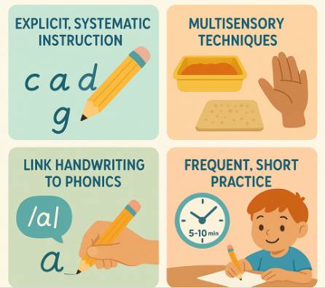
Handwriting Foundations
Explicit, systematic instruction: Teach letter formation in a clear, sequenced manner (e.g., start with letters that use similar strokes like c, a, d, g).
Multisensory techniques: Use sand trays, skywriting, or tactile surfaces to reinforce motor memory.
Link handwriting to phonics: When teaching a phoneme, have students write the corresponding grapheme. This reinforces the sound-symbol connection.
Frequent, short practice: Daily 5–10 minute sessions help build automaticity without fatigue.
Notes:
We can’t leave kids to develop their own approach for forming letters and we can’t just assume children will learn the most efficient ways for letter formation. Once a motor pattern is developed or established, it is really difficult to change it.

Slide 12

Strategies for Teaching Handwriting
Morning Message/Bell Work:
Idea: Model a letter or word, then have students practice it in their journals or on whiteboards.
Name Writing:
Idea: Consistent, daily practice of writing their own name correctly.
Labeling and Captions:
Idea: When drawing, encourage students to label their pictures, focusing on legible letters.
Short Dictation:
Idea: Dictate a few high-frequency words or a simple sentence for students to write, emphasizing neatness.

Slide 13

“Automaticity of letter writing is the single
best predictor of length and quality of written
composition in the primary grades.”
-Graham

Slide 14

Typical Progression for Beginning Composing
Scribbling random marks on a page
Drawing illustrations
Dictating ideas and thoughts to a teacher who scribes
Labeling objects and illustrations, lists of words
Combining words and pictures
Adding phrases and sentences
Notes:
As students enter kindergarten, they can be anywhere on this progression. Use a mentor text (Pete the Cat) to illustrate these writing practices.

Slide 15
Drawing
Model how drawing can be used to share ideas and stories
  Think/plan
  Write
  Revise
Provide explicit instruction on drawing basic shapes
Guide students in combining shapes and adding details to better convey their messages
Encourage students to orally share
Notes:
If we want students to share their ideas through drawing, there are some things that we need to do. Teachers need to model how to draw using the stages of the writing process. We can’t assume students know how to draw or draw well enough to express their ideas.
do an activity teaching drawing with basic shapes and then use that drawing to label

Slide 16
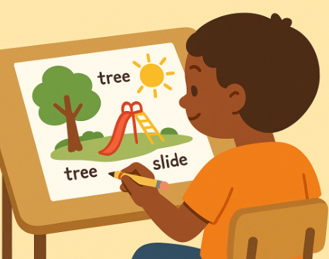
Labeling Strategies
1. Connect to Oral Language and Vocabulary
Use real objects or pictures and model naming them aloud before writing.
Use sentence frames to scaffold oral to written language.
2. Phoneme-Grapheme Mapping
Stretch out the word orally (e.g., “d-o-g”) and map each sound to a letter.
Use Elkonin boxes or sound boxes before writing the label.
3. Scaffold with Guided Drawing
Have students draw a scene and label parts.
Model how to listen for sounds and write what they hear.

Slide 17

Drawing and Labeling Activity
Notes:
Hand out an empty sheet of paper and do a quick drawing to go with the Narwhal book. do an activity teaching drawing with basic shapes and then use that drawing to label

Slide 18
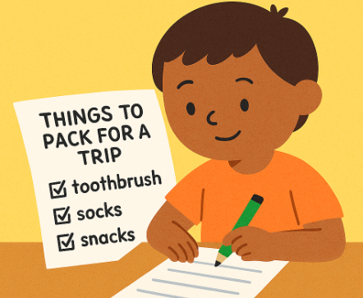
List Writing Strategies
1. Purposeful Lists
Tie to real-life contexts: grocery lists, “things I see in spring.”
Use sentence stems like: “I need ___.” or “I see a ___.”
2. Sound-Spelling Support
Encourage invented spelling with phonics support
3. Sentence Expansion from Lists
Turn list items into full sentences: “Apple” → “I like apples.”
Use sentence starters to build from lists.
4. Repeated Practice with Routines
Make list writing a daily or weekly routine
Use shared writing to model and then move to independent practice.

Slide 19
Sentences
Sentences
Teaching sentence Basics
Developing Syntactic Awareness
Two Sentence Parts
Four Kinds of Sentences
Sentence Scramble
Sentence Combining
Sentence Elaboration
Notes:
Students need explicit instruction about basic parts of speech, basic parts of a sentence, the four kinds of sentences, and sentence punctuation. Students also need to be taught Syntactic awareness which is the ability to understand and manipulate the grammatical structure of sentences. It involves recognizing how words are ordered, how they relate to each other, and how different sentence structures convey meaning. This understanding is crucial for both comprehending spoken and written language and for producing clear and coherent communication.
Teaching sentence skills begins in kindergarten who are using simple sentences and moves on up to the older grades where students are writing more sophisticated sentences.

Slide 20
Teaching Sentence Basics
Two Sentence Parts
Four Kinds of Sentences
Matching Two Sentence Parts
Add a Sentence part
Sorting: Sentence or Fragment
Sentence sorts
Change the sentence
Create and write sentences based on a read aloud

Slide 21
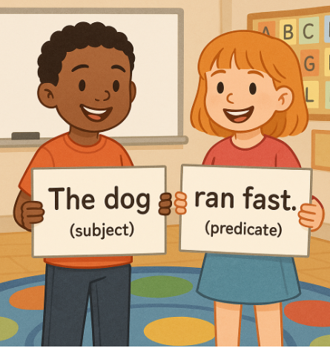
Sentence Matching Activity
Find a match
Read the whole sentence
Switch pieces with the person
Go find another match.
Notes:
2 minutes, then talk about how to scaffold the activity or extend it.

Slide 22
Change the Sentence Activity
Turn the statement into a question. (?)
  Narwhals can live up to 90 years.
Turn the question into a statement. (.)
  What is a group of jellyfish called?
Turn the question into a command or exclamation. (!)
  Does a narwhal live in a pod?

Slide 23
Sentences
Sentences
Teaching sentence Basics
Developing Syntactic Awareness
Two Sentence Parts
Four Kinds of Sentences
Sentence Scramble
Sentence Combining
Sentence Elaboration
Notes:
There are three different types of activities that help students develop syntactic awareness: sentences scrambles, sentence elaboration, and sentence combining.

Slide 24
Developing Syntactic Awareness
Sentence Scramble
Sentence Elaboration
Sentence Combining
Kernel sentences
Because, but, so
Use questions
Fragment or sentence
Notes:
We’re going to spend the rest of our time looking at sentence elaboration. Sentence combining will be discussed in the writing 3-6 presentation that is after this one.

Slide 25

Sentence Expansion: Kernel Sentences
The kernel must be a complete sentence
Avoid using commands
Choose question words:
  Who?
  What?
  When?
  Where?
  Why?
  How?

Slide 26

Kernel Sentences –Let’s Try It!
Sentence: Narwhal swims.
Where?
How?
Why?
Your sentence:

Slide 27
Because, But, So
You can do this activity orally as a scaffold.
Give students sentence stems and have them turn them into 3 separate sentences using each conjunction.
Ensure they understand the meaning of each conjunction.
because explains why something is true, why something happened, or why a certain condition exists
but indicates a change of direction
so tells us what happens as a result of something else-a cause and its effect
Notes:
(7-8 mins) pg.78 WHY Page 78
meaning page 79
15 mins do activity then plan it for their week
After reading the story “The Real Story of Stone Soup” instead of asking a question like What does the uncle think of the boys…and get the answer Lazy, change it to this idea of because, but, so
you could have your students answer these sentence frames. You can do it orally or written depending on the level of the students.
You could also do this with teachers looking at data or instruction
The data shows _____, because
The data shows _____, but
The data shows _____, so

Slide 28
Because, But, So- Let’s try it!
Teach the vocabulary word pod from the Narwhal story.
  Narwhals travel in groups called pods.
Narwhal was looking for his pod because_________________
Narwhal asked Jelly to join his pod but_________________
Narwhal was missing his pod so_________________
Notes:
How does using this help students dive deeper into the content then just writing the meaning of the word down. Where else could you use this activity.

Slide 29
Think-Pair-Share
One strategy that you plan on trying this upcoming school year

Slide 30
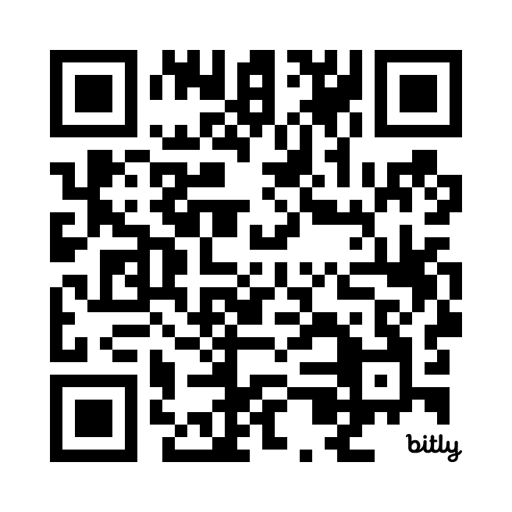
Learning Intentions:
Success Criteria:
Understand the importance of writing.
Learn evidence-based strategies for teaching writing in the foundational grades.
Implement new practices in writing instruction.
Use evidence-based strategies for teaching writing in the foundational grades.

Slide 31
