Slide 1

Teaching with
Fostering Compassion and Hope in Every Classroom

Slide 2
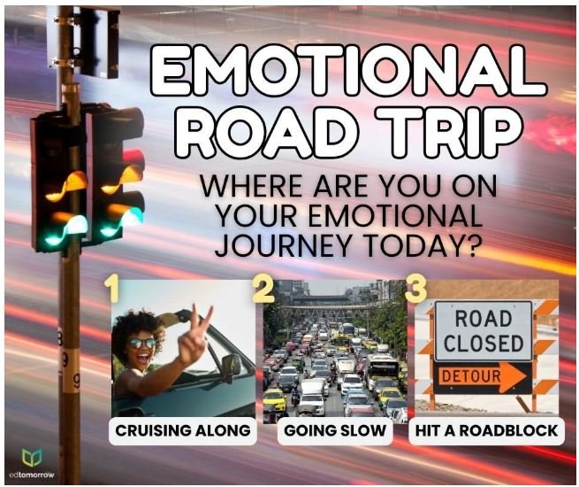

Slide 3
Overview
Why compassion and hope in the classroom
What are compassion and hope
How to implement both compassion and hope every day

Slide 4

Why?
Resilience
  1 in 5 students struggles with mental health challenges
  80.5% of teens experiencing 1 or more ACE
Self-efficacy (belief in one’s abilities)
  1/3-1/2 teens lack self-esteem/confidence
Coping and regulation
Engagement

Slide 5

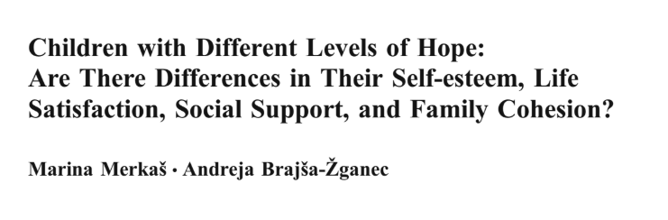

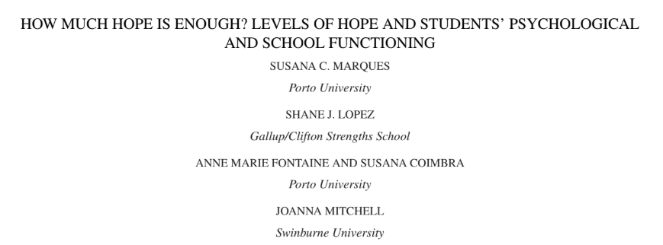
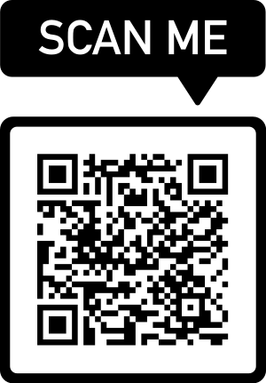

Slide 6

What is COMPASSION?
A sense of care and understanding which involves treating others with kindness and respect, helping to create a safe, supportive, and nurturing space for learning through connection, problem-solving, and improved well-being.
  Empathy and understanding
  Respect and dignity
  Support and care
  Active listening
  Flexibility and accommodations
  Promoting a culture of care

Slide 7
“Compassion is not a virtue – it is a commitment. It’s not something we have or don’t have – it’s something we choose to practice.”
BRENE bROWN

Slide 8

2 X 10
Choose one student you would like to strengthen your relationship
Select when you are going to approach that student (beginning of class hour, at recess, etc.)
Have a 2-minute conversation with the student for 10 days.
  Brevity
  Non-academic
  Honesty
  Reciprocal

Slide 9
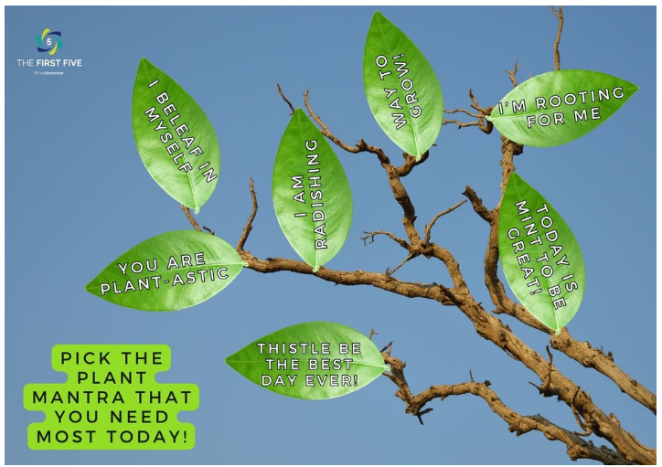
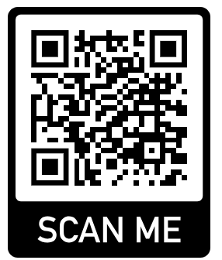

Slide 10
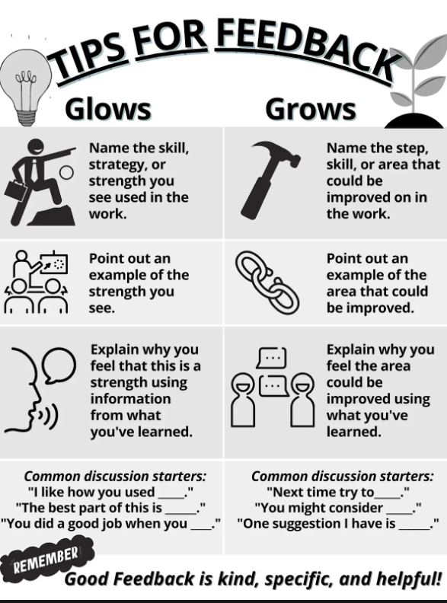
Glows and Grows
Teaching kids to give compassionate feedback

Slide 11

What is HOPE?
A desire accompanied by expectation or belief of fulfillment
  Trust
  Goal oriented
  Optimistic belief
  Determined

Slide 12
Hoping vs. Wishing
Hoping involves a commitment to seeking future outcomes - active
Wishing represents a general want or desire for something in the future - passive

Slide 13
“Hope is the belief that your future will be better than today and that you have the power to make it so.”
Cr. Chan Hellman

Slide 14
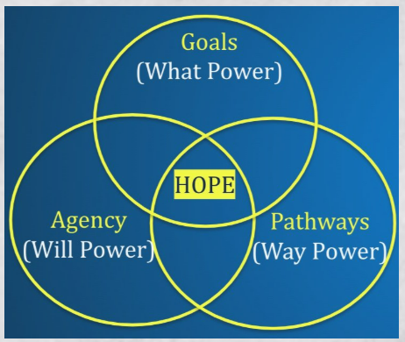
Hope Theory
Psychologist, Dr. Rick Snyder defined hope as a positive cognitive process in which a person has goal-directed thinking that uses both pathways (the capacity to find routes to their desired goals) and agency (the necessary motivation to use those routes).
  Perceived capability to create pathways to desired goals and motivate oneself through agency.

Slide 15
https://www.youtube.com/watch?v=ZuHZhi1B4T4

Slide 16
Examples
A student who is struggling with chemistry shows agency thinking by believing in their ability to improve and pathway thinking by seeking alternative strategies, such as tutoring or YouTube videos that explain chemistry concepts.
A student from a low-income, marginalized community, hopes to become a doctor but faces barriers like limited financial resources, which impact her sense of hope. Her cultural values and family’s belief in education drive her, but systemic inequalities require extra support to help her overcome these obstacles.

Slide 17
“Hope is being able to see that there is light despite all of the darkness.”
Desmund Tutu

Slide 18
3 Good Things
Record 3 good things
  Think about when you worked really hard in class today.
  Think about when you helped a friend today.
  Think about when you did something nice for someone or someone did something nice for you.
  Think about when you tried your best at something today.
  Think about something you did that made you feel really good about yourself.
  Think about a difficult situation that worked out well in the end.
Next, write down what they contributed to the “good things”
  How did you do that?
  What did you do exactly?
  How did you make that happen?
  What did you do to make that happen?

Slide 19

Letters of Belief
At the beginning of the year
  Ask the students to each write a positive letter to themselves
    Tell them you are going to read them for appropriateness, not content
  Ask parent or caregiver to write a letter of encouragement to their child.
Use it on their bad days.

Slide 20
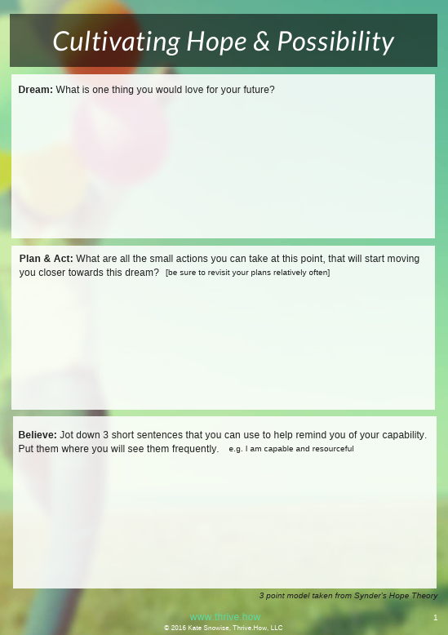
Hope Theory Worksheet
What is one goal you hope to achieve in the future?
What small actions can you take that will start moving you closer towards this goal?
Write down 3 short sentences that will help remind you of your capabilities, for instance, “I am capable and resourceful.”
      Kate Snowise (2016)

Slide 21
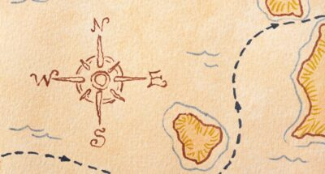
Hope Map
Islands of Importance
  2-3 things that are most important to them (family, friends, endangered animals, etc.) – make each one a separate island
  Next to each island, write 1 sentence on how you can positively impact that island (Create a fund for animal research)
Pick one island to focus on
    Write down 2-3 goals that will help you reach that island
    Rank goals in order of importance
    Break the top goal into steps
    Think about detours they might encounter
    Plan mini-goals and action steps
Reflection – pair/share, gallery walk, etc.

Slide 22
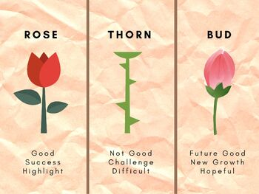
Rose, Thorn, Bud

Slide 23
https://www.youtube.com/watch?v=dlcU5uHMdTM

Slide 24
“We can’t change a child’s home life, but we can change a child’s HOPE in life.”
Cathleen Beachboard

Slide 25

Holly Todd
holly@nucenter.org
435-503-7390

