Slide 1
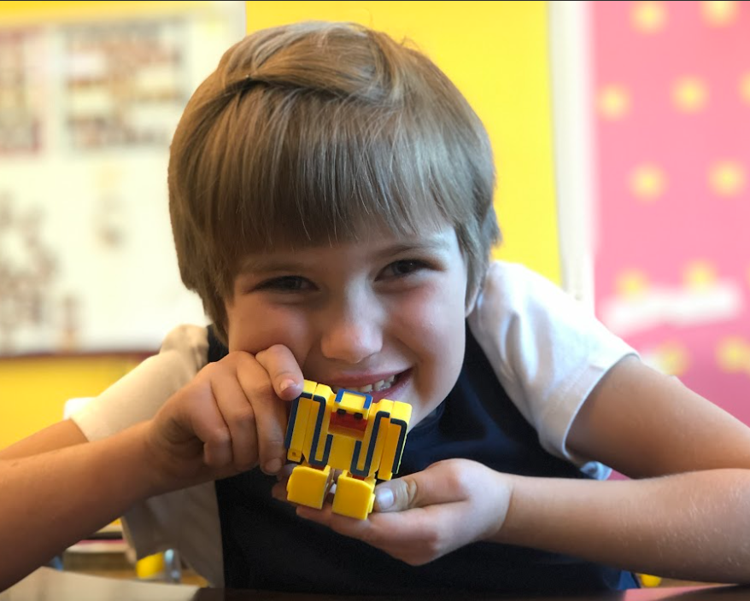
Katrina Herd, EdD
Jared Lisonbee, PhD
Cristina Barrera, MEd
Utah State Board of Education
Preschool Education Specialists
Playful Pathways
Teaching Science of Reading Concepts Using Developmentally Informed Interactions
Notes:
Katrina
During this session, we will focus our energy on beginning to address the challenges of teaching science of reading skills in a developmentally appropriate manner. Discover how these skills connect across different age groups and engage in meaningful conversations about their development. We will define these skills in the context of early childhood development and collaborate on strategies to seamlessly integrate Science of Reading instruction into play-based learning experiences for children.

Slide 2

URSA 2025 Resources Shared Library from USBE's Preschool Education Specialists (Scrible.com)
https://tinyurl.com/URSA2025PKResources

Slide 3

What are we even doing??
Learning Intentions
Review the stages of literacy development
Identify the stages of literacy I most frequently target during instruction
Identify the early learning skills that are the highest indicators of long-term literacy success
Draw meaningful connections from theory to practice
Success Criteria
Identify & describe one or more instructional strategy I can use to build student skills using developmentally informed interactions
Describe how the highest-indicator skills develop across the early grades (preschool – 2nd grade)

Slide 4

Terms for today
The Early Care & Education Garden
EC/ECE
Early Childhood Education
Early Care & Education
Birth-age 8
PK
Preschool, pre-k, pre-kindergarten
Ages 3-5
Developmental Stages
Periods of expected progress marked by milestones
Explicit Instruction
Intentional, planned, purposeful teaching
NOT whole group
K-2
Kindergarten, First & Second Grade
Ages 6-8
Literacy Domains
Reading
Writing
Speaking
Listening
Kindergarten
Preschool
Birth - 3
1 & 2 Grade
Instruction
Developmental Stages
Notes:
explicit instruction can happen in a variety of settings. When does in happen in your classroom?
We see literacy when we look at the bouquet. It’s the outcomes of all of these.
As we talk today, think about the age group You work with, or the group that you are most concerned about.

Slide 5

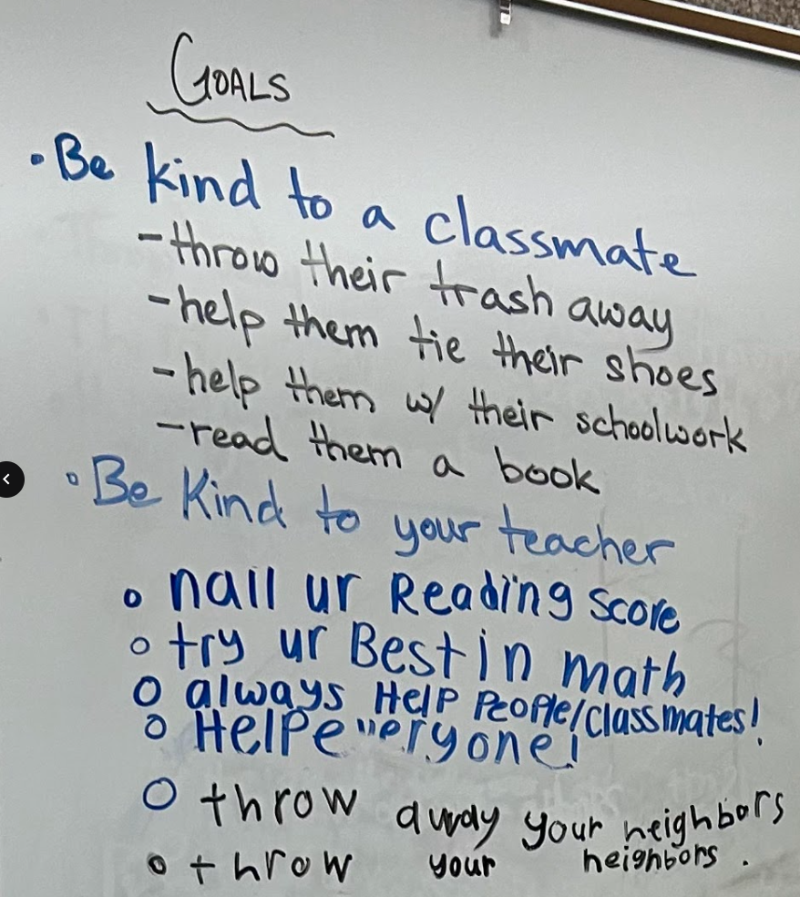
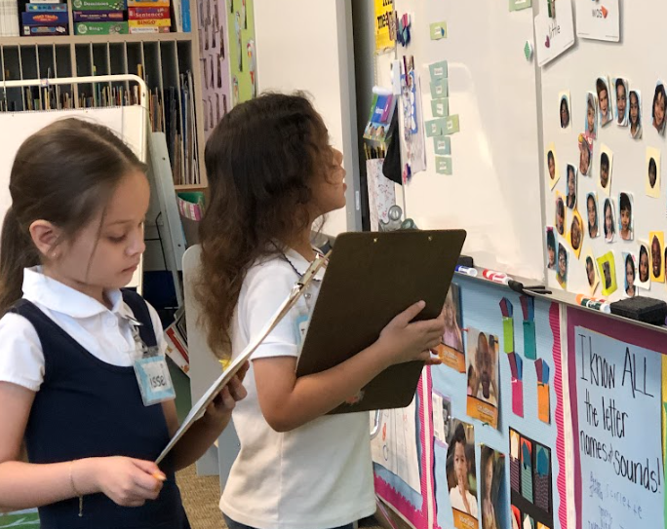
The
Science of
Reading
Develop communicators.
The cognitive neuro- and psycholinguistic
Science of what happens in the brain when
Reading skills are developing.
Notes:
What jumps to mind when you see this title?
The science of HOW to and understand reading
When you know HOW you can teach it.
We are developing humans who can build palaces out of paragraphs.
Foundation of literacy development
Background knowledge for participants
Data-driven instruction: how can you know where you’re going if you don’t know where you are?
Drill down (back up): know the skill that came before. BUILD the skill that came before. “This kid can’t read!” Are you a teacher???
Difference between exposure and mastery

Slide 6

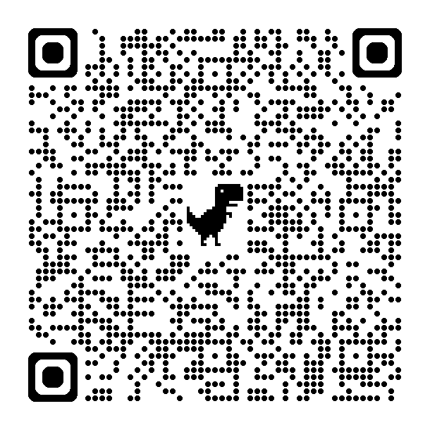

Ages and Stages:
What makes a communicator?
Birth to Three Standards
Early Learning Standards
Kindergarten Standards
Notes:
Cristina
Brainstorm: For the age group you work with, what does it look like when they are a successful communicator?
Make a communication development continuum with post-it notes color code for age group or developmental range.

Slide 7
Predictive Indicators of Learning
Domain | Predictive Indicator
Approaches to Learning | Executive Functioning Emotional Regulation Temperament
Health and Physical | Executive Functioning Visual-spatial skills Precision in movement
Cognitive | Number identification Subitizing Ordinality Executive Functioning
Social/Emotional | Executive Functioning
Language and Literacy | Vocabulary Phoneme Isolation Letter Naming Executive Functioning
Guide to Executive Functioning
Notes:
Cristina
Let’s get a strong footing in WHY we do this.
This chart comes from LETRS-EC. I refer to LETRS-EC because it is currently the most widely-used program for SoR professional development. Disclaimer about endorsing specific programs etc etc.
We want children to be successful, lifelong learners. And we know that there are people in power who are interested in children developing literacy. How we draw the connection between LLL and literacy is how we explain what P-2 literacy development works and why each stage matters.
Of course we could spend our time exclusively on Exec. Funct.
However, we’ll direct our attention to lang&lit skills specifically. Your job will be to identify HOW exec functioning fits into these skills as we go through them.

Slide 8


Alignment?
Today’s Big Ideas:
Vocabulary/Oral Language
Phoneme Isolation
Letter Naming
+Writing
PreK 3 - 2nd Grade Literacy Development
Spreadsheet
Notes:
Katrina
When I say alignment, I mean that we (teachers) know not only what we teach, but we are also aware of what came before and what skill we are building towards after. We’re making sure our ladder rung is stable and strong so students can use it to reach the next rung AND we know what the next rung is they are reaching for. If a child can’t reach the next rung, we know what rung is missing or what rung came before and we can help build up those pieces so that progress can continue.
3 highest predictors are Vocabulary, phoneme isolation, and Letter Naming Fluency (try not to spend too much time linking these to executive function😉).
We’re going to add writing because it can be integrated into the other 3 in ways that benefit both skills together.

Slide 9
The hallmark of developmentally appropriate teaching is intentionality.
LETRS-EC pg. 11 & NAEYC DAP
“Just as explicit, systematic, and sequential instruction is important in the elementary grades and beyond, the same also holds true in preschool settings. The teaching strategies must be developmentally appropriate as well as explicit and intentional, framed within playful learning and intentional play.”
LETRS-EC pg. 6, emphasis added
Informed teachers are our best insurance against reading failure. While programs are very helpful tools, programs don’t teach; teachers do.
Louisa C. Moats, emphasis added
USBE Explicit Instruction Resource
Notes:
Cristina
Programs are written for the middle ladder rung. Only teachers can fill in the rungs in between.
Define “explicit instruction” it is NOT whole group instruction, not drill and kill
https://www.schools.utah.gov/curr/pcbl/Explicit%20Instruction%20-%20ADA%20Compliant%204.19.24.pdf

Slide 10
Vocabulary Development
Notes:
Katrina
Reading fluency takes about 6 years to develop and it's dependent on oral language. (LETRS3)
If you come across a word you have never seen or heard before, it's harder to read the word fluently and automatically.

Slide 11
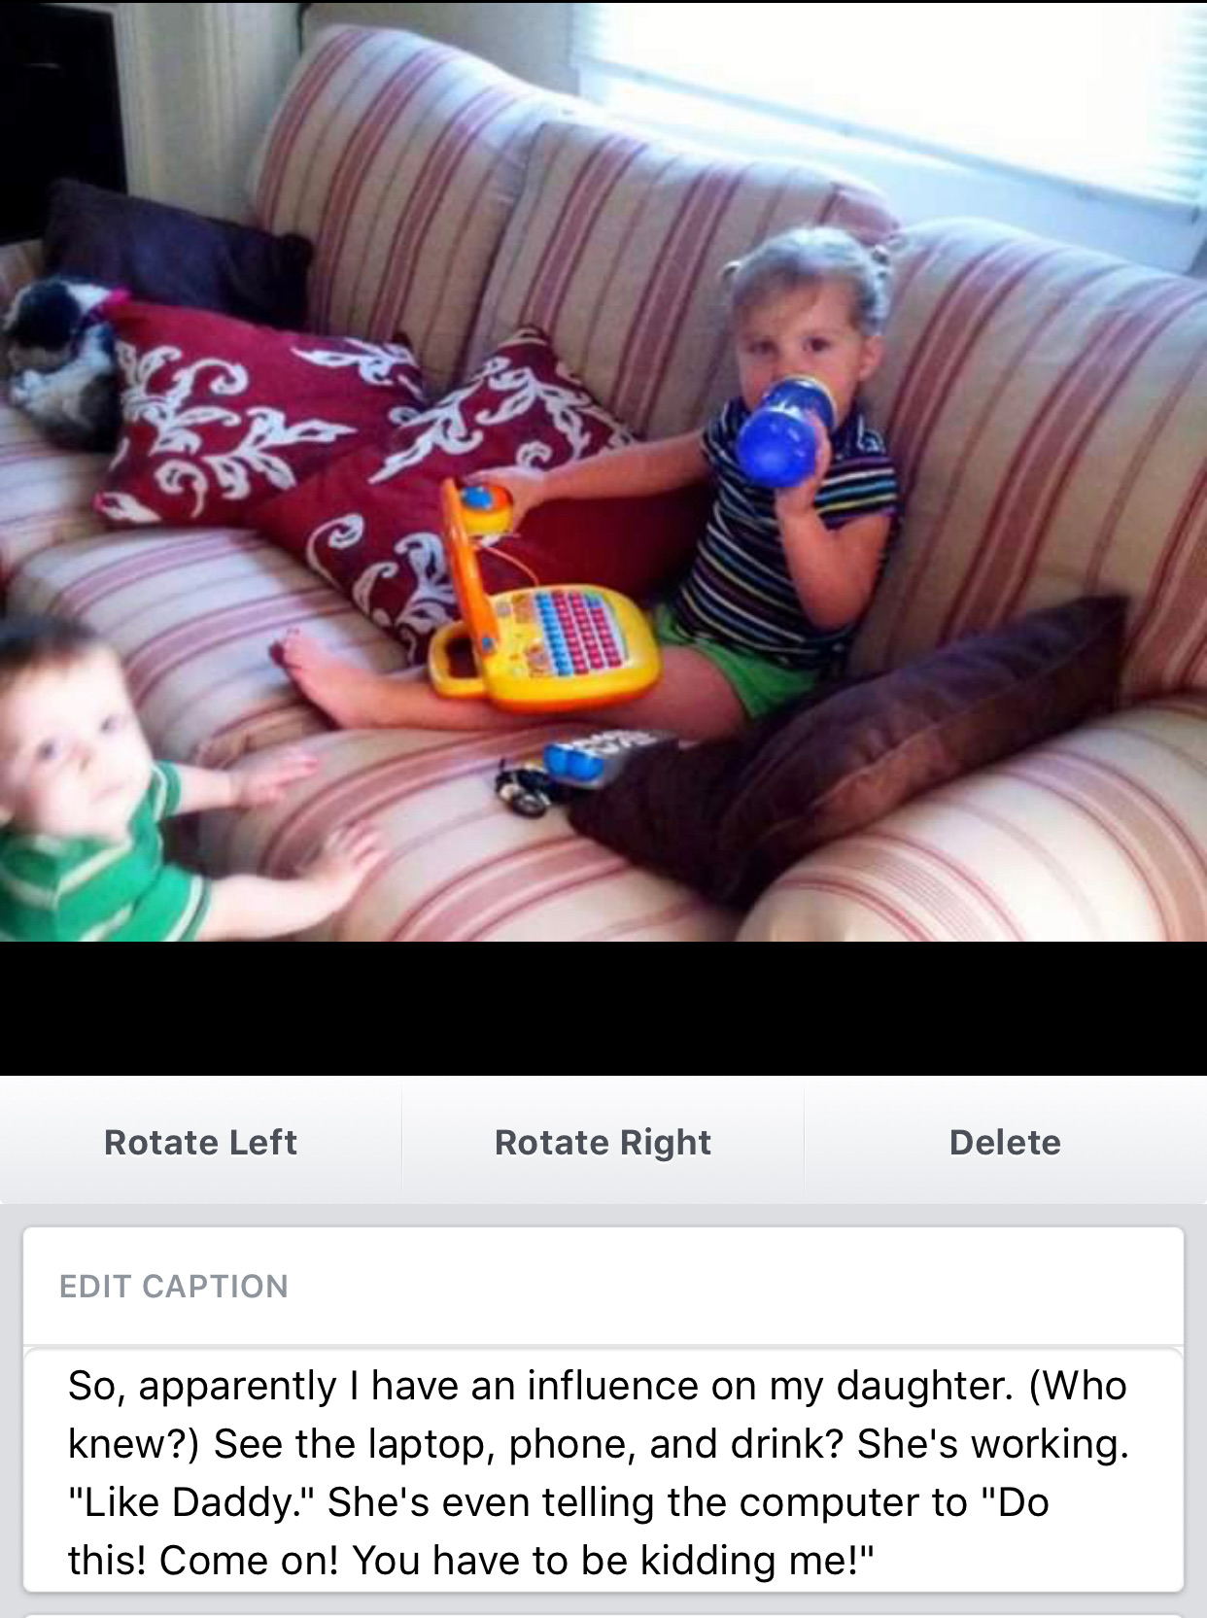
Vocabulary ECE
By practicing social language skills, we learn to understand the intentions, motivations, feelings, and beliefs of the people we communicate with... These skills are building blocks for healthy connections and strong relationships.
Lindsey Pruett-Hornbaker, MA
Notes:
Katrina
Image of Lilah (age 2) and post caption from dad’s facebook page
Have you ever had a kid use a very adult word and it’s surprised you? Of course! We are programmed to hear language and repeat it.
We are WIRED for Oral language development. We are NOT wired for print. It’s the teacher’s job to build a connection between oral language and print. THAT is SoR.
The point? We teach vocabulary all the time. BE INTENTIONAL.
“Flood words”: We aren’t expecting mastery for all children. We’re just putting it out there so children encounter it, in context, many times.

Slide 12
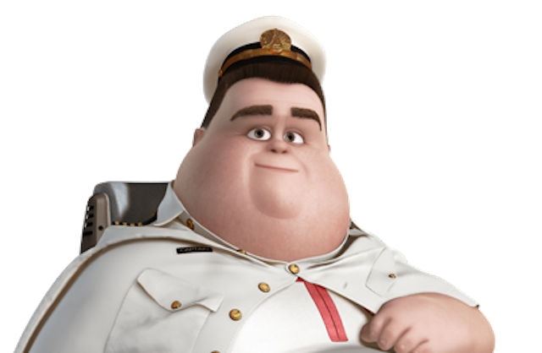
Vocabulary PK
Young children require visual-phonological paired-associative learning—seeing an object, and hearing someone say the label in a meaningful routine—to learn the word…
Caregivers’ intentional interaction is vital to language development.
LETRS-EC pg. 58, emphasis added
Notes:
Katrina
How do we build vocabulary?
Why?
How do we do it intentionally??
https://www.marzanoresources.com/professional-development/vocabulary#conIframewrapp
https://www.region10.org/r10website/assets/File/Six_Step_Process%20Teaching%20Academic%20Vocabulary-%20Marzano(2).pdf

Slide 13
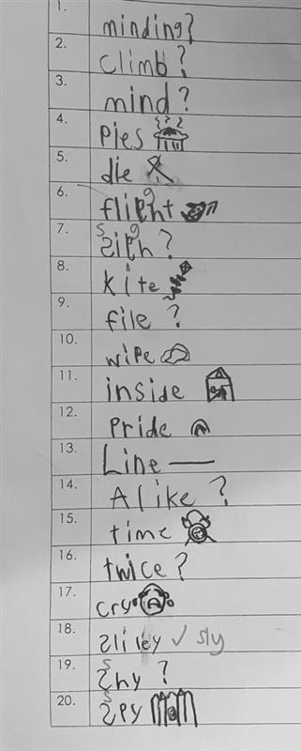
Language acquisition research shows that, to own a word, an individual must be able to:
Describe the word
                It’s like… Goes with… Reminds me of…
            Personalized definition (child-friendly)
            Represent it visually
            Draw a picture
            Show how to use the word
Discuss the word
Use it in a sentence
Ask & answer questions
Notes:
Lorelei’s 4th grade spelling test. Which words does she OWN? This wasn’t planned, but could you plan this? Why and how?

Slide 14
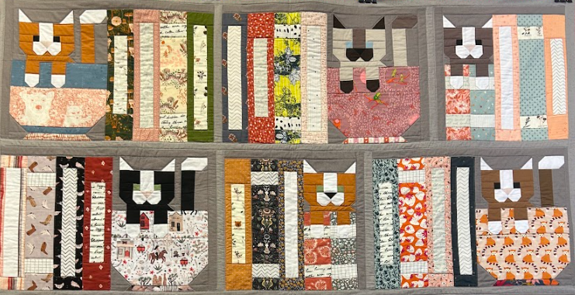
Vocabulary K-2
Comprehension is a condition created over time, defined by purpose, and influenced by prior knowledge.
Dr. Hugh Catts, Science of Reading The Podcast, S9 E4
Notes:
Katrina
You comprehend the pieces when you understand how they fit within the big picture, but you can’t comprehend the big picture without knowledge of all the pieces. For example, I know cat ears can be represented by triangles; books can be represented by rectangles; AND I know that these shapes are representations and not literal. This is the “vocabulary” of this quilt. Without the vocabulary, I can’t understand what the artist has created. Even if I look at the full image, I have to have a base understanding of the vocabulary before I can comprehend.
It’s the same with words. We have to know words before we put them in context. Then, in context, we build better understanding of the words.
https://amplify.com/science-of-reading-the-podcast/
https://www.npr.org/sections/ed/2018/06/01/615188051/lets-stop-talking-about-the-30-million-word-gap
*attire story
*there’s no smokes here!
The #1 influence on comprehension is vocabulary
Foundational for connection sound and grapheme/symbols and context clues
What strategies do we build in preschool that prepare students for the K-2 skills?
Do your students know how to recognize and unfamiliar word? Do they know what to DO when it happens?

Slide 15

See it, then be it.
Kingston's conversation with Me over next season
Nurse Listens Intently as Toddler Takes Charge of Own Medical Appointment
Language we cannot understand by listening is language we cannot understand by reading.
Ludwig Wittgenstein
Notes:
Katrina
Video: choose 1 to watch
While we watch, make notes of what skills are being taught/learned. Why are those skills important? Connect it using the standards crosswalk.

Slide 16

Phonological Awareness
Notes:
Cristina

Slide 17
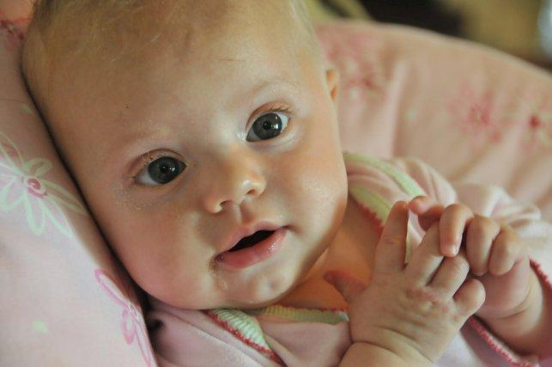
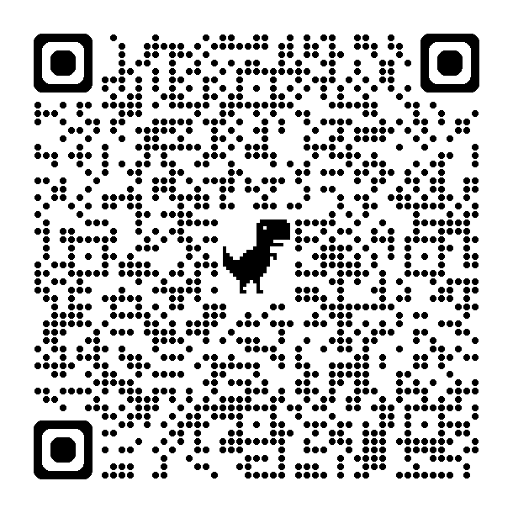
Phonological Awareness ECE
Oral language development is the foundation for literacy.
The purpose of phonological awareness is to establish mental “parking spots” into which the letters in print can be slotted for later recall.
Life Long Learning Standard P 3 / 4.1.2
Notes:
Cristina
Possible analogy to a car/parking lot here.
Phonological awareness: “phono”=sound (telephone, phonograph, etc.)
Awareness: Executive functioning: tuning in to key elements while tuning out input that does not matter (executive functioning).
The bottom line here is to help children associate sounds with representations. Cow says “moo” is one step on the pathway to A says /a/. We also need to build up the child’s understanding that sounds communicate. When they make a sound, we respond. Sounds make words and words make meaning.

Slide 18
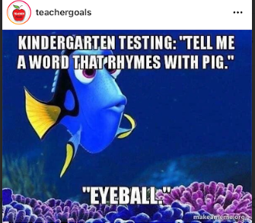
Phoneme Isolation PK
Phonological processing: Multiple functions of speech and language perception and production such as
perceiving,
interpreting,
storing (remembering),
recalling or retrieving, and
generating the speech sound system of a language.
(LETRS-EC pg. 91)
Notes:
Katrina
This image is silly, yes. AND it’s an indicator that there’s perhaps something missing in the child’s developing connections. The question is, is it a gap of understanding or a gap needing intervention?
This is where we need to think: what are the rungs around phoneme isolation and which rungs are loose or missing?
A sound disappears, articulation is the concrete. Notice what your mouth looks like, how your tongue feels, where your lips move
What parts of phonological processing do the children in your classroom engage in most often?
Where can you take that skill next?
(toddlers and infants repeat sounds of animals, cars, spitting, etc. Where do 3 year olds build on that repetition?)
This skill is, in my mind, the easiest to play with because children love how silly you can be.
Bubble gum bubble gum in a dish
Banana name game
Miss Mary Mack & other clapping games
Going on a picnic
How do we do it intentionally??

Slide 19
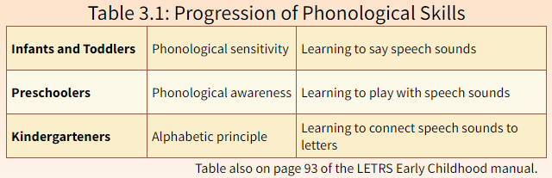
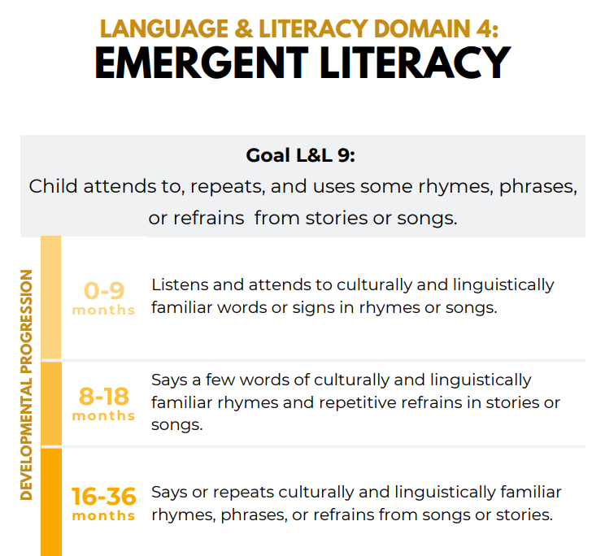
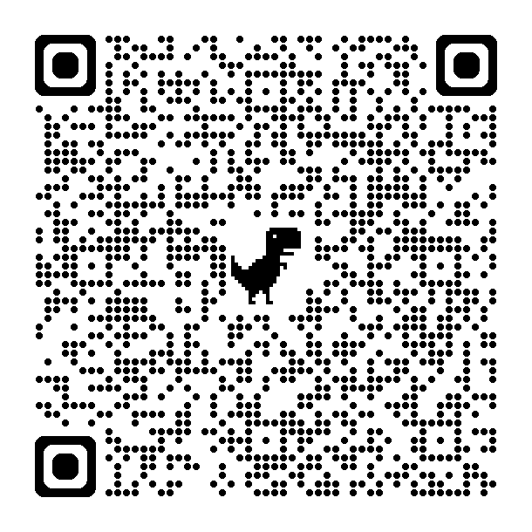
Utah Early Learning Standards for Birth to Age 3
Utah Core State Standards for Early Learning for Ages 3-5
Notes:
Cristina
Go to the birth to three standards and find domain 4

Slide 20
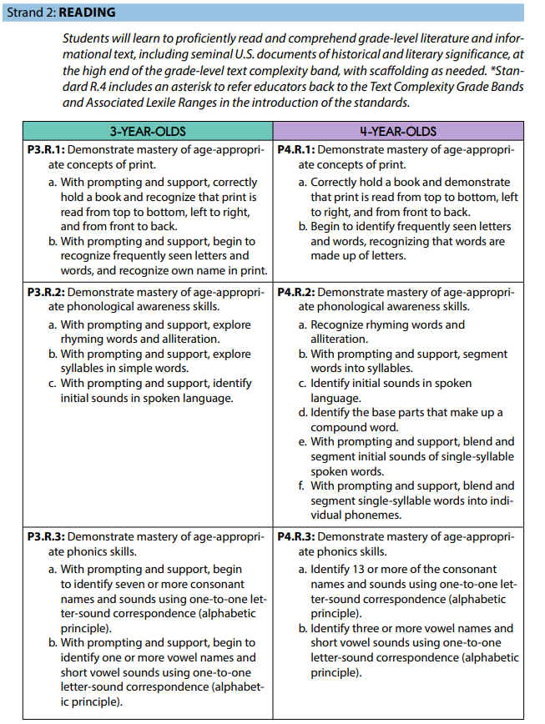
Notes:
Cristina
Although some children are not yet ready for phoneme segmentation or blending, they are aware of and can manipulate larger units of speech sounds: compound words, syllables, onsets, and rimes. Teachers can strengthen this early awareness by drawing attention to rhyme and alliteration during read-alouds of stories and nursery rhymes.
Talk to and with young children A LOT!!!
Exposure to sounds begins prenatally. Talk to infants and toddlers whenever possible to build phonemic attunement.
The connections we make as educators is knowing what skill was developed before and where the current development is going next. This is why it’s important to know all your developmental stages (or where to find them) and be able to share that understanding with parents, other caregivers, and the community.

Slide 21

Phoneme Isolation K-2
Instruction that includes phonemic awareness training for a few minutes per day, several days per week, is one of the best antidotes for future reading failure. However, instruction must be linked to explicit phonics instruction (letter-sound correspondences) to benefit young learners.
LETRS 3rd Edition, pg. 102 (emphasis added)
Notes:
Cristina
For beginning readers, the more automatic phoneme awareness becomes, the better their word recognition, leaving them able to attend to other aspects of the text.

Slide 22
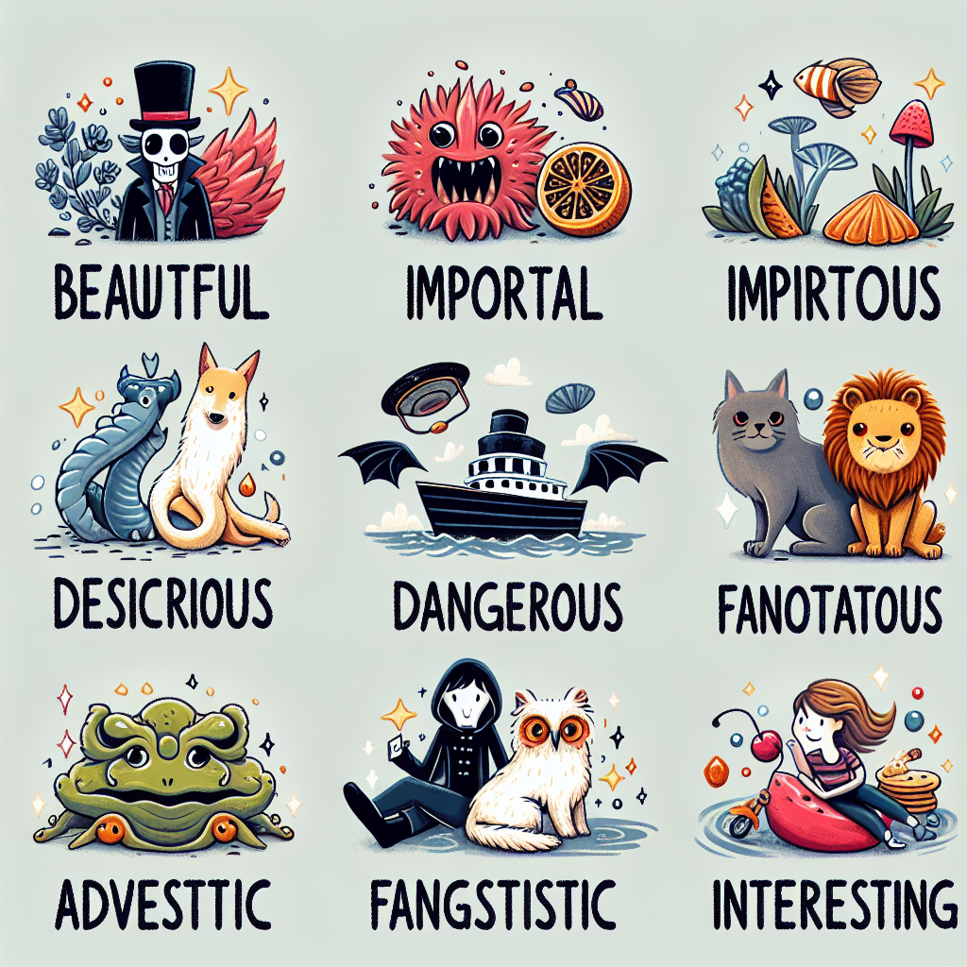
A bit of nonsense
Meaning matters.
Then why practice random phoneme isolation, nonsense word fluency, common spelling (grapheme) patterns, and other skills outside of a text?
Notes:
Katrina
This is an AI generated image. After I laughed and laughed, I realized that it actually illustrates the point of NWF and grapheme patterns really well. We can decode these words. HOW?? We can even come up with some idea of what these words could mean. HOW? How did AI select these images to go with these invented words? (LETRS Unit 4)
Students who receive solid phoneme awareness instruction coupled with phonics instruction in an interactive manner become more accurate, automatic readers. This automaticity in decoding frees up their cognitive “desk space” to attend to other aspects of a text, resulting in higher levels of reading comprehension; in fact, it predicts better reading comprehension for years to come. Many unskilled readers have weak phonological and phoneme awareness skills. One extremely important characteristic includes deficits in phoneme awareness and related skills such as rapid automatic naming (RAN) and phonological working memory (PWM). Students who are weak in these areas need additional attention in small-group instruction to help them catch up.

Slide 23
Letter Naming Fluency
Notes:
Katrina

Slide 24

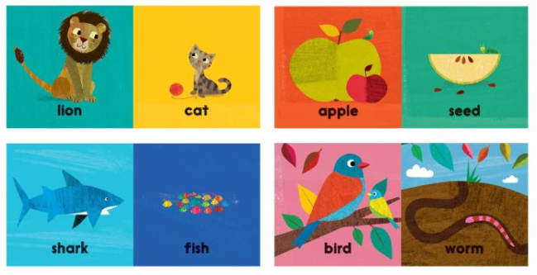
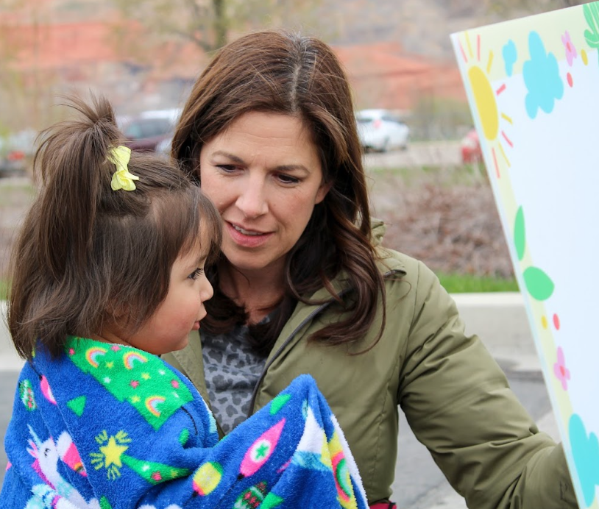
Letter Naming ECE
The language development and communication domain involves the development of the ability to use language to communicate with others.
Notes:
Katrina
Don’t panic. I’m not going to try and tell you Your BABY can READ!!
Print-rich environments with intentional teaching in context to connect the meaning.
The objective is to establish that 1. Print is different from pictures and 2. Print carries meaning
Picture is Karrie “reading” a poster while waiting with the child. Small moments like this are foundational for LNF

Slide 25
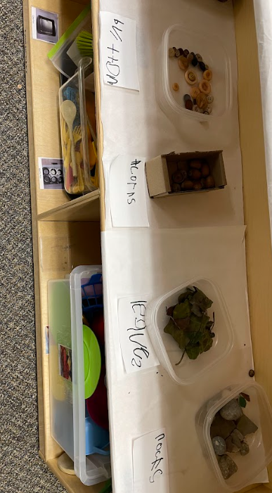

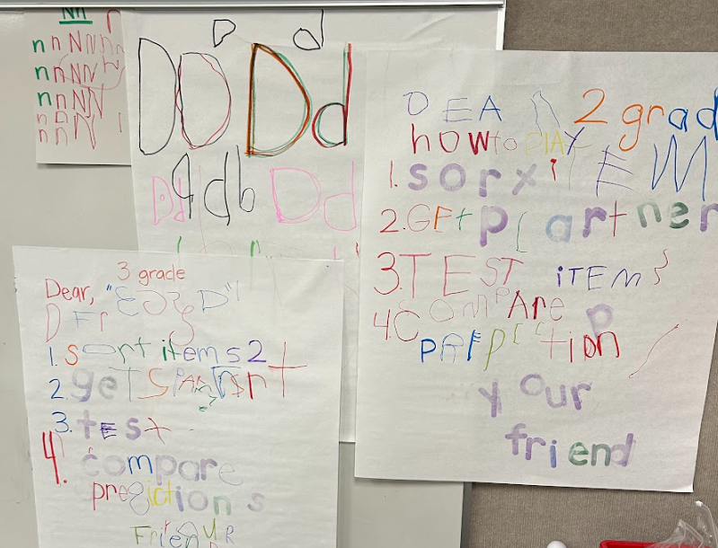
Letter Naming PK
Notes:
Katrina
Letter robots at headstart example
Start by making a strong connection with print as the mechanism that carries meaning
Sort numbers and letters
ID things that matter to the child: own name, names of peers, environmental print connected to full print of the word
A flash card doesn’t have meaning. Keep flash cards use minimal.
The number of letter names children know as they enter kindergarten is the second best individual predictor of reading achievement in the primary grades after phoneme segmentation. LETRS-EC pg.134
How do we do it intentionally??
Jared video from Head Start--la maestra

Slide 26
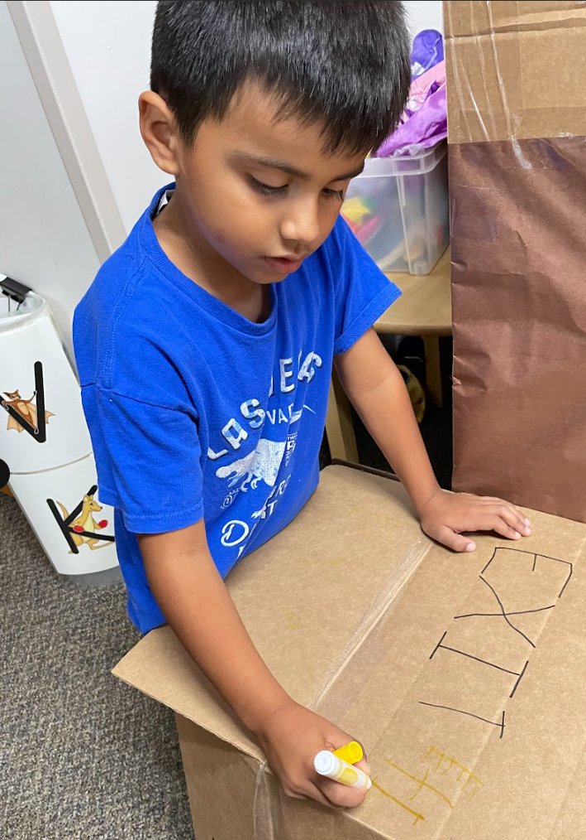
Letter Naming K-2
“Although it might seem logical to tackle the problem of slow naming speed head-on, with drills or other activities directed at increasing naming speed, there is no evidence that such drills have any positive effect.
On the other hand, [RAN] sometimes improves as a consequence of practicing phonological manipulation as well as reading itself.”
LETRS 3rd edition, pg. 93
Notes:
Katrina
Teaching RAN in isolation is not the best way. We have to provide opportunities to connect RAN practice to real context.
How do you teach RAN in context? How do you draw the connections and strengthen the foundation so children know how to do this skill moving forward?
Use letters to solve your problems: make a grocery list for snack tomorrow, post a reminder to put lids on markers
Create a print-rich environment and draw attention to words and names in the environment.

Slide 27
Writing
Notes:
Cristina

Slide 28

Writing ECE
“…the act of putting spoken words and unspoken thoughts into written words releases and, in the process, changes the thoughts themselves.”
Lev Vygotsky
Fine motor skills
Grip
Purpose
Notes:
Cristina
Power of written communication
Building executive functioning--solidify ideas and develop understanding of how to share the desired meaning with others
(if we want to get geeky, can talk about function of learning cursive [solidify conceptual understanding of graphemes])

Slide 29
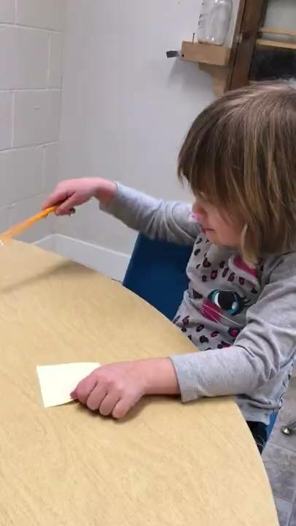
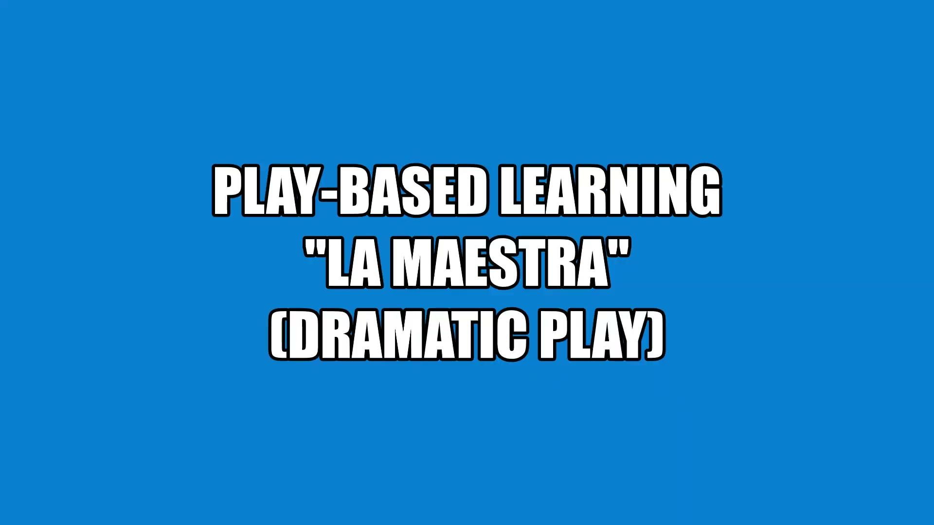
ECE Writing Examples
Notes:
Cristina
Show examples if there is time:
We begin with a foundation: You CAN write and when you write you communicate
“DEFERRED IMITATION WRITING VIDEO”
Kindergarten post-it note

Slide 30
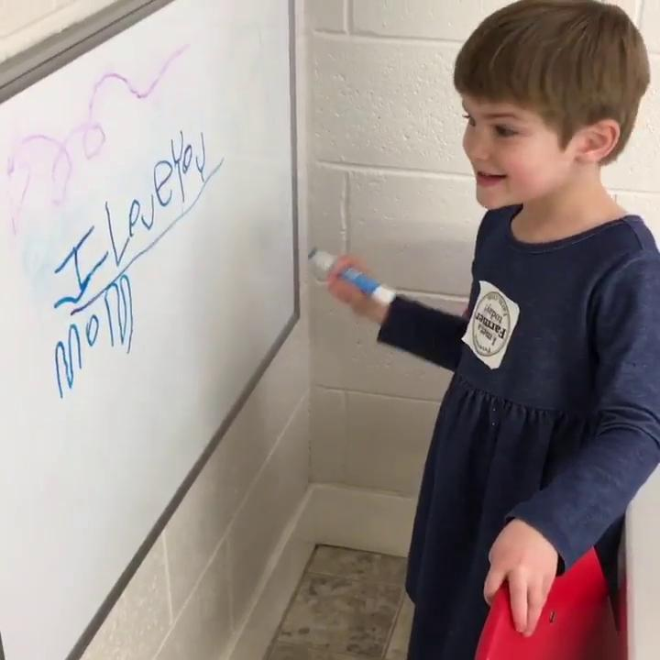
Writing PK
Self-regulation, restraint, planning:
I am a writer!
I communicate when I write.
Working memory and goal-setting
I remember what I wrote and why
I want to write because…
Visual and spatial connections:
Letters are made of lines, curves, slants & shapes.
Perceptual motor skills:
Holding a writing tool feels like…
Moving my hand/arm feels like…
Notes:
Cristina
Remember those exec functions we connected to? Here’s where the rubber really meets the road.
How do we do it intentionally??
Scaffold using the tools and surfaces

Slide 31
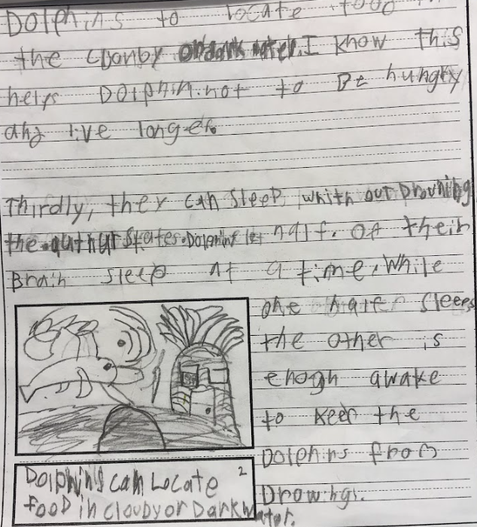
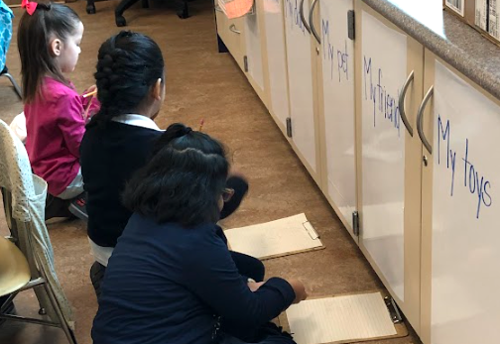
Writing K-2
Automaticity:
Strong Foundation:
Handwriting Writing Fluency Early Spelling Punctuation Capitalization
Sentence Structure Spelling Complexity
Notes:
Cristina
Purpose of the exercise—Informational writing about what the class had learned about dolphins
Writing is different from HANDWRITING; the skills develop differently but develop together
Lifting the cognitive burden through purposeful practice

Slide 32
Final Thoughts
How do we bring it all together?
Notes:
Katrina

Slide 33
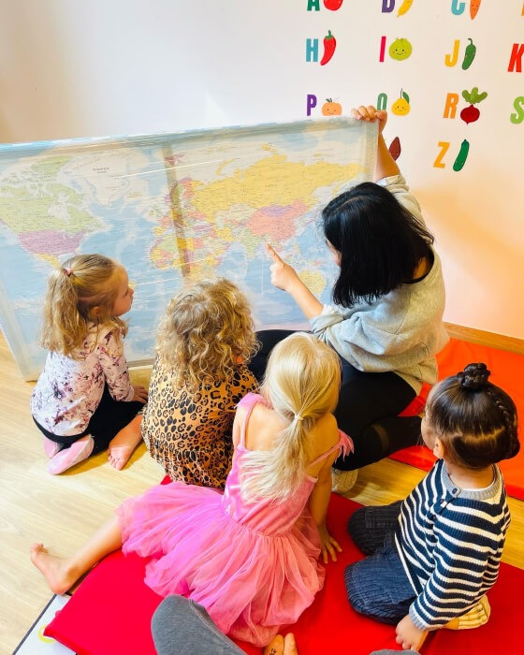
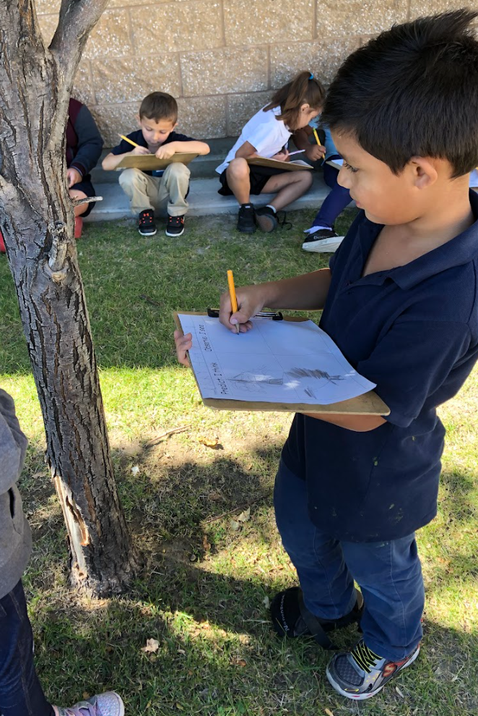
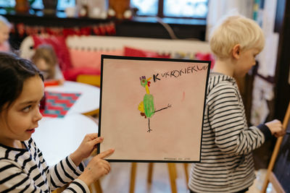
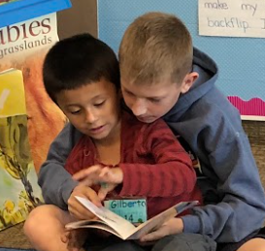
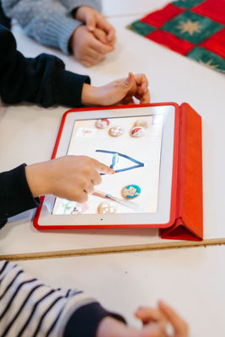
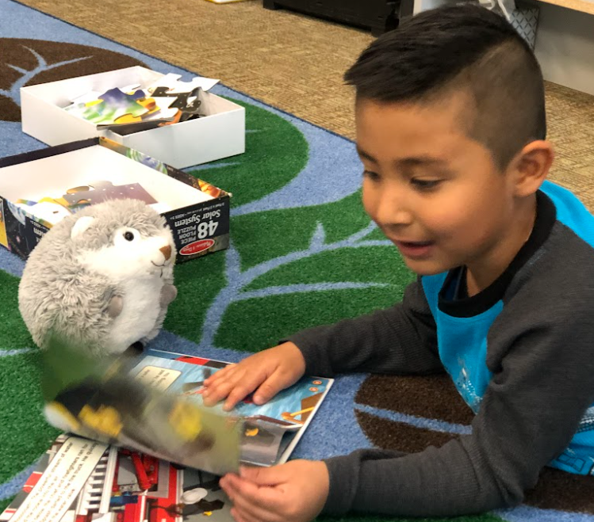
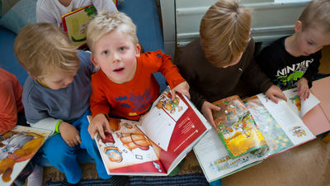
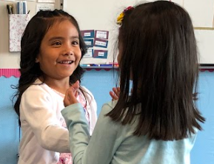
“Big Kid” Skills
…are not exclusively for big kids.
Notes:
Katrina
Yes, some countries don’t do “reading instruction” until age 6 or 7. But do you think that means they completely ignore literacy up until then? Reframe what literacy instruction looks like!
Science of reading is not the same as “formal” reading instruction.
Vocabulary-rich discussions
Providing information in conversation and encouraging children to fully participate in conversations (ask and answer questions).
Encouraging curiosity and modeling how language (speaking & listening, reading, and writing) helps find answers and greater understanding.
We’re not pushing down, we’re understanding where the skills begin to develop and we’re supporting that foundation better.

Slide 34
So, how did it go?
Learning Intentions
Review the stages of literacy development
Identify the stages of literacy I most frequently target during instruction
Identify the early learning skills that are the highest indicators of long-term literacy success
Draw meaningful connections from theory to practice
Success Criteria
Identify & describe one or more instructional strategy I can use to build student skills using developmentally informed interactions
Describe how the highest-indicator skills develop across the early grades (preschool – 2nd grade)

Slide 35


Joyful Journeys Facebook Group

Slide 36
References & Resources https://tinyurl.com/URSA2025PKResources
Barber, J., & Cervetti, G. (2019). No More Science Kits or Texts in Isolation: Teaching Science and Literacy Together (Not This but That). Heinemann.
Brown, P. C., III, H. L. R., & McDaniel, M. A. (2014). Make It Stick: The Science of Successful Learning. Belknap Press: An Imprint of Harvard University Press.
Christakis, E. (2016). The Importance of Being Little: What Preschoolers Really Need from Grownups. Viking.
Hart-Paulson, L. (n.d.). LETRS For Early Childhood Educators Print Module. Cambium Education, Incorporated.
Kamenetz, A. (2018, June 1). Let’s Stop Talking About The “30 Million Word Gap.” www.npr.org/sections/ed/2018/06/01/615188051/lets-stop-talking-about-the-30-million-word-gap
Lambert, S. (2024, October 16). Comprehension is not a skill (4) [Audio Podcast]. In Science of Reading: The Podcast. Amplify. amplify.com/science-of-reading-the-podcast/

Slide 37
References & Resources continued
Moats, L. C., & Tolman, C. A. (2019a). LETRS VOLUME 1:UNITS 1-4. Voyager Sopris Learning.
Moats, L. C., & Tolman, C. A. (2019b). LETRS VOLUME 2:UNITS 5-8. Voyager Sopris Learning.
Palmer, J., & Invernizzi, M. (2014). No More Phonics and Spelling Worksheets (Not This but That). Heinemann.
Playing with Stories: Using Books to Inspire Play. (n.d.). NAEYC. Retrieved July 7, 2025, from www.naeyc.org/resources/blog/playing-stories-using-books-inspire-play
Position Statement: Developmentally Appropriate Practice. (2020). In National Association for the Education of Young Children. https://www.naeyc.org/resources/position-statements/dap/purpose
Sheninger, E. (2021). Disruptive Thinking in Our Classrooms: Preparing Learners for Their Future. ConnectEDD.
Supporting Great Communication Skills for Kids | Parenting Tips &…. (n.d.). PBS KIDS for Parents. Retrieved July 7, 2025, from www.pbs.org/parents/thrive/supporting-great-communication-skills-for-kids
Thinkmap, & Inc. (n.d.). Marzano’s Six Steps to Effective Vocabulary Instruction. Retrieved July 7, 2025, from www.vocabulary.com/articles/wordshop/marzanos-six-steps-to-effective-vocabulary-instruction/

Slide 38
References & Resources continued
Utah Core Standards. (n.d.). Utah State Board of Education Utah Core Standards. Retrieved July 7, 2025, from www.schools.utah.gov/curr/utahcorestandards
Utah State Board of Education. (2021a). Building Readers A Parent Guide. In Utah State Board of Education English Language Arts. Utah State Board of Education. https://www.schools.utah.gov/curr/elaelementary/_eleelementary_/-Building%20Readers%20A%20Parents%20Guide.pdf
Utah State Board of Education. (2021b). -Fomentar La Lectura Guia para padres.pdf. In Building Readers A Parent Guide, Spanish. Utah State Board of Education. https://www.schools.utah.gov/curr/elaelementary/_eleelementary_/-Fomentar%20La%20Lectura%20Guia%20para%20padres.pdf
Utah State Board of Education. (2023a). Utah Core Standards for Early Learning for Ages 3 to 5. In Utah State Board of Education Preschool Education. Utah State Board of Education. https://www.schools.utah.gov/curr/preschool

Slide 39
References & Resources continued
Utah State Board of Education. (2023b). Utah Core Standards for P-12 English Language Arts. In Utah State Board of Education ELA Elementary. Utah State Board of Education. https://www.schools.utah.gov/curr/elaelementary/index
Utah State Board of Education. (2024). Utah’s P-12 Literacy Framework. In Utah State Board of Education English Language Arts. Utah State Board of Education. https://www.schools.utah.gov/curr/elaelementary/_eleelementary_/-Utahs%20P-12%20LiteracyFramework%20USBE.pdf
Wolf, M. (2017). Proust and the Squid: The Story and Science of the Reading Brain. Harper Perennial.
Wolf, M. (2019). Reader, Come Home: The Reading Brain in a Digital World. Harper Paperbacks.

