Slide 1
Leading with Hope
Building resilient communities

Slide 2
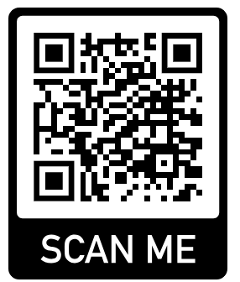
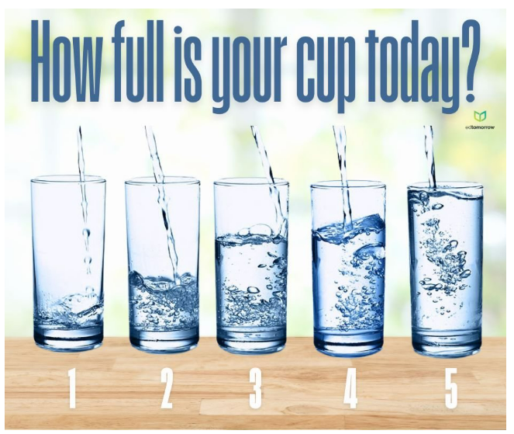

Slide 3
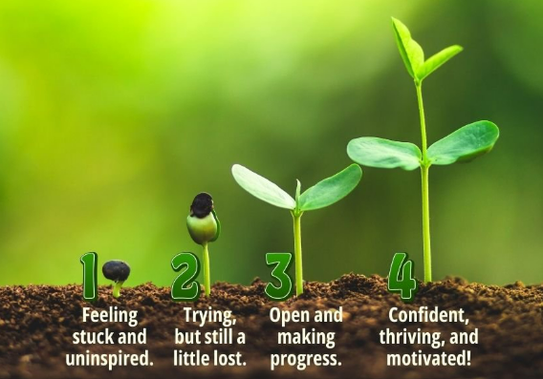
How are you feeling about the culture and climate of your school community?

Slide 4
Overview
Why compassion and hope schools
What are compassion and hope
How to implement both compassion and hope every day

Slide 5

Why?
Resilience
  1 in 5 students struggles with mental health challenges
  80.5% of teens experiencing 1 or more ACE
Self-efficacy (belief in one’s abilities)
  1/3-1/2 teens lack self-esteem/confidence
Coping and regulation
Engagement

Slide 6
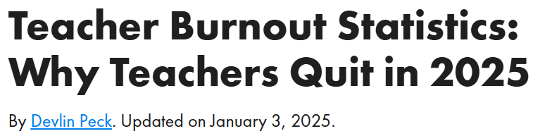
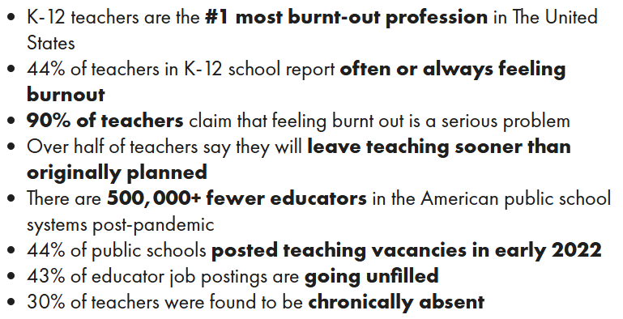
Source: https://www.devlinpeck.com/content/teacher-burnout-statistics
Notes:
Meta-analysis of several surveys and research studies
Education had a median of tenure of just under 3 years.

Slide 7
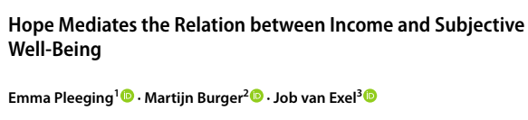

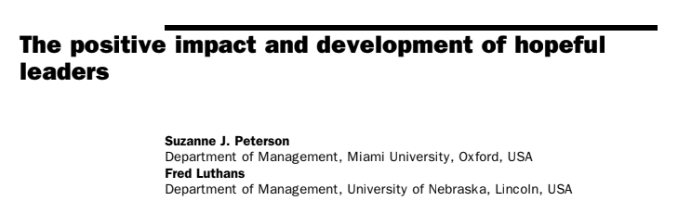
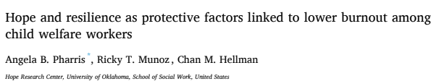
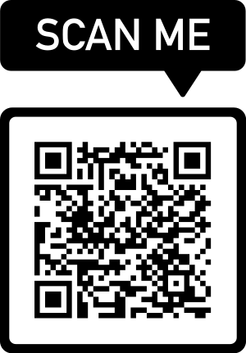
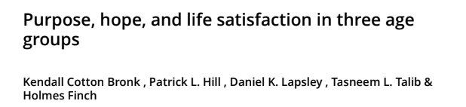

Slide 8

What is COMPASSION?
A sense of care and understanding which involves treating others with kindness and respect, helping to create a safe, supportive, and nurturing space for learning through connection, problem-solving, and improved well-being.
  Empathy and understanding
  Respect and dignity
  Support and care
  Active listening
  Flexibility and accommodations
  Promoting a culture of care

Slide 9

“Compassion is not a virtue – it is a commitment. It’s not something we have or don’t have – it’s something we choose to practice.”
BRENE bROWN

Slide 10
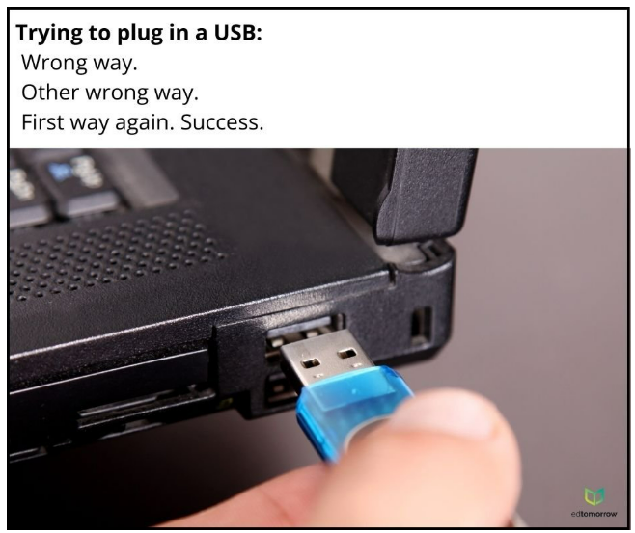
What is HOPE?
A desire accompanied by expectation or belief of fulfillment
  Trust
  Goal-oriented
  Optimistic belief
  Determined

Slide 11
Hoping vs. Wishing
Hoping involves a commitment to seeking future outcomes - active
Wishing represents a general want or desire for something in the future - passive

Slide 12
“Hope is the belief that your future will be better than today and that you have the power to make it so.”
Cr. Chan Hellman

Slide 13
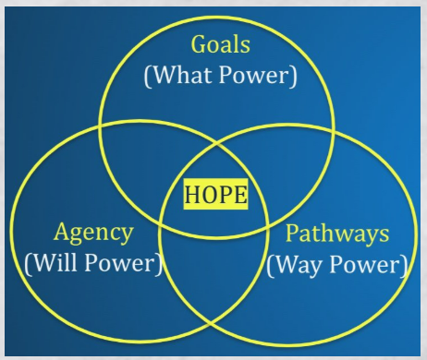
Hope Theory
Psychologist, Dr. Rick Snyder defined hope as a positive cognitive process in which a person has goal-directed thinking that uses both pathways (the capacity to find routes to their desired goals) and agency (the necessary motivation to use those routes).
  Perceived capability to create pathways to desired goals and motivate oneself through agency.

Slide 14
https://www.youtube.com/watch?v=ZuHZhi1B4T4

Slide 15
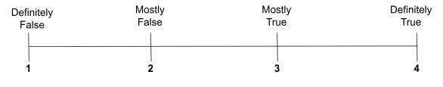
Hope Scale
Number a paper from 1 – 12
Using the scale shown below, select the number that best describes YOU for each statement and put that number next to the questions.

Slide 16
I can think of many ways to get out of a jam.
I energetically pursue my goals.
I feel tired most of the time.
There are lots of ways around any problem
I am easily drowned out in an argument.
I can think of many ways to get the things in life that are important to me
I worry about my health,
Even when others get discouraged, I know I can find a way to solve the problem
My past experiences have prepared me well for my future.
I’ve been pretty successful in life.
I usually find myself worrying about something.
I meet the goals that I set for myself.

Slide 17
Results
Add items 2, 9, 10, 12 = AGENCY
Add items 1, 4, 6, 8 = PATHWAY
Combine both scales = HOPE
  13-15 = hopefully
  16-19 = moderately hopeful
  20 or higher = high hope

Slide 18
“Hope is being able to see that there is light despite all of the darkness.”
Desmund Tutu

Slide 19

2 X 10
Choose one staff member you would like to strengthen your relationship with
Select when you are going to approach that individual (find a consistent time every day)
Have a 2-minute conversation with the staff member for 10 days.
  Brevity
  Non-academic
  Honesty
  Reciprocal

Slide 20
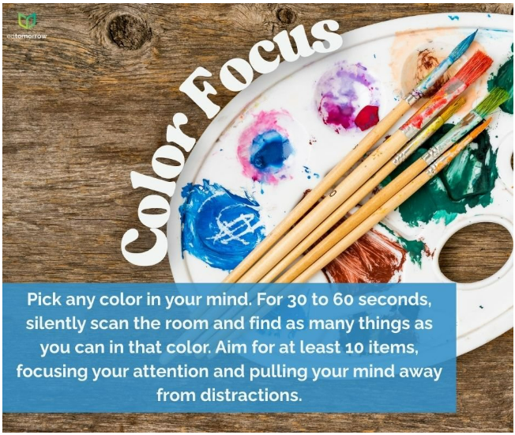

Slide 21
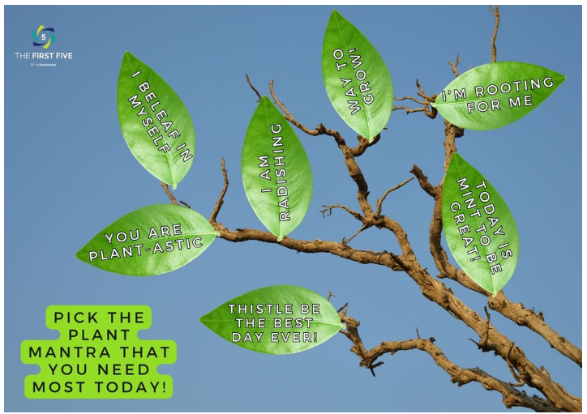

Slide 22

Dignity Principles
1. Dignity is the inherent worth we all have from birth. We all deserve to be treated with dignity, no matter what.
2. Along with our survival instincts, the longing to be treated with dignity is the single most powerful force motivating our behavior.
3. If we violate someone’s dignity repeatedly, we will get a divorce or a war or a revolution, because a desire for revenge is an instant response to a dignity violation.
4. Treating people with dignity means seeing ourselves in them; treating people with contempt means seeing ourselves above them.

Slide 23
Dignity Principles
5. When contempt tears us apart, dignity can bring us together, whether we’re talking about our friends, our family, our community, or our country.
6. Treating people with dignity helps bring out their best and discourages their worst.
7. Treating people with contempt makes both sides angry, anxious and depressed.
8. When we use contempt, we create enemies for ourselves and the causes we care about.

Slide 24
Dignity Principles
9. Contempt gives us an addictive buzz, and people exploit our addictions to get rich, famous and powerful.
10. When people use contempt, they claim noble motives because contempt needs excuses and disguises. When we expose contempt, it loses its power.
11. When we put a spotlight on dignity and contempt, we use more dignity and less contempt.
12. When we create communities that reward dignity and challenge contempt, we can change the culture.

Slide 25
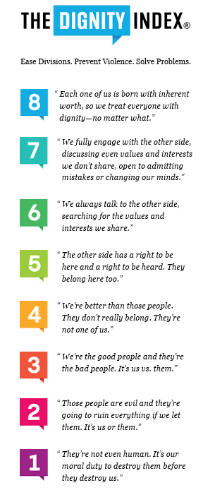
Dignity Index
“Can you tell me more about that?”
“Wow, I think just the opposite. Can you tell me how you came to that view?”
“Let’s figure out what we disagree on; it can’t be everything.”
“I want to hear what you think.”
“Can you explain that to me?”

Slide 26

Letters of Belief
At the beginning of the year
  Ask each staff member to write a positive letter to themselves
Randomly share them back with staff throughout the year.

Slide 27
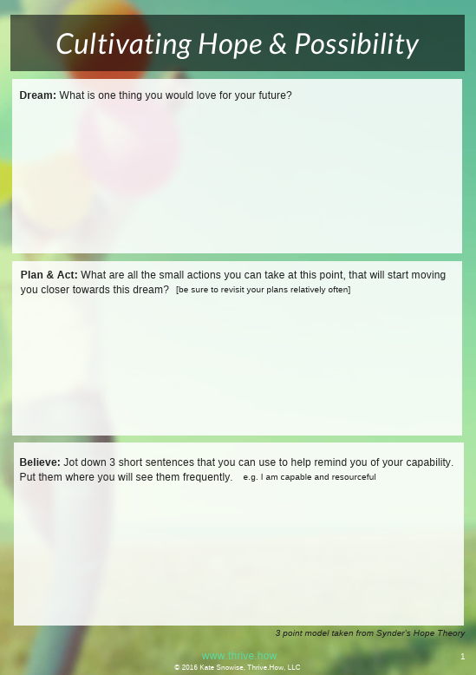
Hope Theory Worksheet
What is one goal you hope to achieve in the future?
What small actions can you take that will start moving you closer towards this goal?
Write down 3 short sentences that will help remind you of your capabilities, for instance, “I am capable and resourceful.”
      Kate Snowise (2016)

Slide 28
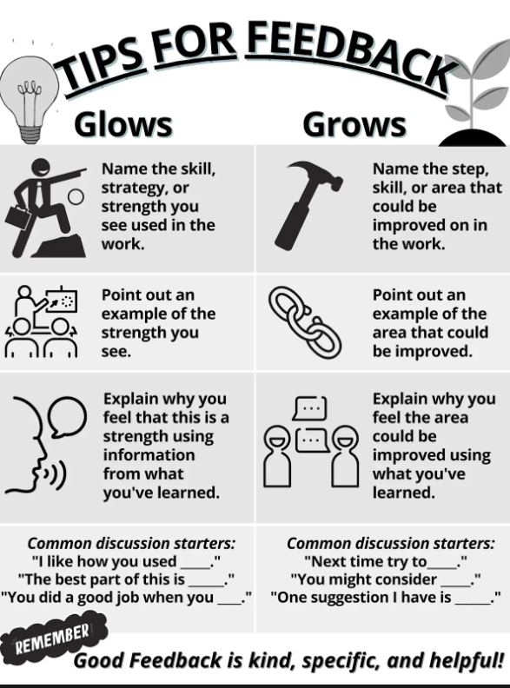
Glows and Grows
Give compassionate feedback

Slide 29
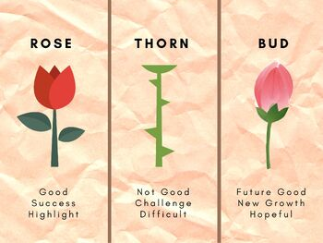
Rose, Thorn, Bud

Slide 30
“We can’t change a person’s home life, but we can help change that person’s HOPE in life.”
Adapted from Cathleen Beachboard

Slide 31
https://www.youtube.com/watch?v=dlcU5uHMdTM

Slide 32
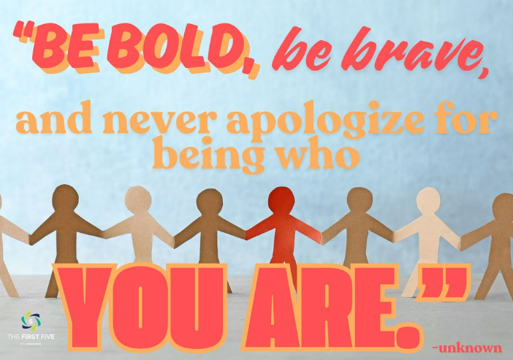
Holly Todd
holly@nucenter.org
435-503-7390

