Slide 1
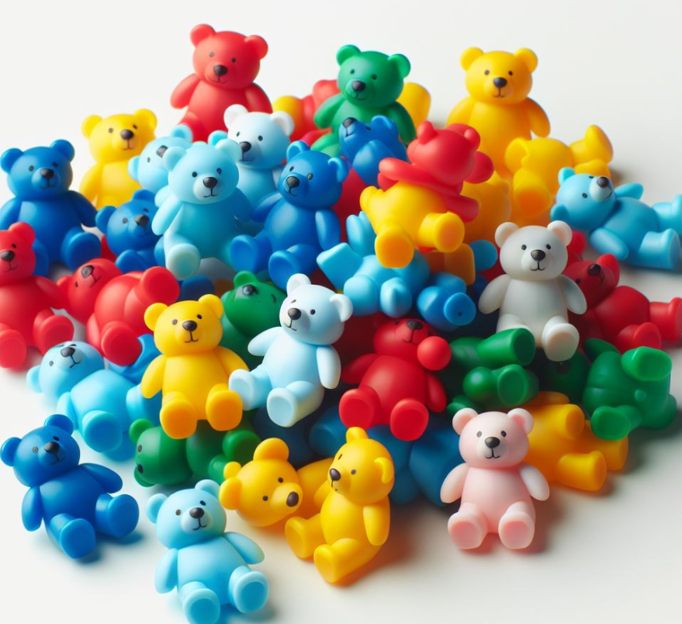
Counting Objects Assessment
Jaci Keetch, RSD Instructional Coach
Jkeetch@richschool.org
URSA 2025

Slide 2
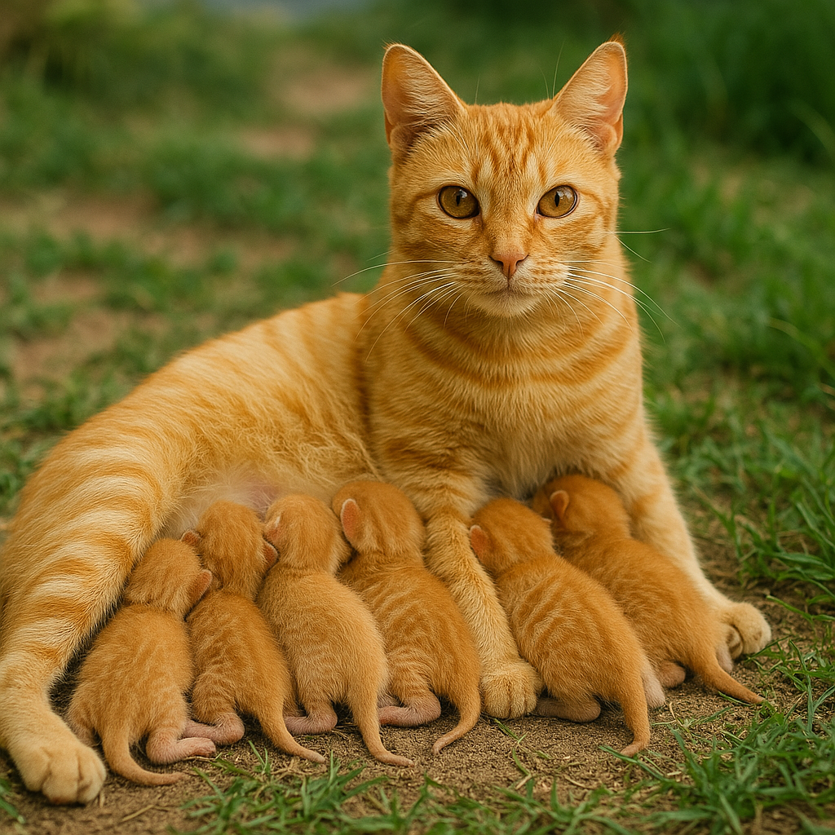
What do you notice?
What do you wonder?

Slide 3
Learning Intentions
Understand the value of counting
Learn and practice a Counting Survey: The Counting Assessment
Learn and practice some intervention counting activities

Slide 4
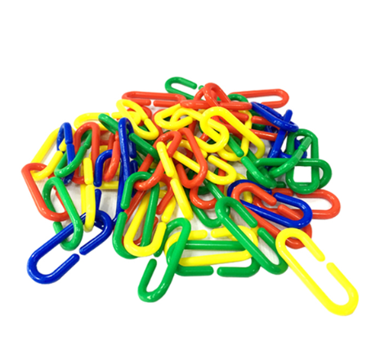
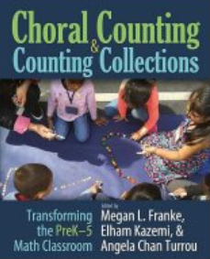
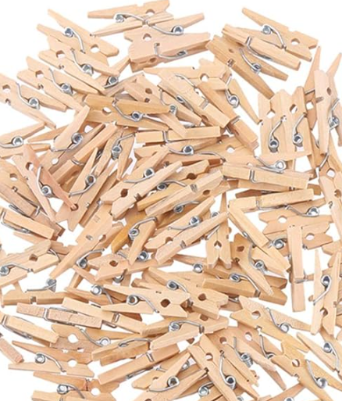
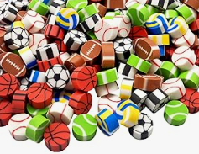
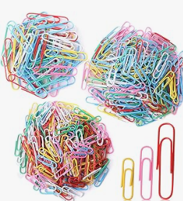

Counting Collections

Slide 5
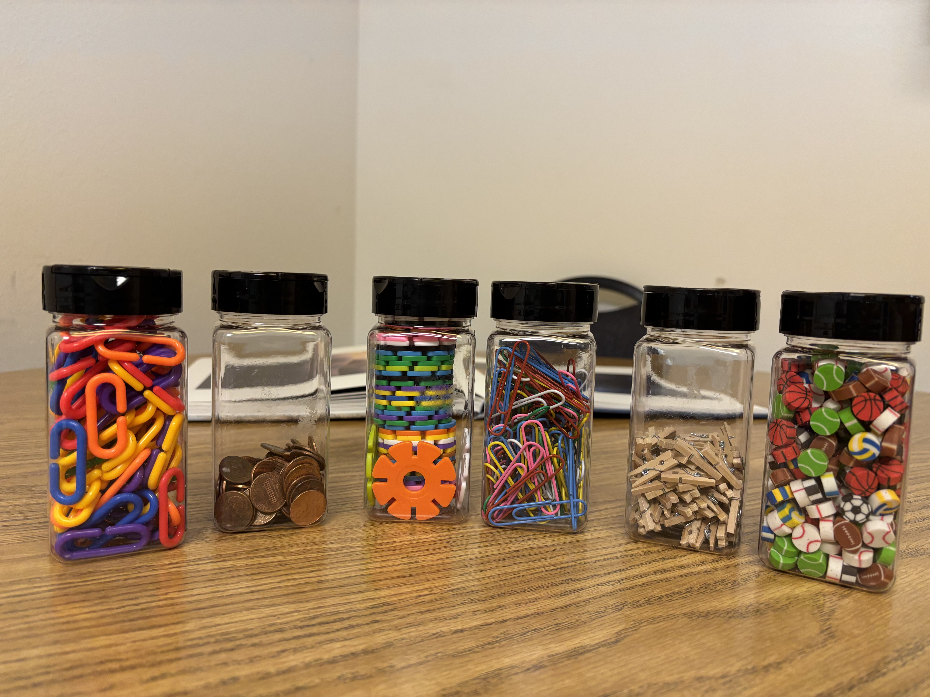
Counting Collections
Choose a team
Estimate how many
Collaborate and count the collection
Be prepared to justify the accuracy of your count
Represent the amount on the Recording Sheet
Find the difference between your estimate and the actual amount
Be prepared to talk about the math that is taking place

Slide 6
Turn and Talk: Goals for Counting Tasks
Why should we have students counting? Is it important?
What mathematics is being learned?
How does it relate to what has already been learned?
Where are these mathematical ideas going?

Slide 7
How Important is Counting?
Find out how many
Often overlooked and underappreciated
Important foundational work for children
Develops a sense of quantities and number relationships
Develops conceptual understanding of the value of a number

Slide 8
Math is Conceptual
Counting
Concept of Number
Counting On
Concept of Sum
Repeated addition
Concept of Product
"When students learn to count, they are learing a method, but that should lead into an understand of the concept of number which leads to the concept of a product. Learning concepts involves thinking deeply."
Jo Bolar, Mathish p. 177

Slide 9
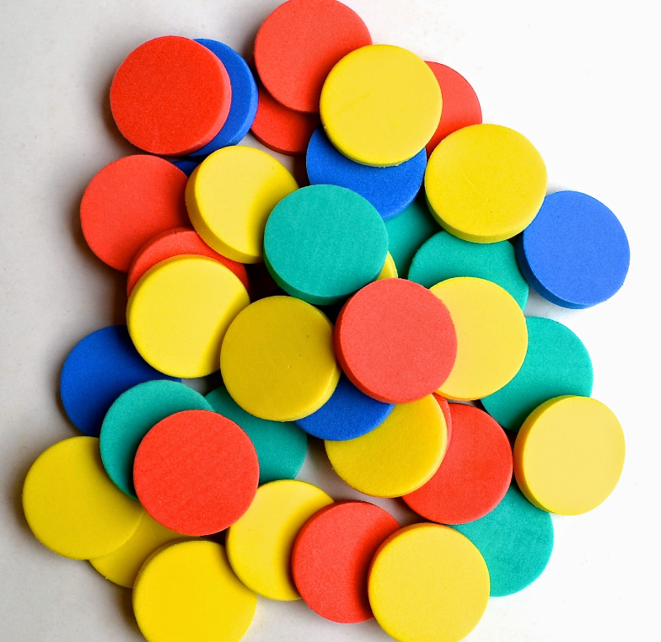
Goals for Counting
Children Need to Learn:
  To use numbers to answer the question, "How many?"
  To count objects with consistency, accuracy, and confidence.
Critical Learning Phases:
  Gets a particular quantity
  Keeps track when counting objects
  Remembers, "How Many?" After counting
  Reacts to estimate while counting
  Knows "one more" without counting
  Knows "one less" without counting
  Reads and writes numerals to label quantities

Slide 10
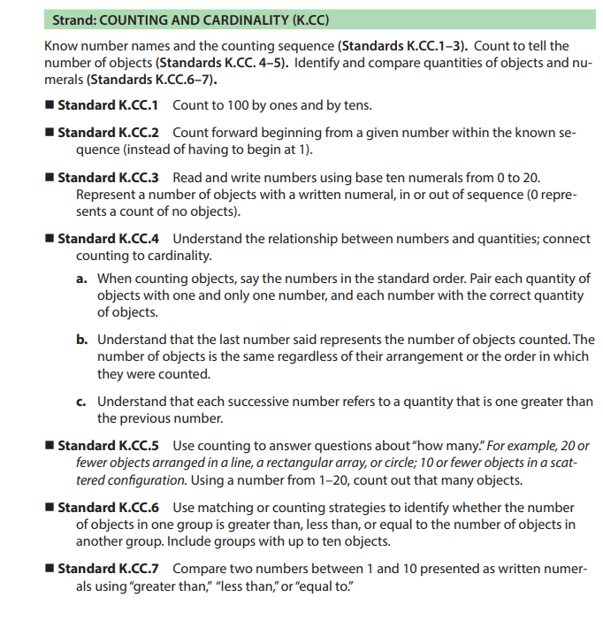
Counting Standards

Slide 11

Standards in Grades 1-3
Standard 1.OA.5 Relate counting to addition and subtraction. For example, by counting on 2 to add 2
Standard 1.NBT.1 Count to 120, starting at any number less than 120. In this range, read and write numerals and represent a number of objects with a written numeral.
Standard 2.NBT.2 Count within 1,000; skip-count by fives, tens, and hundreds
Standard 2.NBT.3 Read and write numbers to 1,000 using base-ten numerals, number names, and expanded form.
Standard 3.OA.1 Interpret the products of whole numbers, such as interpreting 5 × 7 as the total number of objects in 5 groups of 7 objects each. For example, describe a context in which a total number of objects can be expressed as 5 × 7.
Standard 3.OA.2 Interpret whole-number quotients of whole numbers. For example, interpret 56 ÷ 8 as the number of objects in each share when 56 objects are partitioned equally into eight shares (partitive), or as a number of shares when 56 objects are partitioned into equal shares of eight objects each (quotative).
Standard 3.MD.6 Measure area by counting unit squares (square centimeters, square meters, square inches, square feet, and improvised unit

Slide 12
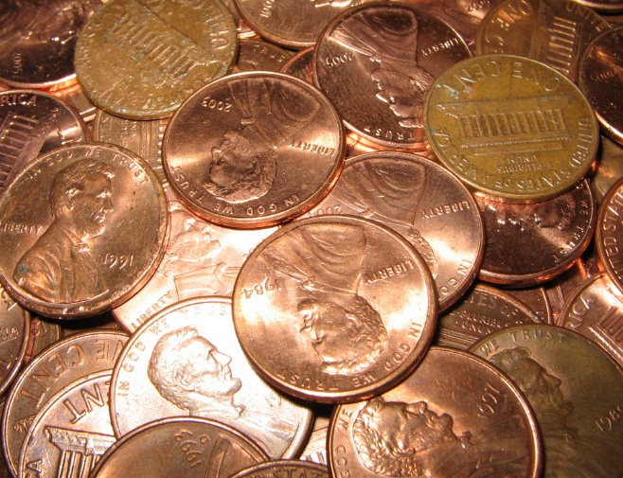
Core Counting Principles
Counting Sequence
There is an ordered sequence of number names. Counting involves using the same sequence each time, starting with one. Extending the counting sequence is accomplished by repeating certain aspects of the previously used numbers in a structured way (according to our base-ten number system).
One-to-One Correspondence
Exactly one number from the counting sequence is assigned to each object in the collection.
Cardinality
The last number assigned to an object in counting the collection indicates the total quantity of objects in the collection.

Slide 13
The Challenge of Counting
Count and Land Stage
  Children touch each object once and only once to keep track of what has been counted. One to one counting. It is common for them to lose track in the early stages, but with more practice they will become more accurate.
Sense of Quantity
  Turn attention to how many they will need guidance in estimating, counting, and noticing if what they counted is reasonable.
Knowing without Counting
  Learning how to determine amounts without counting each one is knowing one more or one less which is a key for addition and subtraction. Subitizing (aka: Groupitizing).
Using Numerals
  Understanding that symbols represent quantities

Slide 14
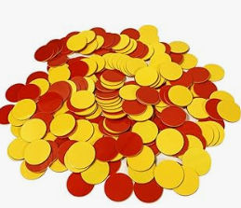
How do we teach, assess, and intervene counting?
Screen with Acadience Math
Kindergarten Counting Skills Monitor Guide URSA 2025.pdf
  Adapted from a document shared by Molly Basham, USBE and Shannon Olsen.
Counting Assessment by Kathy Richardson
Teacher Directed Number Activities from Number Concepts: Counting, Comparing, and Pattern by Kathy Richardson

Slide 15
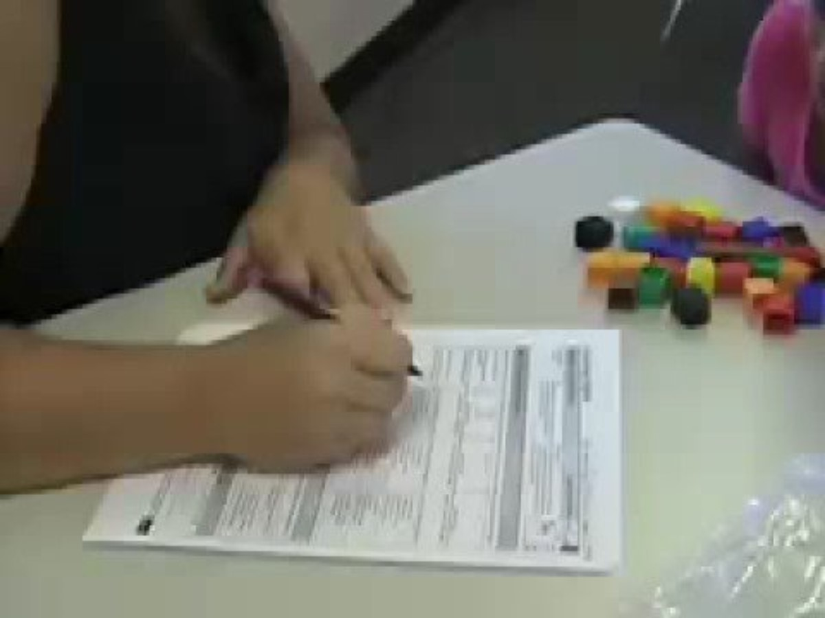

How can we assess counting?
Counting Objects Assessment by Kathy Richardson

Slide 16
Task One: Counting Pile
Give the students a pile of counters.
Ask the student, "How many counters do you think there might be?" Record their estimate.
"Would you count to found out?" Determine how far a child can count without making a mistake.
  Notice the Strategy.
    Lines up
    Looks
    Points
    Moves
  Notice the method.
    One-to-one
    Grouping
    Loses track
    Checks or rechecks
How does the student keep track?
Does the child make any rote counting errors?
It is more efficient to begin with a large number and take it smaller as needed.
  For Example: 32, 21, 12, 7
Notes:
Do they stop counting when the come to a place they don't know? Do they repeat the counting sequenc starting over from one? Do they keep going using a random sequence of numbers? Do they start out keeping rack and then lose track after a while?

Slide 17
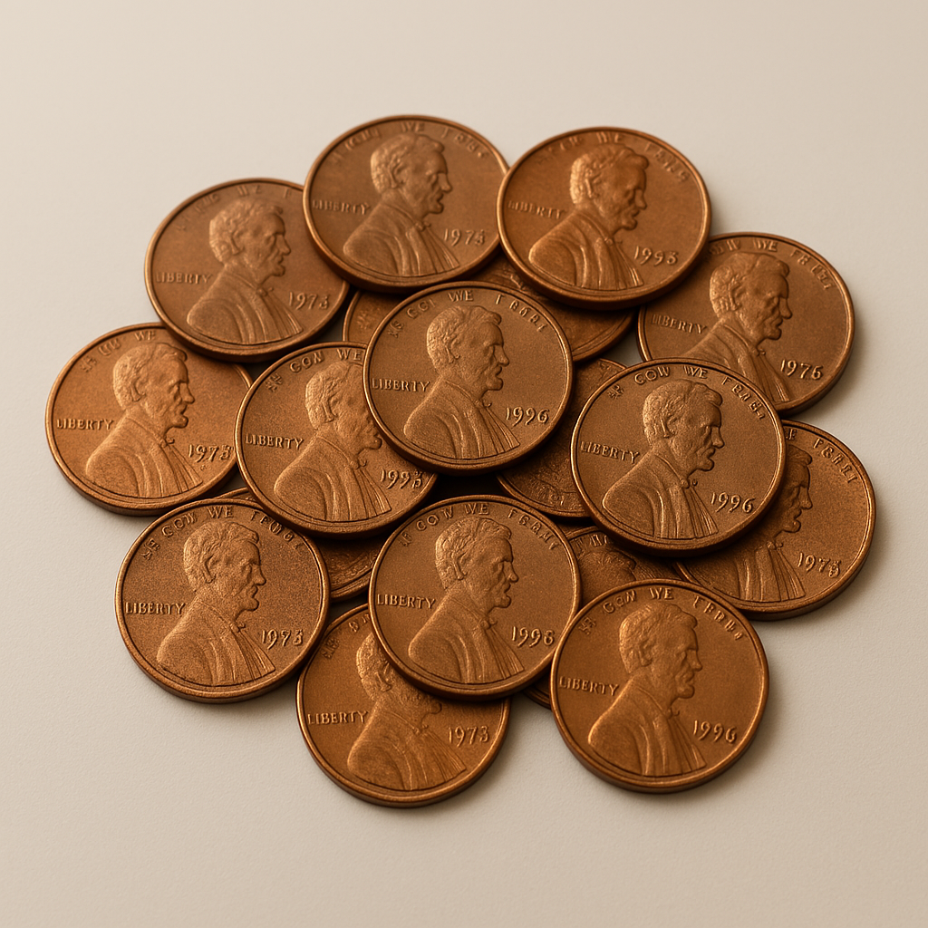
Task 2: Now Make a Pile of _______
Counting out a particular number requires the child to hold the number in their mind while they are counting.
Notice the act of counting, sequencing and attending to the quantity. Rote vs. Conceptual Understanding
Ask the student to, "Make a pile of _______________ counters.
  How does the student count?
  Notice the Strategy.
    Lines up
    Looks
    Points
    Moves
  Notice the method.
    One-to-one
    Grouping
    Loses track
    Checks or rechecks
    Stops on the given number
    Rote counts beyond
  Is it accurate in the proper sequence?
  Does the learner stop at the correct number?

Slide 18
Task 3: One More/One Less
You add one more to the pile the child just counted successfully. "How many now?" (Start with a smaller number as needed.)
Continue to add one more and write the response. Repeat for 4-5 iterations.
Determining how many there are when one more is added is not conceptually difficult if the child knows the counting sequence.
Repeat the process for One Less.
  How many now?
  What if I took one away? (Remove one) "How many now?"
Try without counters using different and random numbers within 10 and 20.
  "What if I we had ____ and we added/subtracted one?"
  "How many?"
For an extension try the decades: 49 and 1 more. Or beyond 100.

Slide 19
Games for Intervention
Count and Land URSA 2025.pdf
Buttons on a Shirt Counting Game URSA 2025.pdf
Clothespins Counting Game URSA 2025.pdf

Slide 20
Resources
Counting Collections Overview | DREME TE
Progression of Early Number and Counting - YouTube
Counting Collections | TEDD
Progression of Early Number and Counting
Counting Collections | TEDD
Math Apps | The Math Learning Center
Polypad – Virtual Manipulatives
Virtual Manipulatives for Math
Ten Frame
Kindergarten Counting Skills Monitor Guide URSA 2025.pdf
Counting Objects Assessment
Writing Numerals PDF

Slide 21
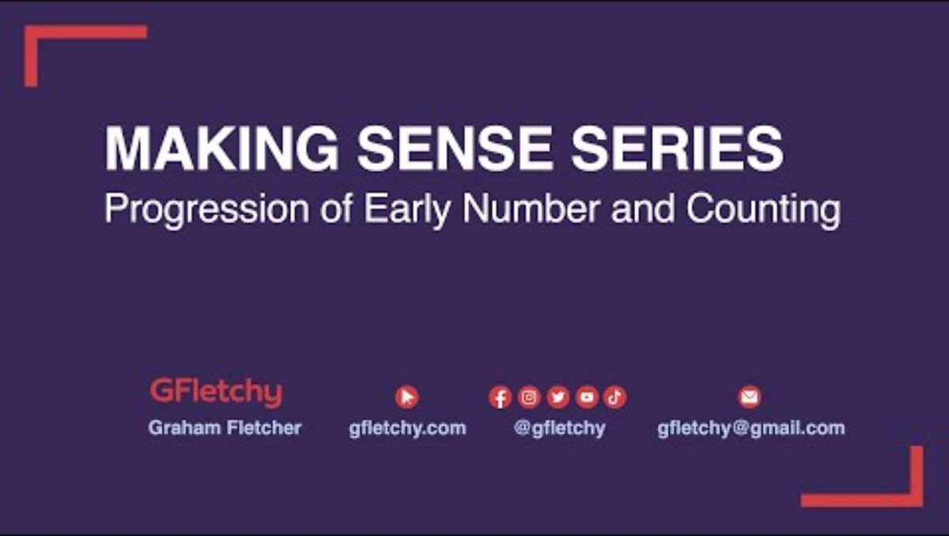
Counting Progressions

Slide 22
jkeetch@richschool.org

