Slide 1

Celebrate America250
with
National History Day Utah
Utah Rural Schools Association
July 10 2025
Presented by
Dr. Wendy Rex Atzet
Tatiana Chudy

Slide 2


Presenters
Dr. Wendy Rex Atzet
K-12 Initiatives Manager
Utah Historical Society
Tatiana Chudy
National History Day Program Assistant
Utah Historical Society

Slide 3
AGENDA
Introductions
America250 Utah
A year of opportunities
Educator themes
Resources
National History Day
2026 Theme
Finding a great topic
Project examples
Primary and secondary sources
Research skills
Historical thinking skills
Questions/Wrap Up

Slide 4

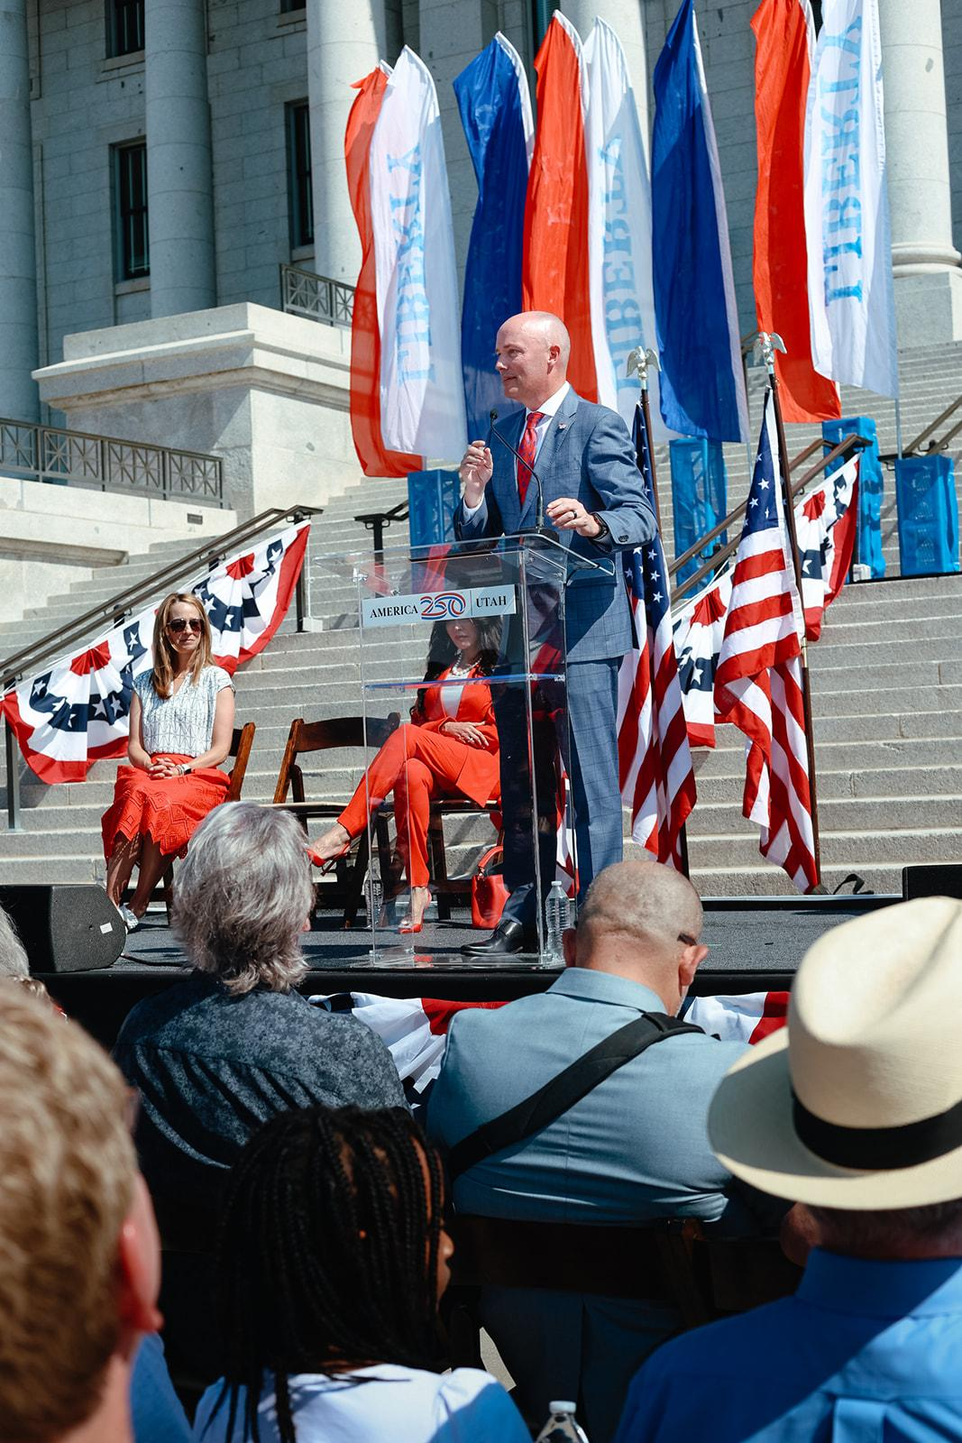
1776 + 250 yrs = 2026
Utah’s Semiquincentennial Celebration
July 1, 2025–July 4, 2026
https://america250.utah.gov

Slide 5
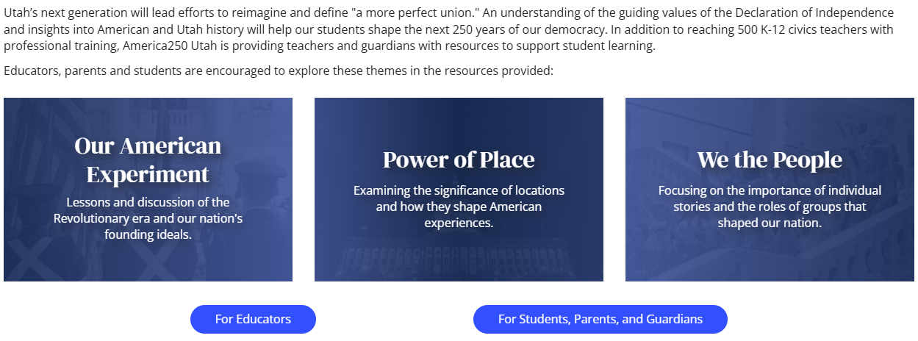
EDUCATE

Slide 6
Theme: Our American Experiment
PHILADELPHIA 1776
British North America
Preamble to the Declaration of Independence
Adopted by Continental Congress, Philadelphia
July 4, 1776
…We hold these truths to be self-evident, that all men are created equal, that they are endowed by their Creator with certain unalienable Rights, that among these are Life, Liberty and the pursuit of Happiness…
Resource: Timeline of the American Revolution Museum of the American Revolution, Philadelphia
“

Slide 7
Theme: We the People
UTAH 1870–1945
How we work through crises
RESOURCES
Women’s History/Voting Rights
Utah Historical Quarterly
utahwomenshistory.org/
World War I
Utahns on the Front Lines
Great Depression
The Civilian Conservation Corps in Utah
World War II
Utah Women on the Home Front
Japanese Internment at Topaz

Slide 8
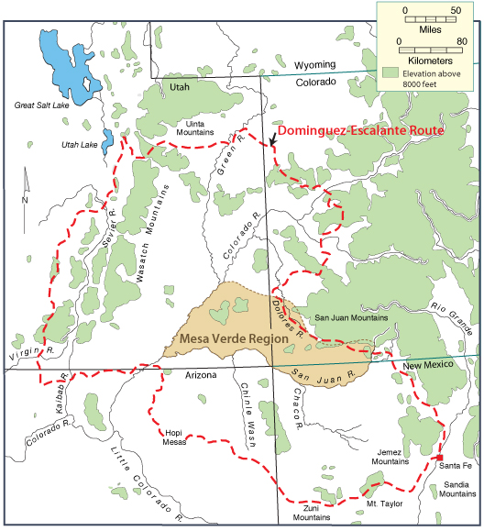
Theme: Power of Place
UTAH 1776
Spanish North America
???

Slide 9
Domínguez and Escalante Expedition
July 1776-January 1777
RESOURCES
Expedition 1776 “Flat Stanley” Explorers
Spanish, Mexican, New Mexican, Ute
GIS Story Map
Lessons
4th Grade Lesson
7th Grade Lesson
7th Grade Journal Writing Activity
Essential Questions
Why does this particular expedition matter?
What is significant about it?

Slide 10
National History Day
+
America250
HISTORY
+
CONTENT
+
SKILLS

Slide 11

What are the causes of a REVOLUTION? What ideas led to it? Who supports it and why? Who opposes it and why? What does the revolution cause in turn?
How does a REACTION lead to change? What are people reacting to and why? Can the change be positive or negative? Both?
What does it mean to REFORM something? What motivates people to engage in reform? What hinders reform? Are the results of reform always positive?

Slide 12
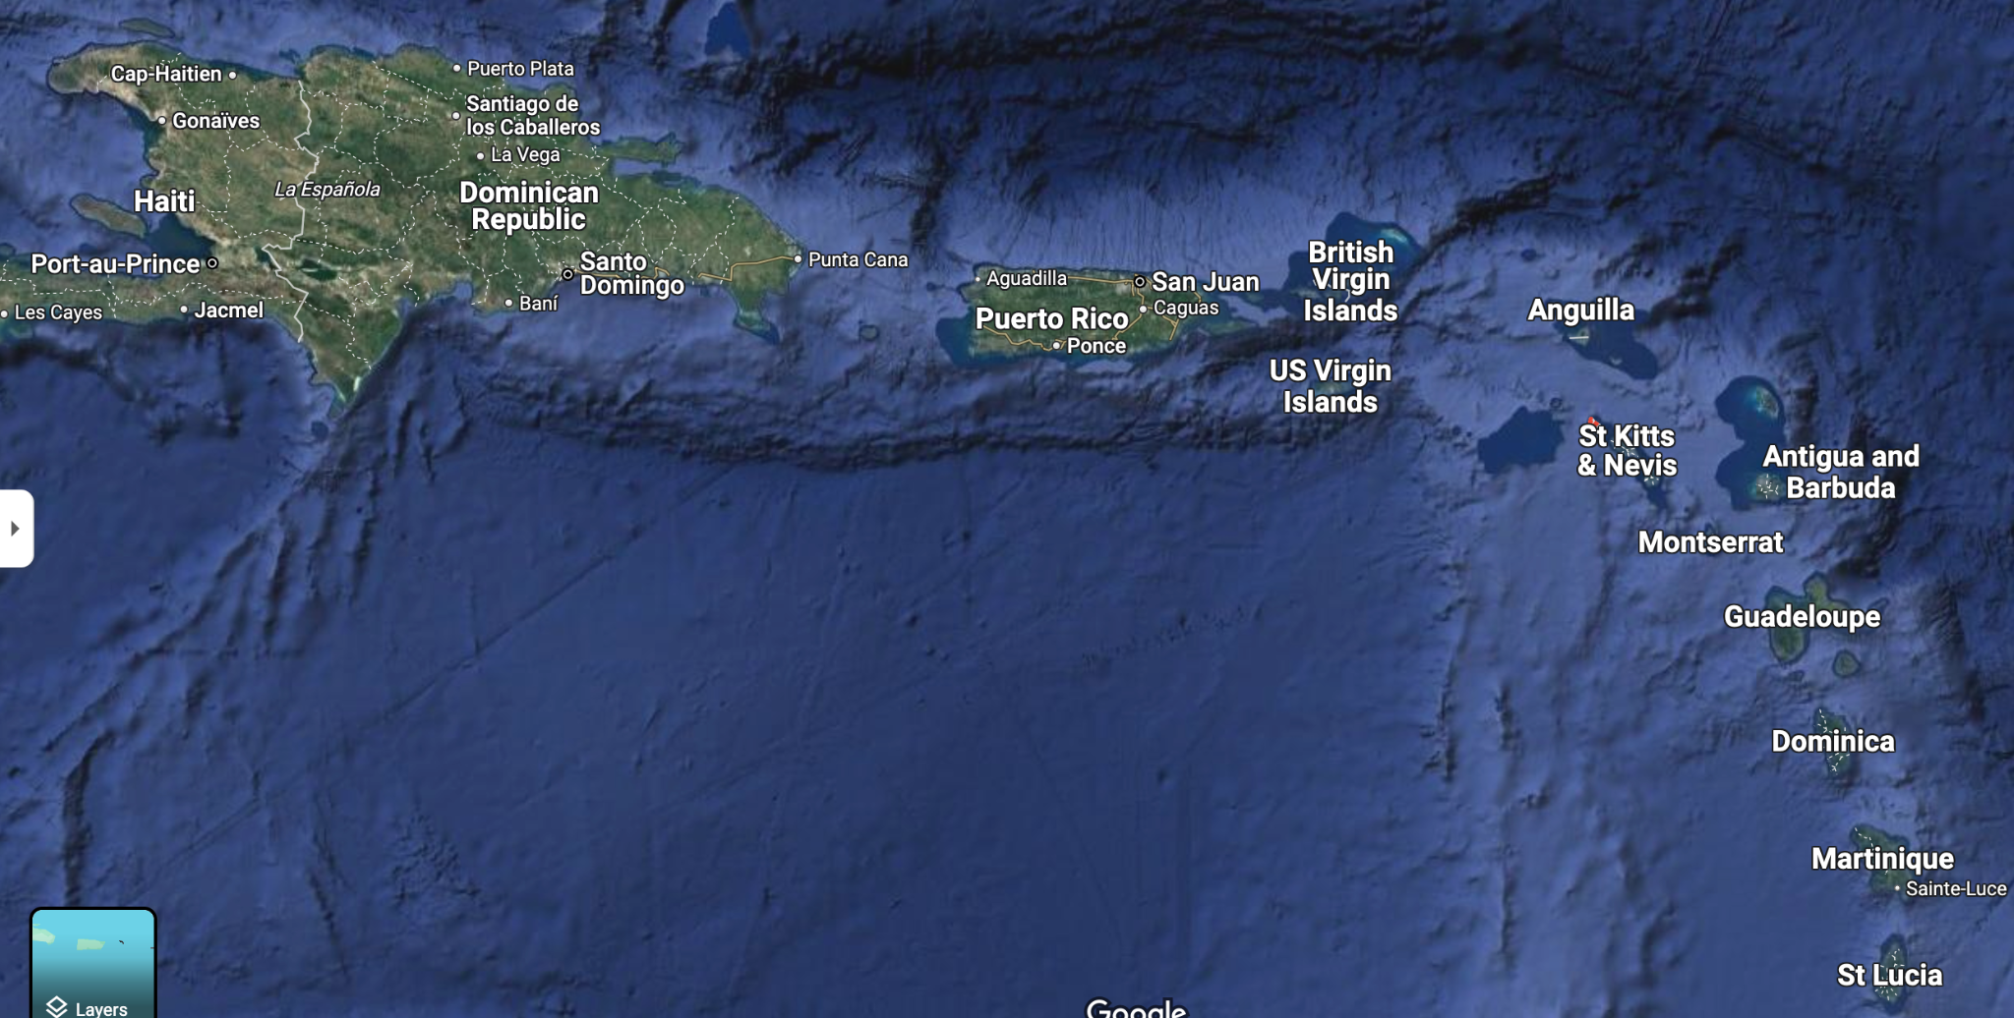
GREAT NHD TOPICS
COME FROM…
→ World History
→ U.S. History
→ Utah History
→ Student interests
→ Meaningful theme connections
St. Eustatius: The Exploration, Encounter, and Exchange that Won the Revolution

Slide 13
National History Day
Step by Step
ANALYZE
Read. Analyze the sources. Place them in historical context. Craft a thesis. Make an argument based on evidence. Show change and impact.
CHOOSE A TOPIC
Research topic ideas that connect to the annual theme. Select the topic that interests you!
RESEARCH
Find credible primary and secondary sources on your topic. Seek multiple perspectives. Keep digging!
CREATE
Develop your exhibit, paper, website, performance, or documentary. Create process paper and bibliography.

Slide 14
Teach the
Skills
Primary and Secondary Sources
Integrate skills with
your content

Slide 15
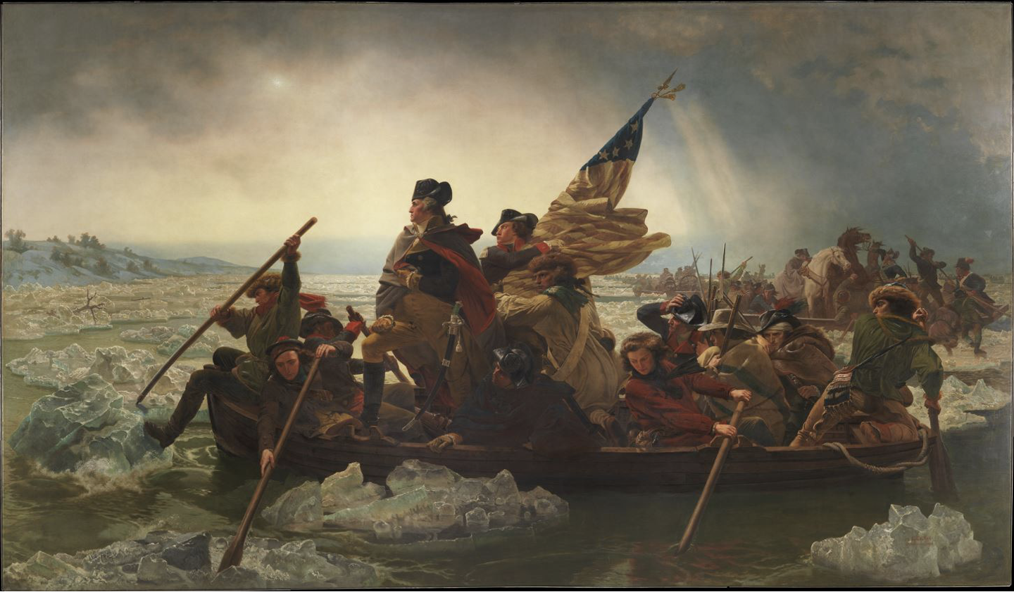
Primary Sources
What makes an artifact or document a primary source?
Keywords:
WHEN was it created?
Washington Crossing the Delaware, by Emanuel Leutze (1851)

Slide 16
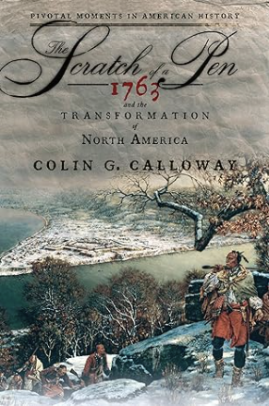
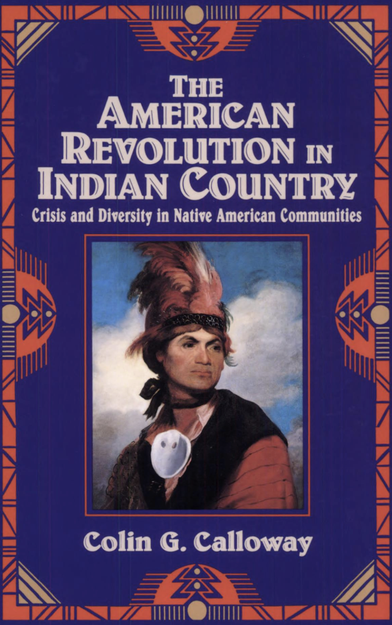
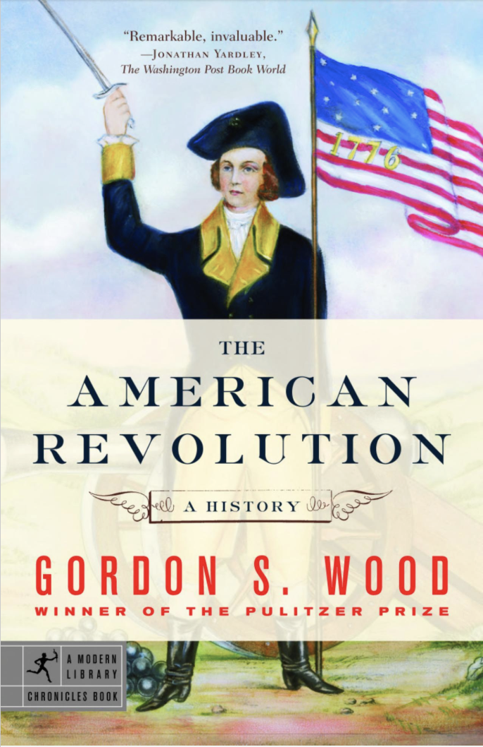

Secondary Sources
What makes a secondary source credible?
Keywords:
WHO wrote it?

Slide 17
Teach the
Skills
Locating credible sources
Research roadmap
Multiple perspectives
Research Strategies and Digital Literacy

Slide 18
Finding Credible Sources for Research
Archives
Museums
Historical Sites
Historical Societies
University Libraries
Peer Reviewed Journals
Books
Secondary Source Databases & Search Engines
> Gale
> EBSCO
> JSTOR
> GoogleBooks
> GoogleScholar
> Utah Historical Quarterly
> Utah History to Go
> I Love Utah History
Researchers Beware!
Crazy Aunt Edna

Slide 19
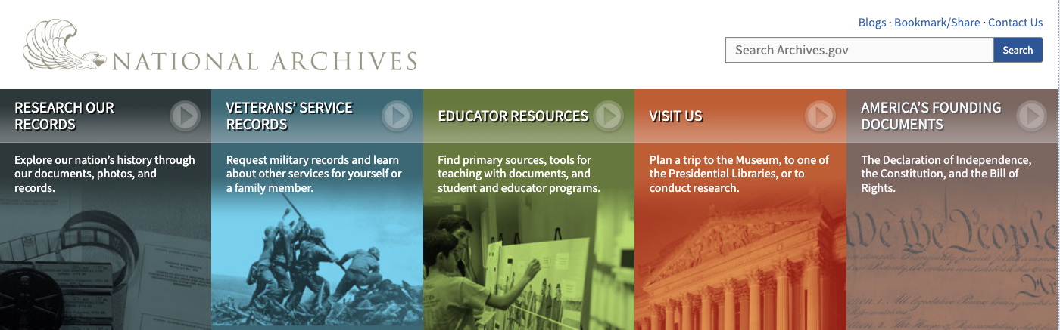
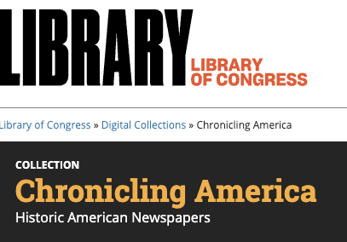
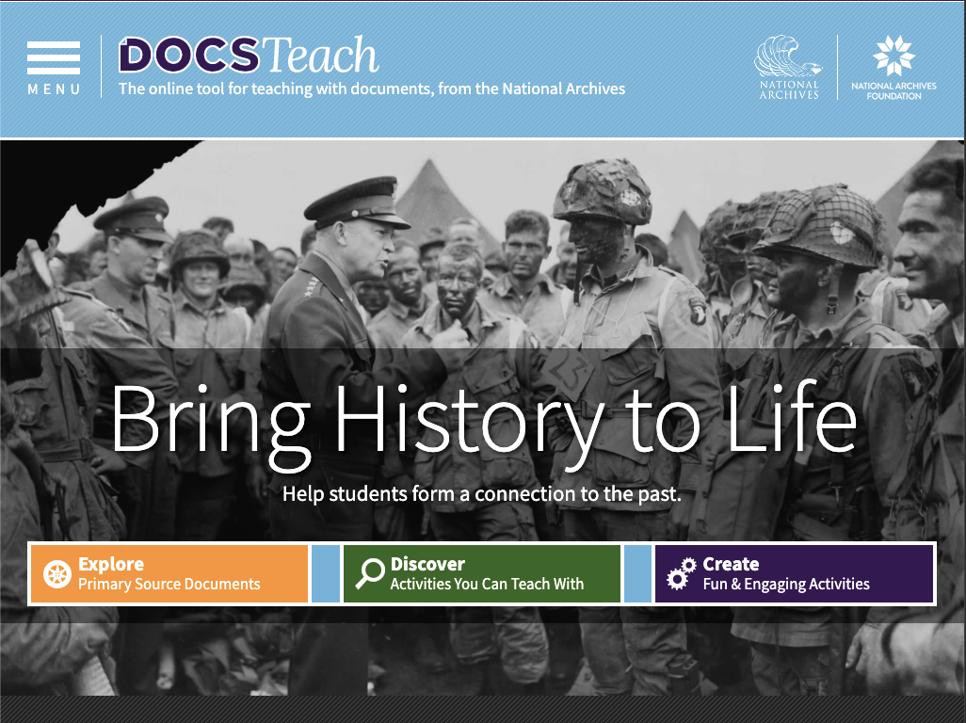

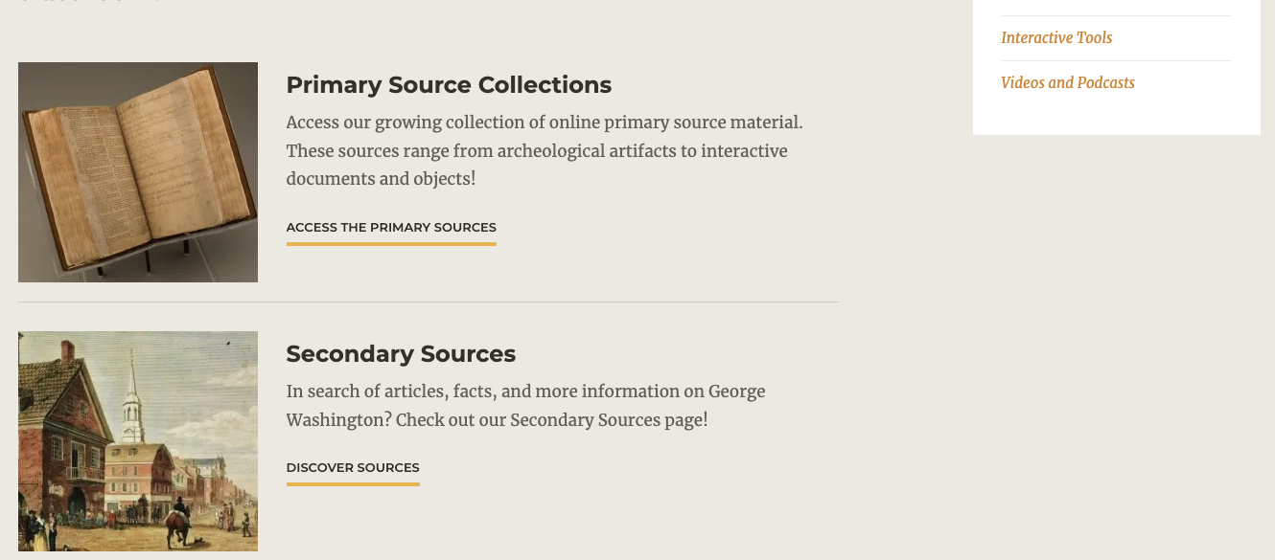
Archives

Slide 20
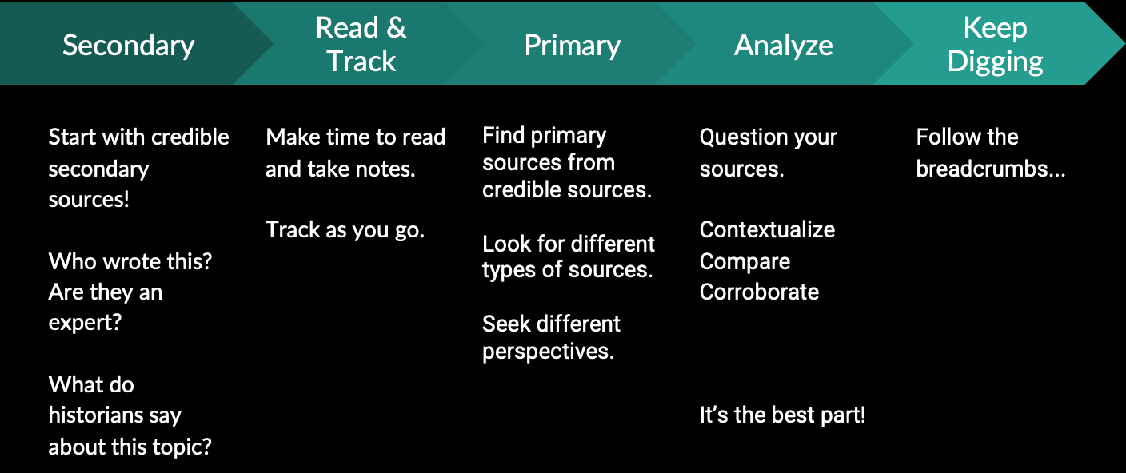
Research: Order of Operations

Slide 21
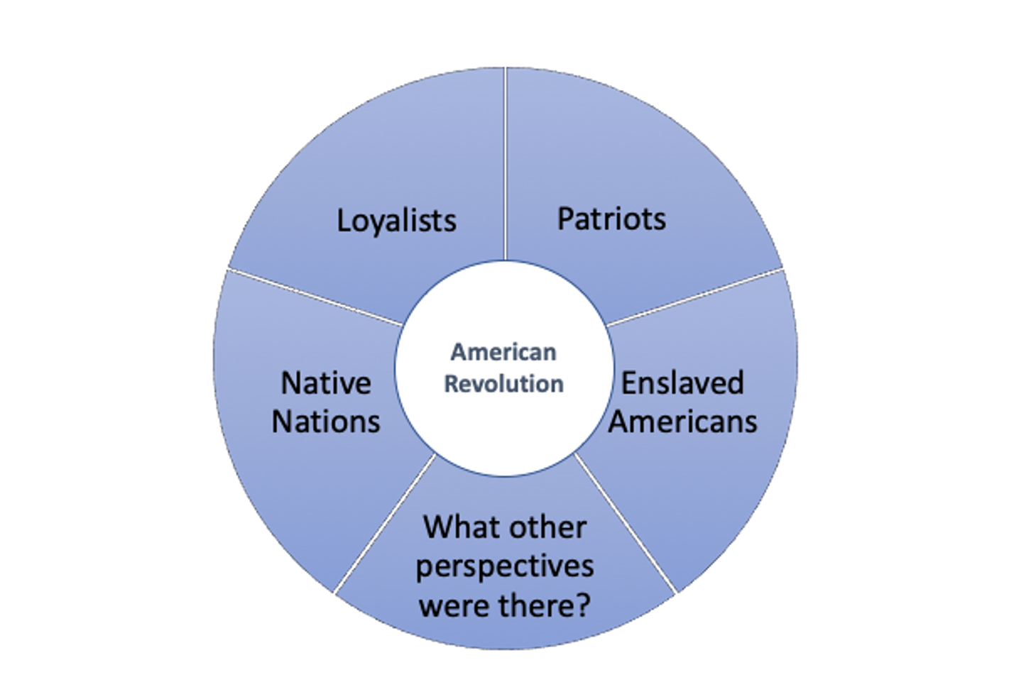
Look for
Multiple
Perspectives

Slide 22
Teach the
Skills
Strategies for analyzing primary sources
Historical thinking skills
Lesson plan
Historical Thinking and Analysis

Slide 23
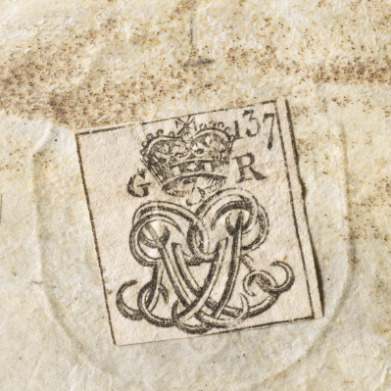
Primary Source
Analysis Strategy
^{OBSERVE:}
^{REFLECT:}
^{QUESTION:}
Library of Congress: Teaching with Primary Sources Model
https://timeline.amrevmuseum.org/objects

Slide 24
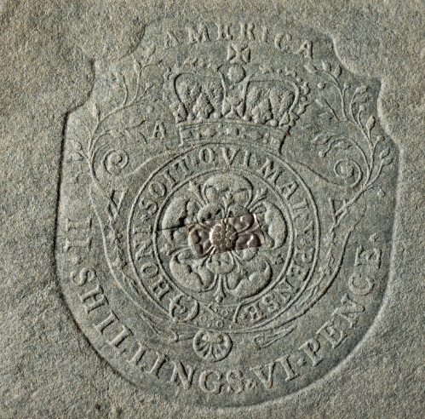
Stamp Act Stamp
1765-1766
Source: Museum of the American Revolution
“Intended to help support the British regiments left to defend the American colonies after the French and Indian War, Parliament passed the Stamp Act tax on March 22, 1765. Stamps, which proved the tax was paid, were to be applied to all legal documents, newspapers, and pamphlets, as well as playing cards and dice. Many Americans thought the tax was unfair and opposed it. Protests broke out in almost every colony, sometimes violently targeting stamp collectors and other government officials. The protests were successful and the Stamp Act was repealed on March 11, 1766, never having taken full effect in the American colonies.”
https://timeline.amrevmuseum.org/objects

Slide 25
Historical Thinking Skills Model
Digital Inquiry Group (DIG): Reading Like a Historian
CONTEXTUALIZE
Place the source in its time and place.
CORROBORATE
Compare & contrast to other sources in time.
SOURCING
Identify the source. Who created it? When? Purpose? Perspective?
CLOSE READING
Examine the message.

Slide 26
Historical Thinking Skills Lesson Plan
BOSTON MASSACRE
Digital Inquiry Group (DIG)
On March 5, 1770, there was a violent confrontation between British soldiers and colonists in Boston. British soldiers killed five colonists in an event that came to be known as the Boston Massacre. The events leading up to the Boston Massacre were chaotic, and there are many conflicting accounts of what took place.

Slide 27
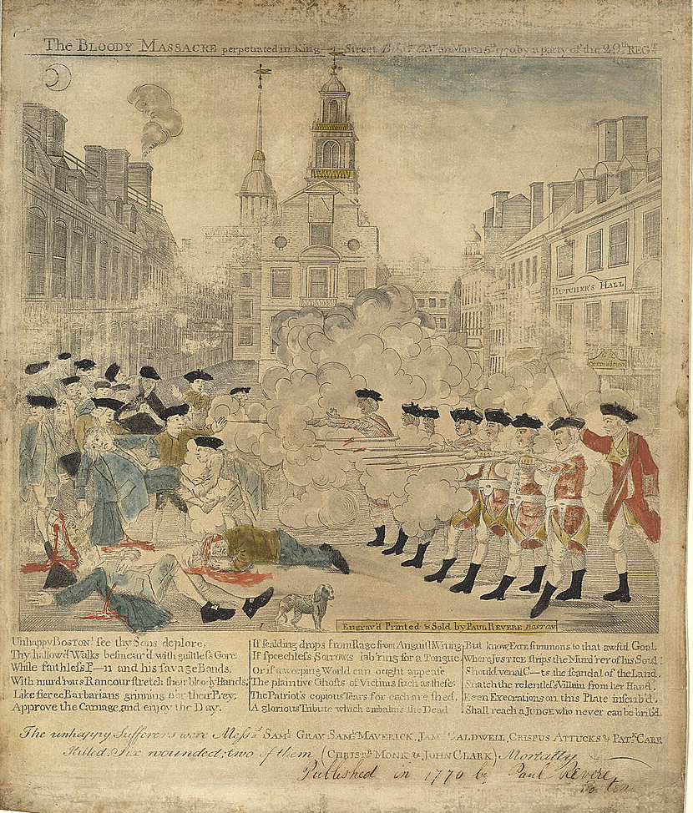
DIG LESSON PLAN
Image 1
Central Historical Questions
What happened in Boston on March 5, 1770?
Who was responsible?

Slide 28
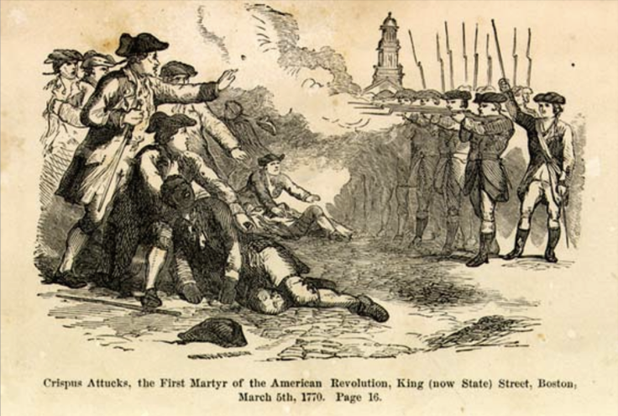
DIG LESSON PLAN
Image 2
Central Historical Questions
What happened in Boston on March 5, 1770?
Who was responsible?

Slide 29
Paul Revere, 1770
“The Bloody Massacre perpetrated in King Street Boston on March 5th 1770 by a party of the 29th Regiment.”
William Nell, 1865
“The Colored Patriots of the American Revolution”

Slide 30
Document A
By Thomas Preston
Captain Thomas Preston was an officer in the British army. While in jail, he wrote this narrative. A British tax collector brought this account to London on a ship that left Boston on March 16, 1770. The account was then re-printed in Boston newspapers in June 1770 after copies of the London newspaper were brought to Boston.
Read and analyze each document. Work with your partner to complete the graphic organizer.
Document B
By Samuel Drowne
On March 12, 1770, Boston residents held a town meeting, which was how local
government decisions were made. At the meeting, the colonists appointed a
committee to produce an account of what happened March 5th to send to officials in
London because they wanted to influence the way the events of March 5th were
portrayed. Drowne was one of 96 residents of Boston to give sworn testimony to
justices of the peace about what happened between the British soldiers and residents of Boston. These accounts were taken by ship to London on April 1, 1770.

Slide 31
Contact Us!
Dr. Wendy Rex Atzet
NHD Utah State Coordinator
Utah Historical Society
wratzet@utah.gov
Tatiana Chudy
NHD Utah Program Assistant
Utah Historical Society
tchudy@utah.gov

Slide 32
Session Description:
In 2026, America250 activities will celebrate our nation’s founding in 1776. In connection with the semiquincentennial, National History Day participants will explore the theme Revolution, Reaction, and Reform in History during the upcoming school year.
NHD brings history to life for young people, providing rich opportunities for individualized learning that makes history relevant and accessible to all. Students may choose a topic from local, national, or world history that relates to the theme. They engage in authentic discovery, building digital literacy and analytical skills as they research their topic. They develop literacy skills as they make an argument based on evidence from their research. They develop presentation skills and creativity by creating an exhibit, documentary, performance, website, or paper to showcase their work. Students may opt in to our spring 2026 tournaments, which culminate in a national competition held in Washington, D.C., each June.
NHD is appropriate for 4th-12th grade social studies and E/LA classrooms, and supports a diverse range of students from special education and English language learners through accelerated classes.
In this session you will learn how to put this inquiry model to work in your classroom and meet core standards in social studies and E/LA, all while centering student choice and student voice. National History Day in Utah is a free program housed at the Utah Historical Society. Teachers will receive a set of classroom materials, along with the Utah Historical Society’s free online resources for K-12 learning.

