Slide 1

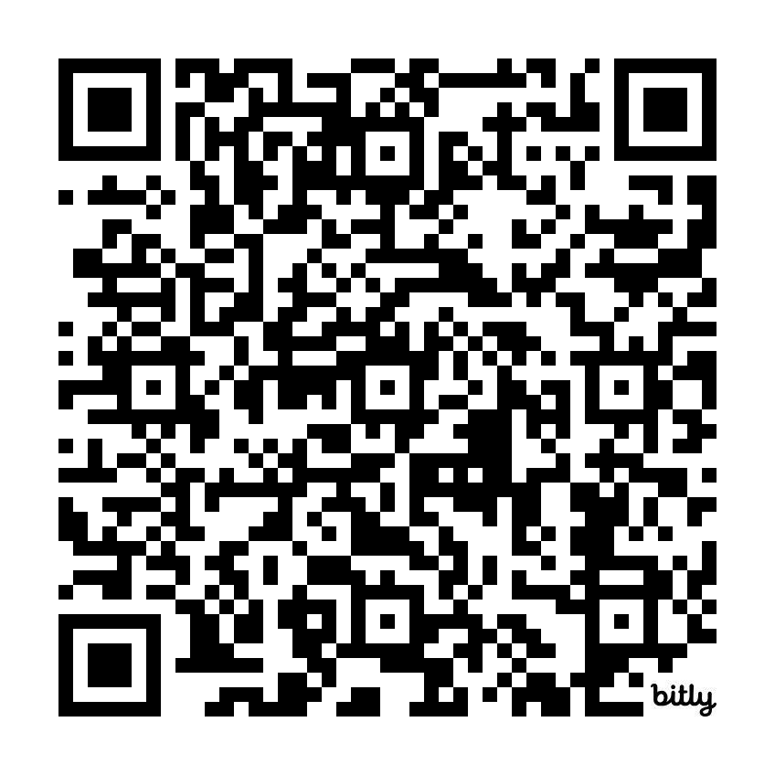
Power Tools: Differentiate for All Learners Without Teacher Burnout
https://bit.ly/Power_Tools_Differentiate_Without_Burnout
Dari Thacker
dariscreativecorner@gmail.com
Silver Summit Elementary
(South Summit School District)

Slide 2
The Dilemma
How can I best meet the diverse needs of ALL of my students and still provide the same instruction to all while simultaneously not burning myself out in the process?
https://bit.ly/Power_Tools_Differentiate_Without_Burnout

Slide 3

A Little About Me & My Educational Journey
With Differentiation
Dari Thacker
dariscreativecorner@gmail.com
https://bit.ly/Power_Tools_Differentiate_Without_Burnout

Slide 4
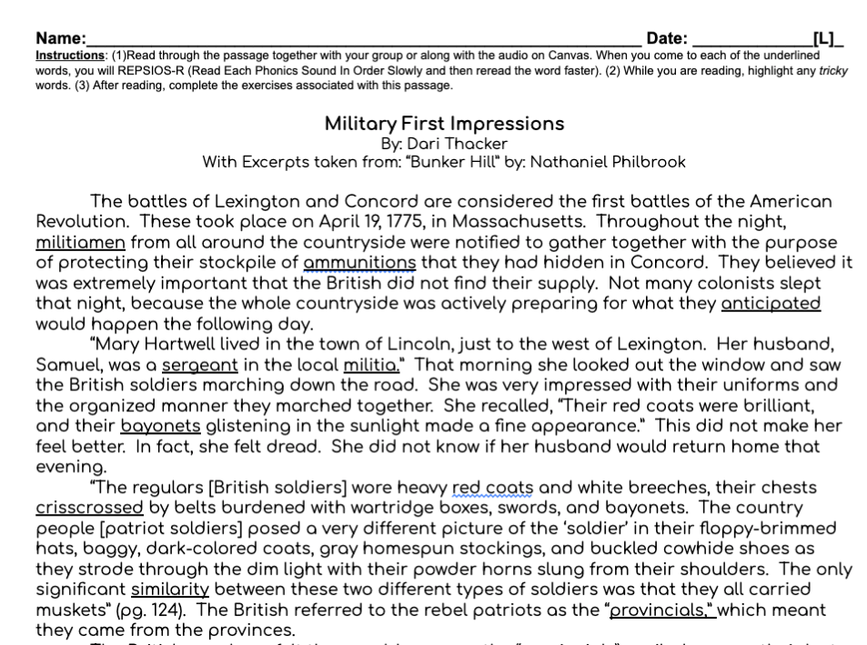

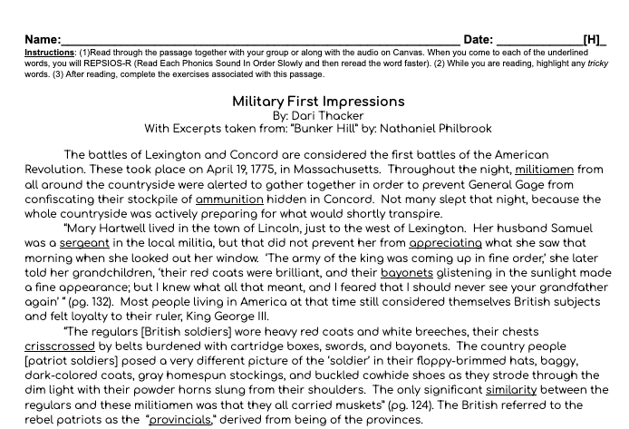

Slide 5
Further Complications
New student straight from another country- knew no English
Lucky- could read in native language
https://bit.ly/Power_Tools_Differentiate_Without_Burnout

Slide 6
ANSWER
Using AI tools/resources
https://bit.ly/Power_Tools_Differentiate_Without_Burnout

Slide 7
Learning Objectives
Ways to easily re-level texts
Quickly produce a text that meets requirements for a given standard
  Age appropriate and accessible
Translate any assignment into another language
https://bit.ly/Power_Tools_Differentiate_Without_Burnout

Slide 8
RE-LEVEL TEXTS
School.ai
Magicschool.ai
Organize in Google Docs
https://bit.ly/Power_Tools_Differentiate_Without_Burnout

Slide 9
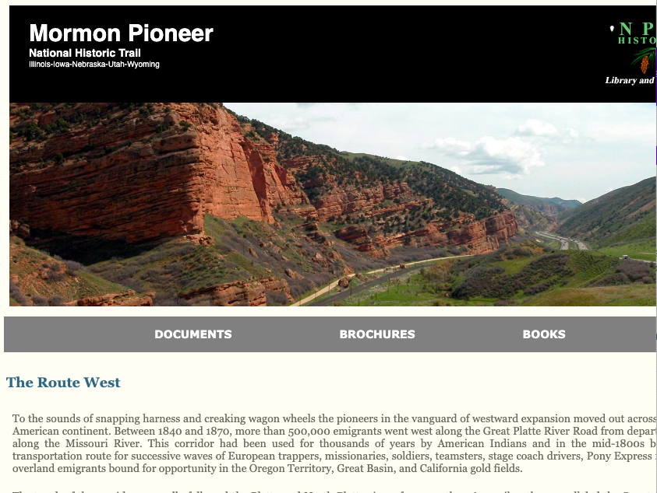
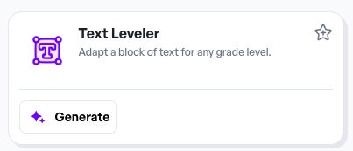

Re-Level Texts
School.ai- freemium
  Sample Text ->

Slide 10


Re-Level Texts
MagicSchool.ai- freemium
  Sample Text ->

Slide 11
Quickly Produce Text Meeting Standards
Magicschool.ai
School.ai
Google Gemini
Organize in Google
https://bit.ly/Power_Tools_Differentiate_Without_Burnout

Slide 12
Tips for Success
Prompt is EVERYTHING!
Be as specific as possible:
  Standard
  Age-appropriate
  Accessible
  Type of text
https://bit.ly/Power_Tools_Differentiate_Without_Burnout

Slide 13
Quickly Produce Texts
5th Social Studies Standard:
(SS 5.4.1b) I can examine causes and consequences of important events in the United States expansion (e.g. Louisiana Purchase, Lewis and Clark expedition, treaties with American Indians, Homestead Act, Trail of Tears, California Gold Rush) (SS 5.4.1b).

Slide 14
Quickly Produce Texts
Sample Prompt: I need an informational text that is accessible to and age appropriate for 5th graders that meets the following criteria: causes and consequences of important events in the United States expansion (e.g. Louisiana Purchase, Lewis and Clark expedition, treaties with American Indians, Homestead Act, Trail of Tears, California Gold Rush) (SS 5.4.1b). Can you provide me with one?

Slide 15
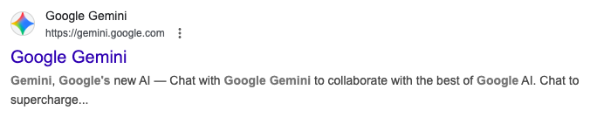
Quickly Produce Texts
Google Gemini

Slide 16

Quickly Produce Texts
MagicSchool.ai
  Great for informational texts
  Create Google Doc w/ tabs

Slide 17
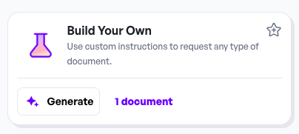
Quickly Produce Texts
School AI
  Great for informational texts

Slide 18
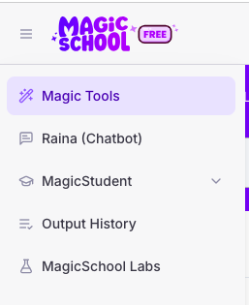
Quickly Produce Texts
MagicSchool.ai
  RAINA CHATBOT
  Other Types of Texts
    Ex: Stars & Nebulae poem, narrative, etc.

Slide 19

Quickly Produce Texts
School.ai
  CURRICULUM COACH
  Found on toolbar on right side. Scroll down.

Slide 20
WHAT ABOUT FOR K-2?
https://bit.ly/Power_Tools_Differentiate_Without_Burnout

Slide 21
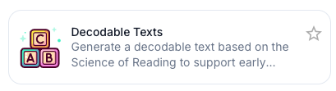
Quickly Produce Texts
MagicSchool.ai

Slide 22

Quickly Produce Texts
MagicSchool.ai
  Sample Prompt: Can you provide me with a decodable text about patterns of living things (plants and animals, including humans) in a desert habitat? Emphasize the diversity of living things in land and water habitats. Examples of patterns in habitats could include descriptions of temperature or precipitation and the types of plants and animals found in land habitats (SC 2.2.1). I would like this to include lots of opportunities for students to practice decoding words containing the “ai” dipthong. And, it needs to be age-appropriate and accessible for struggling 2nd graders.

Slide 23
Translate Resources
Magicschool.ai
School.ai
Google Translate
Organize in Google
https://bit.ly/Power_Tools_Differentiate_Without_Burnout

Slide 24
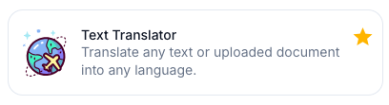
Translate Texts
MagicSchool.ai
  Does better than Google Translate in authenticity

Slide 25
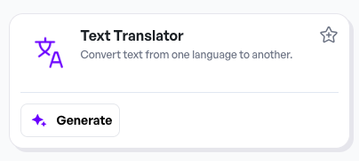
Translate Texts
School.ai

Slide 26
WHAT ABOUT ASSIGNMENTS?
https://bit.ly/Power_Tools_Differentiate_Without_Burnout

Slide 27
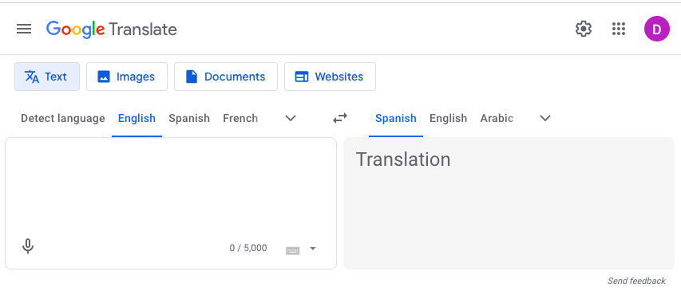
Translate Texts
Google Translate

Slide 28
See It In Action
Waves Science Notebook (pgs. 10-12)
Steps:
Open resource
Save desired page(s) as image or pdf
Open Google Translate
Upload file
Choose language
PRINT-can choose to save as pdf here. Works better than just downloading
https://bit.ly/Power_Tools_Differentiate_Without_Burnout

Slide 29
Questions
What questions do you have that have not already been addressed?
https://bit.ly/Power_Tools_Differentiate_Without_Burnout

Slide 30
Discussion
What are your thoughts about how you might be able to implement this in your educational role?
https://bit.ly/Power_Tools_Differentiate_Without_Burnout

