Slide 1


Making Peace Circles Work
A Tiered MTSS Framework for Everyday Classrooms and Student Needs

Slide 2

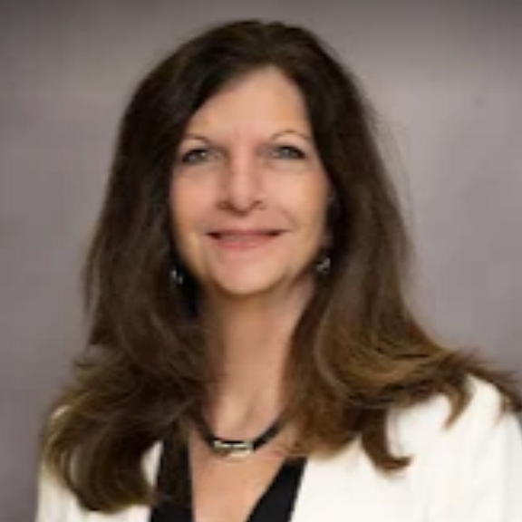
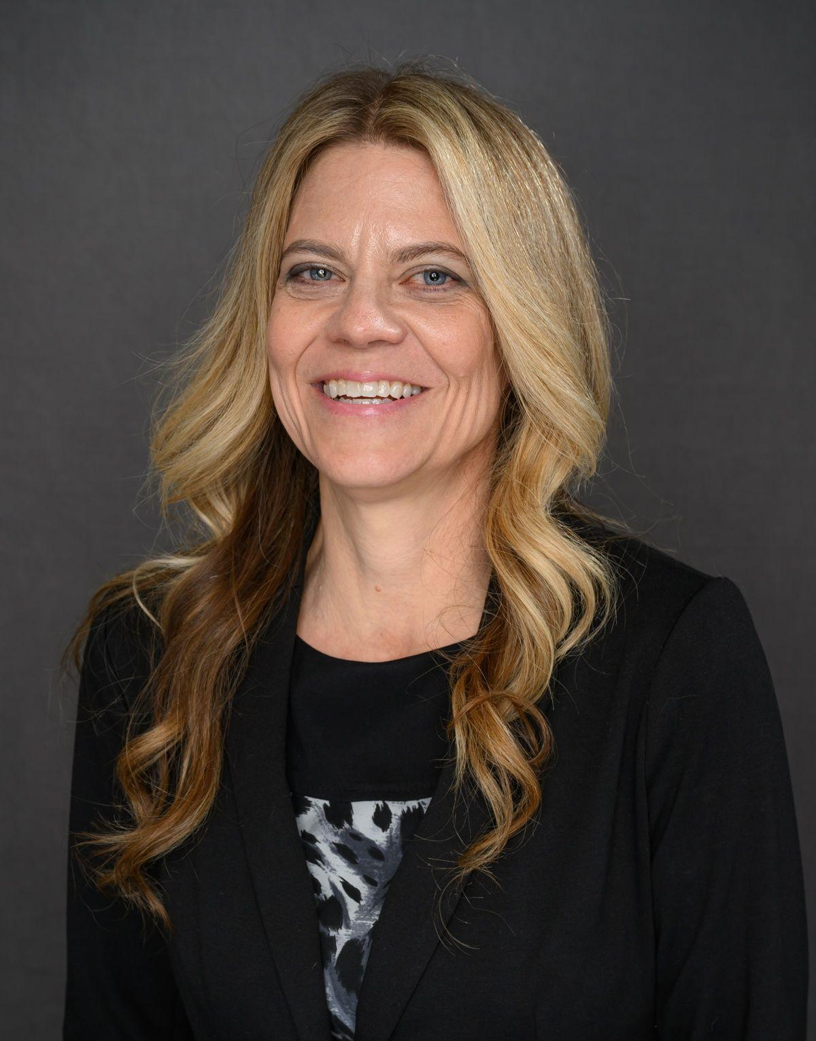
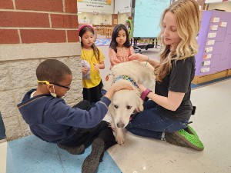
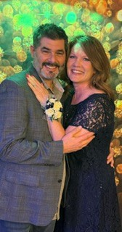
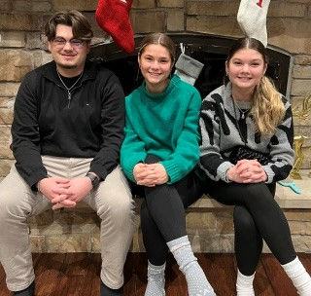
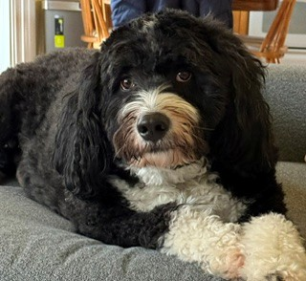
Our Peace Circle Team
Lisa Allen
Director of Student Supports
Dena Hasselberg
Student Services Coordinator
Joanna Hanson
Student Services Coordinator
Rachel Dellamorte
Continuous Improvement Coaching Coordinator

Slide 3


What are Peace Circles?
Peace Circles are a structured process of communication where students and staff gather in a circle so every voice is heard and valued.

Slide 4

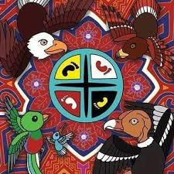
What are Peace Circles?
Rooted in Indigenous traditions and restorative justice practices, circles are now used in schools to build community, strengthen relationships, promote equity, and repair harm. They create safety, belonging, and connection—the conditions for learning.

Slide 5
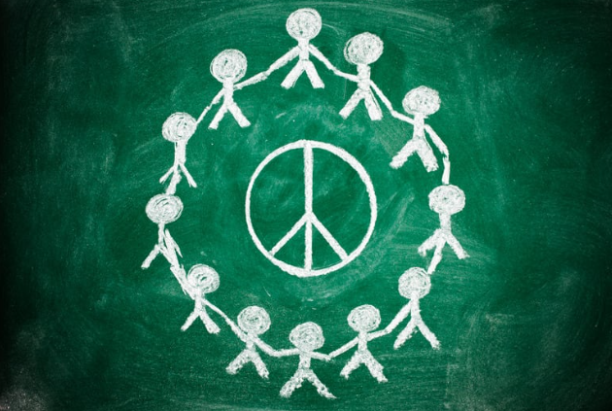
Theoretical Foundations for Using Circles in Schools
The Whole Child Approach
The Importance of Relationships in Child Development and Learning
The Importance of School Climate & Culture and a Sense of Belonging
Positive Discipline
Trauma- Sensitive Learning Environments
Mindfulness Practices
(Circle Forward pgs 6-7)
Circle Process Infographic

Slide 6
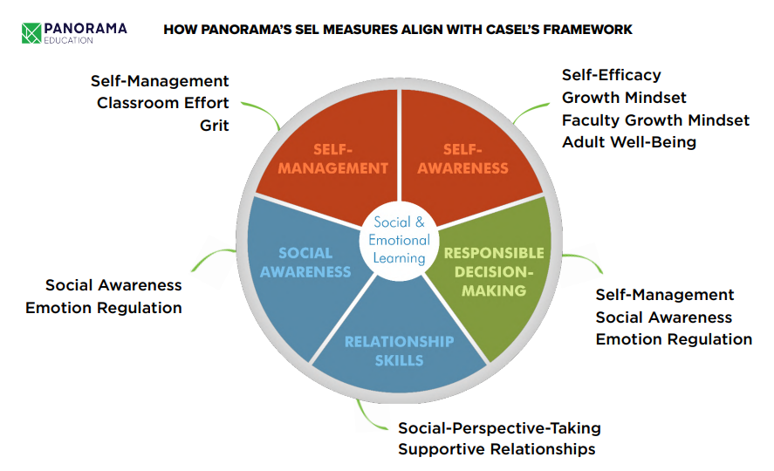
How Circles Support Social-Emotional Learning
Circle routines build belonging, engagement, and SEL skills
Self-Awareness
Use voice, reflect, build confidence
Self-Management
Managing emotions, attention, and responses.
Social Awareness
Listen, show empathy, value perspectives
Relationship Skills
Communicate, connect, build trust
Responsible Decision-Making
Use evidence, think critically, solve problems
CASEL: Community-Building Circles Guide

Slide 7
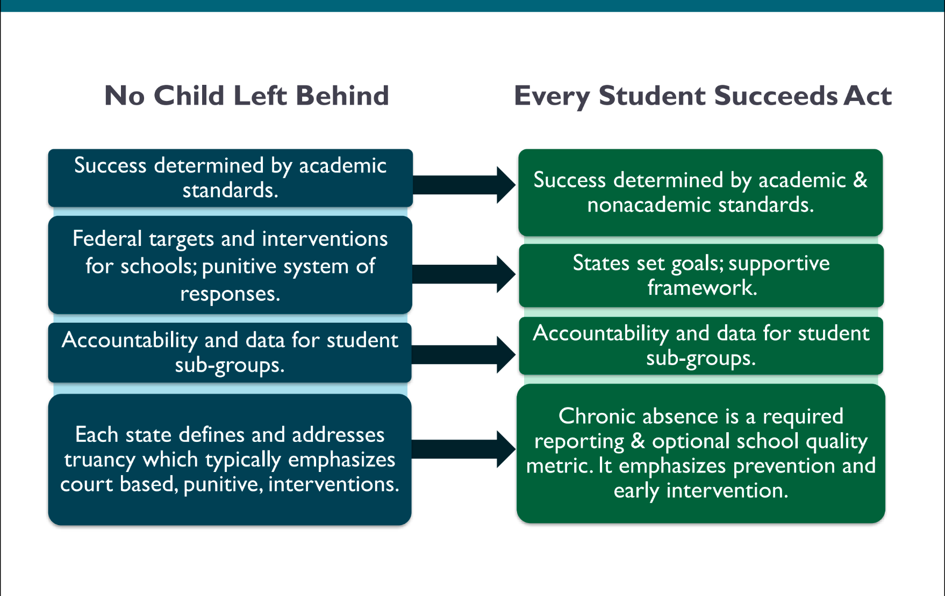
Senate Bill 100 and the Every Student Succeeds Act

Slide 8
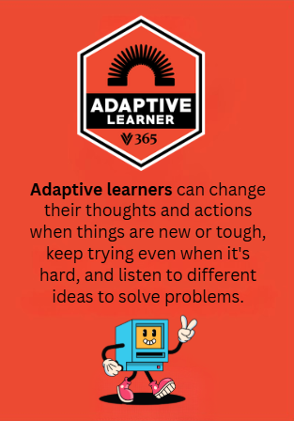
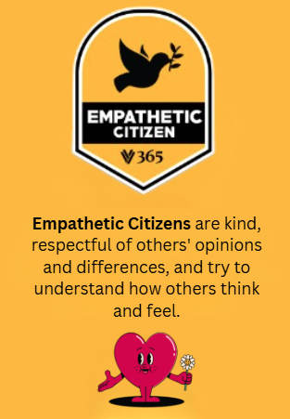
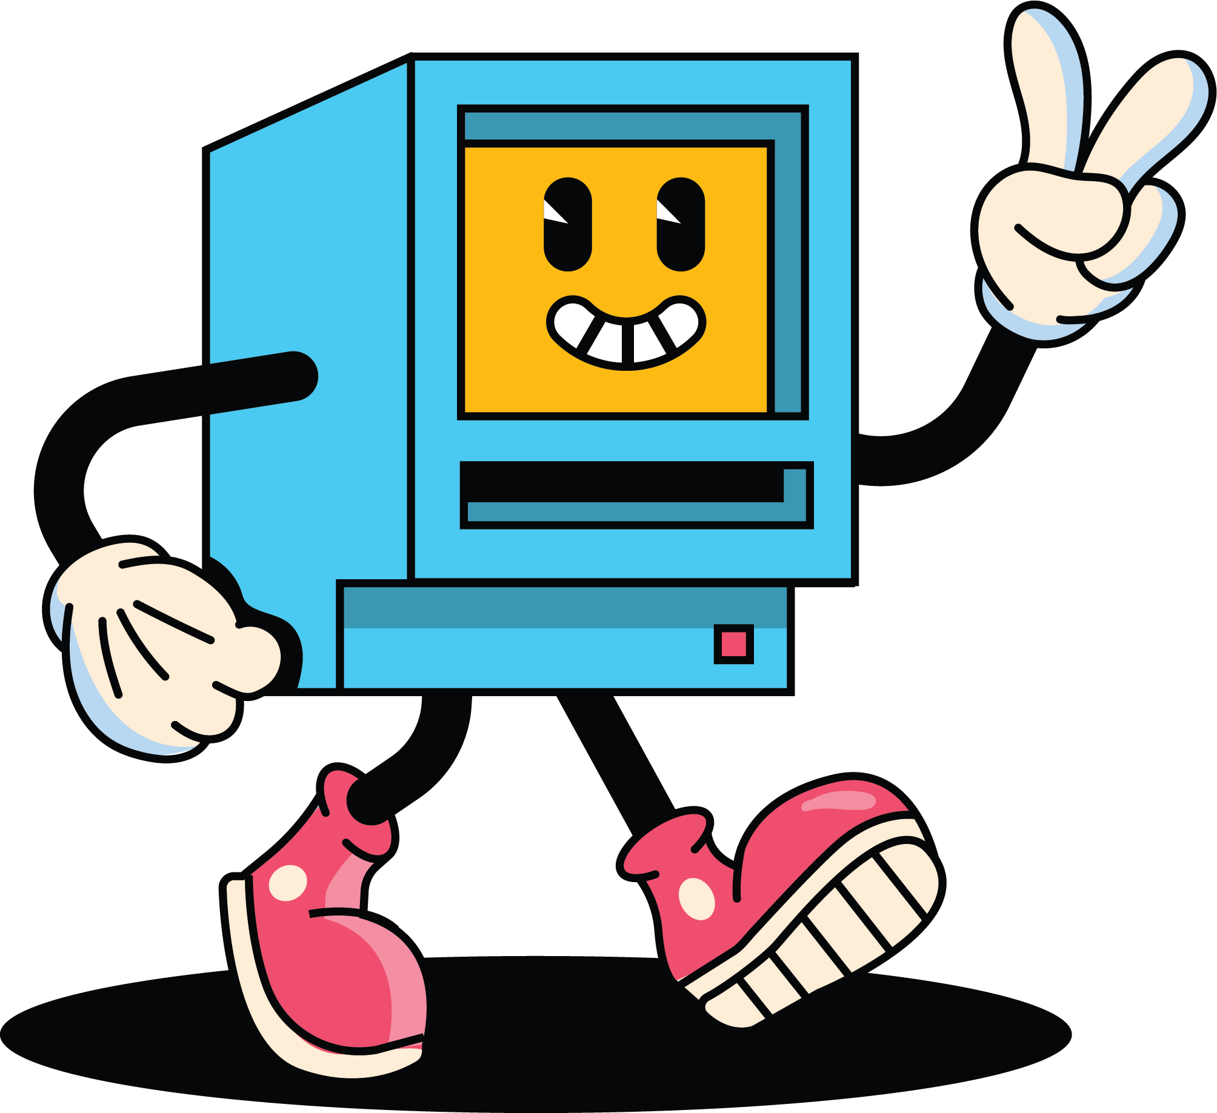
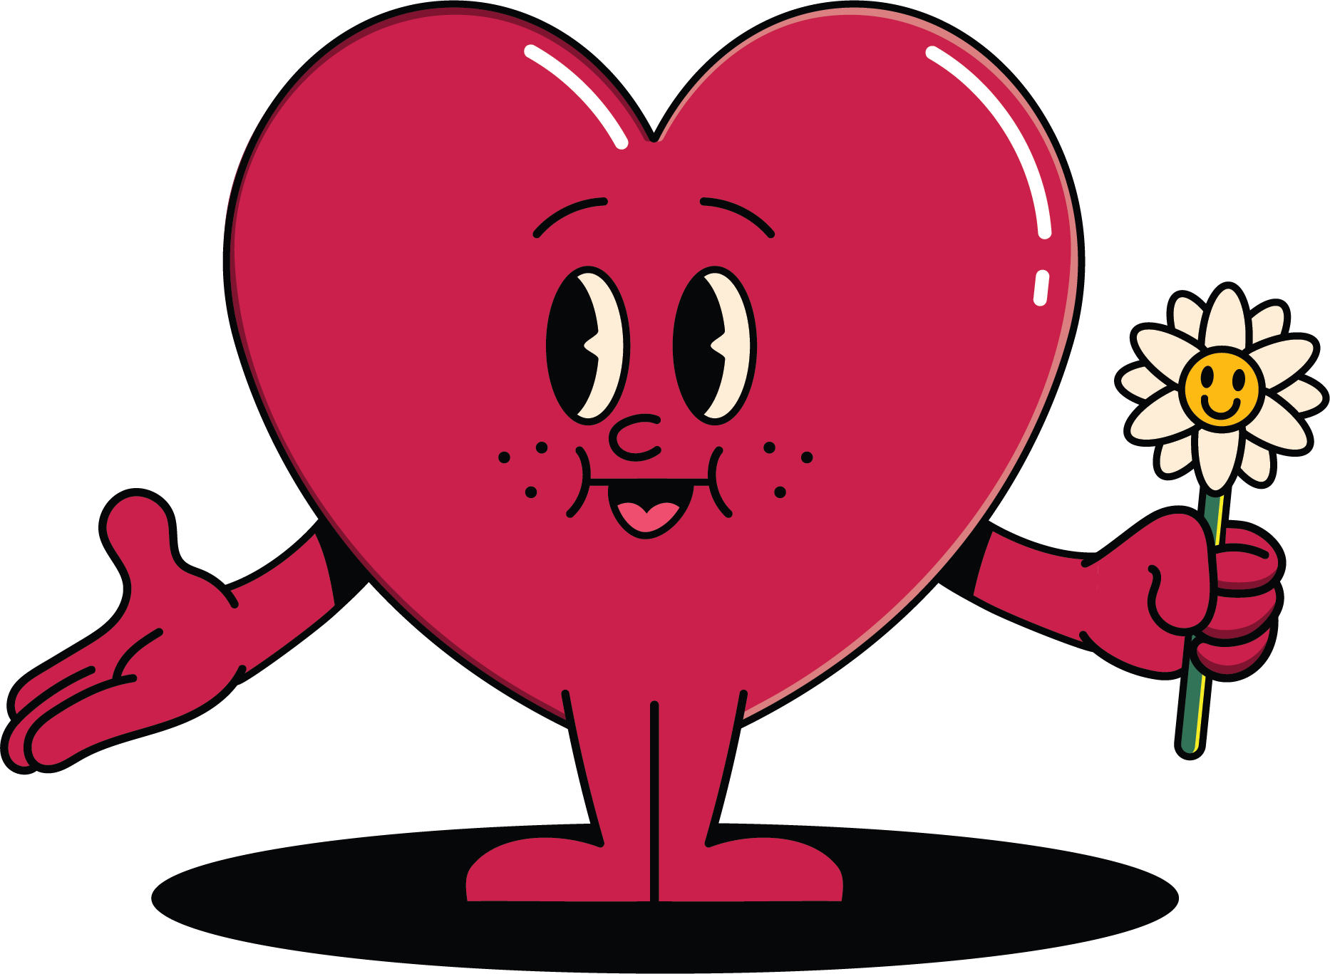
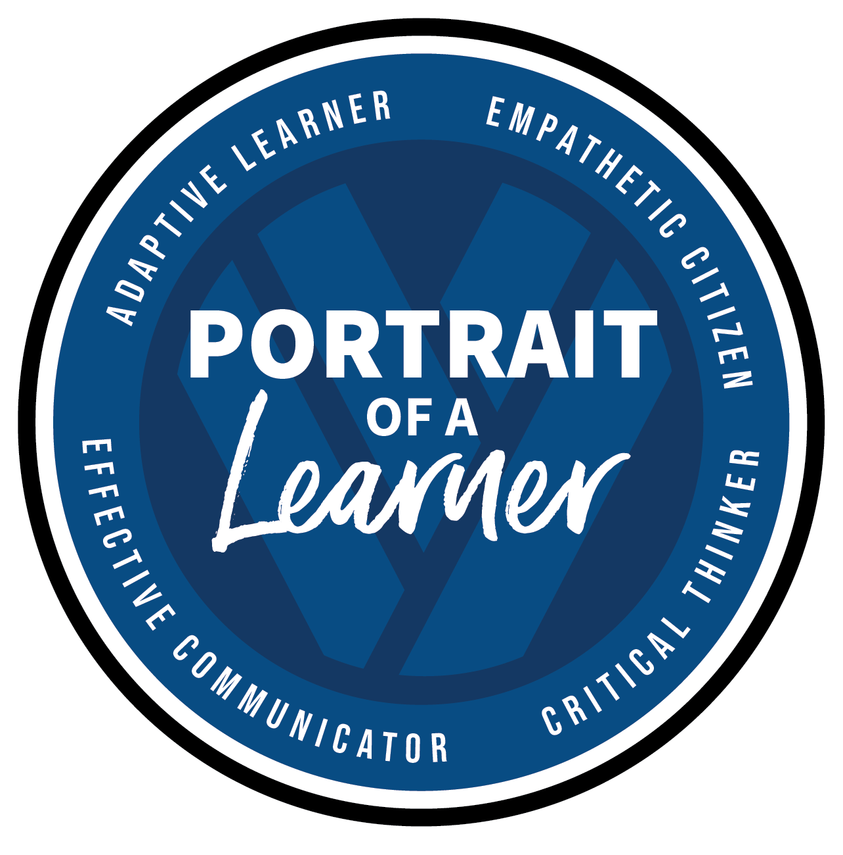
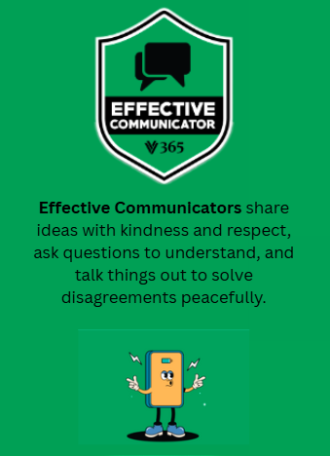
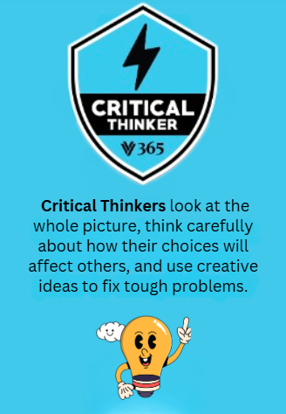
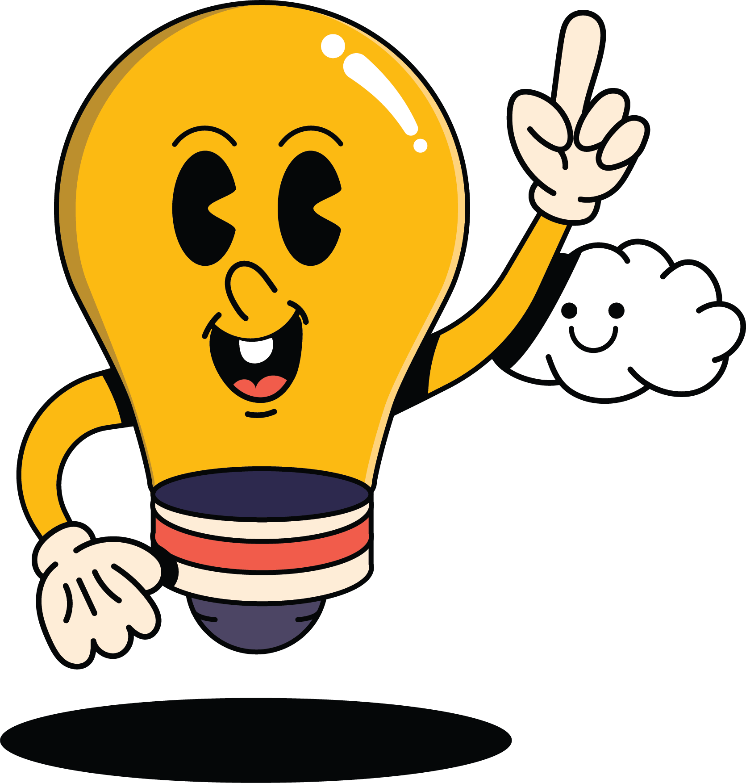
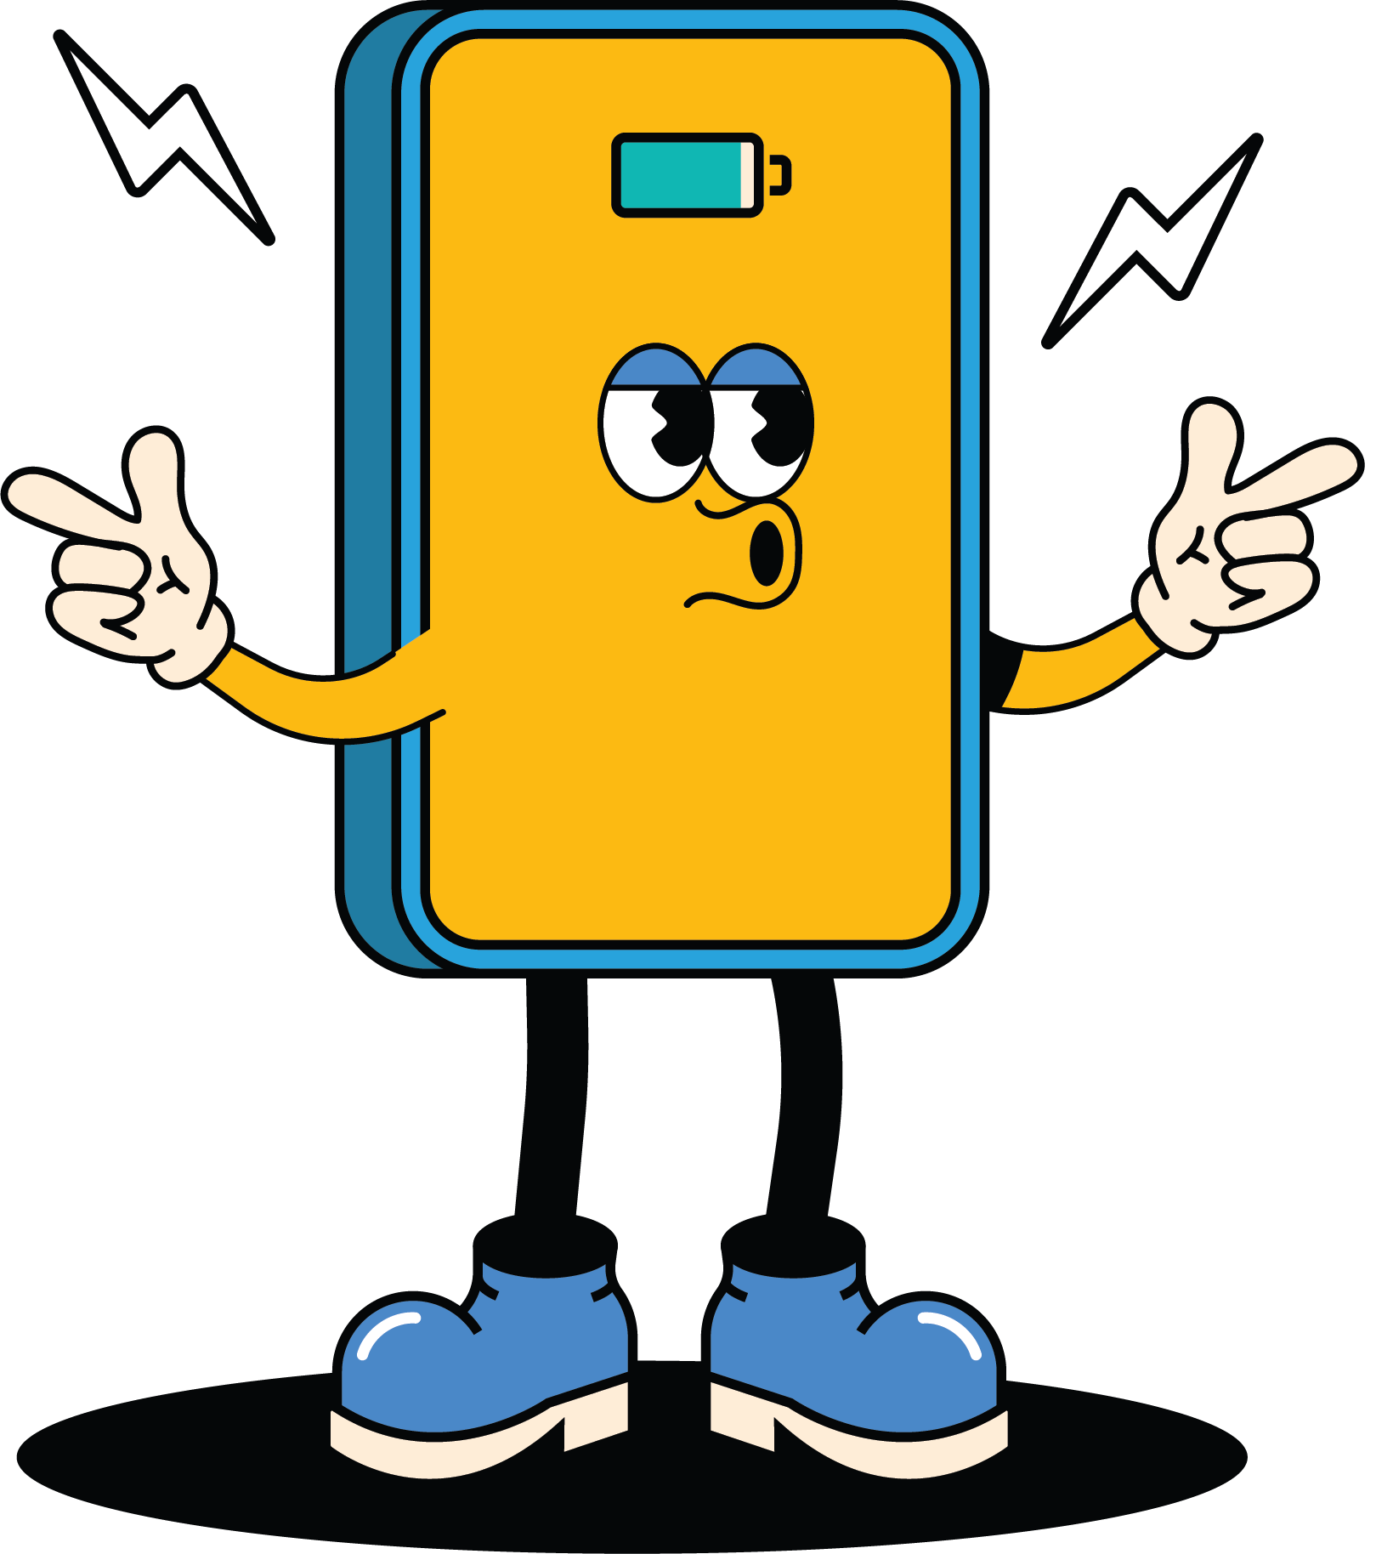
How Circles Support Social-Emotional Learning
VVSD Portrait of a Learner

Slide 9
The Circle Process
Elements of a Circle
🔔
Chime-In
→
🌟
Opening Reflection
→
💬
Check-In
→
🎯
Ice Breaker / Activity
→
🤝
Values & Agreements
🗣️
Question Rounds
→
💛
Check-Out
→
🌱
Closing Reflection
→
🔔
Chime-Out

Slide 10
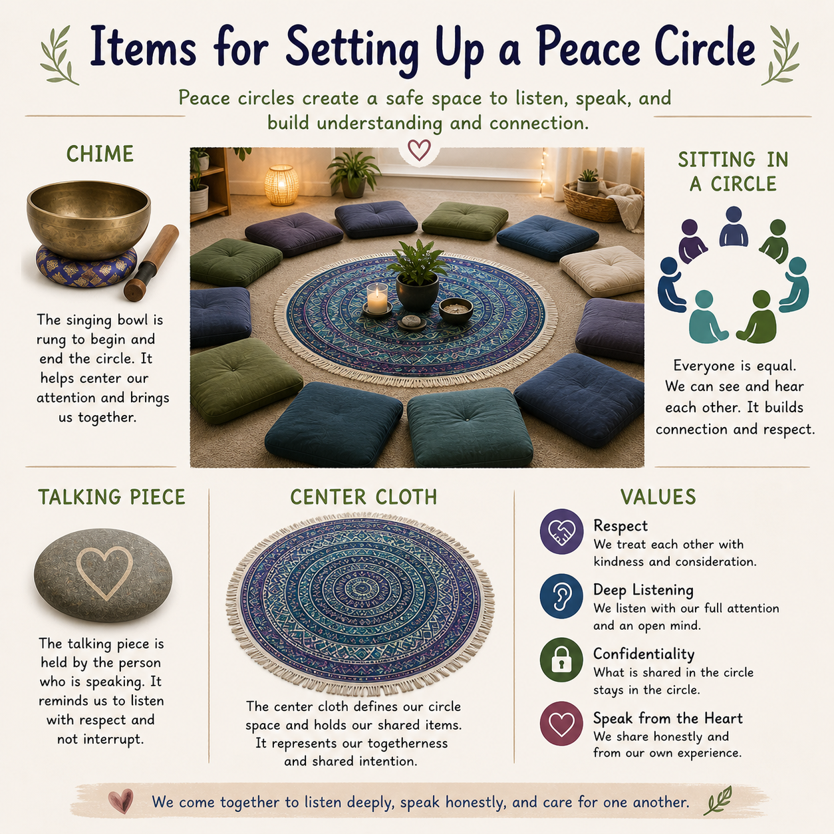
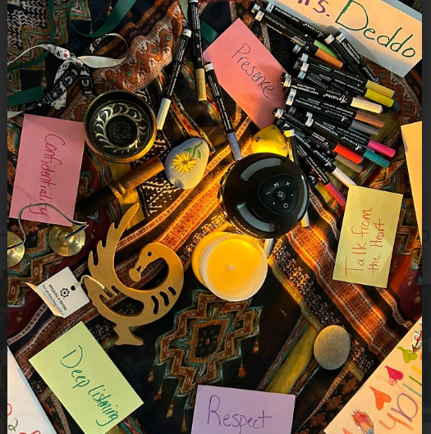
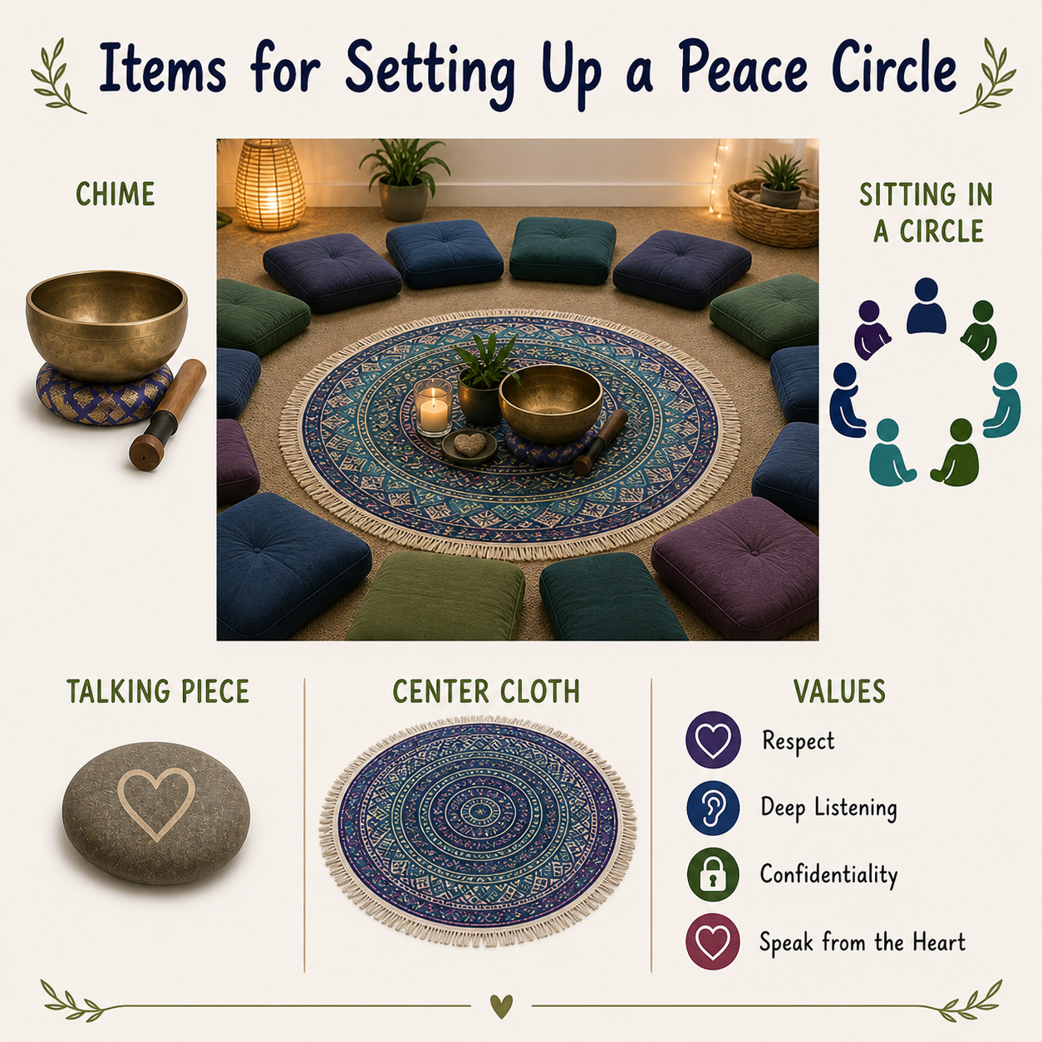
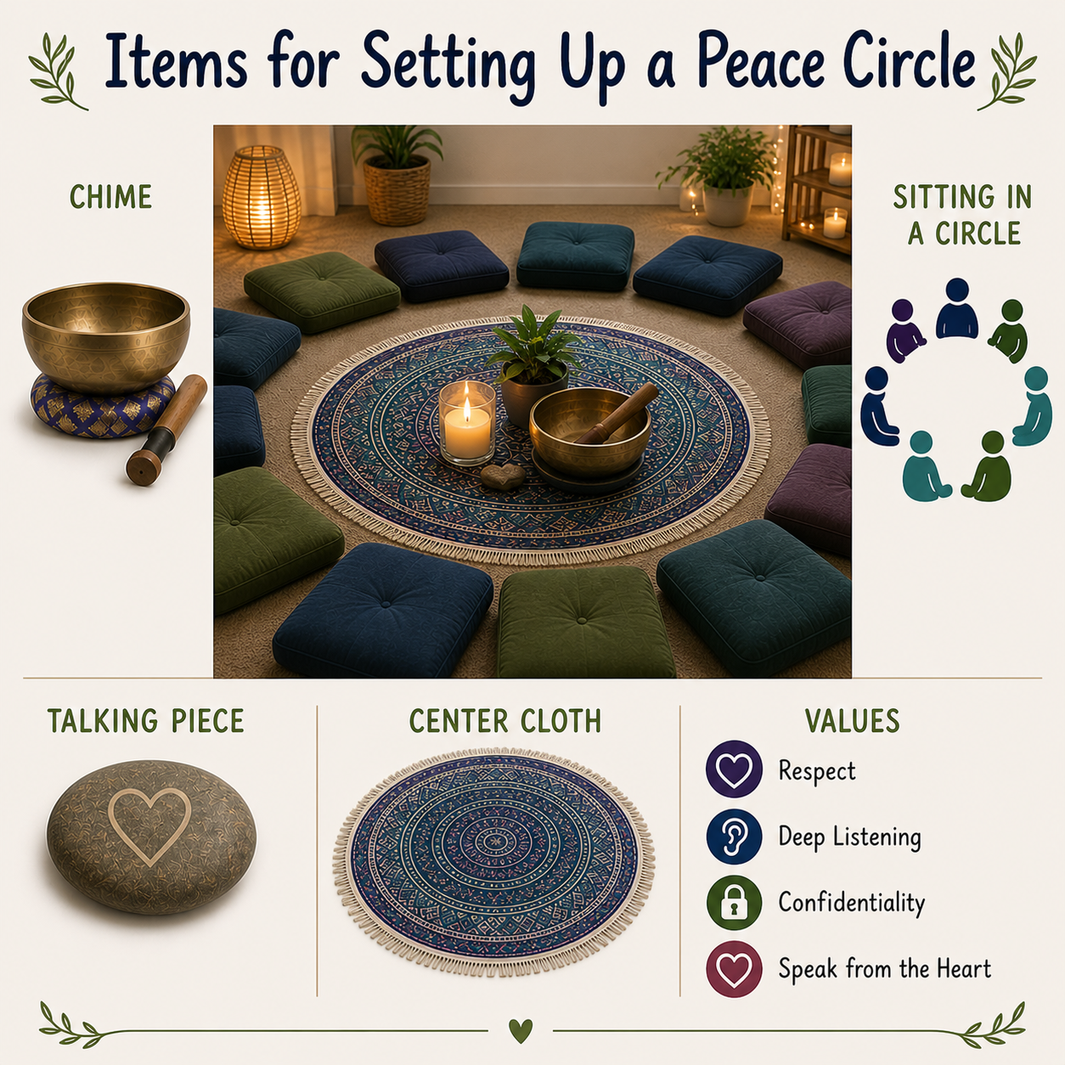
Setting Up Your Circle

Slide 11
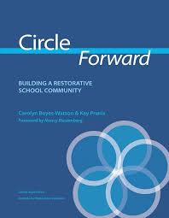
Writing Your Circle Lesson Plan
Identify your goal
Consider your circle participants’ interests and relationships
Do you need/have time for an icebreaker?
Find your reflections
Develop your questions

Slide 12
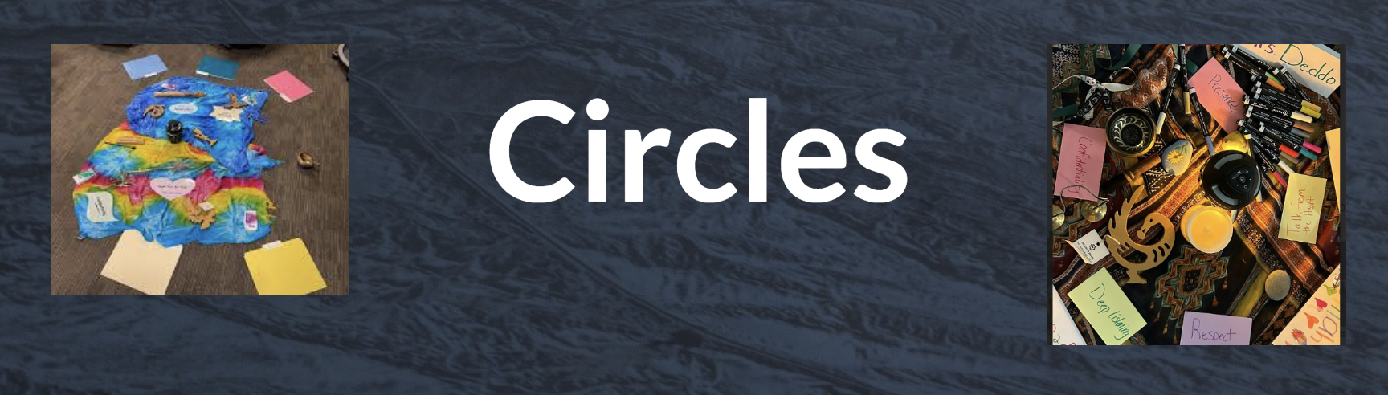
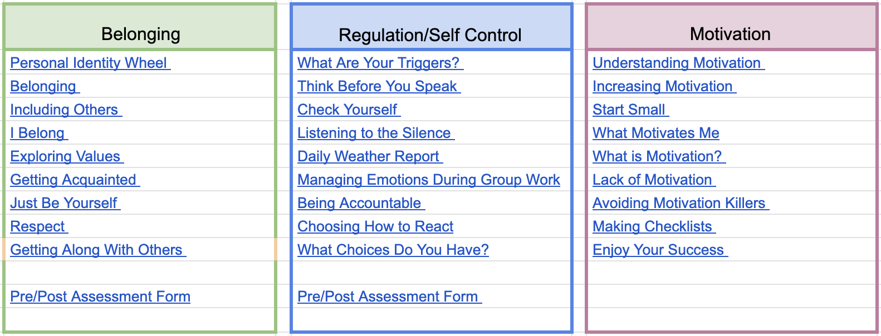
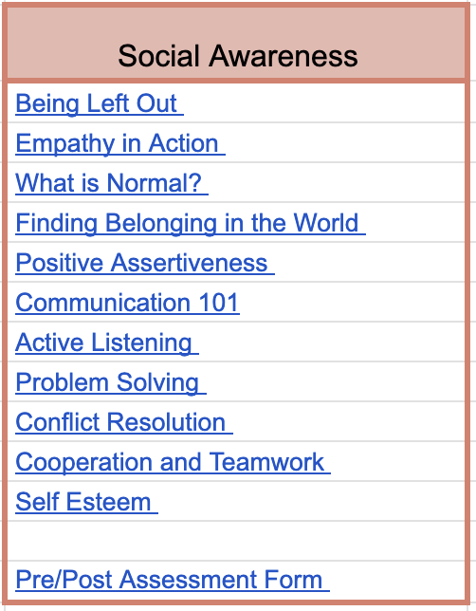
Circles Staff
Resource Page

Slide 13
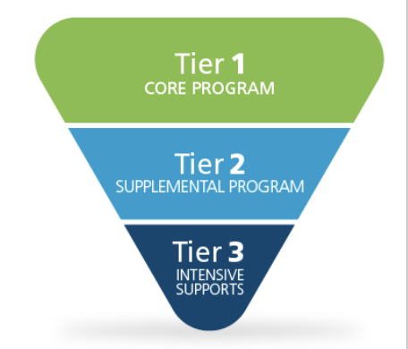
Using Circles in a Tiered Model
Tier 1 - Universal

Slide 14

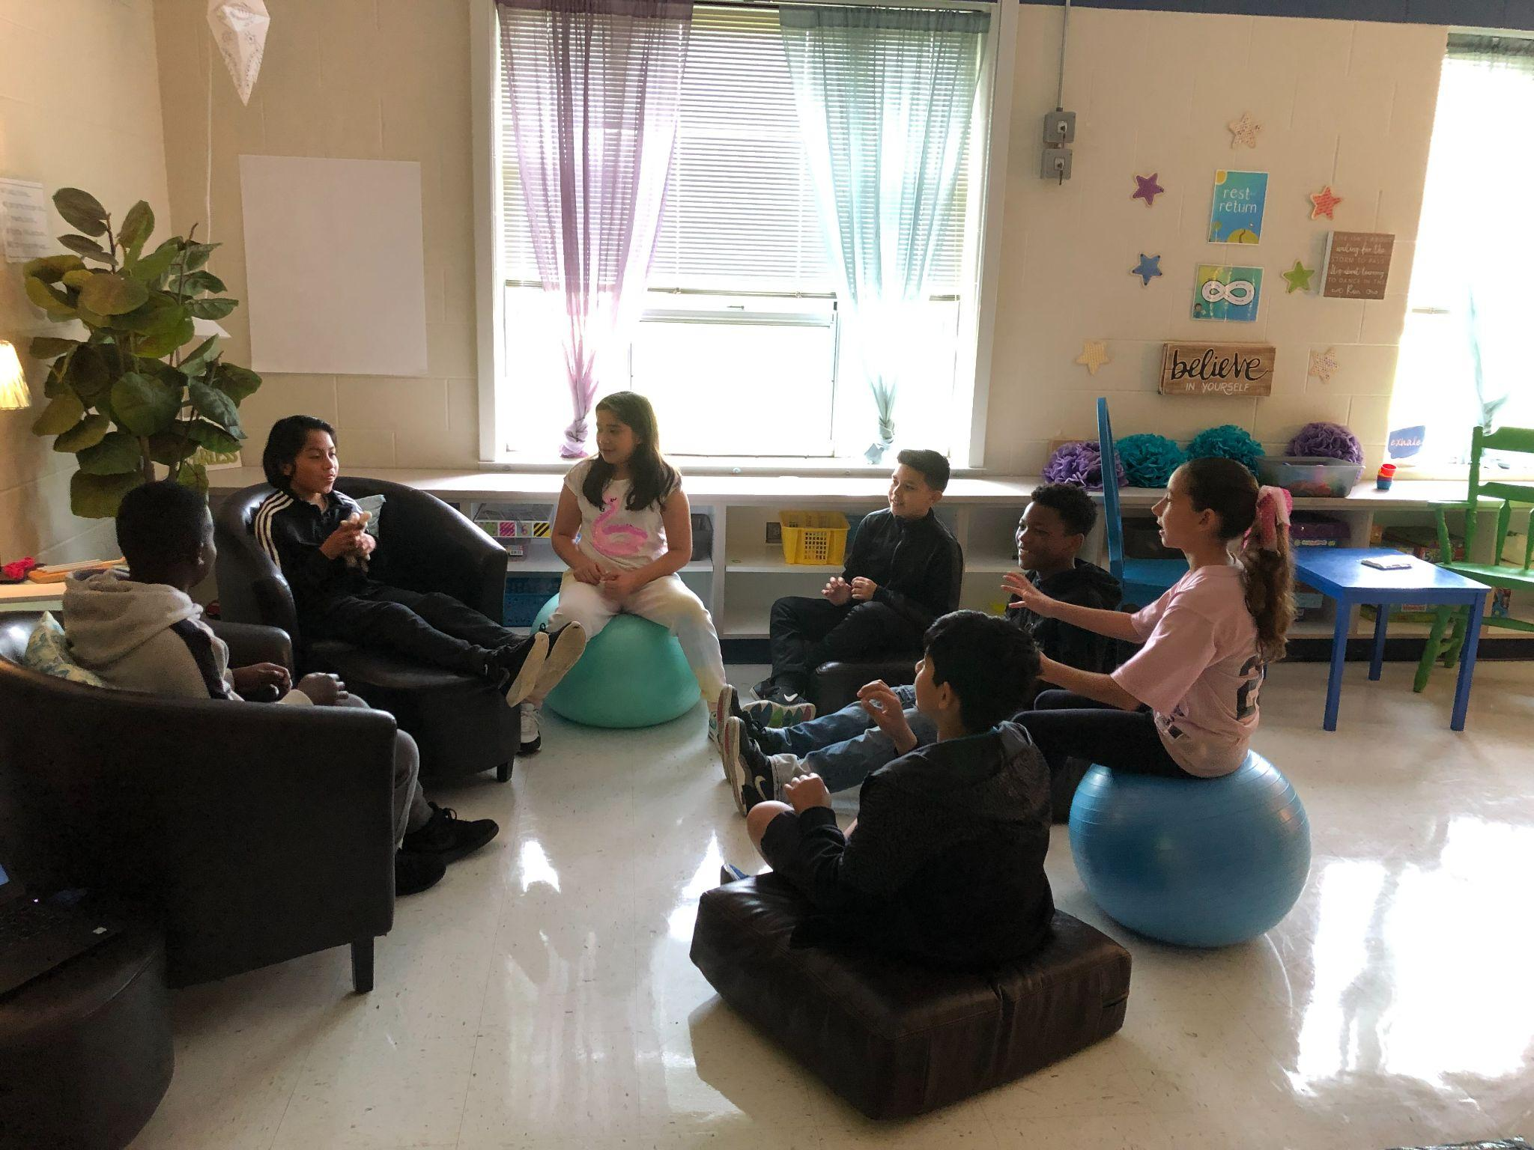
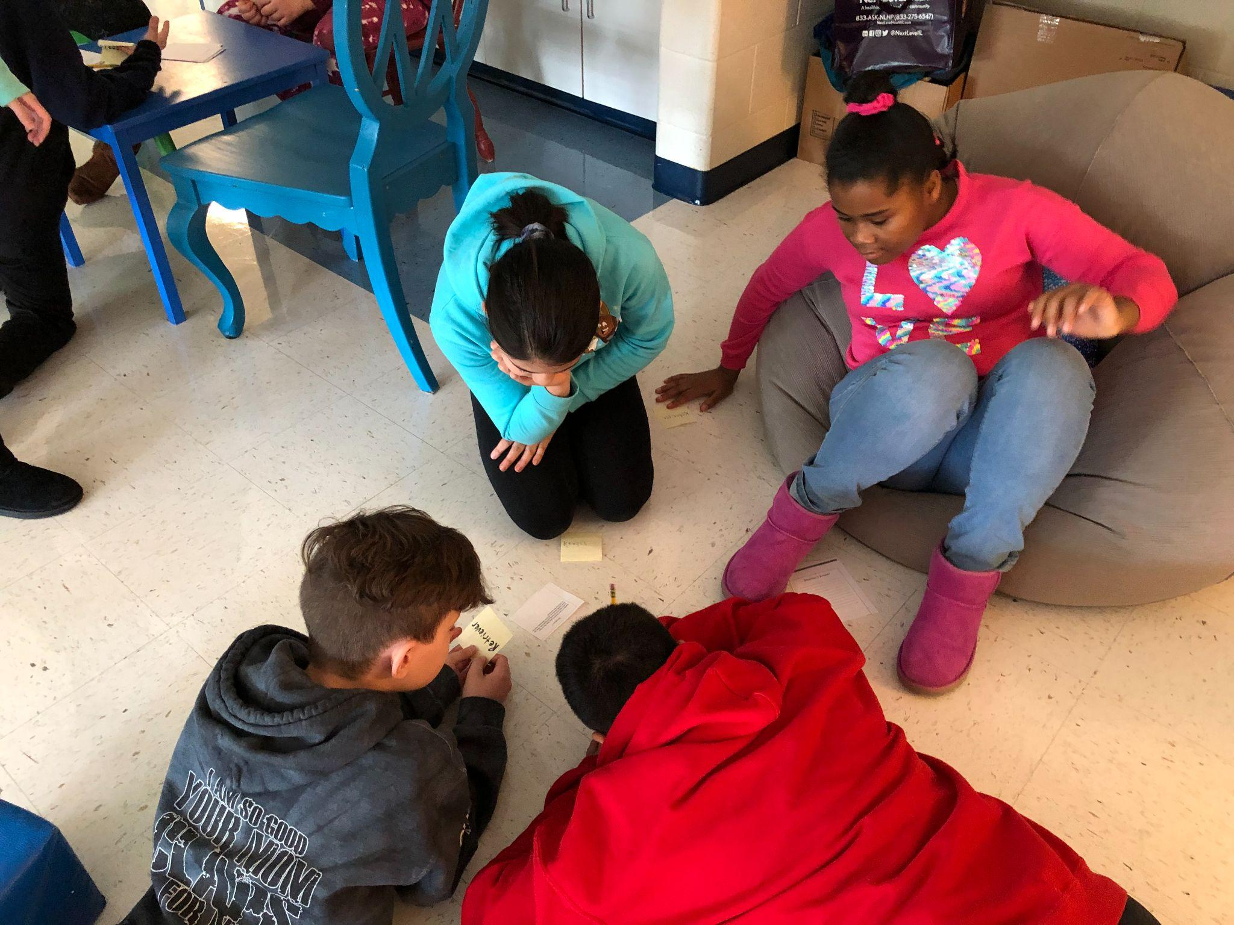
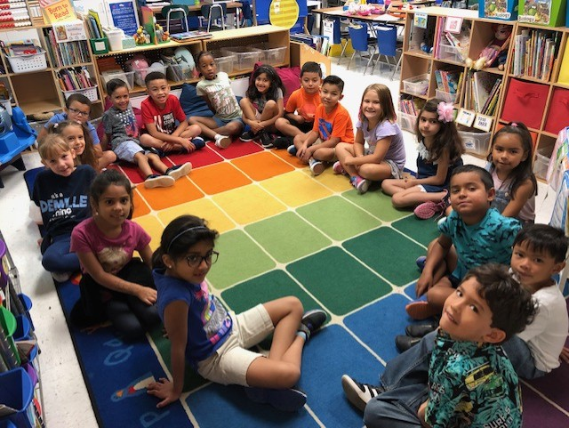
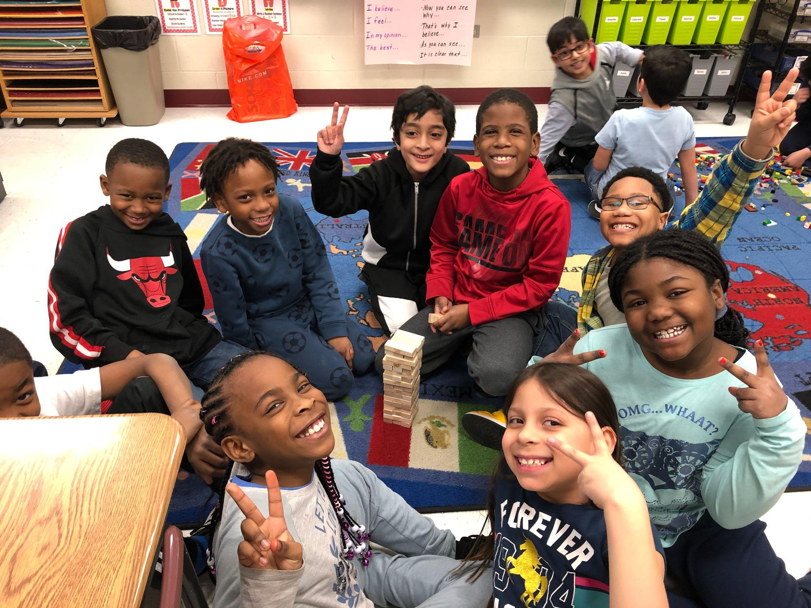
Community Circles
Whole-class circles to build connection and belonging schoolwide.
Morning Meetings K-5 & Advisory (6-8)
Grade Level Meetings at Elementary
Universal SEL Lessons
Helped students feel connected and successful throughout the school day.
Notes:
Joanna

Slide 15

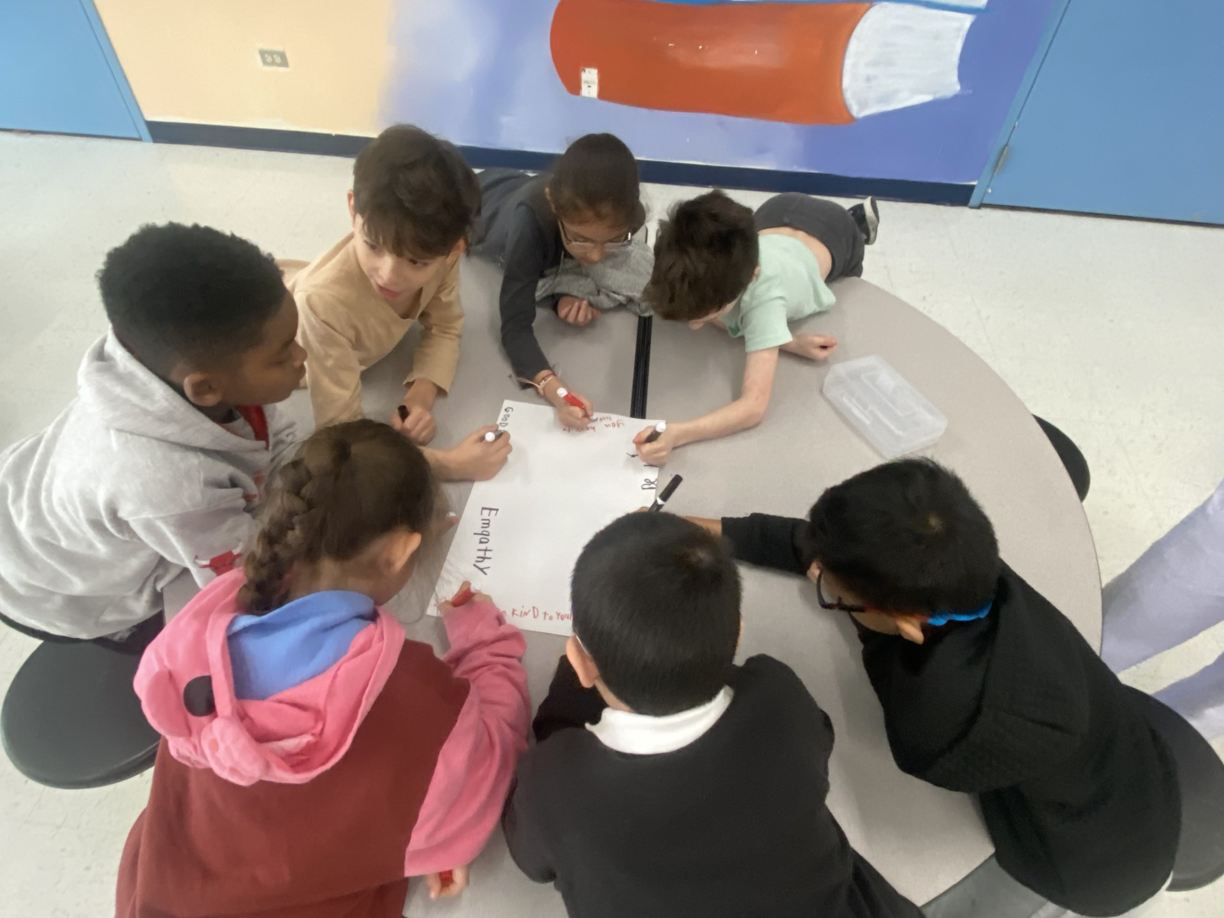
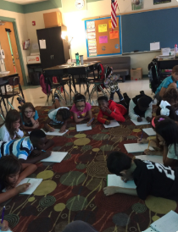

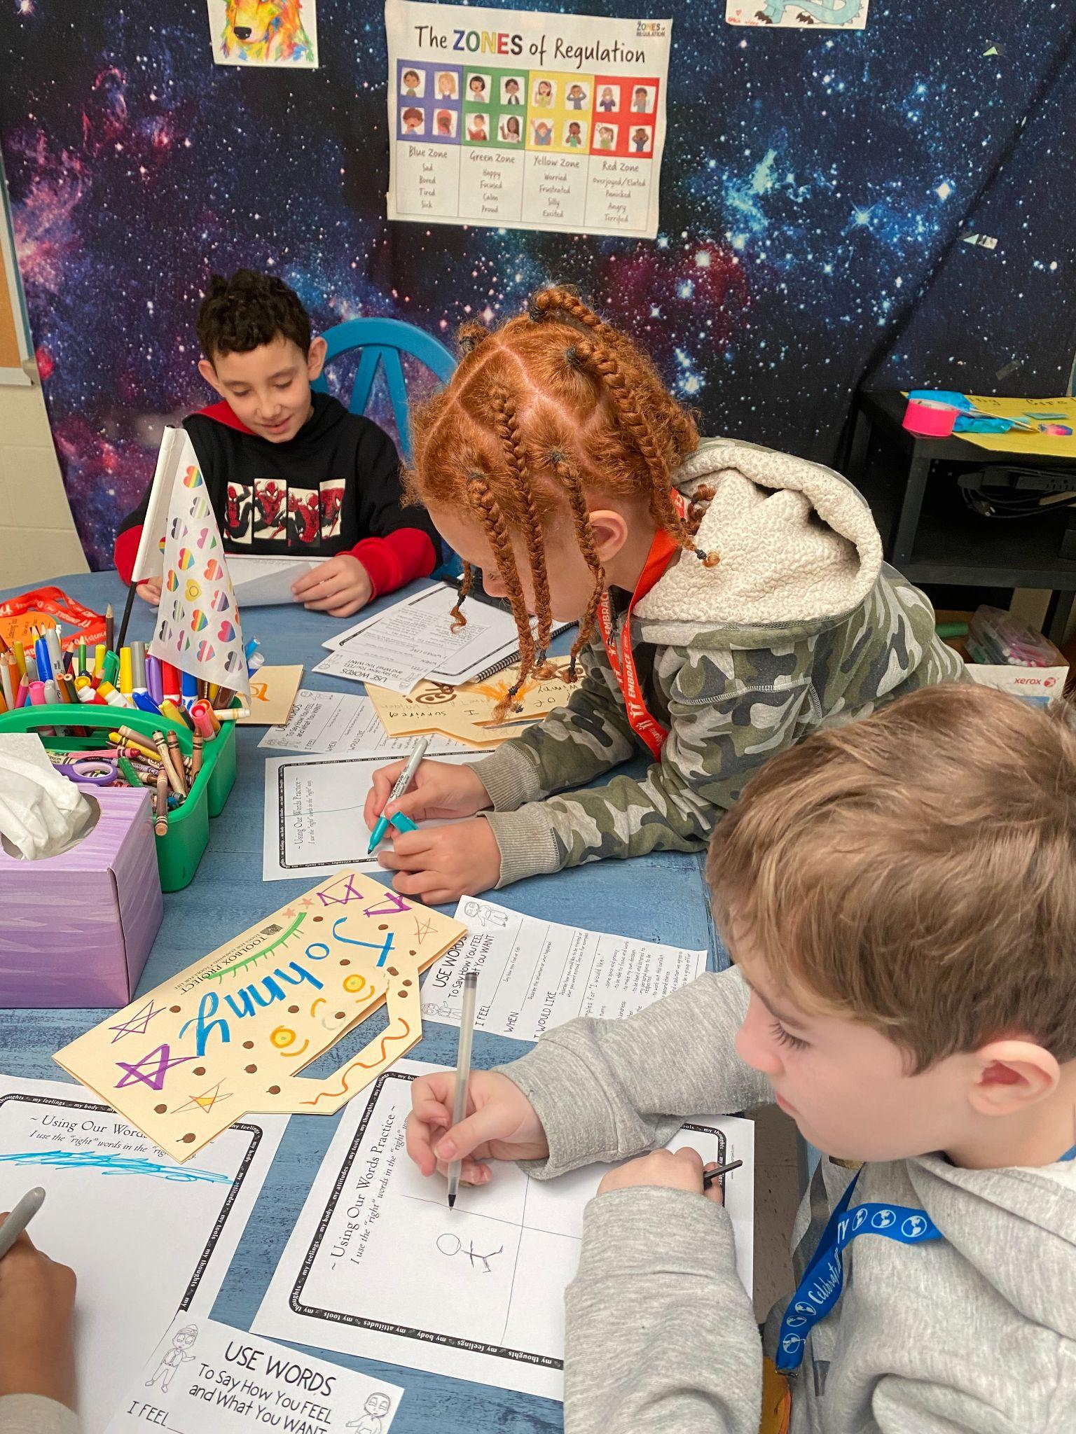
Academic Circles
Every student has a voice and a way to participate
Students think, question, and build ideas together
Confidence, connection, and communication grow

Slide 16
Using Circles in a Tiered Model
Tier 2 - Targeted

Slide 17
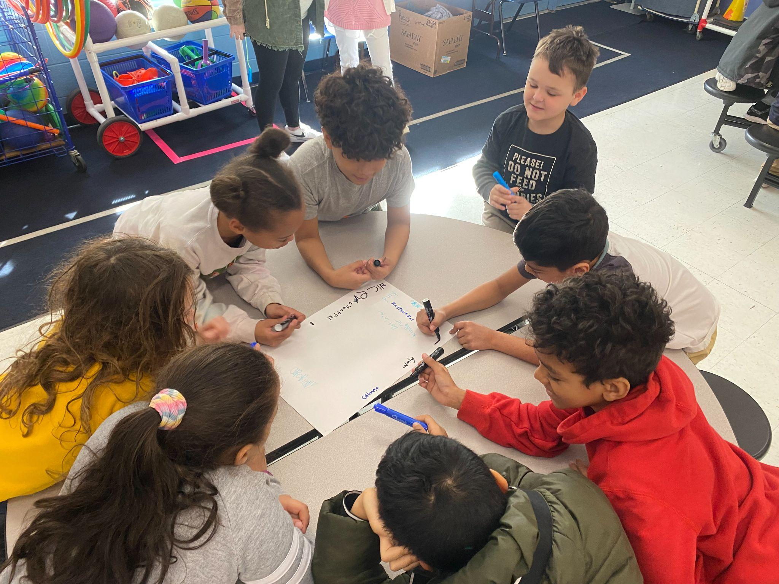
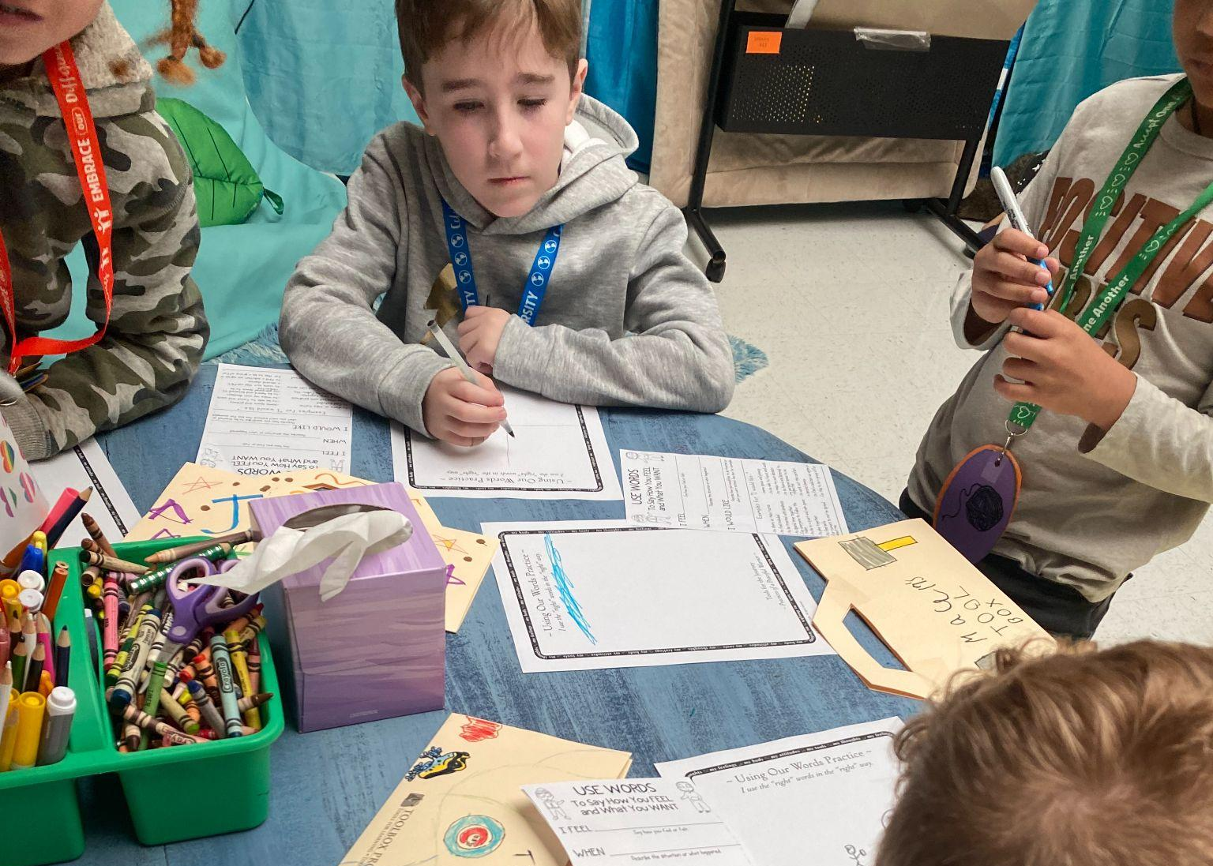
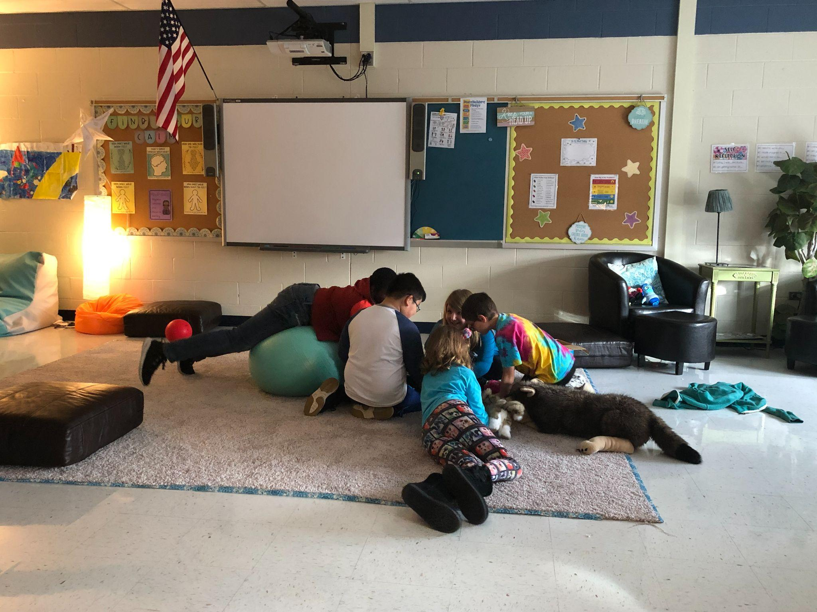
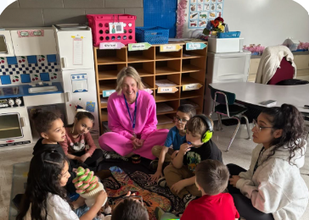
Intervention Circles
Identified students needing added support, connection, or skill-building through Panorama data, staff observations, and student needs.
Matched students into purposeful circles based on needs and strengths.
Monitored progress through feedback and staff input.
Celebrated growth and supported classroom success.

Slide 18

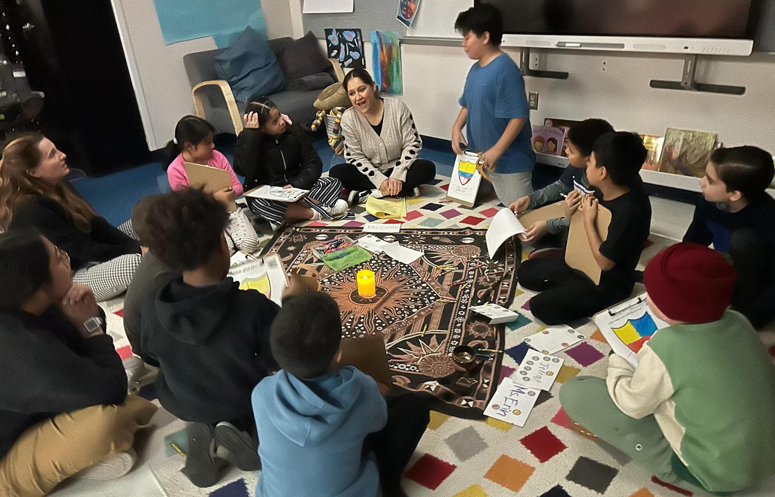
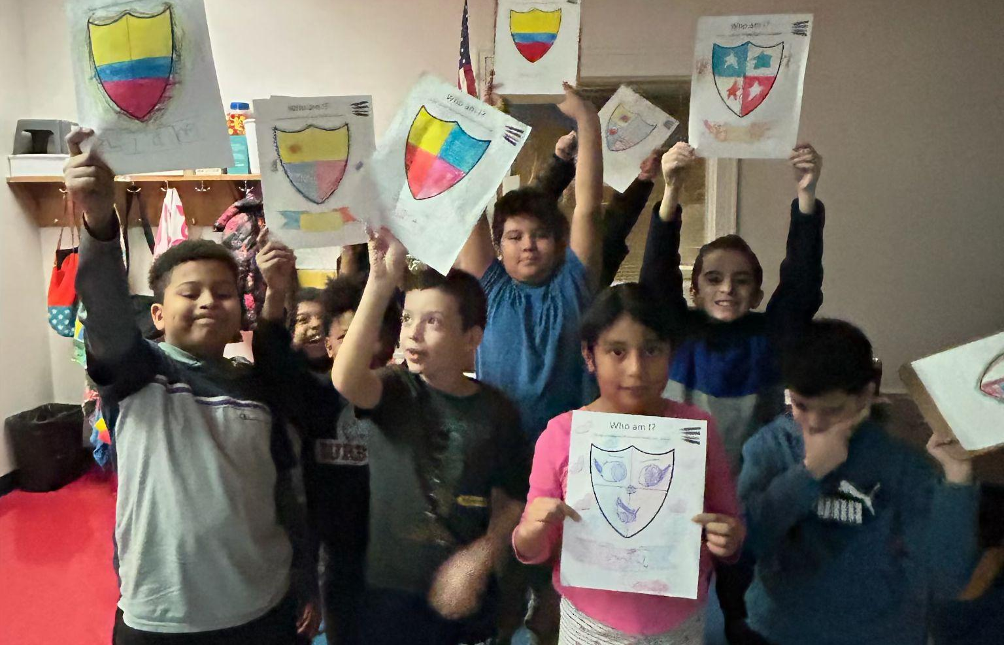
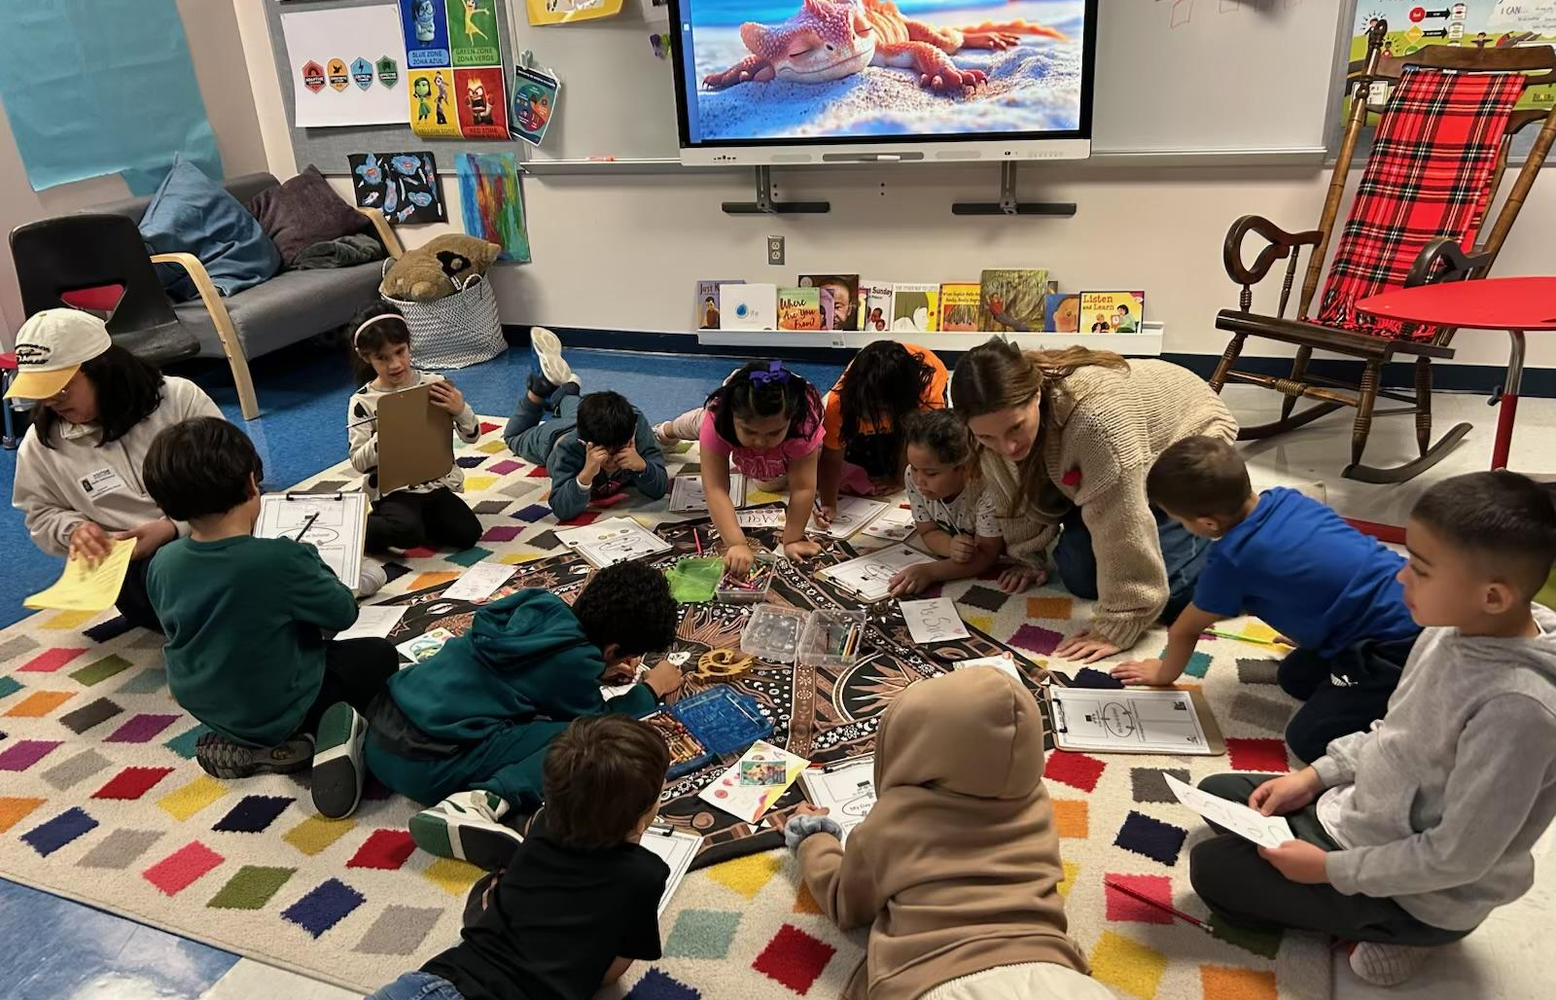
Newcomer Circles—Elementary
Build belonging through targeted support
🌟 Feel seen, valued, and welcomed
🌟 Connect with peers and trusted adults
🌟 Share names, interests, and experiences

Slide 19
We led Newcomers Circles, and I found it incredibly helpful. It gave students a chance to connect with peers from their own countries, people who truly understood the pain of leaving their homeland, friends, families, and even pets.
They also shared the struggles of not knowing a new language, unfamiliar customs, holidays, and traditions.
Most importantly, the circle offered a safe space where children could express their identities: what they like to eat, listen to, wear, and celebrate.
This experience was priceless; it helped students make new friends and feel genuinely welcomed by school staff. They also had the opportunity to create crafts and display them in our hallways.
It was an honor to be part of this experience! I treasured it as a gem.
--Special Education Dual Language Teacher

Slide 20
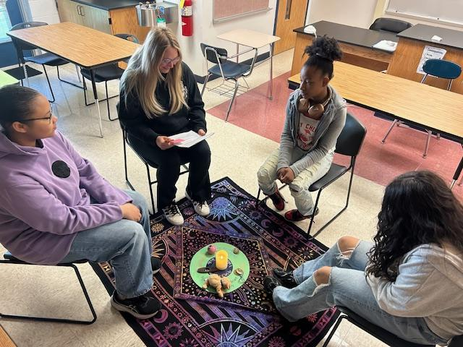
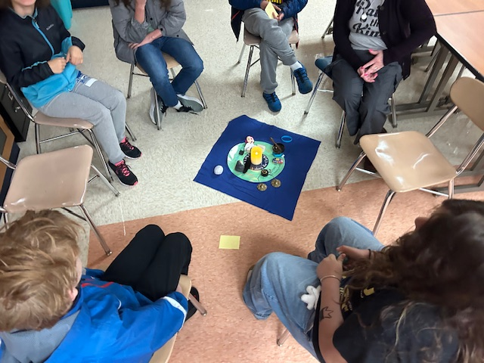
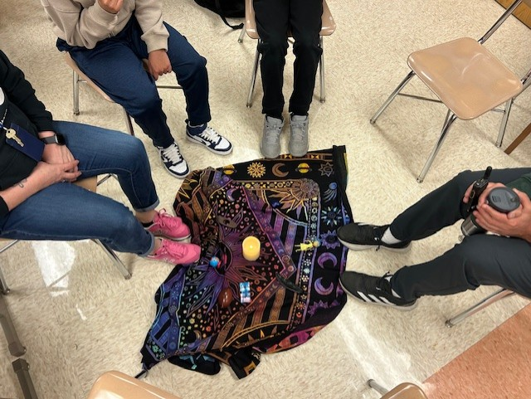
Advisory at the Middle School
20 minute Circles during advisory
1 day a week during an intervention cycle
9-12 week intervention cycles
Staff scheduled in partners to lead 3 Circles per week
Circle Keepers: deans, counselors, social workers, teachers, coaches

Slide 21
Circles Staff
Resource Page

Slide 22
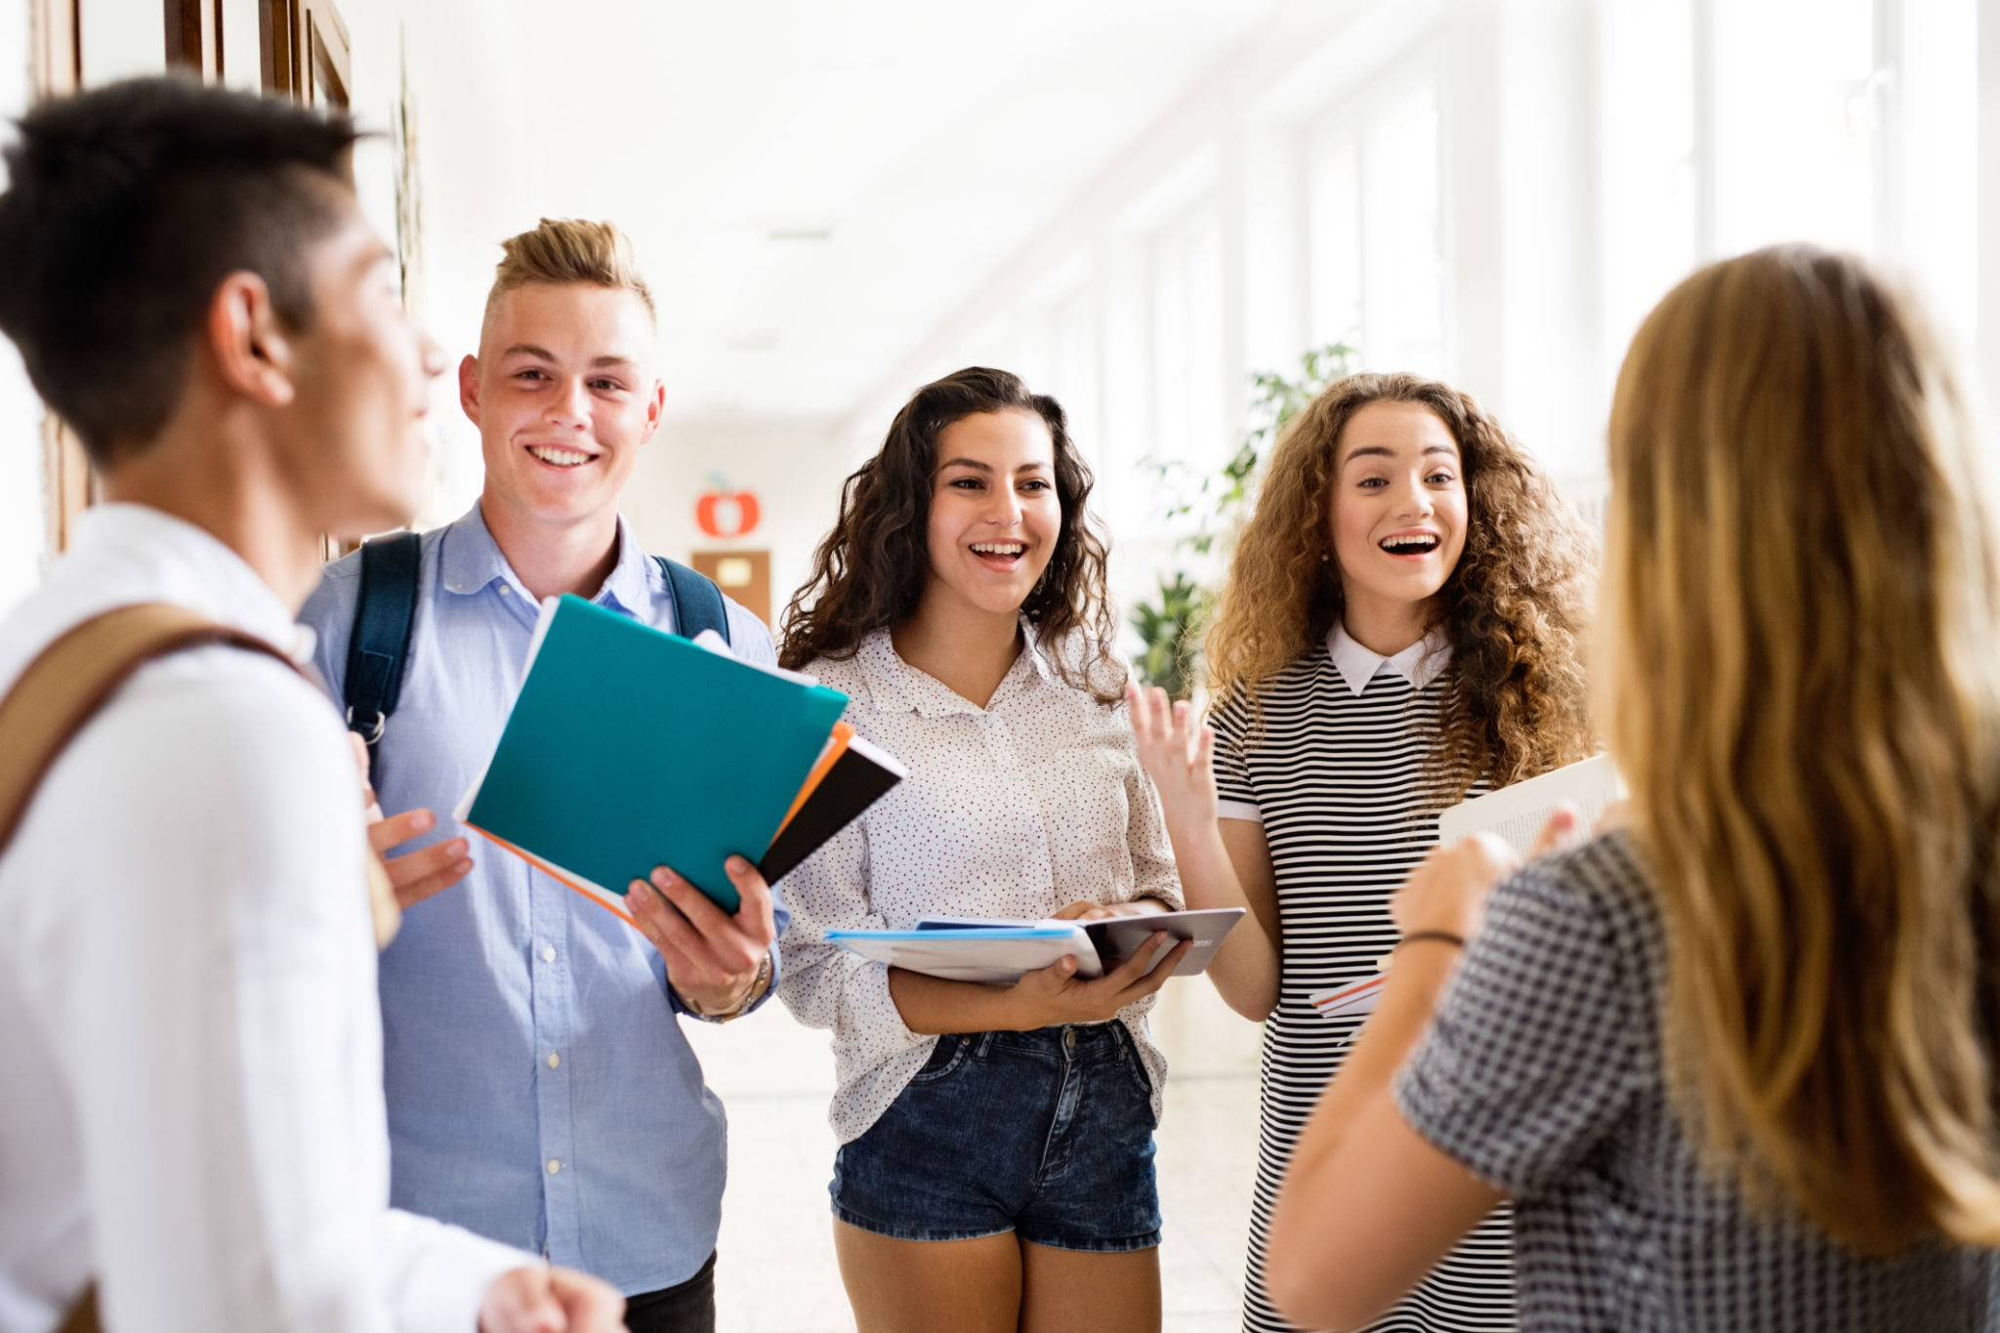
What did you like about Circles?
I liked the calmness and making new best friends from 7 and 8th also learning things that i did not know also learning harder words.
I liked the activities we did, and all the new people I got to learn more about and become friends even. I
LITERALLY EVERYTHING.
i liked that the circle was a safe space to talk about our feelings

Slide 23
Circles changed me. I talk more than I used to and I love Circles because we did 2 rounds with the same people.
I liked being able to express myself with a good group and had fun.
It helped me come out of my shell and this group helped me make bonds with others.
No teacher is yelling and I can start my day off good
I get to relax and be more calm.

Slide 24
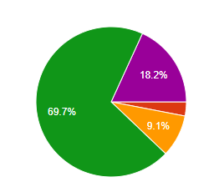
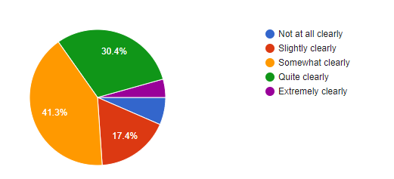
How clearly are you able to describe your feelings?
% responses “Quite clearly” and “Extremely clearly”
Total growth: +53.2%

Slide 25
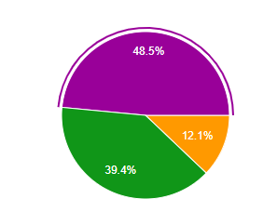
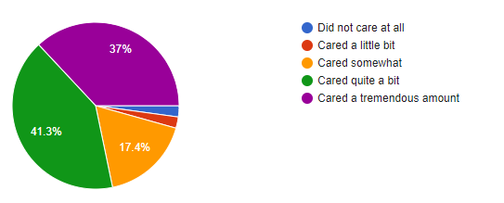
How much did you do you care about other people’s feelings?
% increase in responses selected as “Cared a tremendous amount”
Total growth: +11.5%

Slide 26


How well do you get along with students who are different from you?
% increase in responses selected as “Got along extremely well”
Total growth: +26%

Slide 27


How carefully do you listen to other people’s points of view?
% increase in responses selected as “Extremely carefully”
Total growth: +49.6%

Slide 28
Using Circles in a Tiered Model
Tier 3 - Intensive

Slide 29


Restorative Circles
Response to conflict • Space to be heard
Repair and rebuild through guided conversations
Reconnect, solve problems, and move forward

Slide 30



Special Education Self Contained Classroom- MS & HS—Elementary
Universal community & Skill Building
Academic tier 1-3

Slide 31



Jane Addams Middle School Girls Volleyball Team

Slide 32


21st Connections
After School Program
29 staff in 5 buildings trained

Slide 33

Staff Circles

Slide 34
Our Starting Point (2015)
Training with Robert Spicer
Administration and select staff
Established foundational understanding
Sustained Growth (2020–2025)
3 day Gros Institute training through Lewis University
Expanded staff access (student services and small number of teachers)
Shift to application
District-Led Training (2024–Present)
Piloted three one-day trainings
Increased access and streamlined training
Focus on implementation
Journey of Training

Slide 35

Training Pathway
Introductory / Community Circles
  Learn structure and purpose
  Access district resources
  Create and implement circles
Academic Circles
  Embed curriculum into circles
  Increase engagement
  Elevate student voice
Restorative Circles
  Proactive restorative curriculum to establish norms
  Teach staff how to run a restorative circle for conflict mediation

Slide 36


Ongoing Circle Keeper Support
Refresher trainings
Co-facilitation support
Lesson development

Slide 37

Future Training
Circles for SLPs
Circles for Multi-Needs
Expanded role-based access
Family Circles
Student Led Circle Training

Slide 38
District Reach
220+ staff trained
All buildings represented
Excludes early childhood

Slide 39
Questions…..
…..Thank you!

Slide 40
Additional Resources
CASEL: Community-Building Circles Guide: This tool includes planning considerations, a set up checklist, a recommended circle process and planning template, and four sample circle scripts for middle and high school classrooms.
Circle Forward: Essential resource for circle lesson plans, prompts, and openings/closings.
Circle Process Infographic
Lewis University--Gros Institute Training Information
Panorama Playbook: Focused on building circles tied to belonging, engagement, and emotional regulation.
Kay Pranis: Author of The Little Book of Circle Processes, focusing on belonging and responding to conflict.
Dr. Robert Spicer: A national leader in Restorative Justice
VVSD Resource Folder

