Slide 1
Simplify Coding Instruction with Web-Based IDEs:
Accessible, Secure, and Time-Saving Tools for Every Classroom
Anthony Barba / 26’ CSTA Impact Fellow / June 15th / 9:45 am

Slide 2

What!
A session on Web-Based IDE’s…
… will it be worth my time?
Session Goals:
Learn how JuiceMind’s free web-based IDE can streamline program development and grading, including free AI tools!
Explore strategies for maintaining academic integrity and accessibility.
Walk away with tools and classroom practices to make CS instruction more efficient and equitable.

Slide 3
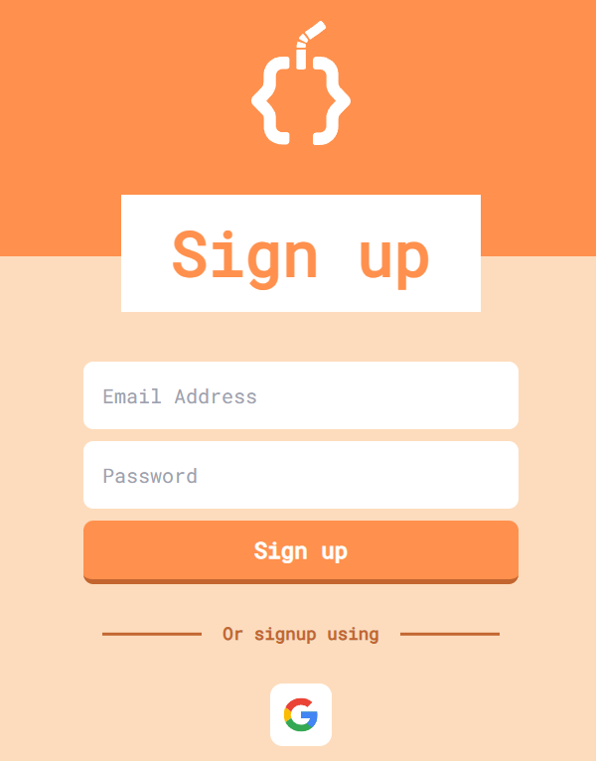
Feel FREE to explore during the session!
To make an account:
Go to Juicemind.com and click JOIN

Slide 4

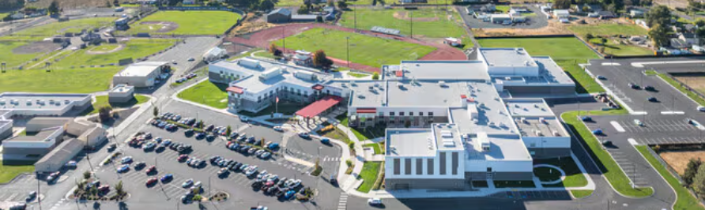


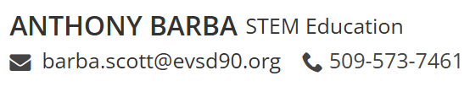
Welcome and …
Primarily a teacher at East Valley High School…
… in Yakima, WA but also …

Slide 5



Disclaimer: I do not work for…
But I the platform!

Slide 6
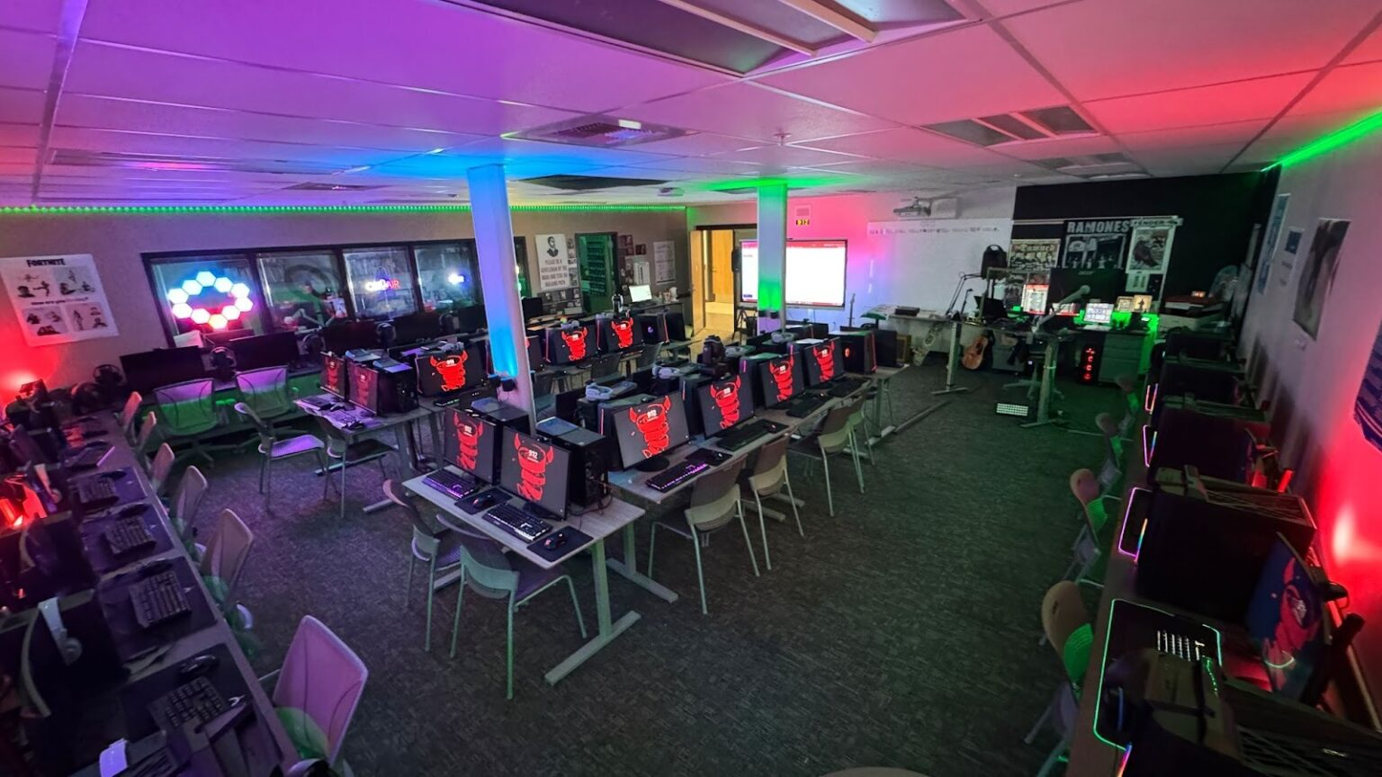
This is my Classroom

Slide 7

This is my Family

Slide 8

This is my Family

Slide 9


This is my Summer Plan

Slide 10
Framing the Problem …
Software IDEs in a classroom introduce challenges:
Often too complex for beginners
Over-dependence on features like autocompletion
Plagiarism/AI-generated code concerns
Compatibility issues with classroom management platforms
Students may not have access to software at home
Teachers often depend on their IT department for technical issues

Slide 11
Web-Based vs Desktop IDE
Feature | Web-Based IDE (e.g., GitHub Codespaces, Replit) | Traditional Desktop IDE (e.g., Visual Studio Code, IntelliJ IDEA)
Setup & Maintenance | No local installation or environment configuration required; the workspace is ready instantly. | Requires local installation, manual software updates, and local dependency management.
Hardware Dependency | Low. The remote server handles heavy lifting (compiling, running), allowing work even on low-spec devices. | High. Relies heavily on the local machine's CPU, RAM, and storage capacity to compile and run code.
Collaboration | Built-in, real-time collaboration (like Google Docs for code). | Collaboration typically requires manual file sharing, Git commits, or screen sharing.
Connectivity | Requires an active, stable internet connection to code and access files. | Works offline; you only need an internet connection to sync changes or pull external packages.
Portability | High. Access your exact, customized development environment from any computer. | Low to medium. Tied primarily to the specific machine where the software is installed.

Slide 12
What do I want in a web-based IDE?
Easy to Grade!
Plagiarism Tools
LMS Integration
Comment on Code
Multiple CS Languages
Accessibility
GUI Capability
AI Teacher Tools

Slide 13
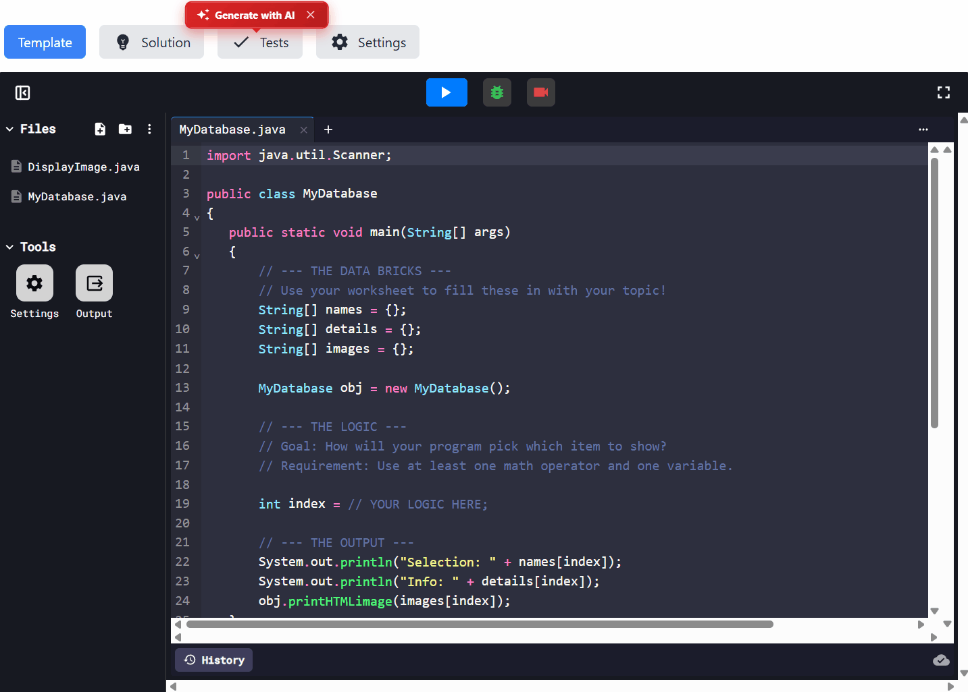

The best solution I have found is …
Online IDE | Quizzes | Coding Curriculum

Slide 14
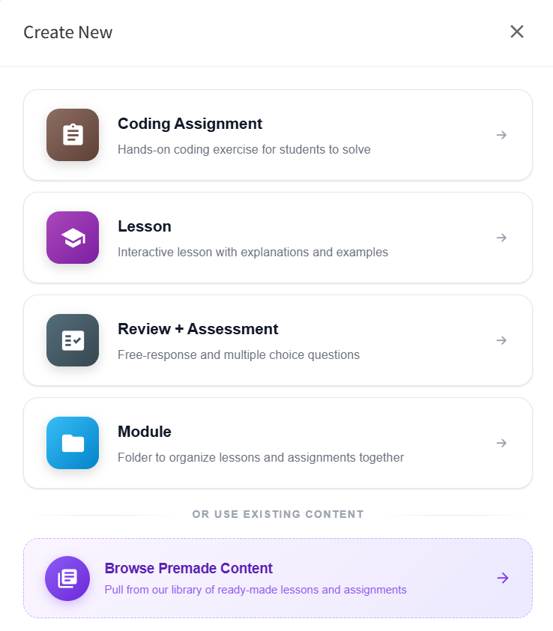
Two Ways to Use the IDE
Coding Assignment
or
Lesson

Slide 15
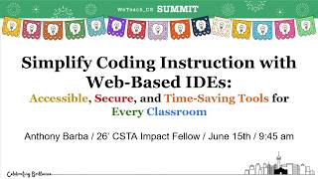
In a Coding Assignment

Slide 16
In a Lesson

Slide 17
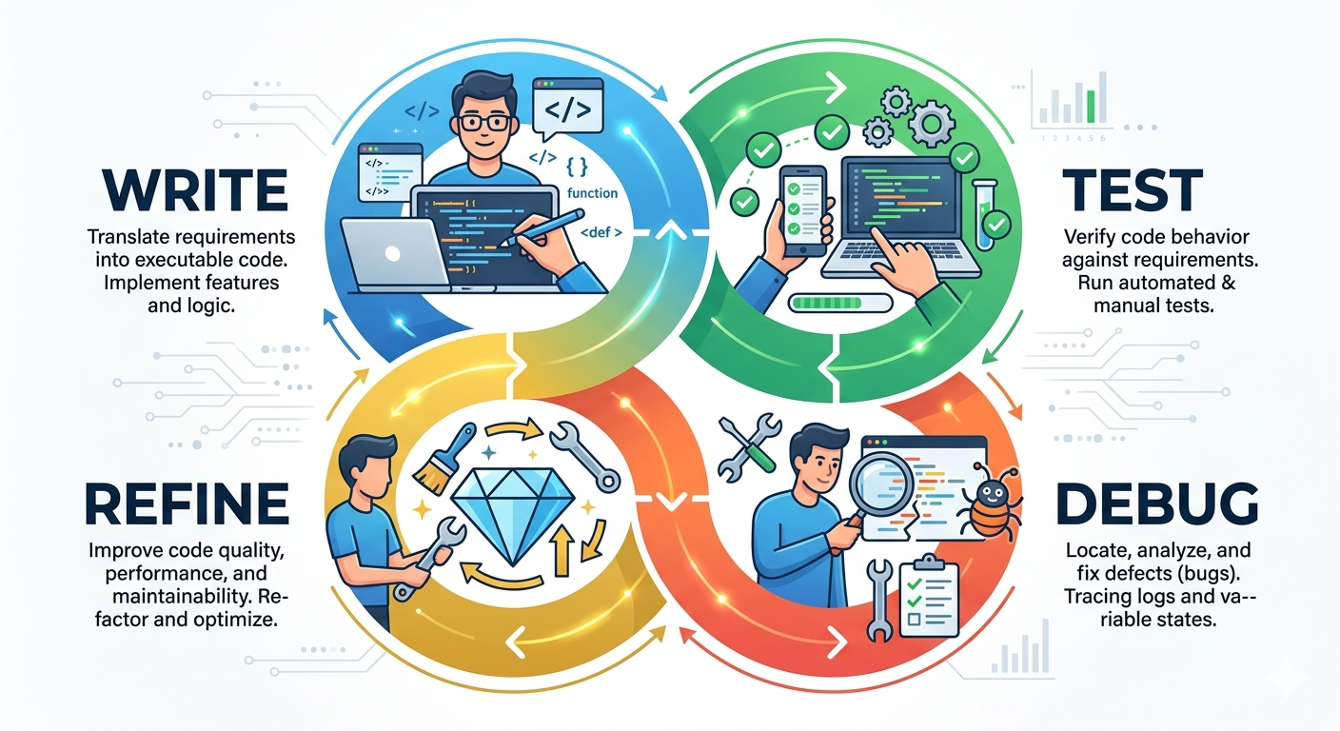
Applying CS Practices in Real Time
How does the IDE support the programing development cycle?

Slide 18
Applying CS Practices in Real Time

Slide 19
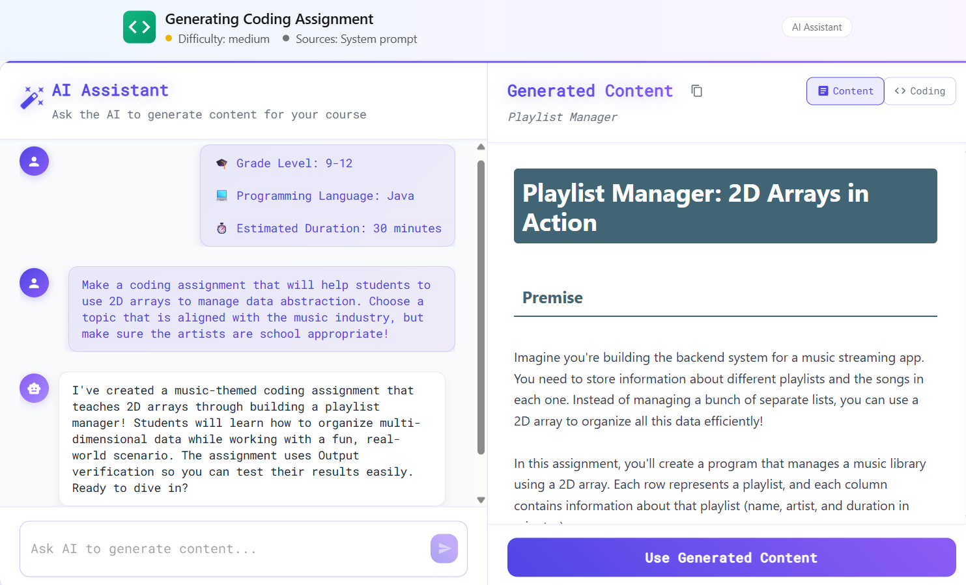

Supporting Content Development
FREE!

Slide 20
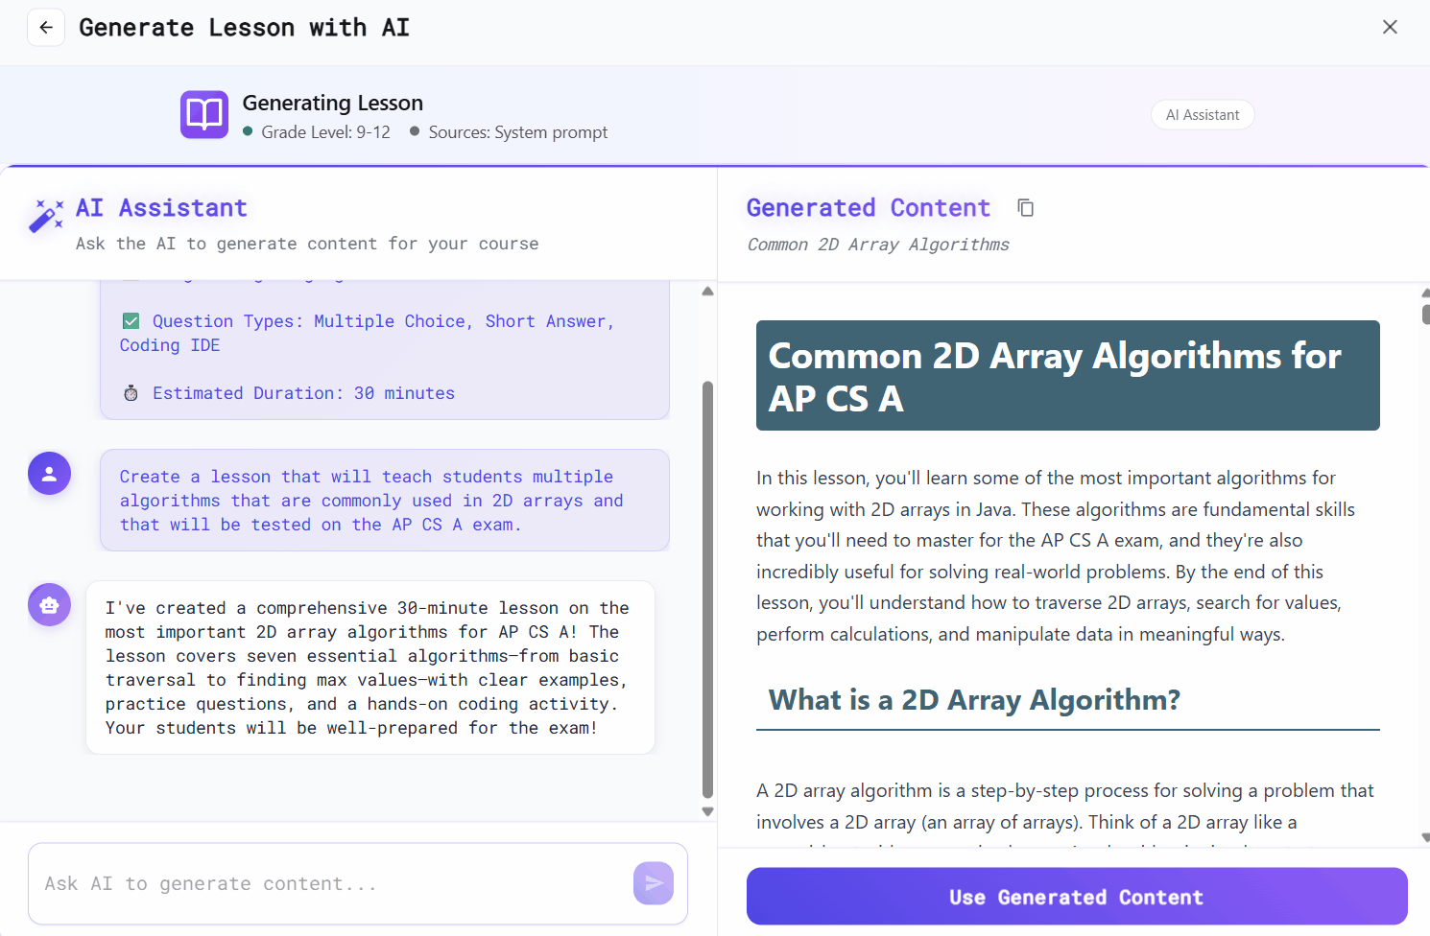
Supporting Content Development
FREE!

Slide 21
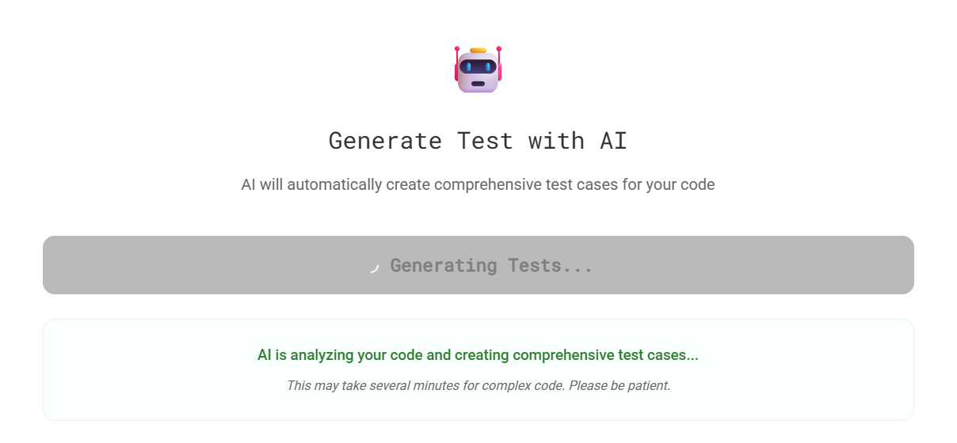
Supporting Content Development
FREE!

Slide 22
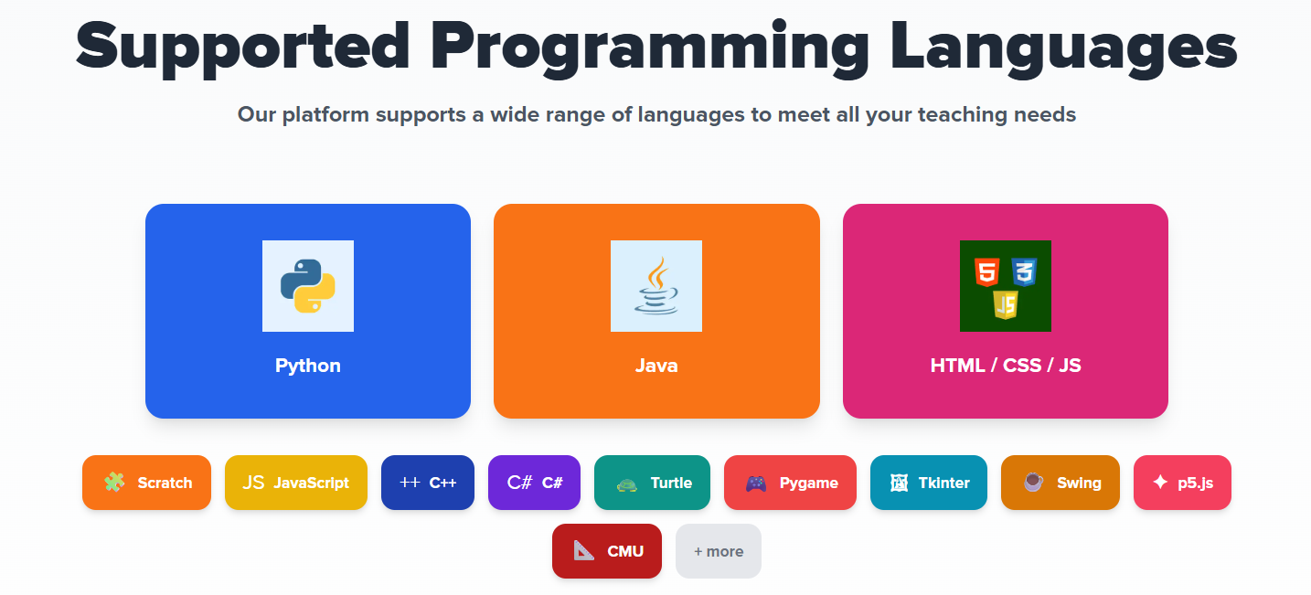
Supporting Content Development
Mostly
FREE!

Slide 23
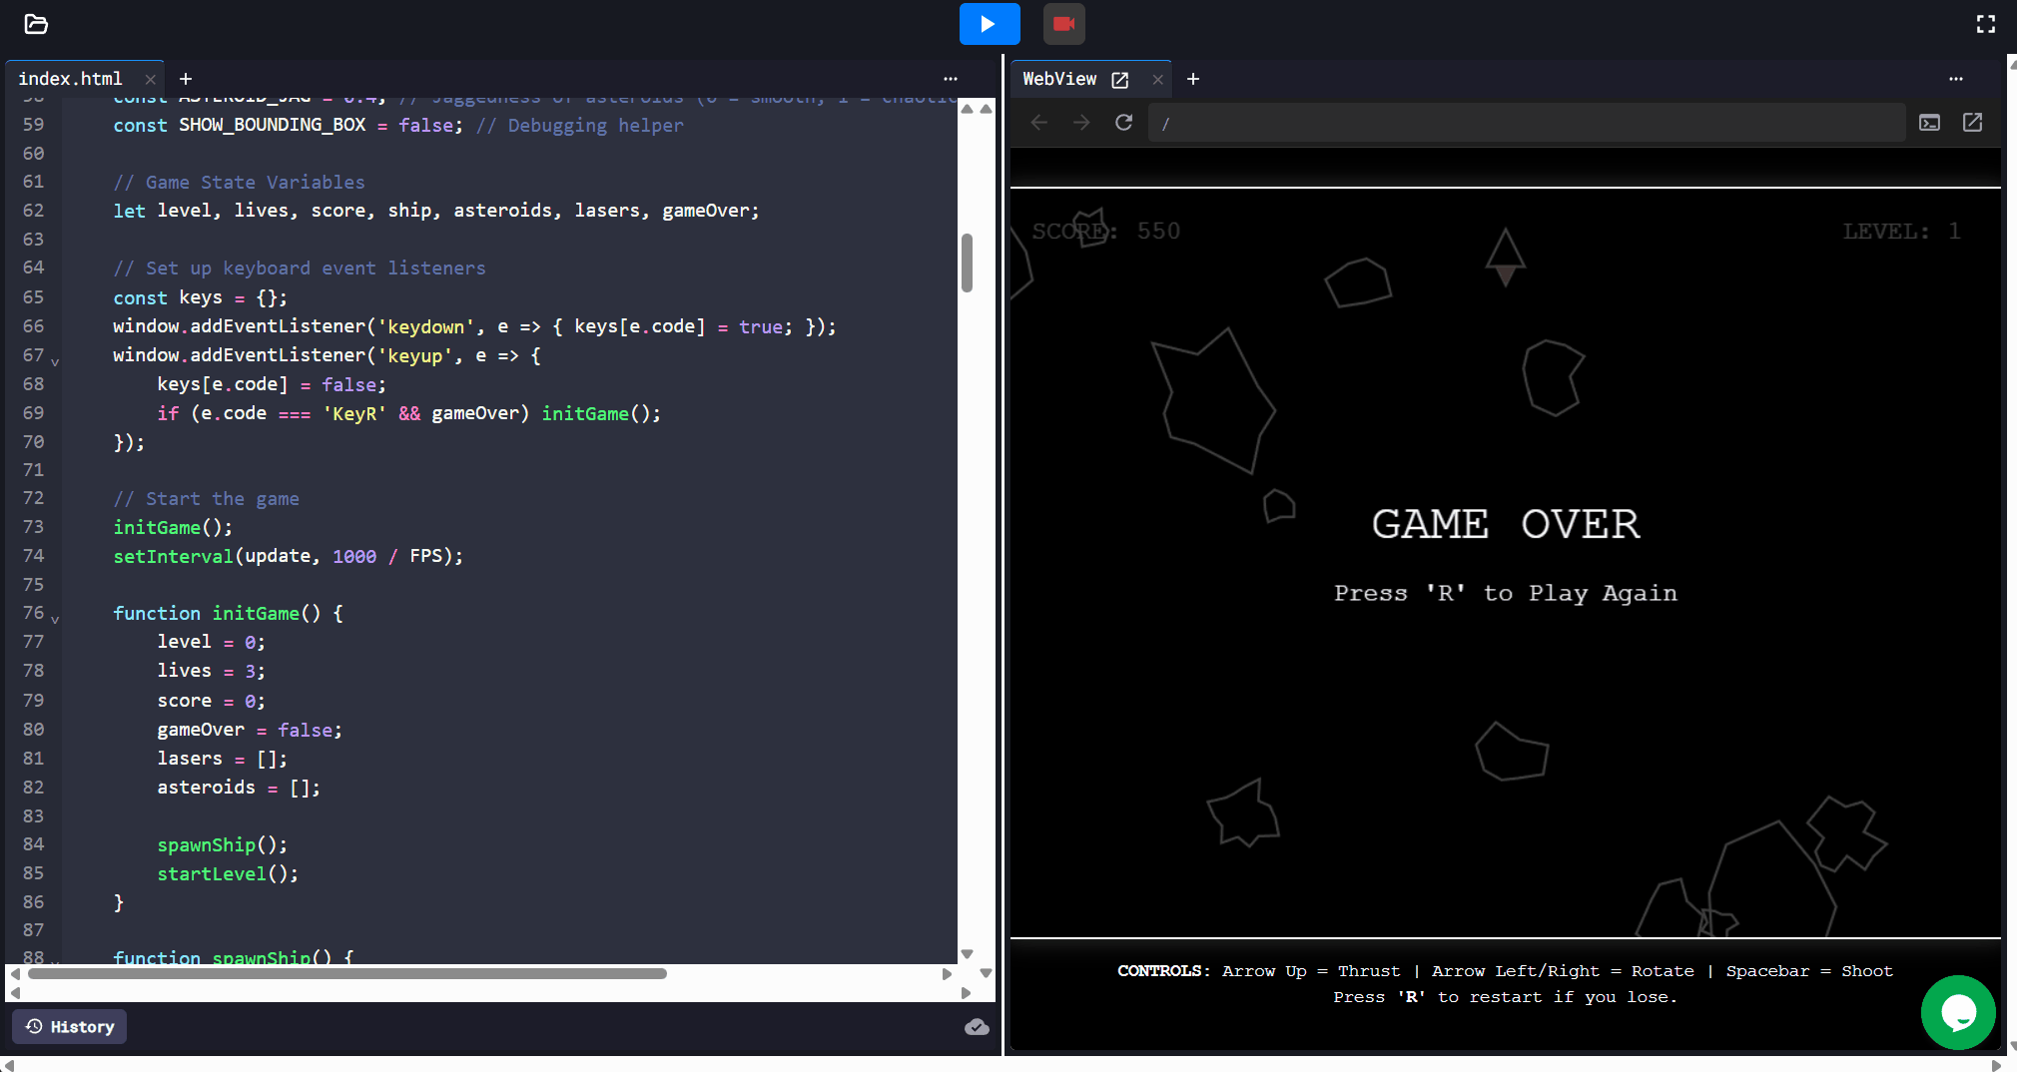
Supporting Content Development
FREE!

Slide 24
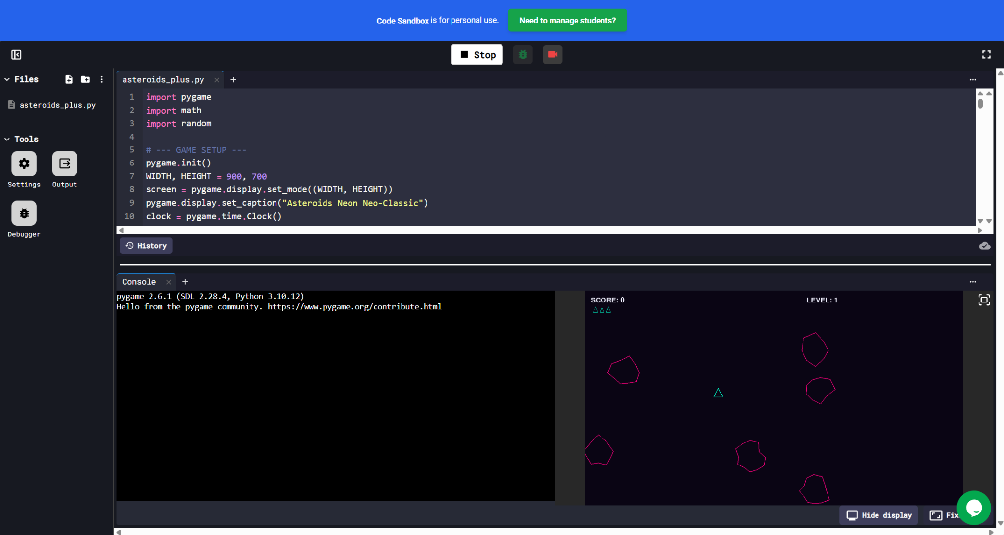
Supporting Content Development
FREE!

Slide 25
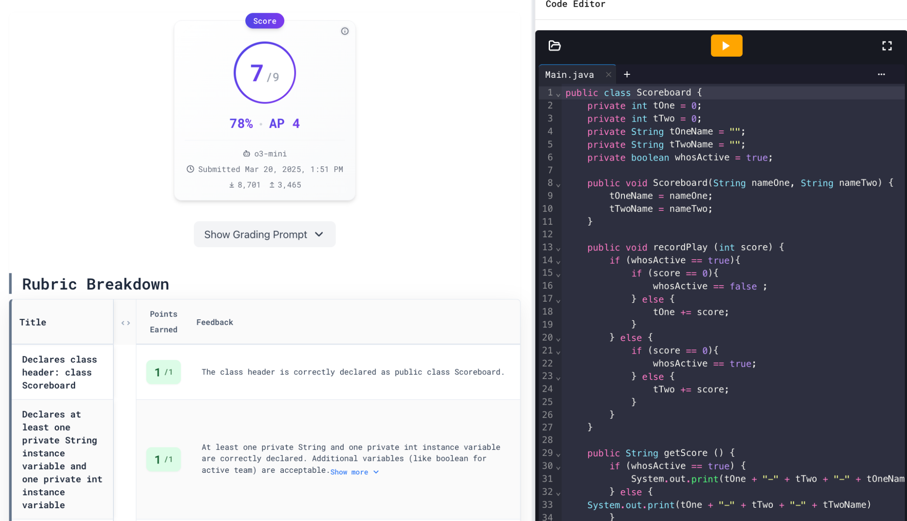
Supporting Content Development
FREE
for
AP CS
Grading with Artificial Intelligence
Efficient, consistent, reliable grading

Slide 26
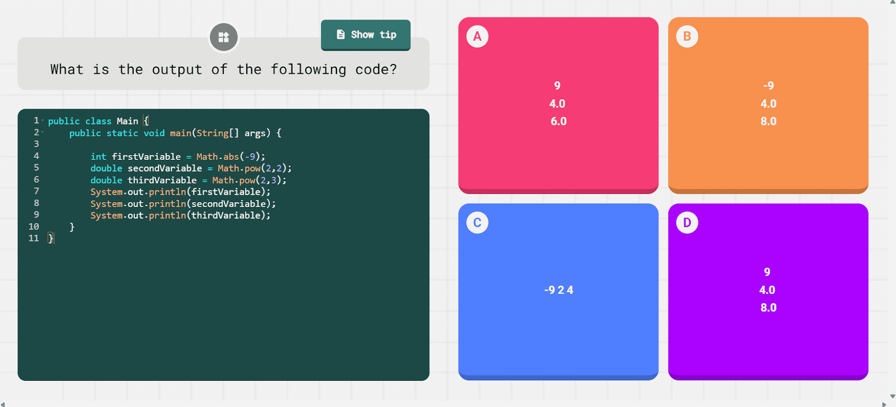
Supporting Content Development
FREE!

Slide 27
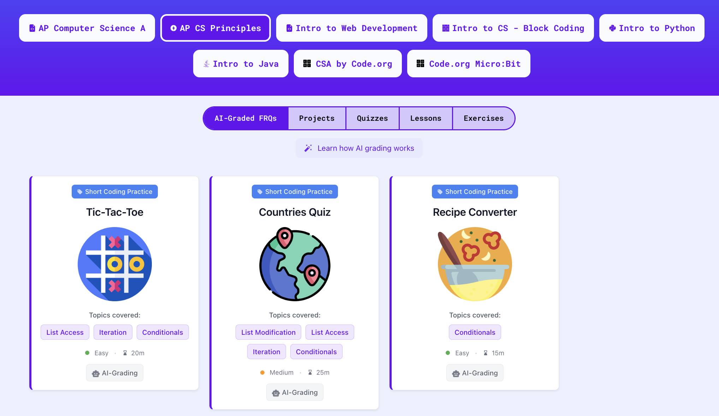
Supporting Content Development
Teach with pre-made lessons, exercises, Unplugged activities, and quizzes
Mostly
FREE!

Slide 28

Wrap-Up and Q&A

