Slide 1


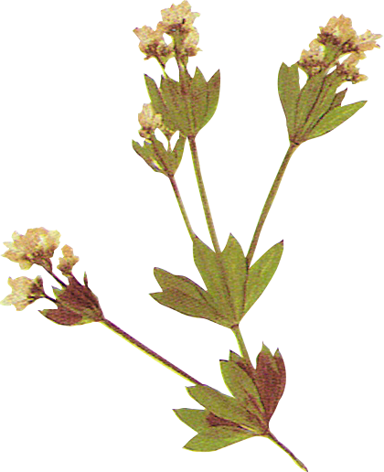
Test Like a Parent:
Skills from Motherhood that Enhance Software Quality
12.05.2026. │ Žaklina Polak Matanović

Slide 2




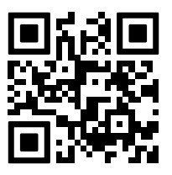
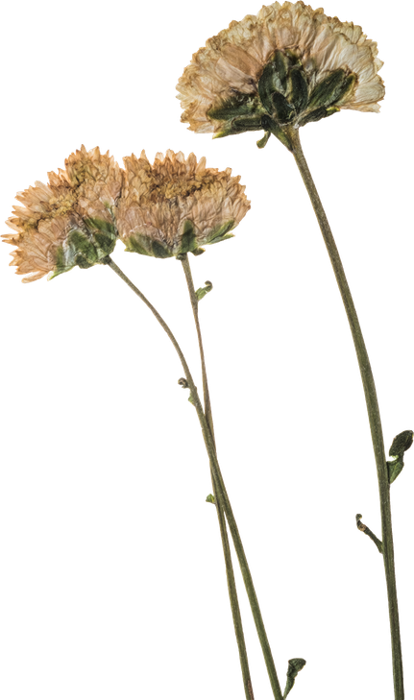
Let’s start with a quick warm-up!
What do you think about parenting & career balance?
Scan and vote 👇

Slide 3

Introduction
for anyone thinking about becoming a parent
or already juggling parenting and a career
for anyone who works with, evaluates, or supports working parents
Page 3

Slide 4

Introduction
Can I really do both well?

Slide 5
Introduction
Can parenting sharpen your
skills and make you better at
your job?

Slide 6






Introduction
Contribute!

Slide 7


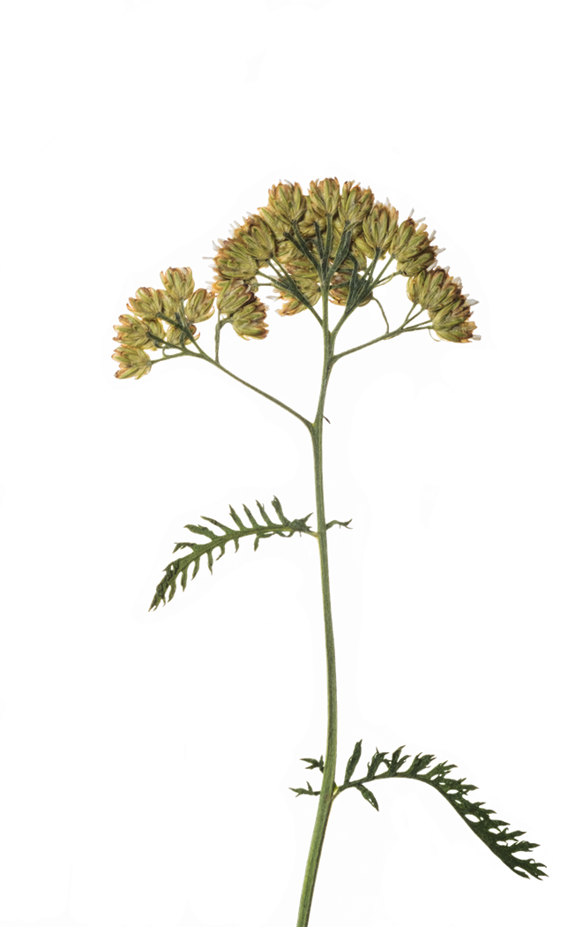
    Story 1: Cooking Meat (for the Cats)
One day, my daughter (she was about 10) called to ask how to cook meat for our cats.
I told her to put it in a pot and cook it on low heat for 30 minutes.
A few minutes later, I added, “You can start with high heat, then lower it once it boils.”
She paused and asked, “What needs to boil?”
I said, “The water.”
She replied, “But I didn’t put water in. You didn’t say I should!”
And she was right - I didn’t.

Slide 8


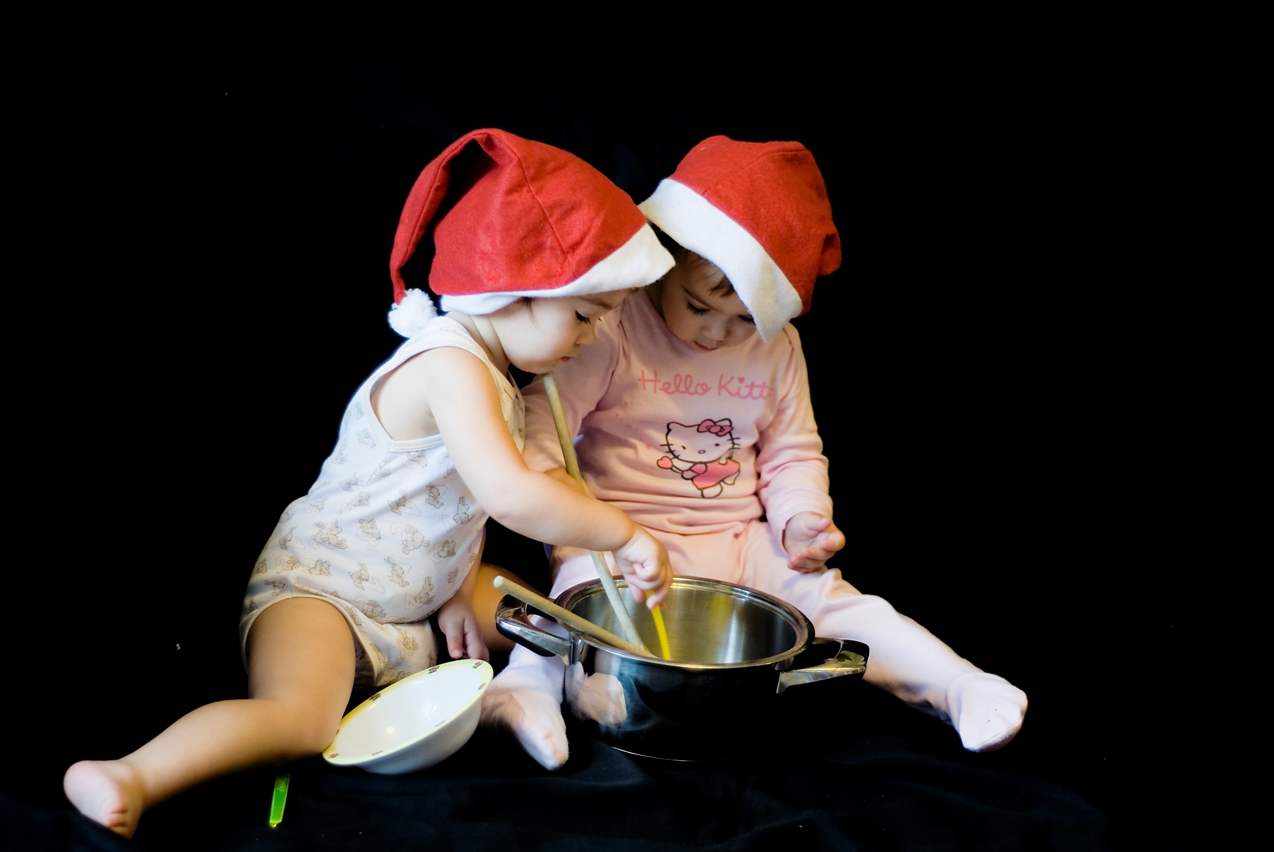
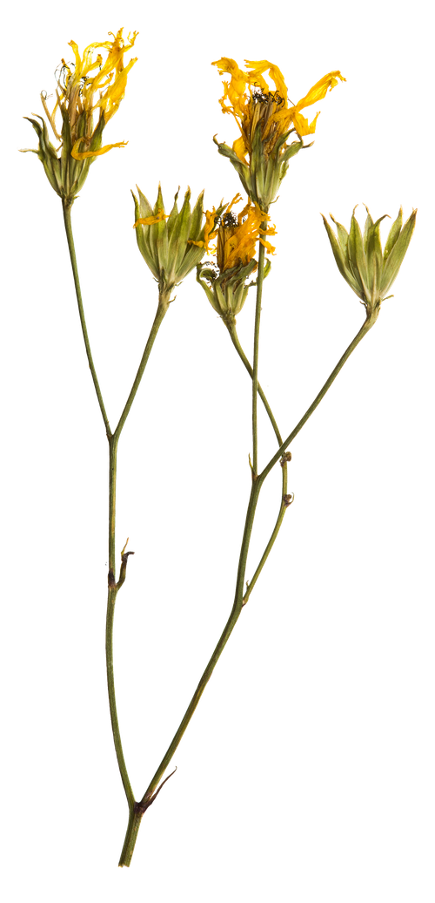
    Reflection
I had assumed she knew that cooking meat involves water.
…But I didn’t say it out loud.
https://www.youtube.com/watch?v=cDA3_5982h8

Slide 9
    Conclusion
What I learned
Never assume, always check
What's "obvious" to you might be invisible to others. Context is crucial.
Instructions need to be complete and clear
Clear, unambiguous instructions prevent errors and rework
Effective Communication
Communication is only effective when both sides understand

Slide 10

    Story 2: The Sock in the Hall
A very normal scene at my house:
- there's a sock in the hallway.
I don’t know whose it is - my kids wear the same kinds of socks.
I say, “Please, pick up this sock!”
But nothing happens.
Why?
Because the one who wore it might not be there.
And the other two don’t feel responsible, because they didn’t wear it. So the sock stays.
12.5.2026.
Žaklina Polak Matanović

Slide 11
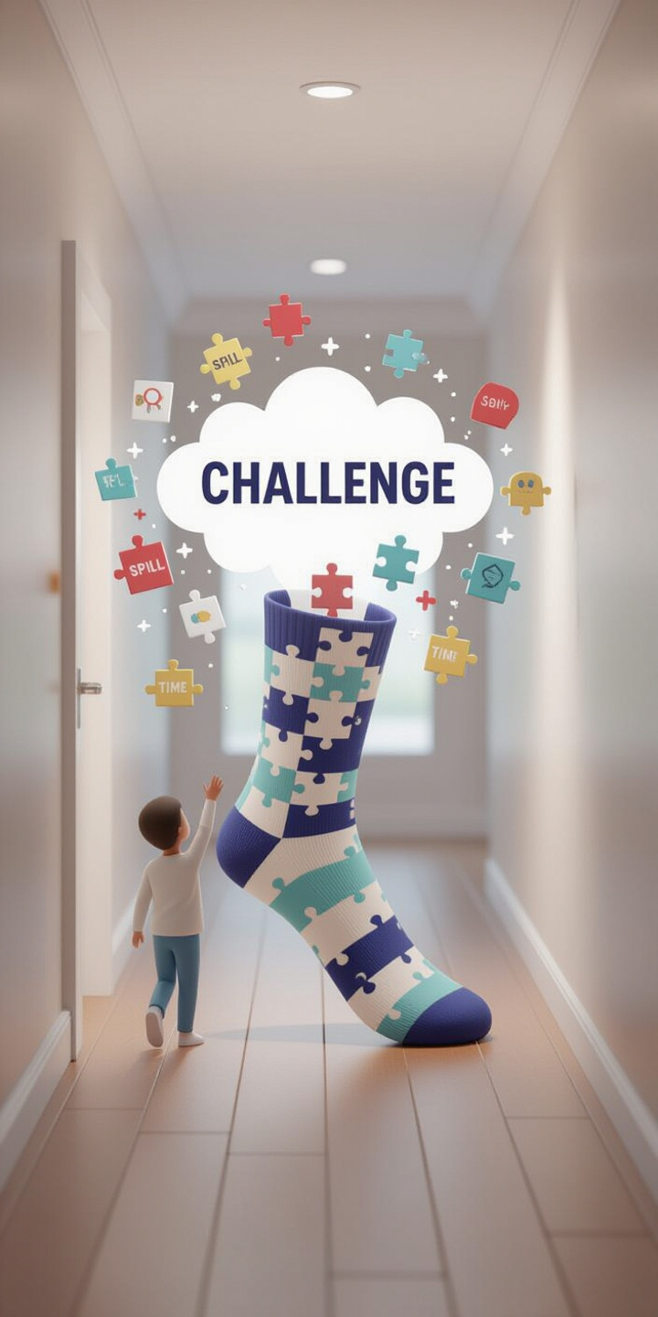
    Reflection
What works?
Being specific.
“Marta, it’s your sock? Please pick it up.”

Slide 12
Ambiguity breeds inaction
Clarity gets results

Slide 13
    Conclusion
What I learned
Be precise
Assign Ownership
Fairness in Tasking
If you want tasks done right and fairly, assign them to the correct person. Investigate if needed
especially when assigning tasks
Just opening a bug ticket isn’t enough - it needs an owner
Take Ownership
Everyone should understand and embrace their responsibilities

Slide 14

    Story 3: The Playground
Many People used to ask me:
“How did you manage going to the playground with twins when they were toddlers?”
Imagine this: one kid running to the swing, the other heading straight for the road.
My answer? I always saved the one in the greater danger first.

Slide 15
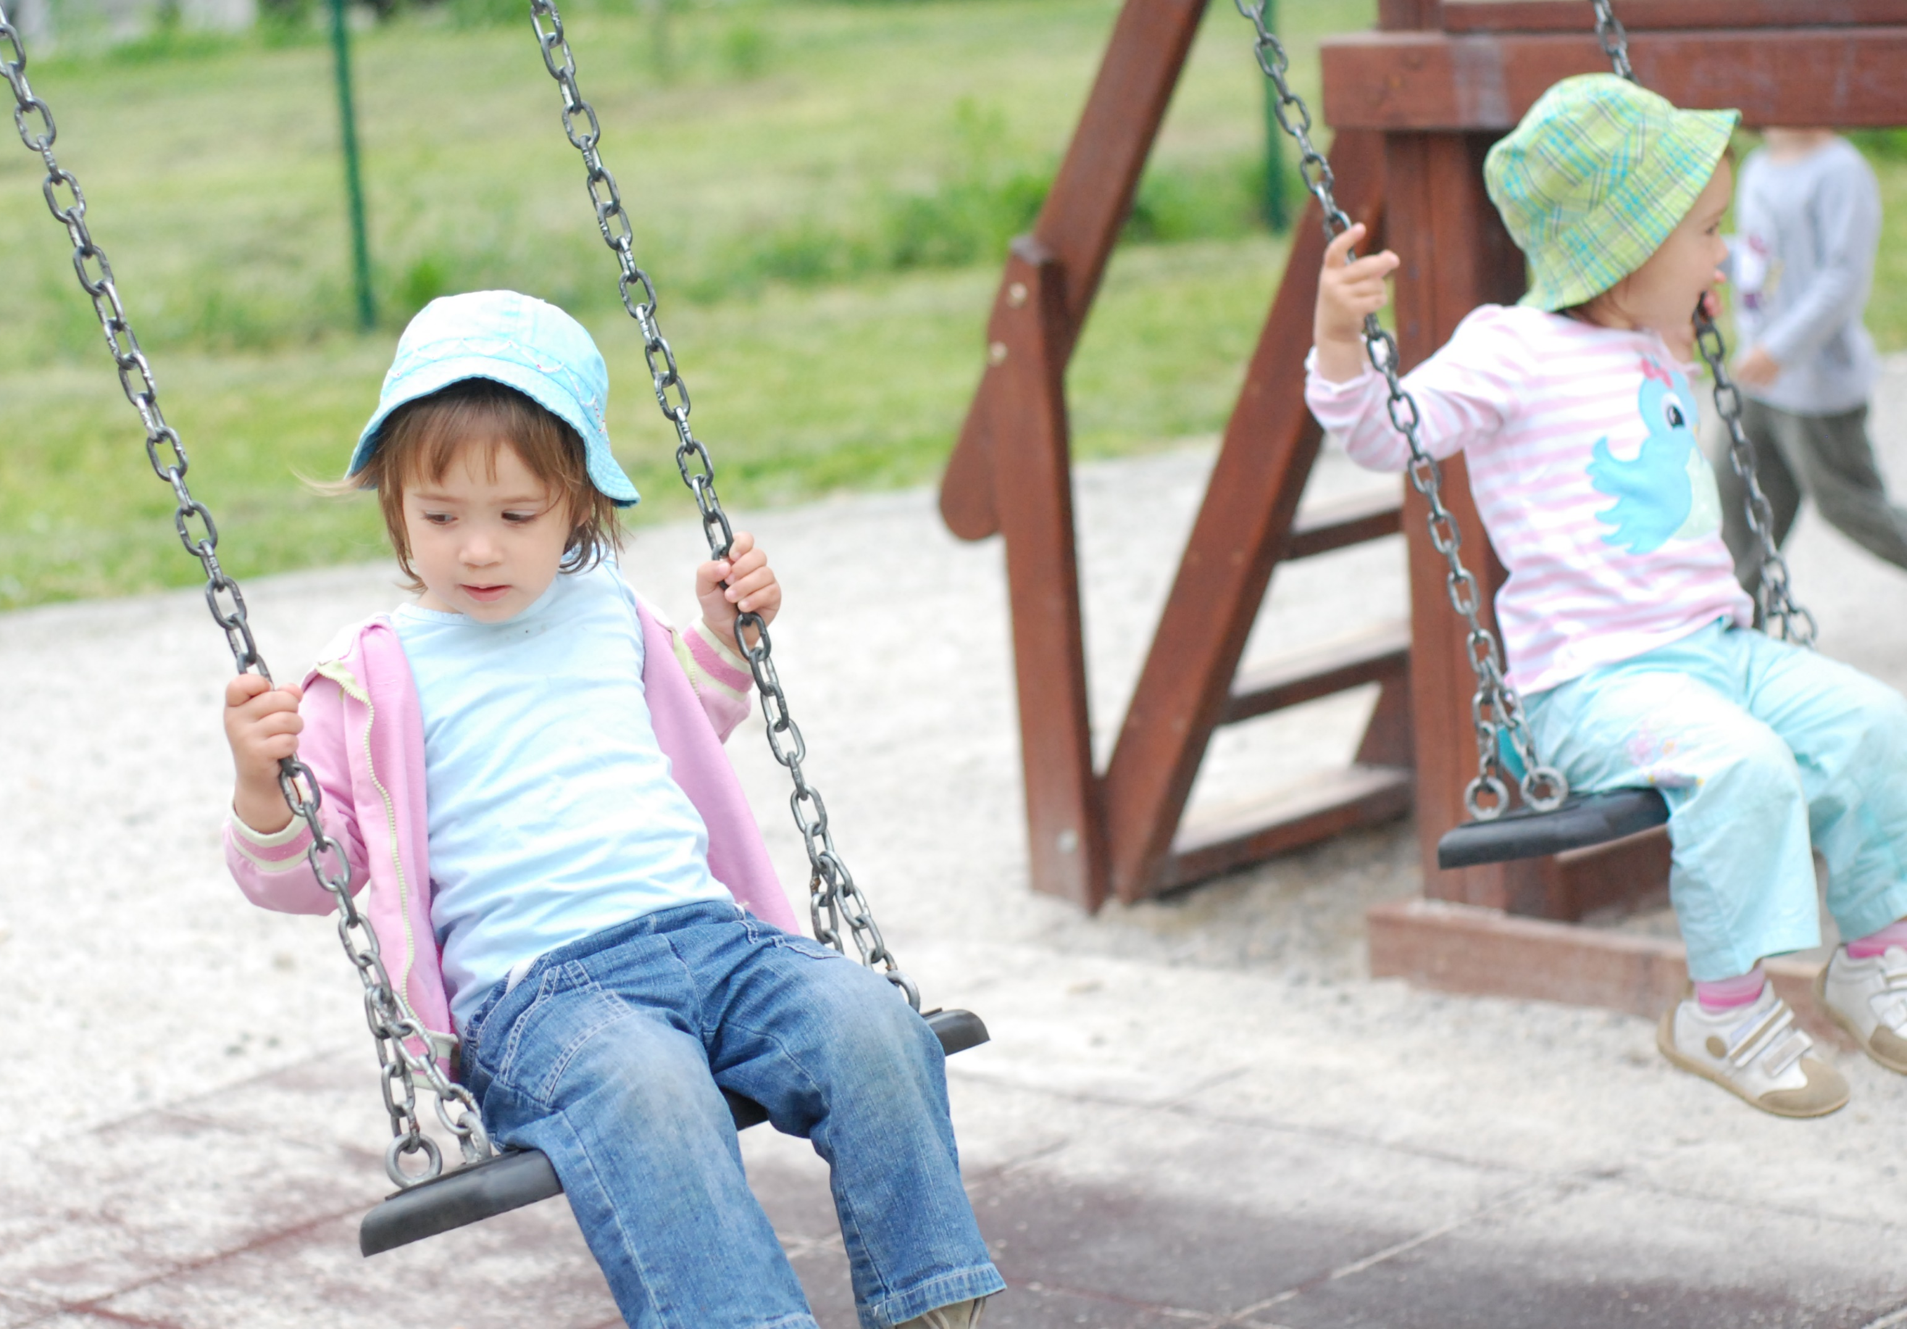
    Reflection
!!What matters most at any given moment!!
The playground and the test environment are not so different.
Both are full of surprises, learning moments and little humans teaching us big lessons.
Ask for support

Slide 16
    Conclusion
What I learned
Prioritization is Everything
You Can't Do Everything
Multitasking has limits. Make lists, communicate and accept parallel work isn't always possible
Ask for Help
Identify what matters most in any given moment
Sharing responsibility makes everything manageable

Slide 17

    Story 4: Night schifts
Night shifts with twins -> make a plan (survival required a strategy).
When they were still very little and feeding during the night, we prepared everything in advance:
Two bottles with the correct amount of water
Milk powder
The moment the first baby made even the slightest “I might wake up” noise, it triggered a full operation; make milk for both,
feed one, feed the other - because if you don’t, the second one will definitely wake up five minutes later, just to keep things interesting.

Slide 18
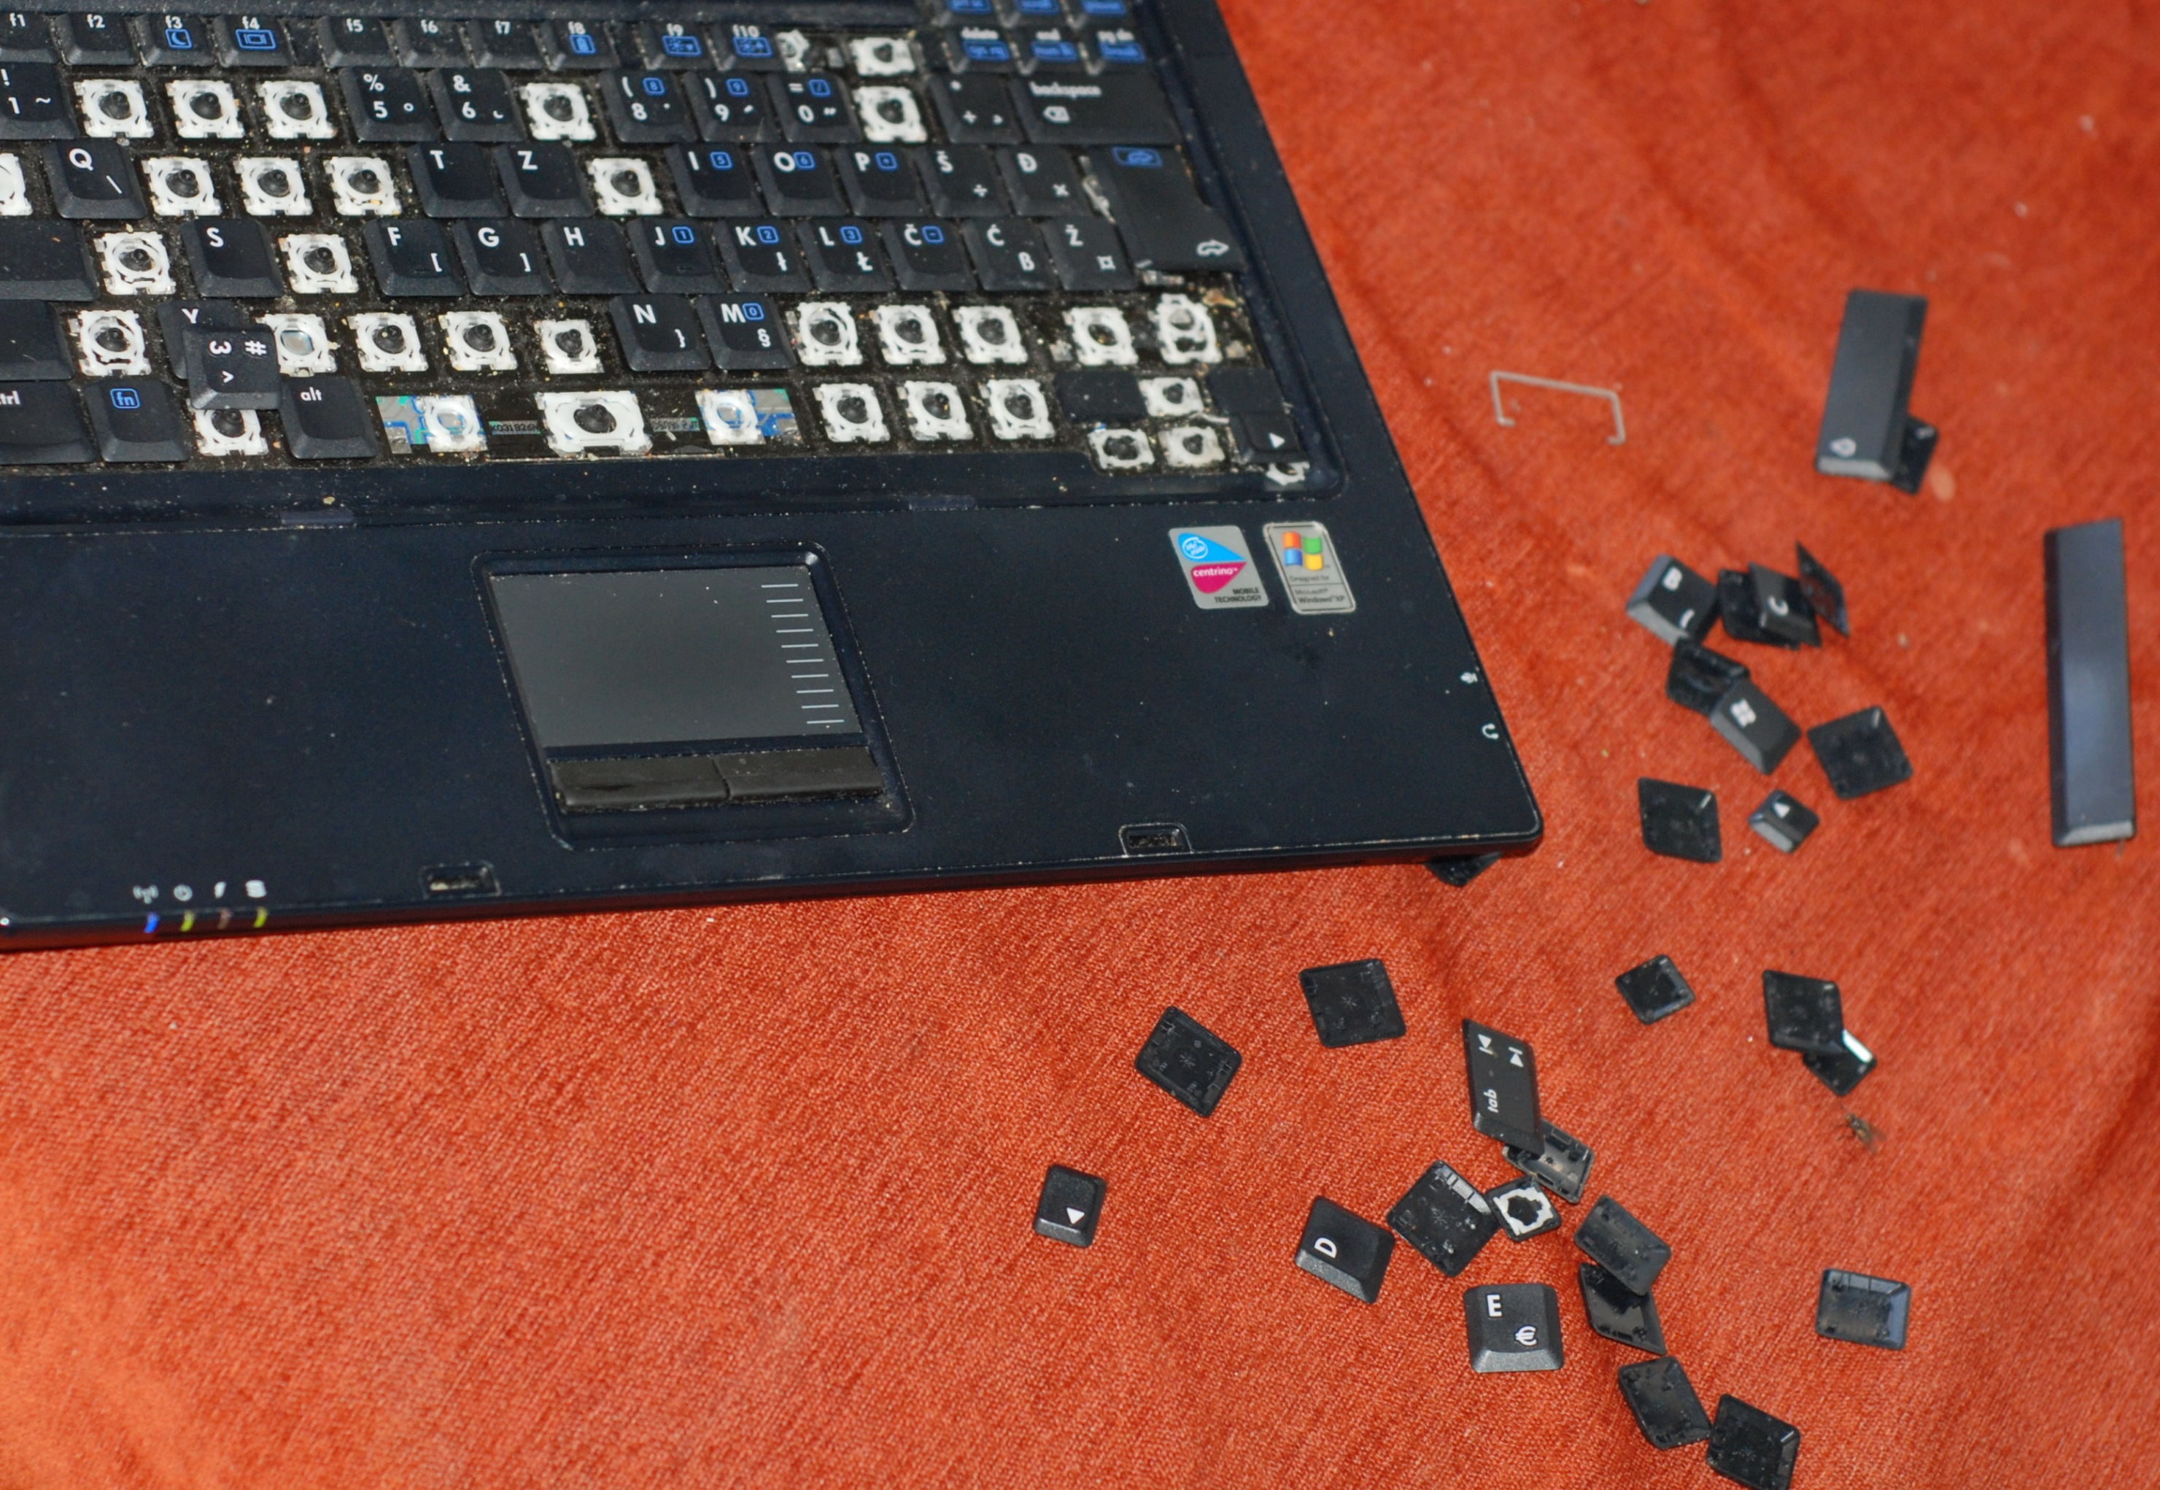
    Reflection
Preparation reduces risk.
Anticipate what comes next:
think in worst-case scenarios.
Efficiency under pressure matters:
when there is a chaos around, plan and ritual can help you a lot.

Slide 19
    Conclusion
What I learned
Prepare in advance
Optimize for efficiency
Create repeatable processes
Smart batching (doing things together) saves time and energy
Stable routines lead to consistent, reliable outcomes.
Good preparation reduces stress, errors and rework

Slide 20
    Story 5: Notebook
One time, we were about to leave for vacation. I was on the phone, organizing something.
My twins - around 1.5 years old - were in the next room.
It was... too quiet.
Every parent knows: quiet means trouble.
I walked in and found them surrounded by a pile of tiny keys. They’d been pulling them out of my laptop keyboard. It was so much fun - for them.
I ended up walking into a computer store with a broken laptop... and a plastic bag full of keys.

Slide 21
    Reflection
Children are the ultimate exploratory testers.
They don’t follow scripts - they follow curiosity.

Slide 22
    Conclusion
What I learned
Embrace Exploratory Testing
Fresh perspective
Beyond the Script
It can lead to unexpected discoveries
Children approach products without assumptions, revealing new use cases
Try things no one would expect. Break the expected flow.

Slide 23


Final thoughts
Creativity
Multitasking
Communication
Clarity
Prioritization

Slide 24
Final thoughts
Testing
Lidership
Teamwork

Slide 25
Final thoughts
Becoming a parent doesn’t weaken professional skills - it sharpens them in new ways!

Slide 26
Final thoughts
working with a parent - especially a mom:
someone with a new skill set:
built under pressure
fuelled by love
tested in the wildest lab of all: real life
someone with “less time”
12.5.2026.
Žaklina Polak Matanović

Slide 27
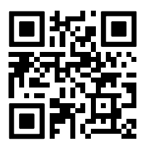
One more quick check!
✨ Did this talk shift your perspective?
Scan again - let's see how we feel now?
12.5.2026.
Žaklina Polak Matanović

Slide 28
Final thoughts
May your home be full of laughter,
your tickets clearly assigned, and your keyboard keys stay firmly in place!
12.5.2026.
Žaklina Polak Matanović

Slide 29
Q&A
12.5.2026.
Žaklina Polak Matanović

Slide 30
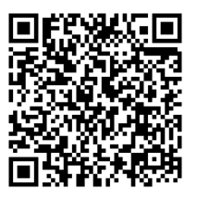
Thank You!
LinkedIn Contact Info

