Slide 1


Mission
The mission of Northeast Wisconsin School of Innovation is championing students through personalized and innovative education built on authentic relationships, self awareness, and growth mindset.
Vision
Graduates of N.E.W. School of Innovation value themselves, are empowered to grow, and are equipped to be lifelong learners in the service of others.
N.E.W. School of Innovation
LOGO HERE

Slide 2
Successes
1,200 students have graduated that would not have.
We have transitioned from an behavior management school to an Innovative School
  Reduced suspensions by 50%
  Significantly reduced student referrals.
  Increase in student attendance
  1.4 years of growth per student per year in Literacy*
  1.3 years of growth per student per year in Mathematics*
Demand is High. Outgrown school space 3 times.
Comprehensive schools have taken our model and are imbedding them into their schools.
Expansion to 6th grade and 11th grade program.
Notes:
Transitioned from Managing behaviors to Innovative School

Slide 3
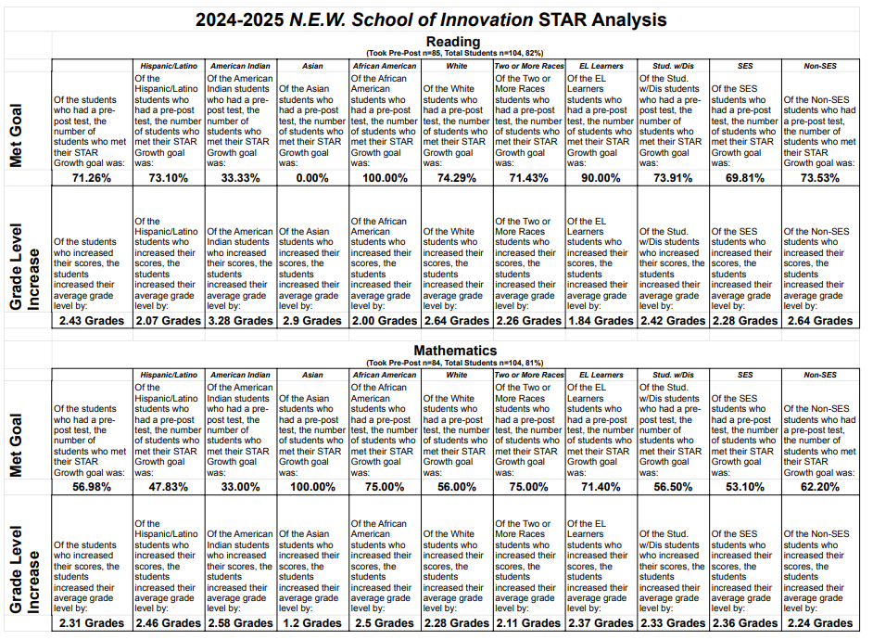

Slide 4
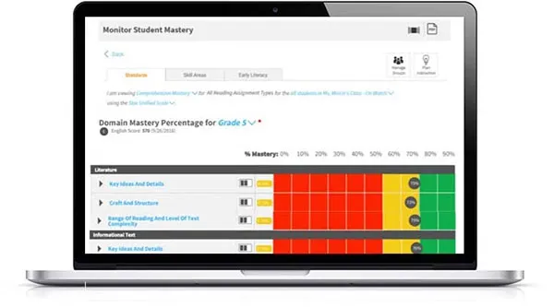
N.E.W. 25/26 Student Growth
115/130 Students-88% met growth
Average growth Literacy-1.98 years
Average growth Math-1.93

Slide 5
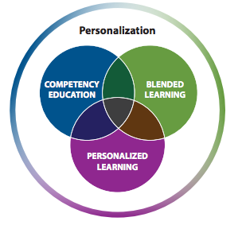
Proficiency Based-Learning

Slide 6
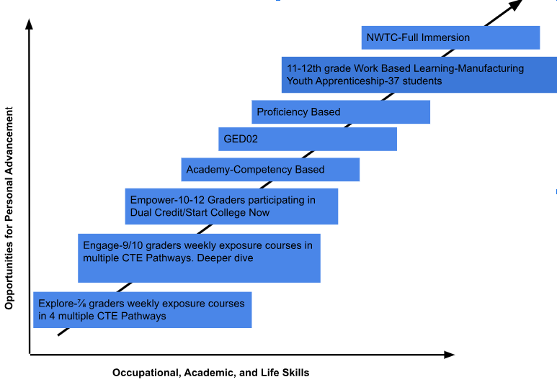

Slide 7
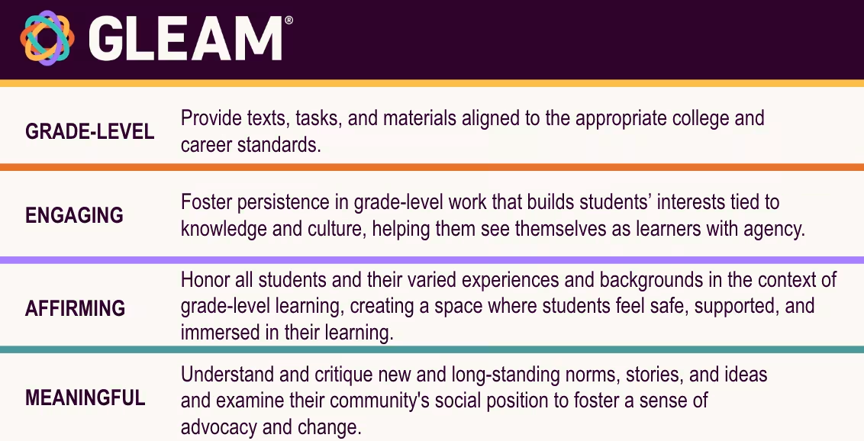

Slide 8
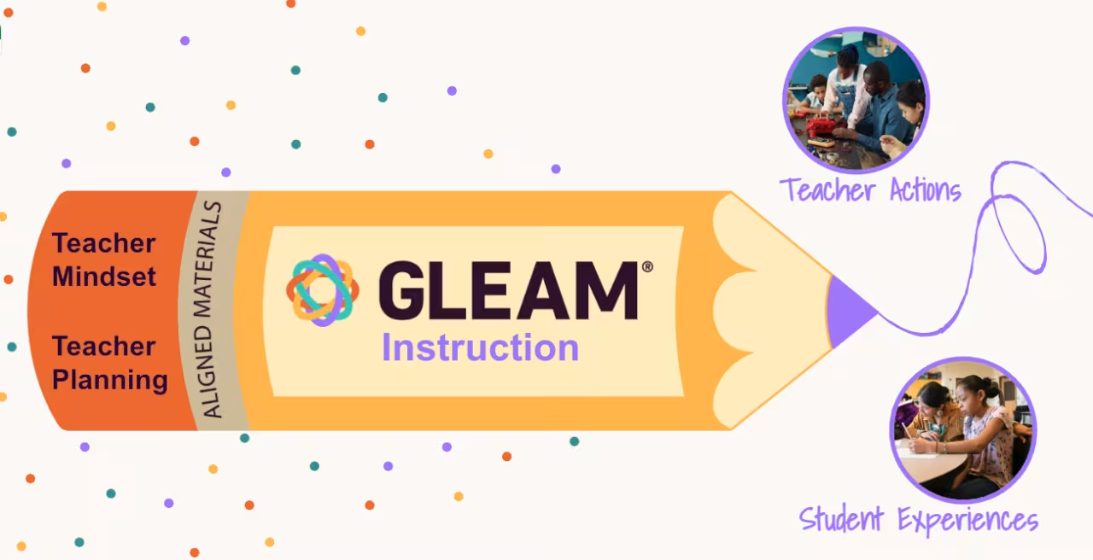

Slide 9
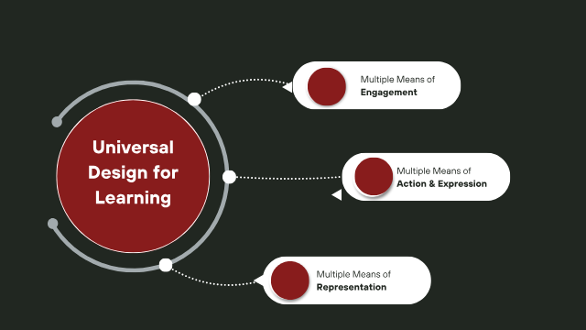

Slide 10
3 UDL principles
Universal Design For
Learning
Engagement | Representation | Action
Interest Persistence Self-Regulation | Perception and Identity Language comprehension | Communication Self expression

Slide 11

Universals:
Student Learning Advocates
  Student voice
  Targeting
  Learning to self advocate
  Space/time
Interventions-secondary support from Students services.

Slide 12
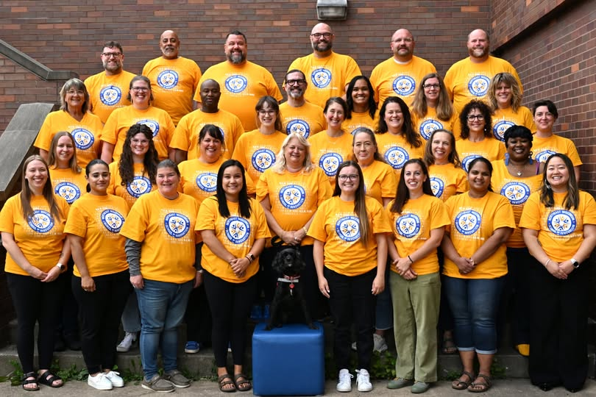
100% of students graduate. Those students will be enrolled, enlisted, or employed.
One
Team
One
Vision
One
Goal

Slide 13
N.E.W. 25/26 Student Growth
115/130 Students-88% met growth
Average growth Literacy-1.98 years
Average growth Math-1.93

Slide 15
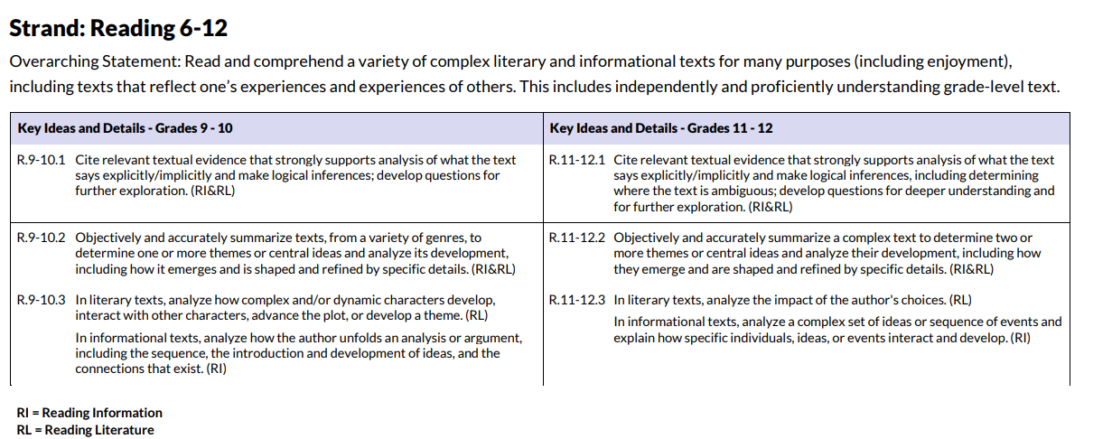
Where do we focus? Standards!
Notes:
This will talk about how we started with proficiencies

Slide 16
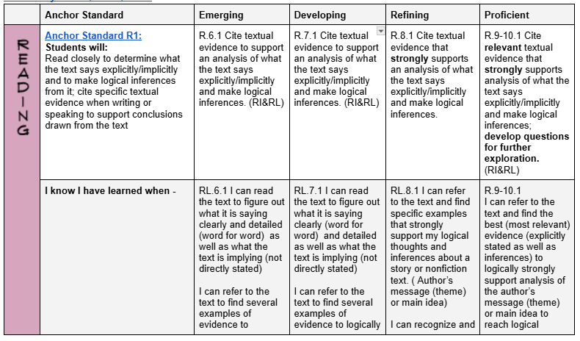
N.E.W. ELA
Notes:
Expand on how we transition from the beginning to create these rubrics

Slide 17


Academics
How are we different from other schools?
PROFICIENCIES VS ALPHABET GRADING
We want students to have the skills to be successful after school.

Slide 18
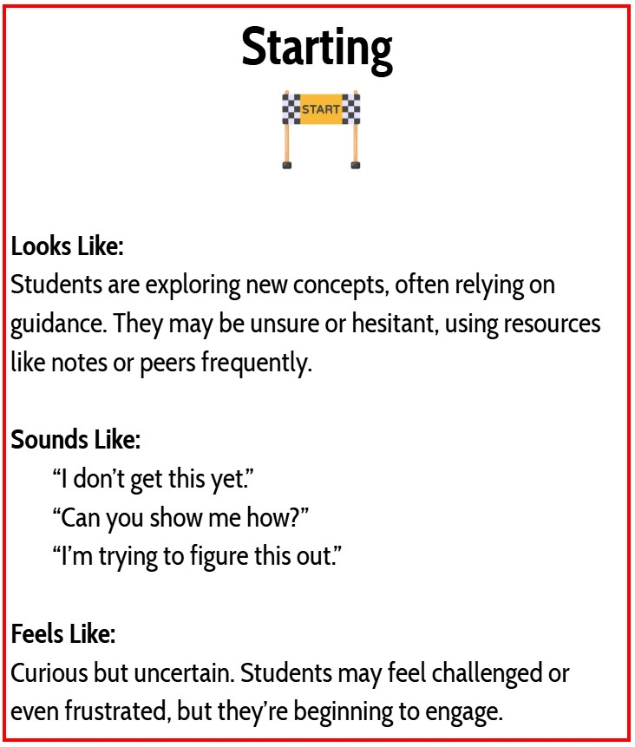
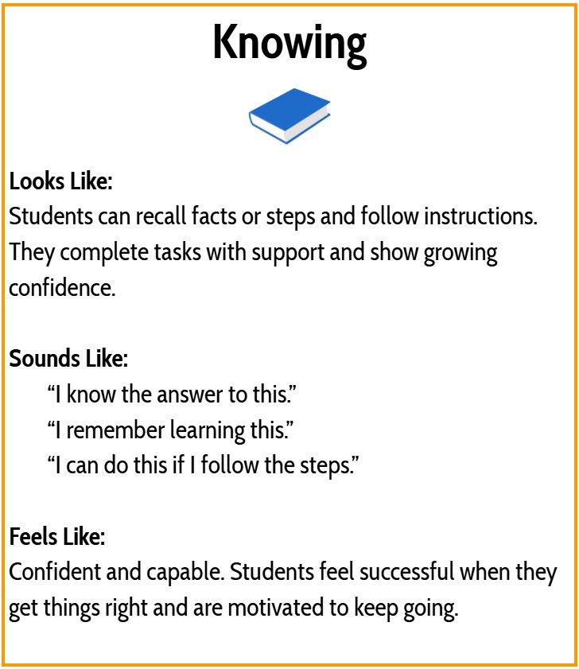
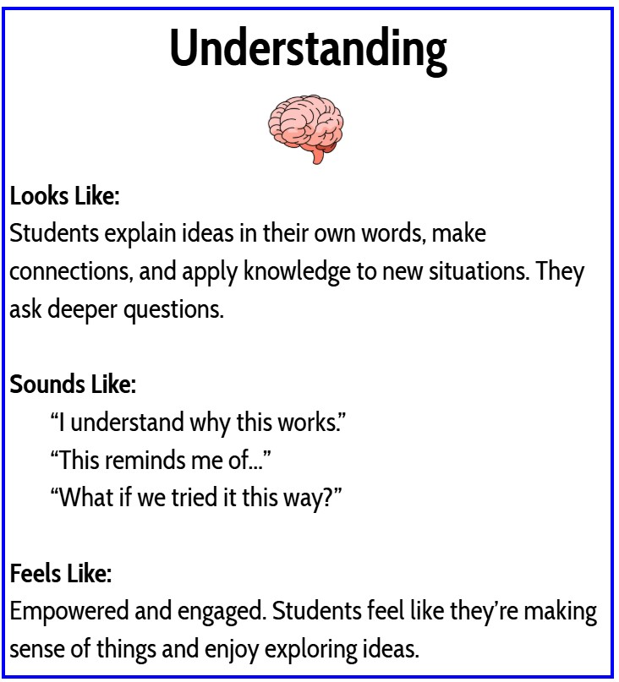
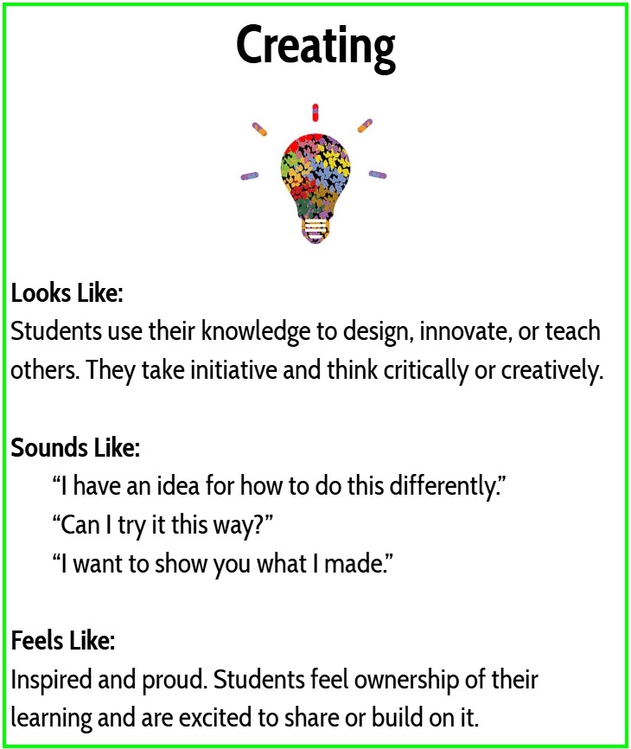
Grading
Middle schoolers will earn middle school proficiencies through skills and practices..
There is the ability to earn high school proficiencies, but this will likely be more for students who are in 8th or 9th grade.
This is not a race, but working towards understanding the knowledge and skills you will need to be successful after high school.

Slide 19
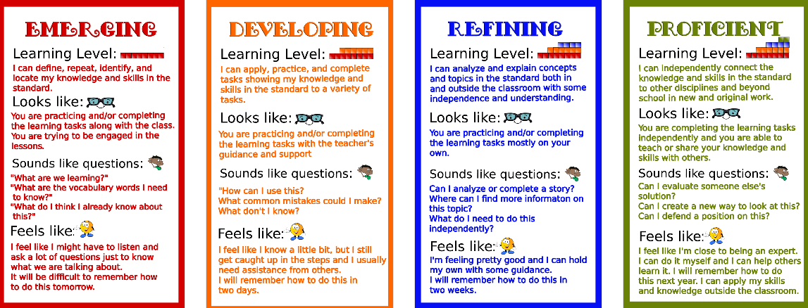
GRADING

Slide 20
Academic
Universal
Design
Notes:
Transitioned from Managing behaviors to Innovative School

Slide 21
“I can do what I want…right?”
Scott (2018)
Notes:
This will be the transition to talk about my experience on why I came to NEW and how being able to use data, check on the changes, and modify my practice

Slide 22
Timeline 2018-2026
Transitioned from Covid → Behavior → Academic → Grade-Level Academic
2019-2021
2021-2023
2023-2025
2025-2026+
Years 1 - 2
Years 3 - 4
Years 4 - 5
Years 6 +
COVID
Gathered Data on Academic Curricula and Engagement
Focused on “Meeting the Students Where They Are”
Evaluated STAR scores, engagement data, focus on behavior and support
Transitioning to Academic Focus
Looked at STAR scores, engagement data, solidified behavior protocols
Focused on “Meeting Students Where Capacity Exists”
Looked at STAR scores, engagement data, met the students at Grade Level
Notes:
This will be an overview of our timeline and evolution of ideas

Slide 23
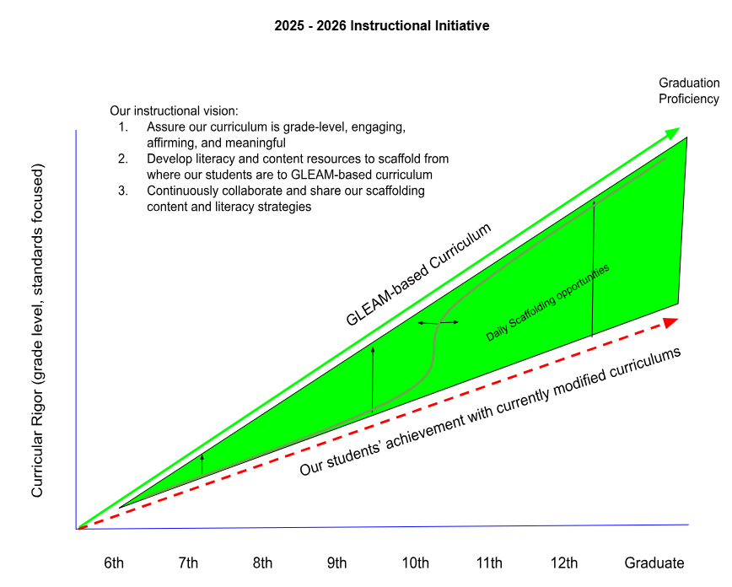

Slide 24
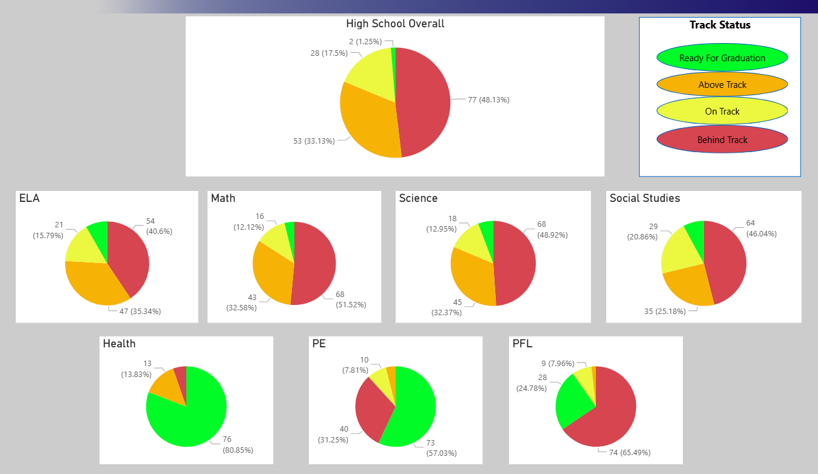
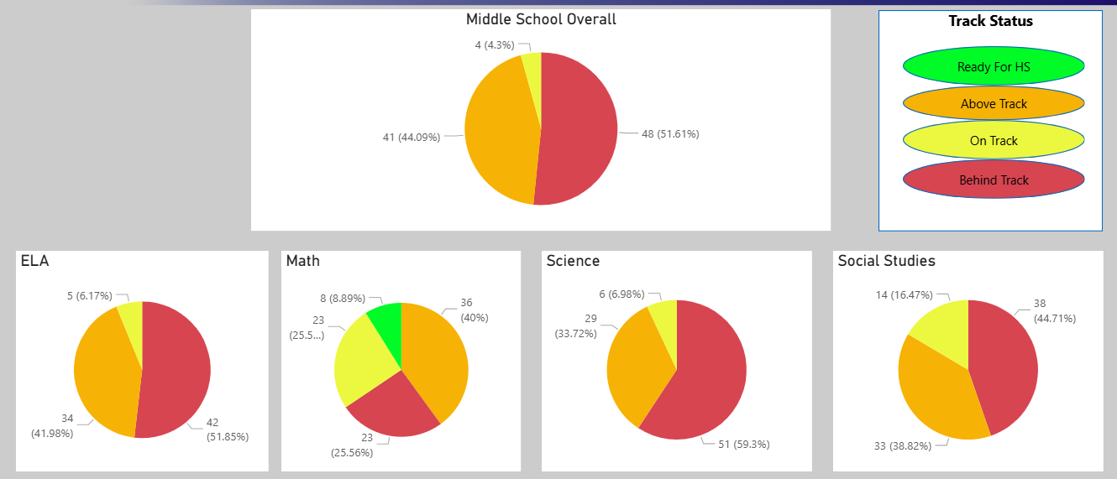
Assessments
Created with and by teachers
  Power BI
  TSAR linked to Infinite Campus and Gradebook
Teachers can enter data and see the results/reports immediately
Teacher provide the inputs and evaluate the outputs together (CLT & PLT)
Close Reading/Writing are what we are working on now
Notes:
These are the Power BI that directly influence daily. Talk about Close Reading

Slide 25
Key Transitions
First moved from focusing on behavior to focusing on academics “Where the students’ are”
Using GLEAM, we went beyond that to “Where the students’ capacity exists”
Our teachers used out own data and analysis to “close the loop” to see what we can do
Teachers need to design the data collection and be able to see it in real time to make decisions.
6-8 Focus/Assess on Skills/Practices
9-12 Focus/Assess on Content
Notes:
Transitioned from Managing behaviors to Innovative School now

Slide 26

Culture
R.I.S.E
Notes:
Our Foundation. Use of RCD and PBIS

Slide 27

FOUNDATION
A school based design for expectations
Team based - systematic planning
It is for ALL students, ALL staff in ALL settings
It is meant to be refined as move through the school year!
monthly data digs

Slide 28
What is Rise and Shine (RCD)?
Responsibility-Centered Discipline (RCD) is a framework for school discipline that emphasizes student ownership of their actions and promotes a positive school climate. It shifts the focus from punishment to empowering students to understand their behavior, take responsibility, and make better choices. RCD is not about removing consequences, but rather about using those moments to foster growth and self-regulation.

Slide 29
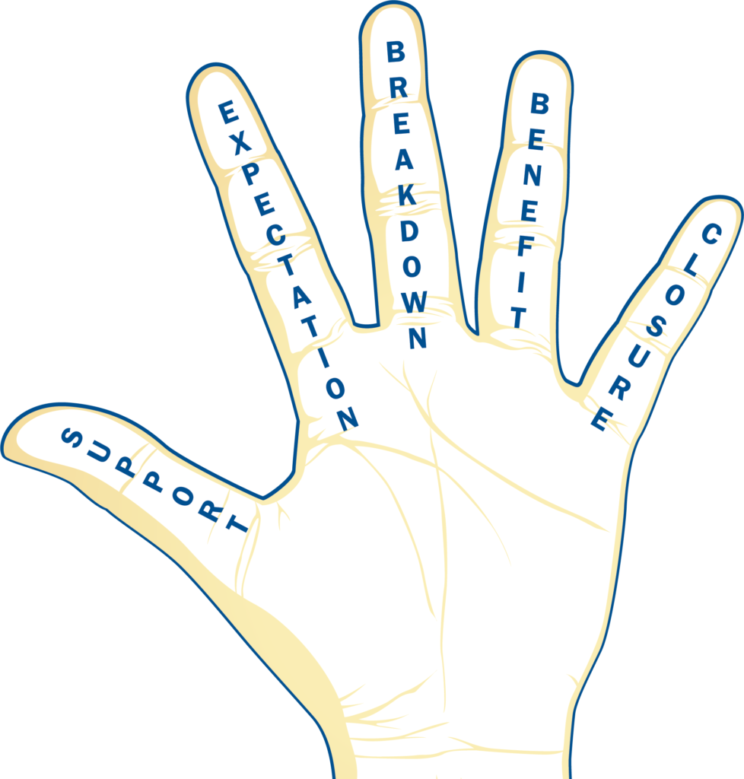
The Five

Slide 30
Support-Focus on the students strengths
Expectation-Refers to RISE (Respect, Integrity, Self-Regulation, Engagement) - FOUNDATION
Breakdown-Describe how the expectation was not met. Be specific
Benefit-State how a different behavior could benefit the student (not the staff member or school)
Closure-finish with a positive statement so both the student and staff are able to move forward without damaging the relationship.
The steps can and will vary in order except the closure step. It will take practice….that support piece…

Slide 31

3 Levels
*It is not about the behavior it is about the response to coaching
Level One
-Our favorite…
Student recognizes the breakdown of the expectation with little coaching from staff, takes ownership and works well with the staff member….We see a change.

Slide 32

Moderate Noncompliance
Student struggles through the process and may resist in some form but eventually is willing and able to work with the staff to resolve the issue.
(Arguing, denying, blaming, ignoring, interrupting, crying. Etc.)
Self-Regulation is the goal.
Documenting with Google Form-
All staff will have access to data
Collaborative Learning/Programming
  Student Services and Admin
Teacher Created Plans-Using Panorama - Review in Programming and LST (Learning Support Team)

Slide 33

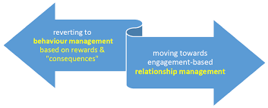

Slide 34

Hard Conversations
PURPOSE

Slide 35
Hard Conversations
Hard conversations are about being true to oneself, doing what is right for students, and shaping an environment that supports learning.
~Jennifer Abrams

Slide 36

Hard Conversations?
Working with a colleague
Working with a parent
Rolling out something new to our school…
Am I missing something?

Slide 37

Get into Trouble… Necessary Trouble
John Lewis

Slide 38

Why speak up?
Collective responsibility
Roles don’t matter
We all build our culture
Continue to work on awareness and empathy
Practice humane, growth producing conversations

Slide 39
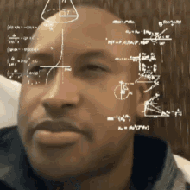
Setting the Stage
Is there a hard conversations you wish you had last school, you want to have this fall?
Use this is a frame of reference going forward today!
What is the context?
What’s bothering you?
Why haven’t you said anything yet?
Let’s normalize this as part of our culture going forward

Slide 40

Competing Commitments
But this is hard (TENSION) stuff… Why?
Wanting to be liked
Safety - emotional, financial
Comfort - Less Effort
No sense of urgency - it only happened once
Personality - but they're just so nice
Survival

Slide 41
What wins out when we don’t speak up?
We don’t live by our principles
The other person has power
Pain and Guilt
Negative Impact on All Students
PARTNER SHARE -
ARE THERE OTHER COMPETING COMMITMENTS NOT LISTED?
DO YOU SEE YOURSELF HAVING ANY OF THESE TENSIONS?

Slide 42

Questions to ask yourself before you speak up?
Thinking - What questions have you asked yourself before speaking up? Are we missing any on this list?
Timing?
Consequence of failure?
Stakes?
Likelihood of Success?
Do-ability?
Options - email? Text? Thoughts on this?

Slide 43

Commitments? Expectations?
Do they know the problem? Have you had a clarifying conversation before the hard conversation?
“They should know…”
Clarity before accountability!

Slide 44

Outcome Mapping
What's the problem?
What do you want to see instead?
What does that look like?
Why might the person not being doing this?
What supports might you offer?
What supports do you need?
Being specific matters!

Slide 45
Outcome Mapping
What questions might you need to answer the most solidly before you speak up?
Are there any other questions you may want to ask yourself not list?
What's the problem?
What do you want to see instead?
What does that look like?
Why might the person not being doing this?
What supports might you offer?
What supports do you need?
Being specific matters!

Slide 46
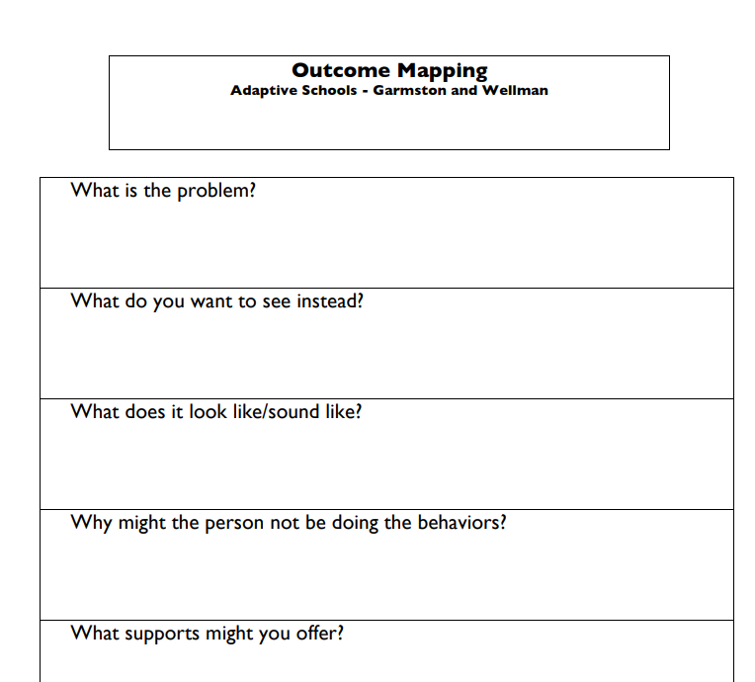
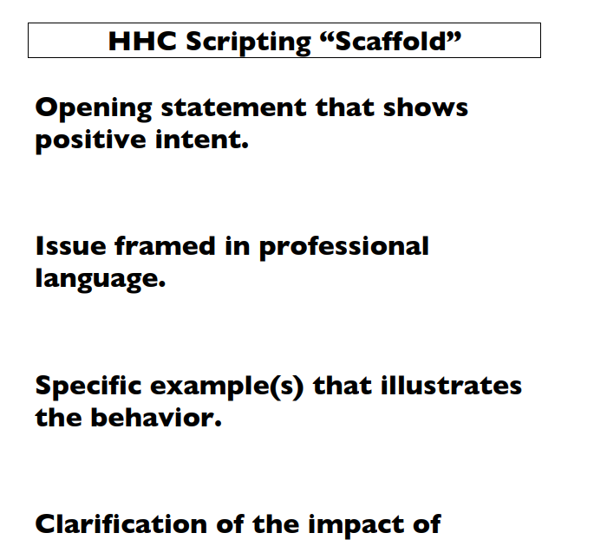
Hand Outs

Slide 47
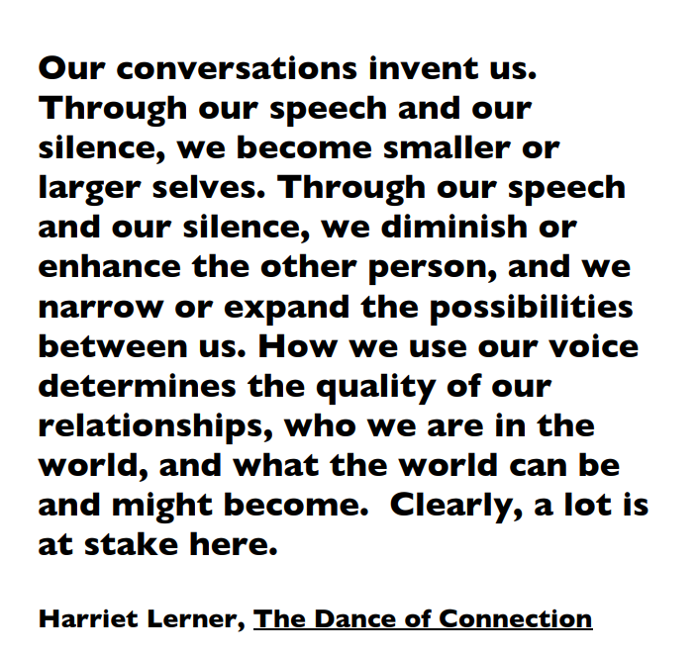
Closing…
FULL NAME
“

Slide 48


Partnership & Access
Assess eligibility for Dual Credit
Explore Work based learning opportunities: internships, apprenticeships, job shadowing
Research college or technical school programs or certifications that align with career goals
Prepare for ACT or Accuplacer if needed for future career
Update resumes
Prepare for interviews
Attend college or career fairs
Explore financial aid, scholarships, or application timelines

