Slide 2

Wisconsin
Charter
School
Summit
2025

Slide 3
Promising Practices in Project-Based Learning
WRCCS Summit 2026

Slide 4
Welcome
Agenda
Grounding
Project-Based Learning activity
Introduction of Best Practices - PBL
Looking towards the future

Slide 5
Notes:
Any additional ones we would like to add?

Slide 6
Charter School Competencies
Teacher/Charter Classroom
Professional Knowledge
Instructional Planning
Instructional Delivery
Assessment for and of Learning
Learning Environment
Professional Duties and Responsibilities
Notes:
I wanted to ground the presentation in our WRCCS competencies. For those of you who have been working towards Charter PD, these may be familiar to you. We did just recently update these, so if you haven’t looked at them in a while they may loo, a little different. But our Teacher (formerly charter classroom) competencies align perfectly with todays presentation. The work involved with this presentation does connect to areas beyond the teacher realm, but we are focusing just on the teacher during our time today.

Slide 7

A little about me
Milwaukee, WI
Advisor at Escuela Verde
  Student-Led PBL
  High School
  Restorative justice discipline model
  Ecopedagogy practice
Teacher-Powered school structure
Consultant for WRCCS - 6 years
CSRC member
Goal this summer - bike to Chicago

Slide 8
Who is in the room? What do you know? What do you bring?
My Right Side | Center | My Left Side
Teacher | Leader/Supporter/Other | Admin
Currently use PBL | Want to learn more | Don’t use PBL
Elementary | Middle | High
Math or Science | Other | Humanities
0-10 years | 11-20 years | 21 or more
Northern WI | Central WI | Southern WI
Notes:
Its a visual cue for not just me, but also you. Take note of perhaps the places you would like to be and see who is there and connect with them during conference.

Slide 9

Let’s tap into our community knowledge
Take 10 minutes and respond to the 5 questions around the room
Take 5 minutes to read the responses
Notes:
Responses can be a paragraph, phrase or words
What did we notice?
What are some words that were repeated as we defined PBL?
How did people KNOW their pbl was working?
What did we notice about the roles?
What was missing?

Slide 10
Promising Practices:
PBL

Slide 11
Promising Practices -Format
Shared key definitions
Objective
Pillars of Practice
Notes:
That activity is a tiny example of how we created this new practice/tool. We (WRCCS) wanted to provide some guiding principles to schools of various academic models that they can use as they design or as they engage in strategic planning/review. A kind of self-assessment and check. This is an online resource - so we have links, interviews, photos, videos, etc.
We are launching it here first - PBL is our first attempt and I’d love your feedback on it - we’ll have time at the end for it. Our aim is to have this all online and accessible. Still working on how to make these more “interactive”. Conduct case studies at about 3 schools, elementary, middle, high…and check out school websites for other schools.
So consider this a test run - walk through of our first Promising practice

Slide 12
Shared Key Definitions
Project- Based Learning - Project Based Learning is a learning method in which students gain knowledge and skills by working for an extended period of time to investigate and respond to an authentic, engaging, and complex question, problem, or challenge. Project Based Learning can take many different forms and can have varying levels of student autonomy.
Project - The learning process consisting of different elements, such as inquiry/question, research, student voice, assessment/reflection, public product. Projects can range from one day to over a few years.
Student-Led/Teacher-Led/Co-Led - The designer(s) of the project. The person(s) responsible for the elements of the project process (ex. identifying the problem, gathering the information and assessing).
Project Process - The systematic and clear process for a teacher/student project from ideation to assessment.
Notes:
Our PBL definition is rooted in the Buck Institute/PBL Works but also influenced by our site visits and community (micro-credentials and networks)
When we asked students to define PBL - many of them mentioned how “free” it was “better than normal school” ….the student defined themselves within PBL

Slide 13
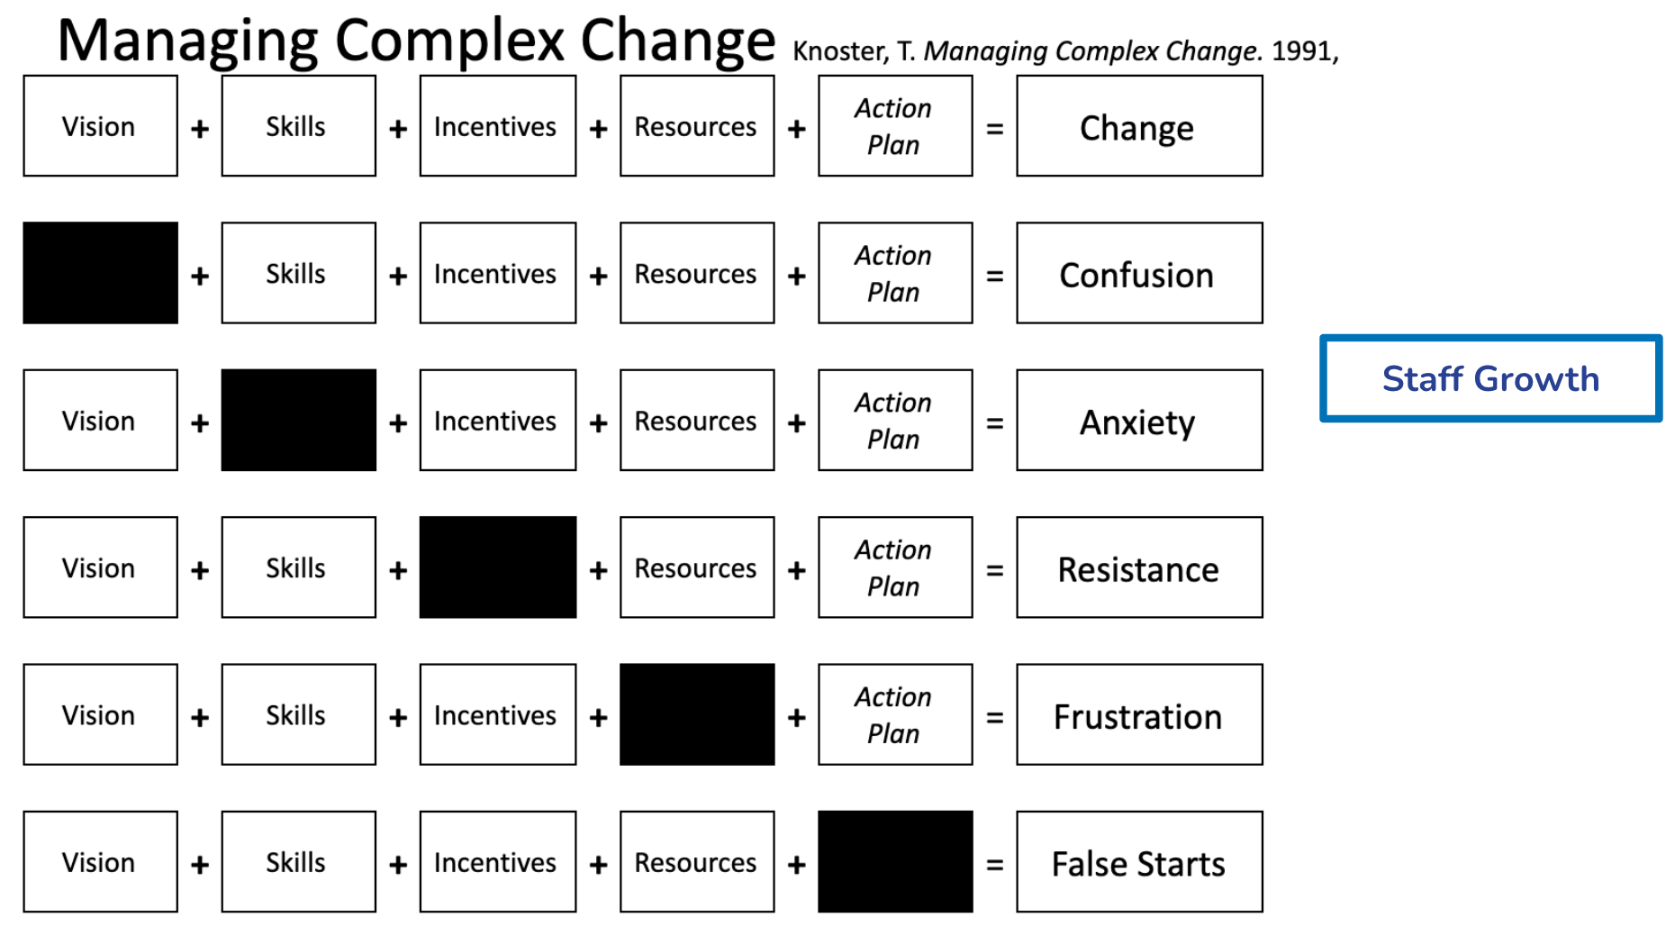
Objective
Teacher - PBL allows teacher to guide students development while supporting their inquiries.
Notes:
As we conducted site visits - we notice these patterns….if you are new to PBL this can be helpful as you design…ensure you have all the elements. If you are already existing, where can you grow?
VIsion - clear definition of PBL…how does PBL connect to your overall mission of vision of the school - without it you get confusion….like is this model working for us?
Skills - any special certifications - conferences that would make teacher better….without it they ask/feel “ahh am i doing this right”
Incentives - how is work valued? Feedback given …without it “why should I do it”.....ESPECIALLY around evaluation….resistance doesnt have to mean active resistance - just not doing it
Resources - simple as materials ..without it frustration
Action Plan…this is your Project process…without a systematic and clear process of PBL teachers experience false starts.
When all of this is happening and functioning there is staff growth :)....which can lead to student growth.

Slide 14
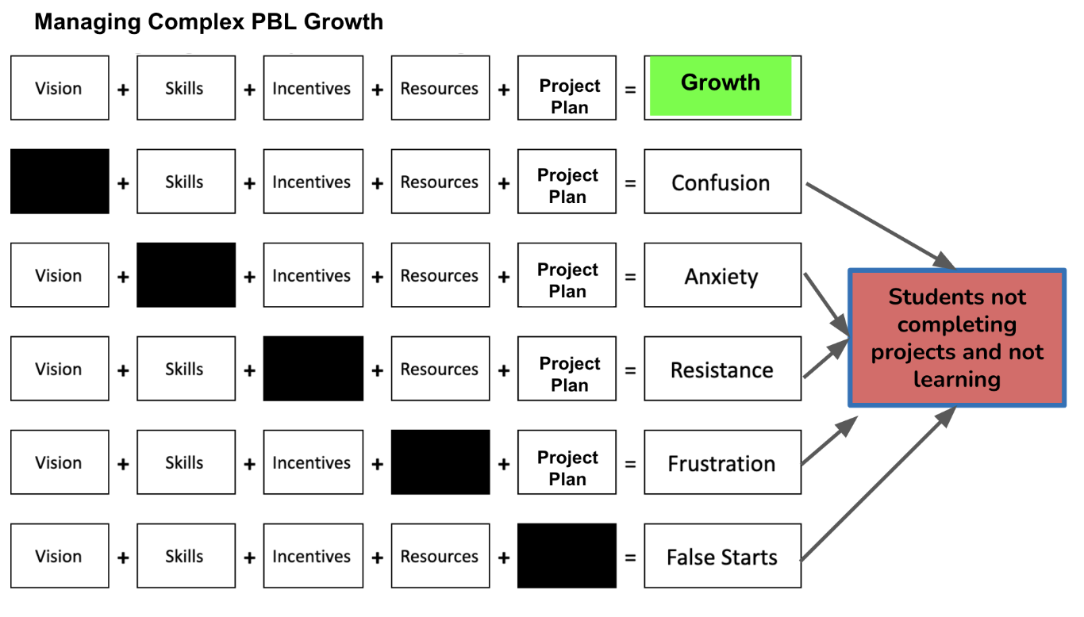
Objective
Student - PBL offers students the opportunity to learn by centering their voice & choice to impact their community and completing projects. .
Notes:
So…lets look at the student.
All academic models have the objective of student growth…usually student growth by XX. in this case…
For those in PBL i’m sure you have students in your mind that fit these examples.
Vision - confused How can I be a successful PBL student?
Skills - missing skills they feel they cant do well, so they become anxious
Incentives - not just rewards…grades, but how is their work valued.--> resistance
Resources - books, access to experts, funds ….frustration
Project plan- procjes process…do they know when and how to take the lead w/o it …false starts
We do have a PBL framework document that I’ll upload to sched. Has guding questions to tune up your PBL growth. https://docs.google.com/document/d/1GLzGMI-E34A_di2b4uFAnxz9lOV3_8iygM3V0TbEQFE/edit?usp=sharing

Slide 15
Pillars of Practice
Each of the 5 Pillars is included for all Promising Practices. They will contain specific elements that correspond to each academic model. Case studies will be referenced.
Other aspects include;
Case study summary
Promising Practice one pager
Curriculum
  Buy vs. Build
Staff Training
  Conferences
  PD
  Books
  Pedagogical standards
  Teacher evaluations
Learning Reporting & Feedback
  Assessments
  Final products
School Culture
  Innovative design practices
  Relationships
Community Connection
  Open house
Notes:
Onboarding - students (what is PBL…transition), parents (sessions/open house)
Before pager - https://drive.google.com/file/d/0B6vNaSzVordoU3Vpdk95Y2xLV1AybldBLVJCWmNFWmJWT0RV/view?usp=sharing&resourcekey=0-KxIwnmsEb6SusuUBhzAAmw
Have thought of just 3 pillars (student learning, Staff training, and school culture)...
Site visits
Assessments
Public Presentations
Flexibility & Alignment to standards
Clear expectations
Onboarding
Staff training
Student Autonomy
Learning Reporting/Evidence of student learning
Community Connection
Daily Schedule
Learning Feedback
Culture

Slide 16
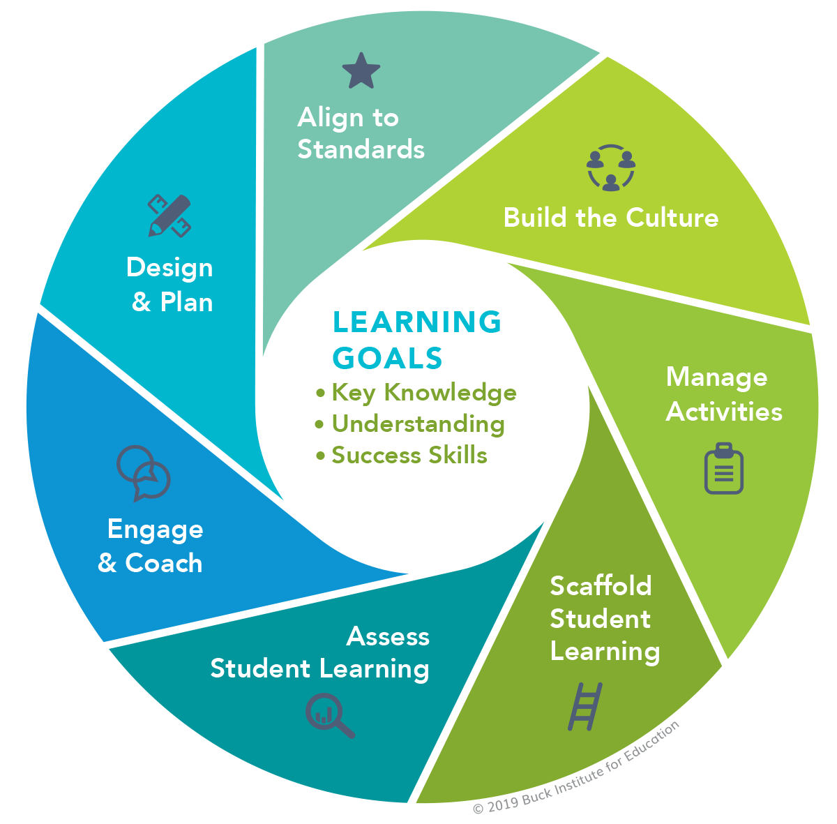
Curriculum
There isn’t a standard baseline of PBL so there are lots of versions out there
Schools did reference PBLWorks/Bucks Institute
Build curriculum
Decide to what degree student-led and/or teacher-led
Sample Resources
Student/Teacher Led Continuum
PBLWorks: Project Design Elements
Bucks Institute Project Design Rubric
PBL Documents
Notes:
Curric is probably the most complex for PBL.
Decide if its student led or teacher lead? Which content areas….most schools were full PBL, but some had PBL for humanities

Slide 17

Staff Training
Site Visits - Seeing other schools in action very valuable in (re)designing PBL.
PD - In house, district assigned
Conferences - Attending conferences to deepen pedagogical knowledge and praxis
Networks - Spaces to network and connect with schools in similar situations
Books/websites - Want to create a living library
Sample Resources
Site Visit Note Catcher
PBL World (very expensive)
P3 Conference
Notes:
Where do staff get trained and how?
What we heard were the following
Site Visits - almost every school referenced
If you have books/websites that you reference regularly or have and enjoyed please share them when we talk about next steps.

Slide 18

Learning Reporting & Feedback
Rubrics - As a way to assess individual projects
Capstone/YPEAR - senior project
Seminars- more structured teacher-led experiences
Advisories - Cohort style project
Sample Resources
Kaleidoscope Project Elements
Class Act Project Checklist
Student Self-Assessment
Project Process
Project Rubric
Notes:
Capstones
Community-engaged learning
E-portfolios
First-year seminars and experiences
Interdisciplinary learning
Learning communities
Service learning
Transition Seminars
Rubrics

Slide 19
School Culture
Student Autonomy - Students valued their own autonomy
Student/Teacher Relationship -Emphasis on relationships
Continuous Improvement - Committing to learning and improving - student, teacher, and leaders
Sample Resources
Photos & student interviews
School videos
Improvement Mapping

Slide 20
Community Connection
Presentation Nights- A designated time for students to showcase their learning
Open House - A time for the community to learn about the school
Parent Groups- A space for caregivers to advocate for students
Community Partnerships - Organizations playing various roles, credit earning, funding, experts and more
Sample Resources
Student & Parent Expectations

Slide 21
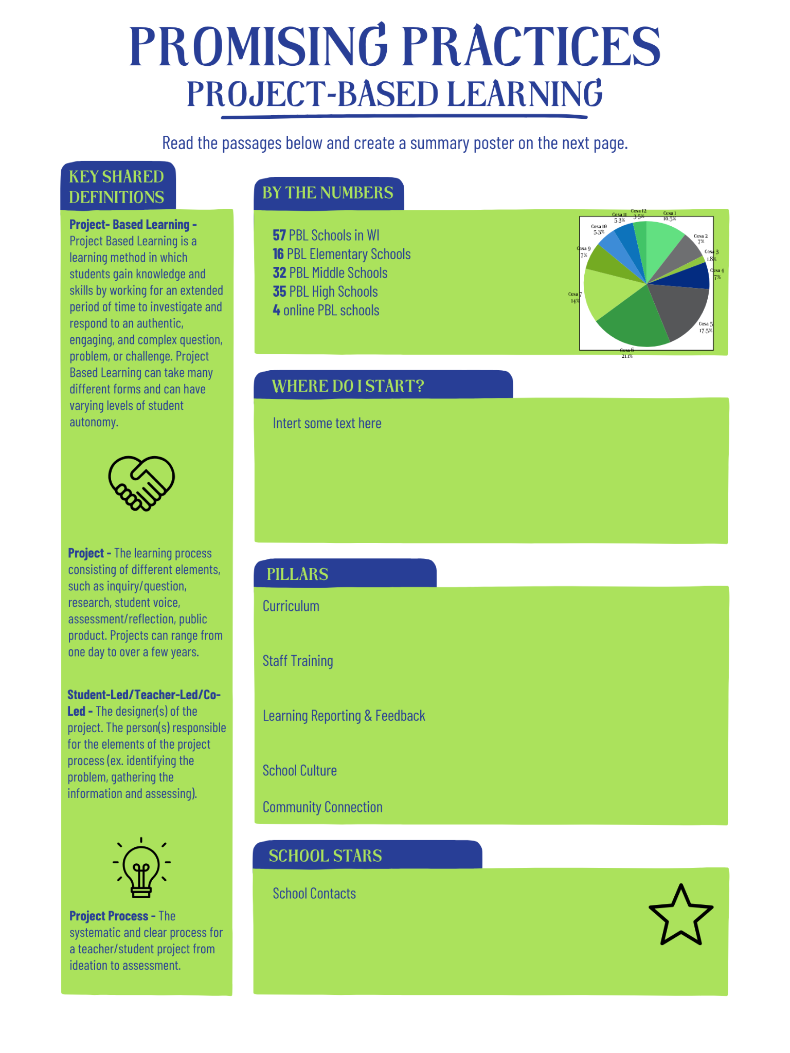
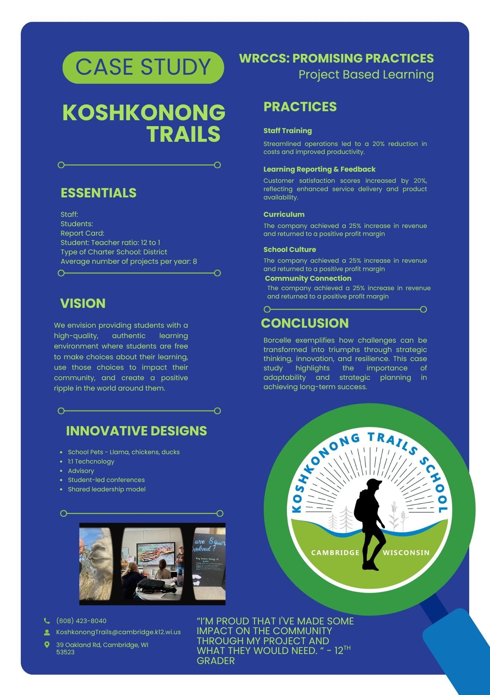
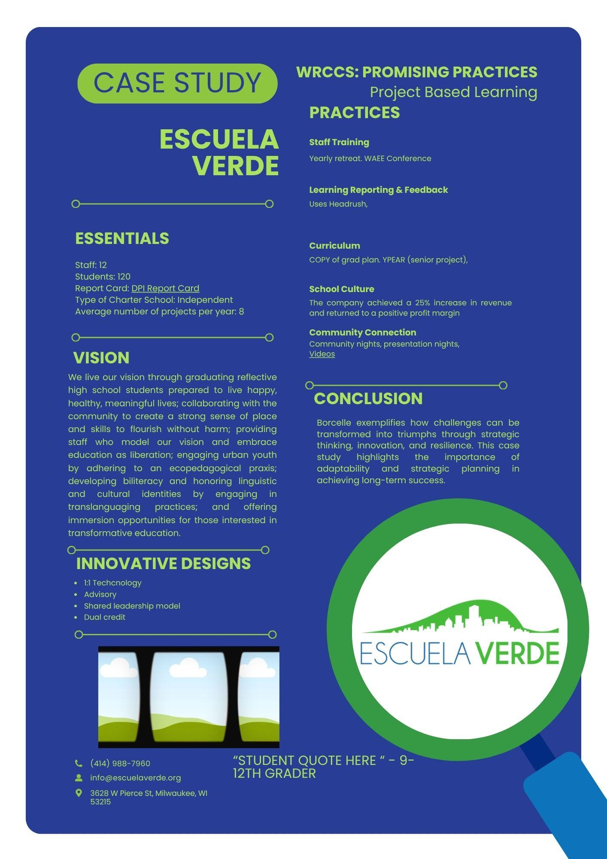
Drafts of Promising Practices
Notes:
In the works….
The new one-pager….and online it will have links

Slide 22
Looking towards the Future

Slide 23

What are WRCCS next steps
Will use feedback from this session as we roll out additional promising practices over the next months
Will be creating a “by the numbers” visual document
Montessori learning is our next Promising Practice to roll out
Which ones should we focus on afterwards
  List of academic models
Be on the lookout for updates reflected on our website in the classroom section
Notes:
What definitions could be added? Ones you have been wondering about?

Slide 24
Thank you

