Slide 1


Framework for Charter Contract Renewal Process & Decision-Making
Bridget Schock Anderson
Director Contracted School Services
Milwaukee Public Schools
Wisconsin Charter School Summit 2026

Slide 2
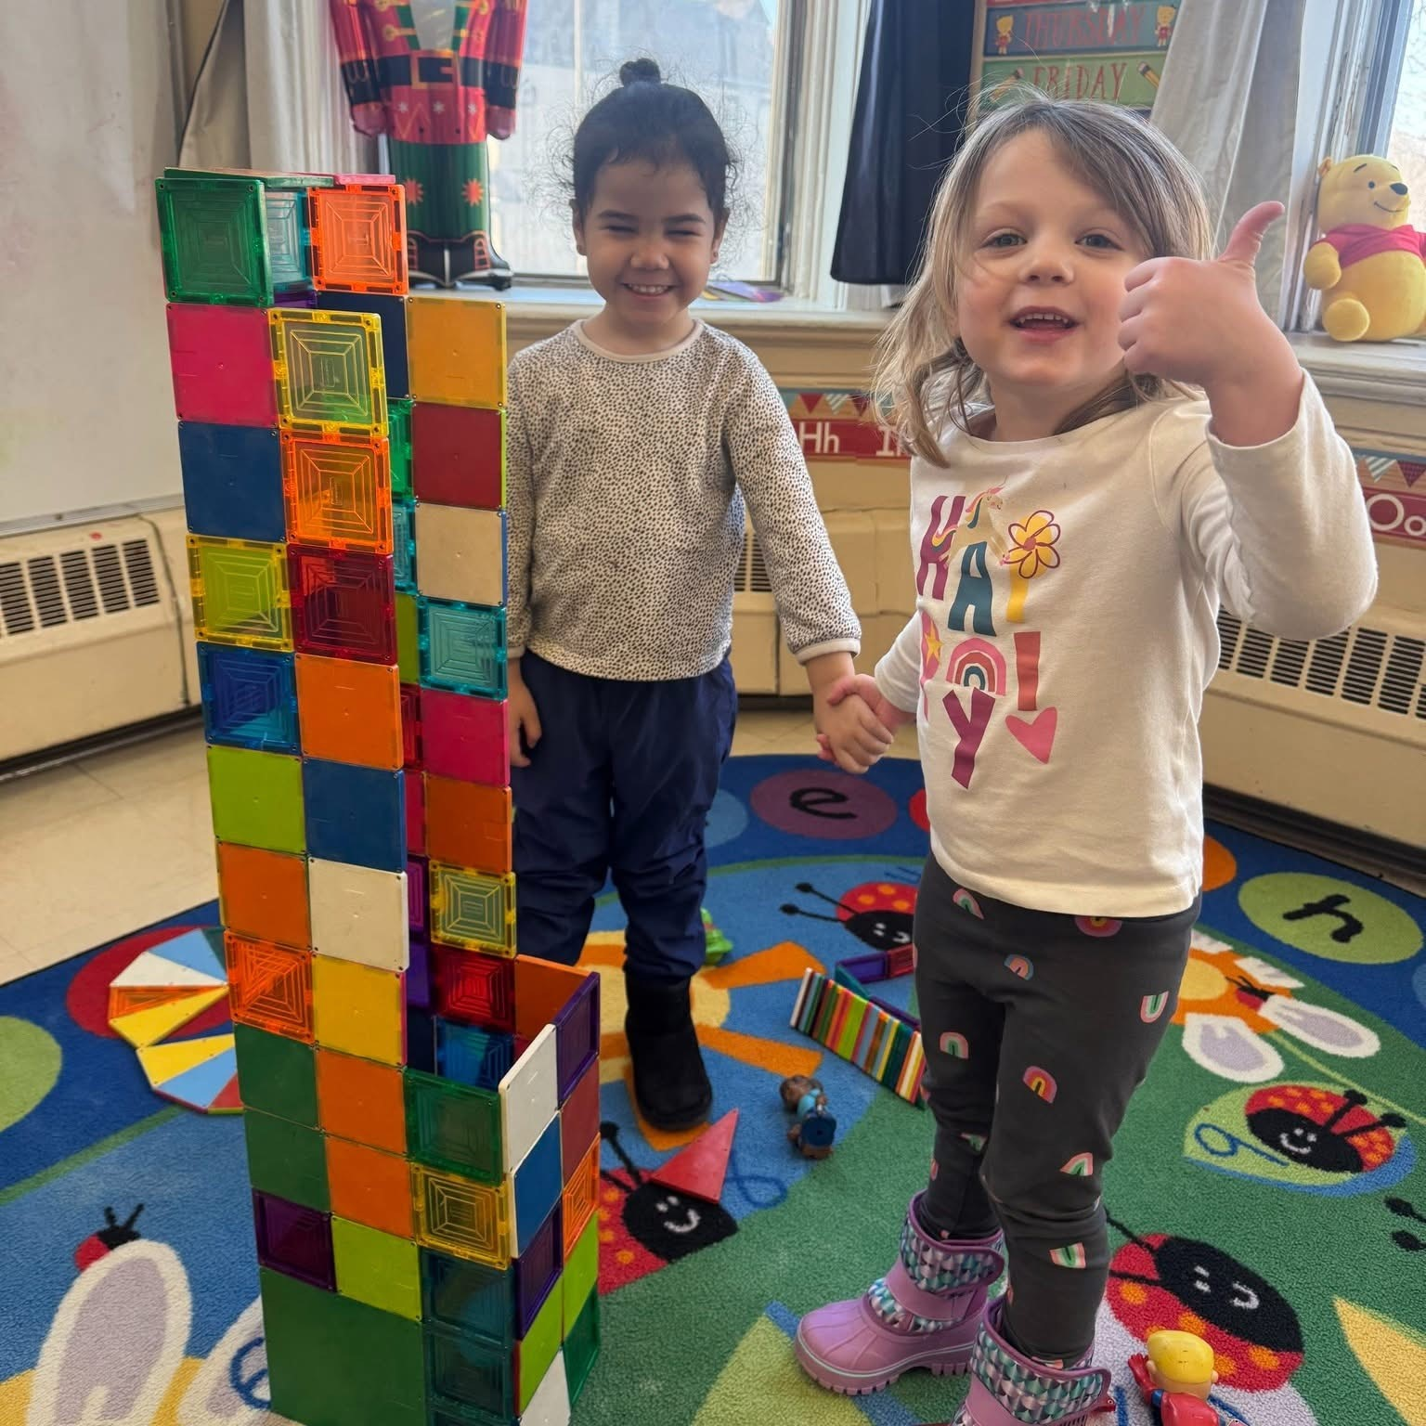
Creating a Solid Performance Framework
Creating a fair evaluation process with clear timelines and evidence requirements
Data-driven decision making practices
Communication to stakeholders

Slide 3
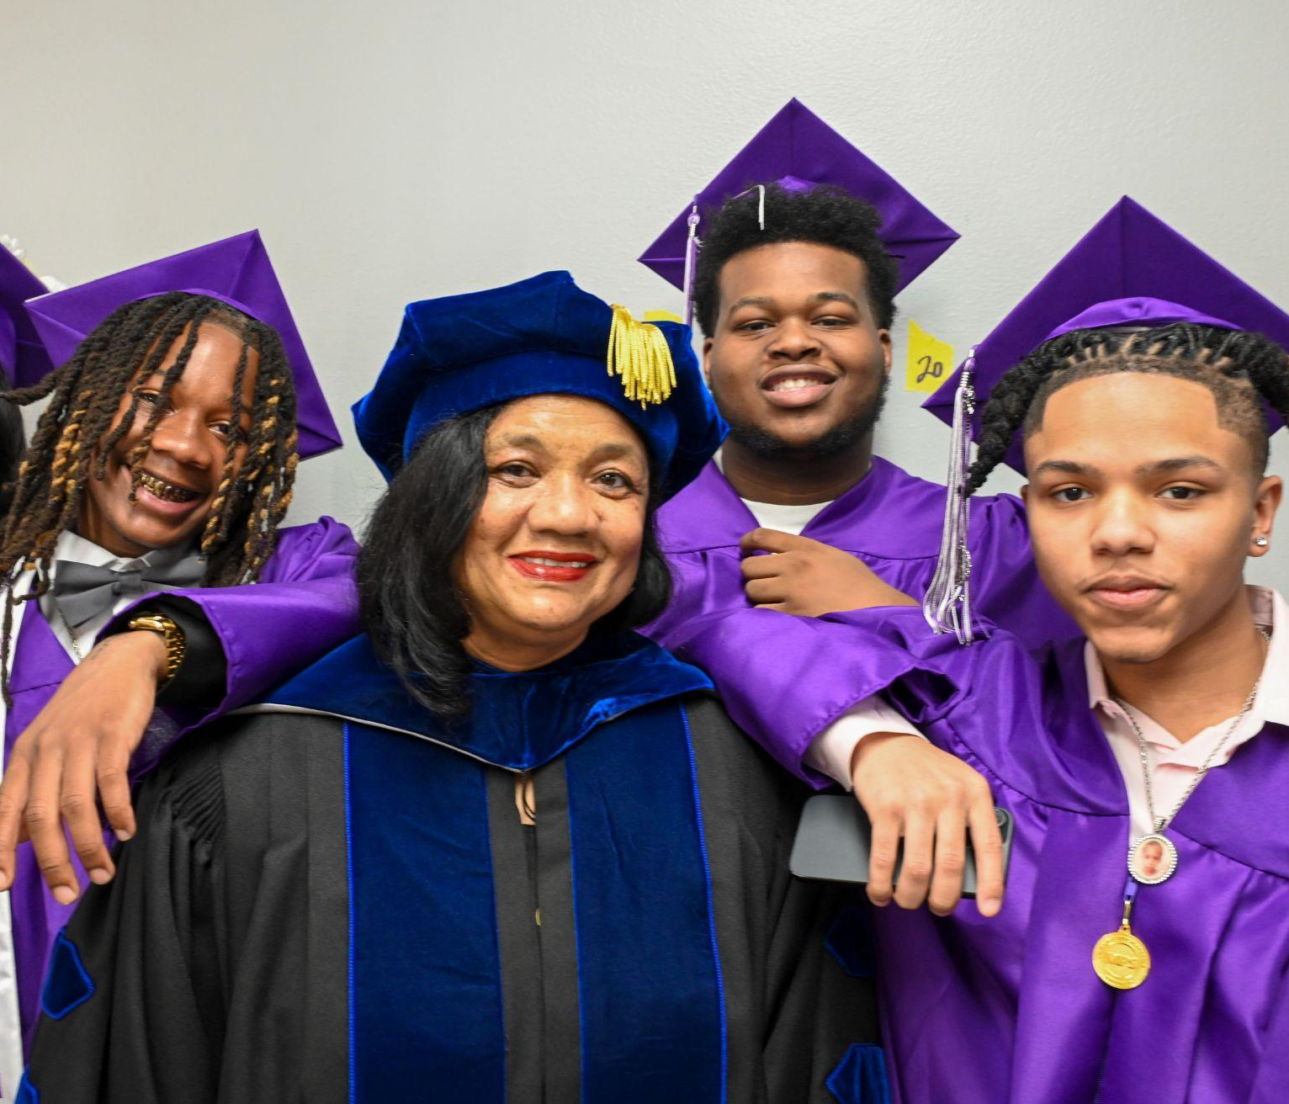
Charter School Renewal Timeline
WHEN? | Last year of the charter school term
June | Leaders Orientation
August | Letter of Intent and Application Due
September | Review Team Orientation Preliminary Performance Summary
October | Site Visits Classroom Visits Student Focus Groups Governance Board Focus Groups Family Focus Groups Staff Focus Groups Data Review
November | MPS Board Approval
Charter School Renewal Process Document

Slide 4

Academic Performance Standards
The academic performance measures growth, proficiency and mission-specific goals. The overall rating for each section is completed via collaboration and consensus by the MPS Charter School Review Team of the Pupil Academic Achievement Report (PAAR), application, and site visit. This score takes into consideration the overall performance of students and applicable subgroups over the term of the contract.
(3) EXCEEDS STANDARD: Charter School consistently exceeds the district rates over the term of the contract. Note: schools that demonstrate at least 20% or more above the standard would qualify for this rating.
(2) MEETS STANDARD (baseline): Charter School meets the standard over the term of the contract.
(1) APPROACHES STANDARD: Charter School demonstrated consistent growth each year of the contract term, but has not fully met the standard on a given measure. Note: schools that show inconsistent growth would not qualify for this rating.
(0) BELOW STANDARD: Charter School does not consistently meet the standard and/or the school continues to show a decline that falls below the standard each year of the contract term.
Charter School Performance Framework (Scorecard)

Slide 5
Academic Performance Standards
Achieve a percentage of pupils in charter school scoring proficient or advanced on the WSAS tests in ELA that is the same as, or higher than, the percentage of pupils scoring proficient or advanced in corresponding grades in all MPS schools. | Exceeds Standard (3) Meets Standard (2) Approaches Standard (1) Below Standard (0)
Achieve a percentage of pupils in charter school scoring proficient or advanced on the WSAS tests in MATH that is the same as, or higher than, the percentage of pupils scoring proficient or advanced in corresponding grades in all MPS schools.
Achieve a percentage of pupils in charter school scoring proficient or advanced on the WSAS tests in SCIENCE that is the same as, or higher than, the percentage of pupils scoring proficient or advanced in corresponding grades in all MPS schools.
Achieve a percentage of pupils in charter school scoring proficient or advanced on the WSAS tests in SOCIAL STUDIES that is the same as, or higher than, the percentage of pupils scoring proficient or advanced in corresponding grades in all MPS schools.
Using a DPI formula for comparison, charter school shall achieve a HS GRADUATION RATE that is the same as or higher than the HS graduation rate in all MPS HS.

Slide 6

Performance Framework in Practice

Slide 7

Love2Learn Charter School
MISSION: Provide innovative, foundational, and culturally rich academic programs focused on fine arts and vocational education, bilingual education, and English as a Second Language, while engaging the entire family in their children’s educational experience.
CURRICULUM EMPHASIS: Dual language/two-way immersion program in both Spanish and English. Combining culture, language, and literacy to prepare students for success with a focus on fine arts, science, and careers in technology.
Opened: 2003
Contract Term: 2021-26
Grade Levels: K4-8
ENROLLMENT AND DEMOGRAPHICS
 | 25-26 | 24-25 | 23-24 | 22-23 | 21-22
Total Enrolled | 521 | 558 | 573 | 627 | 675
Contract Max | 800 | 800 | 800 | 800 | 800
ELL | 59% | 61% | 60% | 60% | 57%
SwD | 14% | 13% | 13% | 12% | 13%
ED | 80% | 93% | 85% | 77% | 84%
Hispanic | 96% | 96% | 97% | 97% | 98%
Black | 2% | 3% | 3% | 3% | 2%
Love2Learn Charter School Snapshot

Slide 8
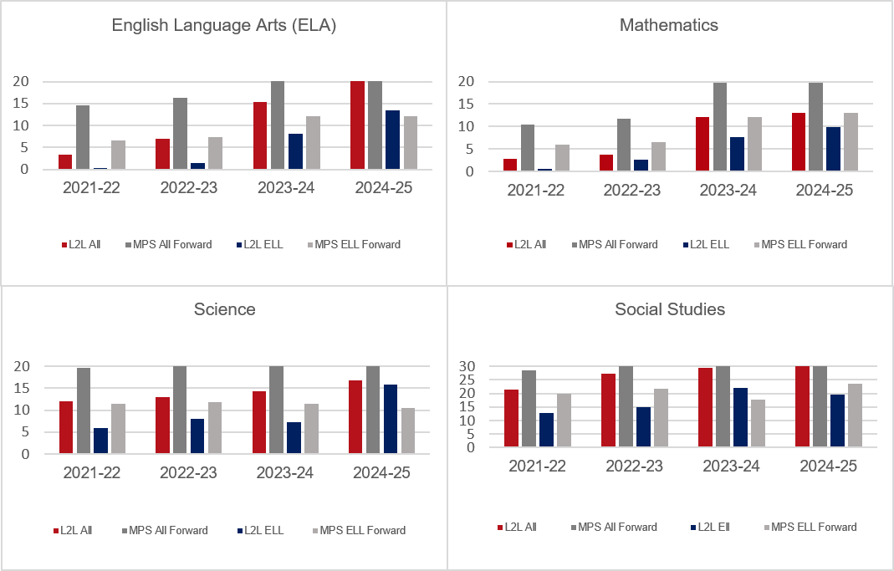
Love2Learn Charter School
73.5
EXCEEDS EXPECTATIONS
2024-25 State Report Card
50%
OF MEASURES MET
demonstrated on pupil academic
achievement report

Slide 9
Additional Performance Standards
Achieve a STABILITY RATE of pupils in charter school that is the same as, or higher than, the stability rate of pupils in corresponding grades in all MPS schools. | Meets Standard (1) Does Not Meet Standard (0)
Achieve an average daily ATTENDANCE RATE of pupils in Charter School that is the same as, or higher than, the average daily attendance rate of pupils in corresponding grades in all MPS schools.
Achieve a MOBILITY RATE of pupils in charter school that is the same as, or lower than, the mobility rate of pupils in corresponding grades in all MPS schools.
Achieve a percentage of pupils PROMOTED FROM GRADES 4 AND 8 in Charter School that is the same as, or higher than, the percentage of pupils being promoted in corresponding grades in all MPS schools.
LOCAL MEASURES - Love2Learn has identified additional local measures related to English Language Learners and the WSAS. This is illustrated in previous slide.
Achieve a SUSPENSION RATE of pupils in Charter School that is the same as, or lower than, the suspension rate of pupils in corresponding grades in all MPS schools.

Slide 10
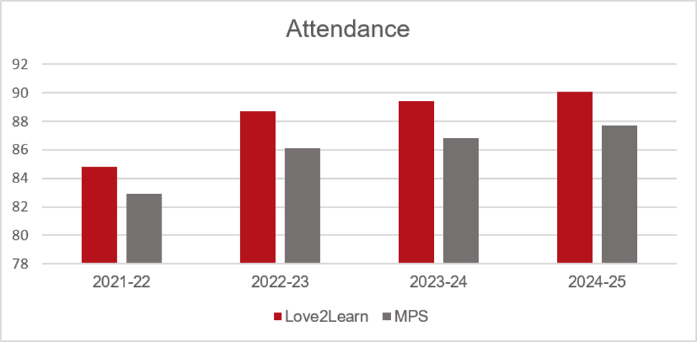
Love2Learn Charter School
89.7%
STABILITY RATE
Stability rate refers to the percentage of students enrolled in May count and still enrolled on the September count.
3.3%
MOBILITY RATE
Mobility rate refers to the percentage of students that enroll after the September count.
100%
OF STUDENTS
promoted from 4th grade and 8th grade.
1-3%
OF STUDENTS
suspended each year compared to district average of 11%.
Love2Learn Pupil Academic Achievement Report (PAAR)

Slide 11

Financial Performance Standards
The financial performance measures the financial health and viability of schools through near-term and long-term indicators and financial management indicators. This section encompasses the application for renewal and documents gathered over the term of the contract (financial audits and budgets).
(1) MEETS STANDARD: Charter School meets all the provisions of the standard.
(0) DOES NOT MEET STANDARD: Charter School fails to comply with the provisions of the standard.
Charter School Performance Scorecard

Slide 12
Financial Performance Standards
STANDARDS | EVIDENCE | RATINGS
Financial Audit, Accounting, and Records Unqualified opinion No significant findings Budget Accounts Meets 10% deviation provision Budget Deficit Current ratio is greater than or equal to 1:1 Financial Reporting Balanced statements Enrollment variance equals or exceeds 95% Governance Board involvement Categorical Aid | Financial Audit MPS Financial Review Budget Revenue and Expenditure Financial Snapshot Categorical Budget and Review | Meets Standard (1) Does Not Meet Standard (0)
Love2Learn Charter School Financial Snapshot

Slide 13

Organizational Performance
The organizational performance and compliance targets the contractual obligations that the school must meet. This section encompasses the application for renewal, site visit, focus groups, and documents gathered over the term of the contract.
(1) MEETS STANDARD: Charter School meets all the provisions of the standard.
(0) DOES NOT MEET STANDARD: Charter School fails to comply with the provisions of the standard.
Charter School Performance Scorecard

Slide 14
Organizational Performance Standards
STANDARDS | EVIDENCE | RATINGS
Educational Program Curriculum Instruction Professional Learning Communities Students with Disabilities English Language Learners Employee Qualifications Recruitment and Retention School Governance Compliance and Structure School Community Engagement School Environment Pupil Admissions and Enrollment Policies and Records Retention Transportation and Nutrition Services Annual Performance and Compliance Audit | Application for renewal Classroom Visits Appendix A Curriculum Guides/Courses Professional Development Calendar School Improvement Plan DPI SPED Audit Student Handbook Discipline Data Focus Groups IEP Progress Goals ACCESS Data Staff Rosters Governance Board ByLaws and Meeting Minutes | Meets Standard (1) Does Not Meet Standard (0)
Love2Learn Final Scorecard Recommendation

Slide 15
Renewal Terms
RENEWAL TERMS
Performance Percentages | Renewal Recommendation Term Length | Supports
Charter School combined score of the Academic, Financial, and Organizational Performance is above 80%. | Full Term Contract Renewal Five Year | Annual charter school report Monitor contractual compliance (academic, financial, and organizational) Special education LEA At least one instructional visit per year Monthly leadership meetings Invitation to participate in district professional development Other district supports as required
Charter School combined score of the Academic, Financial, and Organizational Performance is between 79% and 60%. | Short Term Contract Renewal Three Year | In addition to full term supports listed above: Required to use the District Continuous School Improvement Plan (CSIP) template and participate in data retreats Monthly one-on-one meetings with school leadership At least three instructional visits per year Team meeting support
Charter School combined score of the Academic, Financial, and Organizational Performance is below 59%. | Non-Renewal | Closure plan is executed.
MPS Charter School Scorecard

Slide 16

Feedback / Questions

