Slide 1

Collaborative Classroom Strategies:
Practical Approaches for General and Special Education Teams
Hannah Rivers
hannahrivers@usd475.org
Bridget Oliver
bridgetoliver@usd475.org
Notes:
Please note your session title, the presenter(s), and contact information (email, etc.).

Slide 2

USD 475 Strategic Plan Connection
Goal 1: Equitably support the academic learning all students.
Goal 2: Equitably address the social emotional needs of all students.
Goal 3: Create opportunities to enhance family and community engagement in an equitable manner that allows for participation for all.
Goal 4: Develop a plan to recruit, retain, and support high quality staff that reflects our community.
Notes:
Emphasize connection between topic to one or more of the goal areas on the USD 475 Strategic Plan. This is vital for alignment and focus as our district continues accreditation.

Slide 3

Session Objectives/Learning Targets
Collaborate on adapting real classroom activities for diverse learners.
Identify practical ways special education staff can support general education teachers.
Leave with actionable ideas and resources for immediate implementation.
Notes:
We need to model this practice as it is a district-wide expectation. Please outline what it is that participants will learn/know/do as a result of your session.

Slide 4
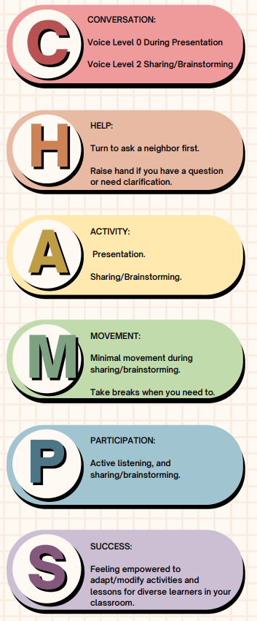




Notes:
We need to model this practice as it is a district-wide expectation for Early Childhood through 12th grade.

Slide 5

Notes:
What the Phrase Means
Special education is not a separate classroom, program, or physical location. It is a set of individualized services and supports designed to help a student access learning and make progress in the general curriculum. These services can be delivered in any educational setting—general education classrooms, community environments, CTE programs, elective classes, or specialized spaces when appropriate.
The key idea:
Students don’t “go to special education.” They receive special education services wherever they learn.
Why This Matters for Staff
1. Supports Follow the Student
Services such as accommodations, modified curriculum, assistive technology, or specialized instruction are tied to the student’s needs, not a location.
This ensures flexibility and responsiveness.
2. Least Restrictive Environment (LRE)
Legal requirements (IDEA) state that students should be educated with their peers to the maximum extent appropriate.
That means general education classrooms are the first placement considered, with additional supports layered in as needed.
3. Inclusion Is a Shared Responsibility
All educators—not just special education teachers—play a role in supporting students with disabilities.
General ed teachers, paraeducators, and specialists collaborate to provide access and maintain high expectations.
4. Students Benefit Academically and Socially
When services integrate into typical school environments, students gain:
more access to grade-level content
authentic social experiences
increased independence
stronger postsecondary readiness
What This Looks Like in Practice
Staff may see special education services delivered through:
Co-teaching in general education classes
Small-group instruction within the classroom
Scheduled pull-out sessions for specific skill-building
Instruction or support in electives and CTE
Behavioral or communication support embedded in routines
Paraeducator support across multiple settings
Assistive technology used throughout the day
Accommodations and modifications that reduce barriers
No single approach is “the special ed room.”
Instead, services are woven into the school day based on the IEP.
How Staff Contribute to This Model
Provide accessible materials and instruction
Collaborate with special education staff on student needs
Embed accommodations consistently
Maintain high expectations for all learners
Promote student independence
Communicate and problem-solve with the team
Support a culture of belonging and dignity
Key Takeaway
Special education is a flexible, individualized service—not a place we send students.
Our collective goal is to ensure every student has the tools, access, and opportunities they need to be successful in every environment where learning happens.

Slide 6
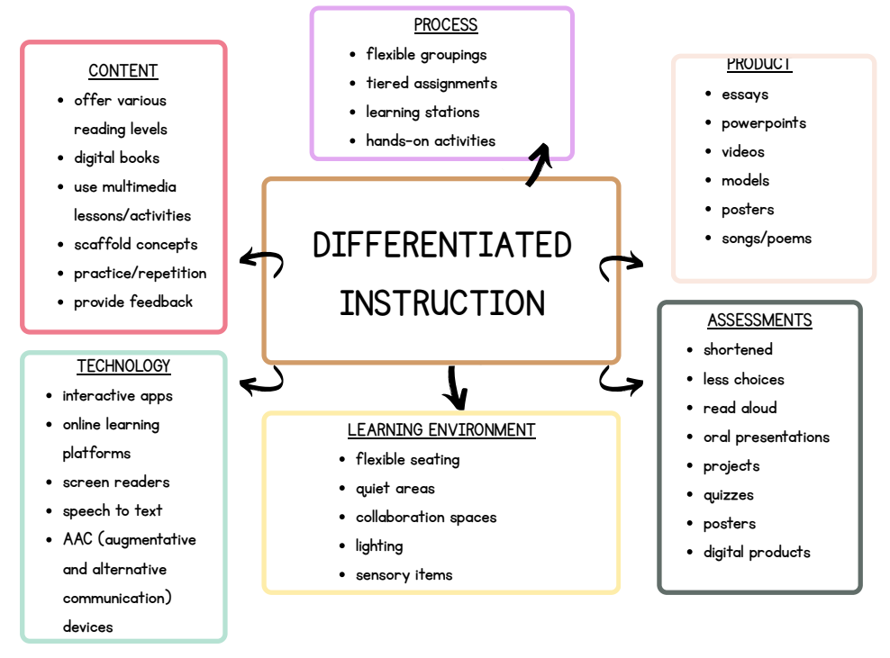

Slide 7

Example A: Reading Comprehension Activity
Original activity:
Students read a grade‑level article and answer 5 written comprehension questions.
Adapted through collaboration:
  Provide audio version of the text
  Offer simplified or chunked versions of the article
  Allow students to respond verbally or using a graphic organizer
  Highlight key vocabulary with visuals
  Pre-teach background knowledge with a short video
Notes:
We need to model this practice as it is a district-wide expectation for Early Childhood through 12th grade.

Slide 8

Example B: Math Multi-step Word Problems
Original activity: Students solve 4 multi-step word problems independently.
Adapted through collaboration:
  Break problems into numbered steps
  Add visuals (bar models, number lines)
  Provide a “problem-solving checklist”
  Use color-coding for key information
  Allow the use of manipulatives or calculators

Slide 9

Example C: Science Lab Activity
Original activity: Students complete a lab report individually.
Adapted through collaboration:
  Provide a partially filled-in lab report template
  Use sentence starters ("I observed…", "The results show…")
  Pair students strategically for peer support
  Offer digital options for typing instead of handwriting
  Speech to text options and/or scribe

Slide 10
Some Ready to Use Strategies & Ideas
Color-coded math steps: (yellow = highlight numbers, green = operation, blue = answer box)
Exit ticket alternatives (oral response, picture sort, 1‑sentence summary)
Graphic organizers (Venn diagrams, sequence maps, Frayer models)
Sentence starters for writing
Noise-canceling tools or headphones (sensory needs)
Timers and checklists/schedules (task initiation and completion)
Read & Write Chrome Extension/ Google Docs voice typing (text-to-speech, highlighting supports)
Khan Academy / IXL skill lessons (for targeted practice)
CommonLit (with scaffolded texts)
Notes:
We need to model this practice as it is a district-wide expectation for Early Childhood through 12th grade.

Slide 11
Paras and Teacher Assistants cannot MAKE the accommodations and modifications.
That is illegal.
Paras and Teacher Assistants can IMPLEMENT accommodations and modifications.

Slide 12

Real Life
EXAMPLES

Slide 13

Hands-On Brainstorming
Notes:
We need to model this practice as it is a district-wide expectation for Early Childhood through 12th grade.

Slide 14
Frontline/Professional Development Credit
Ensure that you have registered for February 16th District Professional Development in the Frontline District Catalog.
Be sure to mark the activity complete within 30 days to receive credit. The exit survey will serve as the Knowledge Evaluation and be given during your building’s “sunset” meeting.
Notes:
Please share this information as a reminder to everyone to receive their PD points.

Slide 15
Collaborative classroom strategies: Practical Approaches for General and Special Education Teams
Thank you for attending :)
Hannah Rivers (hannahrivers@usd475.org) & Bridget Oliver (bridgetoliver@usd475.org)
Notes:
Please note your session title, the presenter(s), and contact information (email, etc.). The exit survey will be taken in the sunset meeting at the end of the day. If you would like to receive individual feedback on your presentation you can add that onto this slide.

