Slide 1
Data Collection in preschool special education
Nadgi Neuman
Cailin Knight
Ann Zier

Slide 2
Session outcomes
Identify what data to collect
Choose developmentally appropriate methods
Match data methods to goals (frequency, duration, task analysis, etc.)
Use data to adjust instruction and supports
Create a simple system that your team can maintain

Slide 3
Why data matters
Shows progress toward IEP goals
Guides instruction and intervention
Documents effectiveness of supports & services
Strengthens communication with families and your team
Maintains compliance

Slide 4
What data to collect

Slide 5
Common data to collect & examples
Communication: requesting, answering, AAC use
Social interaction: turn-taking, joint play, initiated interactions
Behavior/regulation: transitions, coping strategies
Adaptive/self-help: toileting steps, dressing
Motor: grasp, cutting, navigation of space
Imitation goals
Circle time: following 1-step directions​, participation
Centers: peer play, help requests​
Snack: opening items, asking for more​
Outdoor: initiating play, waiting​
Bathroom: handwashing routine
Notes:
Imitations goals – cross many domians

Slide 6
Developmentally appropriate data
Collect in natural routines (play-based, child-led when possible)​
Use brief observation windows (1–5 minutes)​
Prioritize independence: record prompt levels when used​
Keep it simple: 1–2 targets per routine​
Define what counts (clear, observable definitions)

Slide 7
Match the goal to the method
If you can’t measure it, you can’t manage it.
Notes:
AZ - Turn

Slide 8
Methods that work (without stopping instruction)
Method 1: Frequency (count)
Method 2: Duration (how long)
Method 3: Task Analysis (Steps)
Best for: requests, initiations, specific behaviors
Count # of times in a routine or time window
Pair with opportunities when possible (e.g., 3/5)
Example goal: “requests help in 4/5 opportunities during centers”​
Best for: self-help, routines, multi-step
Break skill into steps; score each step
Track independence & prompt level
Example: handwashing, toileting, unpacking backpack
Best for: engagement, tantrums, sustained play, ABC data
Measure time (seconds/minutes)
Use a timer
Example goal: “engages with a peer for 2 minutes in 3/5 opportunities”

Slide 9
Methods that work (without stopping instruction)
Method 4: Work Samples/products
Method 5: Anecdotal Notes
Method 6: Rubrics/checklists
Best for: early writing, cutting, matching, pre-academic tasks
Collect with date & brief note of supports used
Use a simple rubric
Keep 3-5 samples over time to show growth
Best for: complex skills (play, social, communication)
Define levels (e.g., 0-not yet, 1-with prompts, 2-independent)
Use across routines and staff for consistency
Avoid too many times – focus on the goal
Best for: social communication, play skills
Write what you saw/heard (not interpretations)
Include: setting, action, peer/adult response
Example goal: “’At blocks, said “my turn” and waited 5 seconds”

Slide 10
measurable iep goals
Observable behavior (what the child does)​
Conditions (when/where/materials)​
Criteria (how much/how often/how long)​
Prompting/supports noted​
Data method named or implied
** Focus on the most critical areas for a student’s growth and significant needs, rather than writing an excessive number of IEP goals.**

Slide 11
Simple systems for busy classrooms
Assign 1-2 routines per goal (not all day)
Use a rotation schedule (who collects what/when)
Plan ‘data days’ (e.g., Mon/Wed/Fri) when appropriate
Use quick tools – clipboards, sticky notes, tally cards
Train paras with clear definitions & examples

Slide 12
Team Roles & Reliability
Define: what counts, when to record, and prompt codes
Use the same sheet across adults
Do quick ‘calibration’ (2 adults score same moment, compare)
Keep data objective and brief
Notes:
Time: ~3 minutes. If paras collect data: practice with a short video clip or role-play.

Slide 13
Decision Rules (Examples)
If progress is flat for 2–3 weeks → adjust supports/teaching
If child meets criteria for 3 consecutive sessions → consider increasing expectation or generalizing
If prompts remain high → teach prerequisite or adjust prompt fading plan
If behavior spikes with a routine → review antecedents and supports
Notes:
Time: ~4 minutes. Connect to MTSS/PBIS if relevant: data helps identify triggers and effective supports.

Slide 14
Communicating Progress to Families
Use plain language + examples from routines
Share growth (baseline vs now) and next steps
Celebrate strengths and small gains
Invite family input: what works at home?
Notes:
Time: ~2 minutes. Suggest: one data point + one story. Families understand ‘what it looks like’ in real life.

Slide 15
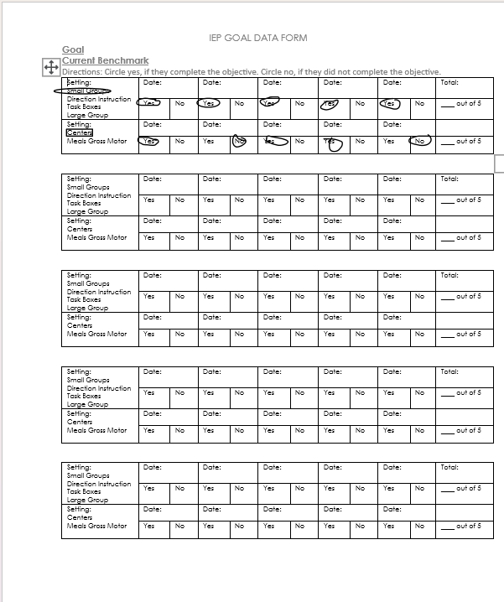
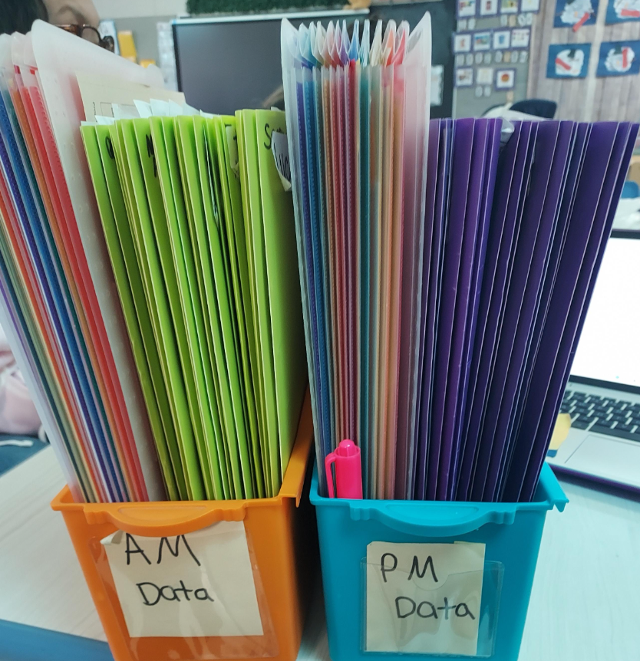
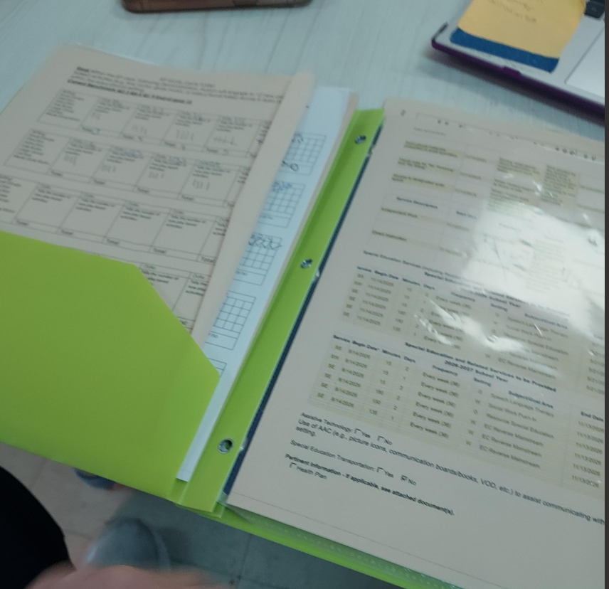
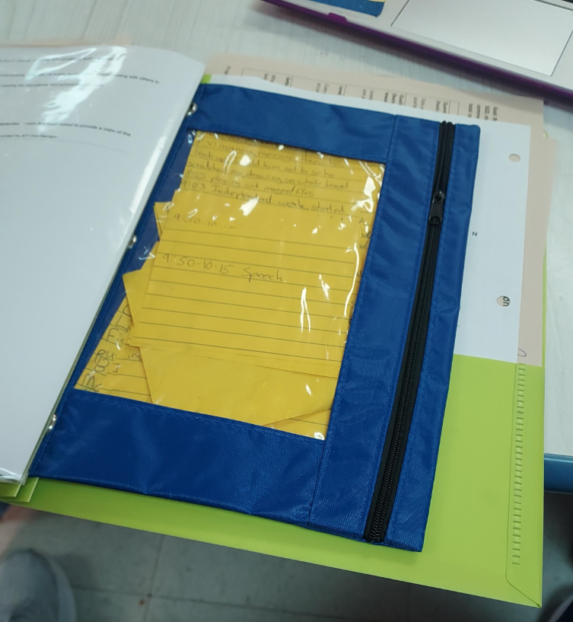
AZ's System
Example of my Quarterly data
Data folders
Inside I have the forms and IEP share sheet
Pencil Bag
….
A pencil bag is a great resource for holding materials used for IEP goals. I also use them to store the Post-it notes my staff makes so I can add the data to my forms later. We find it easier to write notes or record frequency on Post-it notes and then transfer the information to the data forms during planning time.

Slide 16
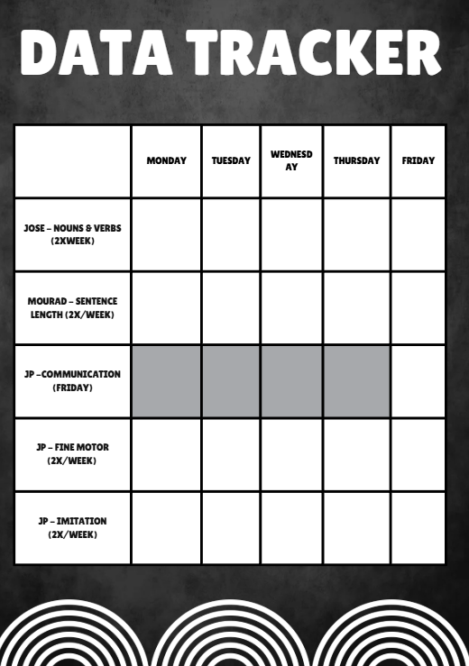
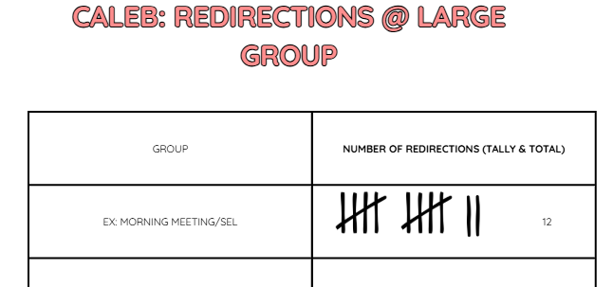
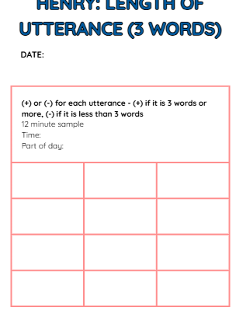
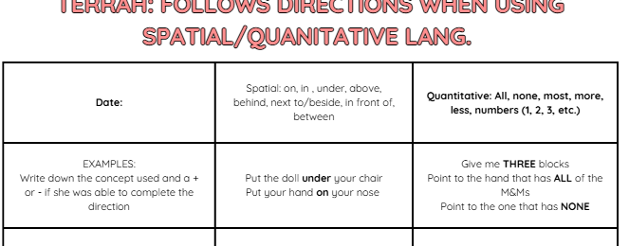
CK’s team System
Take the data
Mark it off
Empty data sheets are stored in individual student folders, along with their share sheet & goals.

Slide 17
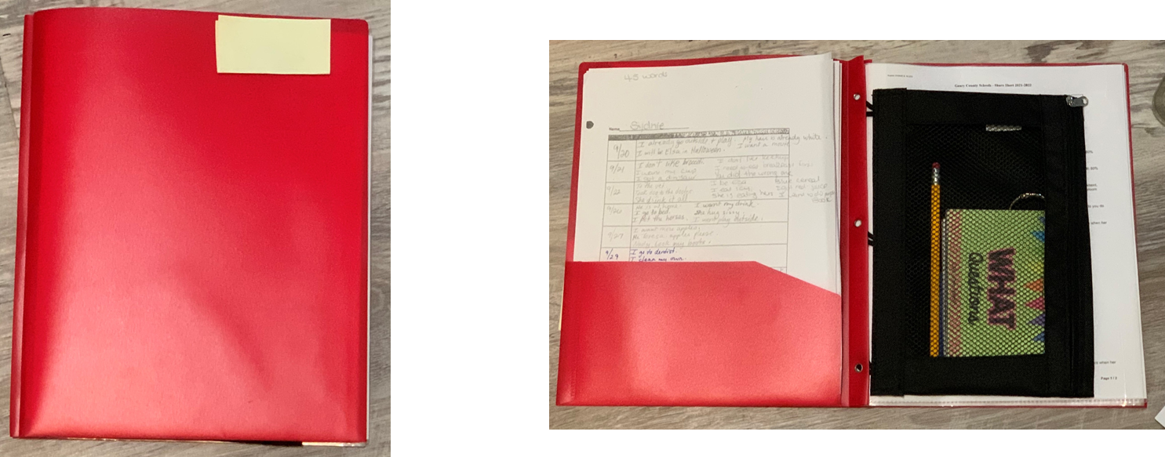
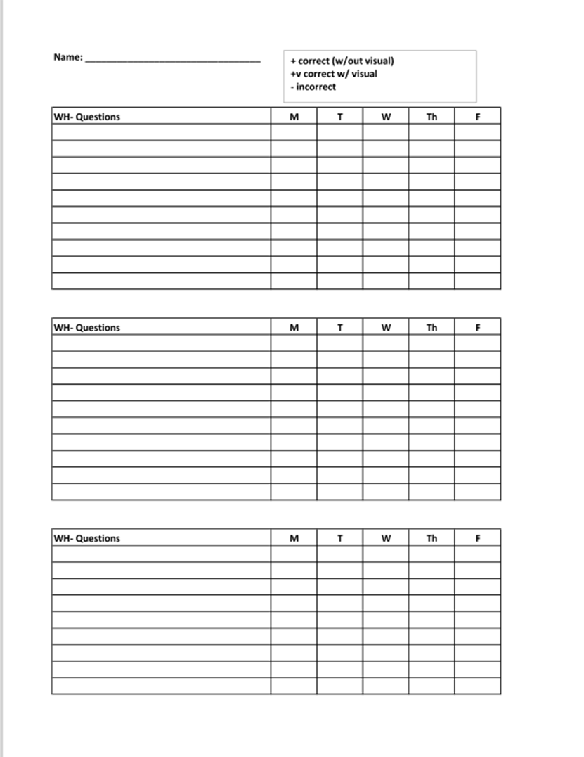
Nadgi's System
Every student that receives SE services has a red folder. The folder contains data collection sheets in the front pocket and a pencil pouch with data collection materials and pencil.
In my classroom data is collected during mealtimes and centers.

Slide 18
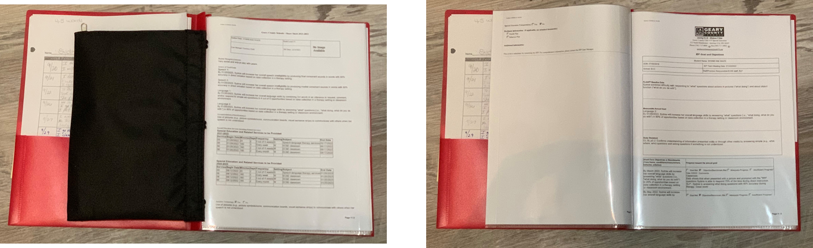
Nadgi's System Cont.
On sheet protectors, I include the share sheet and the student’s goals. This helps my Paraeducators know what to look for and what data to collect.

Slide 19
Printable Data Sheets
Ready-to-use templates (edit for your goals)
Uploaded to Sched
Notes:
Time: ~30 seconds. Introduce templates on next slides.

Slide 20
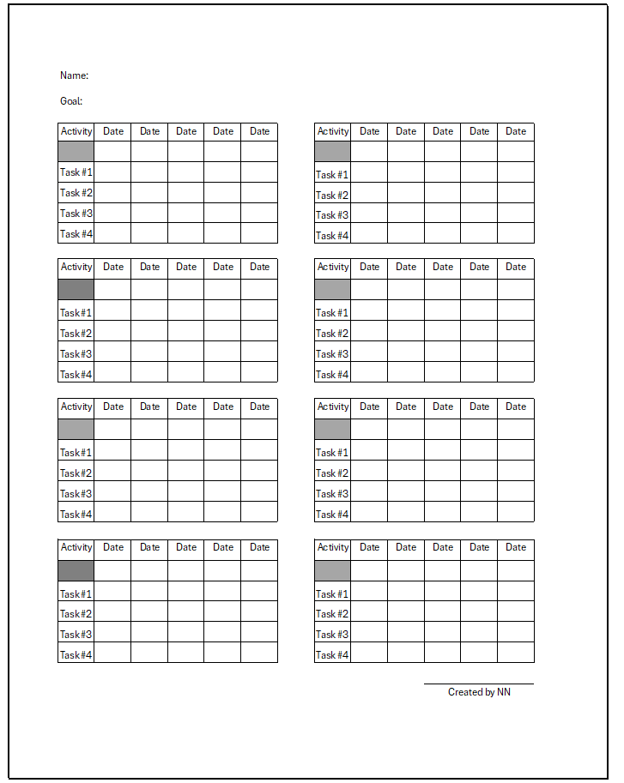
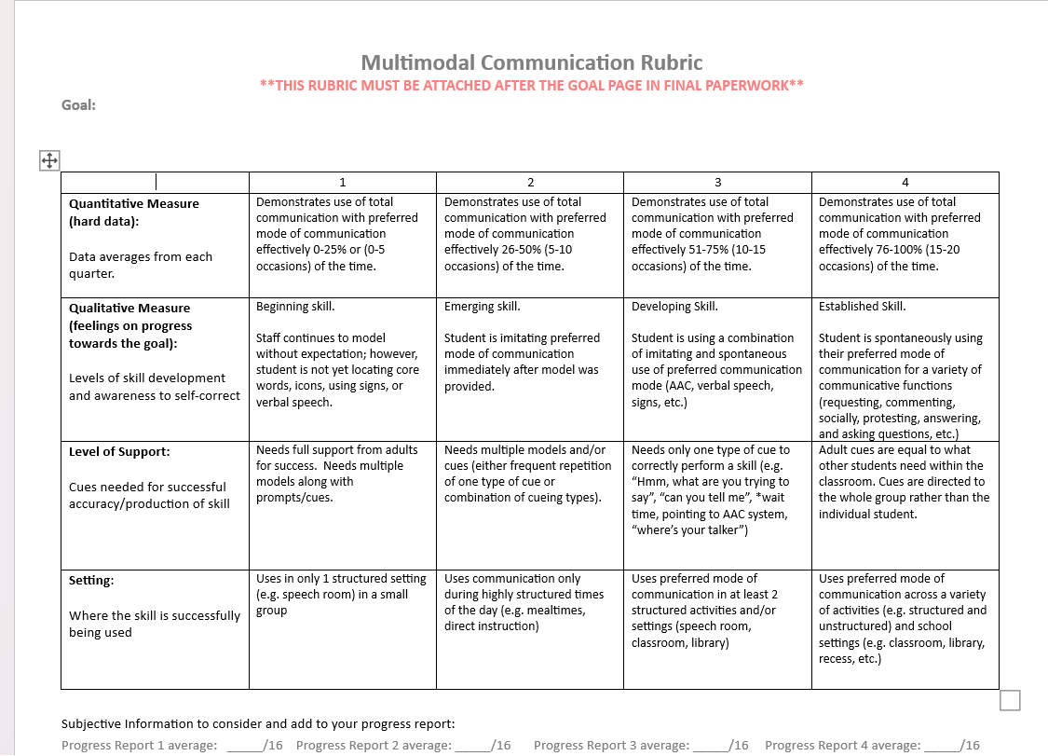
Examples of Data Sheet
Notes:
AZ – On the left language rubric from the SLP team

Slide 21
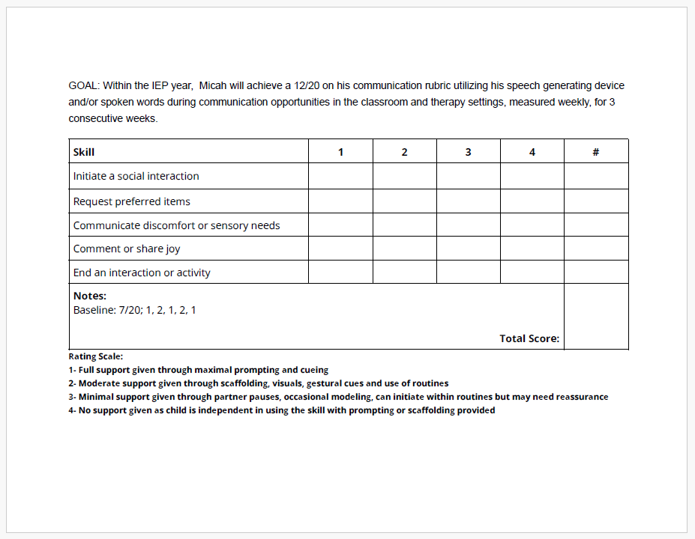
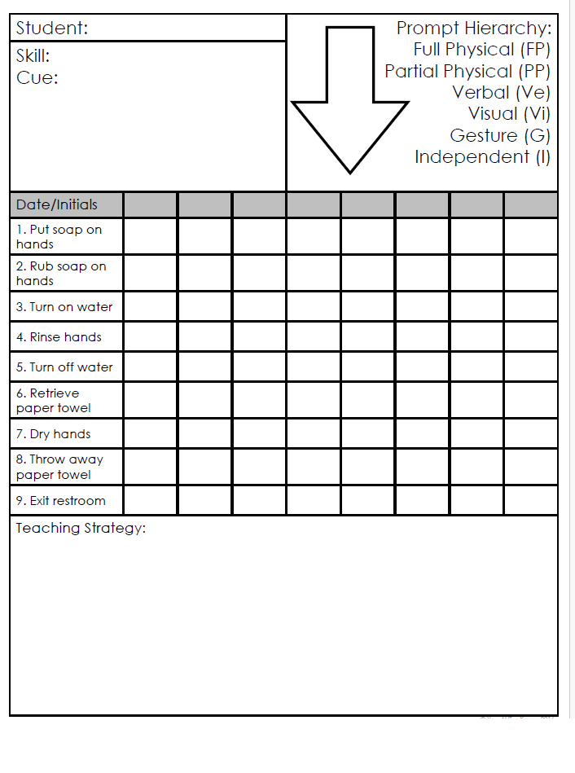
Examples of Data Sheet
Communication and Social Rubric for student using AAC device
Notes:
AZ – on the left my main data form I use for Quartley reporting

Slide 22
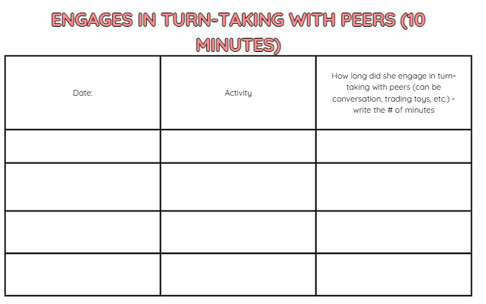
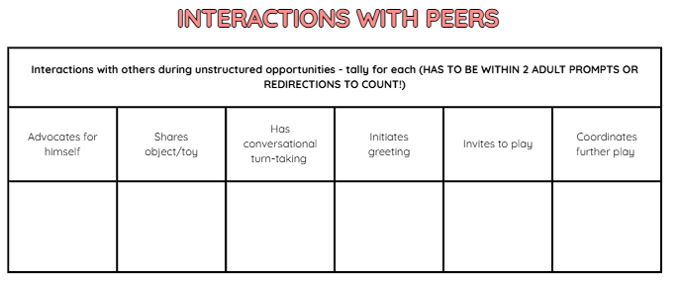
Examples of Data Sheet

Slide 23
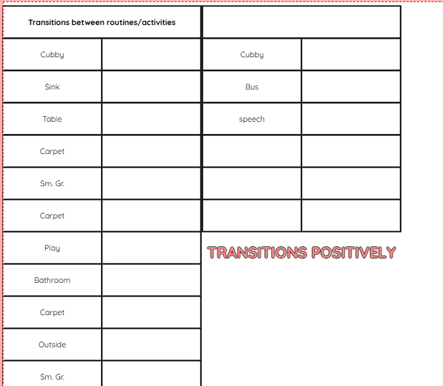
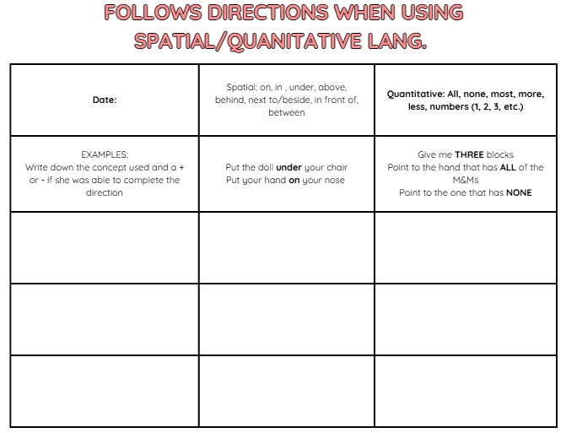
Examples of Data Sheet

Slide 24
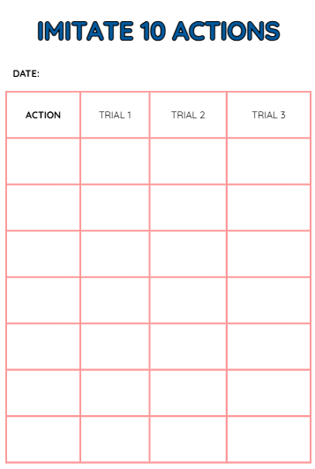
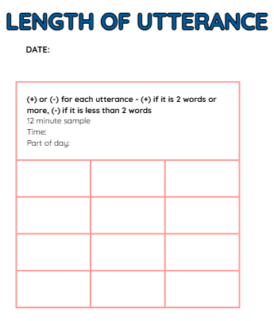
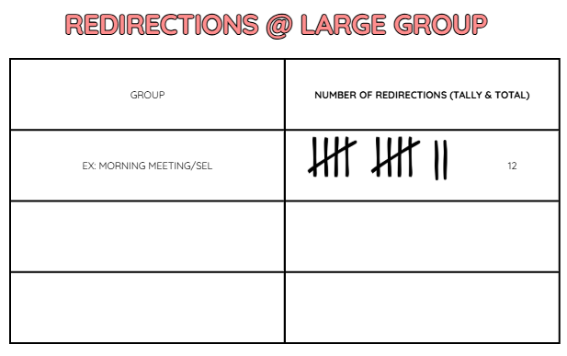
Examples of Data Sheet

Slide 25
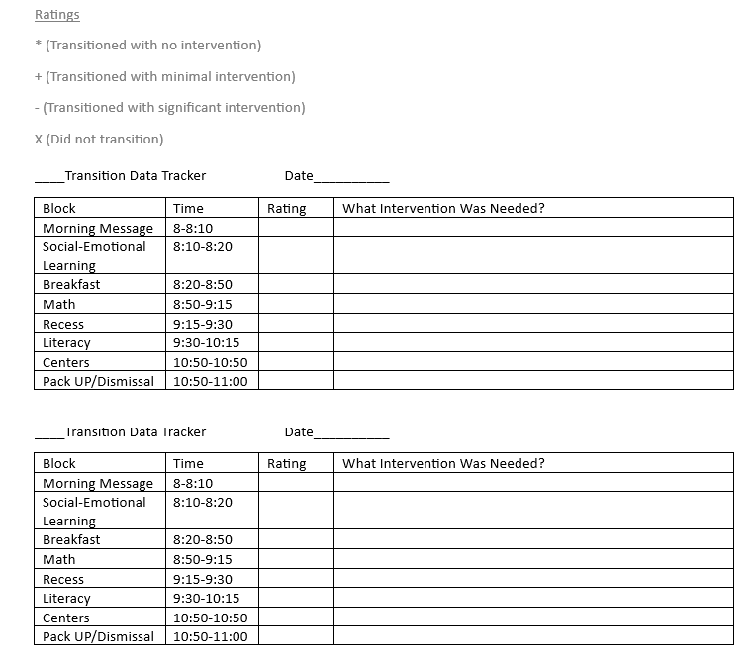
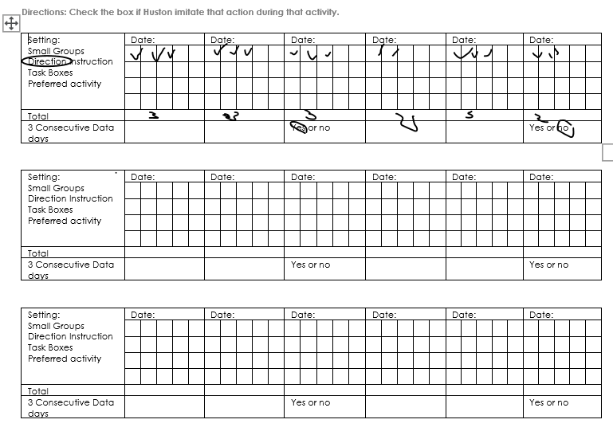
Examples of Data Sheet
Notes:
AZ goals sheets – imitation data form and transition form

Slide 26
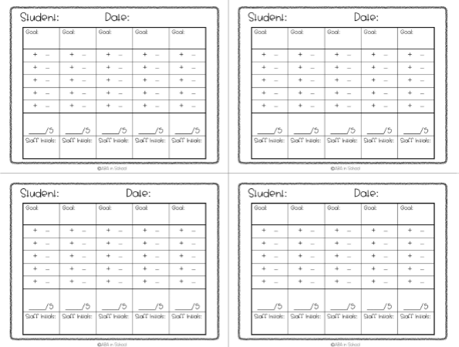
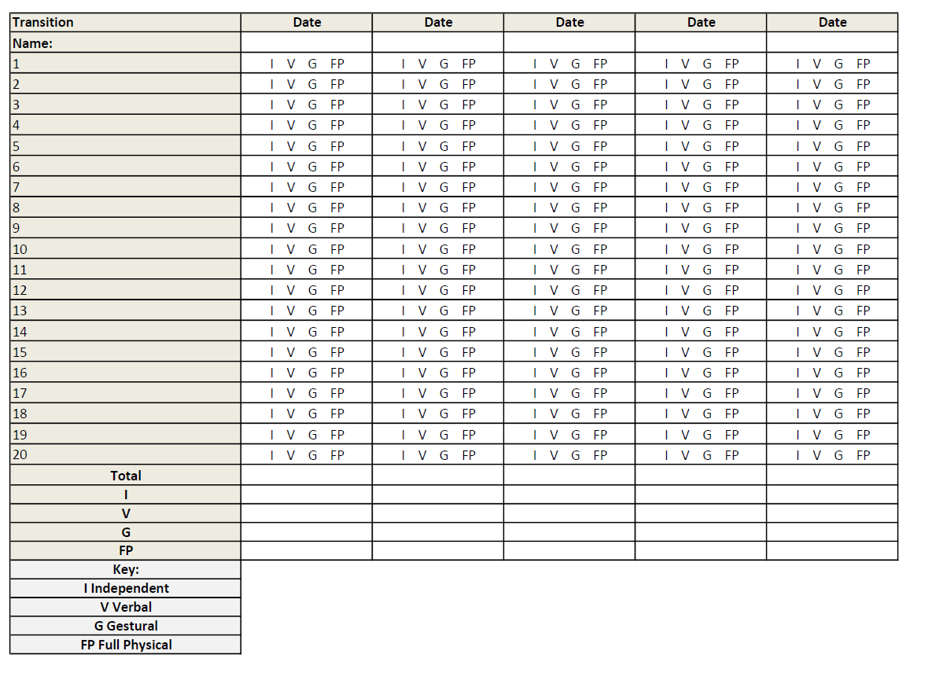
Examples of Data Sheet
Notes:
AZ goals sheets – imitation data form and transition form

Slide 27
Prompt levels
Independent (I)
Gesture/Visual (G/V)
Verbal (V)
Model (M)
Partial Physical (PP)
Full Physical (FP)

Slide 28
THANK YOU
Nadgi Neuman
Nadgineuman@usd475.org
Cailin Knight
Cailinknight@usd475.org
Ann Zier
Annzier@usd475.org

