Slide 1

Interoception in Schools
Understanding & Using Kelly Mahler’s Interoception Assessment
Presented by Kassandra Dunlap
  USD 475 Behavior Consultant
kassandrdunlap@usd475.org
Notes:
Please note your session title, the presenter(s), and contact information (email, etc.).

Slide 2

USD 475 Strategic Plan Connection
Goal 1: Equitably support the academic learning all students.
Goal 2: Equitably address the social emotional needs of all students.
Goal 3: Create opportunities to enhance family and community engagement in an equitable manner that allows for participation for all.
Goal 4: Develop a plan to recruit, retain, and support high quality staff that reflects our community.
Notes:
Emphasize connection between topic to one or more of the goal areas on the USD 475 Strategic Plan. This is vital for alignment and focus as our district continues accreditation.

Slide 3
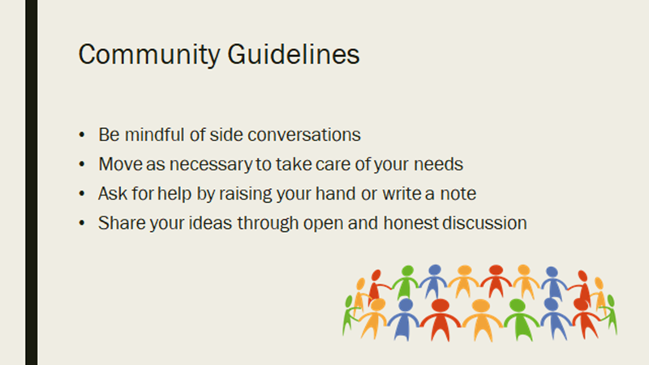
WELCOME and thanks for being here today

Slide 4

Learning Objectives
Understand
Understand what interoception is and why it matters
Learn
Learn the structure of Kelly Mahler’s Interoception Assessment
Use
Use assessment data to guide school-based supports
Apply
Apply strategies across school environments

Slide 5

What Is Interoception?
The sense that helps us notice internal body signals
Includes hunger, thirst, temperature, pain, heart rate, breathing, emotions
Often called the “8th sense”
Notes:
“Take about 30 seconds. Don’t change anything—just notice.
What is your breathing doing?
What do your shoulders, jaw, or legs feel like?”

Slide 6
Pause & Reflect: Body Awareness
Notice your breathing, heart rate, and muscle tension
Silently label one body signal you notice
Notes:
Ask participants to notice how hard this can be even for adults.

Slide 7

Explicit Examples to Share
“My shoulders feel tight.”
“My breathing feels fast.”
“I didn’t realize my jaw was clenched.”
“If adults have to stop and think to notice body signals, we cannot expect students to regulate without teaching awareness first. "This models interoception and builds empathy.

Slide 8
Why Interoception Matters in School
Foundation for self-regulation
Impacts attention, behavior, and emotional regulation
Supports independence and self-advocacy

Slide 9
Interoception & Self-Regulation
Students must notice body signals before regulating
Behavior is often communication of unmet interoceptive needs
Misinterpretation leads to dysregulation

Slide 10
Behavior → Body Signal Reframe
Think of a common classroom behavior
What body signals might be driving it?
Notes:
Facilitator note: Guide staff to reframe behavior as communication of an unmet need or internal state. Write down behavior and what might be driving it. Elopement: fast heart, wiggly legs, hot face
Calling out: excited body, high energy
Refusal: heavy body, tight stomach

Slide 11
Reframing Behavior:
“What is the body saying?”
Instead of asking:
“Why is the student doing this?”
We ask:
“What might their body be telling them?”
This shifts the response from correction to regulation.

Slide 12
Example: Student repeatedly leave seat, fidgets, and touches objects around the room during independent work.
Traditional Interpretation
Interoception-Based Reframe
“They’re not paying attention.”
“They’re being disruptive.”
“They lack self-control.”
The student’s body may be sending signals they can’t yet identify or manage.

Slide 13
Possible Body Signals
Driving the Behavior
Restlessness or excessive physical energy
Muscle tension or discomfort from sitting too long
Need for movement to regulate focus
Elevated heart rate or nervous system activation
Fatigue causing the body to seek stimulation

Slide 14
What the body might be saying (even if the student can’t verbalize it).
“My body feels uncomfortable and I don’t know how to fix it.”

Slide 15
Supportive Response Instead of Punishment:
Offer a movement break or fidget
Allow a standing or flexible seating option
Teach the student to check in: “Is your body feeling tired, wiggly, or tense?”
Help them connect the signal to a strategy: “When your body feels wiggly, movement helps.”

Slide 16
Why This Matters…
When adults help students:
Over time, the student learns:
Notice body signals
Name the feeling
Match it to a regulation strategy
…behavior improves without relying on consequences.
“This feeling has a name, and I know what helps.”
This is self-regulation – not compliance.

Slide 17
Common School-Based Challenges
Difficulty identifying emotions
Over- or under-reacting to stress
Fatigue, shutdown, or explosive behaviors
Toileting, eating, and hydration challenges

Slide 18
Who Benefits From Interoception Support?
Students with autism
ADHD
Anxiety
Trauma histories
Sensory processing differences

Slide 19
Overview of Kelly Mahler’s Framework
Developed by occupational therapist Kelly Mahler
Focuses on awareness, interpretation, and response
Emphasizes body-based emotional learning

Slide 20
What Is the Interoception Assessment?
A comprehensive assessment of interoceptive awareness
Identifies how students notice and interpret body signals
Guides individualized intervention planning

Slide 21
Age Range & Formats
Versions for children, teens, and adults
Self-report and caregiver/teacher input
Flexible for school settings

Slide 22
Key Areas Assessed
Awareness of body signals
Understanding what signals mean
Ability to act on body information
Emotional awareness linked to body cues

Slide 23
Assessment Structure
Questions organized by body signals
Rating scales indicate consistency and awareness
Patterns reveal strengths and needs

Slide 24
Interpreting Assessment Results
Look for trends rather than single scores
Identify under- or over-awareness
Connect results to observable behaviors

Slide 25
Interoception Assessment Reflection
Student elopes during group instruction
What body signals might they notice? What might they miss?
Notes:
Facilitator note: Connect assessment data to intervention planning.

Slide 26

Assessment Example: Emotional Signals
Student notices:
fast heart rate
Fast heart
Body feels jumpy
Student does NOT understand:
  This feeling means anxiety
  A break or help would regulate their body
Teaching Point
  “The Interoception Assessment tells us where the breakdown is—not just what the behavior looks like.”

Slide 27
Using Results in the School Setting
Inform IEP and 504 goals
Guide behavior intervention plans
Support MTSS and SEL instruction

Slide 28
Linking Interoception to Behavior
Behavior is a response to internal signals
Lack of awareness leads to maladaptive responses
Teach awareness before expecting regulation

Slide 29
Setting Meaningful Goals
Focus on noticing body cues
Build emotional-body connections
Gradually introduce regulation strategies

Slide 30
Classroom-Based Interoception Supports
Daily body check-ins
Emotion-body mapping
Visuals showing body cues
Scheduled movement and hydration breaks

Slide 31
Classroom Application Brainstorm
Choose a setting: whole group, transitions, independent work
Identify one interoception support
Notes:
Facilitator note: Emphasize practicality and consistency across staff.

Slide 32
K–2 Explicit Examples
  “Check your body: fast or slow?”
  Visual body maps
  Movement before carpet time
3–5 Explicit Examples
  Body rating scale (1–5)
  Written body check-ins
  Choice of regulation strategy
Behavior Link
  “These supports reduce elopement, avoidance, and attention-seeking by preventing escalation.”

Slide 33
Teaching Interoception Explicitly
Use simple, concrete language
Pair emotions with physical sensations
Model noticing your own body cues

Slide 34

Strategies Sort
Awareness
Body check-ins
Naming body sensations
Regulation
Deep breathing
Calm-down corner
Break requests
Clear Message
“If a student doesn’t know what their body feels like, regulation strategies become compliance tools instead of skills.”
Awareness must come first!
Notes:
Facilitator note: Reinforce Kelly Mahler’s core principle. Awareness before regulation.

Slide 35
Interoception Across the School Day
Morning arrival check-ins
Before tests or transitions
After recess or lunch
End-of-day reflection

Slide 36
Supporting Students With Limited Awareness
Use
Use visuals and body maps
Provide
Provide external cues initially
Fade
Gradually fade adult prompting

Slide 37
Role of Staff & Collaboration
All staff working with the student are calibrated by:
Using consistent language across settings
Shared understanding of body-based regulation

Slide 38
Family Collaboration
Share interoception language with families
Promote consistency across home and school
Empower caregivers to support awareness

Slide 39
Data Collection & Progress Monitoring
Track awareness and use of strategies
Monitor reduction in behavior incidents
Adjust supports based on response

Slide 40

Common Misconceptions
Interoception is not just emotions
Regulation strategies alone are not enough
Awareness must come before control

Slide 41
Key Takeaways
Interoception is foundational to regulation
Assessment guides targeted intervention
School-wide understanding improves outcomes

Slide 42
Questions & Discussion
How could interoception support your students?
What settings could benefit most?

Slide 43

Interoception Assessment
Each building has an Interoception Assessment binder.
Please reach out to your building social worker for more information and the assessment.

Slide 44
Exit Reflection
One interoception support you will try this week
Optional share-out
Notes:
Facilitator note: Encourage immediate application.

Slide 45
Frontline/Professional Development Credit
Ensure that you have registered for February 16th District Professional Development in the Frontline District Catalog.
Be sure to mark the activity complete within 30 days to receive credit. The exit survey will serve as the Knowledge Evaluation and be given during your building’s “sunset” meeting.
Notes:
Please share this information as a reminder to everyone to receive their PD points.

Slide 46
Interoception In Schools
Thank you for attending
Kassandra Dunlap, USD 475 Behavior Consultant
kassandrdunlap@usd475.org
Notes:
Please note your session title, the presenter(s), and contact information (email, etc.). The exit survey will be taken in the sunset meeting at the end of the day. If you would like to receive individual feedback on your presentation you can add that onto this slide.

Slide 47
Resources
Kelly Mahler – Interoception Curriculum
The Interoception Assessment
Body-based emotional regulation tools

