Slide 1

Behavior Intervention Plan
Kassandra Dunlap
USD 475 Behavior Consultant
kassandradunlap@usd475.org
Notes:
Please note your session title, the presenter(s), and contact information (email, etc.).

Slide 2

USD 475 Strategic Plan Connection
Goal 1: Equitably support the academic learning all students.
Goal 2: Equitably address the social emotional needs of all students.
Goal 3: Create opportunities to enhance family and community engagement in an equitable manner that allows for participation for all.
Goal 4: Develop a plan to recruit, retain, and support high quality staff that reflects our community.
Notes:
Emphasize connection between topic to one or more of the goal areas on the USD 475 Strategic Plan. This is vital for alignment and focus as our district continues accreditation.

Slide 3
Session Learning Targets
Participants will:
become familiar with the Behavior Intervention Plan process
become familiar with Behavior Intervention Plan form
practice filling in a Behavior Intervention Plan

Slide 4
What is a Behavior Intervention Plan (BIP)?
(Note: An FBA does not need to be completed to create a BIP if the function of the behavior is known)
A Behavior Intervention Plan (BIP) defines how an educational setting will be changed to improve the behavioral success of the student. The BIP describes how the environment will be changed to prevent occurrences of problem behavior to make the behavior irrelevant, describes the teaching that will occur to give the student alternative ways of behaving to make the problem behavior inefficient, and describes the consequences that will be provided to reinforce appropriate behavior to make the problem behavior ineffective.

Slide 5
When to consider a BIP?
A team may consider the need for a behavior plan when the existing basic classroom supports aren’t working or a student’s behavioral concerns are increasing in frequency or intensity. Behaviors targeted should only be those that are impeding the student’s learning or safety or the learning and safety of others. If a behavior seems “different” but isn’t harmful, it may not need to be changed.

Slide 6
BIP Flowchart
Establish a team
Define Target Behavior
Data Collection
Preference/Reinforcement Assessment
Student Interview
Analyze and graph data
Progress monitoring
BIP Development
BIP Meeting

Slide 7


Practice makes perfect!
You will be given a case study student, after each section of the BIP you will fill out the information for that section on the BIP form you have been provided.

Slide 8
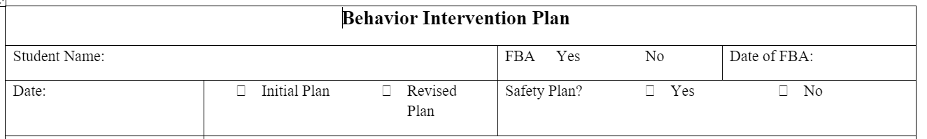
Basic Information

Slide 9
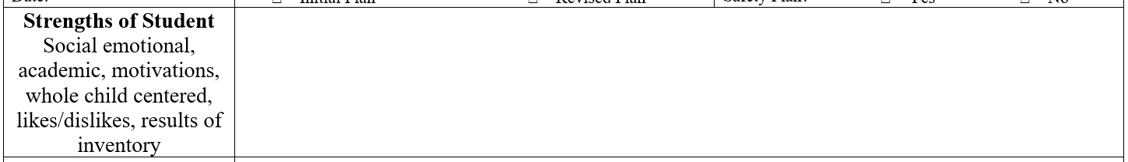
Strengths of Student
Social Emotional
Academic
Motivation
Whole child centered
Likes/Dislikes
Results of inventory

Slide 10
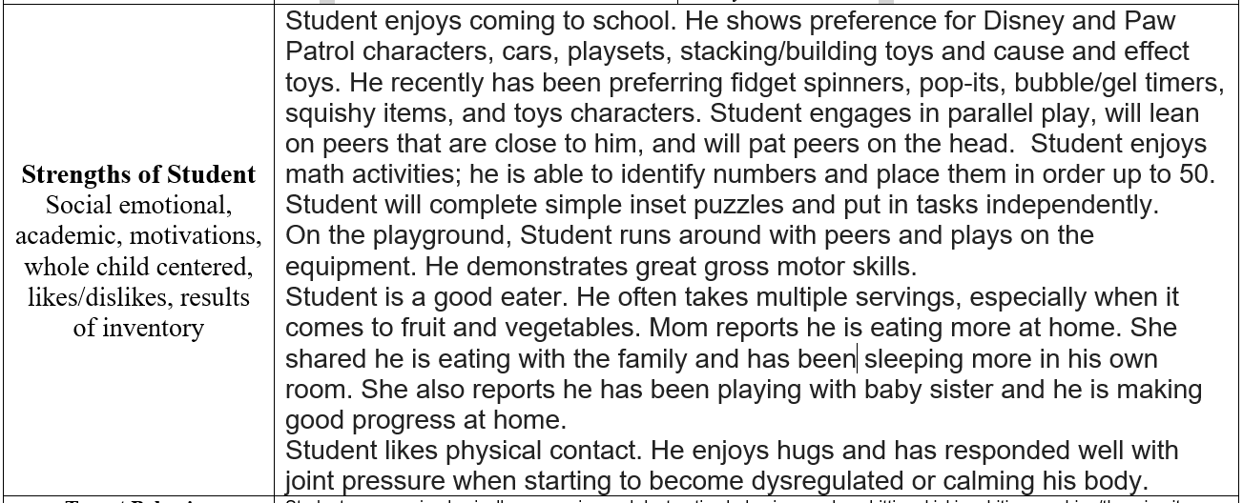
Strengths of Student Example

Slide 11





Practice time! Fill in the strengths for your case study student.

Slide 12
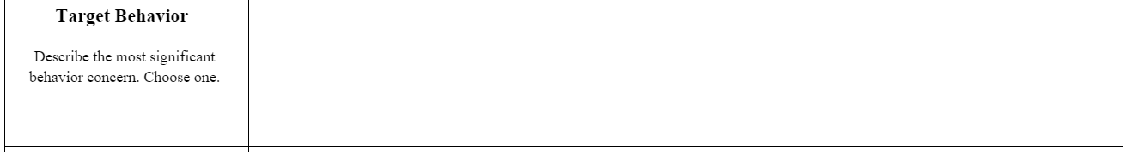
Target Behavior
Describe the most significant behavior concern. Choose one.
Prioritize the problem behavior, is it:
Harmful to person or others
2. Impedes their learning or that of others
3. Significantly limits social interactions with others

Slide 13
Operational Definition of Target Behavior
Objective: measurable and have observable characteristics, should be able to see it or hear it and count it.
Clear: should be distinct, explicit, obvious and clear so another person can read it and measure it.
Complete: it should include language that directs the observer in all situations, leaving little for judgment (i.e. examples and non-examples).

Slide 14
Operationally Defining Behavior
How to Implement
Label the behavior
1
Define the target behavior in objective terms
2
Develop examples and non-examples
3
Put the definition, examples, and non-examples together to write the operational definition.
4

Slide 15
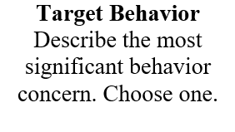
Target Behavior Example
When given a direction, student will display refusal to follow directions by verbally stating "no", walking away from immediate area, walk out of classroom, put head down on desk, and/or poke holes in work. If demand continues student will engage in physical aggression this can look like, hitting, kicking, slapping, scratching, pinching, using objects to stab or hit with, or ramming into another person with enough force to cause them to become off balance.
Examples: Student is given a direction and yells “no”.
Student puts head on desk and does not move to follow direction.
Non-examples: Student walks around desk to sit in chair.
Student touches adults' hand to get attention to ask for help.
Label Objective terms Examples/Non-examples

Slide 16

Practice time! Fill in the target behavior for your case study student.

Slide 17
Target Behavior Baseline
What is the student’s current level of performance?
Use data, how often is it happening?
Use data, how long is it happening?
ABC data is necessary!
Documentation is key and must be done.

Slide 18
ABC data collection
A
Antecedent
Happens immediately before the behavior
B
Behavior
The response, what the person does
C
Consequence
Happens immediately after the behavior

Slide 19
ABC Data Collection
Collect A-B-C Data on the behavior for 5-10 days
Look for:
Patterns of behavior
Triggers
Responses that may be reinforcing the behavior
Caution: For severe, dangerous behavior, put preventative strategies in place immediately.

Slide 20
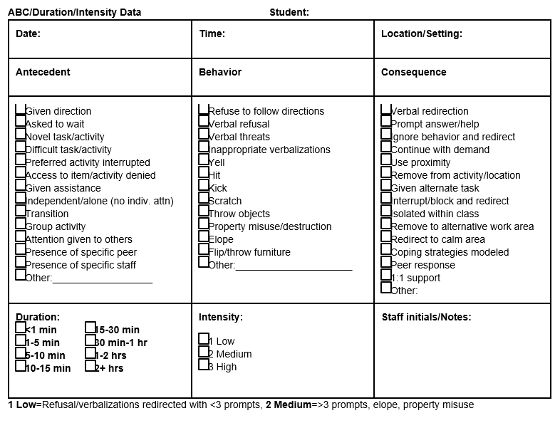
ABC Form

Slide 21
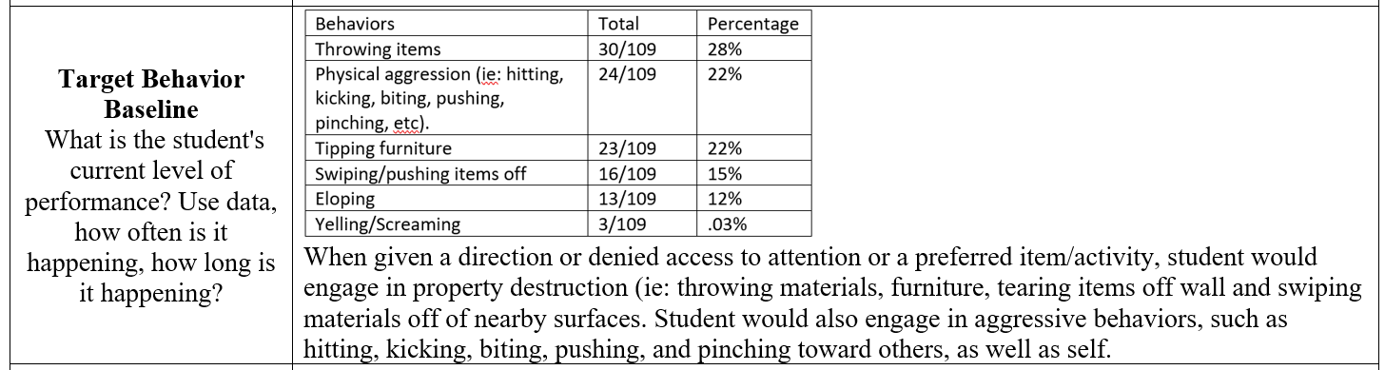
Target Behavior Baseline Example

Slide 22
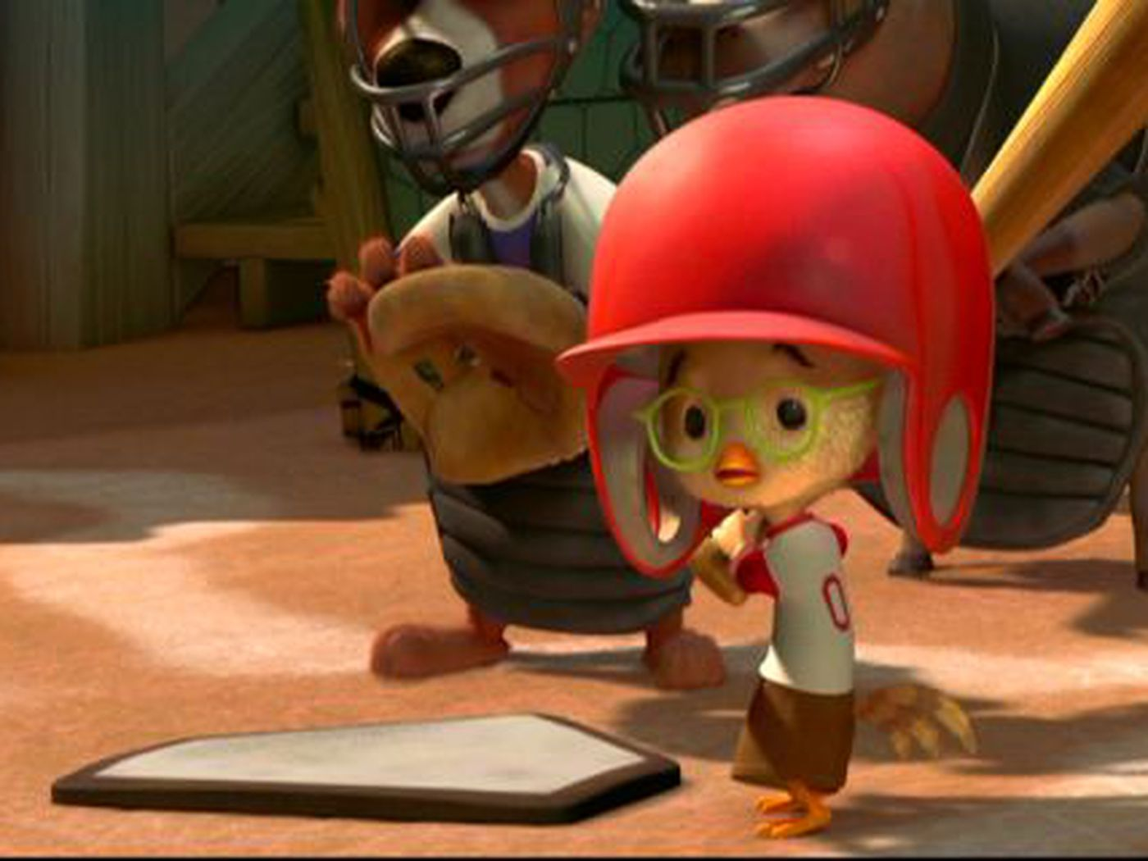
Practice time! Fill in the target behavior baseline for your case study student.

Slide 23
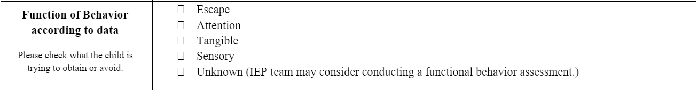
Function of Behavior according to data
Mark appropriate boxes
Refer to ABC data

Slide 24
Functions of Behavior
Escape: Behaviors are used to avoid or escape from something unpleasant, like a task, situation, or social interaction.
Attention: Behaviors are engaged in to gain attention from others, whether positive or negative.
Tangible: Behaviors are used to gain access to desired items or activities
Sensory: Behaviors are engaged in to provide sensory stimulation or regulation.

Slide 25
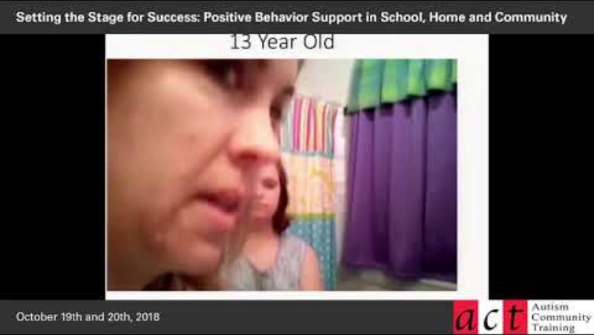
What is the function?

Slide 26

Practice time! Fill in the function of behavior for your case study student.

Slide 27
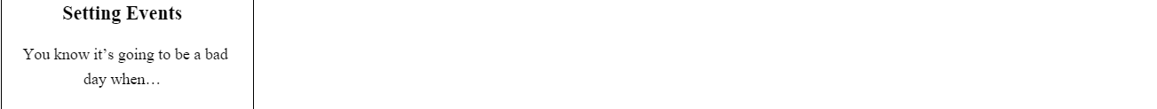
Setting Events
Setting events are antecedent factors that can increase or decrease the likelihood of a specific behavior occurring. They are not the immediate triggers that directly lead to the behavior, but they can create an environment where certain behaviors are more or less likely.
Could be: not getting to wear favorite shirt, stepped in a puddle of water on the way to school, missed breakfast, had a fight with a sibling before leaving the house, dog ate their toy……endless possibilities!

Slide 28
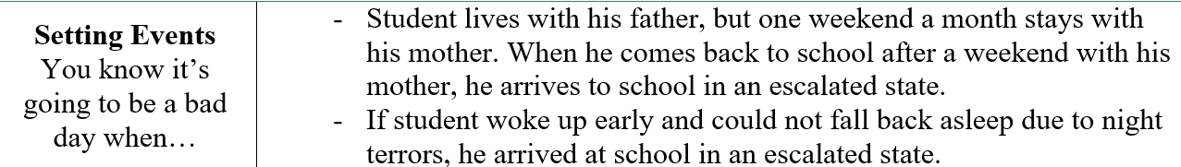
Setting Events Example

Slide 29

Practice time! Fill in the setting events for your case study student.

Slide 30
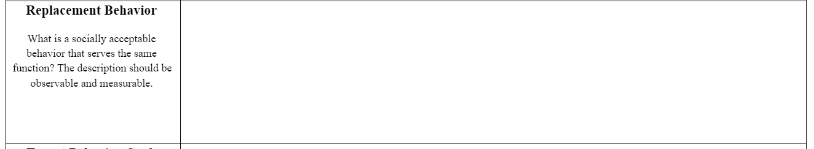
Replacement Behavior
What is a socially acceptable behavior that serves the same function?
The description should be observable and measurable.
Function of behavior- this is the effect of the response on the environment, all behavior happens for a reason, function is the why it occurs and why it continues to occur. (Hershfeldt et al.,2010)

Slide 31
What is a functional replacement behavior?
Functional equivalent replacement behavior is a positive alternative that allows the student to obtain the same outcome that the challenging behavior provided; that is, the student is able to obtain or escape something in their environment in an appropriate, acceptable way” (Pent.ca.gov, n.d.).
Things to consider:
A functionally equivalent replacement behavior needs:
To serve the same function of the behavior is it replacing.
Should be an action that is more appropriate to engage in than the behavior of concern.
Be explicitly taught and reinforced.
Take less effort to engage in than the problem behavior that it is replacing (meets the need quicker, less steps)
Is age appropriate.
Is within the student’s skill level.

Slide 32
Examples of Functionally Equivalent Replacement Behavior
Function | Replacement | Example
Escape | Teach requesting a break Teach asking for help | Student uses visual cue card to indicate they need a break. Student puts their thumb up on desk to ask for help.
Attention | Teach how to gain attention | Student is taught to put a pom-pom on the end of their desk to request a staff member to come over to them.
Tangible | Teach how to give up reinforcers Teach how to request items | Student is taught how to put item in bin or give to an adult when prompted “give”. Student is taught how to ask for preferred item vocally.
Sensory | Teach how to request sensory input | Student gives staff a visual cue with a picture of the sensory activity on it.

Slide 33
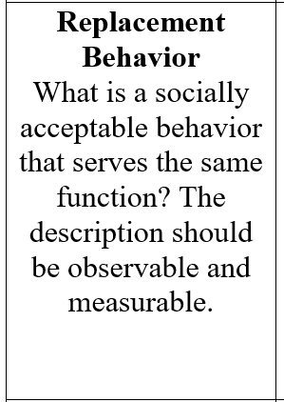
Replacement Behavior Example
Student will be taught to raise his hand when he feels like he wants to make a comment to another student to gain assistance from an adult to help facilitate that communication. This will assist with decreasing disruptive behavior within the classroom.
Note: This replacement behavior targets the function of attention..

Slide 34

Practice time! Fill in the replacement behavior for your case study student.

Slide 35
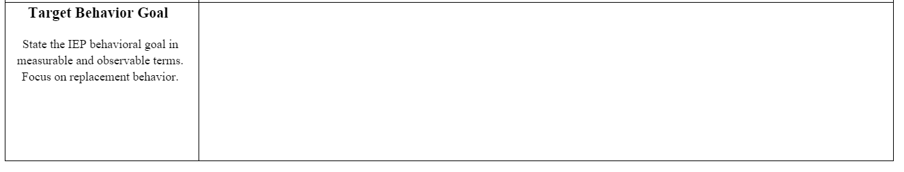
Target Behavior Goal
State the IEP behavioral goal in measurable and observable terms.
Focus on replacement behavior.
Don’t forget to add a goal sheet and put goal in IEP!

Slide 36
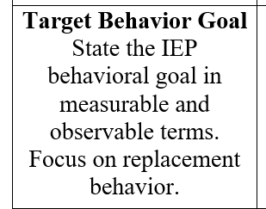
Target Behavior Goal Example
By the end of the IEP cycle, student will reduce instances of disruptive, attention seeking behavior in class (i.e., blurt outs/shout outs, using unkind language, moaning, cursing, etc.) to no more than 1 per school day, in 4 out of 5 days, as evidence by observational data tracking.

Slide 37
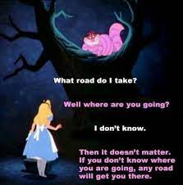
Practice time! Fill in the target behavior goal for your case study student.

Slide 38
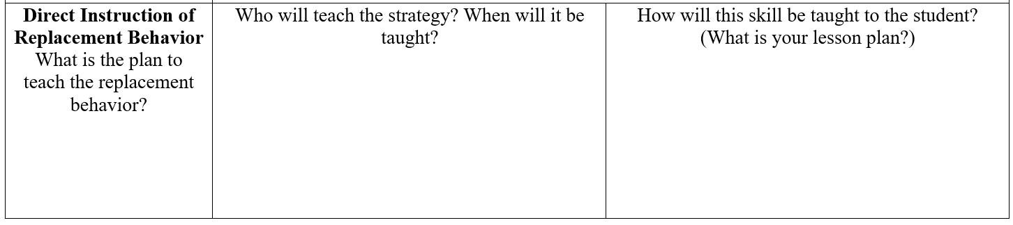
Direct Instruction of Replacement Behavior
What is the plan to teach the replacement behavior?
Who will teach the strategy? When will it be taught?
How will this skill be taught to the student? (What is your lesson plan?)

Slide 39
Direct Instruction of Replacement Behavior Example
Direct Instruction of Replacement Behavior What is the plan to teach the replacement behavior? | Who will teach the strategy? When will it be taught? Case manager Paraprofessionals Social worker will provide explicit instruction in social/emotional learning specifically in social skills and self-regulation skills during social work sessions twice weekly as well as teaching the replacement behavior. | See next slide

Slide 40
Teach Intervention: Raise Hand
What will be done?
Prior to implementing the intervention in the classroom, the special education case manager will review exactly how the student will raise his hand for communication. The instructions will include (a) when he should raise his hand; (b) what he does when he raises his hand (c) what will happen when he raises his hand:
a. When the student wants to answer a question, ask a question or make a comment will raise his hand.
b. Student will raise hand and wait (hand up, voice off, remain in location where hand was initially raised) for response from an adult.
c. When student raises their hand the staff will acknowledge the hand raise by saying "(Student name) I see you hand, I am coming to you" staff will immediately walk to student (see fading plan for further information)
Implementing the intervention:
Throughout the school day the student will be prompted to raise hand to engage making comments, asking/answering questions: (all other forms of attention seeking behavior defined in target behavior will be put on extinction (attention will not be provided for the target problem behavior). Prompts will be faded out when student begins to raise his hand on his own.
Student begins to engage in disruptive behavior.
Staff will immediately prompt student to raise their hand (prompt through visual or verbal cue, when using either cue provide in a way that other students are unaware of the cue)
When student raises hand (arm is extended with hand elevated past student shoulder), staff will immediately respond and provide student with attention. Staff will say "(Student name) I see you hand, I am coming to you" Staff will immediately go to student and ask, "What do you need?"
If student does not raise hand (hand stays below shoulder level) attention will not be provided

Slide 41
Prompt fade
Student begins to engage in disruptive behavior.
Staff will wait 3 seconds to provide prompt (if needed, student does not begin to move hand in an upward motion) for student to raise their hand (prompt through visual or verbal cue, when using either cue provide in a way that other students are unaware of the cue)
When student raises hand, staff will immediately respond and provide student with attention. "(Student name) I see you hand, I am coming to you" Staff will immediately go to student and ask, "What do you need?"
If student does not raise hand (student does not move hand above shoulder height) attention will not be provided
After 5 days of student raising their hand with 80% accuracy fade prompt to 5 second wait
After 5 days of student raising hand with 5 second prompt with 80% accuracy fade to 10 second prompt if needed.
Attention fade:
Once student is raising their hand independently, staff will begin to fade attention.
At the beginning of the intervention attention will be provided to student immediately upon them raising their hand
When student is independently raising their hand across 5 days without displaying disruptive behaviors, staff will say "be there in just a second" and wait for 5 seconds before providing the student with attention. This will be done on an intermittent basis with a fixed ratio of 5 (every hand raises but the 5th one will get immediate attention, the 5th one will be the delayed attention one)
The above step will be repeated expanding 5 seconds to a 10 second wait time for attention to be provided.
The attention fade out will continue until attention is provided at a typical rate.

Slide 42

Practice time! Fill in the direct instruction of replacement behavior for your case study student.

Slide 43
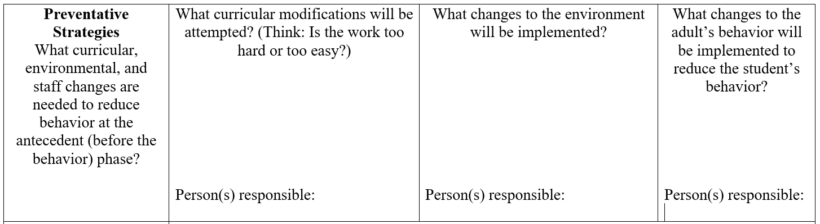
Preventative Strategies
Think about accommodations and modifications

Slide 44
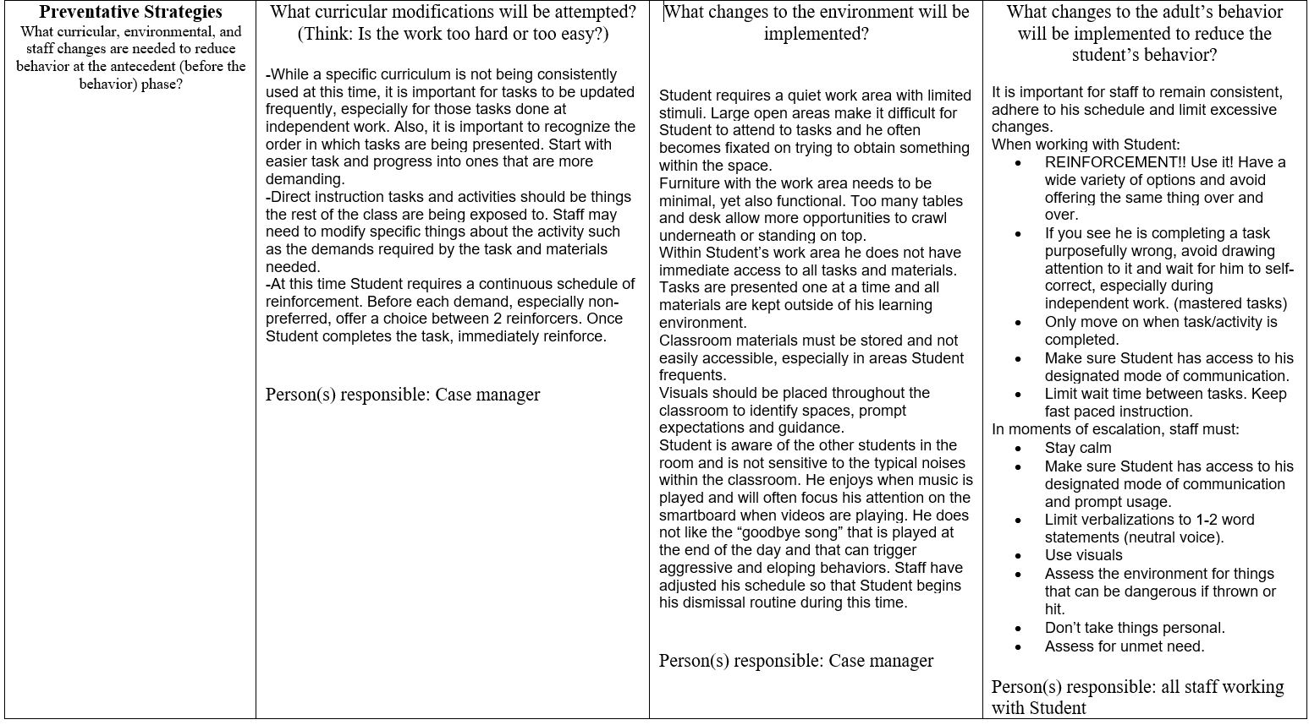
Preventative Strategies Example

Slide 45

Practice time! Fill in the preventative strategies for your case study student.

Slide 46
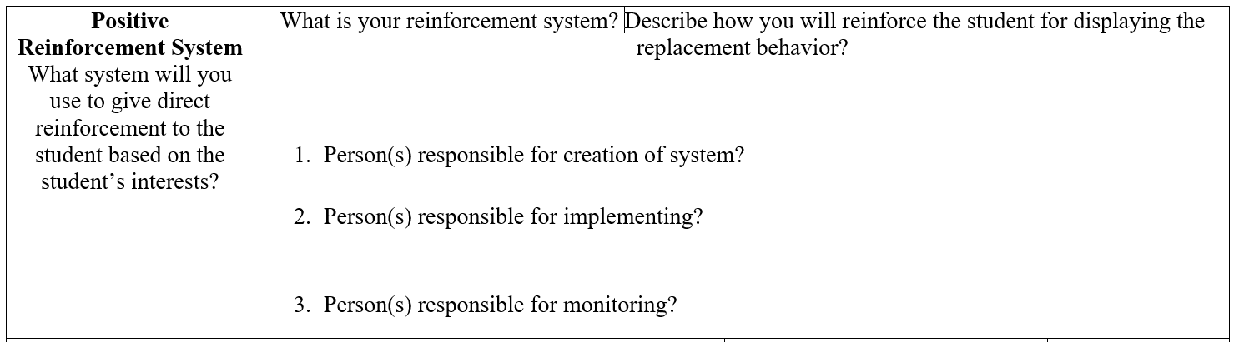
Positive Reinforcement System

Slide 47
What is reinforcement?
Reinforcement is an evidence-based practice that increases the future probability that the target behavior or skill that is encountering reinforcement will occur.
Reinforcement involves providing a consequence following a student’s response that increases the likelihood that the response will occur again.
Notes:
Jackie

Slide 48
Something to think about with Reinforcement!
There are two primary purposes for using reinforcement, when teaching new skills and managing appropriate and inappropriate behavior. (Otten et al., 2023)
Reinforcement should be motivating to the learner.
A variety of reinforcers should be used in order to avoid satiation of a reinforcer.
Reinforcement is anything that is motivating the learner, this may include: verbal praise, tangible items (toys, fidgets, objects of interest),edible reinforcement (m&m’s, goldfish, sprinkles), extra free time, and so much more!

Slide 49
Reinforcement Schedules
Schedules of reinforcement refer to the frequency or timing of the delivery of reinforcement following a target behavior.
The goal of reinforcement is to increase skills while gradually fading reinforcement strategies to promote maintenance and generalization through the use of reinforcement schedules.
Used in positive reinforcement programs and within token economy systems.
Two Types of Reinforcement Schedules: Continuous and Intermittent

Slide 50
Continuous Reinforcement Schedule
A continuous reinforcement schedule is used when learners are reinforced each time they use the target behavior.
This type of reinforcement schedule is most often used when first teaching learners new skills.
It is very effective in establishing a relationship between the target behavior and the reinforcement.
While continuous reinforcement will create an association between behavior and reinforcement, it will not produce long-term changes in behavior.
If only continuous reinforcement is used, once it is withdrawn, the desired behavior will likely cease. Also, if used too long, a student may learn to manipulate the intervention by behaving appropriately only when reinforcement is desired..
Once an association has been established, it is time to change schedules of reinforcement.

Slide 51

Intermittent Schedules of Reinforcement
Once a relationship is established, move from a continuous schedule to an intermittent schedule of reinforcement. The word intermittent means not every time.
When using intermittent reinforcement, the response is reinforced only part of the time.
Produces strong and steady results!
Slot machines use intermittent schedules of reinforcement.

Slide 52
Intermittent Schedules of Reinforcement
Fixed-Ratio schedule- reinforcement is delivered after a “fixed” number of correct responses
Variable-Ratio schedule- delivery of reinforcement is varied, but should average out at a specific number (hover around 4)
Fixed Interval schedule- reinforcement becomes available after a specific amount of time (after 2 min has passed)
Variable Interval schedule- time period must pass before reinforcement is made available , will very but must average out at a specific time (hover around 5 min)

Slide 53

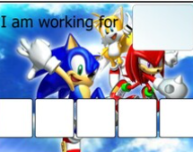
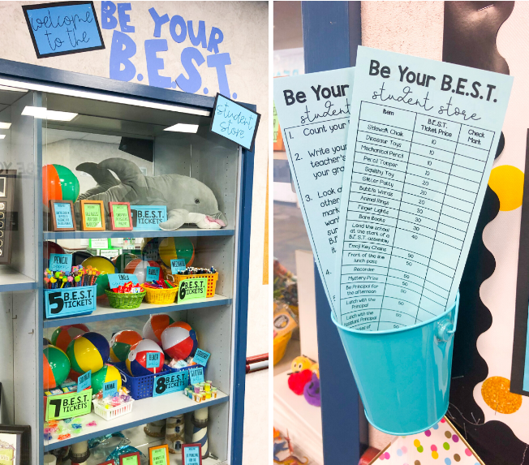
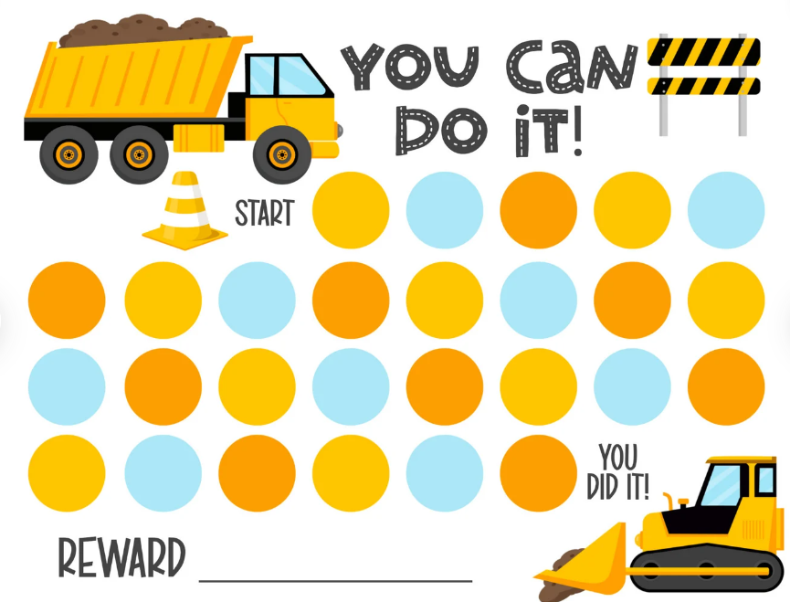
Token Economy
A token economy system is another type of positive reinforcement strategy that can be used effectively with learners.
Consider student's interests when designing a token system
Token economy programs are referred to as such because they are based upon a monetary system in which tokens are used to acquire desired reinforcers (e.g. tangible objects, activities, or privileges), also known as back up reinforcers.

Slide 54
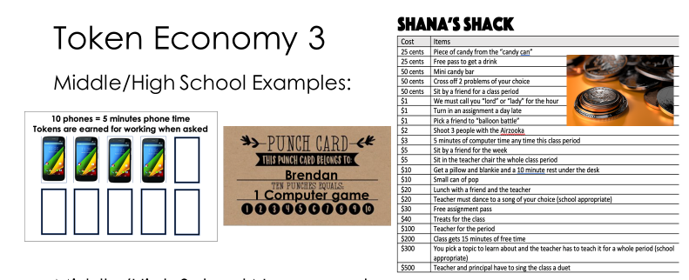

Slide 55
How do I implement it?
Identify
Identify the skill or behavior(s) to increase
Collect
Collect baseline data on target skill
Decide
Decide what tokens and reinforcers to use
Make
Make a menu to identify what reinforcers will “cost”
Decide
Decide how tokens are earned
Identify
Identify when/where tokens may be exchanged
Provide
Provide instruction or task and make earning easy
Up
After consistent responding , up the criteria
Use
Use data to determine how often to reinforce

Slide 56
Token System: How to use
1) Ask “what are you working for?” and show the student the picture choices
2) You or the student can move the picture to the box on the token board
3) Provide the student with tokens when they engage in the target behavior
4) State exactly why they are getting the token
5) Once the student earns all their tokens provide them with the item they chose to work for immediately

Slide 57
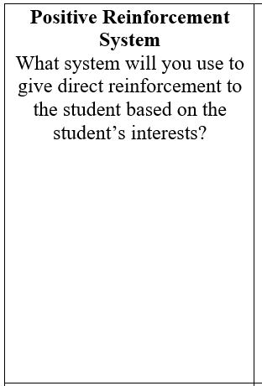
Positive Reinforcement System Example
The function of the behavior is escape, by providing student with a way to communicate that he needs a break the direction or task will be removed therefore the reinforcement will occur automatically through the replacement behavior.
Differential Reinforcement of Other (DRO) behavior will be implemented. DRO refers to providing reinforcement for when the student is engaged any other behavior that is not the problem behavior of interest. When student follows a direction or completes a task without engaging in the problem behavior reinforcement will be provided. Reinforcement will be provided through a token board system, each time student completes a task or direction a token will be given. Student will earn 5 tokens before given the back up reinforcement that he was working toward.

Slide 58
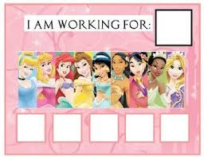
Practice time! Fill in the positive reinforcement system for your case study student.

Slide 59
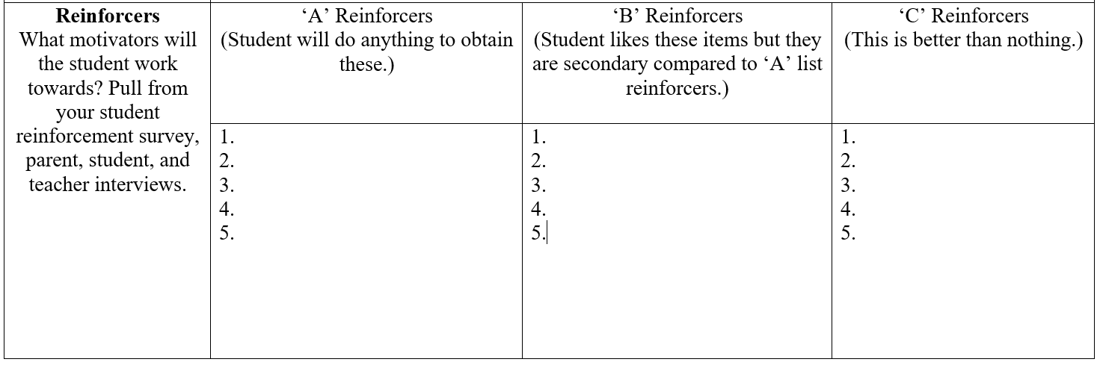
Reinforcers

Slide 60
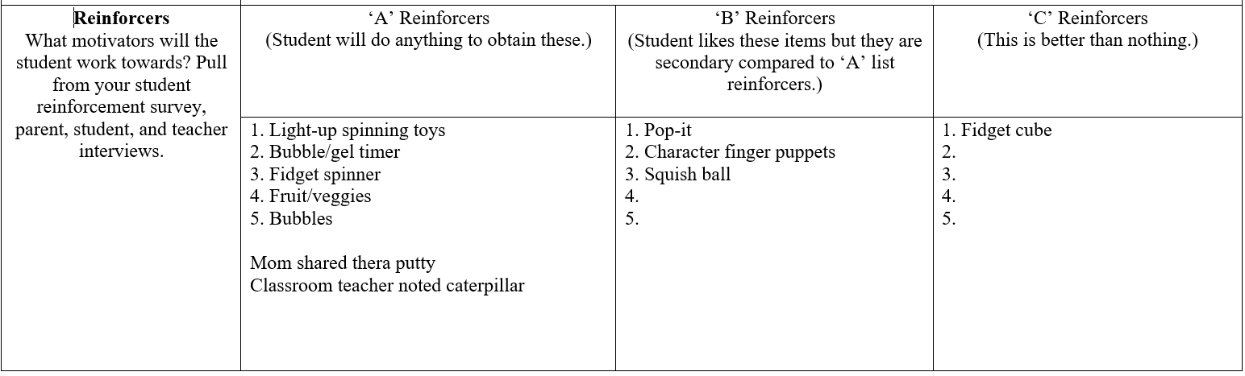
Reinforcers Example

Slide 61

Practice time! Fill in the reinforcers for your case study student.

Slide 62
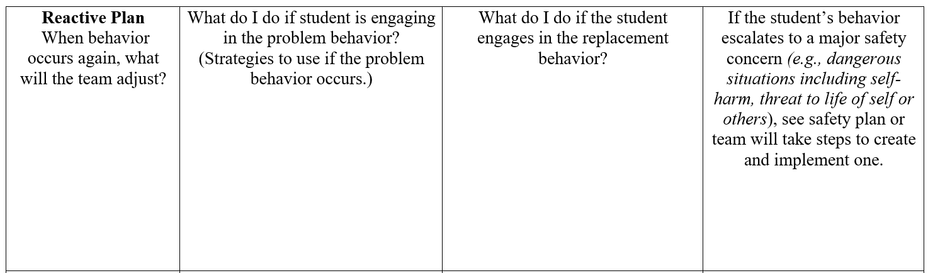
Reactive Plan

Slide 63
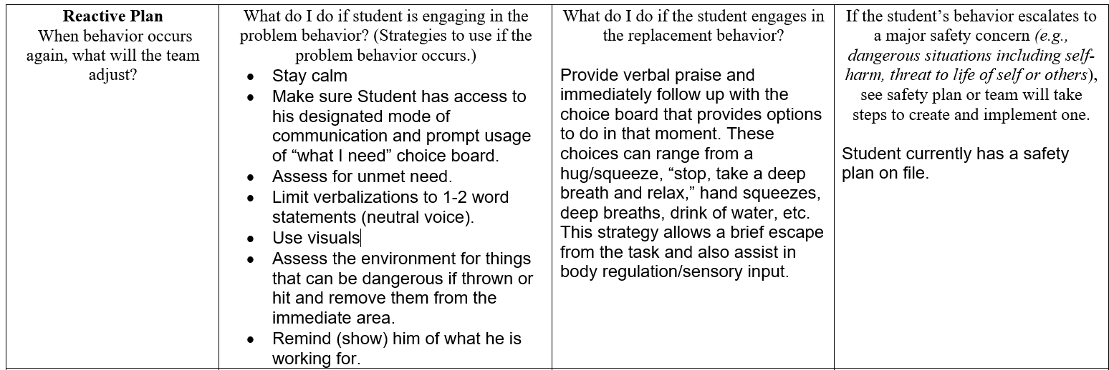
Reactive Plan Example

Slide 64

Practice time! Fill in the reactive plan for your case study student.

Slide 65
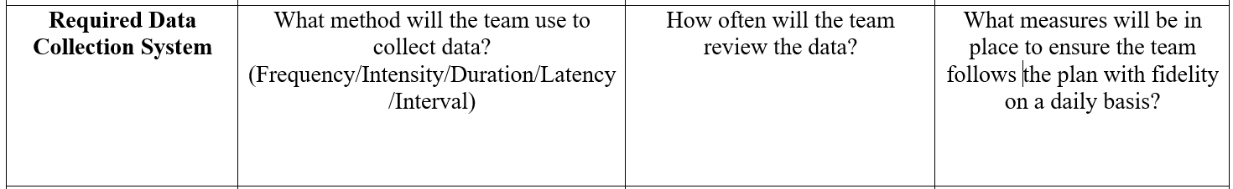
Required Data Collection System
Use for progress monitoring!

Slide 66
Different Ways to Collect Data
Frequency (count) recording is a way to measure the number of times a behavior occurs.
Duration the amount of time from the onset to the end point of a response. It measures how long the behavior occurs, such as how long someone is engaged in a task, behavior, or activity.
Latency is a measure of the elapsed time between the antecedent and when the student begins the specified behavior.
Partial Interval recoding is an interval recording method, that breaks times down into smaller intervals. The observer records whether the behavior occurred at any time during the interval. The observer will use one symbol if the behavior is not observed and another symbol if it is observed, such as a + or -.
Whole interval recording is a type of data collection that involves observing whether a behavior occurs or does not occur during the whole specified interval of time. It is used to measure continuous behaviors or behaviors that occur at high rates that it is difficult to distinguish one response from another.
Momentary time sampling is when an observer records whether a behavior occurs or does not occur at the end of a specified interval. It is if the behavior occurs or does not at that moment.

Slide 67
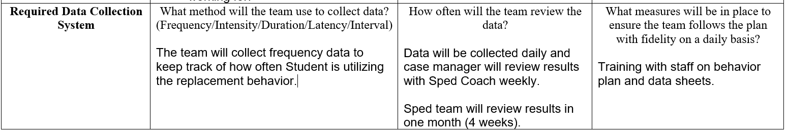
Required Data Collection System

Slide 68

Practice time! Fill in the required data collection system for your case study student.

Slide 69
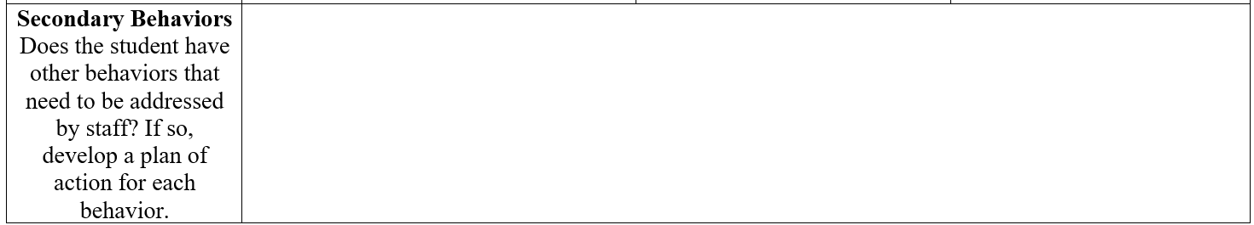
Secondary Behaviors

Slide 70
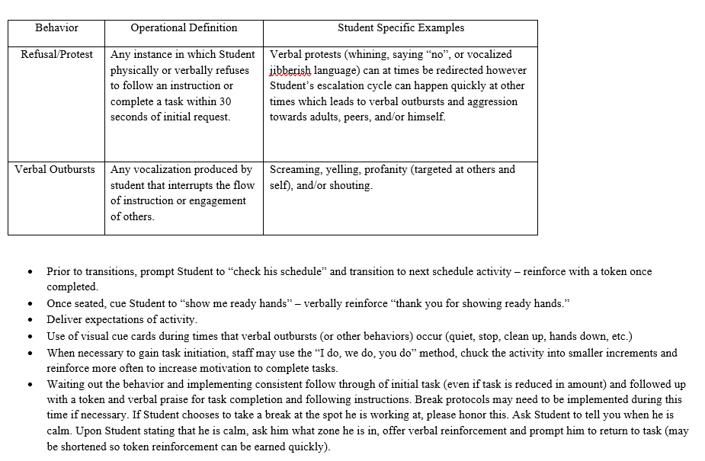
Secondary Behaviors Example

Slide 71
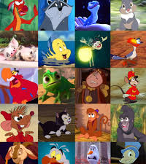
Practice time! Fill in the secondary behaviors for your case study student.

Slide 72
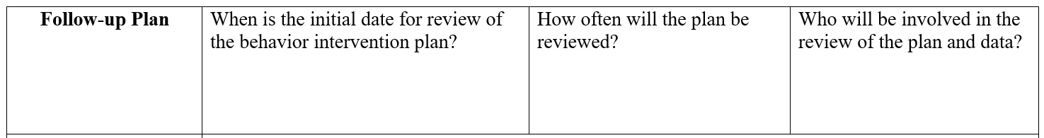
Follow-up Plan
Individualize!

Slide 73
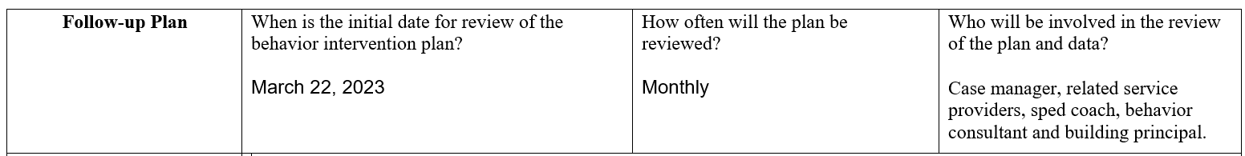
Follow-up Plan Example

Slide 74

Practice time! Fill in the follow up plan for your case study student.

Slide 75
Other Information

Slide 76

Practice time! Fill in the other information for your case study student.

Slide 77

Questions????

Slide 78
References
Cooper, J. O., Heron, T. E., & Heward, W. L. (2020). Applied Behavior Analysis (3rd Edition). Hoboken, NJ: Pearson Education.
Hershfeldt, P. A., Rosenberg, M. S., & Bradshaw, C. P. (2010). Function-based thinking: A systematic way of thinking about function and its role in changing student behavior problems. Beyond Behavior, 19(3), 12-21.
Otten, Kaye L., et al. The Educator’s Guide to Autism Spectrum Disorder: Interventions and Treatments: For Educators, by Educators. Corwin Press, Inc., 2024.

Slide 79

Thank you!

Slide 80
Frontline/Professional Development Credit
Ensure that you have registered for February 16th District Professional Development in the Frontline District Catalog.
Be sure to mark the activity complete within 30 days to receive credit. The exit survey will serve as the Knowledge Evaluation and be given during your building’s “sunset” meeting.
Notes:
Please share this information as a reminder to everyone to receive their PD points.

Slide 81
Thank you for attending - Behavior Intervention Plans
Kassandra Dunlap
Notes:
Please note your session title, the presenter(s), and contact information (email, etc.). The exit survey will be taken in the sunset meeting at the end of the day. If you would like to receive individual feedback on your presentation you can add that onto this slide.

