Slide 1

Working with Students with Oppositional Defiant Behaviors
Presentation Adapted from Bev Johns and The ODD Classroom Guide
Presented by: Kassandra Dunlap, USD 475 Behavior Consultant

Slide 2

USD 475 Strategic Plan Connection
Goal 1: Equitably support the academic learning all students.
Goal 2: Equitably address the social emotional needs of all students.
Goal 3: Create opportunities to enhance family and community engagement in an equitable manner that allows for participation for all.
Goal 4: Develop a plan to recruit, retain, and support high quality staff that reflects our community.
Notes:
Emphasize connection between topic to one or more of the goal areas on the USD 475 Strategic Plan. This is vital for alignment and focus as our district continues accreditation.

Slide 3
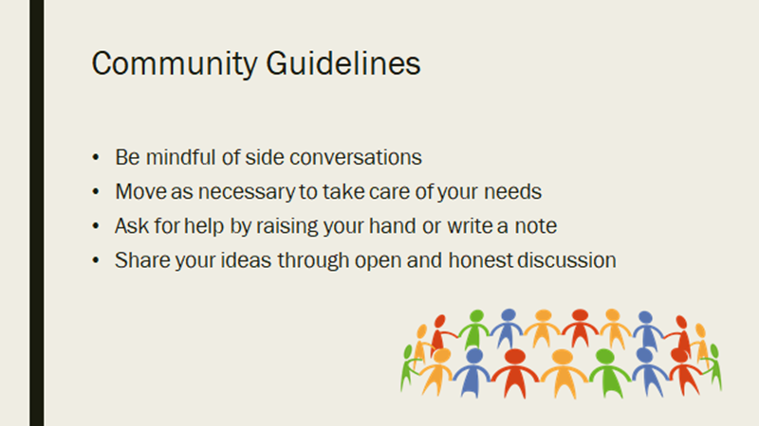
WELCOME and thanks for being here today

Slide 4
Objectives
Understand
Understand ODD characteristics & myths
Learn
Learn immediate response strategies
Explore
Explore preventive practices
Identify
Identify collaboration tools
Apply
Apply strategies through case studies
Notes:
Explain the objectives of the training. Emphasize that participants will leave with real tools to apply in their classrooms.

Slide 5
ODD Defined
According to the DSM-5, a diagnosis of ODD requires that the child exhibit frequent behaviors in three main categories:
• Angry and irritable mood: losing temper easily, often touchy or easily annoyed, frequently angry and resentful.
• Argumentative and defiant behavior, often argues with adults, actively refuses to comply with rules or requests, deliberately annoys others, blames others for mistakes or misbehavior.
• Vindictiveness: spiteful or vindictive behavior that occurs at least twice within six months.
Oppositional Defiant Disorder is a behavioral condition that goes far beyond the occasional defiance seen in most children.
It is characterized by a persistent and ongoing pattern of negative, hostile, and defiant behaviors that last for at least six months and are directed primarily toward authority figures.
Notes:
It is essential for teachers to remember that ODD is not the result of a student being “bad” or a teacher failing to manage the classroom. It is a recognized disorder that has biological, psychological, and environmental roots.

Slide 6
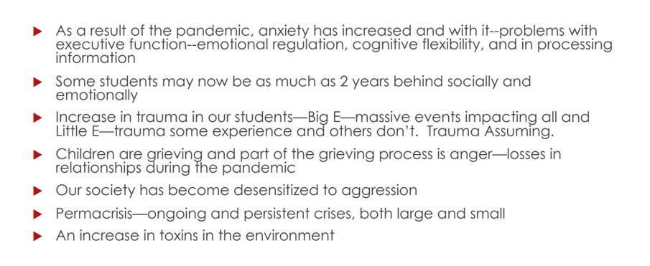
Why Are We Seeing More Oppositional Behavior….

Slide 7

Incident Rates – anywhere from 1 to 16% of all school-aged children and adolescents have ODD.

Slide 8
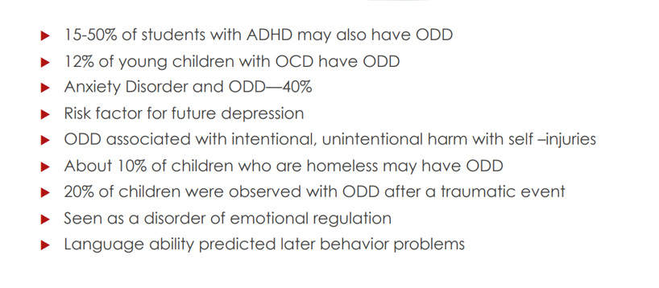
More About ODD and Co-morbidity

Slide 9
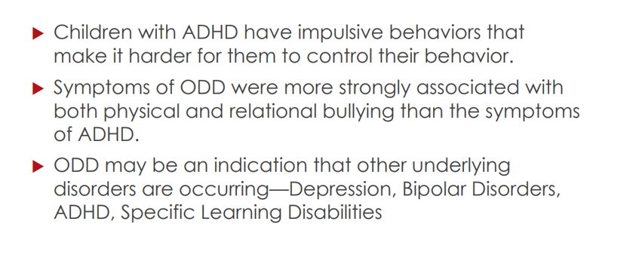
Some Facts About Co-morbidity

Slide 10

Common Classroom Behaviors
Refusal to follow directions
Defies rules
Arguing with teachers
Disrupting lessons
Provoking peers
Uncooperative on purpose
Notes:
Discuss common ODD behaviors such as refusal, arguing, and deliberate disruption. Normalize that these are ongoing, not one-off issues.

Slide 11
Triggers in School
Transitions
Unfair/overwhelming tasks
Multiple-step instructions
Strict discipline
Peer attention
Notes:
Review triggers like transitions, unfair tasks, or peer attention. Ask participants to identify triggers they have seen.

Slide 12
Myths vs. Realities
Myth: ODD caused by bad parenting/teaching
Reality: ODD is a clinical disorder
Myth: Stricter rules fix ODD
Reality: Harshness increases defiance

Slide 13
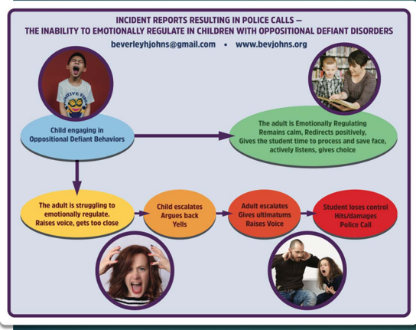
What happens when the child isn’t emotionally regulating, and the adult isn’t either?

Slide 14
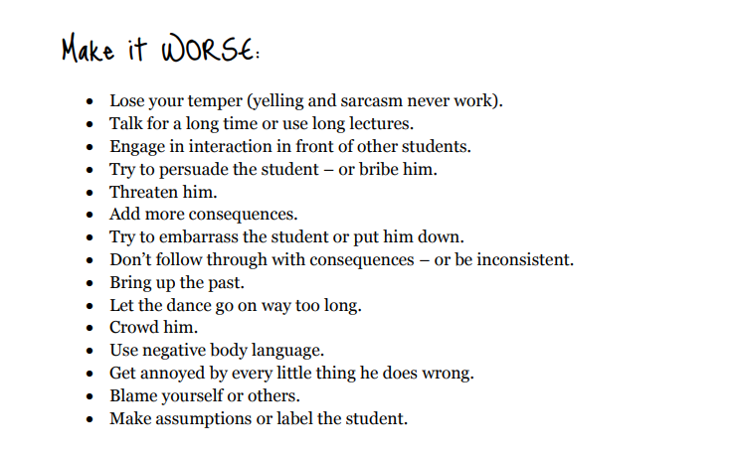
The Dance

Slide 15
Stay Out of The Dance – Prevention and Adult Language are Key
By Reframing Adult Thinking…
Put on your investigative hat
Use a skill deficit lens

Slide 16
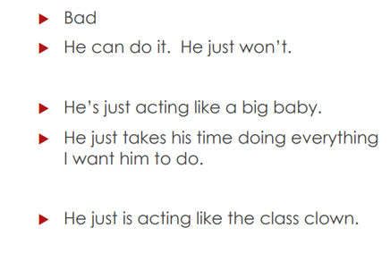
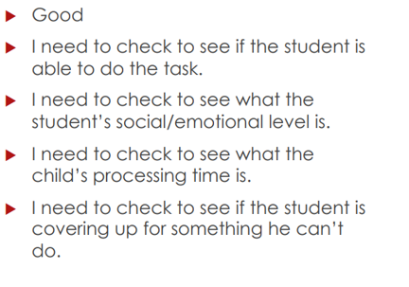

Reframing Adult Thinking: The Good, The Bad, Using the Good to Prevent the Ugly
Notes:
Flip the switch in our thinking

Slide 17
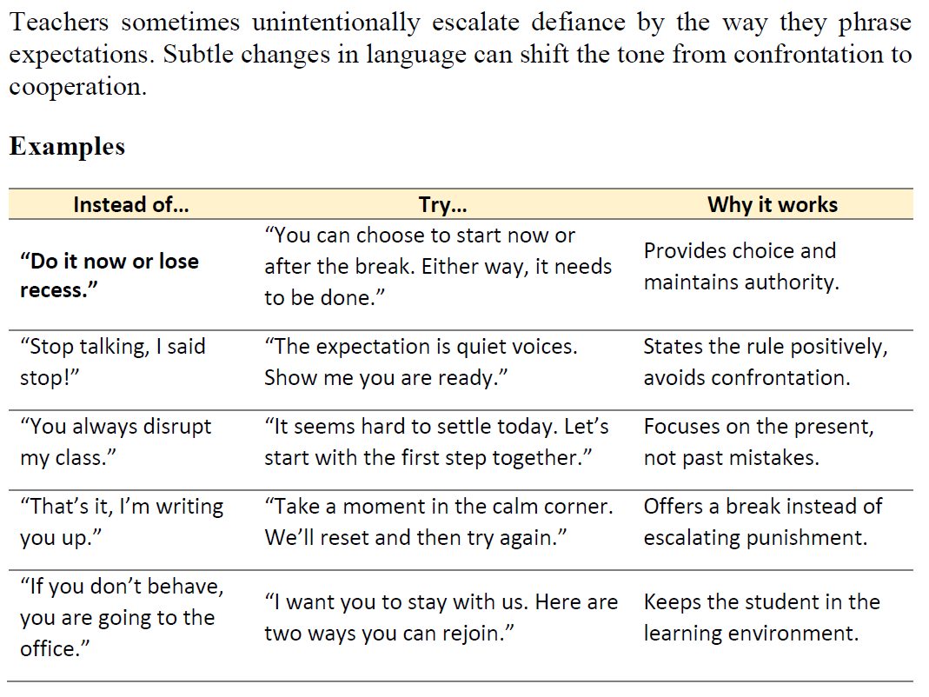

Slide 18
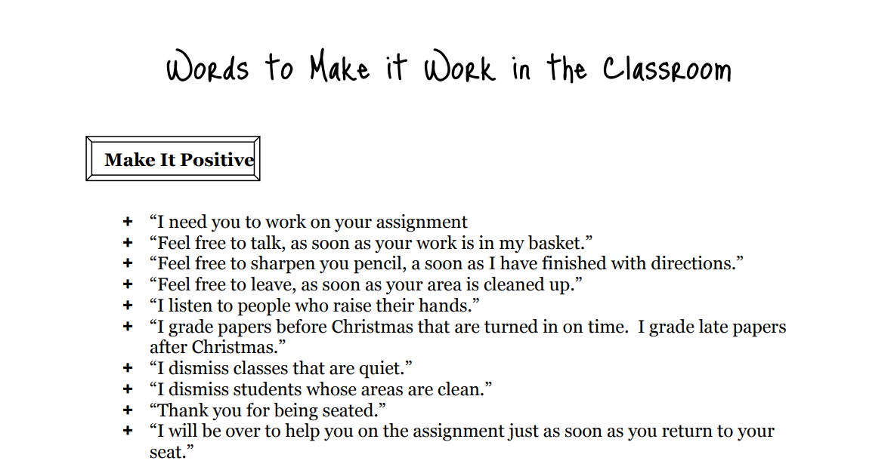

Slide 19
Understand the why and remember to make prevention a priority by …
Building relationships
Structure for success though establishing predictability
Anticipating triggers

Slide 20
Building Positive Relationships
A positive relationship reduces the need for power struggles. Students are more willing to comply with expectations when they feel respected and understood.
Daily positive greetings
Non-contingent attention
Use student strengths
Repair quickly after conflict
Notes:
Emphasize the power of positive teacher-student relationships. Share examples of non-contingent attention and quick repair after conflict.

Slide 21
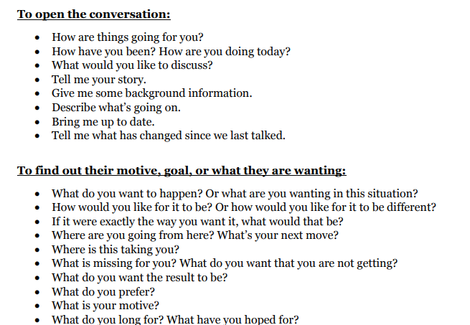
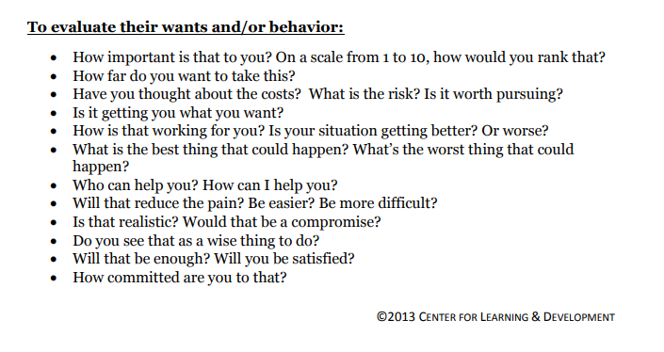
Ways to Engage in Conversations with Difficult Students

Slide 22
Building Positive Relationships
Classroom Example
A teacher notices that a student with ODD enjoys drawing. Instead of focusing only on academic refusal, the teacher invites the student to create visual vocabulary cards for the class. By valuing the student’s talent, the teacher lowers resistance and increases cooperation.

Slide 23
Creating Structure & Predictability
Unpredictability fuels defiance. Students with ODD often thrive on testing boundaries, but they feel less need to push back when the environment is consistent and clear. Predictability reduces anxiety, limits opportunities for arguments, and helps students know exactly what is expected.
Strategies:
Visual Daily Schedule
Announce Transitions
Consistent Routines
Predictable consequences
S
Classroom Example:
During math, the teacher writes the three steps of the activity on the board:
“1. Review,
2. Practice,
3. Share.
When a student begins to resist, the teacher calmly points to the board: “We are on step two now. You know what comes next.” This removes the opportunity for argument.

Slide 24
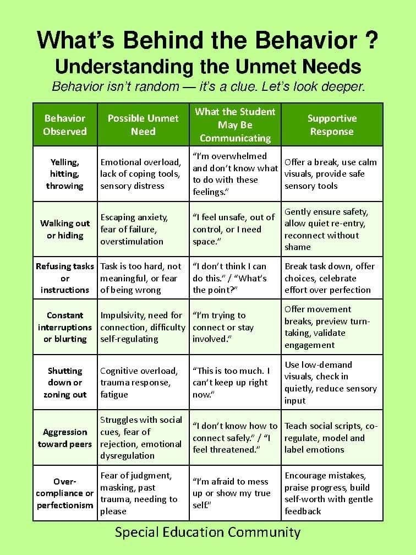
Understanding the why through a behavioral lens by using ABC data

Slide 25
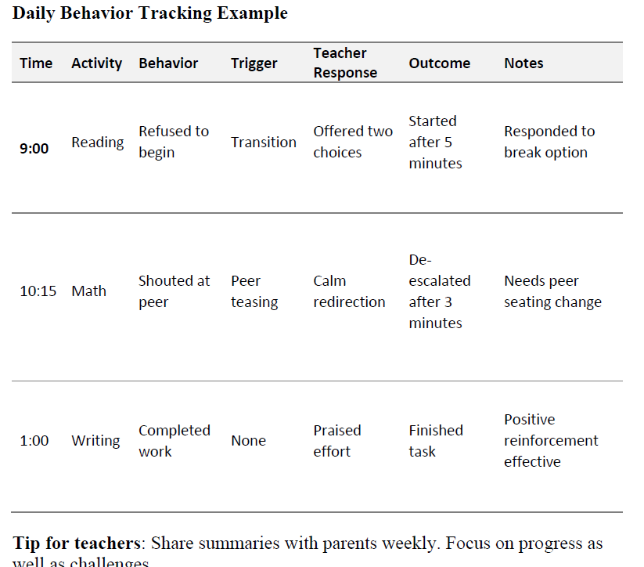
Tracking helps teachers identify patterns and provides data for teams.

Slide 26
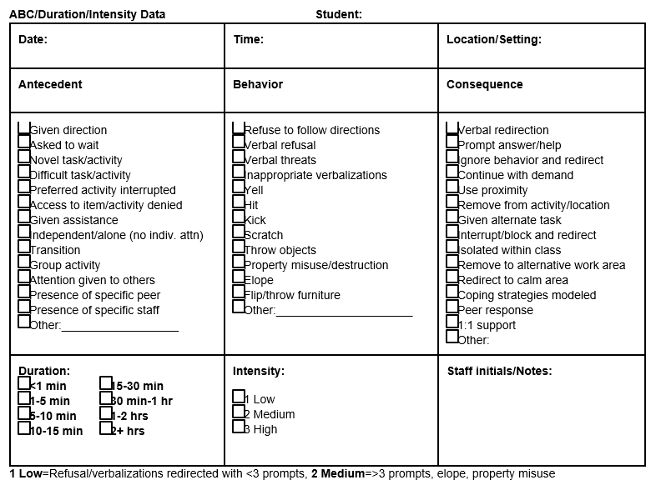
ABC Form

Slide 27
Anticipating Triggers –
Recognizing patterns allows teachers to adapt the environment, tasks, and instructions to prevent escalation. Let the data speak!
Keep a behavior log
Break down tasks
Proactive breaks
Adjust sensory needs
Notes:
Show how to anticipate triggers through behavior logs, proactive breaks, and sensory adjustments.

Slide 28
Anticipating Triggers and Making Adaptations
Classroom Example
A student consistently refuses to participate in group reading. The teacher adapts by allowing the student to first read silently, then join a small group later. This avoids confrontation while still achieving the goal of participation.

Slide 29
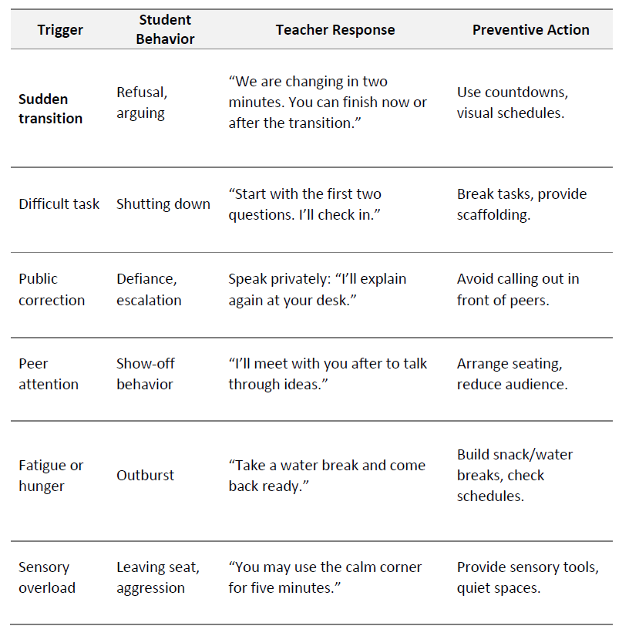
Triggers are predictable if we look for patterns. Matching triggers to effective responses helps teachers act early instead of reacting late.

Slide 30

Immediate Responses – Crisis Response Strategies & Case Study Examples

Slide 31
Refusal to Follow Directions
Stay
Stay composed
State
State expectation briefly
Offer
Offer limited choices
Acknowledge
Acknowledge small positives
Notes:
Walk through the step-by-step strategy for refusal. Provide sample scripts teachers can practice.

Slide 32
Refusal to Follow Directions
STEP BY STEP
1. Stay composed. Responding with visible frustration increases resistance.
2. State the expectation clearly and briefly. Keep instructions short and neutral.
3. Offer limited choices to give the student a sense of control. Example: “You may start the worksheet now, or you can join me at the back table in five minutes.”
4. Provide wait time. Students with ODD often test limits, but silence and calm presence can reduce tension.
5. Acknowledge positive action immediately, even if it is small. Example: “I see you opened your notebook. That is a good start.”
EXPANDED TEACHER SCRIPT
Instead of: “You need to do this right now or you will lose recess!”
Try: “The expectation is that your notebook is open. You may start now, or you can begin after I check in with the group. Which works better for you?”
Instead of: “Why do you always argue with me?”
Try: “I need you to write your name at the top. That is the first step. Let’s get that part done.”

Slide 33
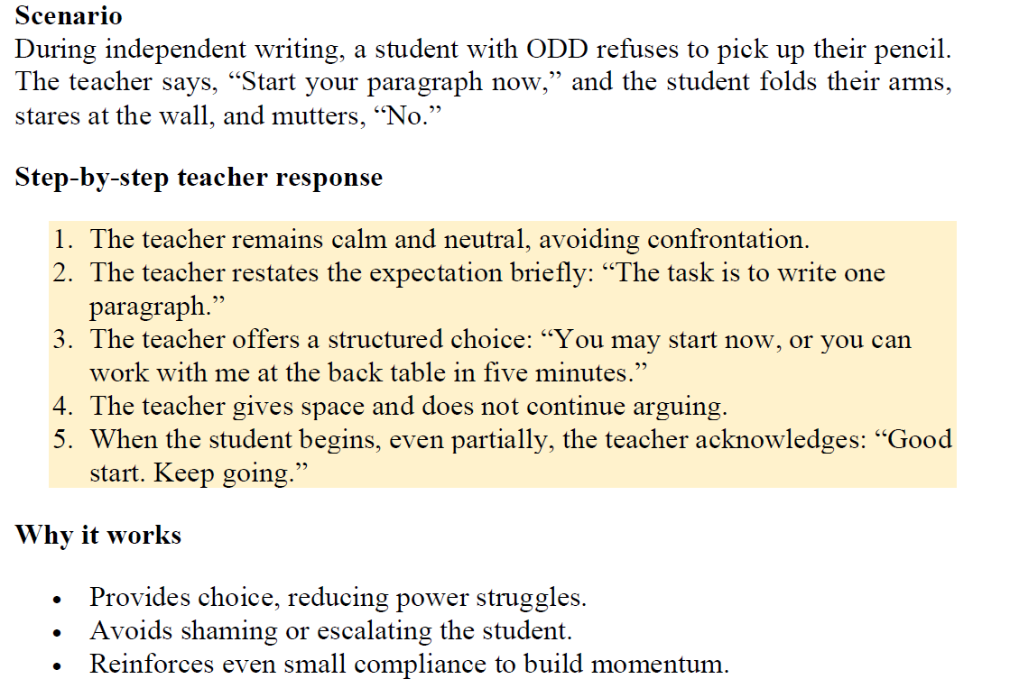

Slide 34
When Students Yell, Insult or Provoke
Avoid reacting emotionally
Acknowledge emotion, not insult
Restate expectations calmly
Notes:
Review strategies for handling yelling or insults. Stress that acknowledging emotion—not insult—can de-escalate conflict.

Slide 35
When the Student Yells, Insults, or Provokes
STEP BY STEP
1. Direct the class first so that learning continues. Example: “Everyone, please continue with the first two questions on your worksheet.”
2. Address the student privately whenever possible to avoid giving them an audience.
4. Avoid shaming or humiliating language. Public confrontations often intensify defiance.
5. Reinforce appropriate behavior quickly when the student redirects.
3. Frame directions as choices, not ultimatums. Example: “You can return to your seat now, or you can join me for a quick check-in. It is your choice.”
EXPANDED TEACHER SCRIPT
Instead of: “You are disturbing everyone. Stop it now!”
Try: “The class is working on the first two questions. You may join them, or you can check in with me quietly for support.”
Instead of: “You are wasting everyone’s time.”
Try: “The class needs quiet to focus. You can decide to work at your seat or take a short break before rejoining.”

Slide 36
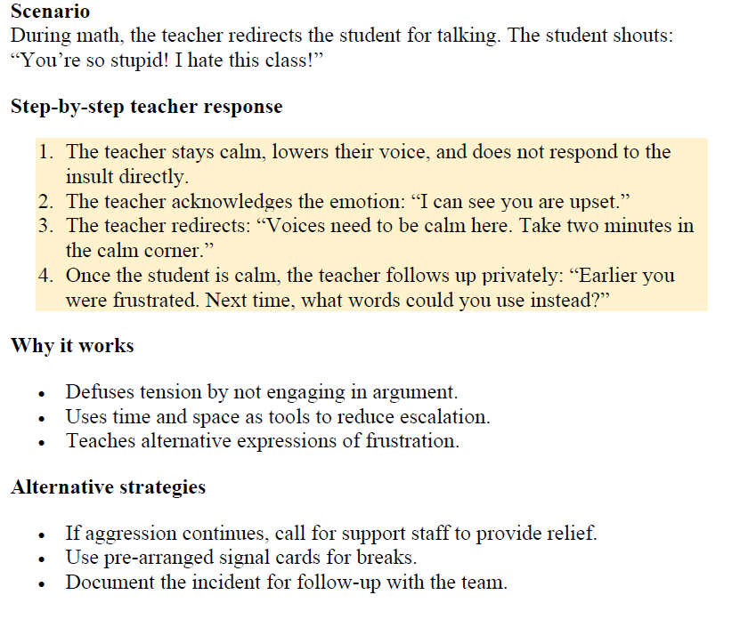

Slide 37
Disrupting the Class / Safety
Protect
Protect learning environment
Address
Address privately
Use
Use choices not ultimatums
Ensure
Ensure safety first
Notes:
Discuss approaches when a student disrupts or creates safety risks. Prioritize protecting the class while de-escalating.

Slide 38
When the Student Disrupts the Entire Class
STEP BY STEP
1. Do not react emotionally. Avoid sarcasm, raised voice, or visible anger.
2. Acknowledge the emotion, not the insult. Example: “I hear that you are frustrated.”
4. Use non-verbal cues when possible:
5. Follow up later when the student is calm. Address the disrespect, set clear boundaries, and teach alternative ways to express frustration.
3. Restate expectations calmly. Example: “We speak respectfully in this classroom.”
EXPANDED TEACHER SCRIPT
Instead of: “Do not you dare talk to me like that!”
Try: “I hear your frustration. Right now, calm voices are expected. We will discuss this privately when you are ready.”
Instead of: “If you insult me again, you will go straight to the office.”
Try: “The language you are using is not respectful. You can choose to take a break, or you can try again with respectful words.”

Slide 39
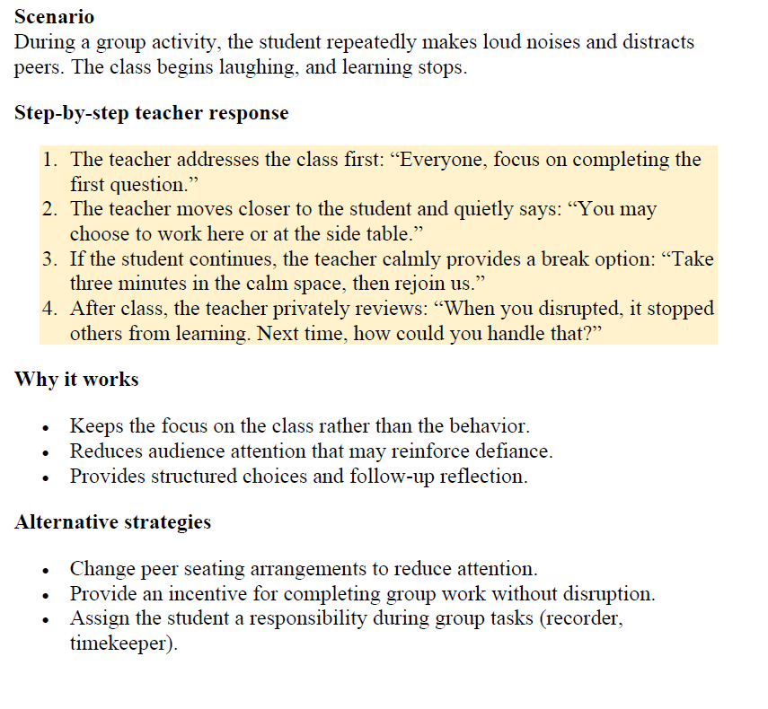

Slide 40
Risk of a Major Crisis
In some situations, behavior may escalate into aggression, property destruction, or unsafe actions. These moments require a safety-first approach.
Notes:
Review strategies for handling yelling or insults. Stress that acknowledging emotion—not insult—can de-escalate conflict.

Slide 41
When There is Risk of Major Crisis
STEP BY STEP
1. Ensure safety immediately. Move peers away from potential danger zones.
4. Call for support promptly if the situation does not de-escalate.
5. Debrief after the crisis with the student, support staff, and the class if necessary. Adjust the crisis plan based on what happened.
3. Maintain a calm and steady tone. Avoid shouting or threatening language.
2. Use clear, direct statements with minimal words. Example: “Put the chair down.”
EXPANDED TEACHER SCRIPT
Instead of: “Stop that right now or you will be suspended!”
Try: “I need you to put the chair down. You are safe. We will talk once you are calm.”
Instead of: “If you throw that, you are in big trouble.”
Try: “Place the object on the desk. Let’s step outside for a break.”

Slide 42
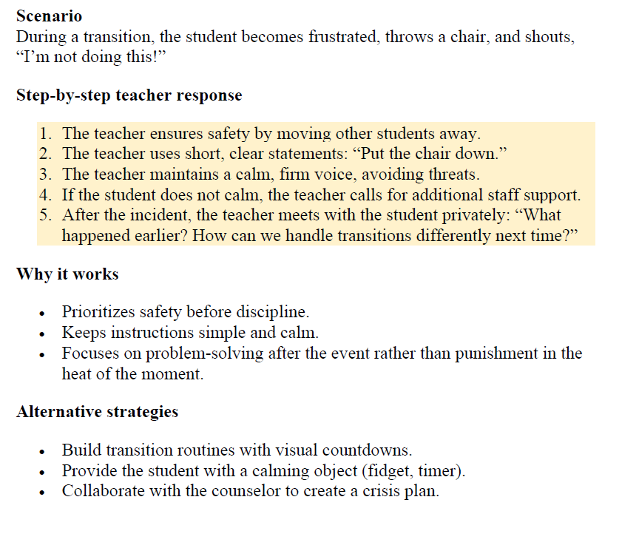

Slide 43
Guiding Principles for Immediate Responses
Teachers cannot predict every situation, but they can hold on to key principles that reduce conflict in almost every case.
Do not take defiance personally. The behavior reflects the disorder, not a personal attack on the teacher.
• Use short and simple directions. Long explanations often fuel arguments.
• Give structured choices. Limited options help the student feel in control without undermining authority.
• Delay consequences until calm. Disciplinary measures are more effective when delivered once the student is regulated.
• Stay relational. Even during conflict, maintain respect to preserve trust.

Slide 44
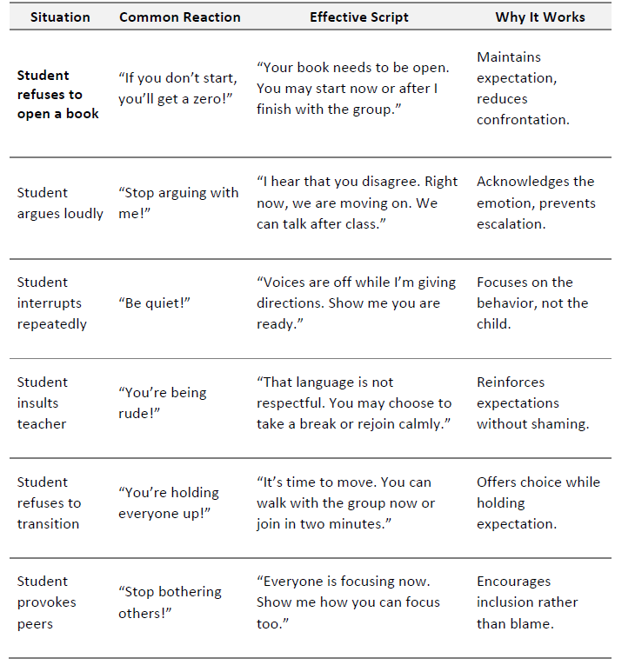
Having a set of short, respectful, and effective scripts helps teachers…
avoid arguments
keep authority without escalation.
These scripts are most effective when delivered in a calm, steady tone with neutral body language.

Slide 45

SDI – Building Social Emotional Skills
Data and goal driven.
Resources for SDI
Lesson Plan for success in decreasing behavioral excesses

Slide 46
Teaching Anger Management
Explicit calming techniques
Model self-regulation
Provide calm corner
Notes:
Introduce anger management strategies: deep breathing, calm corner, modeling self-regulation. Stress teaching them proactively.

Slide 47
Anger and frustration are common triggers for ODD behaviors. Many students have never learned safe ways to handle intense emotions. Teachers can play a direct role by embedding anger management strategies into the school day.
Classroom example
Before a math quiz, a teacher leads the class in two minutes of deep breathing. Students learn that calming their bodies helps them think more clearly.
A student with ODD who often panics before tests benefits from having a predictable, structured routine to manage anxiety.
Why teaching anger management works:
Giving students replacement behaviors for anger prevents escalation and reduces the likelihood of aggression or verbal outbursts.
Strategies
• Teach calming techniques explicitly: breathing exercises, counting to ten, muscle relaxation, or visualization.
• Model anger management: When frustrated, teachers can narrate their own calming strategies. Example: “I am feeling upset. I will take three deep breaths before continuing.”
• Use visual reminders: Posters or cue cards that show calming steps (Stop, Breathe, Think, Choose).
• Practice during calm moments: Students cannot learn new strategies during a crisis; skills must be taught when emotions are stable.
• Provide a safe space for regulation: A “calm corner” equipped with stress balls, timers, and calming visuals.

Slide 48
Conflict Resolution Skills
Teach 'I' statements
Guided role-plays
Use peers strategically
Notes:
Explain conflict resolution through role-play and 'I' statements. Model a short example.

Slide 49
Students with ODD frequently engage in arguments with peers and adults. Role-playing gives them the chance to practice alternatives to defiance in a safe, structured way.
Classroom example
In a social skills group, the teacher asks two students to act out a disagreement over a ball during recess. The teacher models using an “I” statement: “I was using the ball. Can I have it back when you finish?” Students then practice until they can use the script without adult prompting.
Why role-playing conflict resolution works:
Role-play provides rehearsal for real situations. Students develop scripts they can use in the heat of conflict.
Strategies
• Set up short, guided role-plays: Example: “What do you say if someone takes your pencil?”
• Model respectful dialogue: Show how to disagree without yelling or insulting.
• Teach “I” statements: “I feel frustrated when…” instead of “You always…”
• Use peers strategically: Pair the student with a supportive peer who models calm behavior.
• Debrief

Slide 50
Self-Regulation & Mindfulness
Feelings check-in
Movement breaks
Problem-solving steps
Notes:
Discuss embedding self-regulation: mood check-ins, movement breaks, mindfulness.

Slide 51
Self-regulation is the ability to manage one’s emotions, thoughts, and behaviors in different situations. Students with ODD often lack this skill, so teachers must integrate self-regulation strategies into daily classroom routines.
Classroom example
Every morning, students complete a quick “feelings check-in” by placing a card on a color-coded chart. A student with ODD who marks “yellow” knows they will be offered a short movement break to help prevent escalation later in the day.
Why embedding self-regulation works:
Repeated practice makes self-regulation automatic. Over time, students learn to recognize early signs of frustration and intervene before escalation.
Strategies
Teach students to recognize physical signs of stress (clenched fists, rapid breathing).
Introduce a “Feelings Check-In” system: Students mark their mood with colors (green = calm, yellow = frustrated, red = angry).
Use movement breaks: Short, structured breaks (stretching, walking, yoga) release tension and reset focus.
Incorporate mindfulness: Brief exercises like closing eyes for one minute of breathing or listening quietly to sounds in the room.
Practice problem-solving steps: Stop, Think, Plan, Act, Reflect.

Slide 52
Peer Relationships & Cooperation
Assign structured roles
Strategic peer pairing
Cooperative learning activities
Notes:
Provide strategies to support peer relationships and cooperation. Stress structured roles and cooperative learning.

Slide 53
Students with ODD often struggle socially. They may push peers away with defiance, insults, or bossiness. Teachers can actively support the development of healthier peer interactions.
Classroom example
During a science project, the teacher assigns the student with ODD the role of “timekeeper.” This gives the student responsibility without dominance. The group relies on them to manage time, fostering inclusion and reducing conflict.
Why positive peer relationships and cooperation works:
Repeated practice makes self-regulation automatic. Over time, students learn to recognize early signs of frustration and intervene before escalation.
Strategies
Assign cooperative roles: Give the student structured responsibilities in group work (recorder, materials manager, timekeeper).
Pair strategically: Place the student with peers who are patient and socially skilled.
Use cooperative learning structures: Think-Pair-Share, Jigsaw, or small group projects where success depends on collaboration.
Teach peer recognition: Encourage students to notice and acknowledge each other’s efforts. Example: “Thank your partner for their help today.”
Monitor and coach: Step in when necessary to model respectful communication and redirect negative behavior.

Slide 54
Collaboration & Teacher Tools
Effective parent communication
Multidisciplinary teamwork
Behavior contracts & tracking sheets
Reflection sheets for students
Notes:
Review collaboration strategies: parent communication, multidisciplinary teams, consistent documentation.

Slide 55
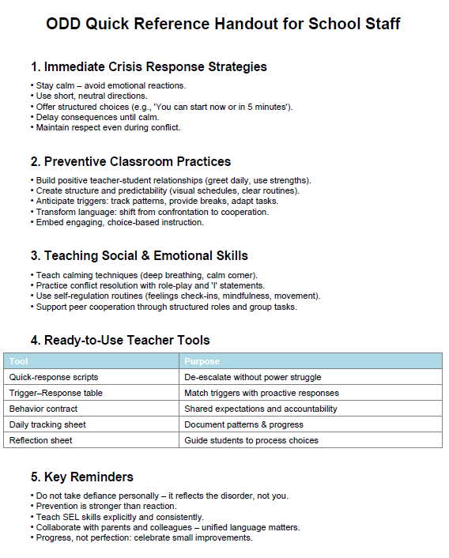
Quick Reference Handout for Staff

Slide 56
Frontline/Professional Development Credit
Ensure that you have registered for February 16th District Professional Development in the Frontline District Catalog.
Be sure to mark the activity complete within 30 days to receive credit. The exit survey will serve as the Knowledge Evaluation and be given during your building’s “sunset” meeting.
Notes:
Please share this information as a reminder to everyone to receive their PD points.

Slide 57
Working with ODD Students
Kassandra Dunlap, USD 475 Behavior Consultant
kassandrdunlap@usd475.org
Thank you for attending
Notes:
Please note your session title, the presenter(s), and contact information (email, etc.). The exit survey will be taken in the sunset meeting at the end of the day. If you would like to receive individual feedback on your presentation you can add that onto this slide.

Slide 58

Thank you for attending today’s session!
Kassandra Dunlap
USD 475 Behavior Consultant kassandradunlap@usd475.org

Slide 59
References
The ODD Classroom Guide: Strategies, Tools and Solutions for Special Education (n.d.)
Blanchard, Sharon, and Jeanie Johnson. May I Have This Dance? Effective Interventions for Oppositional ..., singtoyourplants.files.wordpress.com/2017/03/o-d-d-interventions.pdf. Accessed 19 Oct. 2023.

Slide 60
Helpful Websites:
Research and Interventions
Intervention Central : www.interventioncentral.org
American Academy of Child & Adolescent Psychiatry: www.aacap.org
NASP online (National Association of School Psychologists) : www.nasponline.org
What Works Clearinghouse: https://ies.ed.gov/ncee/wwc
Do 2 Learn: www.do2learn.com
Education World : www.educationworld.com
Free Printable Behavior Charts: www.freeprintablebehaviorcharts.com
Positive Behavioral Interventions and Supports: www.pbis.org
Edutopia: www.edutopia.org

