Slide 1



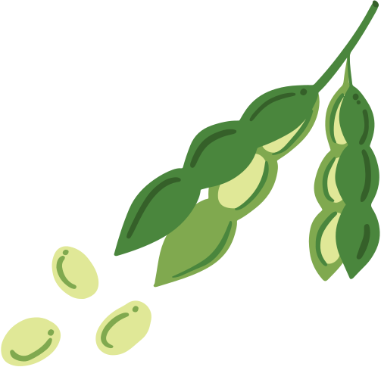









STRENGTHIN.YOUTH
Wellness Together 2026

Slide 2

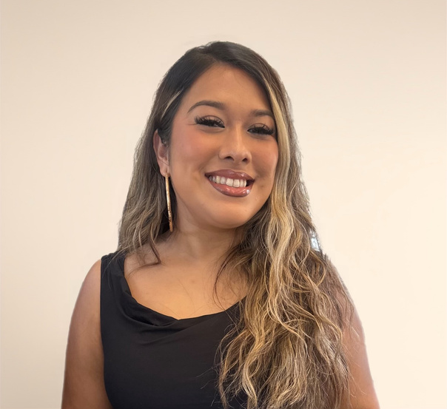

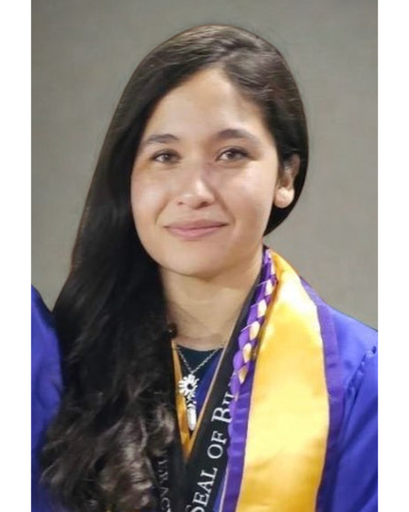

Strengthin.youth
Marilyn Lopez Mota
Youth Outreach Coordinator
Jules Villanueva-Castaño
Peer Support Manager
Laura Avila
Youth Consultant+
UCSD Graduate
Notes:
Supporting healthy and safe peer support dynamics where youth feel empowered to have supportive conversations, set healthy boundaries, and know when to seek additional support.

Slide 3


Goals for our time together
Learn about key concepts in Peer-to-Peer support
Guiding Young people in learning how to have supportive conversations
  Role of a supportive friend.
  How lived experience supports safety.
  How to start.
  What to say.
  How to help.
  Tips for ending.
Questions or thoughts?
We are open to chat beyond this space. :)
Notes:
we want to give you this background but also really share with you the framework that was developed

Slide 4
About StrengthIn.youth
strengthin.youth

Slide 5



Understanding KEY TERMS
where strengthin.youth stands
peer-to-peer
Youth Peer support
Young people supporting other young people in community, voluntary
Paid mental health role, full time, supervision, trained
Strengthin.youth
Youth friendly collection of resources that support peer-to-peer and peer support work
strengthin.youth

Slide 6

background
why?
what?
Young people turn to each other for support before anyone else
Research designed to respond to call for youth centered resources
Youth are calling for support outside of the traditional mental health model
Goal to create resources for young people to support other young people
Need for accessible resources that honor youth wisdom and lived experience
Youth-centered co-design process guiding development of resource
strengthin.youth

Slide 7








Strength
In.Youth Roadmap
Resource Design
Youth Consultants
All alongside young people
Data Analysis
Focus Groups
Survey Launch
Study Prep & Approval
strengthin.youth

Slide 8


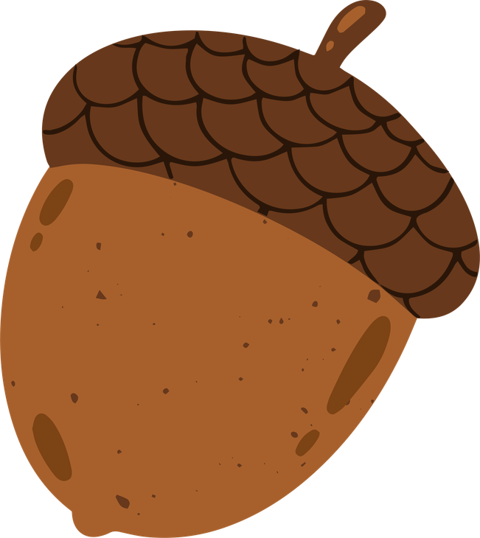
what we explored
FORMATS:
“What have you learned from supporting your friends around challenges in their lives?”
“What would have made you feel more comfortable in supporting a peer through a challenge?”
SURVEY
65 Participants
FOCUS GROUPS
45 participants
14 sessions
“Are there any types of support you think young people should not be providing in community-initiated help?”
“What makes a resource more accessible to young people?”
questions asked in focus group sessions
strengthin.youth

Slide 9
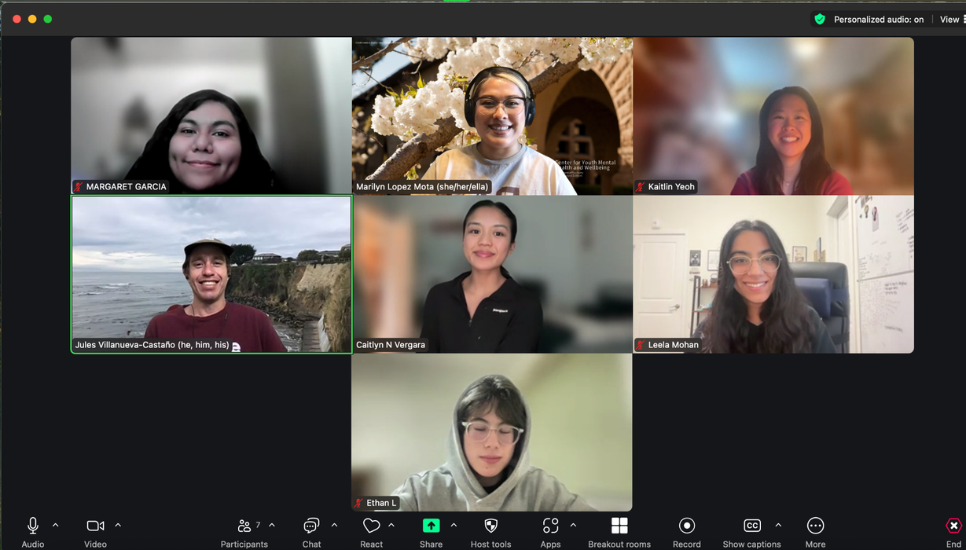
what we explored
Youth Consultant Space:
Youth and young adults from diverse backgrounds & career/education paths who:
  Reviewed materials and emerging findings from the research study.
  Contributed to the design guidance, reviews, and resource finding.
  Provided recommendations for enhancing the effectiveness of youth peer support tools created during the project.
  Continue to support the launch and development of SiY resources
Huge shoutout to: Kenny, Caitlyn, Kaitlin, Rani, Leela, Ethan, Margaret, April, Laura
strengthin.youth

Slide 10


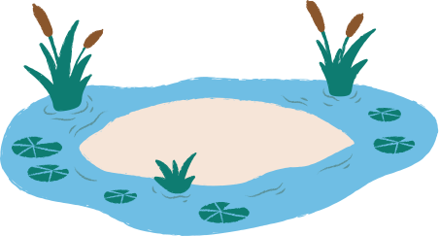

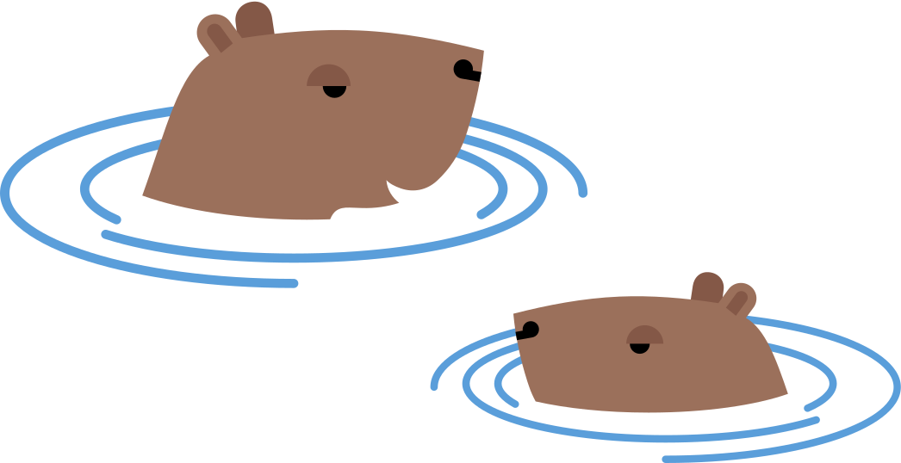


what we learned
Youth
Youth have a strong desire to:
  Help their peers
  Be effective in providing formal and/or informal peer mental health support
  Be well themselves.
Knowledge sharing &
guidANCE
Youth value peers and adults as essential collaborators and partners in this work, but they also need adults who are authentic allies.
Adults
strengthin.youth

Slide 11
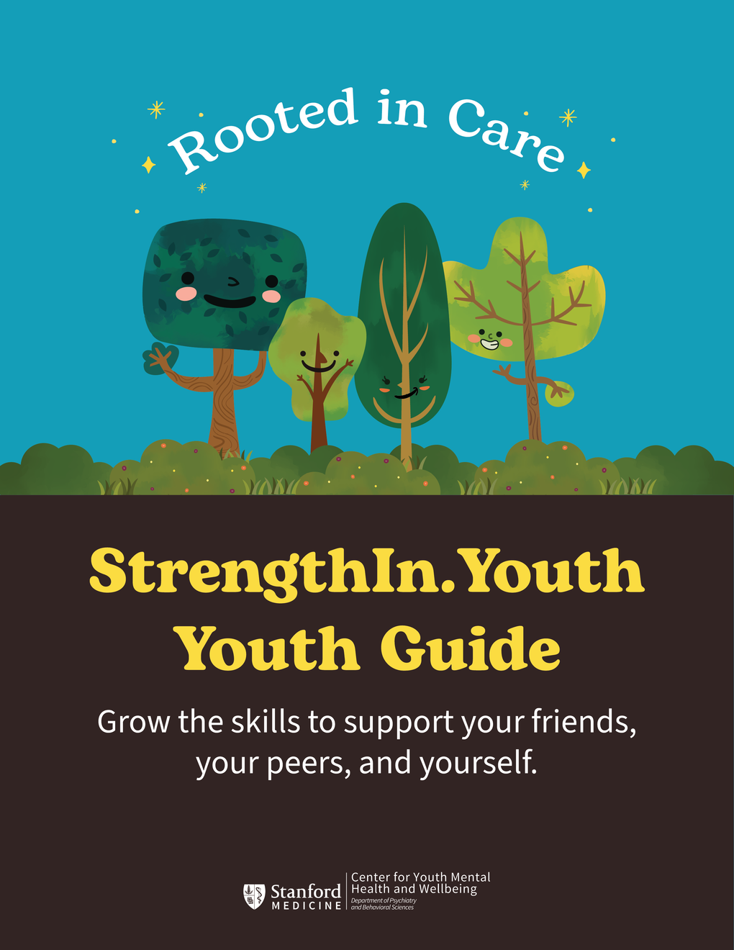

what we did:
SiY’s rooted in care framework
what
Offers tips and guidance to help grow skills and capacity when supporting friends and peers.
who
Meant for young people who support other young people, without formal training.
strengthin.youth
Notes:
age ranges: 13-25

Slide 12
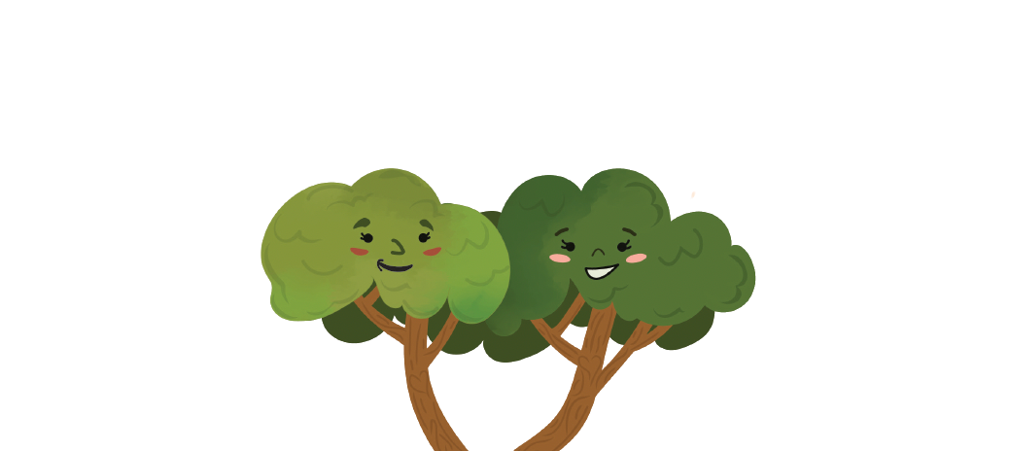
rooted in care:
A 4-step approach to healthy
youth peer-to-peer support
strengthin.youth

Slide 13
SiY’s rooted in care framework
1
Understanding the role of a supportive friend
2
Having Supportive Conversations
3
Healthy Boundaries, Healthy Relationships
4
When and How to Get More Support
strengthin.youth

Slide 14
SiY’s rooted in care framework
1
Understanding the role of a supportive friend
2
Having Supportive Conversations
3
Healthy Boundaries, Healthy Relationships
4
When and How to Get More Support
strengthin.youth

Slide 15


share-out: think-pair-share
what comes to mind when you hear the term “strong friend”?
turn to the person next to you and take turns responding.
strengthin.youth
Notes:
giving a word to something that people have always experienced
- the "mature" ones
- "old soul"
this is what its called now, but has used different names to define the experience
goal: putting into perspective the modern experience
- what are you hearing from young people around this?

Slide 16
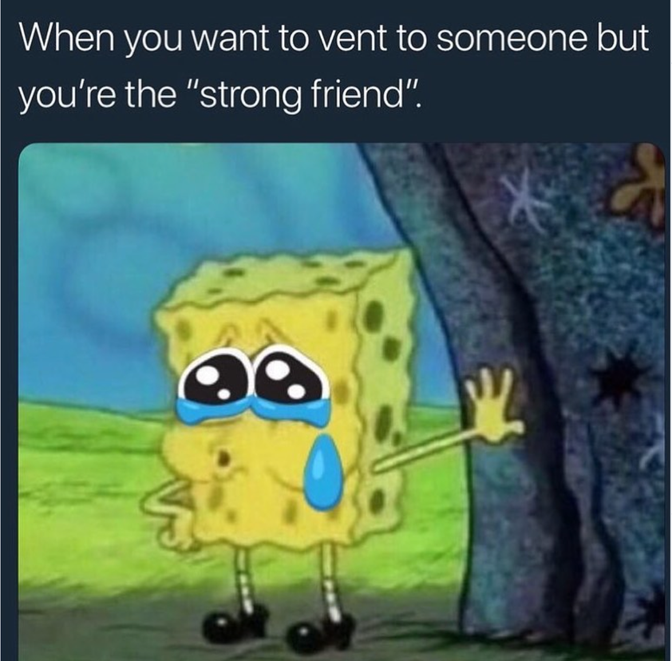
the role of a supportive friend
strong friend: break it down
The person others rely on most is sometimes called “the strong friend.”
This role can feel good because others trust you and seek your guidance.
It can be a heavy role to carry.
strengthin.youth

Slide 17
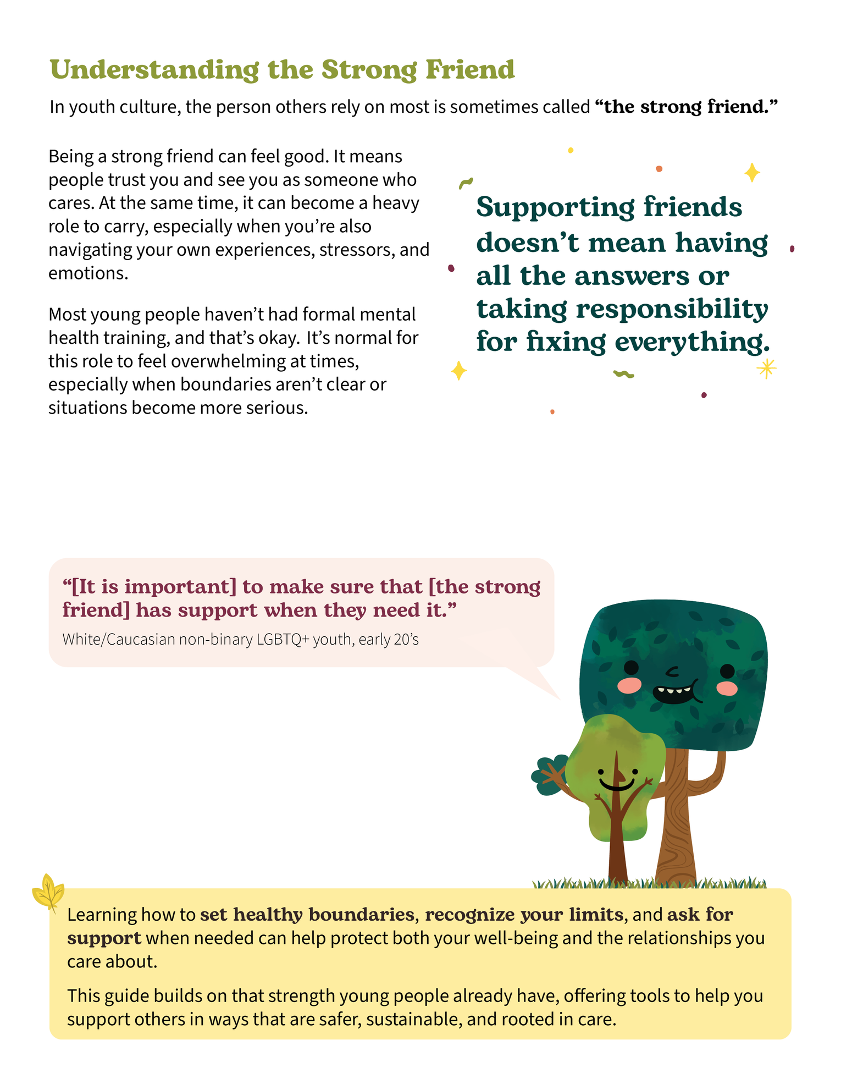
the role of a supportive friend
recognizing boundaries
It’s normal for the supportive friend role to feel overwhelming at times.
Especially when boundaries aren’t clear or situations become more serious.
strengthin.youth

Slide 18


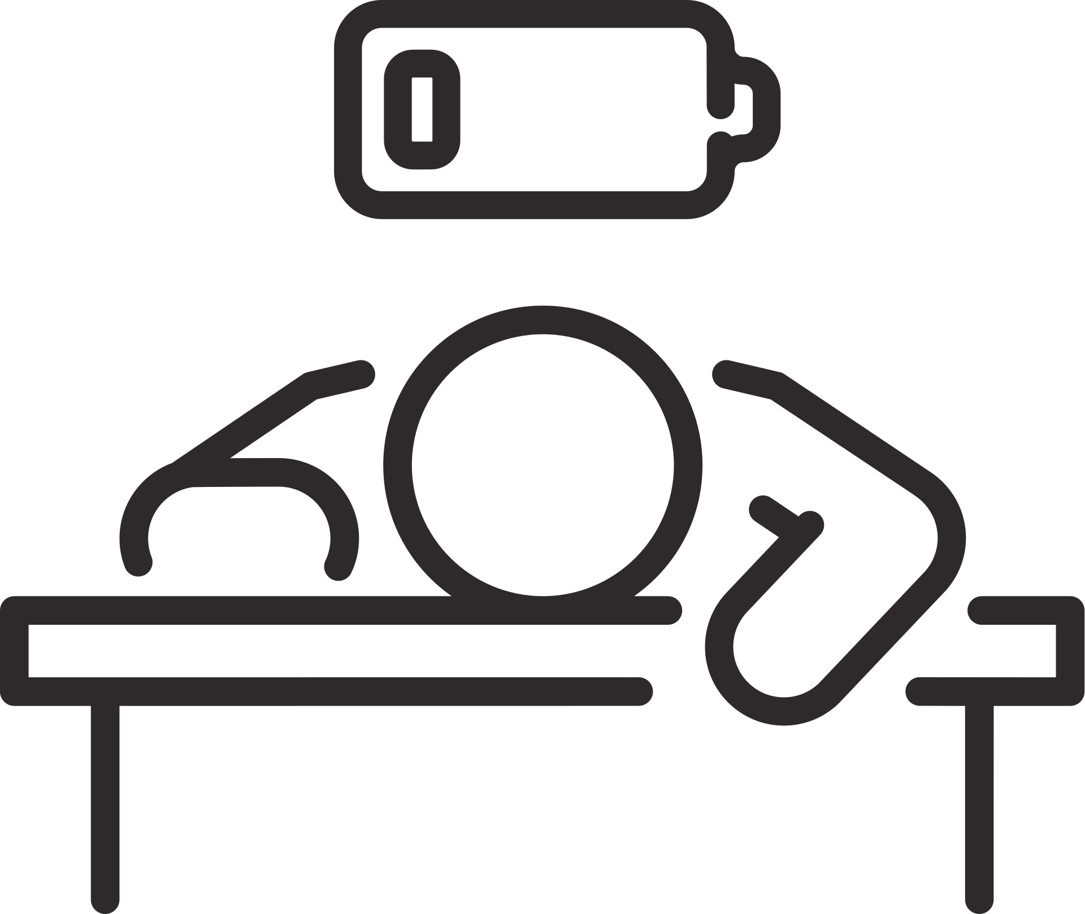
Protect your wellbeing and relationships
“[It is important] to make sure that [the strong friend] has support when they need it.”
Strengthin.Youth focus group participant
Set Healthy Boundaries
Recognize your limits
Ask for support
strengthin.youth

Slide 19
having supportive convos:
a 6-step framework
Starting the conversation | center their experience
get clear on how to help | end with care
having the conversation | gentle follow up
strengthin.youth

Slide 20
starting the conversation
01
Use open-ended questions to start off
“I care about you and wanted to check in. What’s been on your mind lately?”
02
Name the change(s) you’ve noticed
"I've noticed you've been [skipping lunch/staying alone more/seeming stressed]...”
03
Use “I” Statements
“I’m not trying to be nosey, I just care about you.”
04
Invite them to share but don’t push
“If you want to talk about it sometime, I am always here to listen.”
05
Show them you’re there without judgement
“No pressure, you can share what you feel comfortable with.”
strengthin.youth

Slide 21
get clear on how to help
Types of support
01
Brainstorming/
problem solving
Help identifying potential responses to the situation being discussed
02
Offering a “positive distraction”
Going to get a meal/snack or do an activity like a walk to get their mind off things
03
Direct support
Helping with a task on their to-do list like homework, laundry-> “stress relief”
04
Listening space
Offering to be a listening ear to vent instead of trying to solve the issue
05
Finding more support
Brainstorming on where to find more help
strengthin.youth
Notes:
Ask what type of support would be the most helpful for them at that moment.
Give examples and allow them to pick what works best.
Allow them to pick a time and place for these conversations.
If you are the person being supported, you can ask for the type of support you are seeking.

Slide 22
Having the conversation
Listen Affirm & notice strengths
Reflect back what you hear
01
Being present
“It sounds like that’s been stressful for you and you’re still showing up.”
02
Using eye contact (when it feels right)
03
Putting your phone down
“That sounds really tough. I feel like you are handling it with a lot of courage.”
04
Letting them finish before responding
05
Nodding, relaxed posture, calm tone
“So you’re feeling unsure about school right now?”
strengthin.youth
Notes:
Honor the silence
Occasionally, wait 2-3 seconds after someone says something, to respond. Maybe nod your head and smile, to show you are thinking about how to respond.
Taking 1 or 2 slow belly breaths after someone shares something intense to give you and them time to process.

Slide 23

center their experience
“Is my role to simply listen or offer advice, or both?”
“Will this help them feel understood, not overshadowed?”
Pause and ask yourself:
“Is this relevant to what they’re talking about?”
strengthin.youth

Slide 24

end with care
gently wrap up
end on a supportive note
 | “We covered a lot today, so glad we got to talk. I do have to get going soon, is there anything else you’d like to share before we finish up?”
 | “I really appreciate you talking about this. It sounds like it’s been a lot to carry.”
 | “If this keeps feeling heavy, we can find more help together.”
“You’re doing your best and that really shows. I’m here for you.”
“Sharing takes a lot of bravery. I really see you working hard to take care of yourself.”
“Take care of yourself, you are important to me as my friend.”
strengthin.youth
Notes:
Summarize and appreciate their trust: You can reflect what they shared and thank them for opening up.
It reminds them they were heard and that it may not have been easy for them to share. You can say something like:
- “You shared a lot today. Thank you for trusting me with that.”
- “I really appreciate you talking about this. It sounds like it’s been a lot to carry.”
After summarizing and appreciating them, introduce that it's time to start “wrapping up” to bring the conversation to a gentle close.
This helps the other person feel seen and gives them space to close emotionally, too. Say something, like:

Slide 25

Gentle follow up
offer next steps
gentle follow up
 | “Do you have plans after this to relax a bit?”
 | “Would you want to talk again another time?”
 | “If this keeps feeling heavy, we can find more help together.”
“Hey, just checking in. Were you able to look into the resource I sent you? We can do it together if that’s helpful, just lmk!”
“I was thinking of you and our chat. Checking in to see how you are doing?”
“Thank you for talking! Did you get a chance to do some self care after we spoke?”
strengthin.youth

Slide 26
overview of having supportive convos:
a 6-step framework
Starting the conversation | center their experience
get clear on how to help | end with care
having the conversation | gentle follow up
strengthin.youth

Slide 27
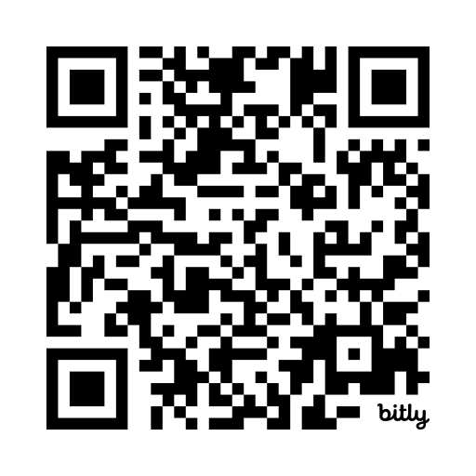

Learning together! reflect & share
  What are common themes that come up during this kind of support?
    How do you see it impacting your school environments?
  How do/can you create spaces where young people feel comfortable reaching out for support? What are barriers to this?
scan to share via padlet
strengthin.youth

Slide 28
SiY’s rooted in care framework
1
Understanding the role of a supportive friend
2
Having Supportive Conversations
3
Healthy Boundaries, Healthy Relationships
4
When and How to Get More Support
strengthin.youth

Slide 29
Looking Ahead
strengthin.youth

Slide 30
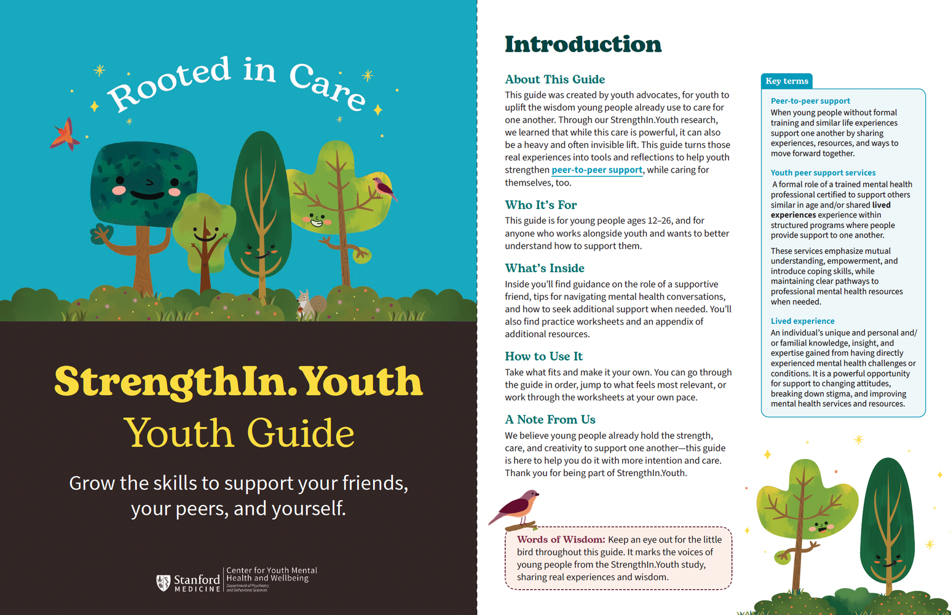
exclusive sneak peek of the
youth guide
strengthin.youth

Slide 31
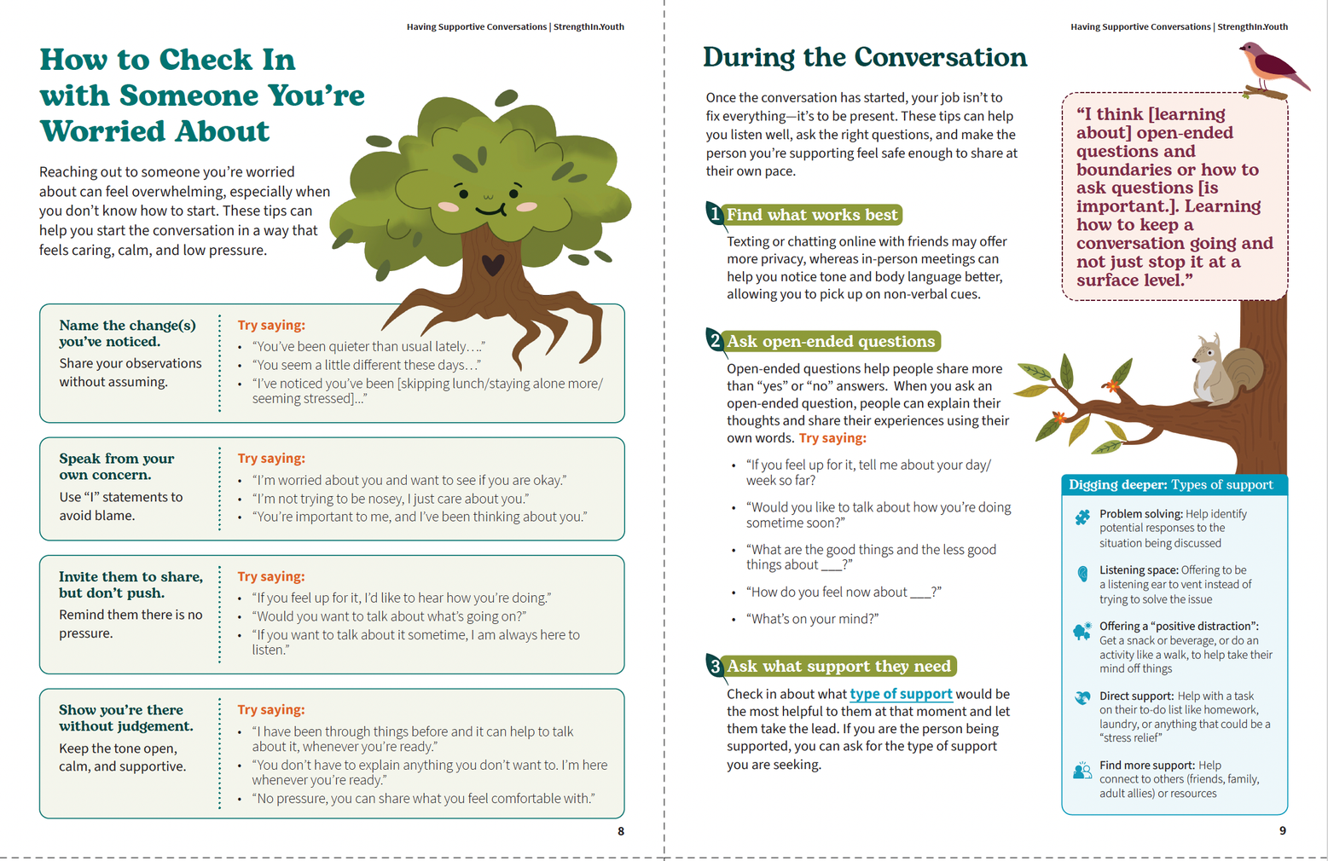
strengthin.youth
Notes:
tips shared by young people to navigate being the “strong friend”
Be sure to practice your self-care (for example: what does self-care mean to you and how do you talk about it when you are supporting others)
See Self-care is important in taking care of your mental health and wellbeing
Encourage your friend to find more support than just you
Go to your own supportive friends and adult allies, especially when you feel like things are out of balance/overwhelming
If you're feeling overwhelmed or stressed yourself, it's healthier for you to not be the “strong friend” until you feel better (for more information, see: Signs you may be overwhelmed/stressed.)
You don’t have to be an expert, it's ok just to be a friend, and not be the “strong friend” all the time.
It’s ok to not want to be the strong friend, regardless of what others may think.
It is healthy to not support everyone who asks for help and to set boundaries (see below).
Sources and additional resources have been compiled for your review and can be found in Appendix B.

Slide 32
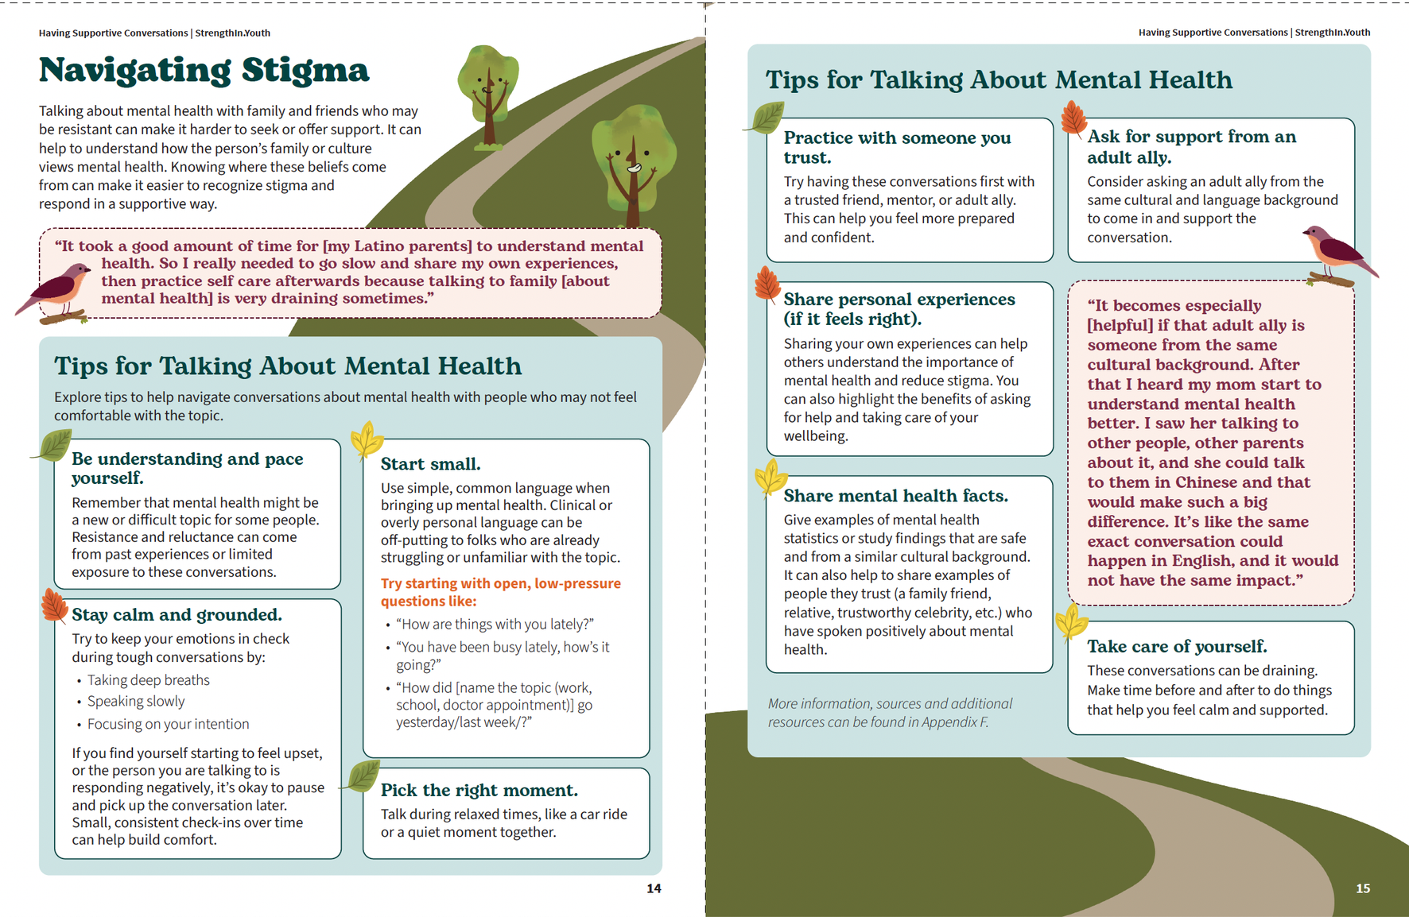
strengthin.youth
Notes:
tips shared by young people to navigate being the “strong friend”
Be sure to practice your self-care (for example: what does self-care mean to you and how do you talk about it when you are supporting others)
See Self-care is important in taking care of your mental health and wellbeing
Encourage your friend to find more support than just you
Go to your own supportive friends and adult allies, especially when you feel like things are out of balance/overwhelming
If you're feeling overwhelmed or stressed yourself, it's healthier for you to not be the “strong friend” until you feel better (for more information, see: Signs you may be overwhelmed/stressed.)
You don’t have to be an expert, it's ok just to be a friend, and not be the “strong friend” all the time.
It’s ok to not want to be the strong friend, regardless of what others may think.
It is healthy to not support everyone who asks for help and to set boundaries (see below).
Sources and additional resources have been compiled for your review and can be found in Appendix B.

Slide 33
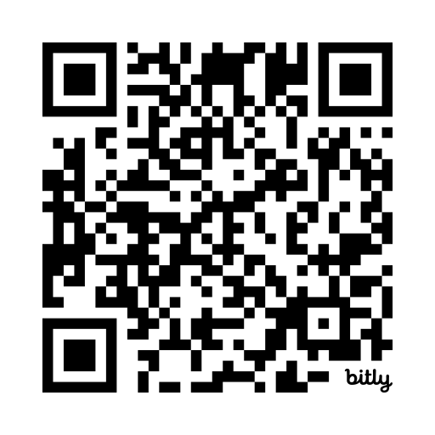
what’s next for strengthin.youth?
Supporting healthy and safe peer support dynamics where youth feel empowered to have supportive conversations, set healthy boundaries, and know when to seek additional support.
early 2027 | Publish & share the SiY Rooted in Care Guide
spring 2027 | Launch & pilot 4-part training series in community (schools, wellness centers, cbo’s)
scan to sign up for updates
Reach out to us: strengthin.youth@stanford.edu
strengthin.youth
Notes:
1 min
Respond in chat, unmute, use an interactive tool?

